Slide 1

DFX Conceptual Design Review:
Outcome and Recommendations from the Review Panel
Michele Modena, on behalf of the Review Committee
DFX Conceptual Design Review outcome and closing remarks, 20 Feb 2019

Slide 2
Introduction
In view of the completion of the design phase and the approaching of DFX prototype procurement, TE/MSC and HL-LHC Project called for a “Conceptual Design Review” of the DFX, the distribution feedbox for the new triplets, CP and D1 magnets.
The Review Panel was charged with the following:
  Scope:
  “Review the conceptual design of the DFX with the purpose of validating maturity and confirm readiness for starting the detailed design”.
  Mandate:
  1) Review the functional specification and confirm its completeness in terms of cryogenic, mechanical and electrical requirements;
  2) Review the functionality of the design concept with respect to cryogenic design and operational aspects, mechanical design and interfaces, electrical design and interfaces;
  3) Review the proposed integration and installation plan in the LHC machine and the compatibility of the DFX location with respect to the tunnel environment (including preliminary plan for maintenance and repair interventions during operation);
  4) Review cryogenic requirements for safety aspects and compatibility of safety equipment with tunnel environment;
  5) Review of plan for detailed design development;
  6) Review schedule for prototype production, including strategy for intermediate validation and production of prototype lambda-plate.

Slide 3
Introduction
Review Committee: S. Atieh, K. Brodzinski, M. Modena (chair),
F. Rodriguez Mateos, D. Tommasini.
Proposed Program of presentations:
  - Welcome (L. Bottura)
  - 1. WP6a master plan, key milestones, functional requirements, DFX within WP6a system (A. Ballarino)
  - 2. DFX Functional specification (Y. Leclercq)
  - 3. DFX Cryogenic cooling and flow scheme, interface with cryo-equipment (S. Claudet)
  - 4. DFX Conceptual design – including strategy for maintenance and repair (Y. Yang)
  - 5. DFX Production strategy and plan – including production of CAD drawings (W. Bailey)
  - 6. Nb-Ti Bus-bar design (H. Prin)
  - 7. Plug development: status, plan and key milestones for intermediate validation, production plan
  (Y. Leclercq)
  - 8. DFX instrumentation requirements (J. Fleiter)
  - 9. DFX safety aspects in the LHC tunnel (V. Parma)
  - 10. Transport and integration of DFX in the LHC underground areas – LHC tunnel aspects (P. Fessia)
  - 11. Transport and integration of DFX in the LHC underground areas – DFX Integration and transport (R. Betemps)
  - 12. Items supplied by CERN and procurement plan (Y. Leclercq)
  - 13 (extra). Electrical qualification of WP6a splices MgB2-NbTi (A. Ballarino)

Slide 4
Introduction
Review carrying out
The Review Session of the 31 January 2019 was followed by a 2nd Session on the 12 February.
Acknowledgement
The Committee would like to thank all the Speakers for their presentations and involvement during the Review days. The content of presentations and information provided were clear and concise, helping in the comprehension of the DFX system, characterized by a wide variety of interfaces and functioning details tightly integrated.
To be underlined are the intense revision activities done by WP6a Team between the 31 January and the 12 of February in order to analyse and solve the open questions about the cryogenic control aspects mentioned before.
A special thanks to M. Mendes who helped with a clear and careful annotation of all Comments & Questions and in revisioning.
(31 January session Indico: https://indico.cern.ch/event/783116/ )
(12 February session Indico: https://indico.cern.ch/event/797964/)

Slide 5
Outcome and recommendations
Referring to the six Review Mandate specifications, the preliminary Review conclusions are here reported:
1. “Review the functional specification and confirm its completeness in terms of cryogenic, mechanical and electrical requirements”:
The Functional Specification seems clear and in a well advanced status. The operating modes and boundary conditions (access during operation, access for maintenance etc.) are known but are not specified in the present version of the Functional/Interfaces Specification (EDMS 1905633).
RECOMMENDATION N.1: Complete the Functional/Interfaces Specification to make it a solid and sound document, to be used as the main part of the Technical Specification and as reference document for the future Collaboration Agreement with Southampton University.
The following, less straightforward, design requirements should be added: access limitations due to the actual available volumes in the Tunnel, accessibility for maintenance/repair, re-working of components, electrical integrity aspects, etc.

Slide 6
Outcome and recommendations
2. “Review the functionality of the design concept with respect to cryogenic design and operational aspects, mechanical design and interfaces, electrical design and interfaces”:
The new proposed design, based on a “cryo-fountain” concept, seems to significantly improve and solve the open questions of helium phases separation and LHe level control. The proposal for the safety equipment implementation (safety valve and burst disk) needs further improvements.
RECOMMENDATION N.2: Complete the design of the new developed concept (“cryo-fountain”). A final optimization of the two chambers volume ratio should be done considering nominal operation conditions (5 g/s of He flow generation for the DSHX) and pre-defined limits for Cryo OK signals for powering.
The committee recommends to investigate the setting of minimum operation autonomy of the system in case of He supply cut, to 10 min.
Design of the extension pipe for the safety devices shall avoid horizontal position and have enough height (potentially with thermalization) to guarantee a correct stratification of helium in order to prevent ice formation on the safety devices (this last point will need a tight collaboration with WP15 to integrate the proposed solution at the Tunnel/vertical core interface).

Slide 7
Outcome and recommendations
(cont.) 2. “Review the functionality of the design concept with respect to cryogenic design and operational aspects, mechanical design and interfaces, electrical design and interfaces”:
The conceptual mechanical design seems complete, but the technical details that still need to be finalized could become critical for the correct and successful assembly of the DFX “in situ” and in case of future required intervention for maintenance/repair.
The final diameter of the horizontal DFX vessel could probably be reduced and this will have a positive impact on the reduction of the total LHe volume of the system.
The final position of the plug must be fixed (it will also depend on the integration of the Cold Diode Box to be developed together with WP03).
RECOMMENDATION N.3: Finalize the mechanical design of the system/components optimizing aspects like:
- Mountability: Number of components, welds feasibility and their QA/QC aspects, integration of ancillaries, required tooling.
- Reliability: Minimize risk of leaks, optimize instrumentation integrity aspects.

Slide 8
Outcome and recommendations
- Maintainability: Minimize the planned interventions on cryogenic and protection instrumentation sensors; for each expected intervention, check the availability of space (at completion of LS3 installations, this will be one of the most crowded regions of the LHC Tunnel).
- Reparability: Check the existence of tooling (e.g. welds-cutting and welding machines) and allocated space for its utilization in case of inspections and minor repairs to be done in the Tunnel (ex. repair of instrumentations, repair of leaks, etc.).
It is recommended to further investigate the possible integration of the vacuum barrier on the top flange interface with the DSHX. This solution should bring advantages as minimization of acting forces eventually developed and a better vacuum sectorization between different elements of the system.

Slide 9
Outcome and recommendations
(cont.) 2. “Review the functionality of the design concept with respect to cryogenic design and operational aspects, mechanical design and interfaces, electrical design and interfaces”:
Interfaces of the DFS system seem to be correctly accounted for.
The electrical design, based on equipment already reviewed in other occasions (MgB2 conductor, bus bars, etc.) seems under control. The plugs and lambda-plates are developed starting from the LHC experience but a full re-qualification of design-components-processes is needed and is ongoing.
RECOMMENDATION N.4: Procurement plan for feedthroughs for voltage taps should be activated as soon as possible in synergy with other WPs that could have the same needs.
N.B. It was requested during the Review to discuss this issue in the Magnet Circuit Forum.

Slide 10
Outcome and recommendations
3. “Review the proposed integration and installation plan in the LHC machine and the compatibility of the DFX location with respect to the tunnel environment (including preliminary plan for maintenance and repair interventions during operation)”:
A conceptual “Installation Sequence” was presented but not a real Installation Plan. This should be presented in detail at the future DDR (Detailed Design Review).
In a similar way, conceptual considerations for (some) repair cases were presented.
The DFX Integration in the HL-LHC layout seems under control with WP15 (Integration) participating in the DFX Technical Meetings and providing Integration models and Equipment Integration Notes (EDMS 1991506). This work will need a continuous and tight monitoring to follow the DFX design evolution.
RECOMMENDATION N.5: A detailed analysis of the Installation and Repair/De-installation sequencing is essential to be developed in parallel to the DFX system design. This is due to the impact that the sequence of operations could have on the details and finalization of the mechanical design.
The MgB2/NbTi splices repair was reported as an: “exceptional major intervention in the Tunnel for the unlikely case that a splice would need to be repaired”. It is not obvious to the Review Committee that a detailed study on the feasibility of the repair of these splices in the Tunnel has been done.
It is recommended to perform this study (considering the activation level expected, “in situ” vertical splicing assembly, etc.) and compare it with other more destructive repairing scenarios. In case an “in-situ” repair is unfeasible, or a more destructive scenario is necessary, this specific repairing case should not be considered as a mandatory requirement for the DFX design (as it is at present).
Design effort and resources should be focused on maximising the QA/QC in the manufacturing of the key components/assemblies and on the study and development of procedures only for the more realistic and probable repair scenarios.

Slide 11
Outcome and recommendations
(cont.) 3. “Review the proposed integration and installation plan in the LHC machine and the compatibility of the DFX location with respect to the tunnel environment (including preliminary plan for maintenance and repair interventions during operation)”:
It was understood that up to the present design phase, HL WP16 (String & Commissioning) was not involved in the technical discussions and meetings.
RECOMMENDATION N.6: Since the DFX prototype will be firstly tested in SM18 and needed for the HL-LHC String program, WP16 Team should be involved in the DFX Technical Meetings in order to check the compatibility of the design with the SM18 requirements and the studies for the String.
RECOMMENDATION N.7: During the 1st assembly and test in SM18, a plan should be prepared to recreate conditions as similar as possible to the ones in the LHC Tunnel. In other words: use the DFX assembly activities in SM18 as a real test of what will be done later in the Tunnel. This could provide valuable indications for optimization of the assembly procedures.

Slide 12
Outcome and recommendations
4. “Review cryogenic requirements for safety aspects and compatibility of safety equipment with tunnel environment”:
The conceptual Cryogenic safety requirements seem correctly addressed. Nevertheless the open points mentioned at 2) could have an impact on the final design or final positioning of safety equipment (ex. GHe release valves) (refer to RECOMMENDATION N.2)
5. “Review of plan for detailed design development”:
The committee understands that SOTON is responsible for the detailed design of the DFX including the Manufacturing Drawings. The design must fulfil PED requirements. The exact role of CERN in this process was not clear to the committee.
RECOMMENDATION N.8: The review committee recommends to organize the next DFX review (DDR) only once the technical design report is completed. The interface between CERN and SOTON regarding development and approval of Manufacturing Drawings should be clarified.

Slide 13
Outcome and recommendations
6. “Review schedule for prototype production, including strategy for intermediate validation and production of prototype lambda-plate”:
The WP6a General Schedule including the DFX prototype and series procurement was addressed in the 1st presentation. For the DFX prototype procurement the schedule seems very tight. In discussions after the review, details on the future main milestones were provided. Our remarks are: - For the DDR, scope and charge should be correctly settled since it will be very difficult to have all the final design details defined for the proposed date of end March 2019.
- For the FC of June 2019 it seems that the necessity is to have released a technical document to support the approval of the Collaboration Agreement with Southampton University and the commitment of resources: this delivery seems feasible.
- For the DFX prototype, the date of delivery at CERN (fully assembled and partially tested) is April 2020: this milestone seems very tight.
RECOMMENDATION N.9: In order to keep a realistic prototype procurement schedule, revise and analyse the procurement phases trying to identify eventual back-up solutions or mitigation actions.
RECOMMENDATION N.10: Even though this point is not strictly part of a conceptual design phase, the strategy and policy for the DFX spares procurement and spare assembly in the tunnel should be defined (e.g. availability of spares as individual components). The extreme boundary conditions in the LHC Tunnel imply that some “controlled dismounting” activities will be probably not feasible.
Possible variants (due to R/L symmetry and IP1/5 slopes) must be properly incorporated within the spare policy.
Thanks for the attention

Slide 14
(12 February Presentation slides)

Slide 15
Evolution of conceptual design wrt cryogenic performance of DFX
Y.Yang, W.Bailey (SOTON)
Y. Leclercq, R.Betemps, S.Claudet, J.Fleiter, I.Falorio, V.Parma and A.Ballarino (CERN)
HL-LHC - WP6a
12 Feb. 2019

Slide 16
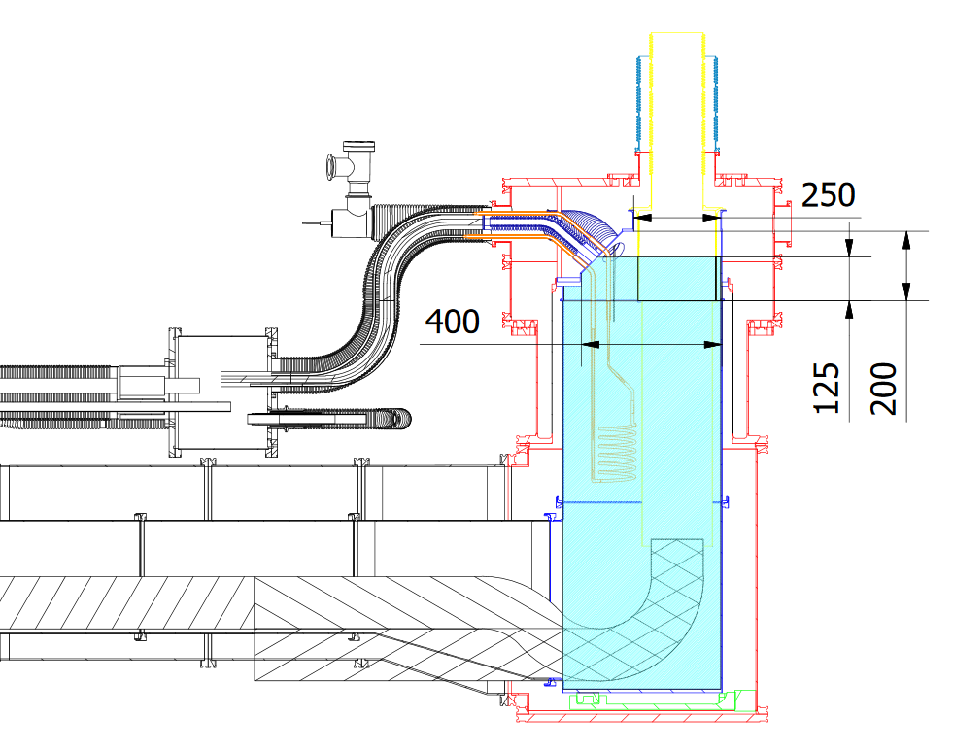
Context
Two critical points brought-up during the conceptual design review:
Limited height & volume between Gas-Liquid interface and SC Link helium volume inlet
  ➔ Difficult Level control
  ➔ Possibility of liquid dragging from gas-liquid interface to SC Link
Vicinity between nominal liquid level and “burst disc flooding” level
  ➔ Possibility of freezing safety device in case of DFX liquid overfilling
Liquid helium
Gas helium
SCLink outer jacket
SCLink He pipe
Safety relief devices
Flooding level
Nominal liquid level
<75
DFX conceptual design

Slide 17
Clarification on requirements
Vertical
Nominal liquid level shall operate in an adjustable range
  Level controlled according to original proposal
If LHe supply stops, the system shall ensure for 5 minutes:
  Immersion of splices in cold configuration
  Gas supply to SC Link at design mass flow 10 g/s
Safety relief devices:
  Located 300 mm higher than exit point from DFX for condensation purposes
  Interface with He reservoir shall be located above highest liquid position (min distance according to proposed sketch)
  Routing line shall not present low point
Cryogenic operation:
  Gas velocity to SCLink shall be such not to drag liquid into SCLink
  Principle and dimensions (vertical and diameters) as defined in conceptual sketch
Burst disc
Min Safety devices
Vertical position
300 mm
Inlet SCLink He pipe
Safety line
interface to DFX
Cryo operation
According to sketch
Liquid upper range
Liquid level adjustable range
75 mm
Nominal liquid level
75 mm
Liquid lower range
Margin for Lhe supply stop
≥ 5 min
Splices
Heaters
300 K
> 300mm
4.5 K

Slide 18
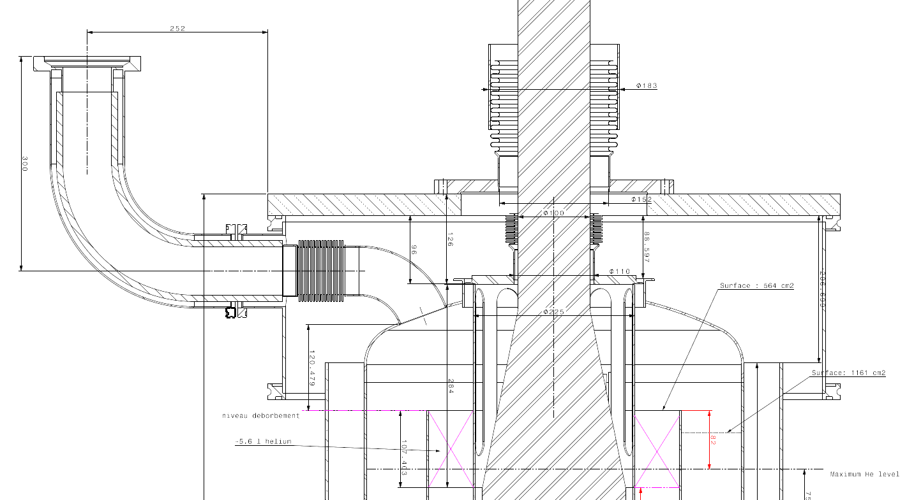
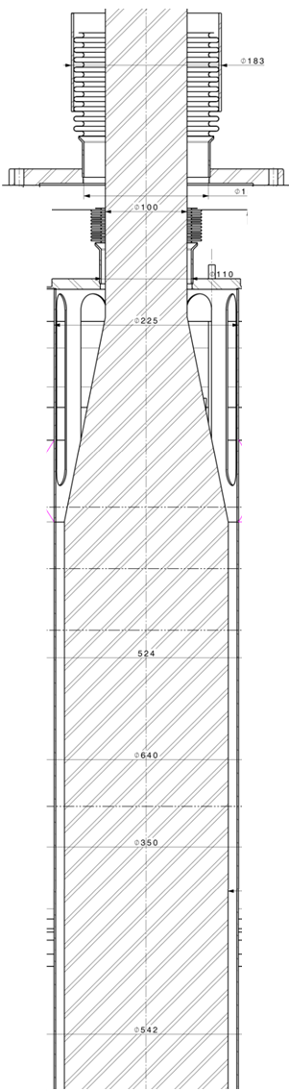
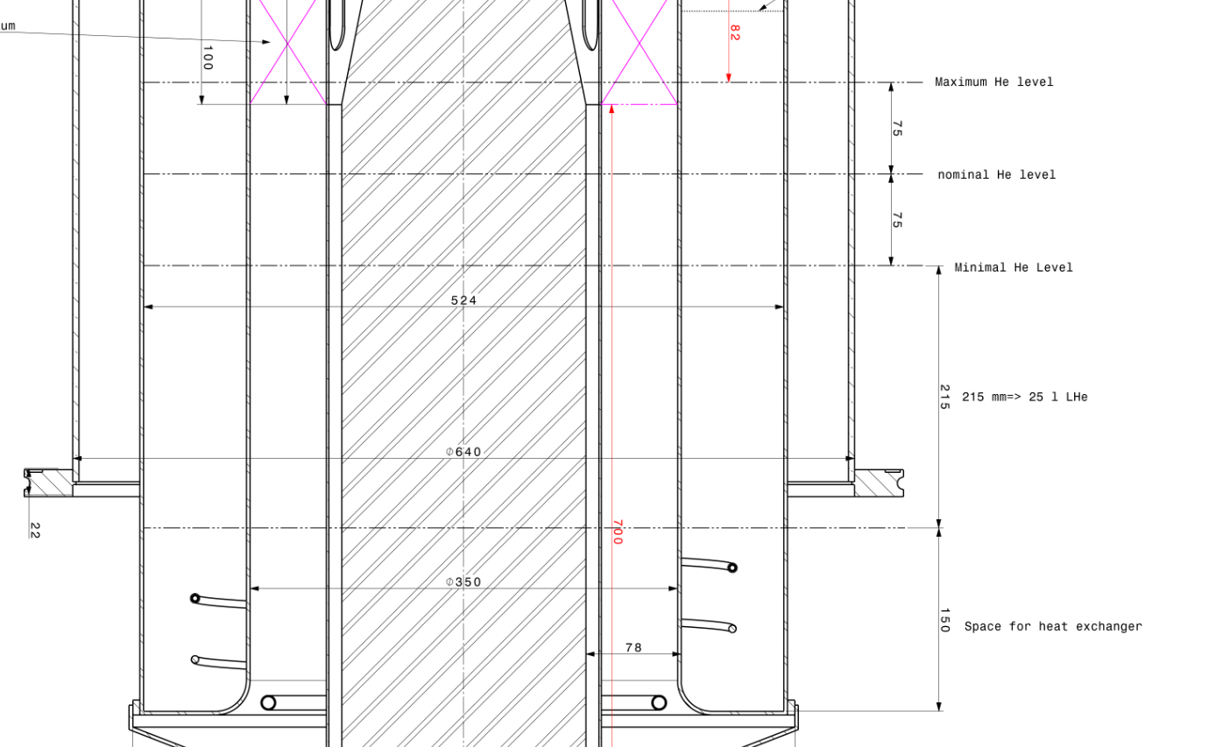
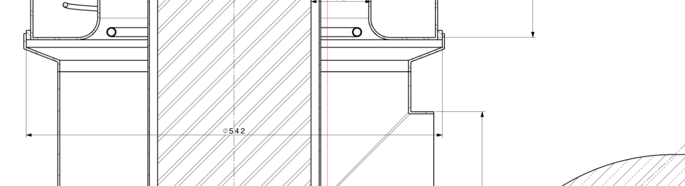
Elaborated concept
Safety relief devices
MgB2
Cables
GHE volume
LHE volume Fountain
LHE volume outer ring
SCLink interface (unchanged)
  Splices in rigid protection part of SC Link
  Same cables configuration
DFX helium reservoir
  Central “fountain” design
  LHe inlet, heater
Operation configuration
  Splices immersion
  Overfill to outer volume
  Level control at lower level
Levels definition
  Nominal & adjustment range
  Splices position
  5 min requirements
    Respect of splices immersion
    Respect 10g/s supply to SCLink
Safety relief devices location
Level gauge
Level gauge
∆P
3.9 litres > 3 litres required
for splices immersion 5 min
High level
Adjust. range
Splice upper position @ 4.5K
75
Splice upper position @ 300K
Nominal level
MgB2-NbTi
Splices
75
Low level
Adjust. range
25 > 24 litres required
for 10 g/s during 5 min
Top heater position
Heater & heat exchanger
Inlet LHE diffuser

Slide 19
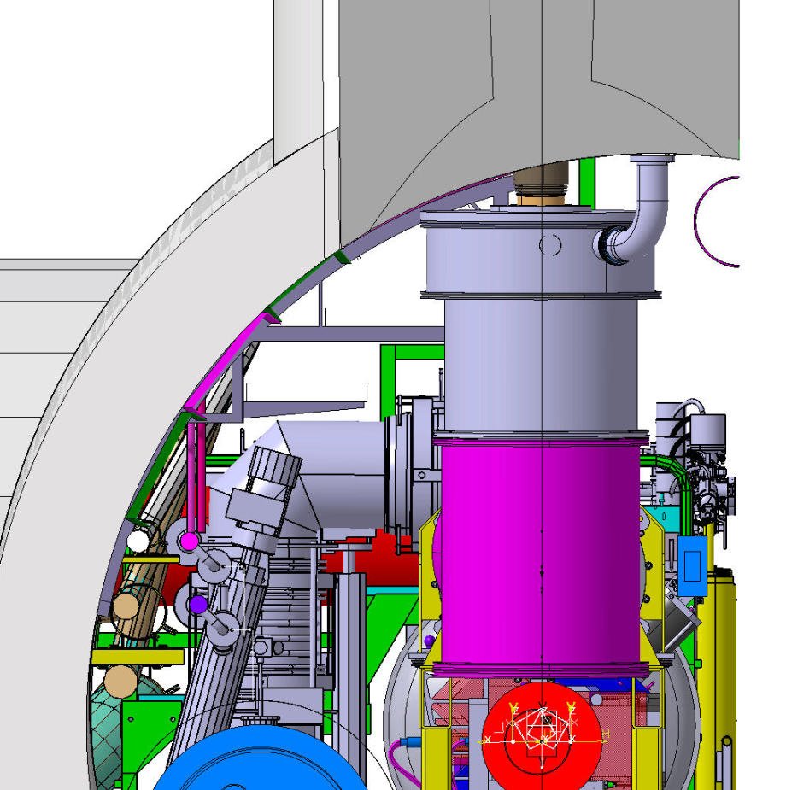
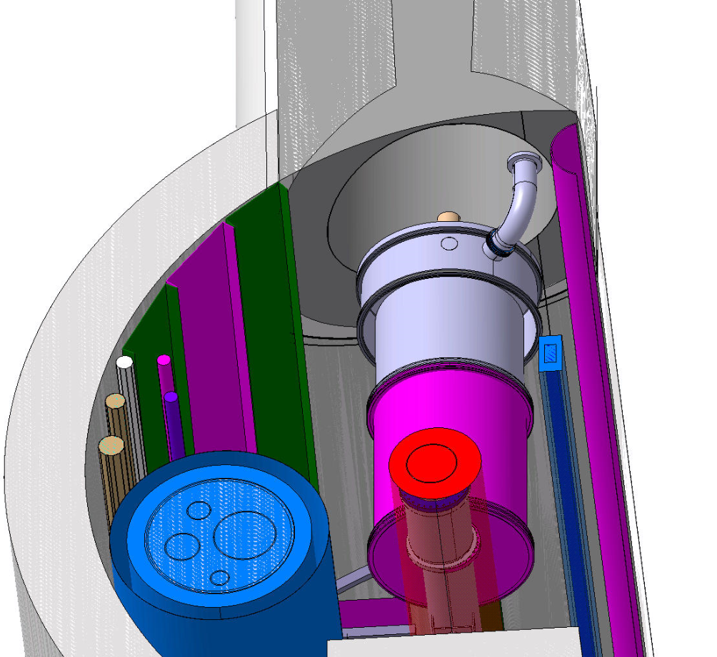
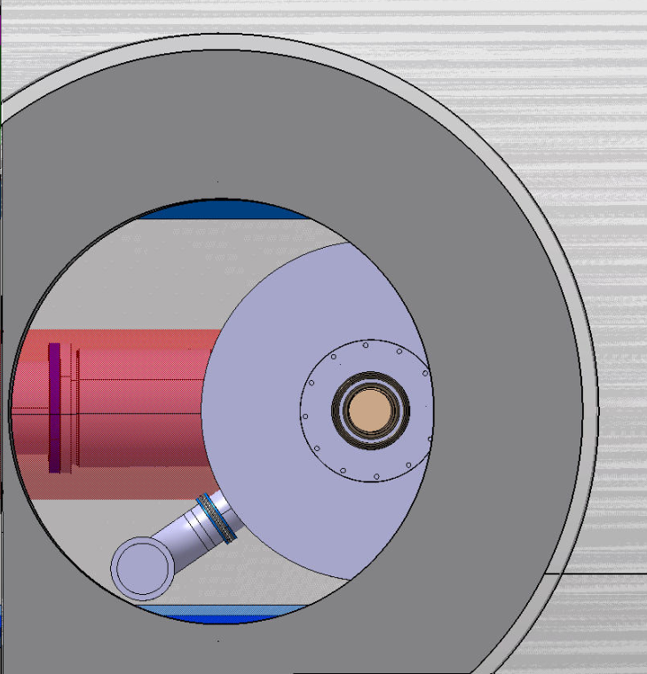
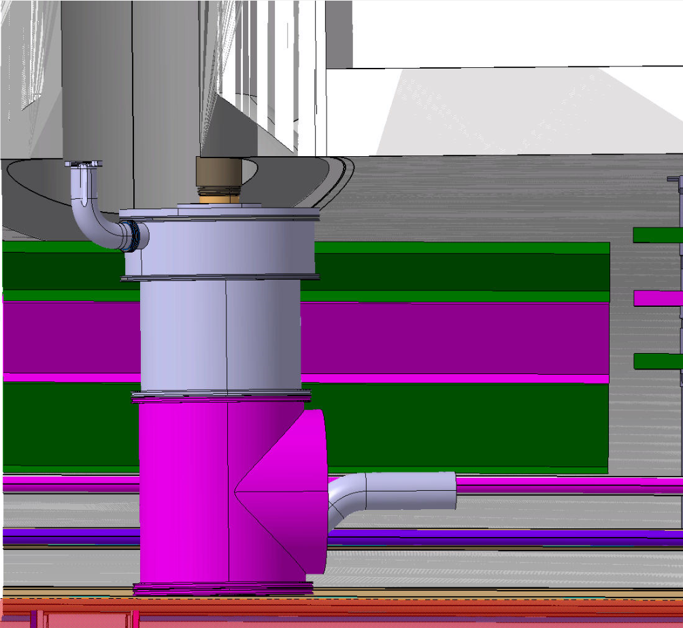
Integration of safety devices
Respect of vertical distance ; device to DFX interface with He reservoir
Accessible for inspection

Slide 20
Observations
Conceptual design adaptation with “Fountain” principle to improve the liquid level control
Proposed dimensions respect 5 minutes LHe supply stop requirements
Same integration envelope
Same interfaces
Safety relief devices located
Cryogenic, mechanical and electrical requirements satisfied

