Slide 1
Introduction
Student Projects & Outreach
Martijn Mulders (CERN)

Slide 2
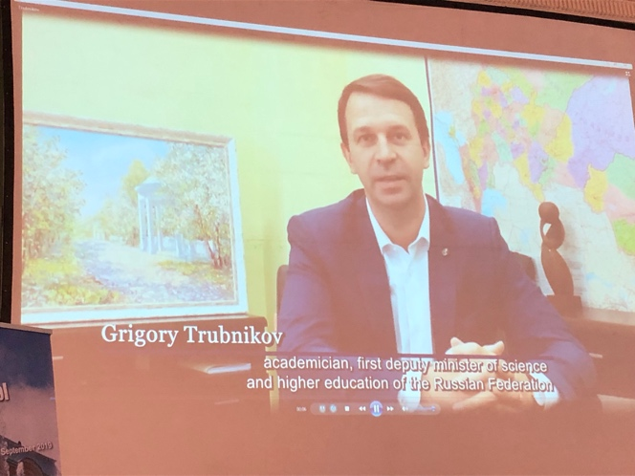
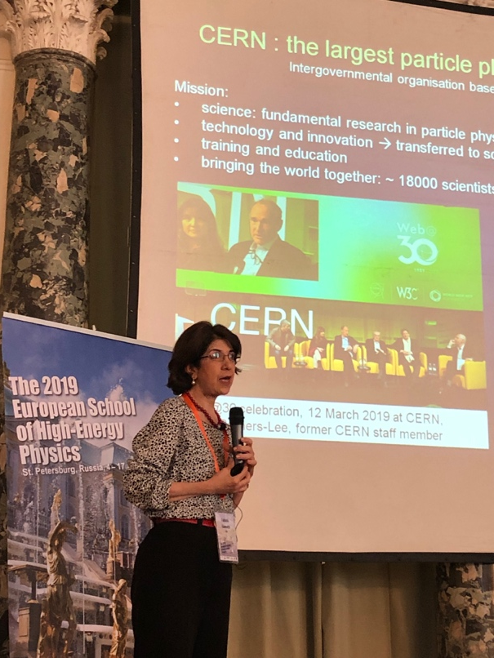

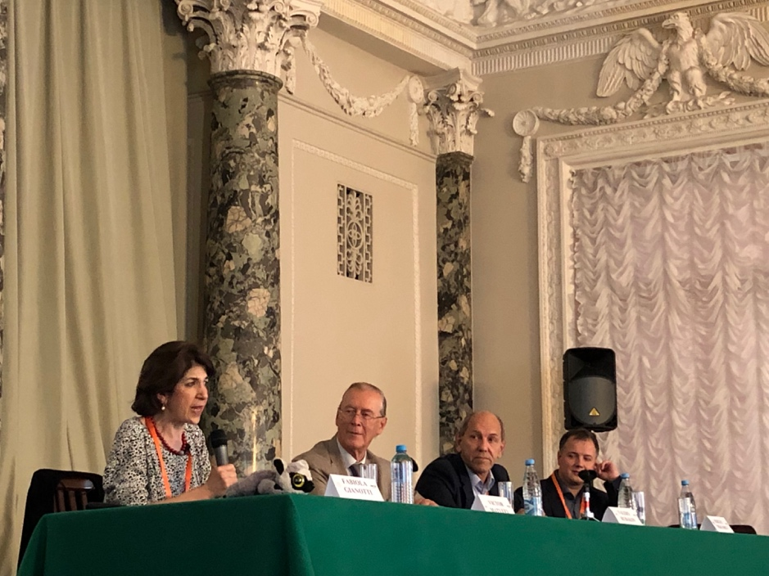
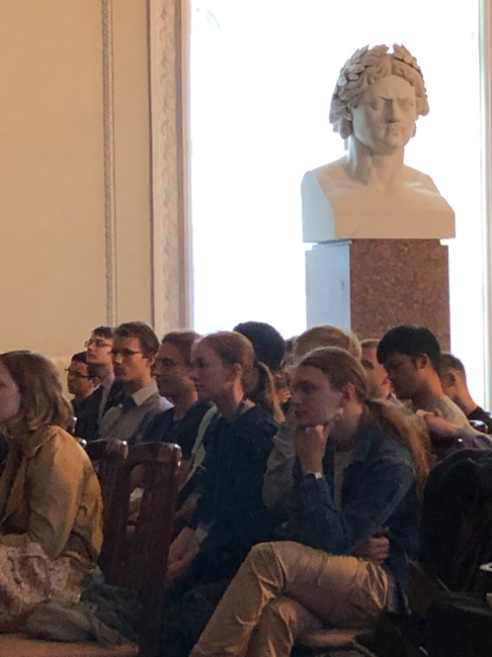
We hope you enjoyed the Outreach event on Friday!
live stream at:
https://vk.com/cernach

Slide 3
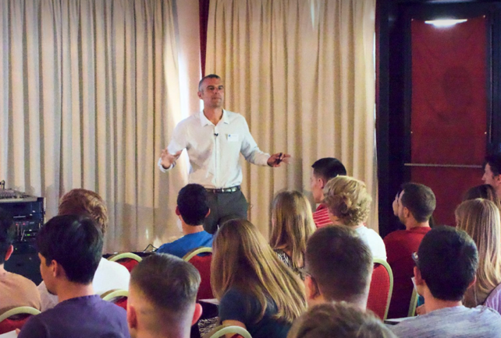
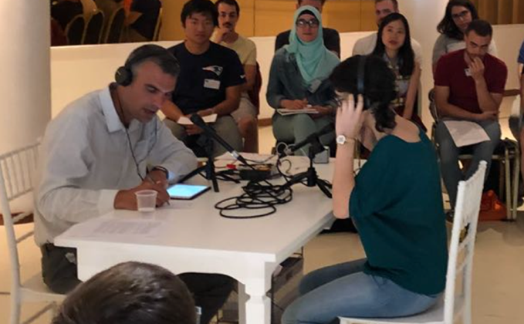
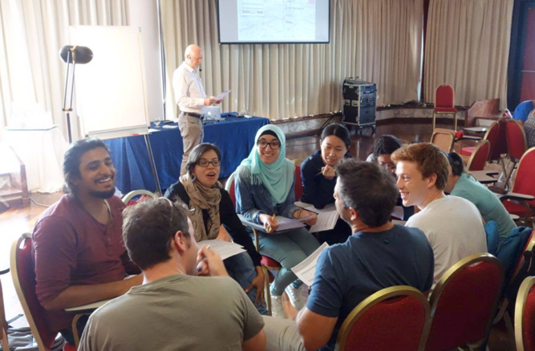
More “Outreach Activities” at this School:
Monday: Outreach / Media training
  Two training sessions (morning and afternoon)
  Evening (optional) one-on-one practice interviews
Sunday (next week): Student Outreach presentations
  Evening session with 1 presentation per Discussion Group

Slide 4
Why Outreach training?
As emphasized by the DGs of CERN and JINR, as well as deputy minister of Science and Education Grigory Trubnikov:
  It is becoming increasingly important that we successfully communicate what we are doing (and why we are doing it) to the general public
  More and more funding agencies insist on this, and many provide dedicated funding for Outreach
It is not just old guys who are involved :-)
Students & postdocs play a very important role!
Whole range of activities
  Acting as guides to visitors (general public, delegations, VIPs, VVIPs)
  Talking in Outreach events (e.g. talks to general public, school kids, etc.)
  Interviews with journalists (newspapers, radio, TV, etc.)
Similar training in previous 5 years, with positive feedback

Slide 5
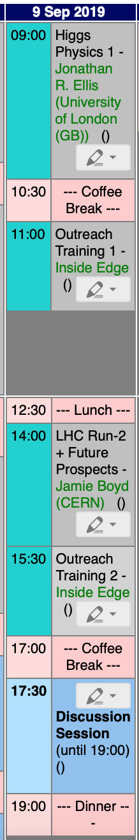
Outreach/Media Training (tomorrow):
Part 1 (11h00) Plenary Session in auditorium
  How to communicate about science to the general public, e.g. interviews with media
Part 2 (15h30) Parallel sessions in 2 groups (Rooms to be announced)
  Discussion Groups A, B, C
    Practice interviews and discussion with ~ 3 “volunteers“
    Based on "SUSY scenario" – collect handout now
  Discussion Groups D, E, F
    Work in small groups
  Swap rooms at about 16h00
  Short plenary close-out in auditorium at about 16h30 (15–30 mins)
Part 3 (20h00-21h30) Optional
  Optional individual practice interviews and coaching
    We will make sign-up sheets with time slots for one-on-one “radio” interviews
    This was very popular last year
    Each person will be able to get the recording of their own interview after the School

Slide 6
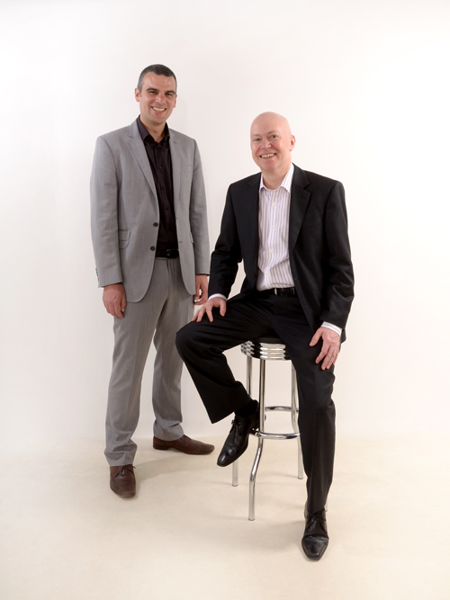
Trainers:
Chris Jameson and Tony Prideaux from “Inside Edge”
  Specialist training company used by CERN
  They do general courses and also individual coaching
  If you had to pay for this training it would not be cheap!
  Trainers both have a background in BBC TV and radio journalism

Slide 7
Student Outreach Projects
Each discussion group
  to be assigned a general topic, related to HEP
  to prepare a 7-minute, outreach-type presentation at a level suitable for a general audience
  For example: in the style of a TV presentation/report by a science journalist, or a briefing to a group of VIP visitors
  - Backed up by graphics, etc
Main work may be done by a subset of people (open to everybody from the group!)
  However, full group should be involved at least at the level of giving feedback (rehearsals)
You can use some time during the discussion sessions to get organized, but most of the work will have to happen during free time

Slide 8
One presentation per discussion group, on Sunday Sept 15, during the evening session, after dinner
The order of the talks will be random
A jury led by Kate Shaw (ATLAS physicist and Outreach expert) will provide feedback and determine a winning presentation
We will record the presentations and put the video files on our public INDICO web pages
  Material from previous years is being used by Outreach colleagues, e.g. showing it to high-school students

Slide 9
Judging criteria:
Content: the content must be scientifically correct, and well chosen to suit the audience
Clarity: critical for effective science communication… the structure of the talk is important, and judges and audience should be able to understand the scientific concept chosen
Connection / inspiration and enthusiasm: the audience and judges should be left inspired and enthused about science
Use what you learned from the Outreach event in St Petersburg & media training tomorrow!

Slide 10
Future Circular Colliders
Searches at the LHC
Future Linear Colliders
Precision measurements at the LHC
Heavy Ion Physics
Neutrino Physics
Group A
Group B
Group C
Group D
Group E
Group F
?

