Slide 1
A Precision PURE Clock Distribution System
R. Rusack – The University of Minnesota.

Slide 2
Collaborators
J. Brashear, E. Frahm, S. Jain, R. Rusack, R. Saradhy
The University of Minnesota
N. Loukas
The University of Notre-Dame
P.-A. Bausson, M. Besançon, Ö. Sahin
IRFU, CEA, Université Paris-Saclay

Slide 3
The Problem to be Solved
The CMS detector is being upgraded with new detectors which measure the time of the arrival of particles with precision of ~30 ps.
  Mip Timing Detector (MTD), ECAL and HGCAL.
10,000 clocks synchronized to less than ~10 ps needs to be distributed to all of them
Clock distribution is ~80 m from the detector.
Detector components are up to 10 m apart.
Light travels 3mm in 10 ps in vacuum.

Slide 4
Physics Motivation
Mitigate effects of 200 interations in a bunch crossing.
  Improve missing p_{T} , b tagging, jet energy resolution etc.
Particle identification in nuclear collision events in heavy-ion running.
Missing p_{T} resolution and tails
Restores Run 2 performance in H ⇾γγ
Pile-up Jet rate

Slide 5
Figures of Merit
We need to identify by timing which tracks or energy deposits are associated with a vertex and reject those that are out of time. Overall hit resolution is 30 ps.
  All detector signals in need to be referenced against a clock that is aligned to better than 10 ps. (TIE_{SS} < 10 ps)
Low phase noise at high frequency in a clock for data link stability. (TIE_{MS})
In principle with data it is possible to correct for low frequency wander using particles in the detector in intervals of 1 second.
~10,000 precision clocks distributed to CMS detectors at 320 MHz, 160 MHz & 40 MHz.

Slide 6
Pure Clock Demonstrator System
Concerns:
  A clock distribution system that uses clock recovery from the encoded downlink control signal is a complex network with multiple frequency modifications, encoding and decoding in the FPGAs and the LpGBT, has various connectors and media (ATCA backplane, optical fibers etc.) and may not meet the requirements of CMS.
  Jitter cleaning PLLs in different clock branches will partially move noise power randomly, from high frequency to low frequency and introduce noise in TIE_{SS}.
Demonstrator system to investigate what can be achieved in a pure clock distribution.
    Overall design philosophy:
    Use modern high-speed RF components.
    Make it realistically scaleable
    Explore different distribution techniques.

Slide 7
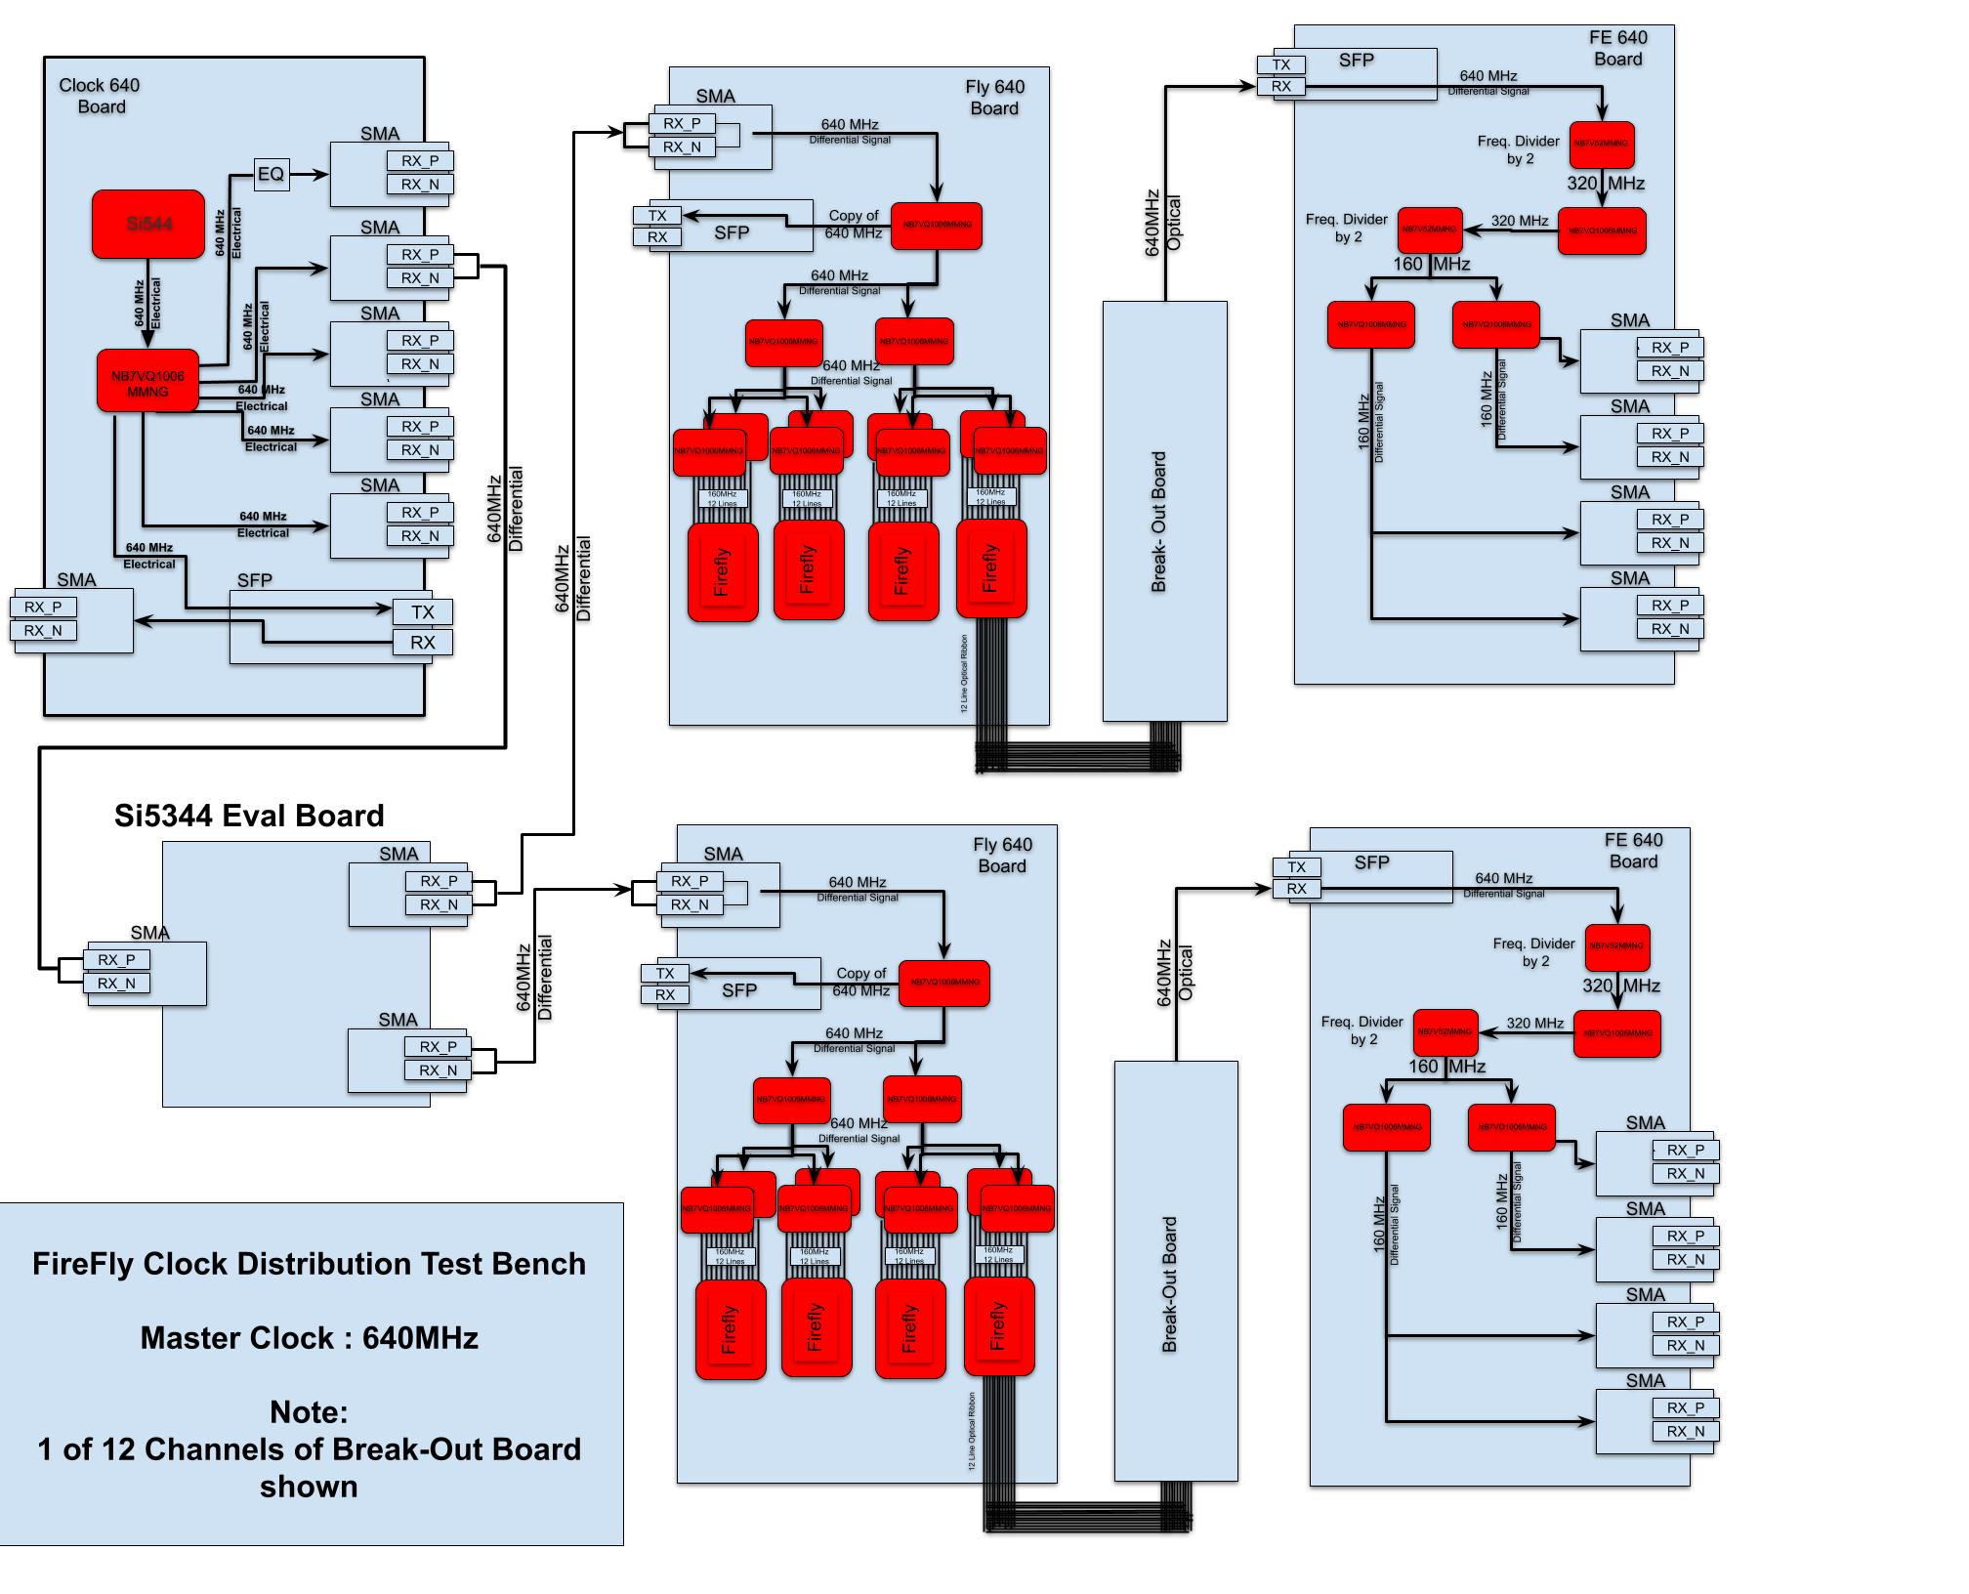
Overall architecture
1 – 48 Fan Outs
90 m MM Fiber
Custom 640 MHz clock board
160 MHz Output
Front-end emulators
Input here to alternative clock sources.
90 m MM Fiber
160 MHz Output

Slide 8
Design
All boards are custom boards.
  PCB material – medium quality with a dissipation factor of 0.006.
  Used microstrip traces on the top layer, avoiding vias for the high performance signals.
  Inter-board electrical signals are on differential pairs of SMA connectors.
  Optical signals transmitted with 12-channel Firefly_TX, alternated 6 in-phase with 6 out of phase by 180 degrees.
  Optical signals received with SFP+ and VTRx.
  Pure clock signals transmitted at 640 or 160 MHz.
    Investigate frequency division by two (or 4) at the destination to reduce phase noise from imperfect waveform duty cycle.
  Use mid-range RF quality components (~10 GHz) to generate, fanout and divide down the signals.
  Design with sufficient fanout to be realistic for an experiment. 1 - 1000
  Measure phase noise and TIE_{ss} between two ends of independent branches.

Slide 9
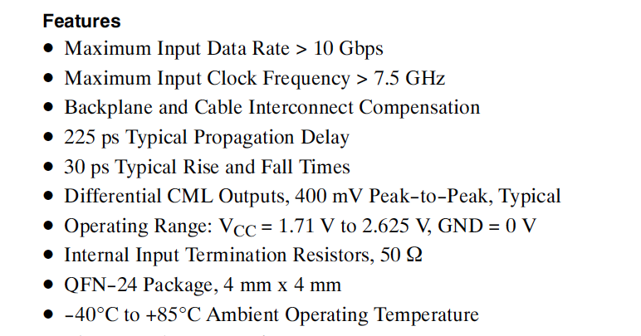
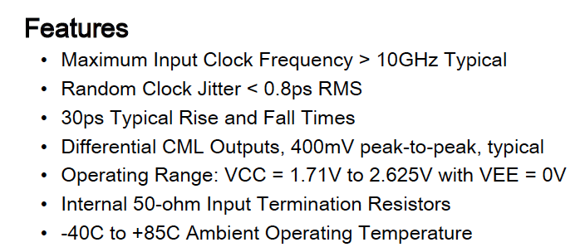
RF Components
ON Semiconductor Fanout: NB7VQ1005MMNG
ON Semiconductor D-Type Flip-Flop:
NB7V52MMNG
RF-quality SMA connectors are qualified up to 12 GHz
Setup time (t_{su}) < 40 ps.
Toggle frequency 12 GHz.
SMA connectors: RF-quality up to 12 GHz

Slide 10
Tests made
Distribution of 640 MHz clock with divide by four front-end emulator.
Distribution of 160 MHz clock without division SFP – SMA
Distribution of 160 MHz clock without division VTRx to SMA.
Test equipment:
12 GHz Agilent scope and 40 GHz Lecroy SDA 820Zi-B scope.
Rohde Schwarz FSW67 2Hz to 67GHz Signal and Spectrum analyzer
Custom Digital Dual Mean Time Difference (DDMTD) circuit
Microsemi 5275A - Measurement of TIE_{SS}
Agilent E5052B – Signal and Spectrum analyzer
And other equipment made available to us by the CERN HPTD lab.

Slide 11
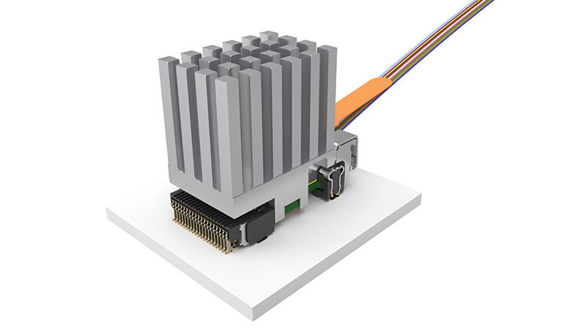
Electrical-to-Optical Fan out board – FLY640.
Two levels of 1 to 6 fanouts drive four Fireflies.
12-Channel O2E drivers.
1 to 48 fanout on the board.
Max possible fanout would be to 18 fireflies (1 to 216)
RaspberryPi to control Firefly parameters.
  Not used. Default settings used for all tests.
Used in these tests to distribute clock at frequencies from 40 MHz to 640 MHz.

Slide 12
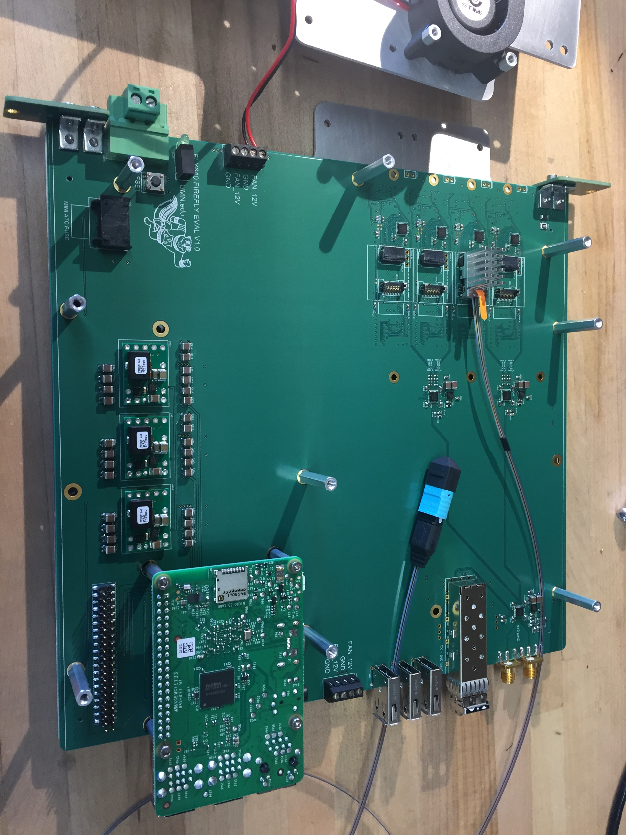
FLY640
Firefly – 12 optical links
Clock in
Clock out
Raspberry Pi to control Firefly optical links
Power in
Power regulators

Slide 13
Front-End Board Emulator
Two levels of 1 – 6 fanout.
Divides clock signal down from 640 MHz to 160 MHz.
Outputs 4 – copies of signals on differential SMAs for the measurement.
All components used in the setup are designed for high speed digital transmission.
The typical RMS jitter of the 1 – 6 Mux and the Divide-by-2 flip-flop is 0.2 ps.

Slide 14
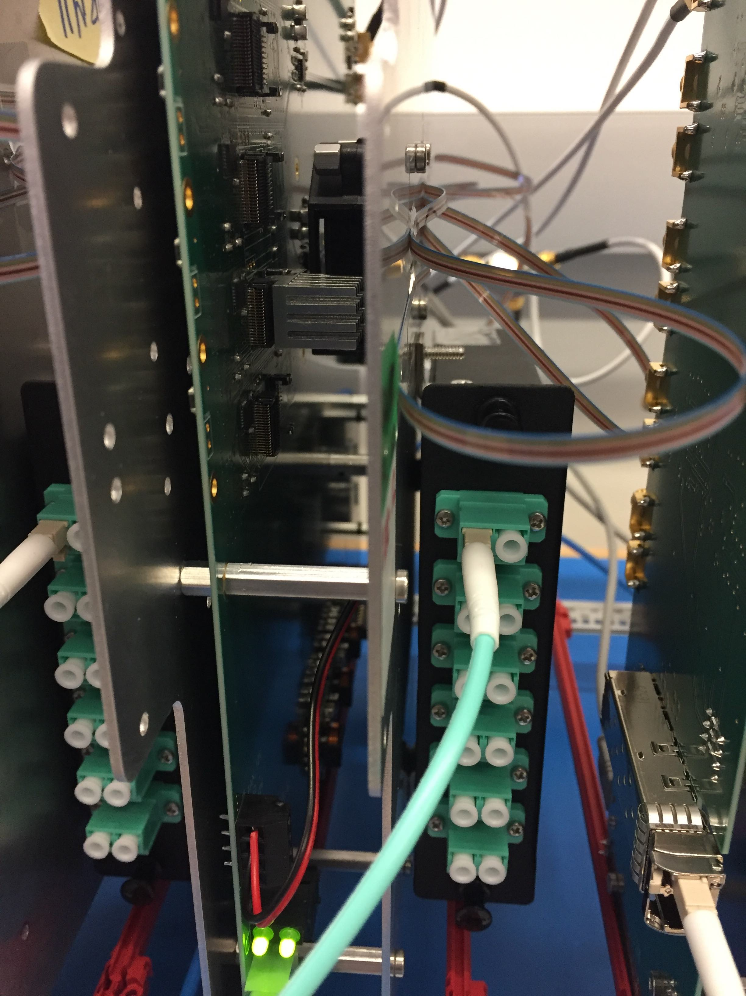
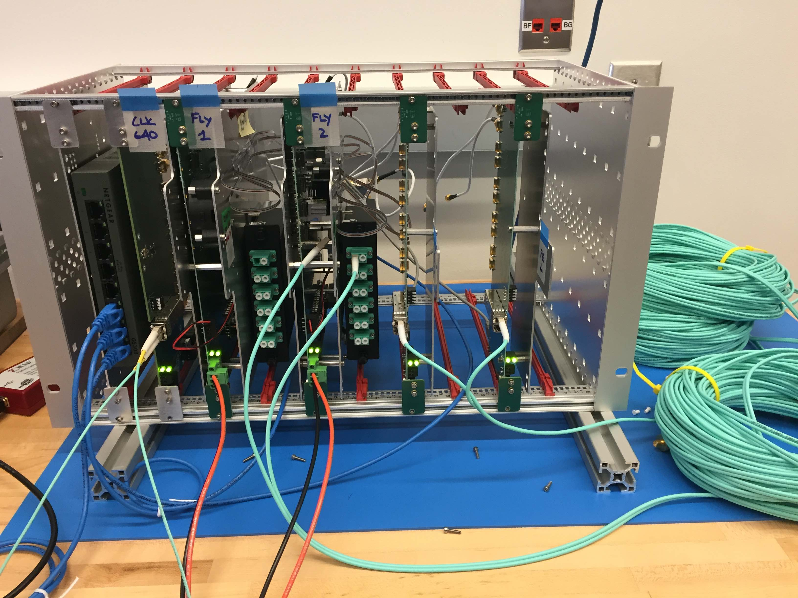
Reality

Slide 15
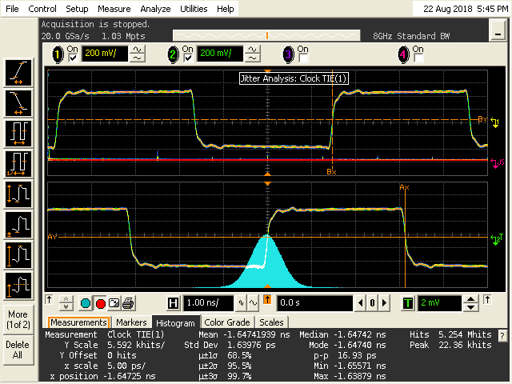
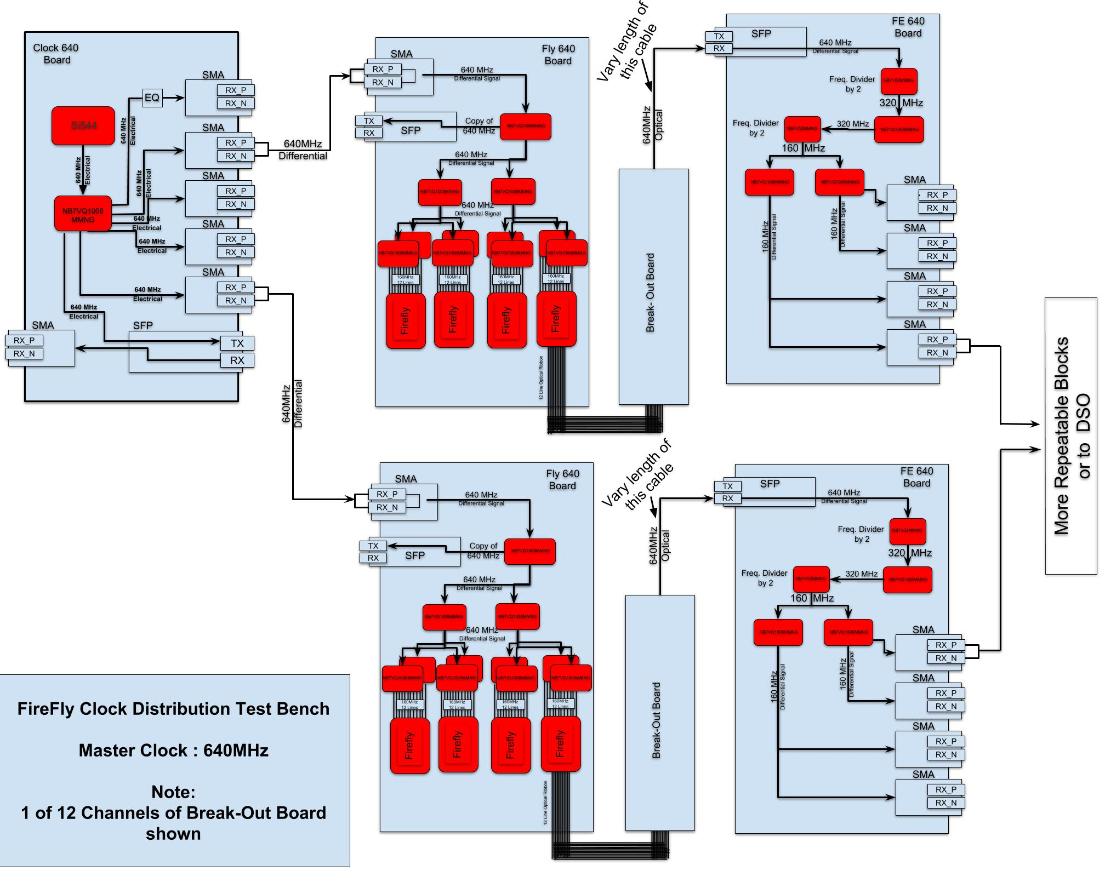
TIE_{SS} of 160 MHz Clock
External Clock mode use the 640 MHz clock. This is the slave-slave mode.
20 Gs/s – 1Mpts --- > 20 kHz
Measure 1.6 ps TIEss

Slide 16
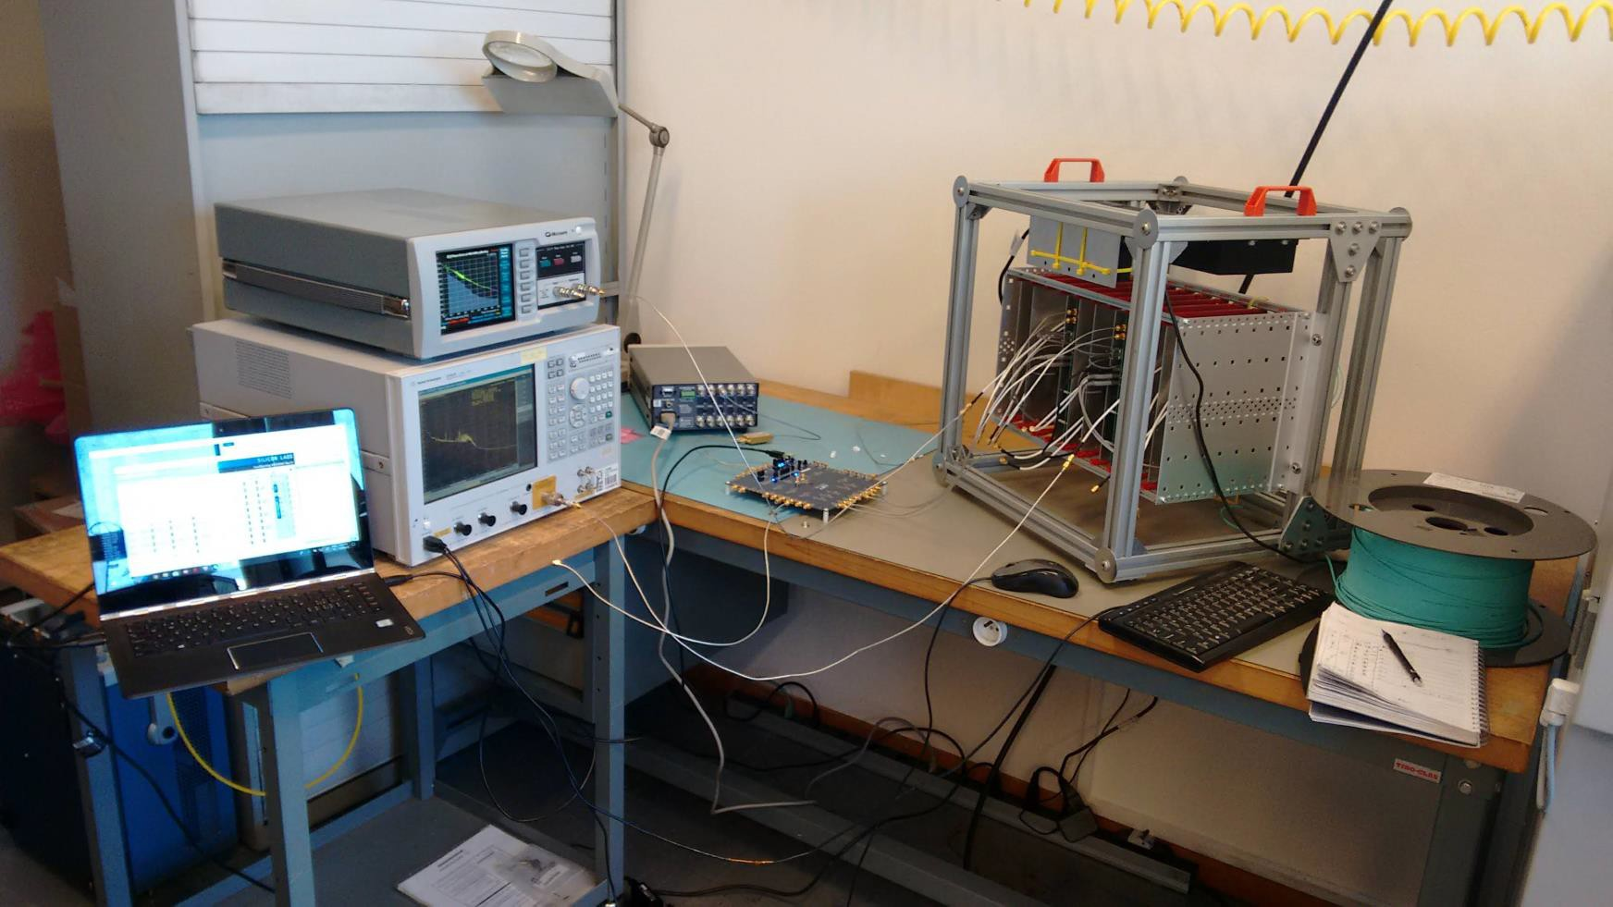
Test Setup at CERN

Slide 17
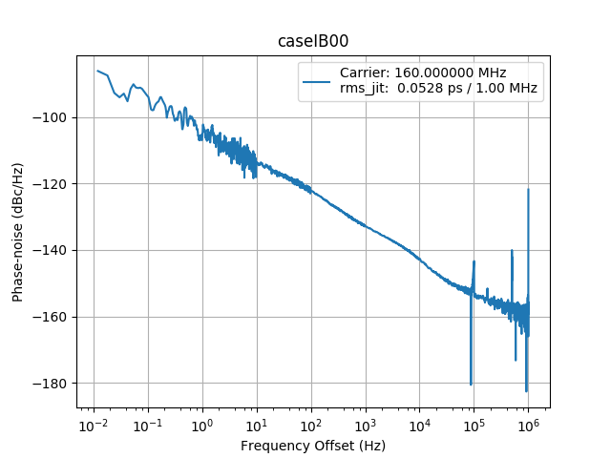
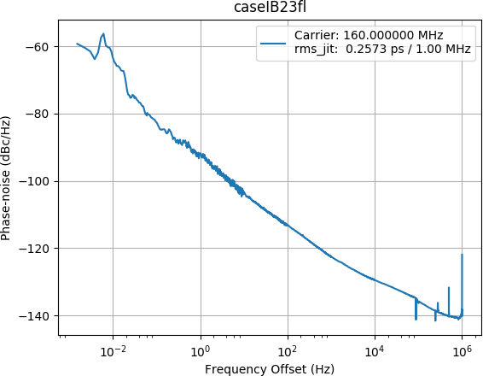
Tests at CERN
Integration between 0.01 Hz to 1 MHz.
TIE_{SS} of copy of clock at input
TIE_{SS} at output of 2 independent branches
Phase difference noise at source 52 fs
Phase difference noise slave-to-slave 257 fs
Measured at CERN HPTD lab with Microsemi 5275A

Slide 18
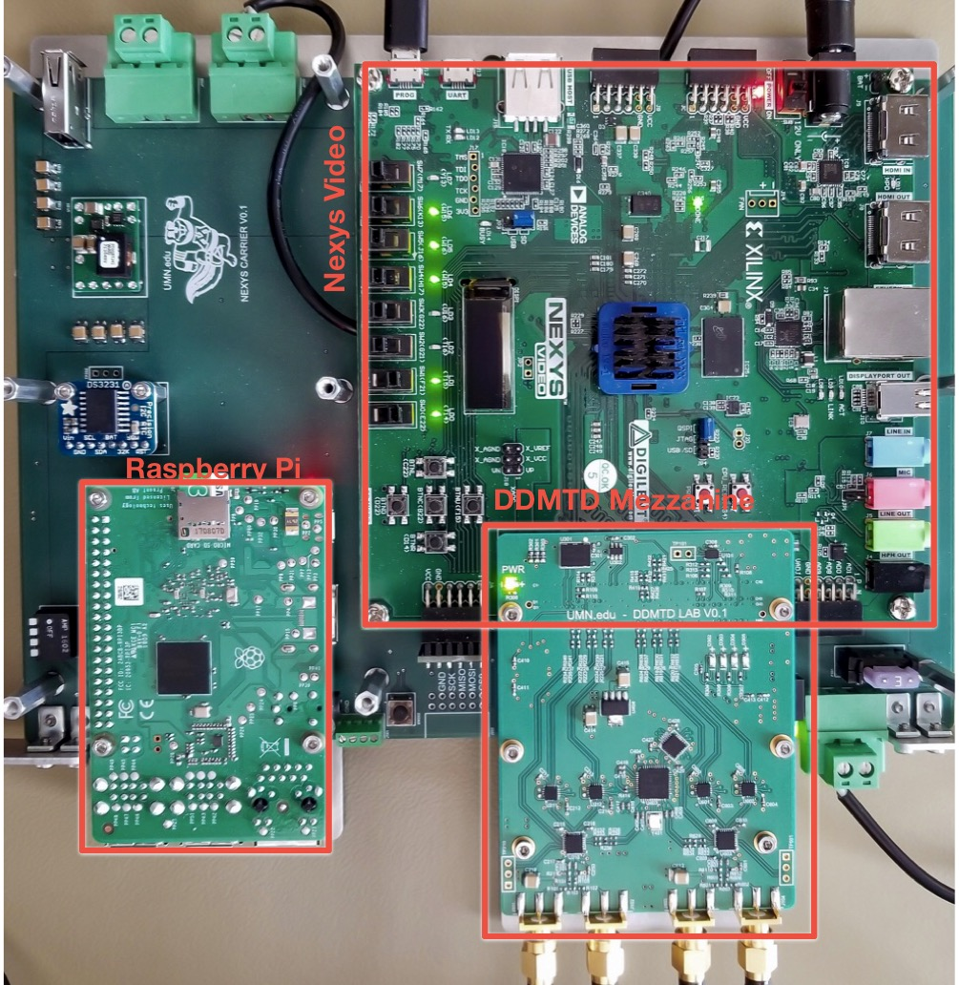
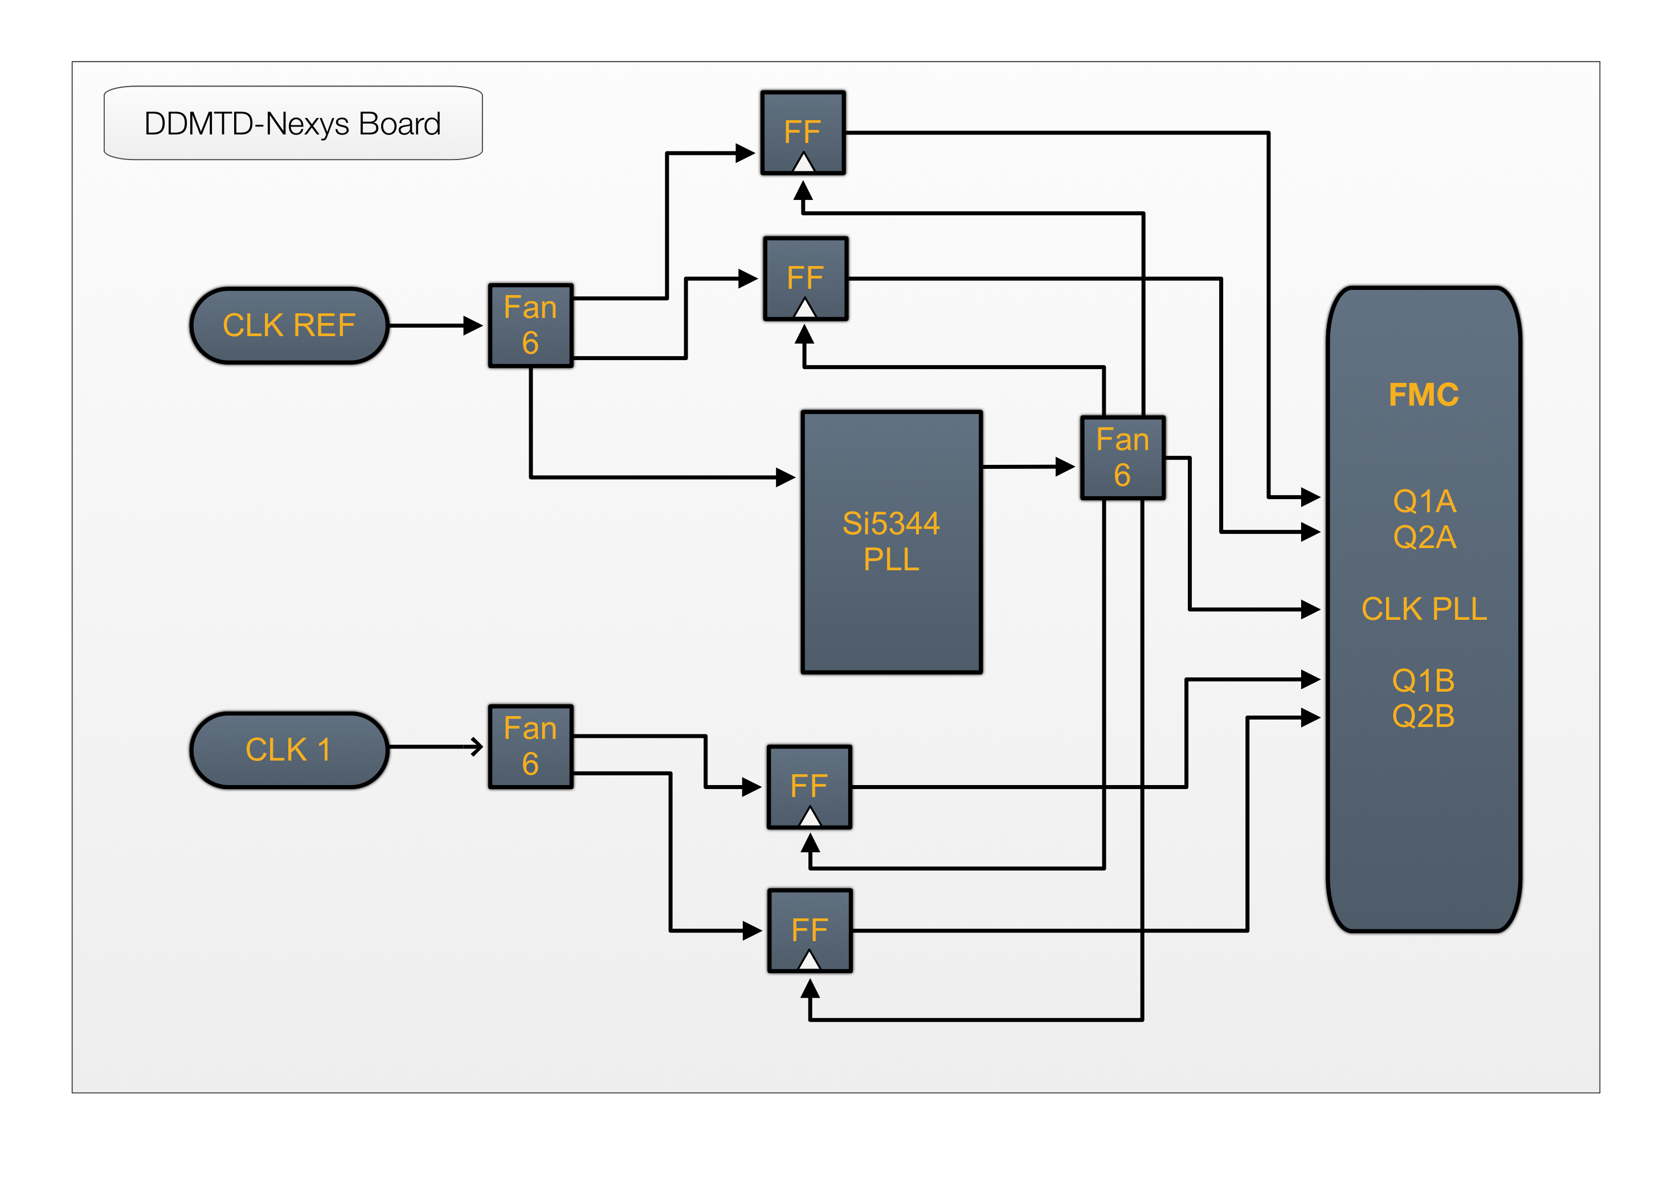
Custom DDMTD
Use Nexsys Video card with Artix-7 FPGA.

Slide 19
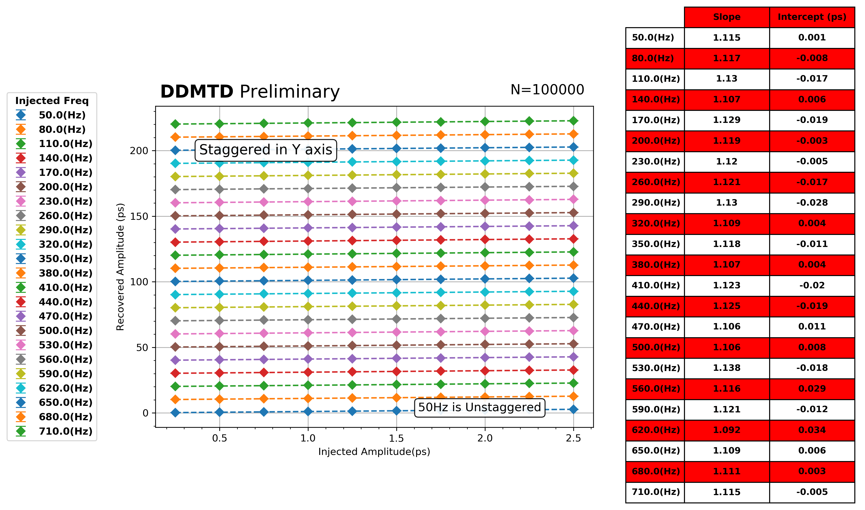
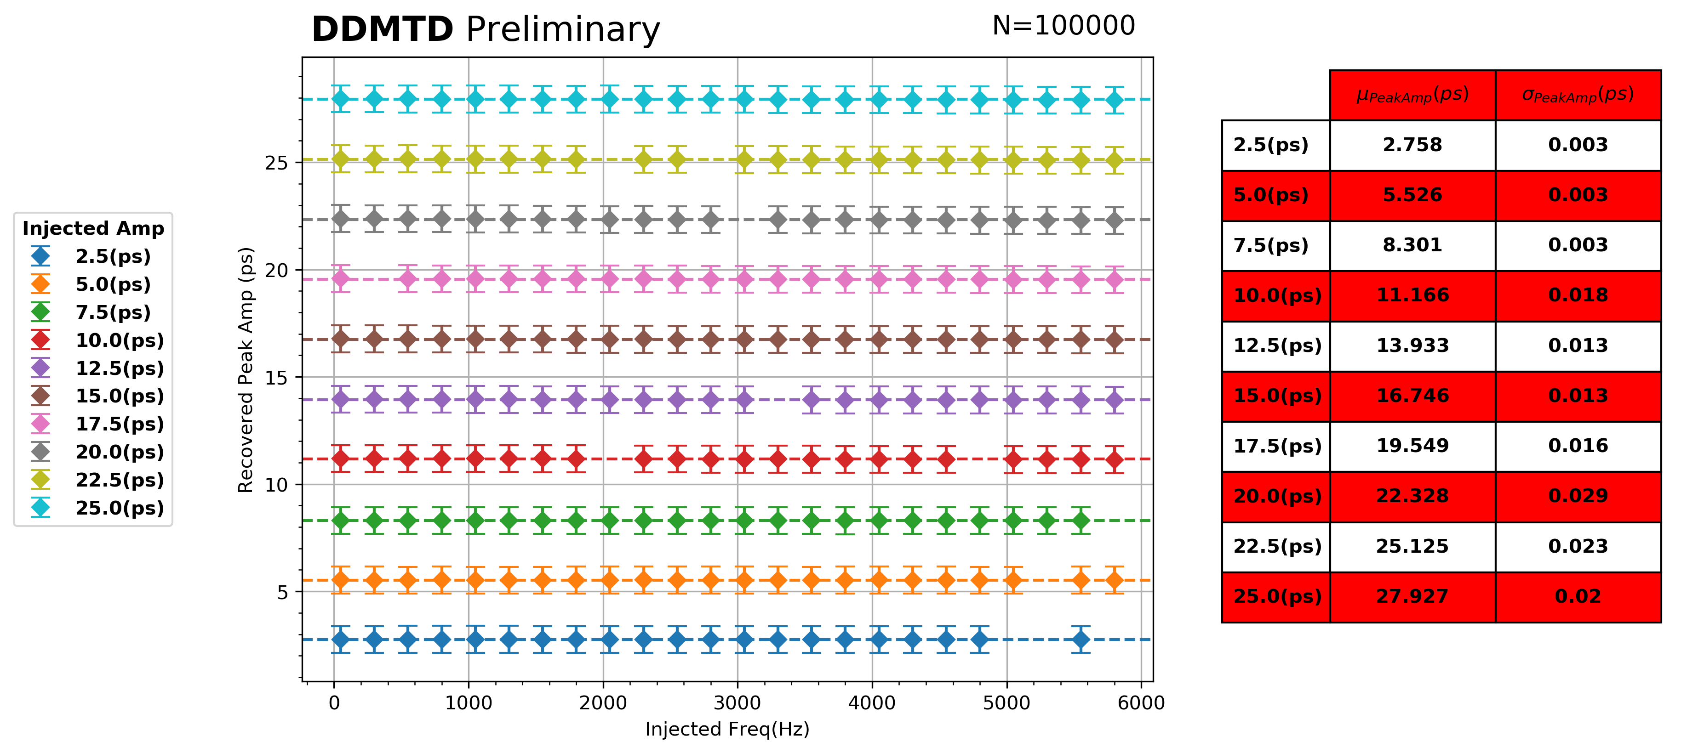
DDMTD Performance
To test performance of DDMTD we injected harmonic phase variations on a 160mMHz Clock and recover frequency and amplitude with DDMTD.
Inject 0.25 ps to 2.5 ps harmonic variations – recover with DDMTD.

Slide 20
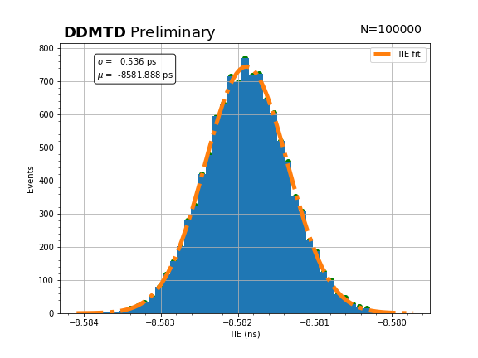
DDMTD Measurements
160MHz Clk at N=100000 → up to 1.6kHz
TIE_{SS} = 0.54 ps

Slide 21
Phase variation with temperature
LpGBT and VTRx inside Climate Chamber
40 MHz clock distributed by FLY 640 Board
28m of optical between FLY640 and VTRx
LpGBT and VTRx inside Climate Chamber
Range -30⁰ C to +60⁰C, step is 10⁰C
TIE_{MS} 40MHz; clock from LpGBT vs Ref Clock (PLL)
We observe 25ps for every 10⁰ C rise
TIE_{MS}
Optical fiber inside Climate Chamber
40 MHz Clock distributed by FLY 640 Board
28 m of MM optical cable inside Climate Chamber
LpGBT and VTRx kept outside climate chamber
Range -30⁰ C to +60⁰ C, step is 10⁰ C
We observe 50 ps step for every 10⁰ C
TIE_{MS}

Slide 22
Test with VTRx
FLY 640
90 M FIBRE
VTRx
OCXO Clock +
Si5344
MEASURE
DDMTD/SSA
Fan-Out
SMA
90 M FIBRE
VTRx
FLY 640
SMA
σ = 0.43 ps
σ = 0.71 ps

Slide 23
Next Steps
Design clock distribution and monitoring system
Principle:
Distribute clock from off-detector electronics to a 1 → N+1 fanout. Distribute N signals to the FE electronics and send one back to monitor phase shifts in the clock.

Slide 24
PCDM Demonstrator
To Detector
12
12 Channel TDC or DDMTD
12
/
/
12
12 Channel TDC or DDMTD
12
/
/
12
12 Channel TDC or DDMTD
12
Input Clock
/
/
On detector 1 ➞ N + 1
12
12 Channel TDC or DDMTD
12
/
/
12
12 Channel TDC or DDMTD
12
/
/
12
12 Channel TDC or DDMTD
12
/
/
Return from Detector
12Tx Fireflies.
12Rx Fireflies.
Phase Difference

Slide 25
Next Step PCDM Demonstrator
Joint Saclay – Minnesota development to demonstrate distribution and monitoring of 72 channels of 160 MHz clocks.
Clock monitoring is done with 72 TDCs or 72 DDMTD circuits on 6 mezzanine boards.
In final details of circuit design. Layout to follow.

Slide 26
Summary
We have investigated methods for distributing a high precision clock and shown that a slave-to-slave time interval error (TIE_{SS}) of less than 1 ps is feasible.
We have developed the major components of clock distribution and phase monitoring system suitable for distribution to the ~10,000 channels of timing detectors that will be installed in CMS for the HL-LHC.

Slide 27
Acknowledgement
We are grateful to the hospitality shown to us by the CERN HPTD lab where many of the measurements reported here were made and one of us (RS) spent this summer making measurements and learning about clock distribution systems.
We are also grateful to the NSF, DOE and to CEA for their support in this project.

Slide 28
Backup

Slide 29
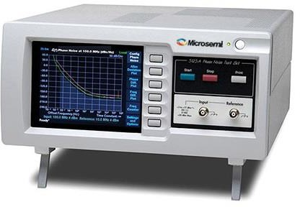
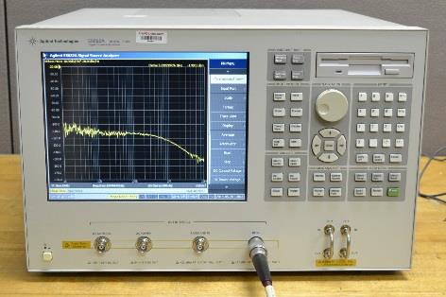
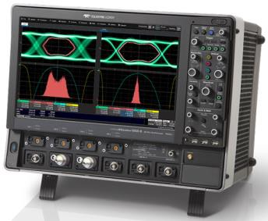
Instruments
• Microsemi 5125A
Relative phase noise to a reference
Offset frequency range: 1Hz to 1MHz
https://www.microsemi.com/product- directory/phase-noise-and-allen-deviation- testers/4129-5125a
Agilent E5052B
Absolute phase noise
Offset frequency range: 1 Hz to 40
MHz
https://www.keysight.com/en/pd- 1081579-pn-E5052B/ssa-signal- source-analyzer-10-mhz-to-7-ghz- 265-ghz-or-110-ghz?cc=US&lc=eng
• LeCroy SDA 820Zi-B
Clock skew → distribution → stdDev
SDA analysis: σ, Random and
Deterministic jitter.
http://teledynelecroy.com/oscilloscop e/wavemaster-sda-dda-8-zi-b- oscilloscopes/sda-820zi-b

Slide 30
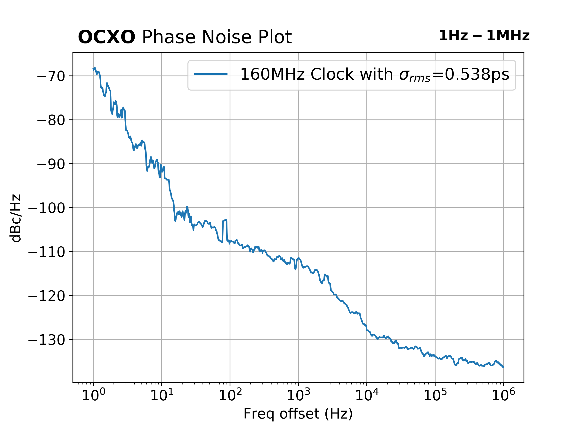
Using simple clock
Use an oven controlled crystal oscillator (OCXO) to produce a low-cost clock in Minnesota

Slide 31
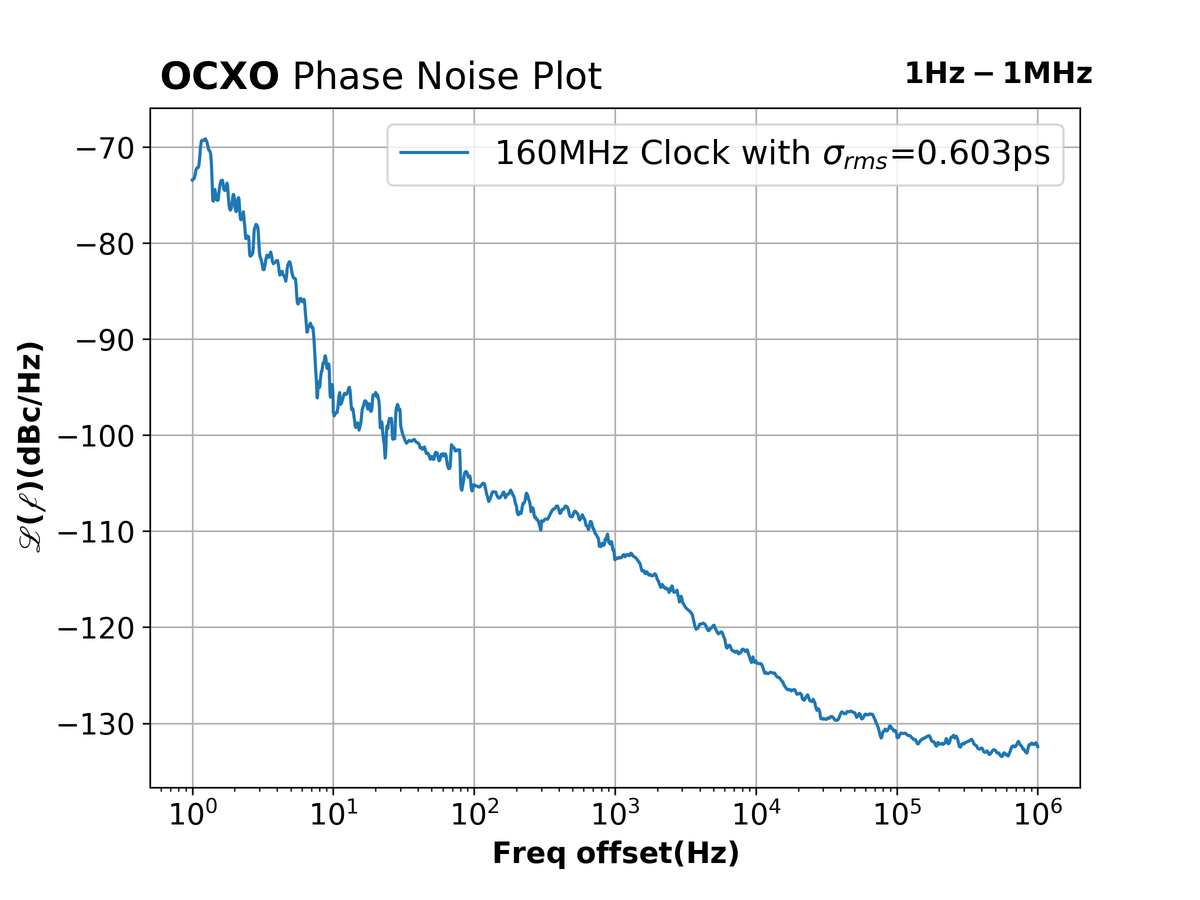
SFP - 1
90m Fiber

Slide 32
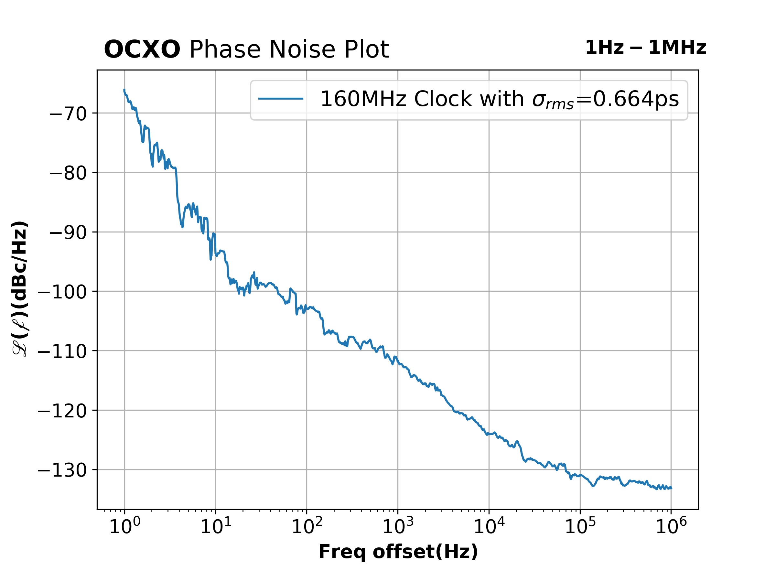
SFP - 2
90m Fiber

Slide 33
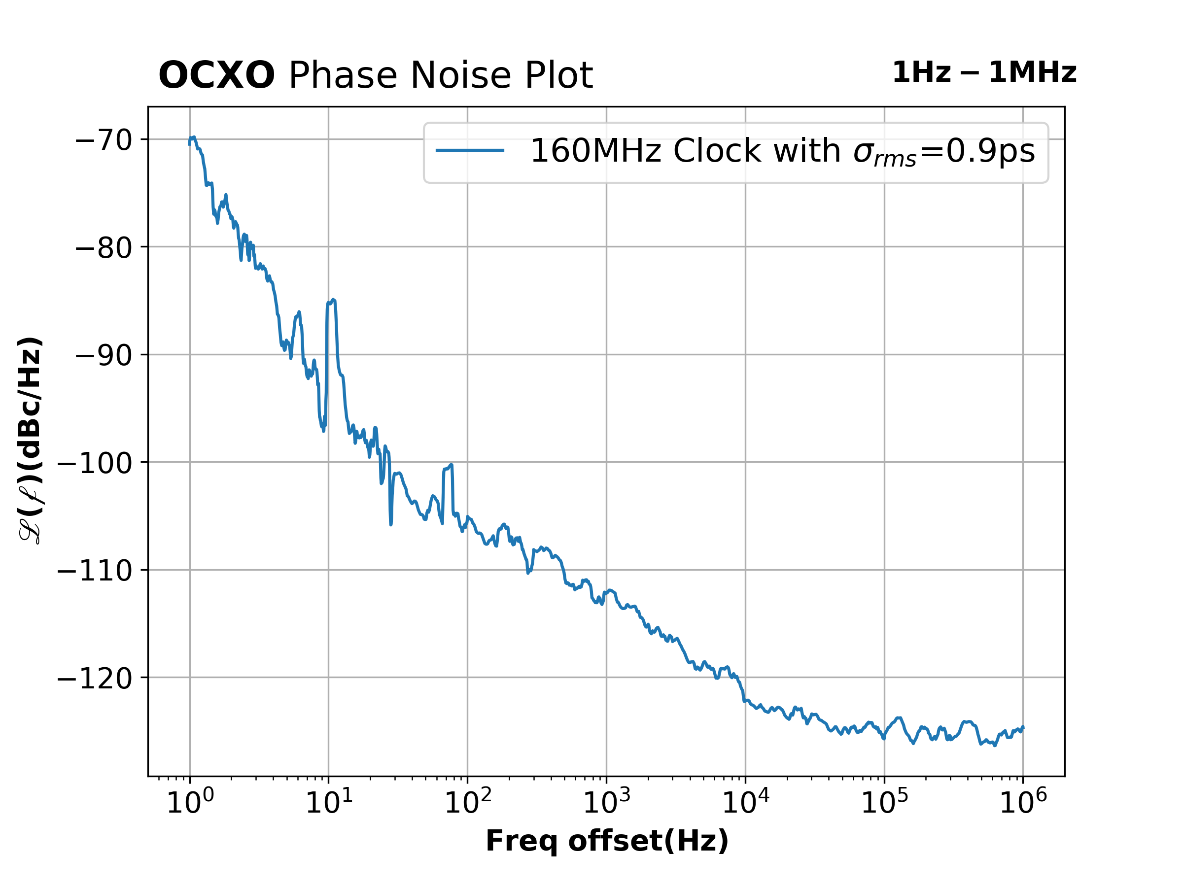
VTRx - 1
90m Fiber

Slide 34
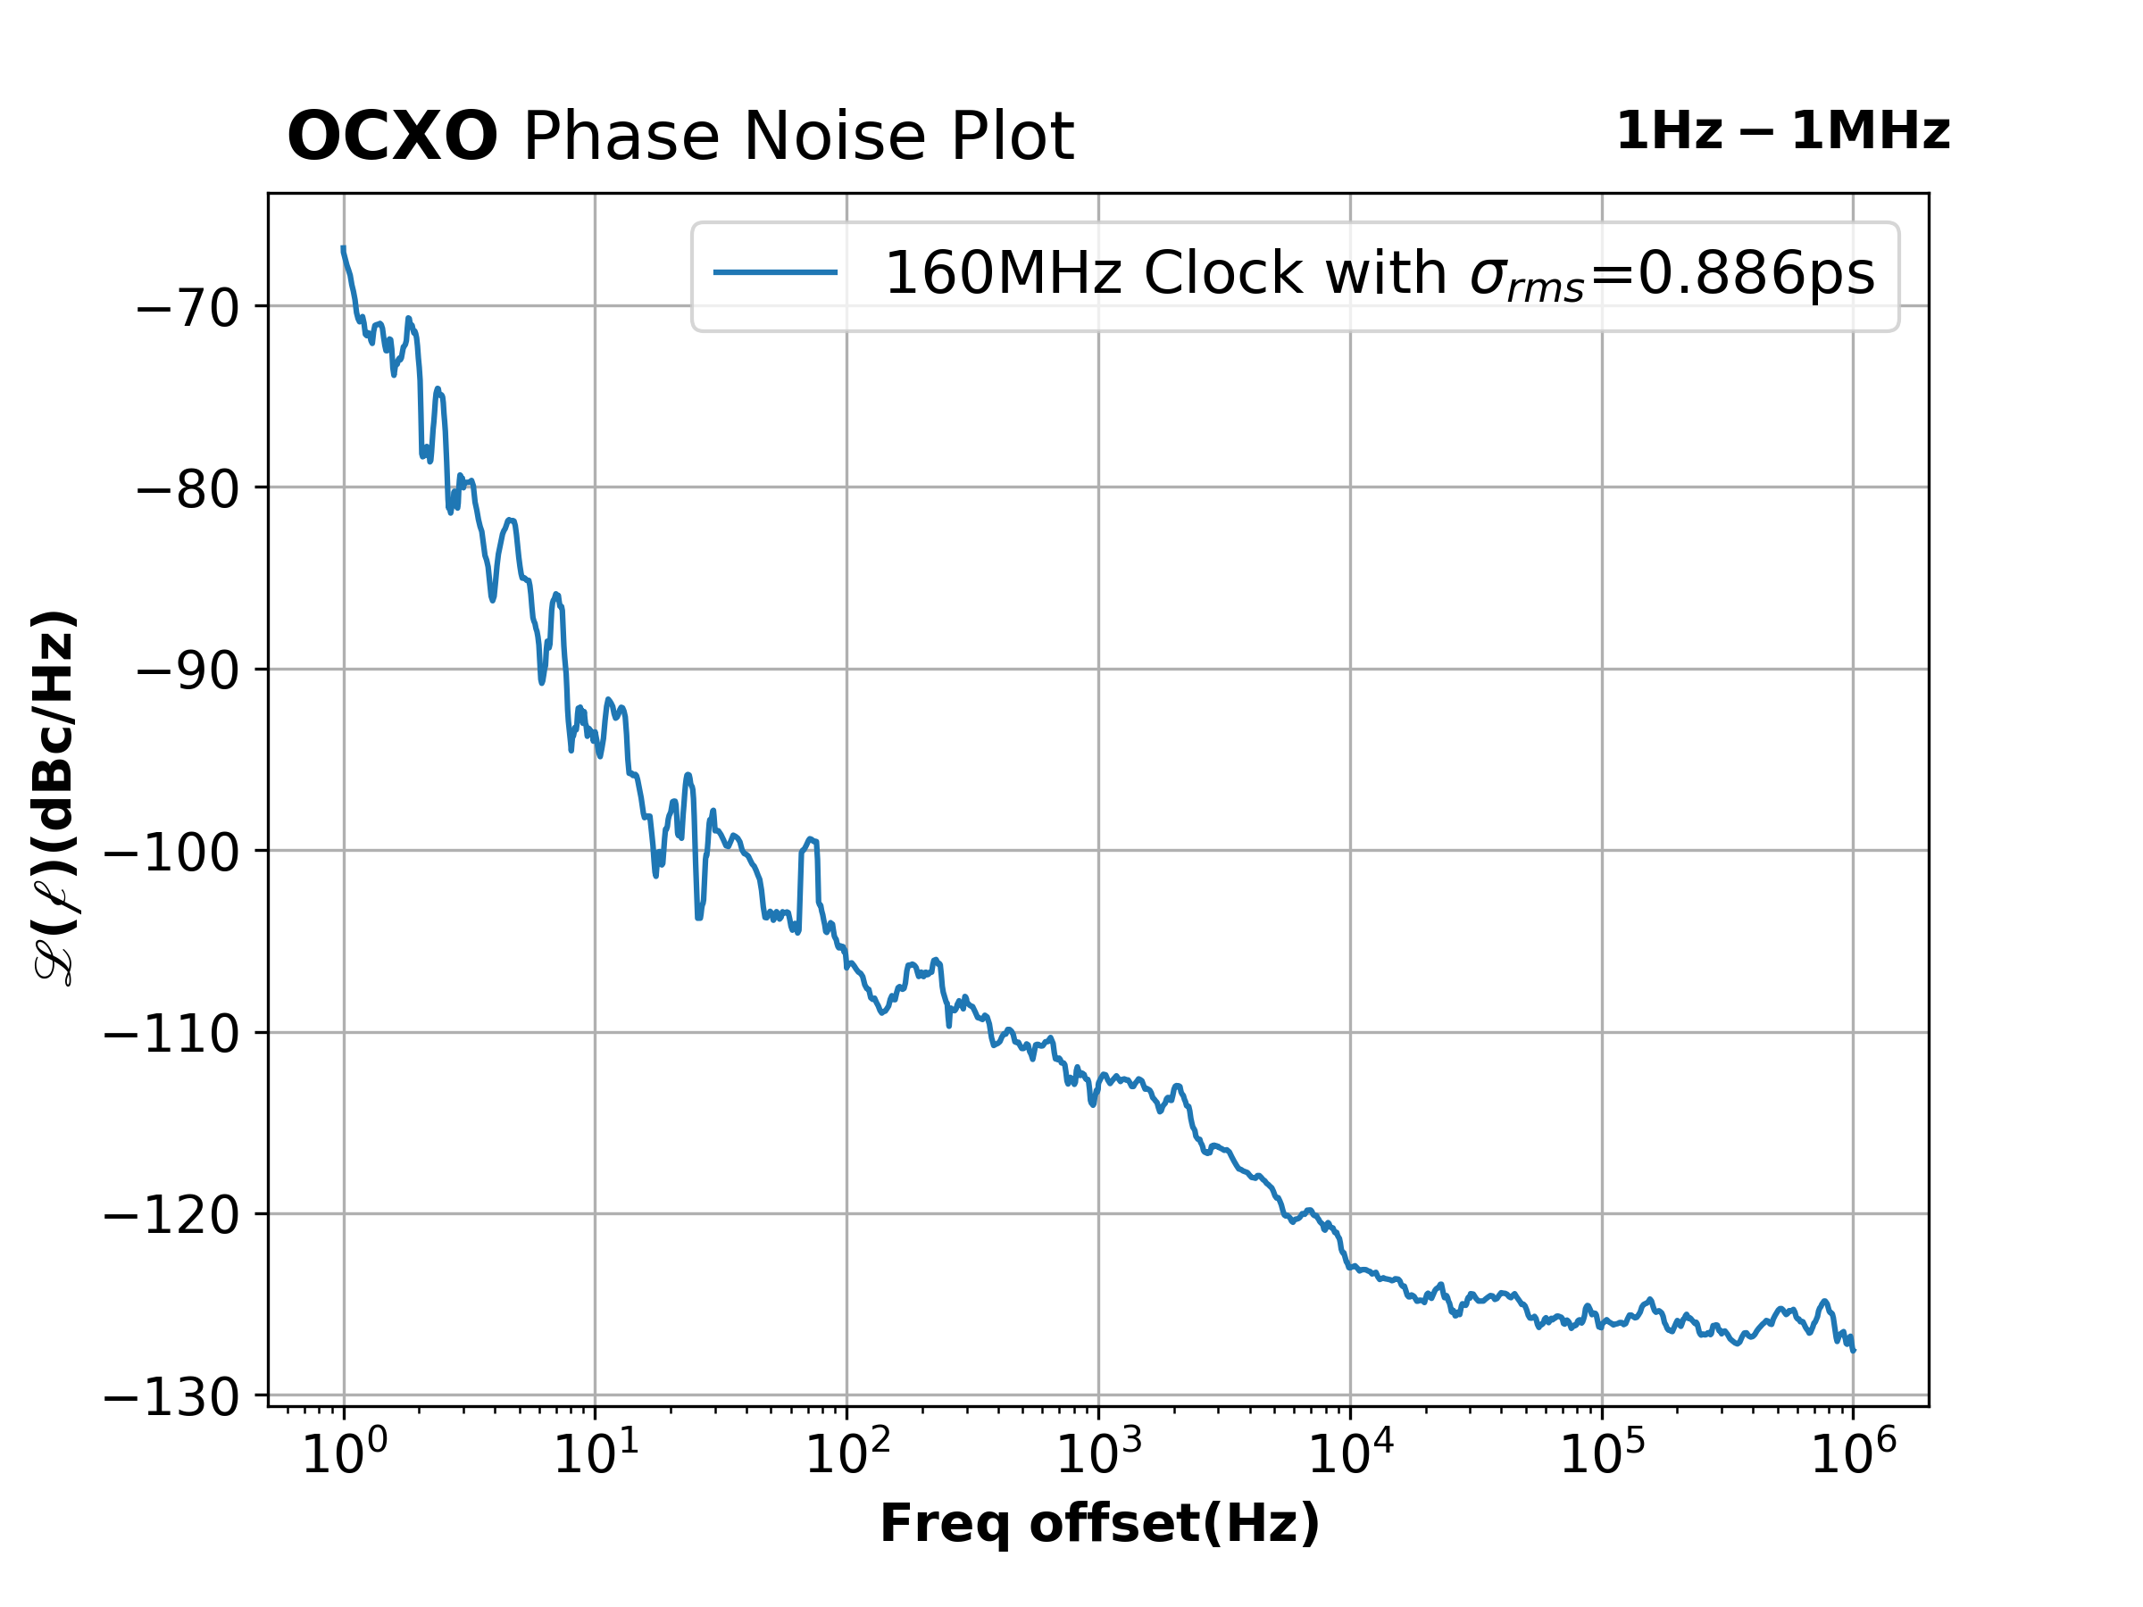
VTRx - 2
90m Fiber

Slide 35
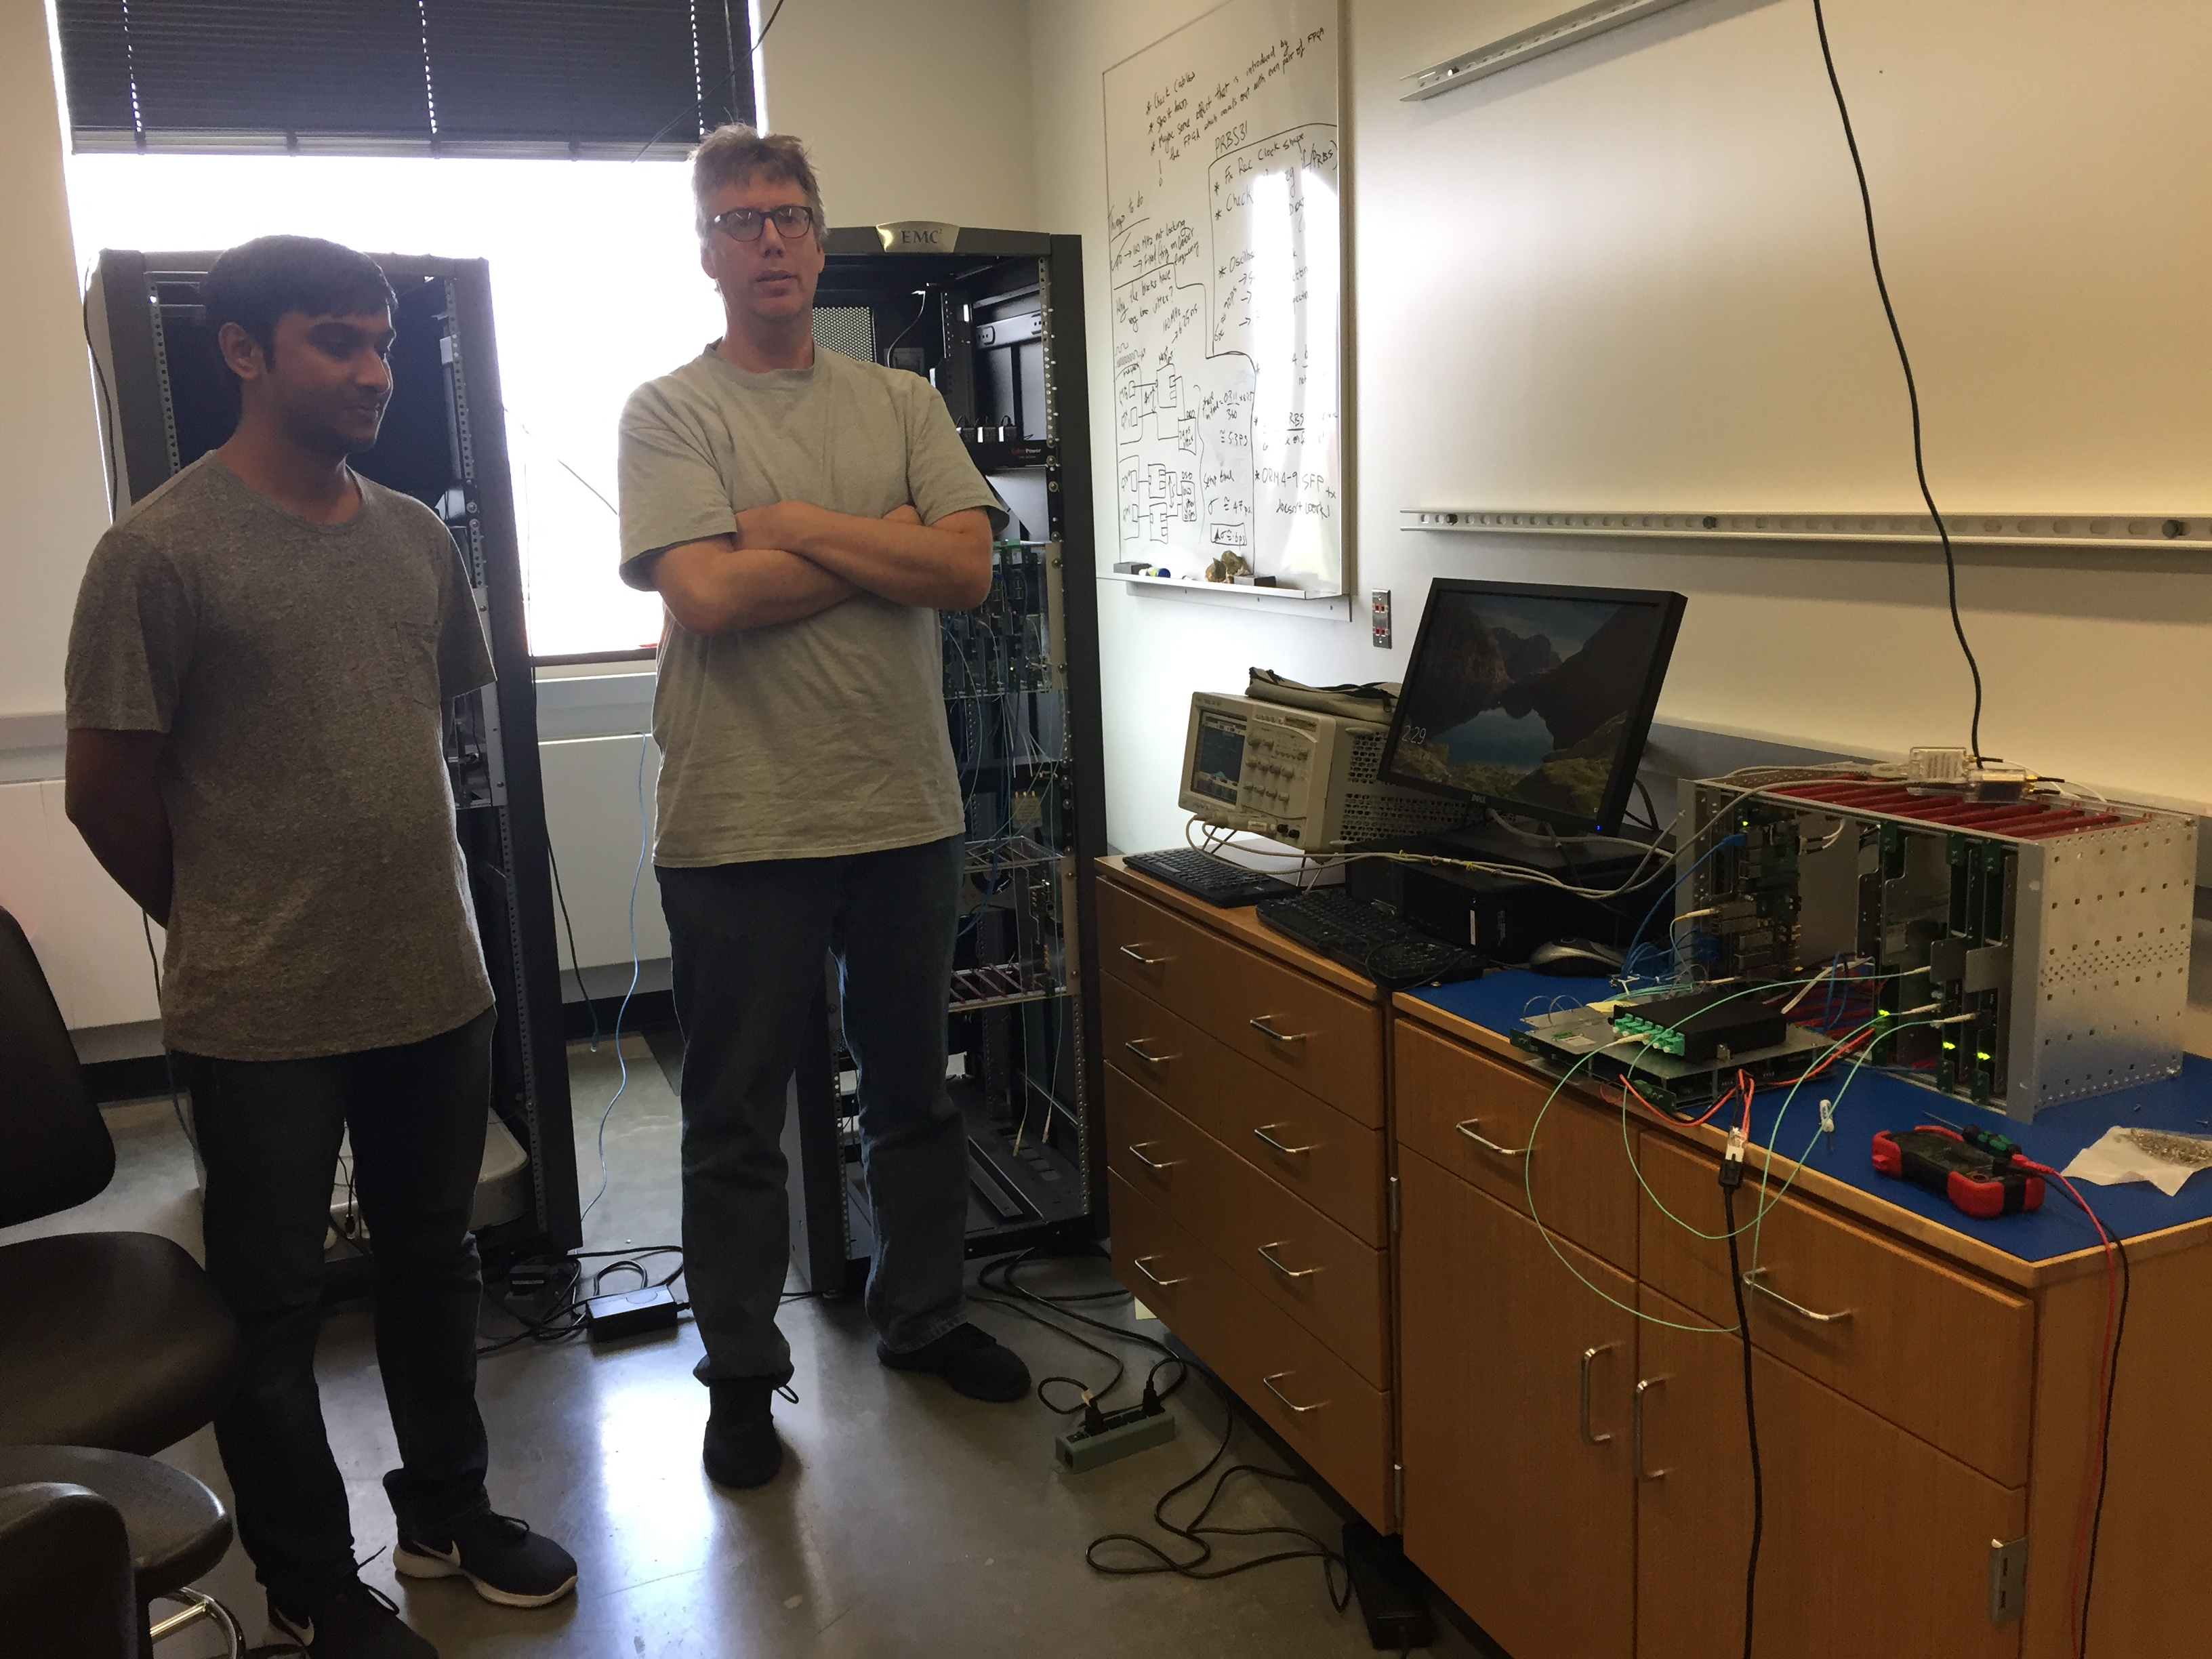
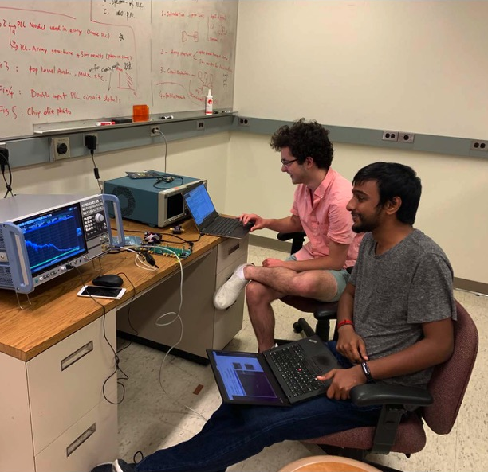
Rohith Saradhy and Erich Frahm
Jonathon Brashear and Rohith

Slide 36
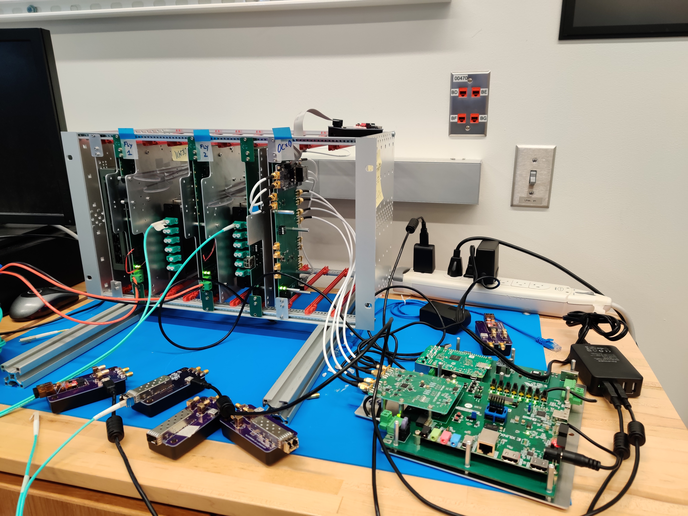
VTRx Test Setup

