Slide 1
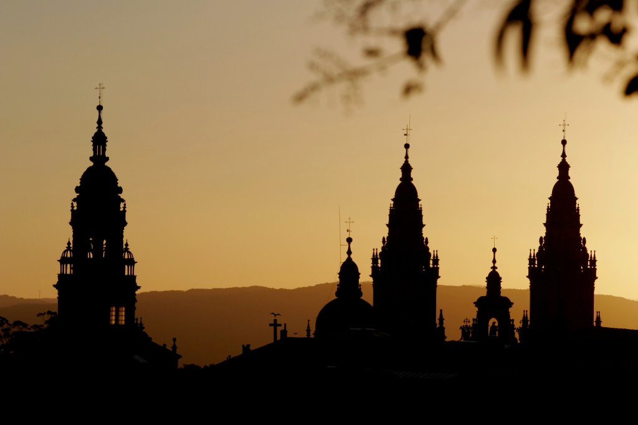

TWEPP 2019 in
Santiago de Compostela
Practical information
Prof. Pablo Vázquez
IGFAE/USC

Slide 2
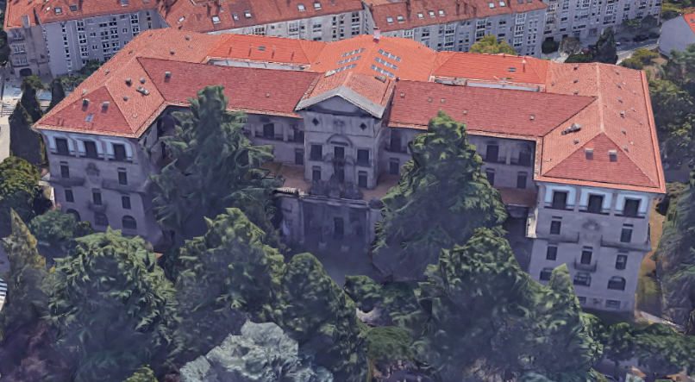
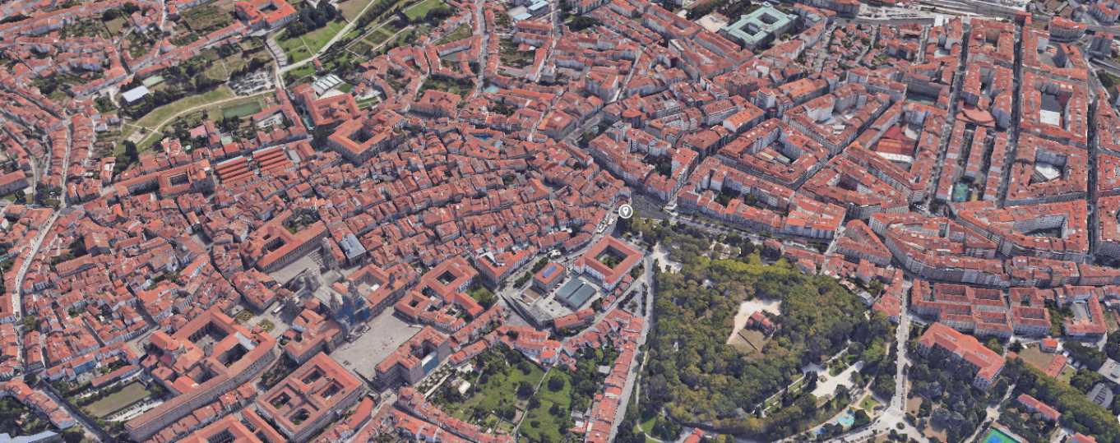
Locations
Venue - Faculty of Chemistry,
Avda das ciencias s/n
Guided tour - Praza do Obradoiro front of Pazo de Raxoi
Welcome drink - Nave 5,
Mercado de Abastos,
Rúa das Ameas, 6
Dinner – Hostal Parador dos Reis Católicos, Praza do Obradoiro
Welcome drink - Nave 5 Abastos
Guided tour - Praza do Obradoiro
Dinner - Parador

Slide 3
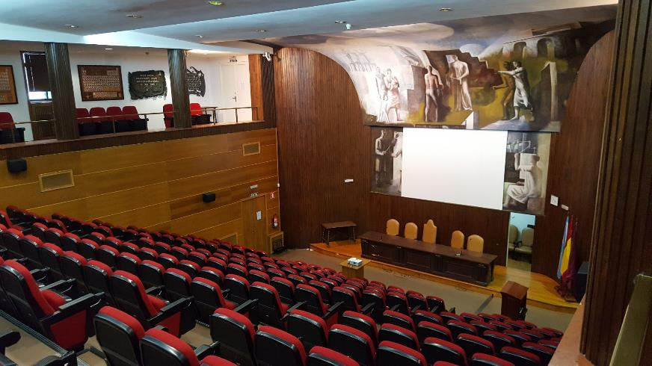
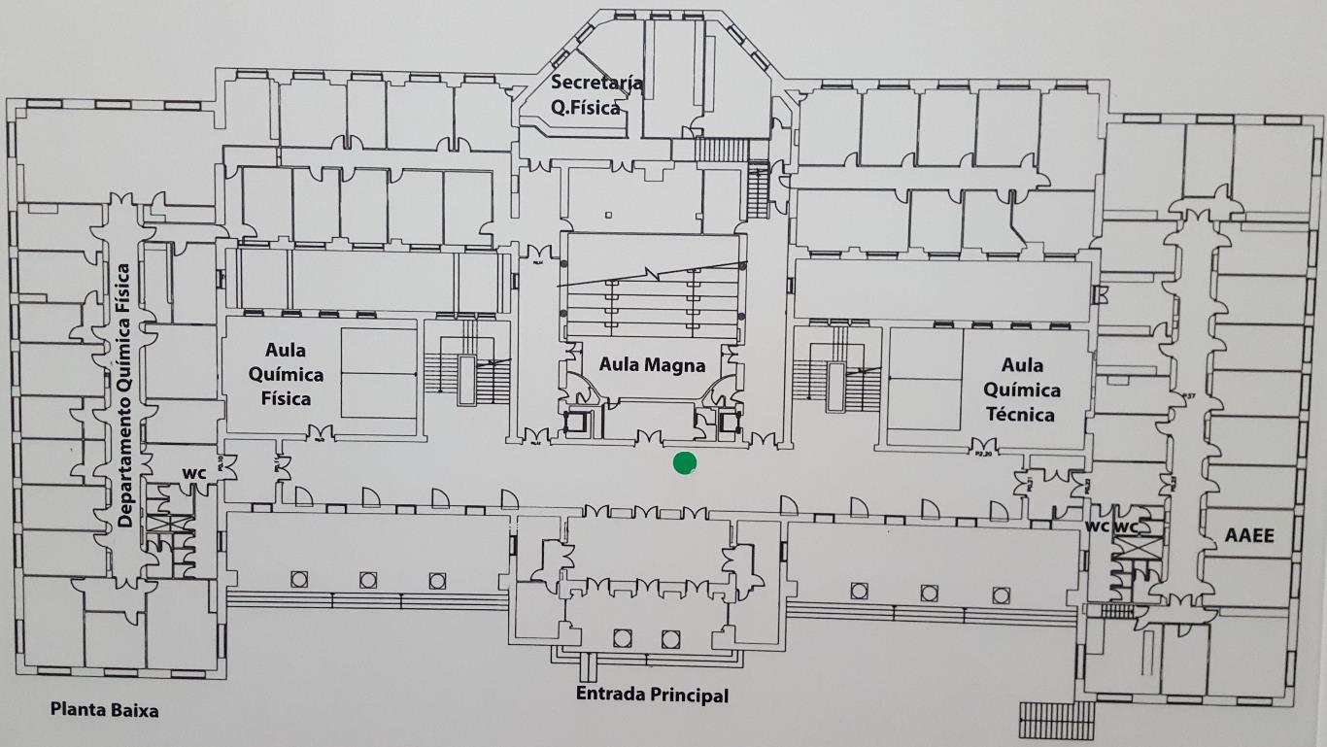
Venue ground floor
Registration desk
elevators
Aula Magna for tutorial, invited talks and regular talks
Access on ground and 1st floor

Slide 4
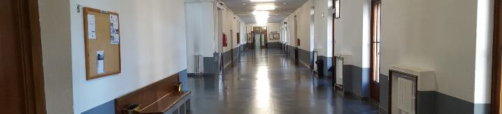
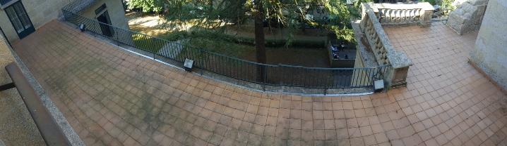
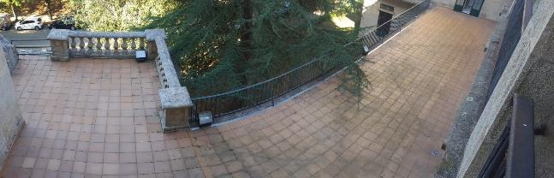
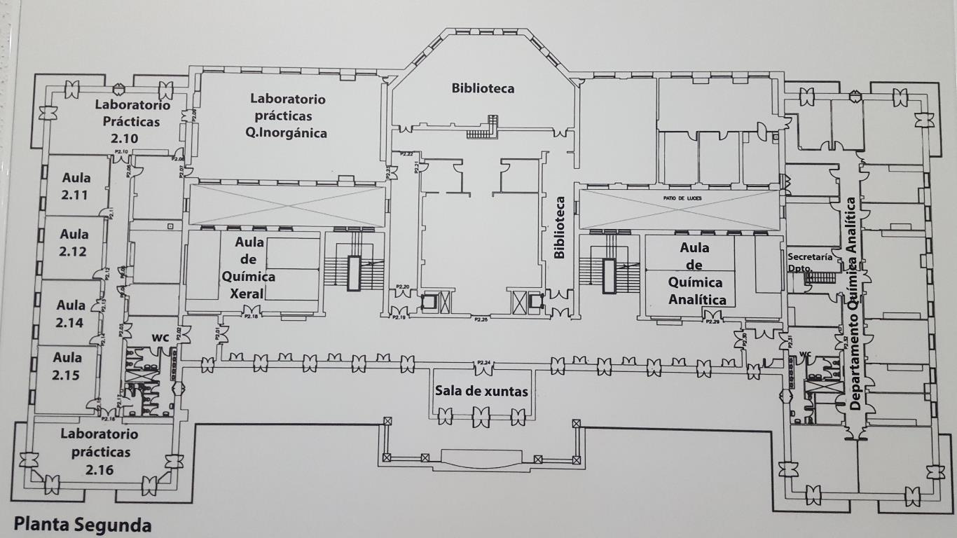
Venue 2nd floor
Posters / exhibitors / lunches / Monday coffees

Slide 5
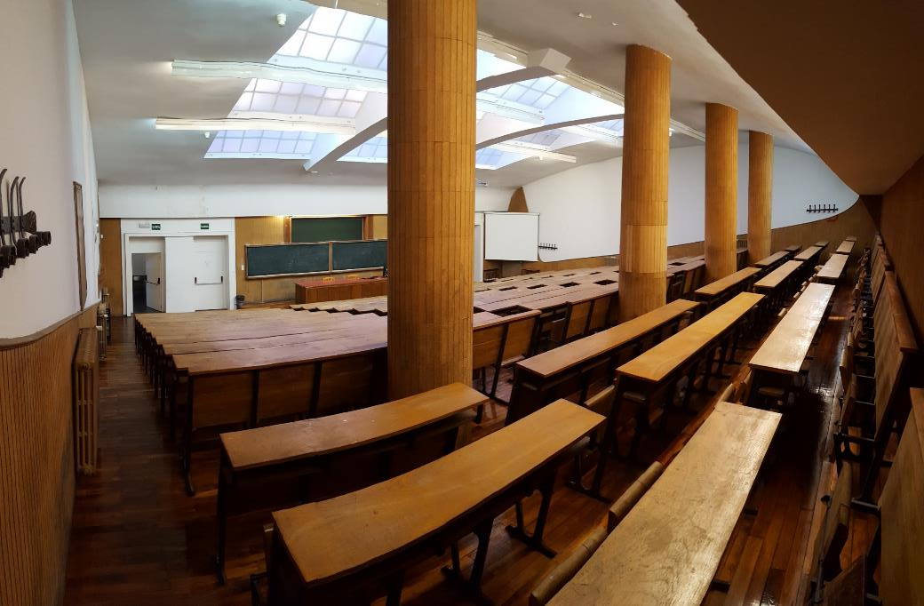
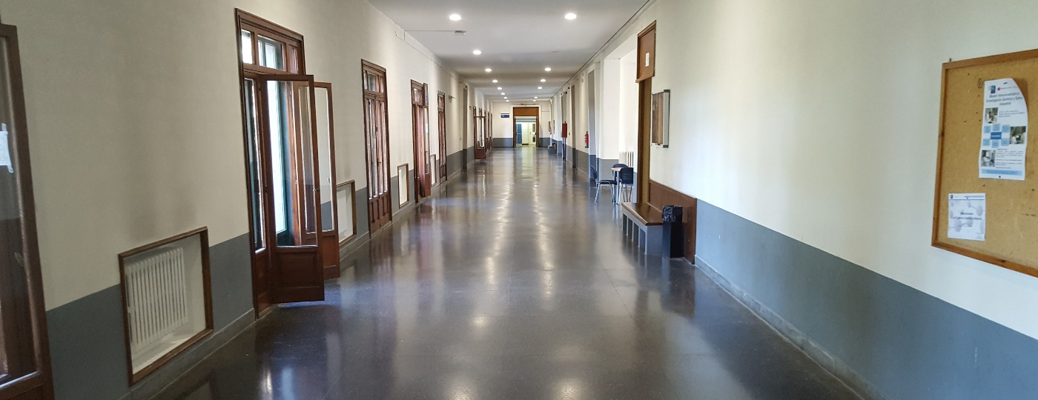
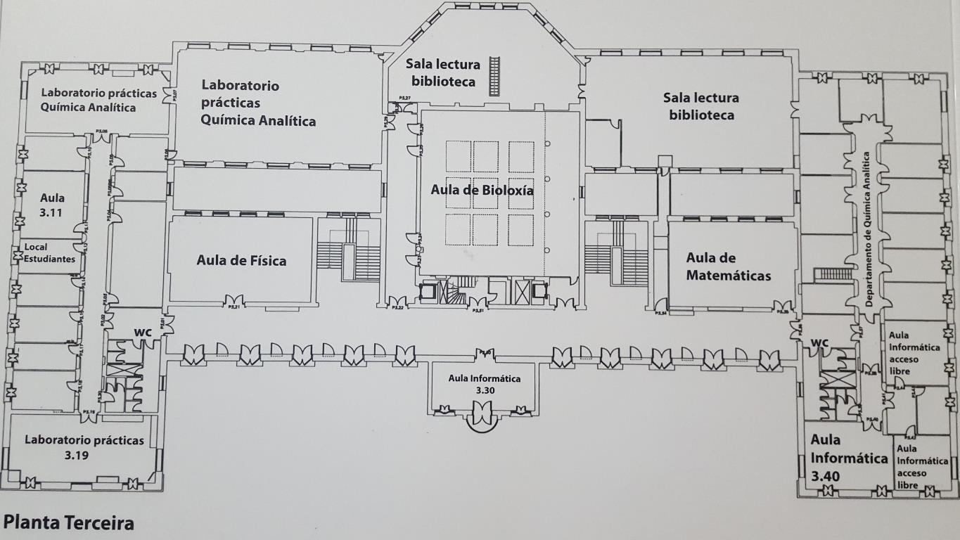
Venue 3rd floor
Aula Bioloxía for regular talks
Posters / Tuesday - Friday coffees

Slide 6
In your bag

Slide 7
General guidelines
Information desk / Secretariat: Inma Villar, Angela Ricci
Local staff: Eliseo Pérez, Antonio Fernández, Edgar Lemos, Xurxo Piñeiro
Wear your badge (preferable with your name visible) all the time
WiFis: eduroam (your institution credentials) / twepp2019 (credentials on your badge)
Conference program on your bag and online https://indico.cern.ch/event/799025
Oral presentations:
  Please keep to your timing
  Upload your ppt or pdf on indico well in advance
  Be present in the conference room 15 minutes prior to the session

Slide 8
General guidelines
Be present at your poster session and during coffee and lunch breaks
Coffees will be served on 3rd floor (except on Monday)
Lunches will be served on 2nd floor
Moving up and down visiting posters, on both floors, and exhibitors and the very nice terrace in the 2nd floor is very good for your health!

Slide 9
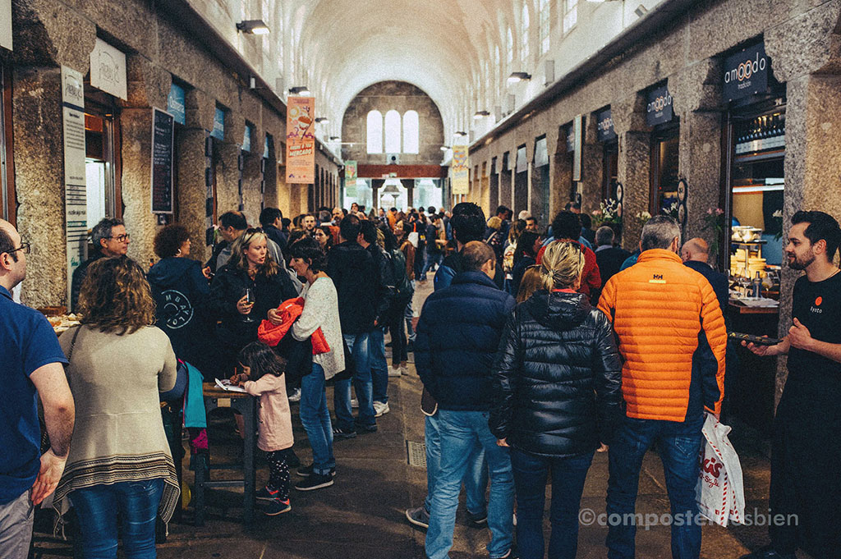
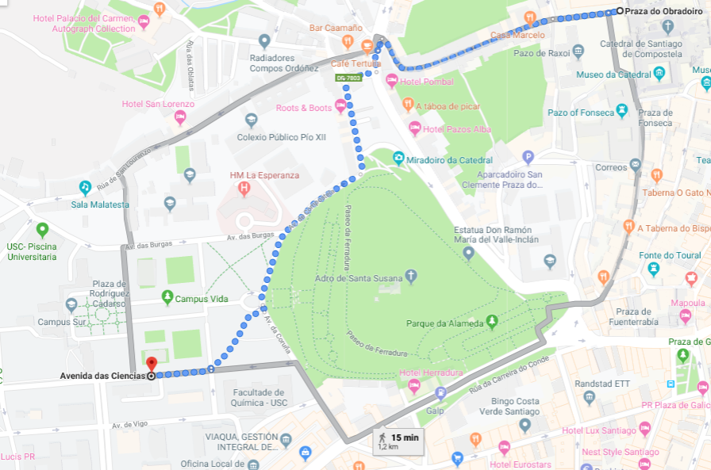
Social activities: Monday 2
Guided tour
Location: Plaza do Obradoiro (15 min walking from the venue)
Timing: 18h30
The guides and 1 Staff from the Organization will be waiting for you
Welcome drink
Location: Nave 5, Mercado de Abastos
Timing: 20h (for those who miss the guided tour)
The return to the hotels is free

Slide 10
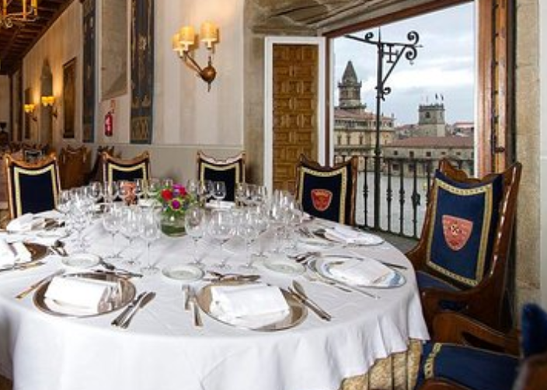
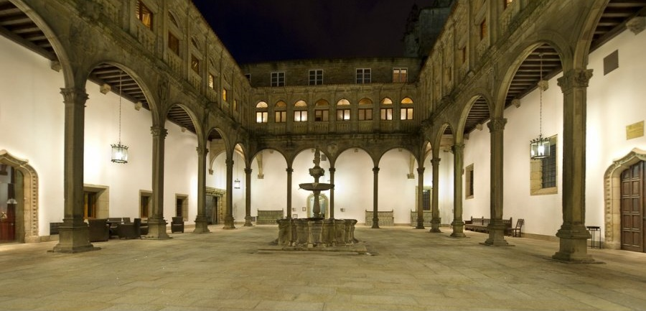
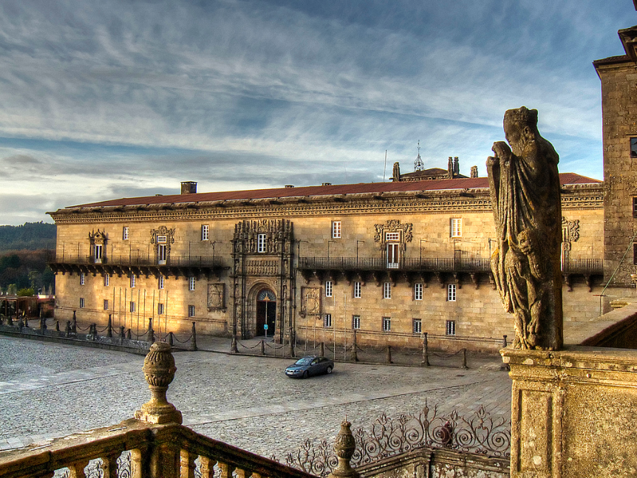
Social activities: Wednesday 3
Conference dinner
Location: Hostal Parador dos Reis Católicos,
Plaza do Obradoiro
Timing: 20h
The return to the hotels is free
Appetiser : Claustro San Marcos
Dinner: Comedor Real

Slide 11
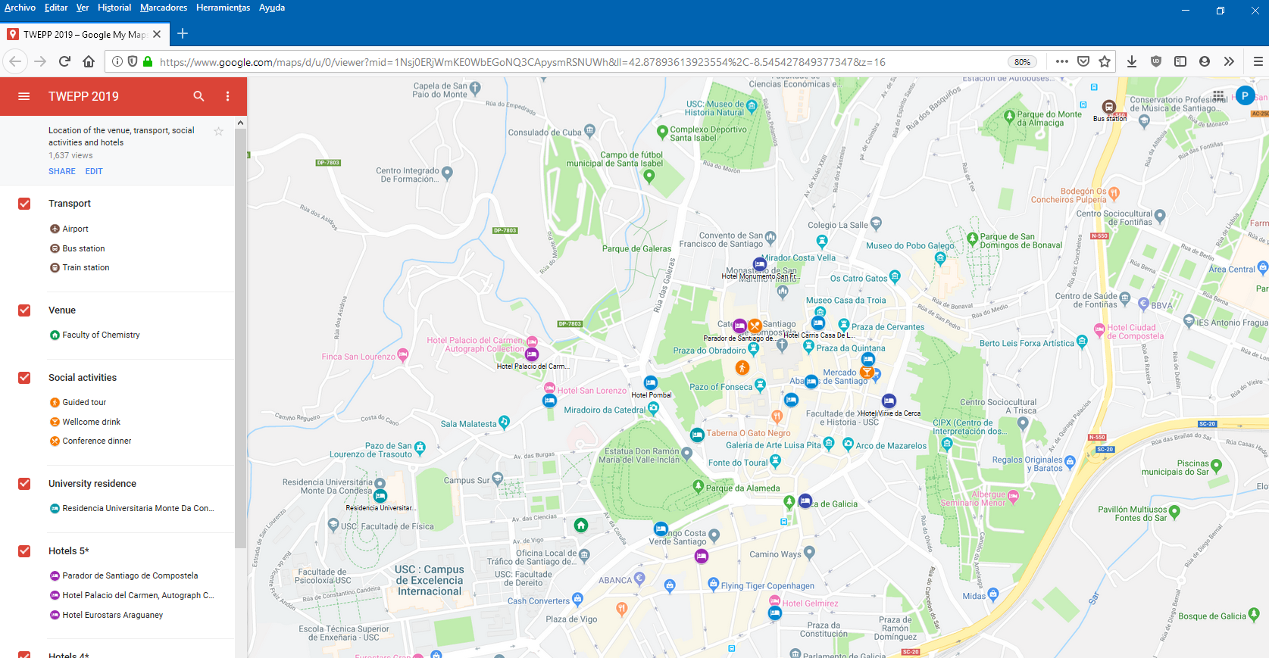
Conference web map
Venue / transport / social activities /accommodation

Slide 12
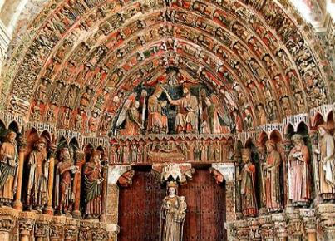
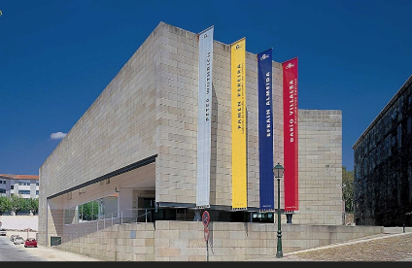
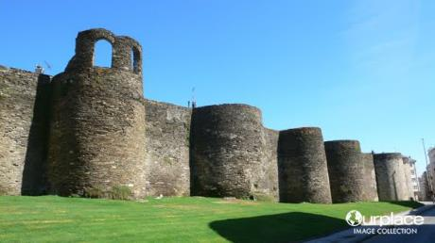
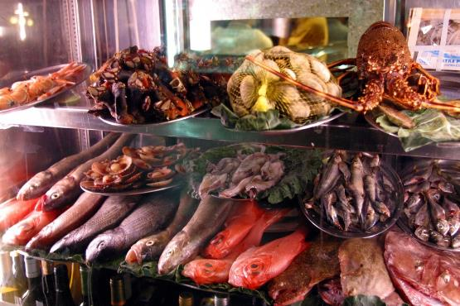
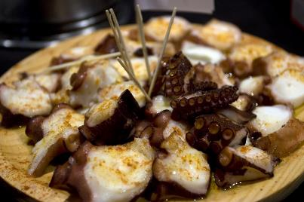
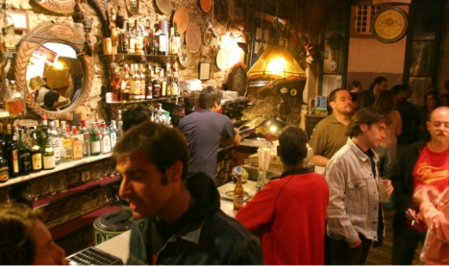
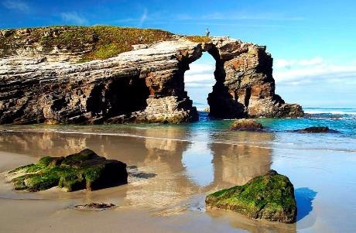
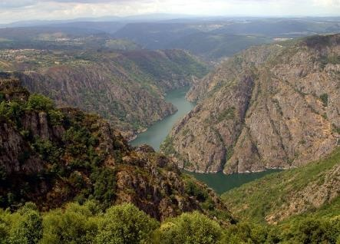
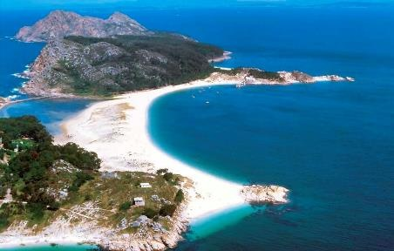
Leave some room for dinner (not included) and other leisure activities
Galicia has the best seafood of the world (Ferrán Adriá and myself)
www.santiagoturismo.com

Slide 13



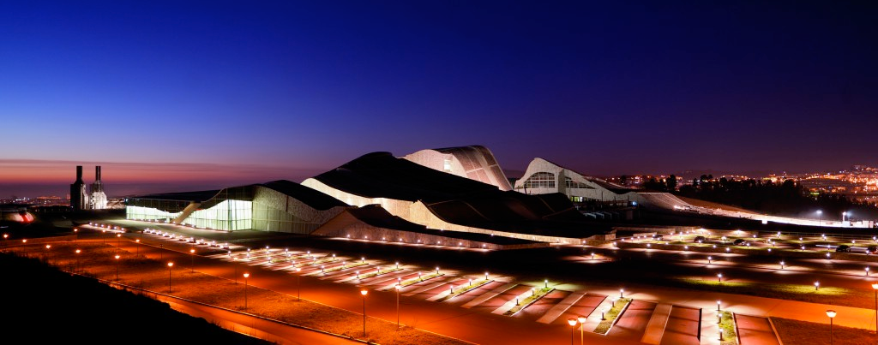



Thank our sponsors

Slide 14
Invited talks
Prof. Faustino Gómez (U. Santiago de Compostela)
Radiation Physics Lab: A TID test installation at USC
Prof. Paula López Martínez (U. Santiago de Compostela)
Focal plane processing in standard CMOS technologies
Prof. David Gascón (U. Barcelona)
Time Resolution of Large Area Low Light Level Sensors

