Slide 1
RWTCS and bldg 573
C. Colloca
RWTCS Steering Commitee

Slide 2
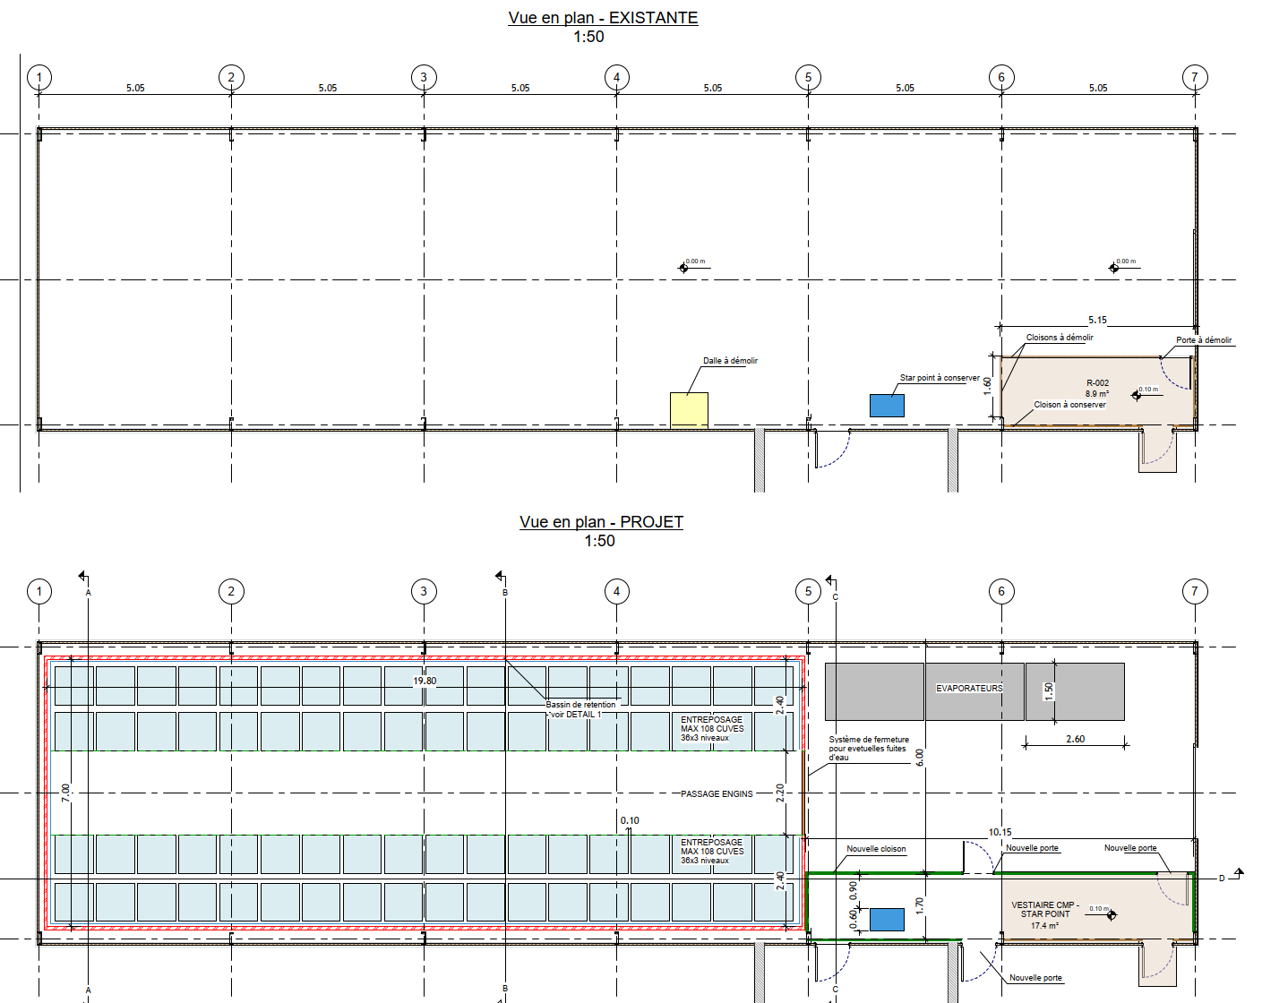
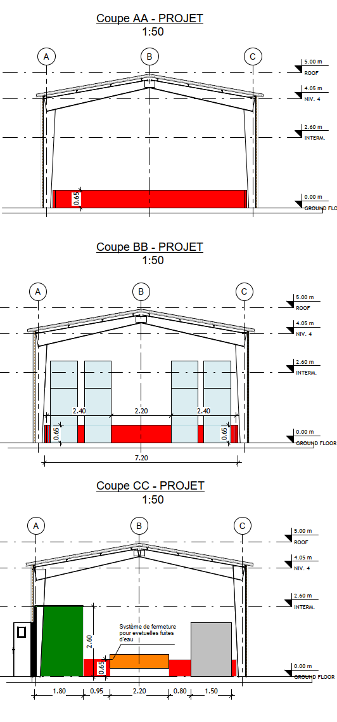
BLDG. 573 Layout

Slide 3
BLDG. 573 Cost

Slide 4
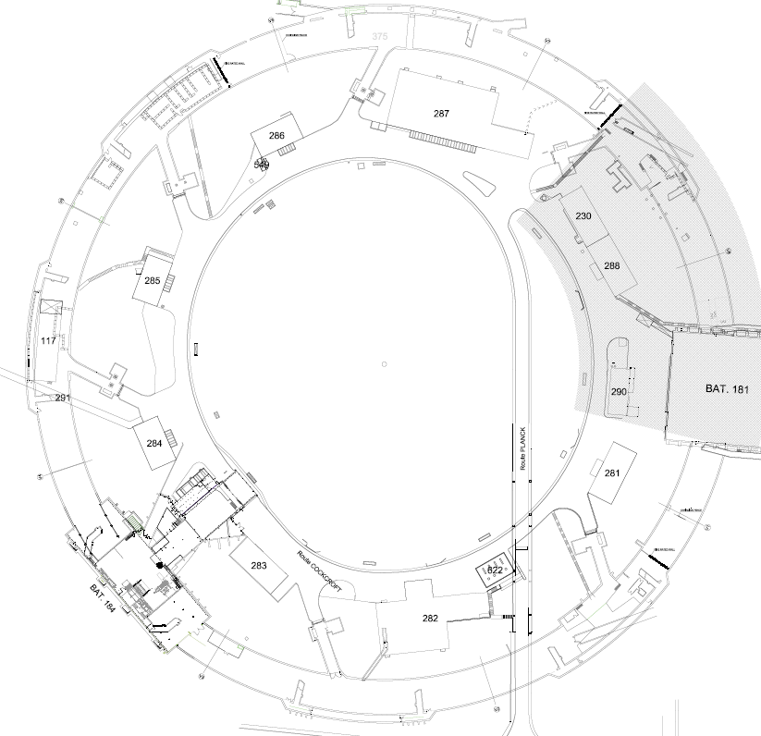
Work progress vs. expenditures
RWTCS Steering Commitee

Slide 5
INFRASTRUCTURE WORK
WORK PACKAGES | WORK PACKAGE OWNER | WORK PACKAGE TEAM
Civil engineering & building work | C. Colloca SMB/SE | L. Maricalva, R. Ortega, Draughtsmen SMB/SE
Electricity | J. Gomez SMB/SE | F. Vincent SMB/SE
HVAC | G. Rouge SMB/SE | L. Fertin SMB/SE
Cranes & handling/lifting equipment | ? EN/HE | Y. Seraphin EN/HE
IT networks | L. Borakiewicz IT/CS
Access control | R. Nunes BE/ICS | N. Rama BE/ICS
Fire detection | D. Raffourt BE/ICS | P. Thome BE/ICS

Slide 6
- Retention basin waterproofing ISR2 entrance
- Rails repairs & replacement ISR2
- TT1 Shaft (empting) + last floor slab sealing
- IT network
- Fire wall ISR2-ISR3
- Fire detection installation ISR2
- HVAC installation ISR2 and ISR1 (CMS side)
- Phase 1 of civil eng. foundation for HVAC surface (sector ISR1-2)
- fast opening doors installation
- new meeting room bldg. 184
FINISHED WORK (OCT 18 – MAR 19)
ISR2 sector…finished!

Slide 7
FINISHED WORK (OCT 18 – MAR 19)
Bldg. 574:
- separation wall & door
floor resin
class C cell
electrical installation
envelope repairs
95% HVAC installation (filter missing)
table for cupboard
racks

Slide 8
FINISHED WORK (OCT 18 – MAR 19)
Bldg. 573:
- old SAS demolition
all technical installation dismantling
floor decontamination & repairs
concrete retention basin
shock protection metallic system
painting

Slide 9
RWTCS:
- DO for motorized fire door IRS2/ISR3
- fire manual doors ISR2
- green space cleaning for HVAC surface
BLDG 573 (1 month) :
- retention basin for evaporators
- resins
- electrical installation
- HVAC installation
- doors (new and replacements)
- roof replacement
- waterproofing barrier
- fire detection
On going/starting WORK

Slide 10
RWTCS:
- phase 2-5 civil eng. for foundation HVAC surface (ISR3-ISR7)
- DO preparation for 10 bldgs for HVAC surface
- estimate for DI, IT & elec for HVAC surface
BLDG 573:
- fire protection wall evaporators
BLDG 225:
- input from BE/ICS for predesign of sprinkler system
On going/starting STUDIES

Slide 11
BUDGET - SPENDING PROFILE
HVAC
2019 : 1200 kCHF
2020: 500 kCHF
New estimate for surface work for HVAC (685kCHF)
PHASE 1 : 70 kCHF + 40 kCHF
PHASE 2 : 135 kCHF + 40 kCHF
PHASE 3: 135 kCHF + 40 kCHF
PHASE 4 : 70 kCHF + 40 kCHF
PHASE 5 : 75 kCHF + 40 kCHF
Possible reports to 2020 (160 kCHF)
- Masonry & fire walls parallel galeries
- Sealing work (walls)
- 4 ducts dismantling in ISR4
- Ventilation unit dismantling ISR2 (entrance)

Slide 12
SPENDING PROFILE
EXPENDITURES (FOR TUNNEL WORK ONLY – NO SECURITY) | 2019 | 2020 | 2021 | 2022 | 2023
GLOBAL BUDGET* (kCHF) | 2’400 | 1’070 | 390 | 340 | 45
TOTAL | 4’245
Includes:
New estimate for dry risers (incl. civil eng. 2020)
New estimate fire door ISR2 + motorised fire door ISR2/ISR3
Fast opening doors (2019)
New estimate of civil eng. Works and services (DI+elec.+ IT) for HVAC
Planning v 64
*Without ‘Access control’, ‘Human resources’

Slide 13
TO BE FIXED
Surface work for HVAC -> IT ?
PHASE 2, PHASE 3, PHASE 4, PHASE 5 = 415 kCHF
Fire door ISR2 (+pedestrian fire door IS2/ISR3) = 62 kCHF
Roof (‘toles’) replacement bldg. 573 = 20 kCHF
Fire wall between ISR1 and ISR2 -> needed ?
Reports to 2020
Contribution/collaboration with HSE-OHS :
- anticipation / suggestions (active presence) of HSE CO
- re-set (or respect) SLA
- clarify MSI (yes or no, and where)

Slide 14
SPENDING PROFILE
EXPENDITURES (FOR TUNNEL WORK ONLY – NO SECURITY) | 2018 | 2019 | 2020 | 2021 | 2022 | 2023
GLOBAL BUDGET* (kCHF) | 890 | 2’750 | 500 | 260 | 300 | 45
TOTAL | 4’745
Includes:
New estimate for dry raisers
Finalization of civil eng. works for HVAC
Floor reparation included (out of the waterproofing)
Planning v 62
*Without ‘Access control’, ‘Human resources’

