Slide 1

Mainz Laboratory Highlights
proton radius, polarizabilities, …, muon g—2, dark photons
Vladimir Pascalutsa
Institute for Nuclear Physics
University of Mainz, Germany
@ HiX Workshop, KPHTH, Greece
Aug 17, 2019

Slide 2
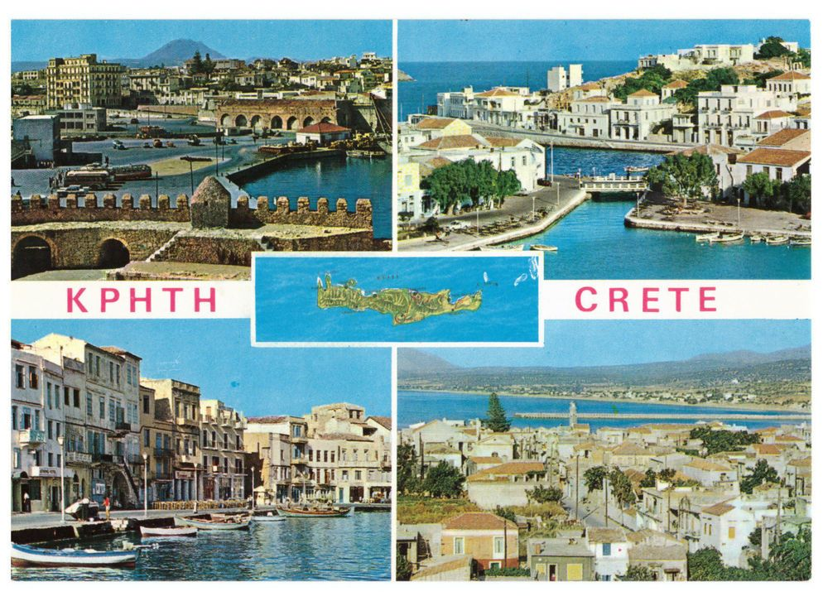
KernPHhysik Inst. — THeorie (KPHTH)

Slide 3
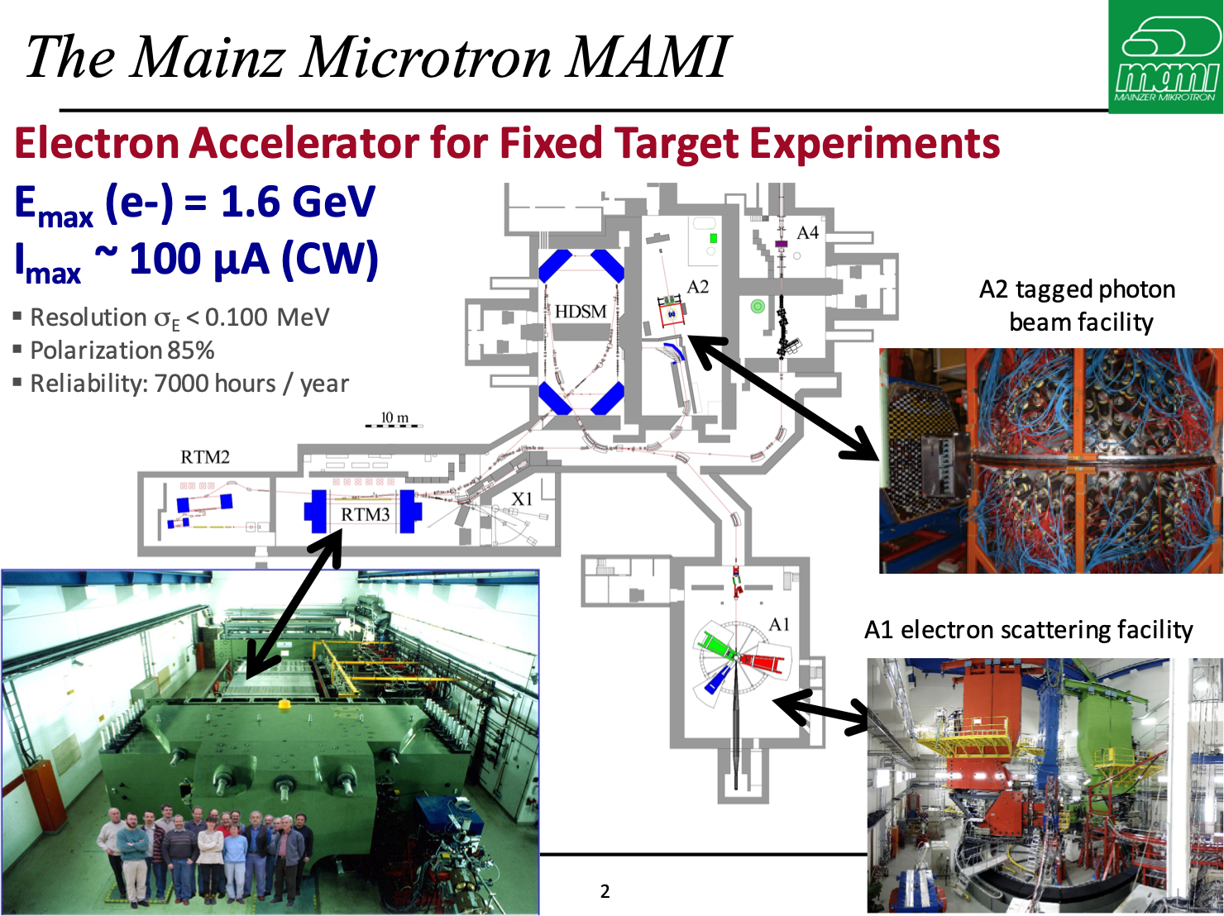

Slide 4
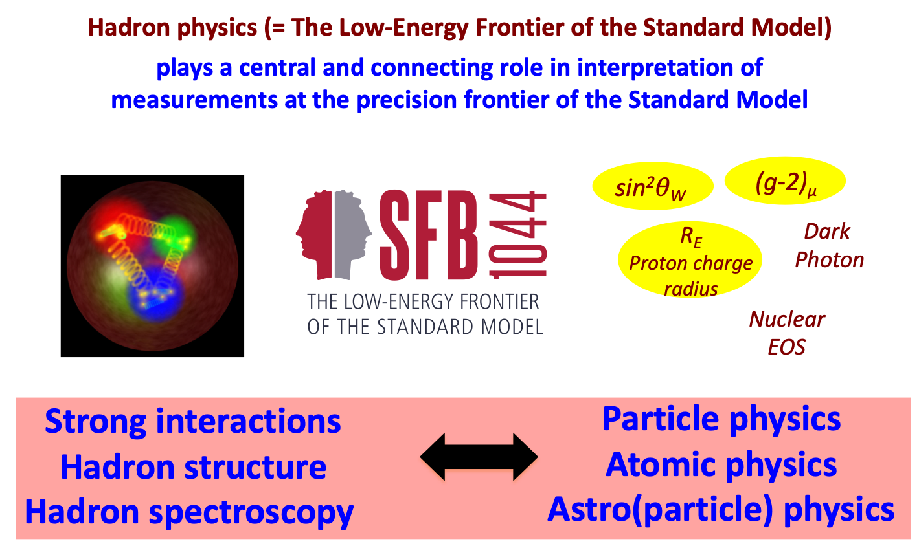
Collaborative Research Centre 1044
coordinators: Achim Denig, Marc Vanderhaeghen

Slide 5
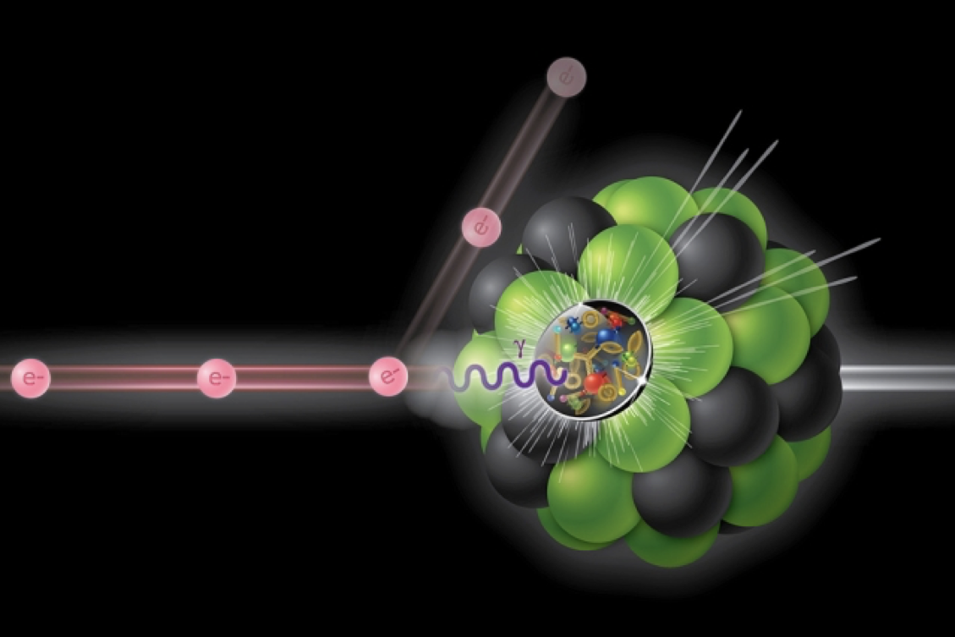


Slide 6
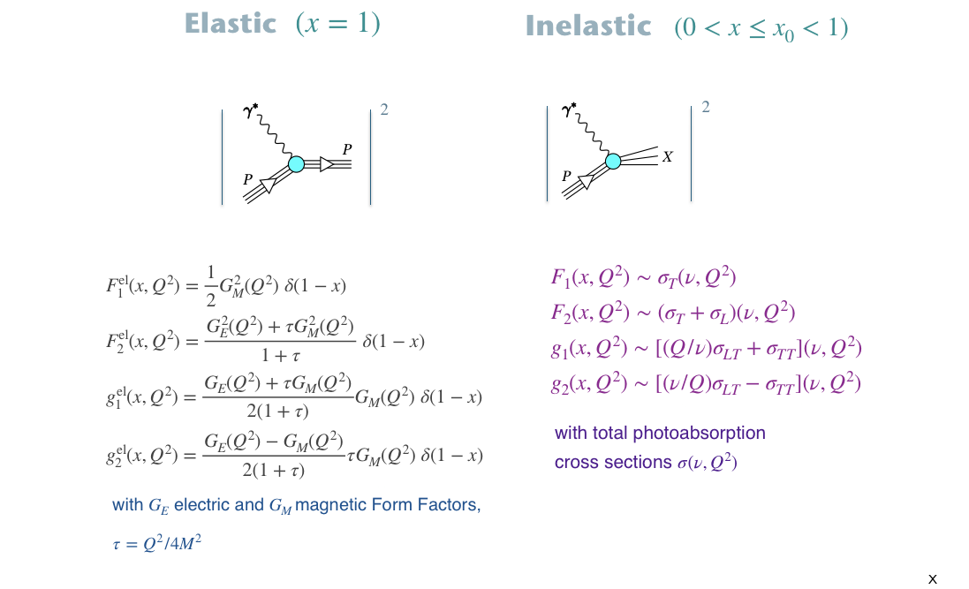

Slide 7
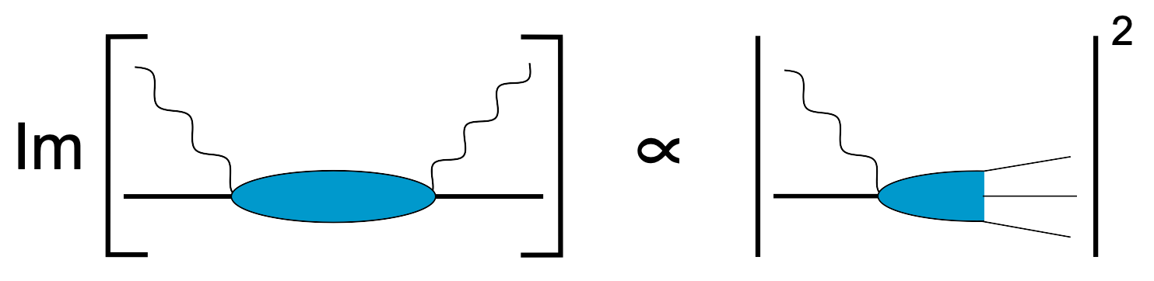
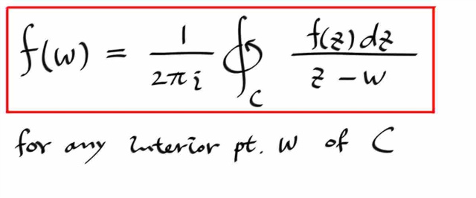
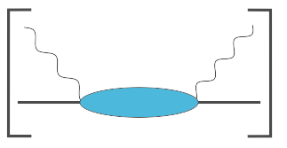
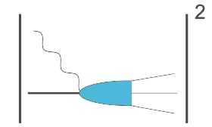
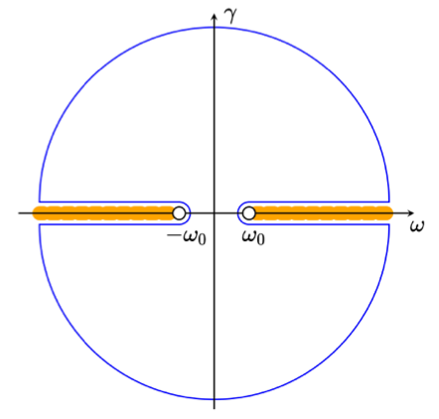
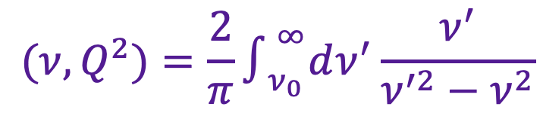

Relation to forward Compton scattering
Optical theorem:
Causality (analyticity, Cauchi formula):
$$(ν,Q^{2})=\frac{2}{π}∫_{ν_{0}}^{∞}dν^{′}\frac{ν^{′}}{ν^{′2}−ν^{2}}$$
$$(ν^{′},Q^{2})$$
Sum
Rules
eg: GDH,
Baldin,
Schwinger
Polarizabilities
Structure
functions

Slide 8
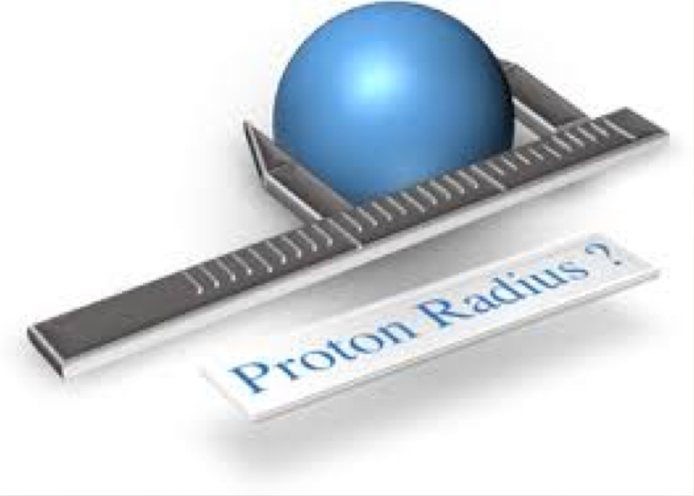
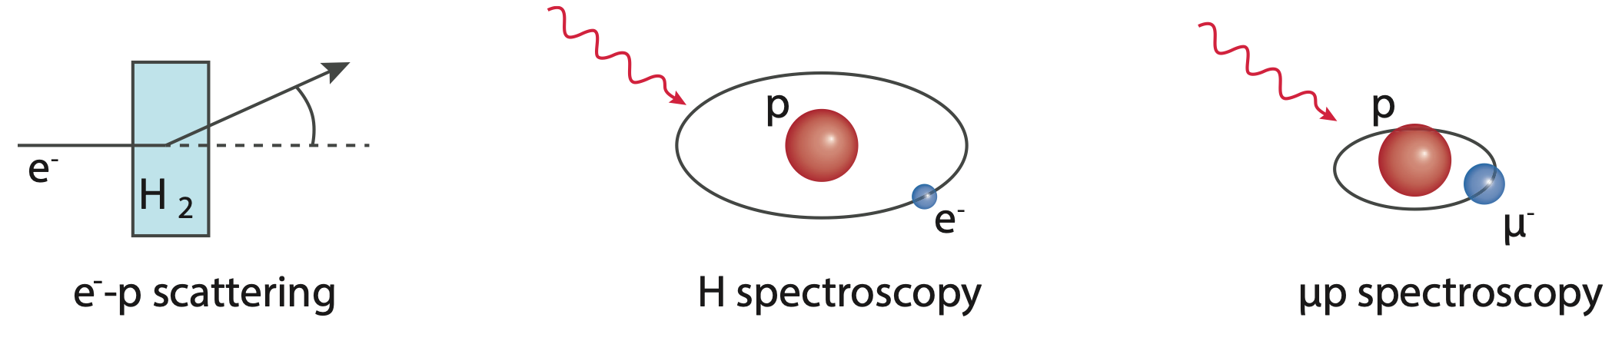

Slide 9
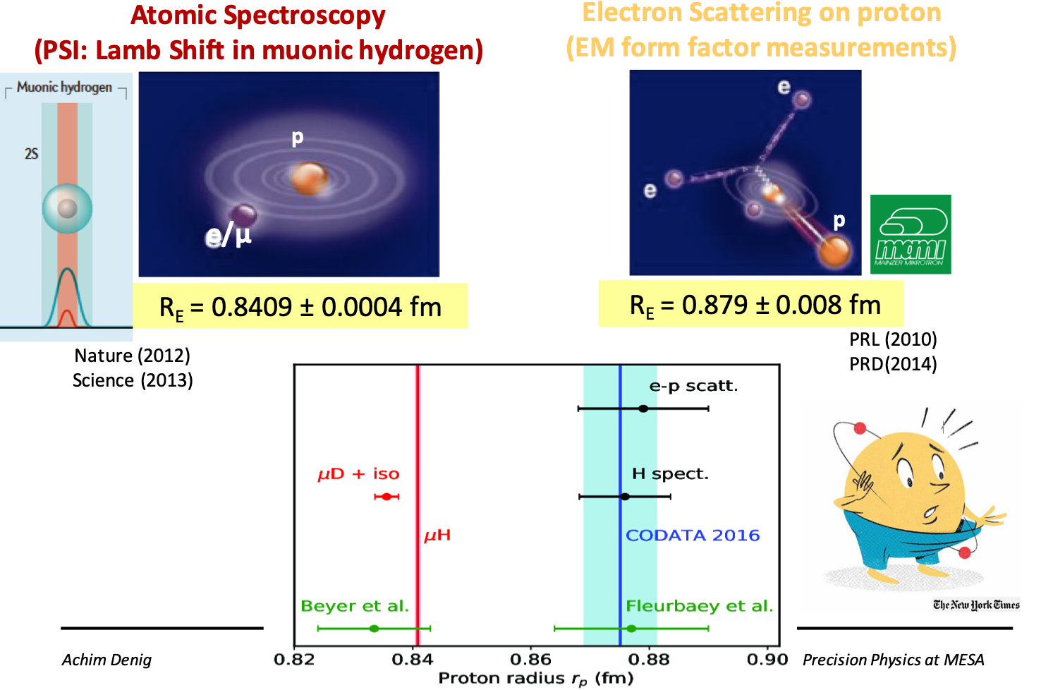
Proton radius puzzle

Slide 10
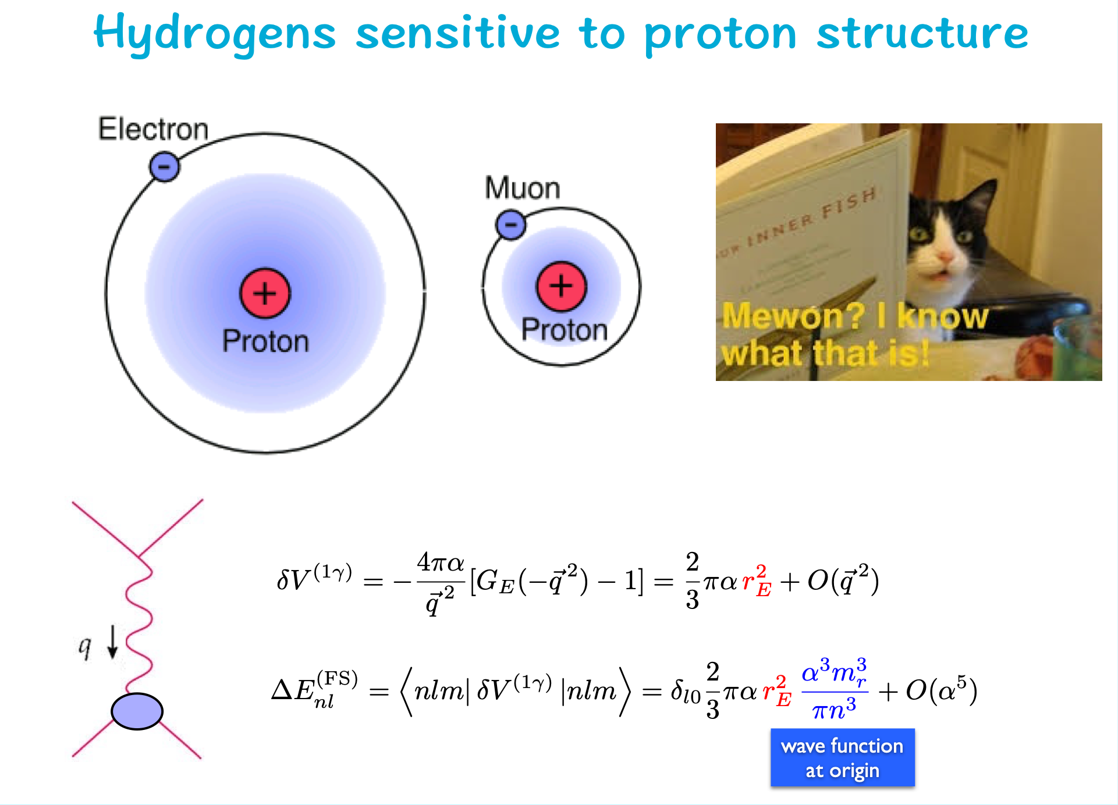

Slide 11
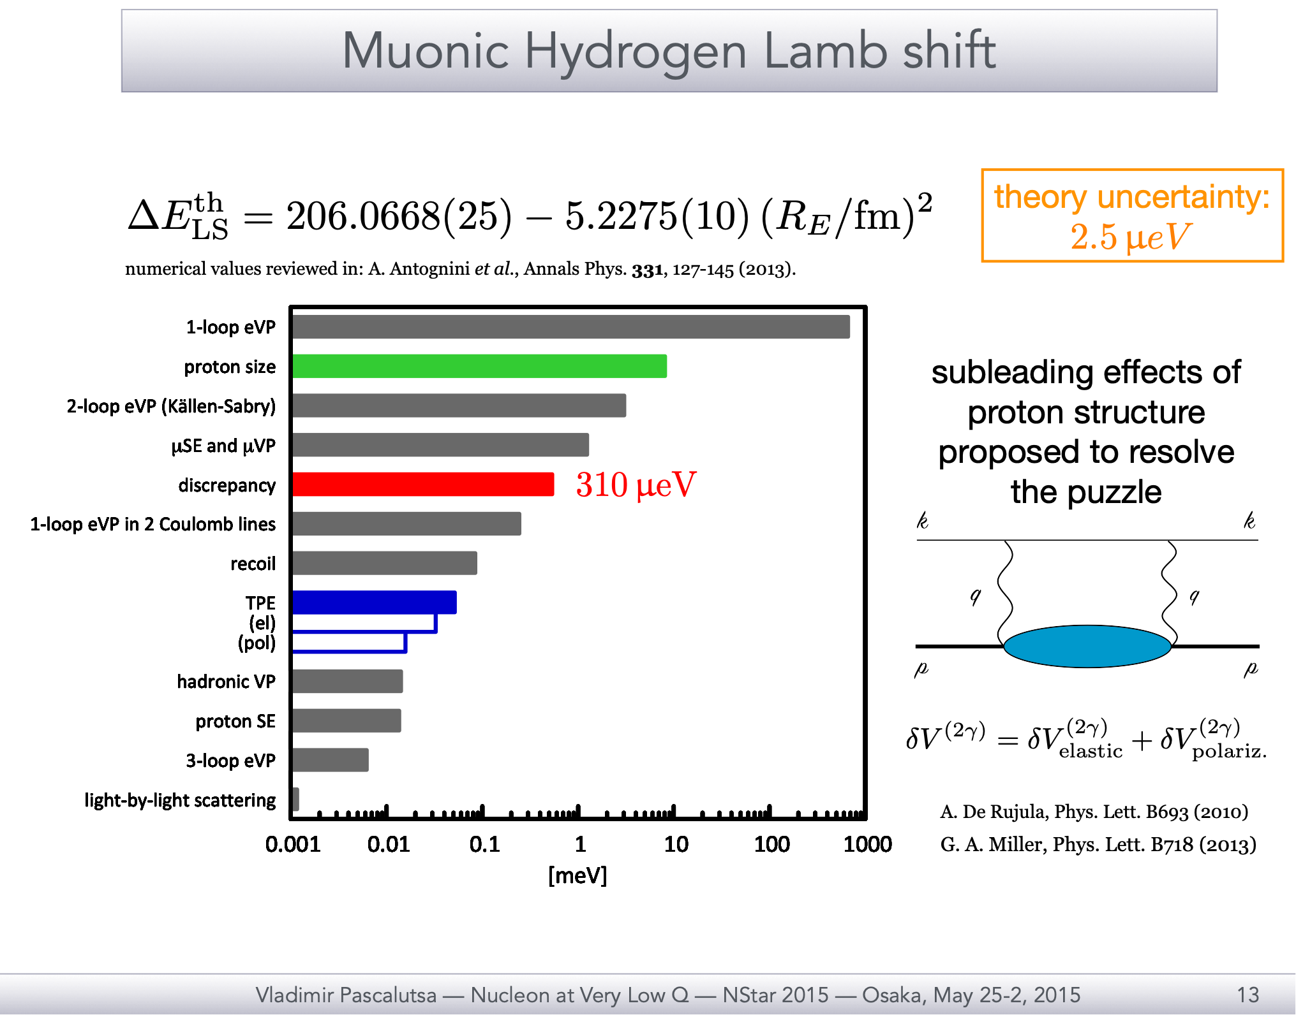

Slide 12
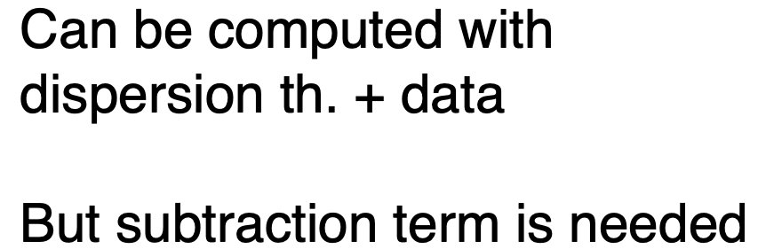
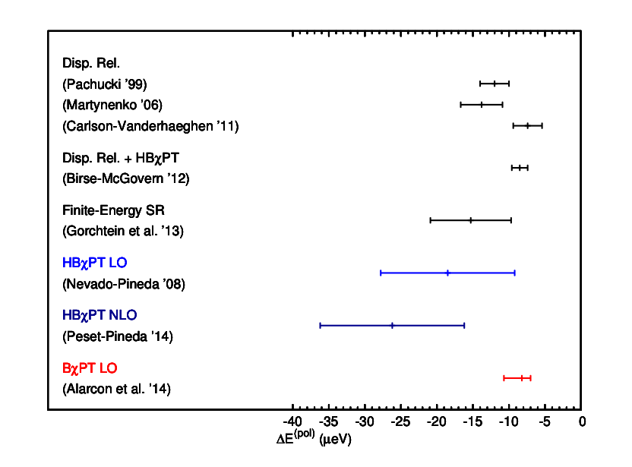
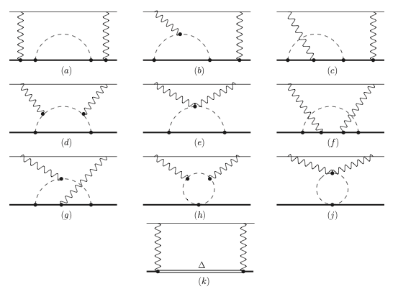
Proton polarizability in muonic-H
Lamb shift
— model dependent
vs.
Chiral perturbation theory
predictive at LO
Compiled by: Hagelstein, Miskimen & VP,
Prog. Part. Nucl. Phys. (2016)

Slide 13
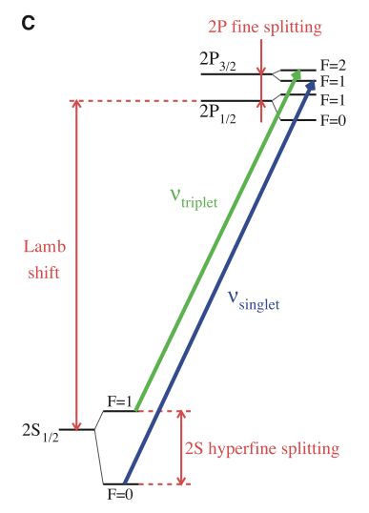

Hyperfine splitting In 𝜇h
with
Zemach radius:
experimental value:
A. Antognini, et al., Science 339 (2013) 417–420
⏰
Measurements of the μH ground-state HFS planned by CREMA, FAMU
and J-PARC / Riken-RAL collaborations
Very precise input for the 2𝛾 polarizability effect needed to find the μH ground-state HFS transition in experiment
Zemach radius involves magnetic properties of the proton

Slide 14
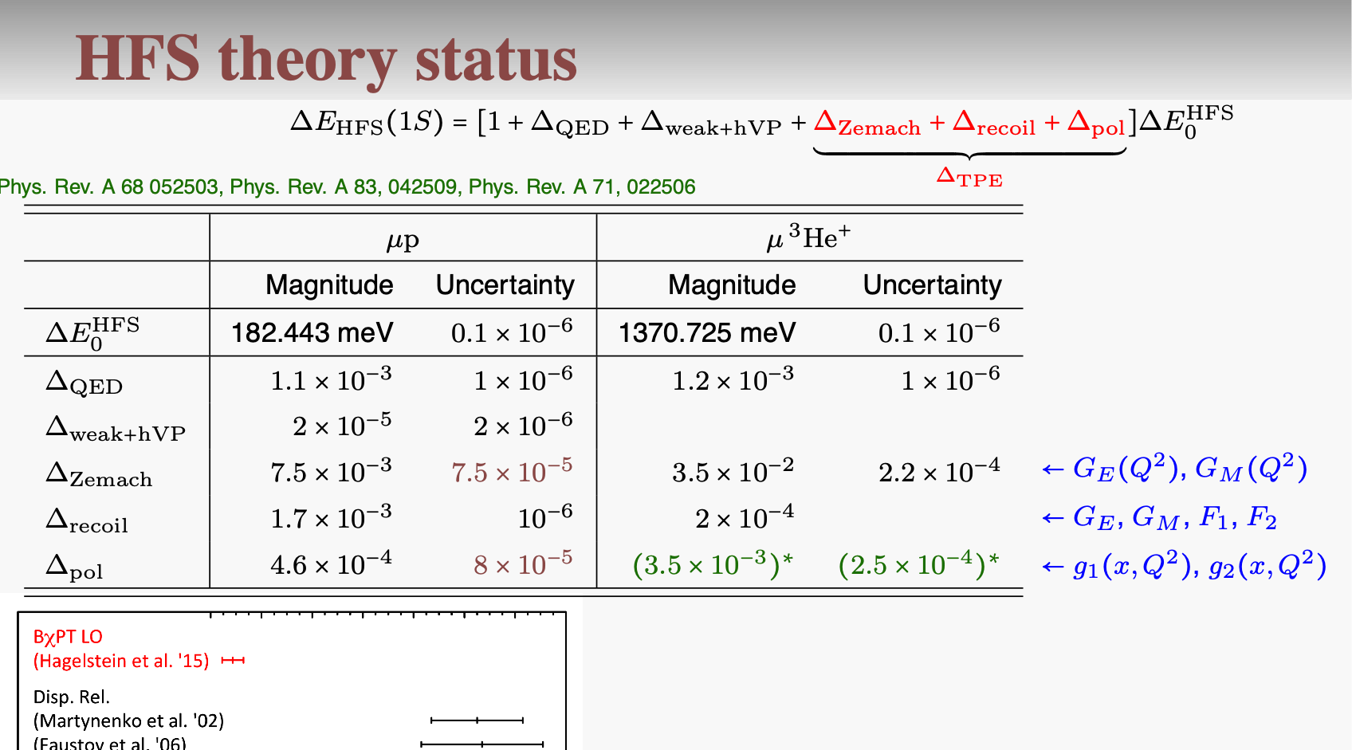
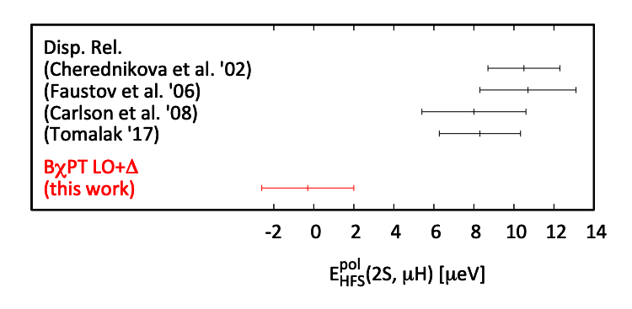
Polarizability correction is fully expressed
in terms of spin structure functions
(no subtractions),
yet their poor knowledge leads
disagreement with ChPT !
Hagelstein et al

Slide 15
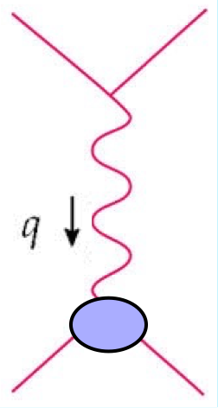
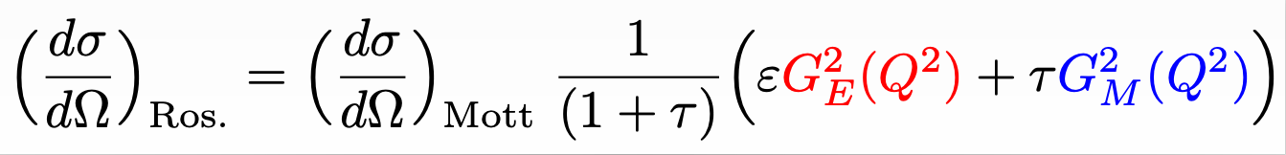
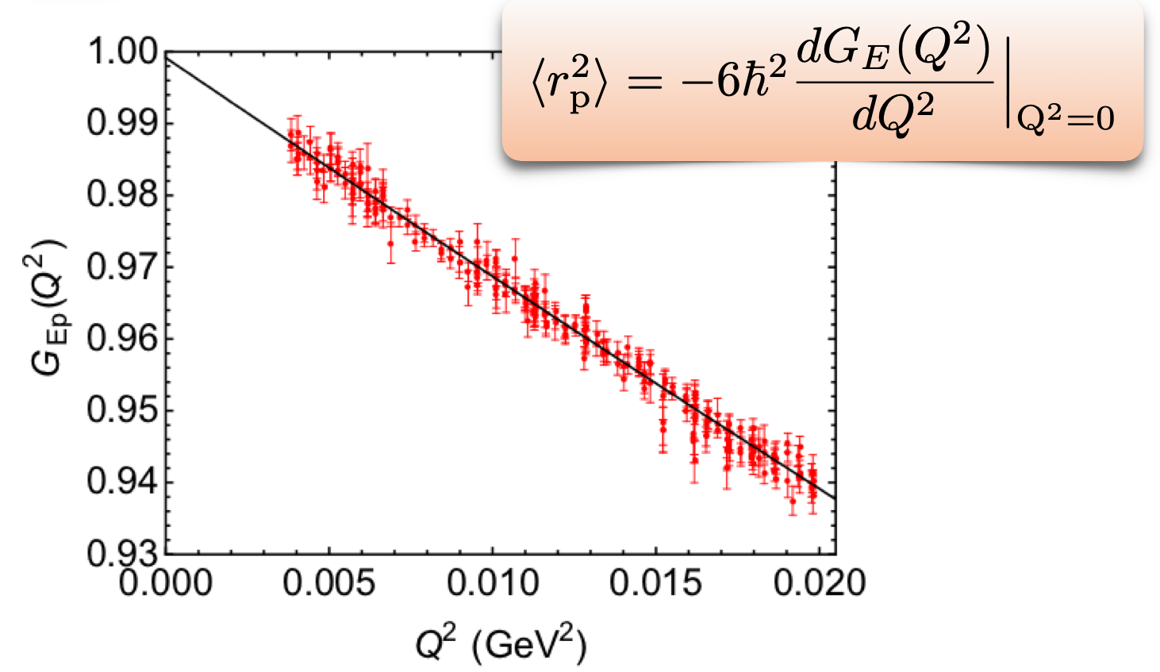



Radius from elastic e-p scattering
$$\text{with}τ=Q^{2}/4M_{p}^{2},ε≲1$$
$$Q^{2}=−q^{2}>0$$
$$G_{E}(Q^{2}),G_{M}(Q^{2})$$
Caveat:
Radius extraction
involves
extrapolation to 0
data points:

Slide 16
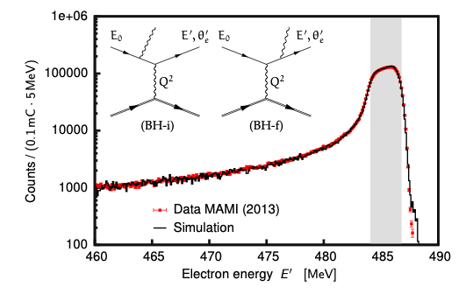
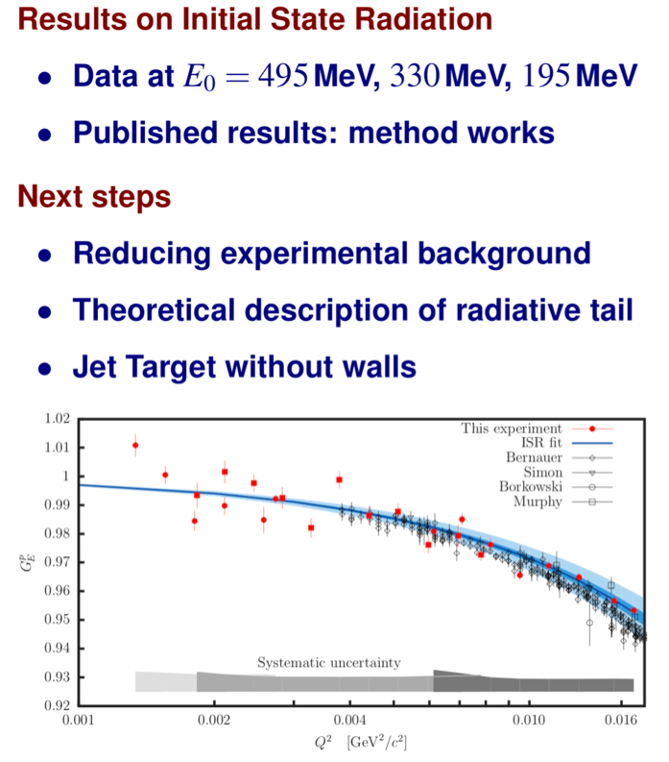
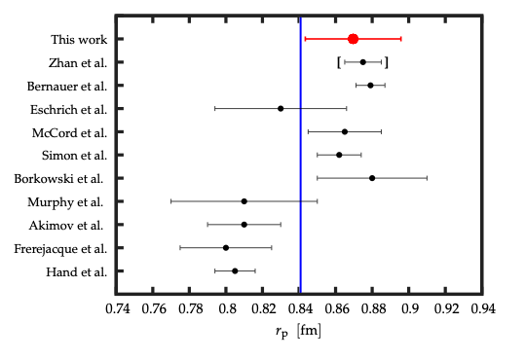
Initial State Radiation (ISR) Expt @ MAMI
M. Mihovilovič et al.., arXiv:1905.11182 [nucl-ex] |

Slide 17

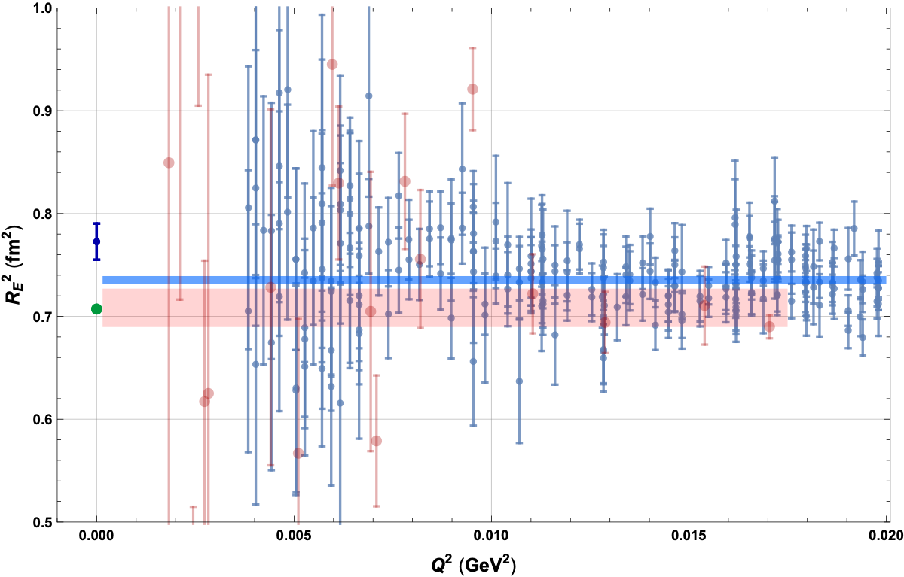

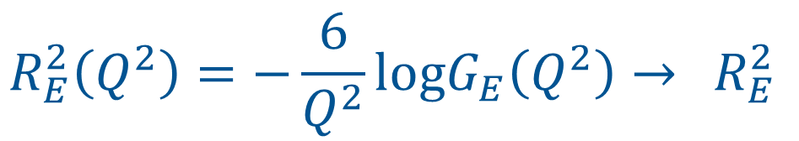
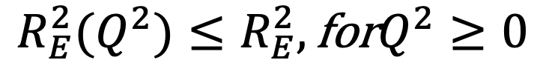
Lower bound directly from e-p data
Hagelstein & VP,
Phys. Lett. B 797 (2019).
$$R_{E}^{2}\left(Q^{2}\right)=−\frac{6}{Q^{2}}logG_{E}\left(Q^{2}\right)→{ R}_{E}^{2}$$
$$Q^{2}=0$$
This function sets a lower bound:
$$R_{E}^{2}(Q^{2})≤R_{E}^{2},\text{for}Q^{2}≥0$$
Data points from A1 Coll.:
Bernauer et al (2010), (2014)
Mihovilovic et al (2017), (2019)
No extrapolation
required

Slide 18

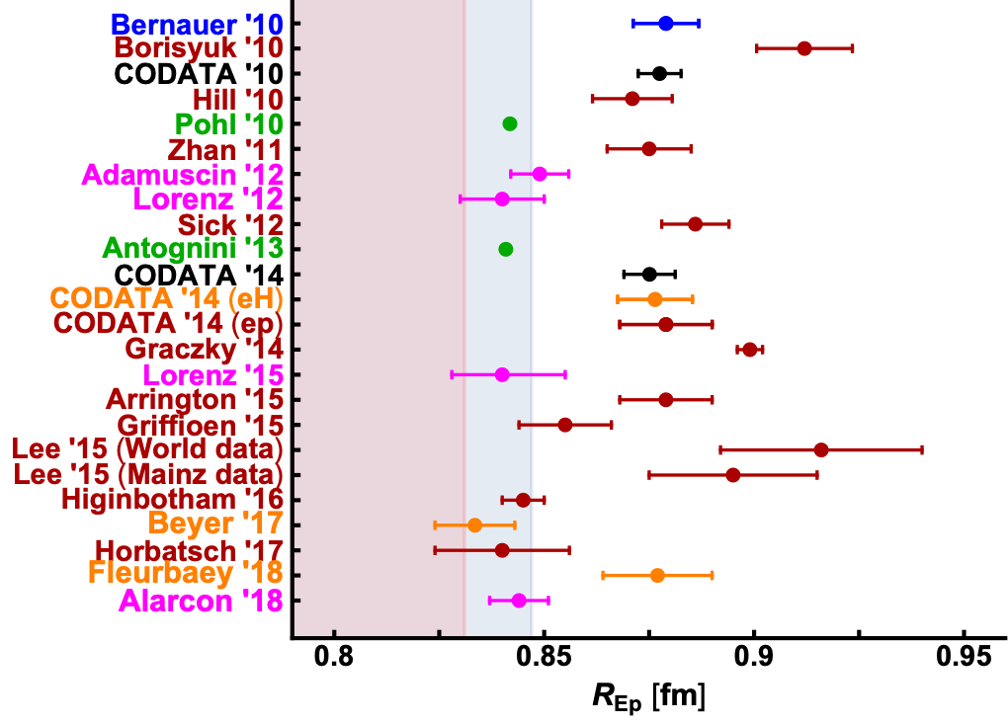
Various extractions

Slide 19
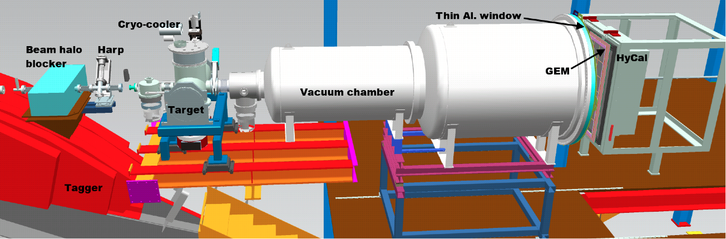
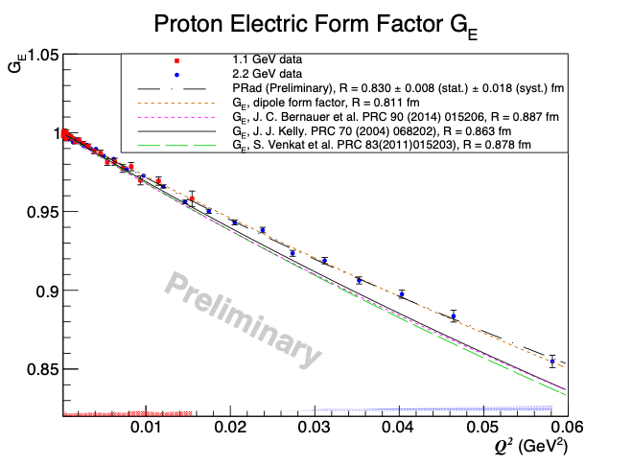
Low-Q² proton FF: PRAD@JLab
Preliminary PRAD@JLab
[H. Gao, A. Gasparyan, et al.] proton charge radius value

Slide 20
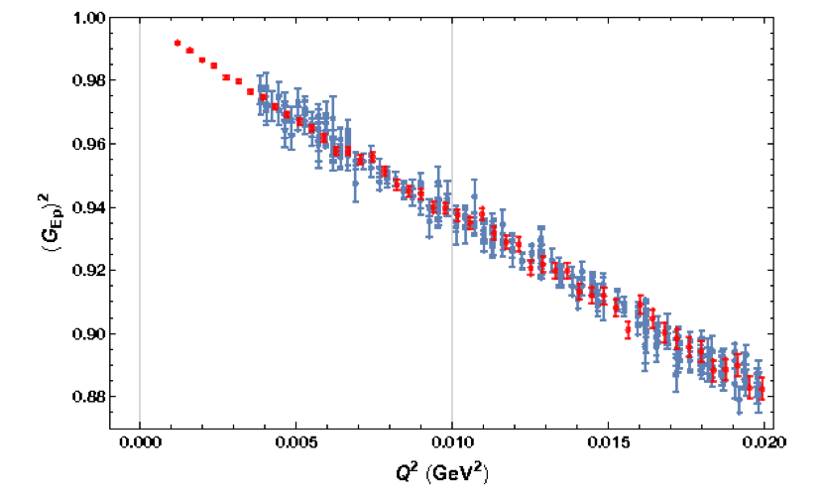
Planned ep-scattering experiment by A2@MAMI [V. Sokhoyan et al.]
Newly built active target: Time Projection Chamber (TPC)
New beam line in A2 Hall
Overcomplete kinematics: both scattered e- and recoiled p
Projected data vs Bernauer’s [A1 Coll.] data

Slide 21

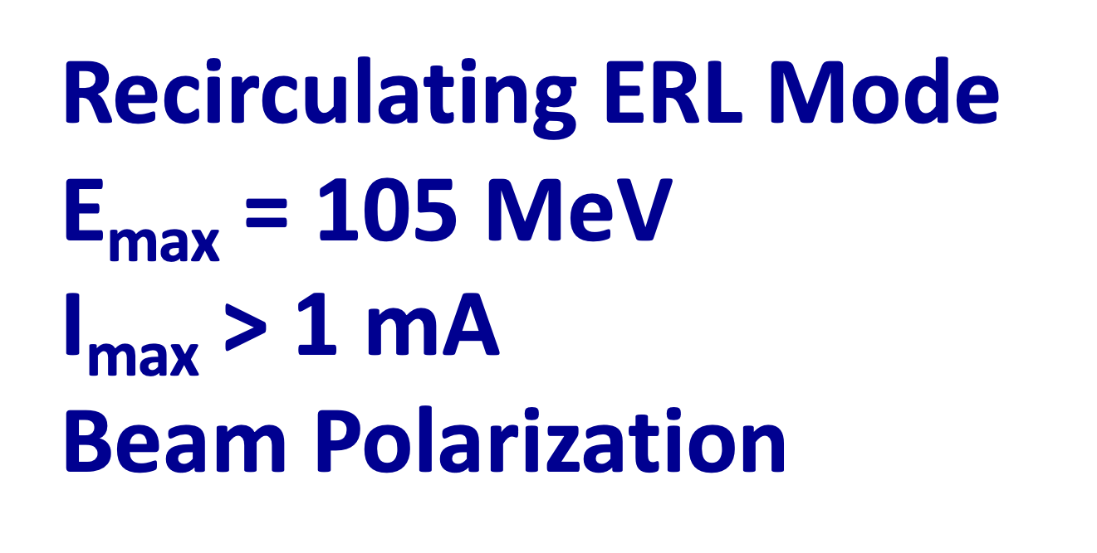
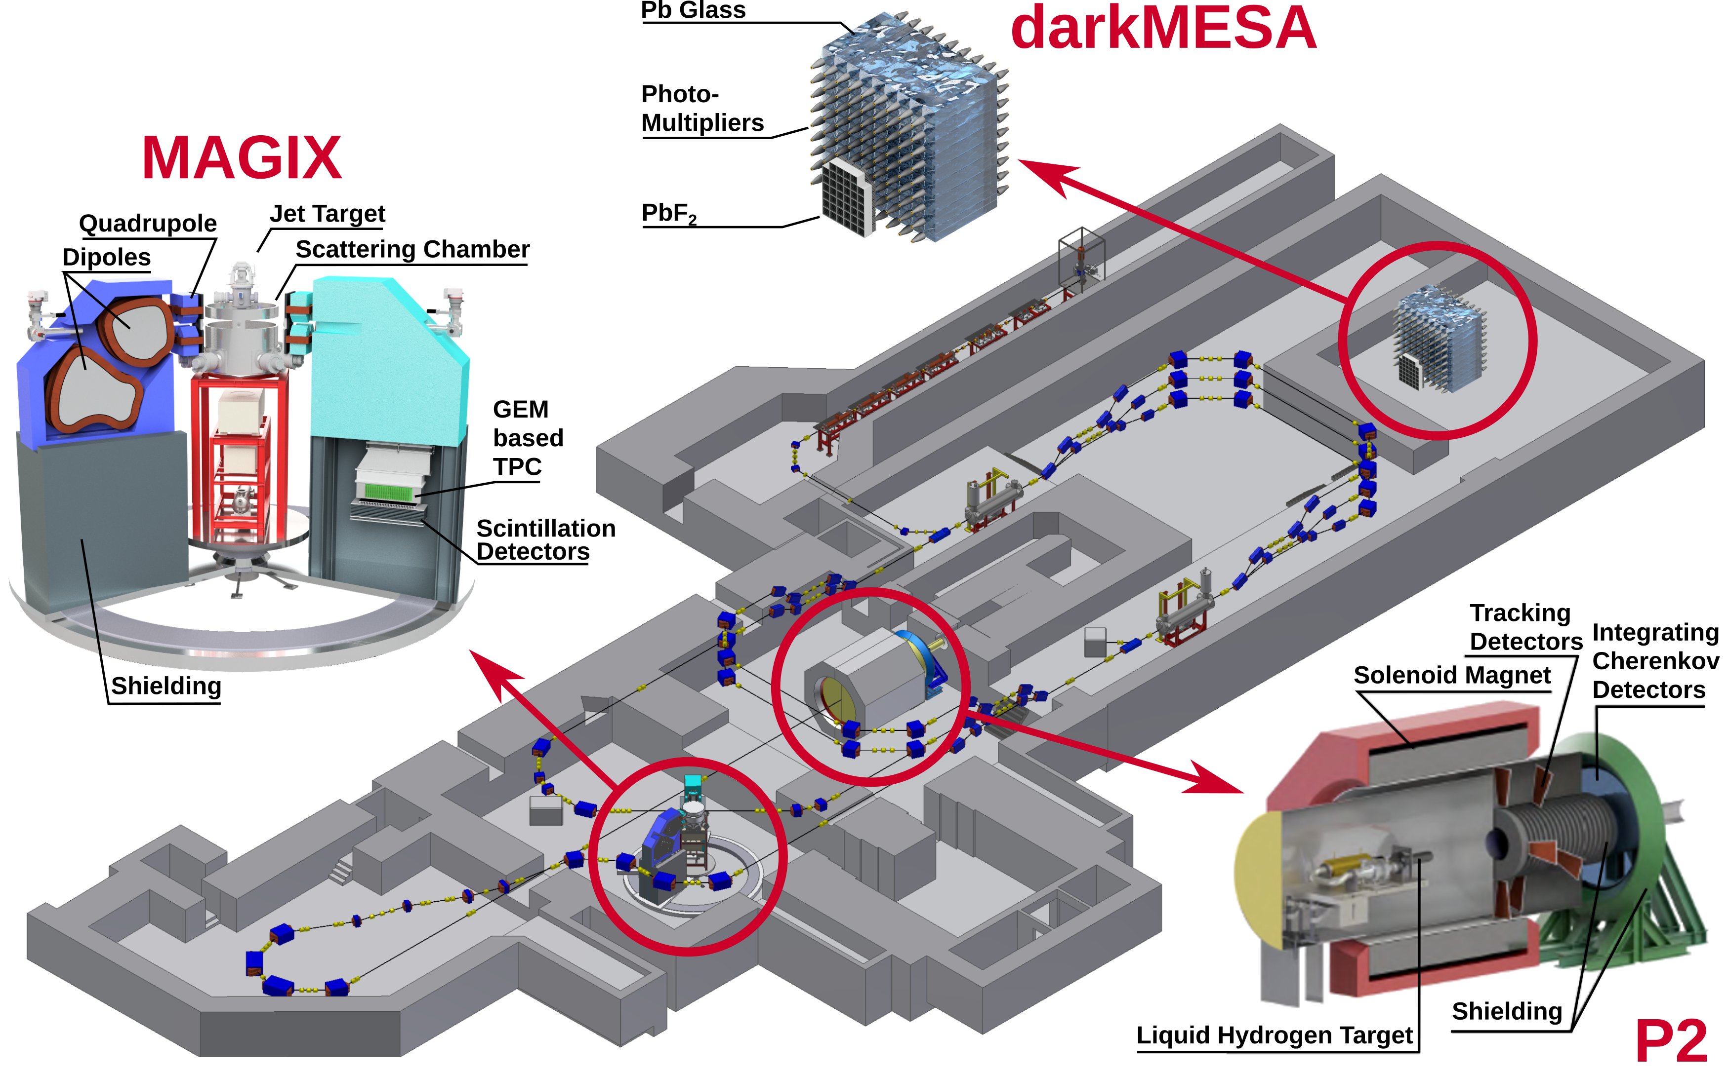
New facility MESA
commissioning 2022

Slide 22
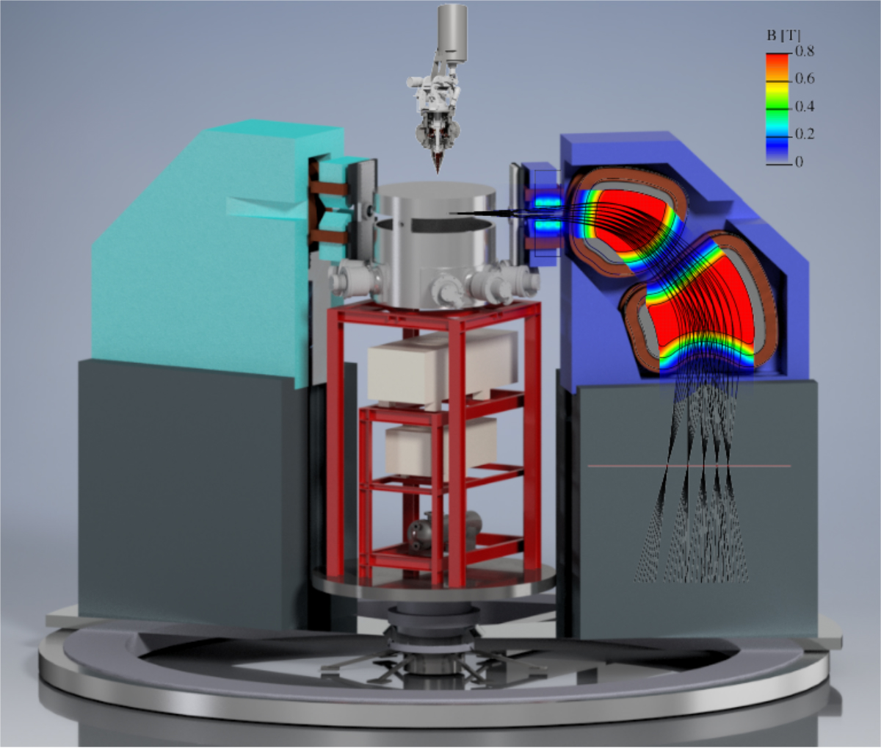
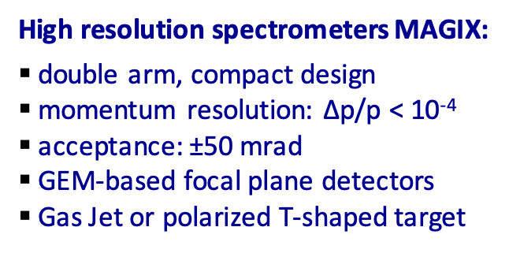
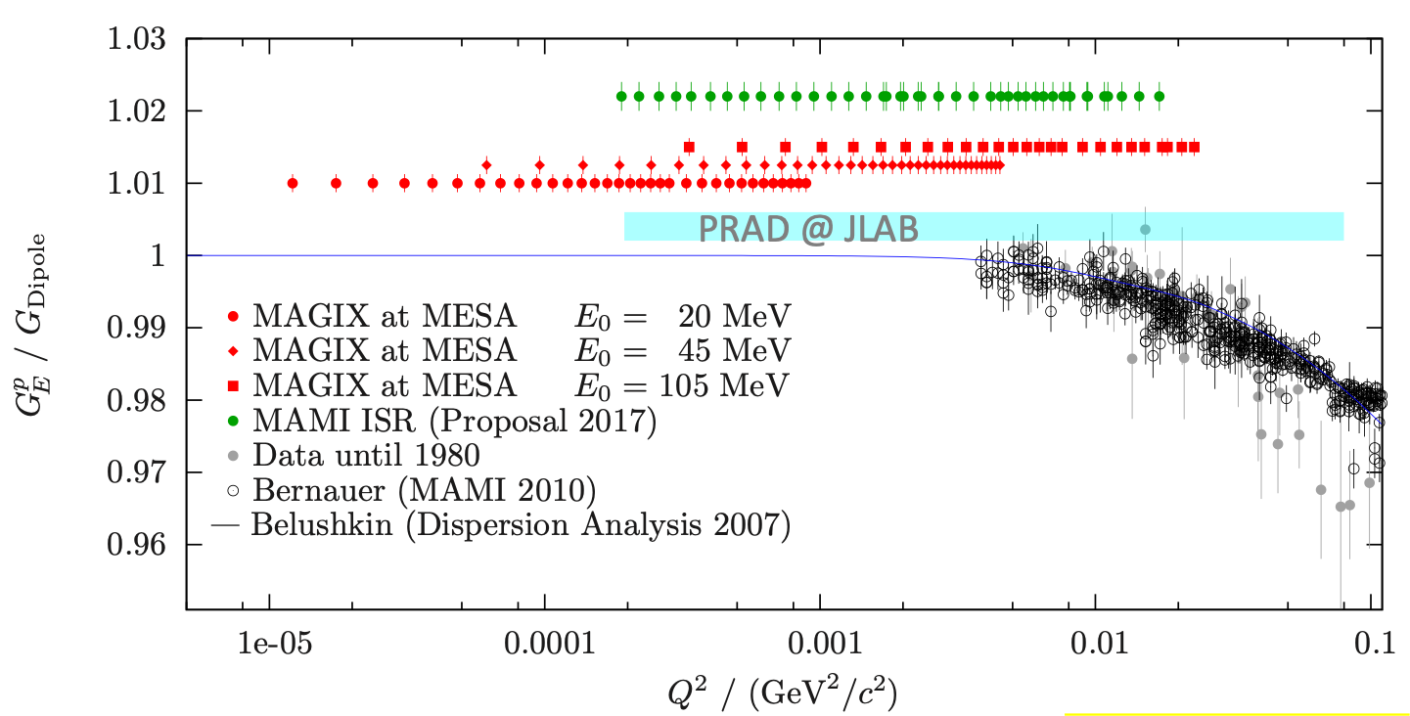
Low-Q² proton FF: MAGIX@MESA

Slide 23
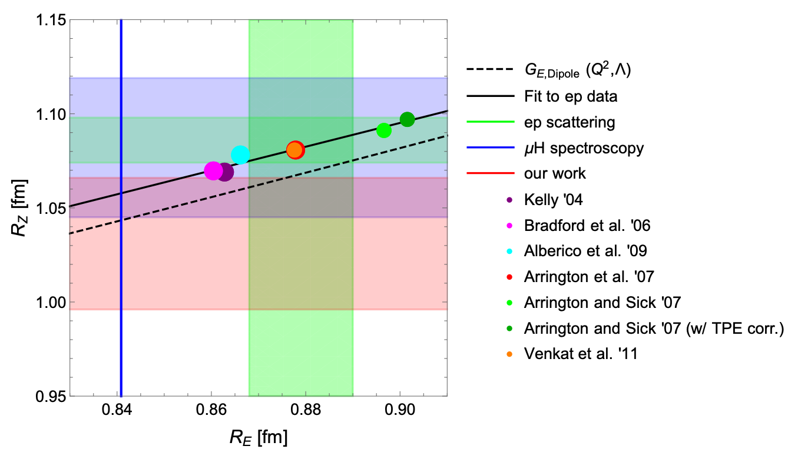
Zemach radius vs the rms charge radius
Hagelstein et al, in prep.
An extraction of Zemach radius from muonic H hfs should be consistent
with the charge radius extraction from muH Lamb shift?!

Slide 24
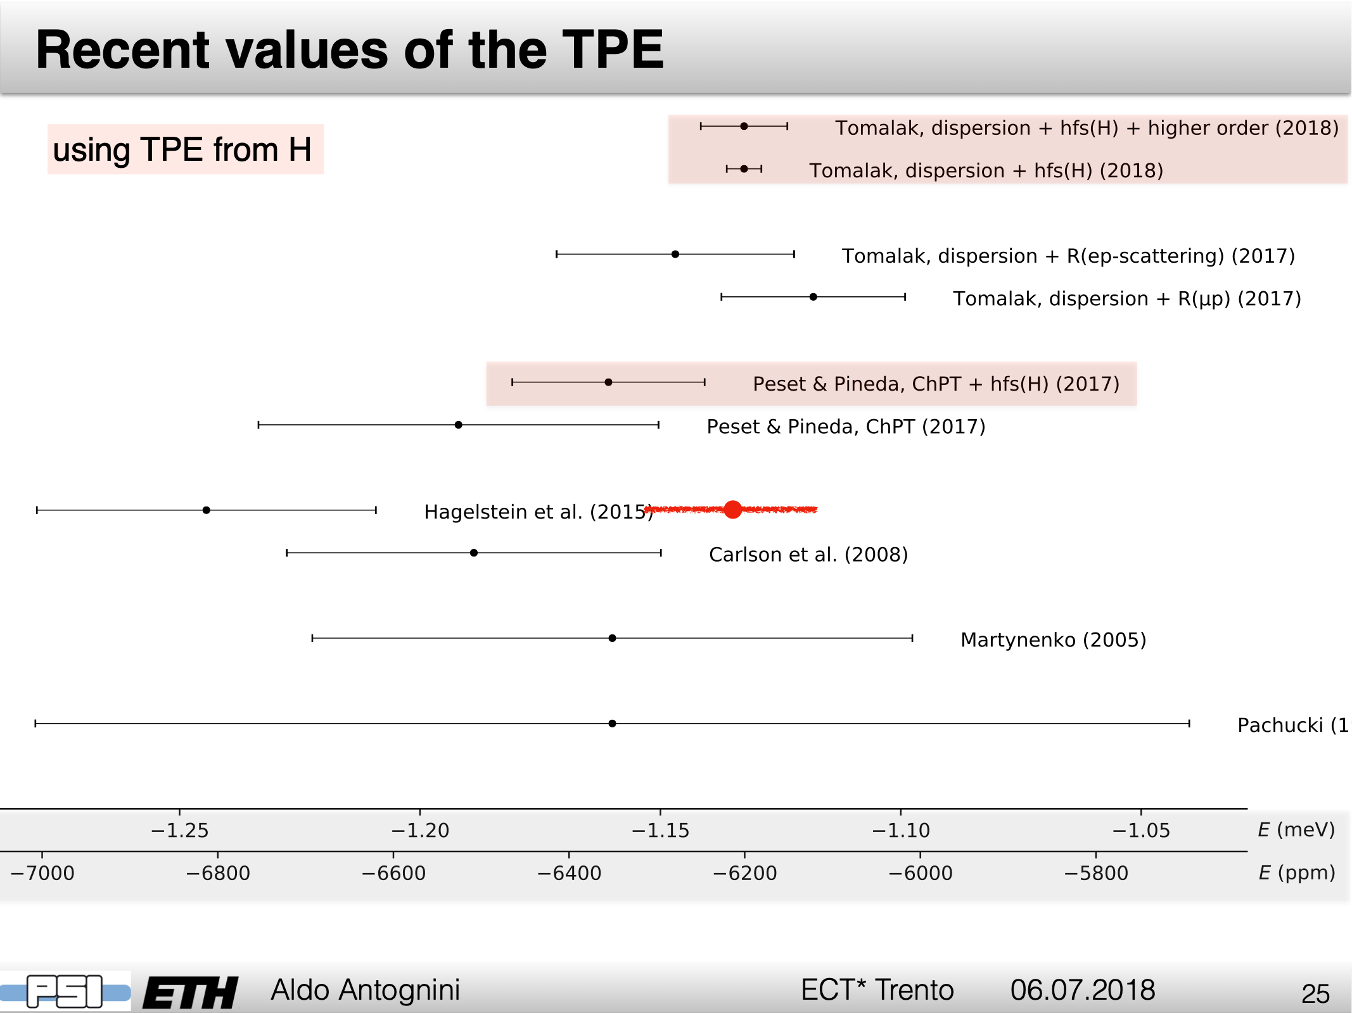


Slide 25
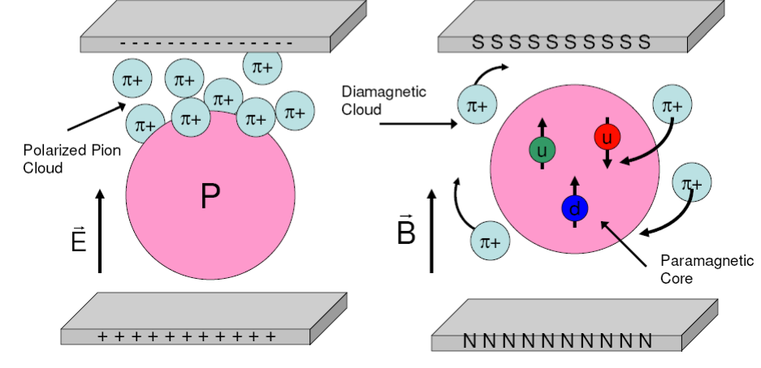
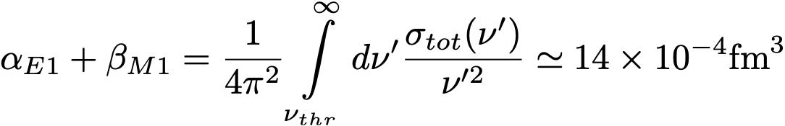
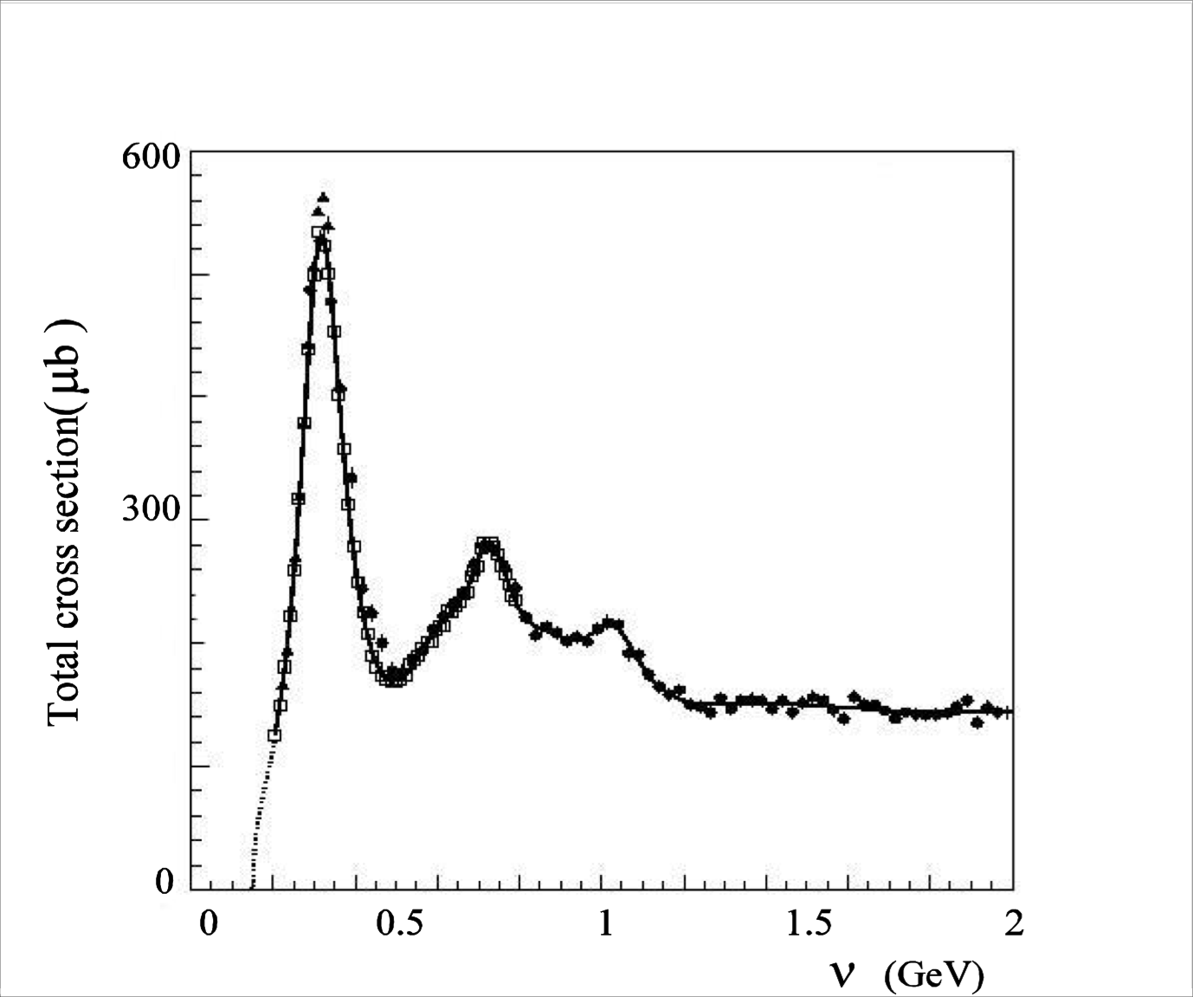
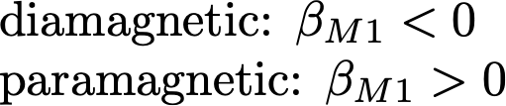
Nucleon Polarizabilities
and Compton scattering
by A2 @ MAMI
h
[Baldin sum rule (1960)]
Δ (1232) M1/E2
N*(1520) E1/M2
N*(1680) E2/M3

Slide 26
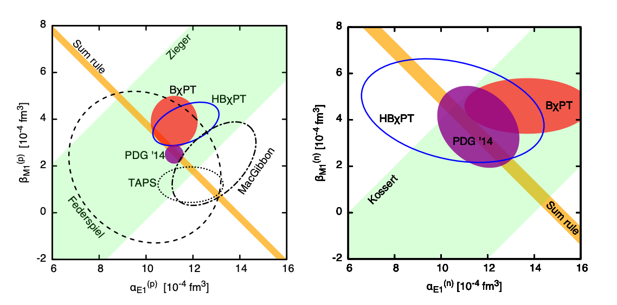
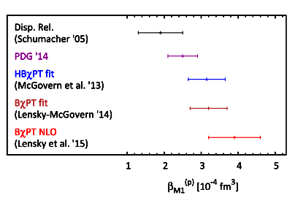
  Magnetic vs Electric polarizability
Proton
Neutron
TAPS: fit to TAPS/MAMI data based on fixed-t DRs of L’vov et al. Olmos de Leon et al., EPJA (2001)
BChPT: “postdiction’’ Lensky & VP, EPJC (2010) Lensky, McGovern & VP, EPJC (2015)
HBChPT: fit to world data Grieβhammer, McGovern & Phillips, EPJA (2013)
systematic discrepancies between DR and ChPT extractions/predictions

Slide 27
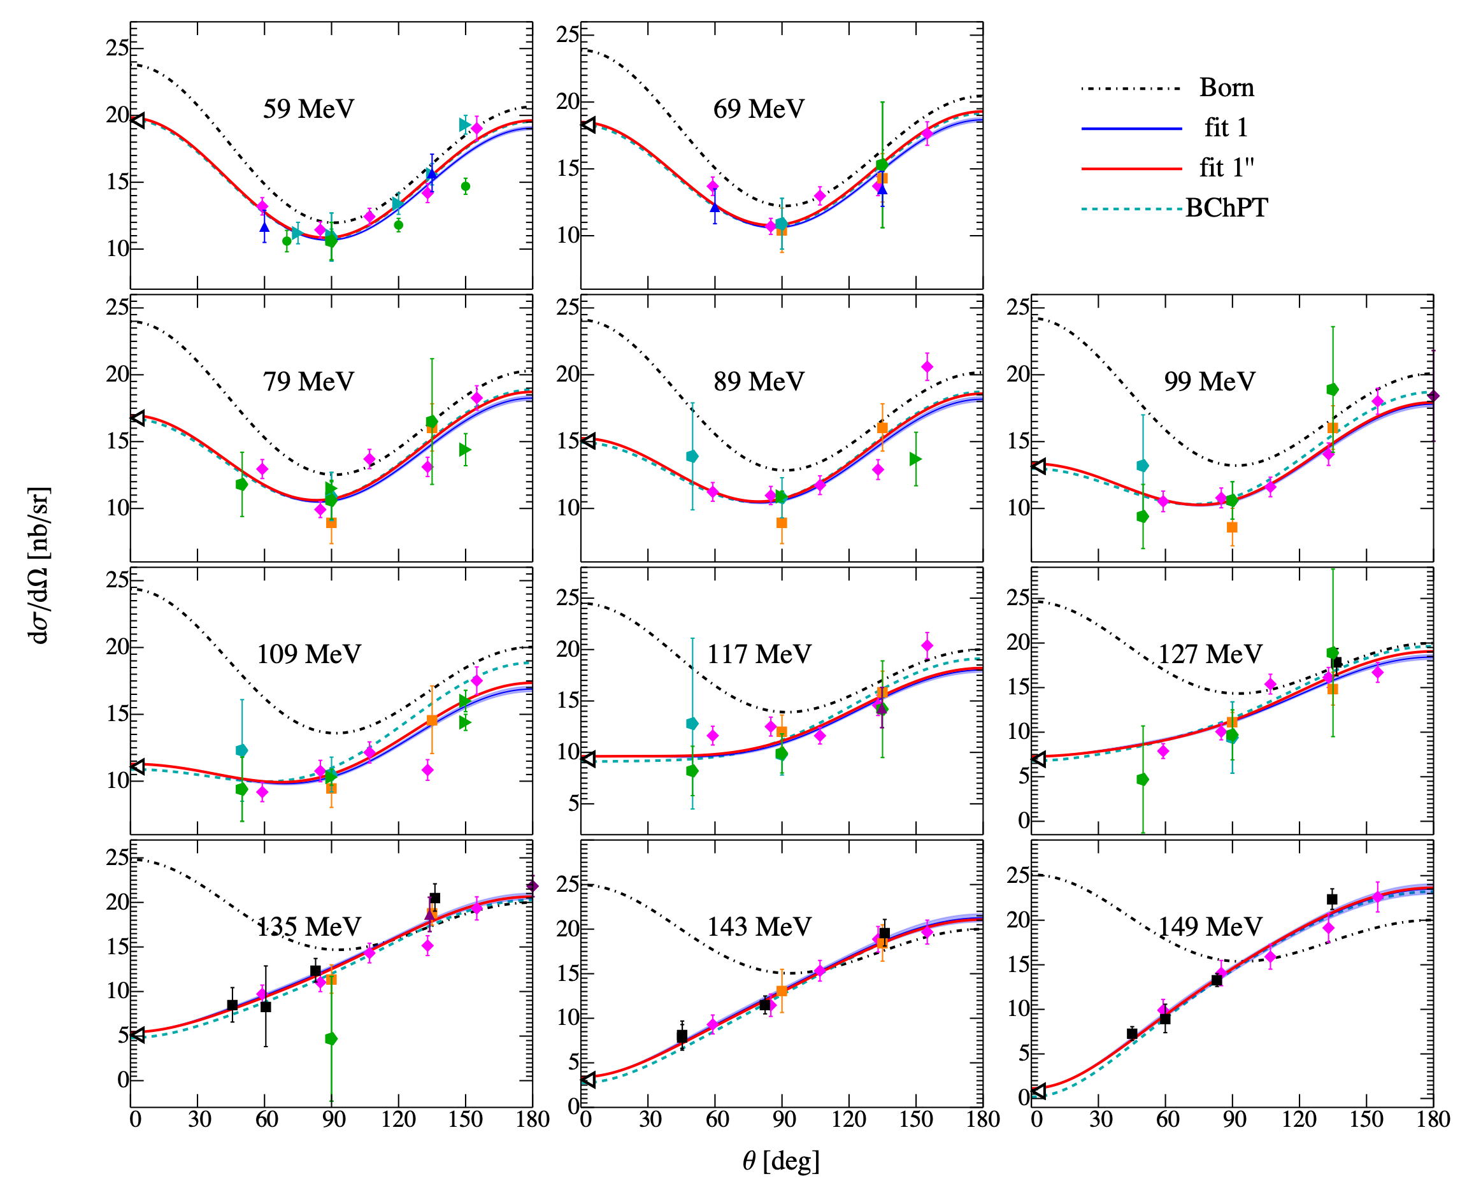
World database of Compton scattering
full database refined database

Slide 28
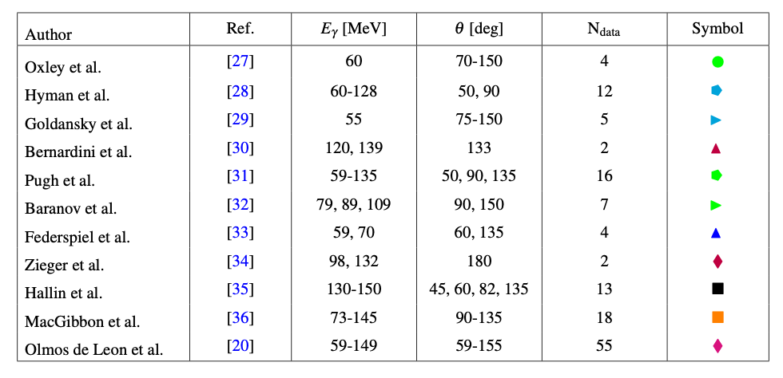

Database of Compton scattering (below pion production)

Slide 29

Electric vs magnetic polarizability of the proton
TAPS: fit to TAPS/MAMI data based on fixed-t DRs of L’vov et al. Olmos de Leon et al., EPJA (2001)
BChPT: “postdiction’’ Lensky & VP, EPJC (2010) Lensky, McGovern & VP, EPJC (2015)
HBChPT: fit to world data Grieβhammer, McGovern & Phillips, EPJA (2013)
PWA: fit to world data Krupina, Lensky & VP, PLB (2018)
Partial-Wave Analysis (PWA):
differences between DR and ChPT extractions are due to database inconsistencies, improvements — new experiments — are needed

Slide 30

New (preliminary) data
from A2@MAMI
[ E. Mornacchi et al. ]
Higher statistics,
better systematics
than any other dataset
No outliers seen
previous MAMI data!
Impact on proton polarizabilities
yet to be analyzed…

Slide 31

Beam asymmetry (polarized photon beam)
cleaner separation of magnetic from electric [N. Krupina & VP, PRL (2013)]
Pilot expt: V. Sokhoyan et al., EPJA (2017)
New expt.: E. Mornacchi et al.

Slide 32

Generalzied polarizabilities from Virtual Compton Scattering (VCS)— new results from A1
J. Beričič et al.. Jul 23, 2019. 5 pp.
e-Print: arXiv:1907.09954 [nucl-ex]
[from V. Lensky, VP & M. Vanderhaeghen, EPJC (2017)]

Slide 33


Spin polarizabilities
— new results from A2
(doubly)-polarized Compton scattering
275 MeV
[P.Martel et al, PRL (2015)]
295 MeV

Slide 34

Summary and outlook
MAMI is up and running, with recent results on
MESA under construction..
elastic ep ISR@A1, TPC@A2
Form factors, radius (lower bound)
(muonic) Hydrogen
Compton Real @ A2 Virtual @ A1
Polarizabilities, spin, generalized
Dark photon searches

Slide 35


Slide 36

Start running in 2022 ?

Slide 37

Thank you!

Slide 38
Backup

Slide 39



Standard Model
Electroweak QCD
is presently the best theory of (nearly) everything

Slide 40

layers of complexity

Slide 41

Approaches to hadronic effects in the SM
QCD Based
Lattice QCD,
Dyson-Schwinger eqs
Empirical
Dispersive data-driven
                Effective-field theories
                (ChPT, SCET, …)
                Constituent quark models
                Other “QCD-inspired” models

Slide 42

Muon anomalies today
~3-4 𝜎 discrepancy
~5-6 𝜎 discrepancy
projection
  Proton radius puzzle
  Muon g-2
Hadronic effects are the main sources of uncertainty

Slide 43




Muon g—2
or, anomalous magnetic moment:

Slide 44






Dispersive “data-driven” evaluation of HVP
Reviews:
F. Jegerlehner, Springer Tracts Mod. Phys. 274 (2017).
M. Davier, Nucl. Part. Phys. Proc. 287-288, 70 (2017).
$$ImΠ^{had}≡\frac{s}{4πα}R(s)=\frac{s}{4πα}\frac{σ(e^{+}e^{−}→had)}{σ(e^{+}e^{−}→μ^{+}μ^{−})}$$

Slide 45


And the result, for HVP contribution
(from M. Knecht’s talk in Feb’18):
What about hadronic light-by-light (HLbL), etc.?

Slide 46



Universal dispersive formula:
Schwinger Sum Rule
J. S. Schwinger, Proc. Nat. Acad. Sci. 72, 1 (1975); ibid. 72, 1559 (1975) [Acta Phys. Austriaca Suppl. 14, 471 (1975)].
A. M. Harun ar-Rashid, Nuovo Cim. A 33, 447 (1976).
muon mass m
photon lab-frame energy 𝜈
and virtuality Q² = -q²
anomalous
magnetic moment
a=½(g−2)
a
longitudinal-transverse
photo-absorption
cross section σLT
photo-absorption threshold ν0
fine-structure
constant 𝛼 ≈ 1/137
σLT is inclusive cross section of polarized photo-absorption on muon:
=𝛾𝜇, 𝛾𝛾𝜇, π⁰𝜇, 𝛾π⁰𝜇, …
𝜇

Slide 47




Origin of sum rules
Sum rules are model-independent relations based on general principles of:
  Analyticity/causality (dispersion relations),
  unitarity (optical theorem)
  crossing symmetry
Examples of sum rules include:
a
a
Burkhardt—Cottingham
sum rule (1970)
⊖
a
Gerasimov—Drell—Hearn
sum rule (1966)
a
Schwinger sum rule (1975)

Slide 48


Expression in terms of
spin structure functions
a
muon spin structure functions
g1 and g2
e⁻
e⁻
𝛾*
hadrons
𝜇

Slide 49







Verifying the Schwinger sum rule in QED
Schwinger term —
the leading QED result
F2(0)=a
a⁽⁰⁾=0
a⁽¹⁾ = 𝛼/2π
Schwinger sum rule:
Input:
q² = -Q²
q’² =0
tree-level QED
Compton scattering
$$\text{with}s=m^{2}+2mν−Q^{2}$$

Slide 50






HVP from Schwinger sum rule
q² = -Q²
q’² = Mx²
+ crossed diagram
Cross section of hadron production through timelike Compton scattering:
factorizes as:
timelike
Compton scattering
virtual-photon
decay into hadrons
Timelike Compton scattering cross section:

Slide 51




HVP from Schwinger sum rule
Hagelstein & VP, Phys. Rev. Lett. 120, 072002 (2018).
a
kernel function:
for Mx=0, we find K(0)=1/2, and therefore the Schwinger term: a⁽¹⁾ = 𝛼/2π
reproduces the HVP standard dispersion formula
a

Slide 52



Hadronic Contributions beyond HVP:
4 channels to order 𝛼³

Slide 53









Light-by-Light meson-exchange contributions
Hadron photo-production channels
Electromagnetic channels
+
(pseudo-)scalar
contribution
+
Double-counting
as 𝜇π⁰ is contained in 𝜇𝛾𝛾
x
x

Slide 54



Pseudoscalar meson-photoproduction channel
No data yet. We use chiral EFT to compute:
1 out of 4 channels at 𝒪(α³): 𝜇 + 𝛾 → 𝜇 + (π⁰,𝜂,𝜂’)
Hagelstein & VP,
arXiv:1907.06927 (2019).
Compare with the conventional (π⁰,𝜂,𝜂’)-pole contributions:
Pseudoscalar production gives a contribution to aμ which is a factor of 2 to 3 larger than the conventional pseudoscalar-pole calculations

Slide 55

Other channels ?
~ 0.5 $×{10}^{−10}$
Biloshytskyi, Hagelstein & VP, in preparation.
Compton scattering channel contribution is nearly two orders of magnitude smaller than the pseudoscalar production contribution.
+
Radiative pseudoscalar-production channel not calculated yet, but is expected to increase the discrepancy.

Slide 56


Prospects for neutral-pion production measurement at COMPASS
(as part of MUonE experiment)

Slide 57


Present status of muon g—2

Slide 58

Muon g—2
or, anomalous magnetic moment:

Slide 59



Hadronic Contributions to g-2
(from M. Knecht’s talk in Feb’18):

Slide 60



Motivation
Uncertainty of the SM prediction for the muon anomaly (g−2)μ is dominated by hadronic contributions (HVP and HLbL)
HVP is calculated with a data-driven dispersive approach:
a
F. Jegerlehner, Springer Tracts Mod. Phys. 274 (2017).
M. Davier, Nucl. Part. Phys. Proc. 287-288, 70 (2017)
HLbL is not as simple, data-driven, systematic
Is there an exact dispersive formula which treats HVP and HLbL (and everything else) in the same way?

Slide 61


Outline of this talk
a
The Schwinger Sum Rule:
Reproducing 𝛼/2π
Hadronic Vacuum Polarization and Light-by-light contributions on the same footing
Pseudoscalar-meson contribution
Muon Structure Functions from inelastic muon-electron scattering
e⁻
e⁻
𝛾*
hadrons
𝜇

Slide 62

Spin structure functions
a
e⁻
e⁻
𝛾*
hadrons
𝜇
muon spin structure functions
g1 and g2
Spin-dependent forward doubly-virtual Compton scattering:
Optical theorem:

Slide 63
Reproducing the leading QED result
a
Schwinger sum rule:
Input: longitudinal-transverse photo-absorption cross section
tree-level QED
Compton scattering
F2(0)=a
a⁽⁰⁾=0
a⁽¹⁾ = 𝛼/2π

Slide 64


Pseudo-scalar contribution in full glory
    No doubly-virtual transition form factors needed, if hadronic channels are measured

Slide 65

Alternative way of accessing the HVP
size of the effect: 𝛼 ∼ 1%
vs.
e⁻
e⁻
𝛾*
hadrons
𝜇

Slide 66




Summary and Conclusions
1. Schwinger sum rule — dispersive formula applying equally to HVP and HLbL
2. Reproduces 𝛼/2π and HVP formula:
3. Splits contributions into hadron production and e.m. (LbL) channels
measurable
spin structure functions
LQCD ?
direct LbL scattering (ATLAS)
4. Partial calculation of PS-meson contributions: a factor of 2 to 3 larger than the conventional model calculations.

Slide 67



The Cross section σLT
Example: tree-level QED Compton scattering cross section
    with conserved helicity:
H=𝜆’𝛾-𝜆’𝜇=𝜆𝛾-𝜆𝜇
2
𝜆𝛾
𝜆𝛾
𝜆𝛾
𝜆’’𝛾
𝜆’’𝛾
𝜆’𝛾
𝜆𝜇
𝜆𝜇
𝜆𝜇
𝜆’’𝜇
𝜆’’𝜇
𝜆’𝜇
helicity difference photo-absorption cross section:
longitudinal-transverse photo-absorption cross section:
𝛾*(𝜆𝛾=0) + 𝜇(𝜆𝜇=-1/2) → 𝛾(𝜆’𝛾=1) + 𝜇(𝜆’𝜇=1/2)
𝜆𝛾=0
𝜆’𝛾=1
spin flip
𝜆𝜇=-1/2
𝜆’𝜇=1/2

Slide 68


Timelike CS mechanism
𝛬^{𝜈}: virtual-photon decay vertex
q
ki
q’
p
p’
q² = -Q²
q’² = Mx²
initial flux factor
I²=(p·q)² - p² q²
phase space of the final state
ρ𝜇𝜈: squared matrix element of timelike CS
+ crossed diagram
Virtual-photon decay width into hadronic state X:
Im ΠX: contribution of state X to the VP
Combine into:
Final factorized cross section:

