Slide 1
LIU-PS Planning report

Slide 2
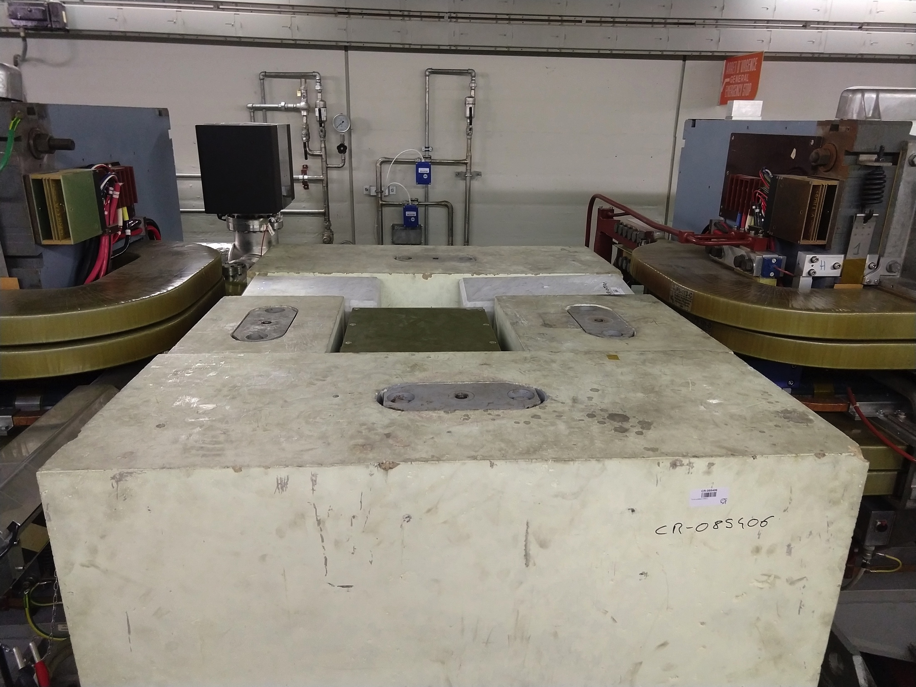
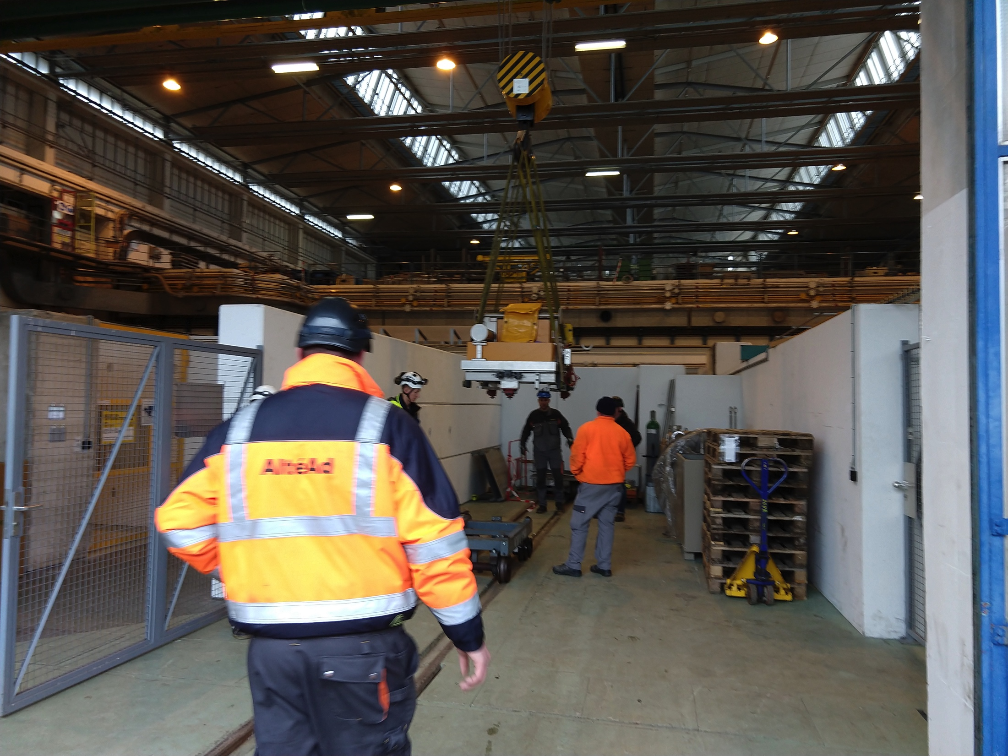
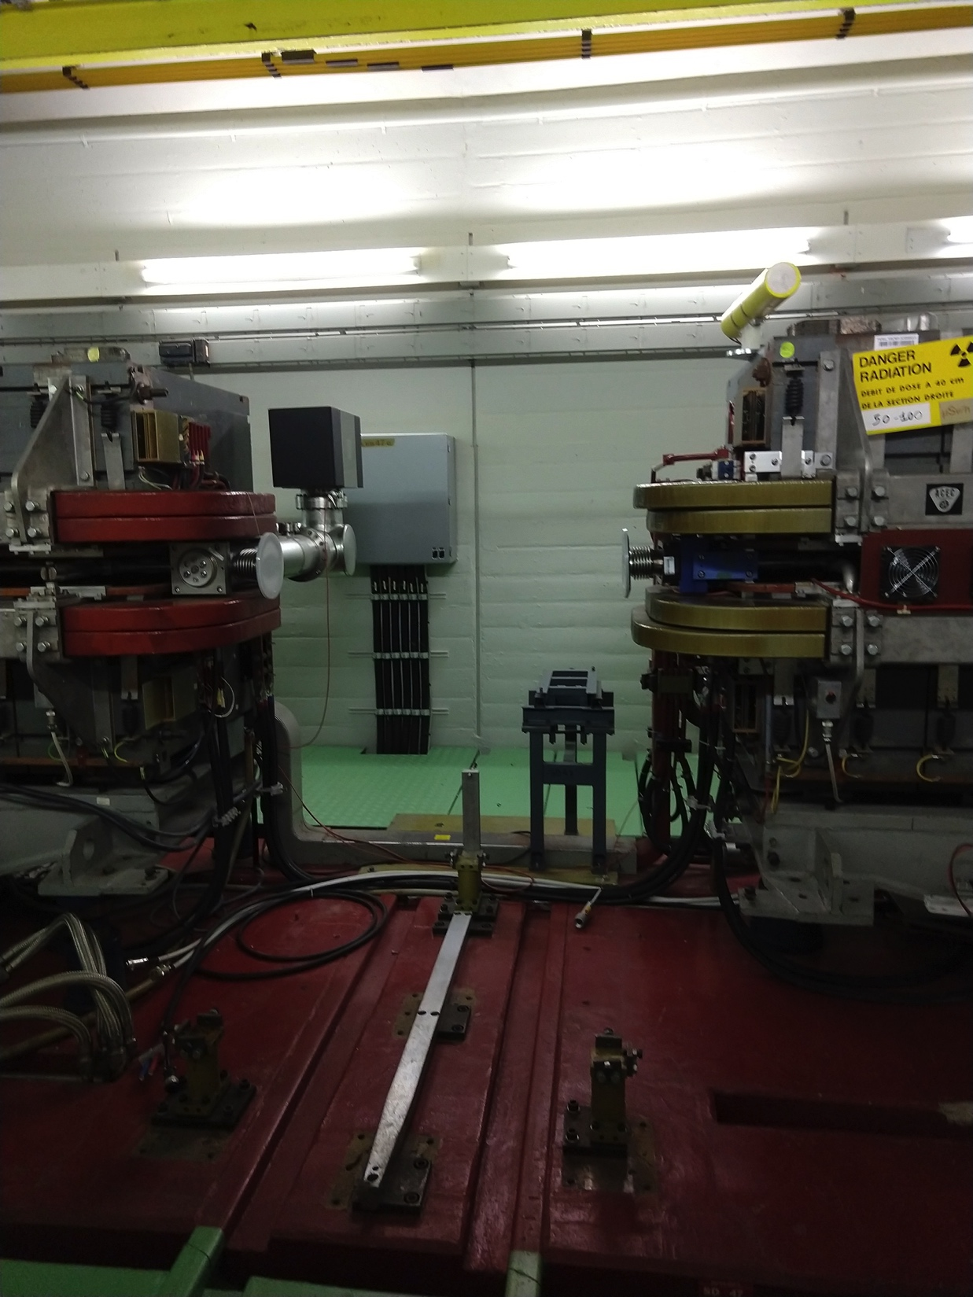
Internal Dumps
Both dumps removed in 1.5 days
Issues:
  There are still few things hanging around that you be good to remove and store it properly

Slide 3
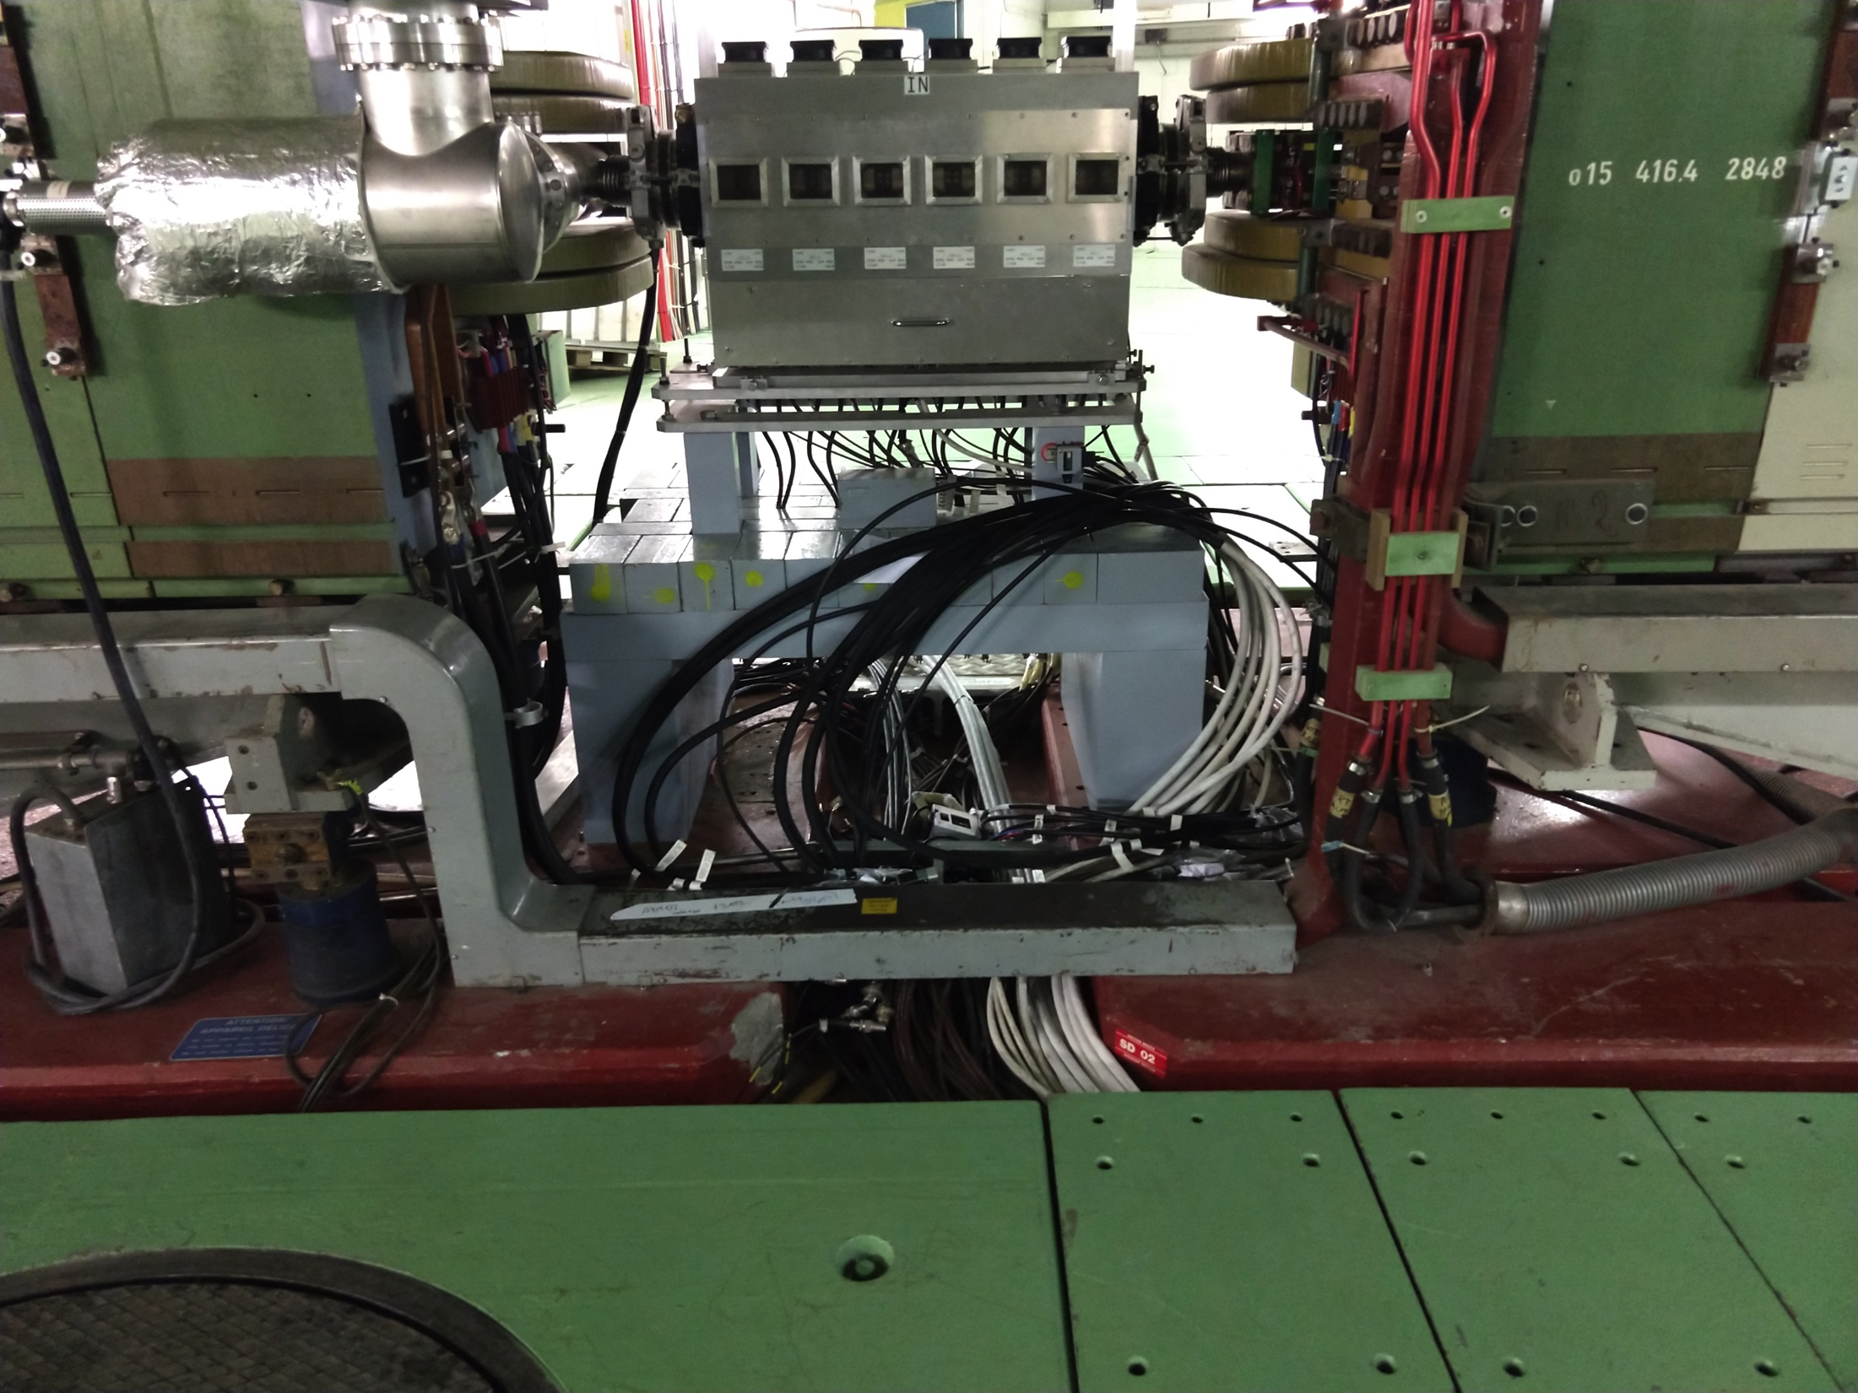
Cabling
Cabling for the RF Damper has been performed and the EN-EL team profited to removed some of the cables that were left from the de-cabling
In the same campaign there were also some cables installed for the RF cavities
Issues:
  The space start to be tight in some areas to pass new cables – A future (LS3) de-cabling campaign in the PS would really help

Slide 4
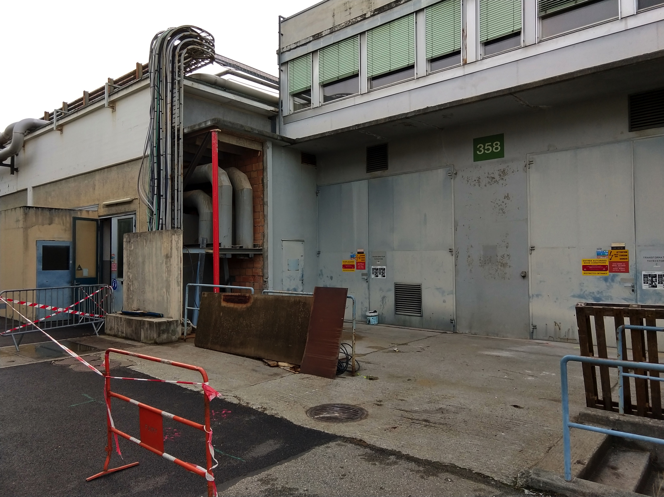
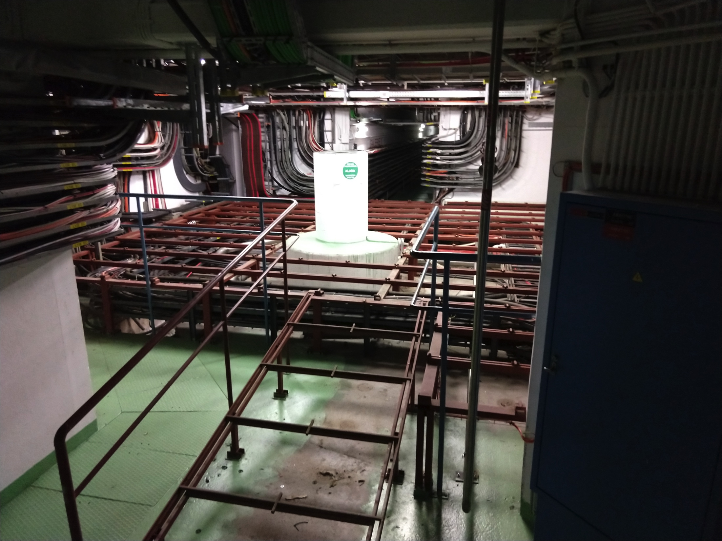
CV works
Progressing quite well
Issues:
  Lead is an issue that is under discussion and that can cause some delays in some CV activities – for the moment some surveys have been organized, but an HSE clarification on the subject is still needed
  Some pipes left in the SWY area due to a misunderstanding during the VIC

Slide 5
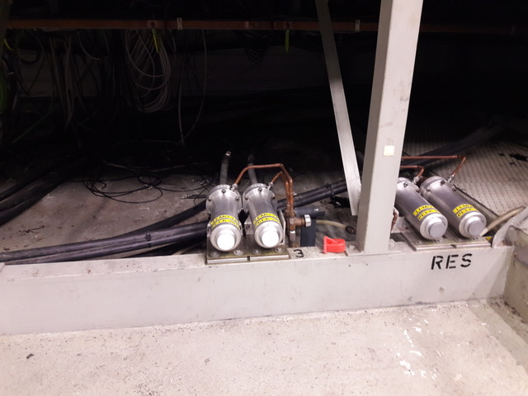
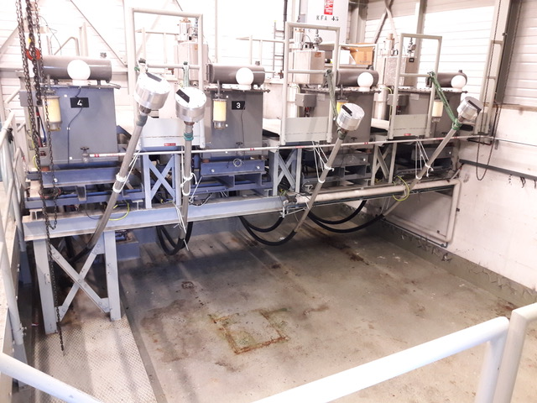
B.365 – KFA45 area
SMB is renovating the oil retention
Issues:
  No issues to report

Slide 6
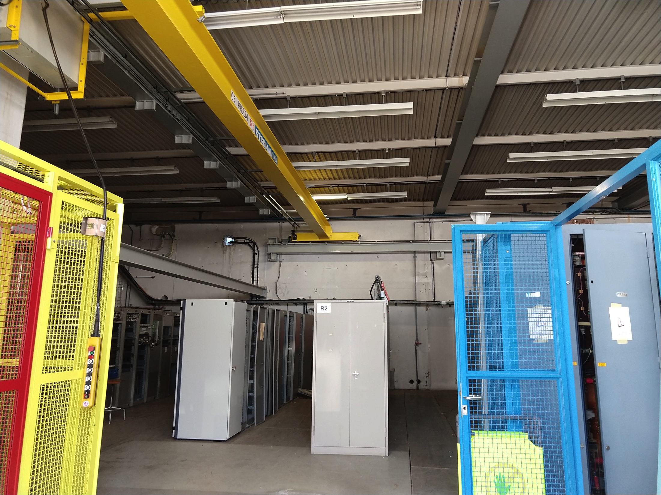
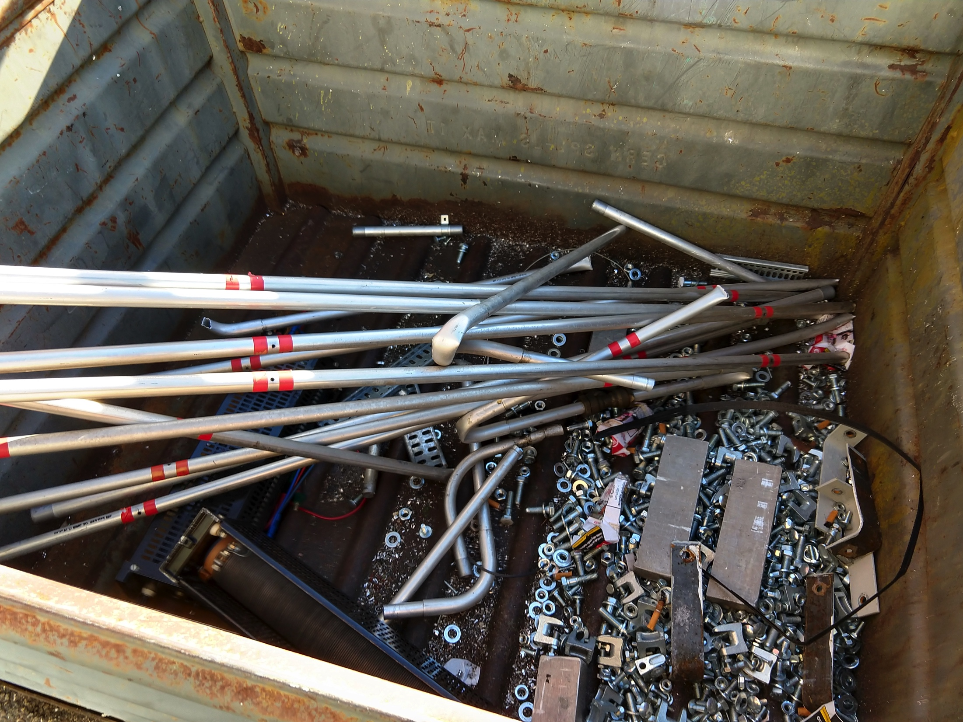
B.269
The metallic structure that separated the two rooms has been removed
The removal of the power converters will start tomorrow
The smoke detection has been removed
Issues:
  EN-EL switchboard is not yet removed – waiting offer from contractor
  Transformer catch-pit – The test results show the presence of PCBs, so discussion is still ongoing with HSE to defined the cleaning procedure
  Scaffolding installed without declaring it and without announcing it, and in conflict with the overhead crane

Slide 7
B.355
The installation of the cooling connection for the future TFB racks and the new PCs is ongoing
Issues:
  Same lead issue as for the other CV works

Slide 8
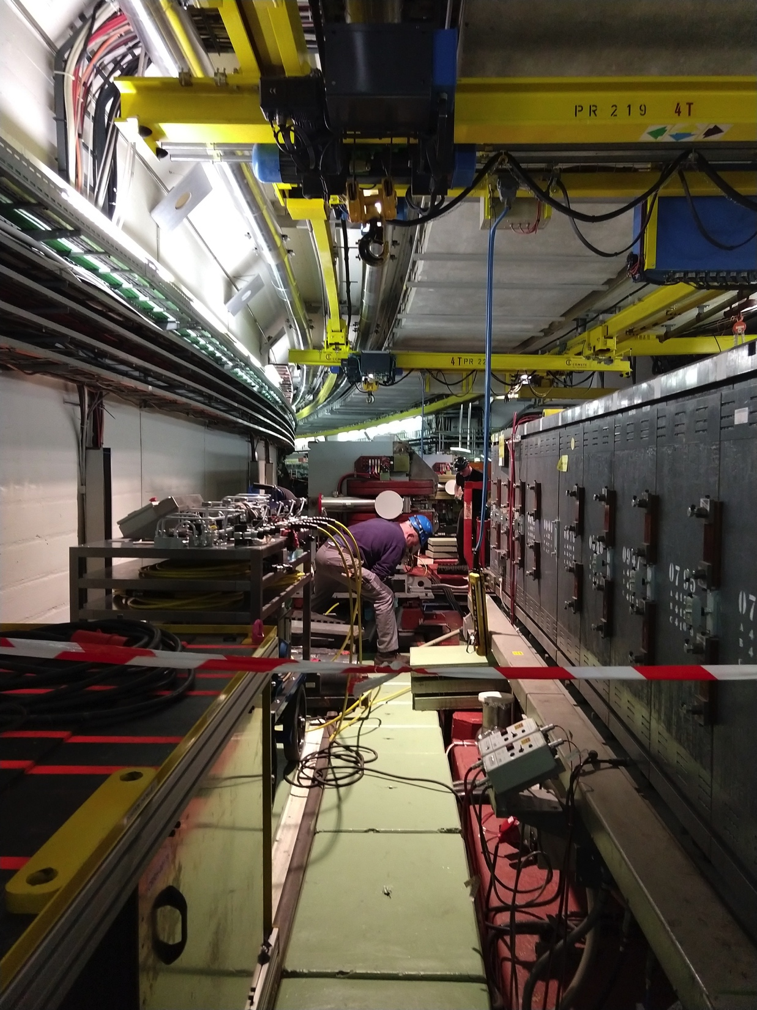
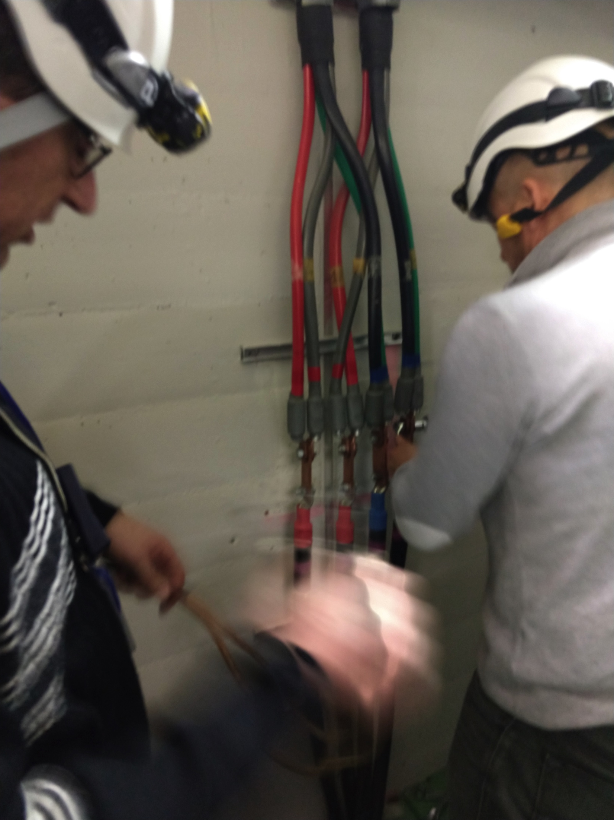
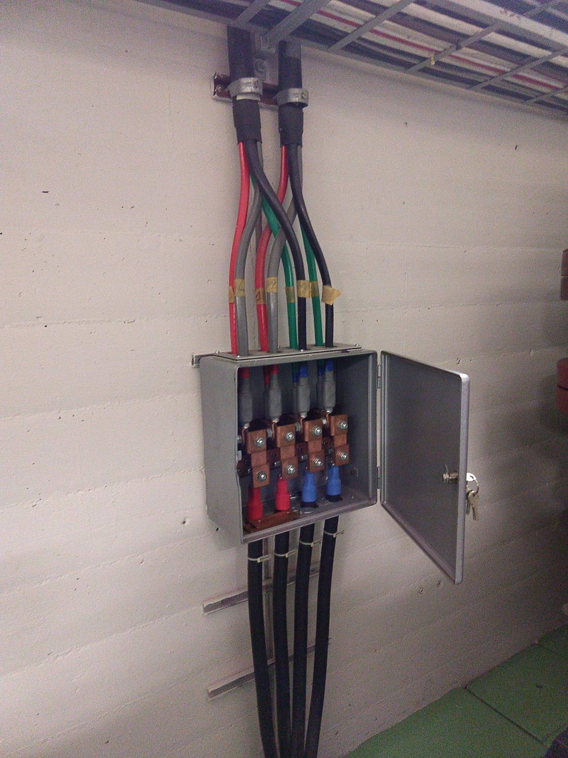
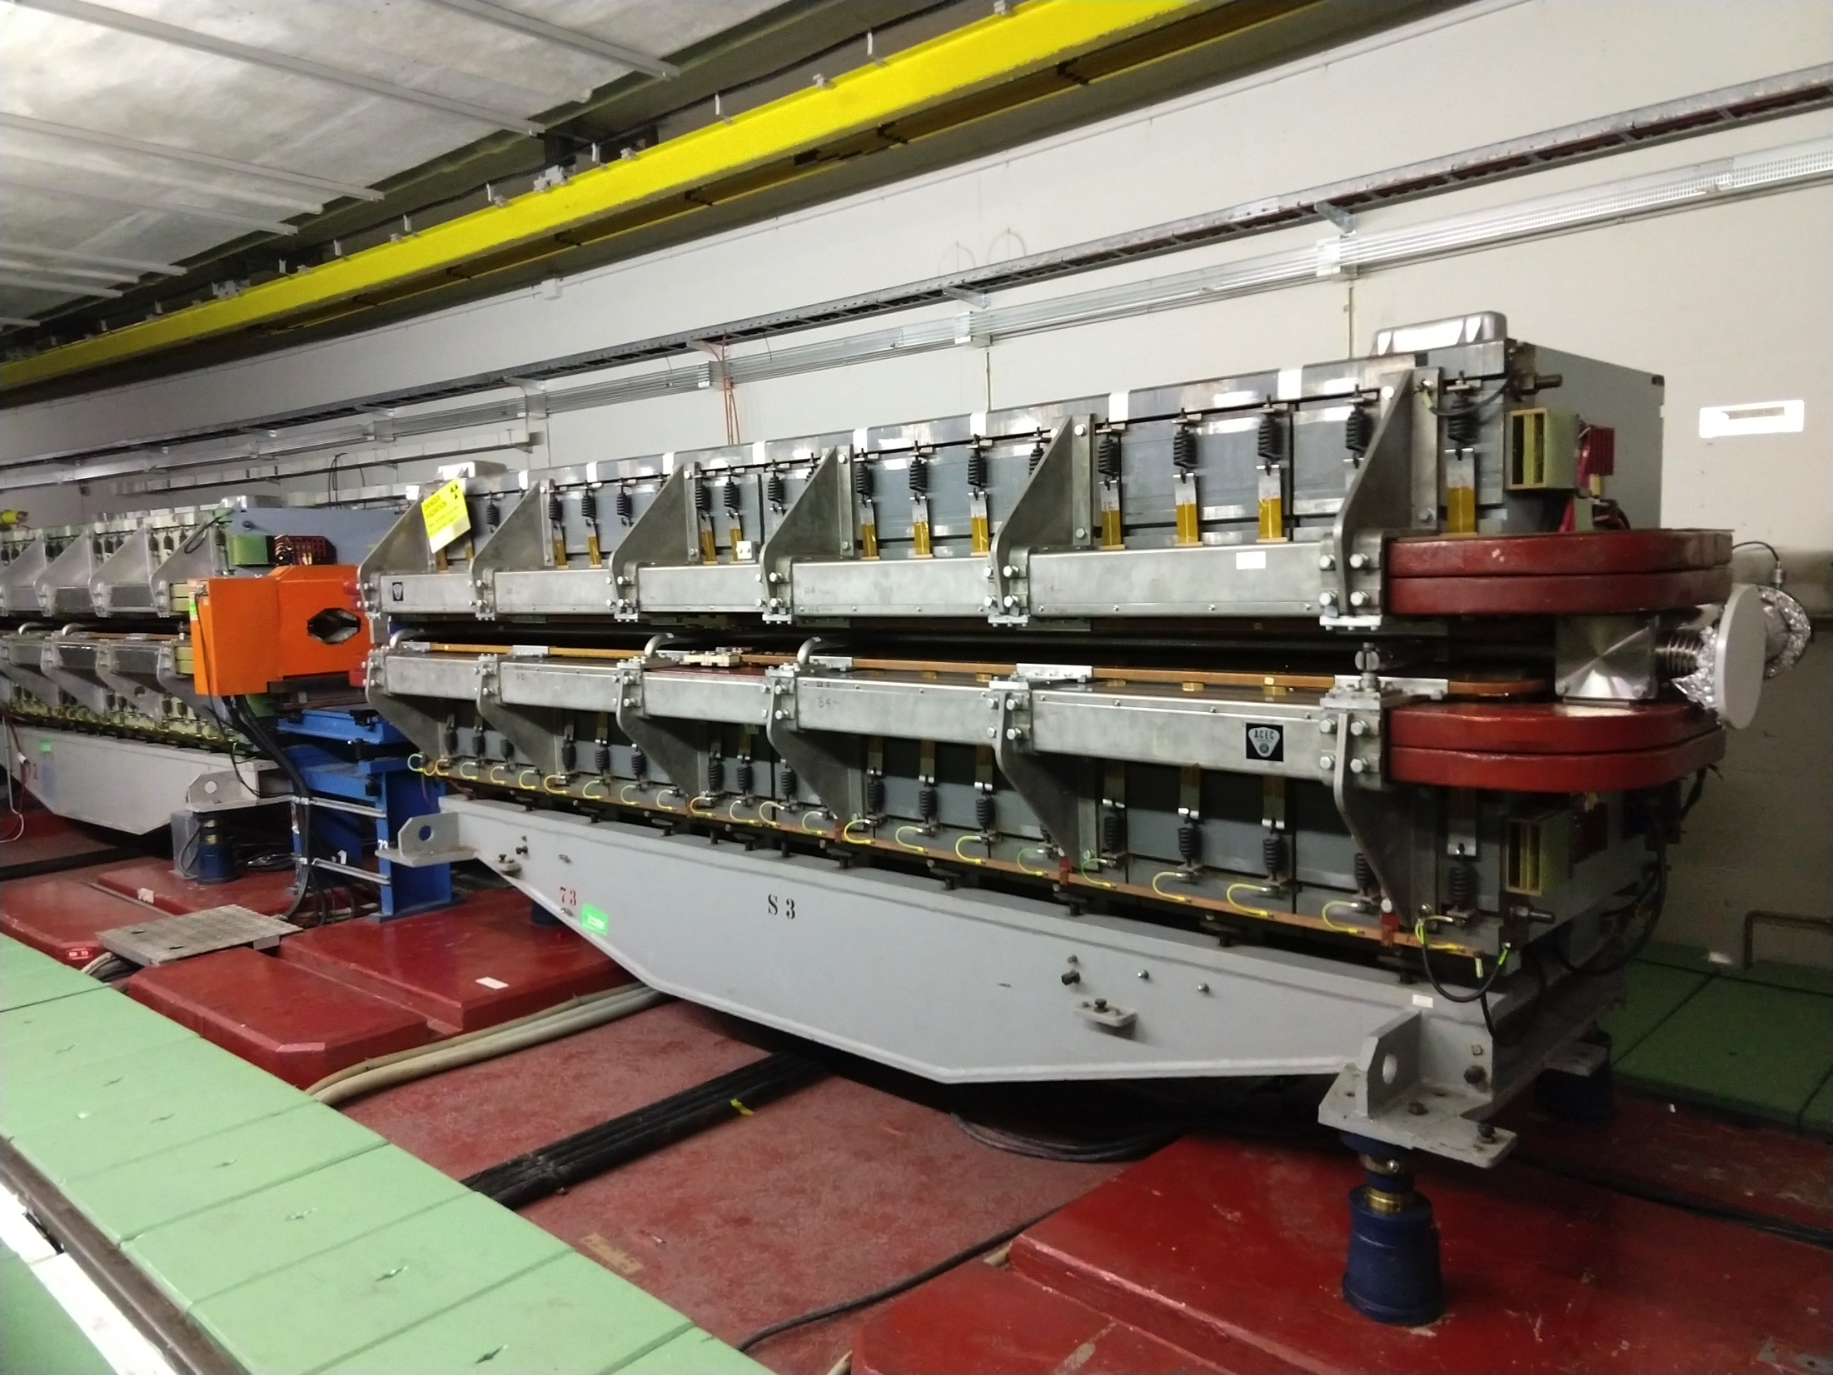
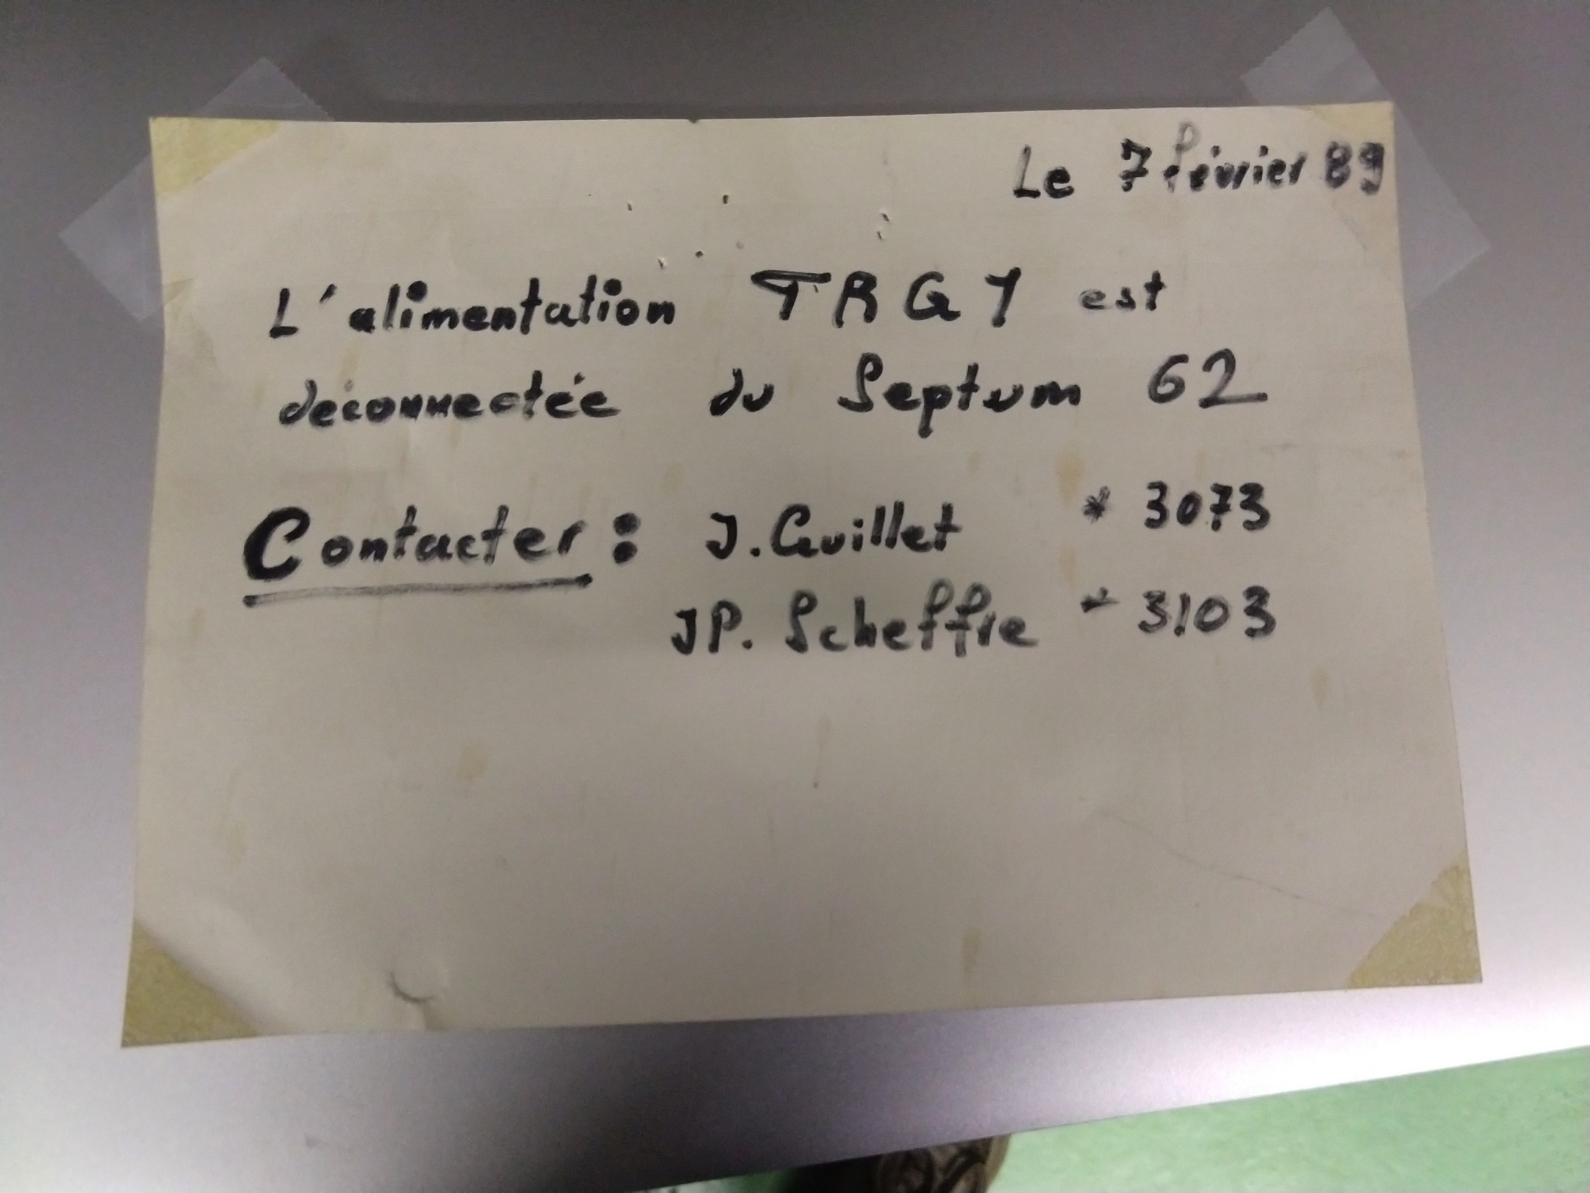
Main Units renovation (cons.)
The first two renovated Main Units (MU73 and MU24) are back to the machine
Issues:
  Old equipment that prevents the passage of the Mus (special thanks to EPC for their help)
MU24
MU24

Slide 9
Question?

