Slide 1
LIU-PS EVM Status
Data extraction: 19 February 2019

Slide 2
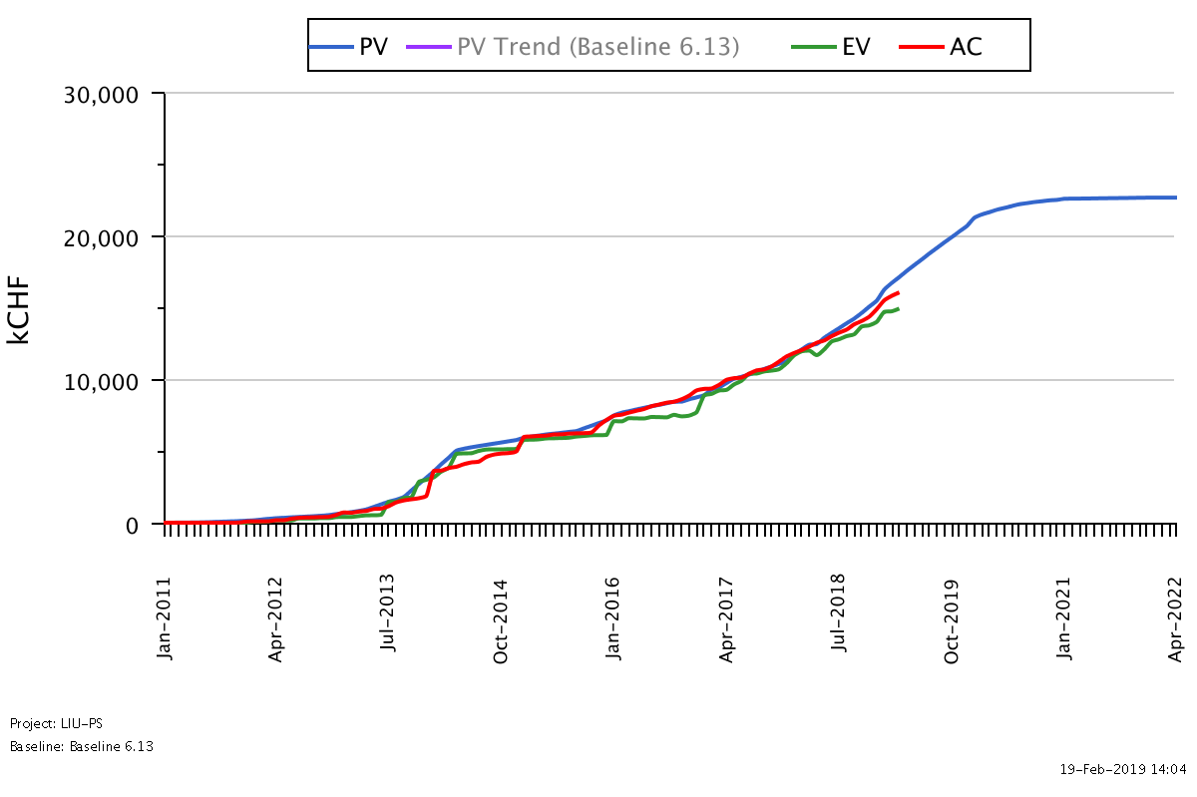
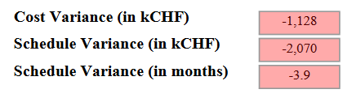
LIU-PS Dashboard
Was 3.6 on the 05.02.19
Reporting up-to-date for 75% of the workunits

Slide 3


LIU-PS Crosstab by Group

Slide 4
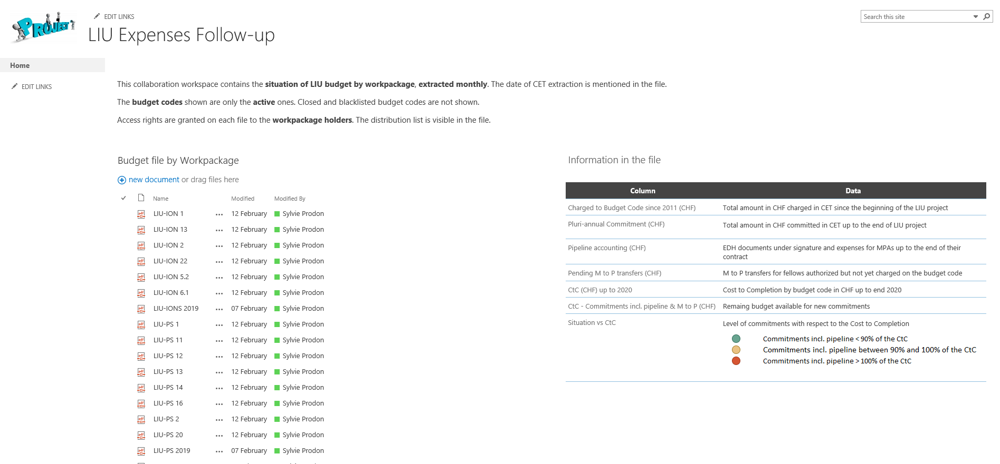
LIU Expenses Follow-up by Workpackage

Slide 5
Spare Slides

Slide 6
LIU-PS Crosstab – BE Department

Slide 7
LIU-PS Crosstab – EN Department

Slide 8
LIU-PS Crosstab – HSE Department

Slide 9
LIU-PS Crosstab – TE Department

