Slide 1
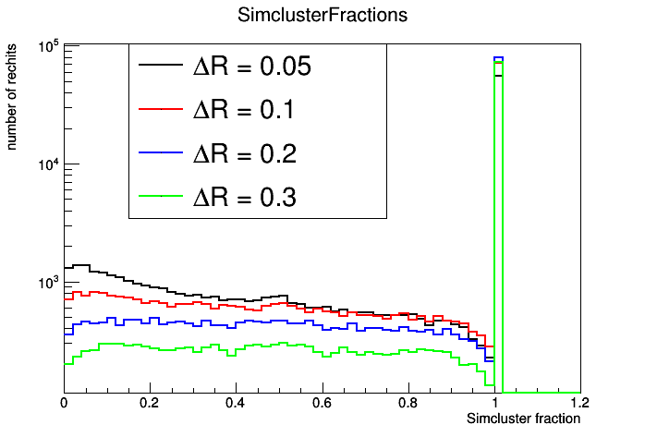
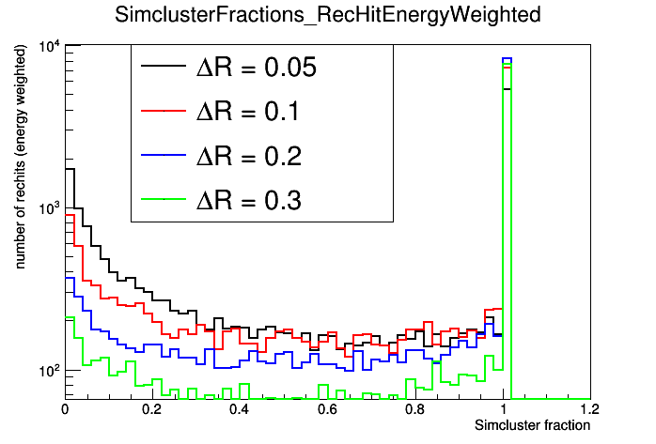
Kinga, Jan, Maurizio, Gerrit, Marcel
6th Patatrack Hackathon
Day 4 4 July 2019
ML4RECO offline: day 4
Fix in adapted CloseByParticleGun validated
Investigated ‘good’ setting for production of a training sample
  1-10 particles
  EM shower, muons, charged pions (25%, 25%, 50%)
  Shot in DR = 0.05, 0.1, 0.2
Worked on more visualization tools
Added sensor ‘radius’ to ntuple, is there anything for the scintillator part?

Slide 2
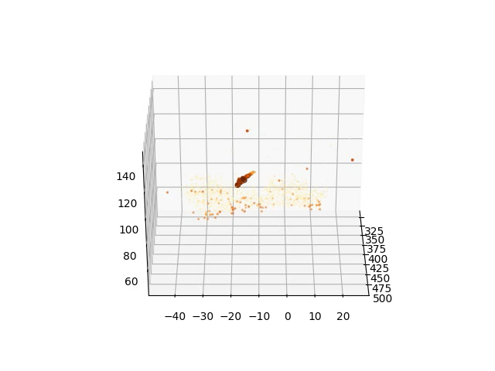
Kinga, Jan, Maurizio, Gerrit, Marcel
6th Patatrack Hackathon
Day 4 4 July 2019
ML4RECO offline: day 4
- Relatively simple events:

Slide 3
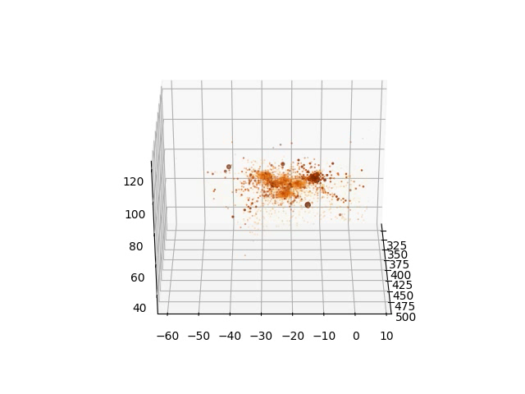
Kinga, Jan, Maurizio, Gerrit, Marcel
6th Patatrack Hackathon
Day 4 4 July 2019
ML4RECO offline: day 4
Started to add truth information to plots
  A few things should be checked, e.g. why we get up to 16 SimCluster with 10 CloseBy particles

Slide 4
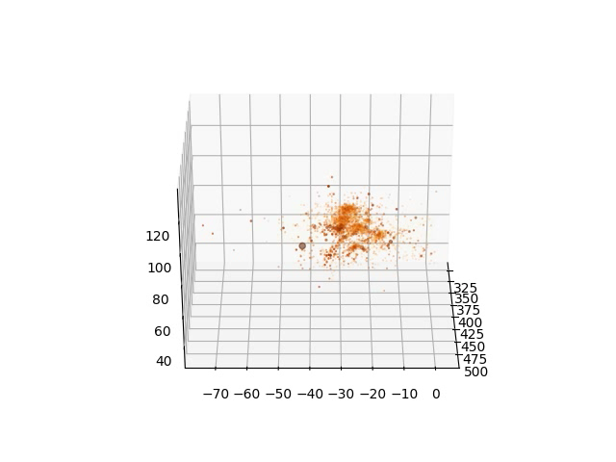
Kinga, Jan, Maurizio, Gerrit, Marcel
6th Patatrack Hackathon
Day 4 4 July 2019
ML4RECO offline: day 4
Preprocessing:
Adding (eta, phi) window selection to preprocessing conversion
  Avoid processing many noise rechits far away from the actual showers
  But include noise in the proximity
  Adding tracks
    (what are track x,y,z in reco-ntuples? At entry point?)
CMSSW
Work on sliding window approach in CMSSW
  No need to make this part parallisable, huge (10k) amount of parallalisable operations already within DNN
  Becomes separate class that bins rechits
    Stores overlap rechits
  Applies DNN to window
    Stitch together using similarities in overlaps, only
  ID could be applied also in each window
    Multiply output probabilities
  Energy regression not (or does anyone have an idea?)

