Slide 1


HL-LHC-related STEAM protection studies 2019
Matthias Mentink,
February 20th, 2019

Slide 2
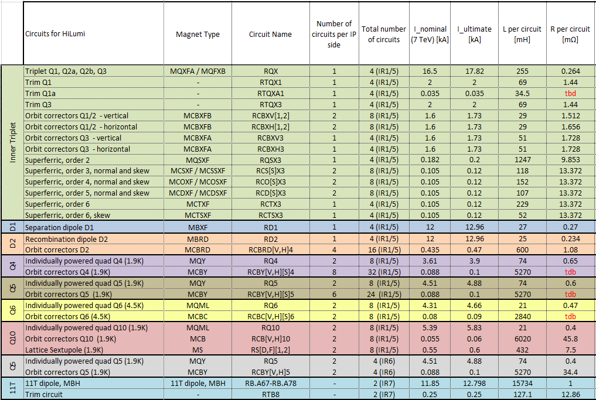
Overview of HL-LHC circuits
HL-LHC circuits (Neglecting types already used in LHC) | Magnet types
Inner triplet (RQX) RCBXV/H High order correctors (RQSX3, RCSX3, RCOX3, RCDX3, RCTX3) (+ skews) RD1 RD2 Orbit correctors D2 (RCBRD [V,H]) Modified RB (RB.A67 – RB.A78) Trim circuit (RTB8) Hollow electron lens (not yet baseline) | MQXF (aka quadrupole) MCBXFA/B (aka Spanish motors) MQSXF, MCSXF, MCOXF, MCDXF, MCTXF (aka high-order correctors) MBXF (aka D1) MBRD (aka D2) MCBRD (aka CCT) MBH (aka 11 T) Solenoids, correctors, CCT
Magnet Circuit Forum circuit table
https://espace.cern.ch/project-HL-LHC-Technical-coordination/MCF/_layouts/15/start.aspx#/Circuits%20Table/
  What are the foreseen protection study needs for 2019?
  Who will work on these various studies?
  Time estimates?

Slide 3
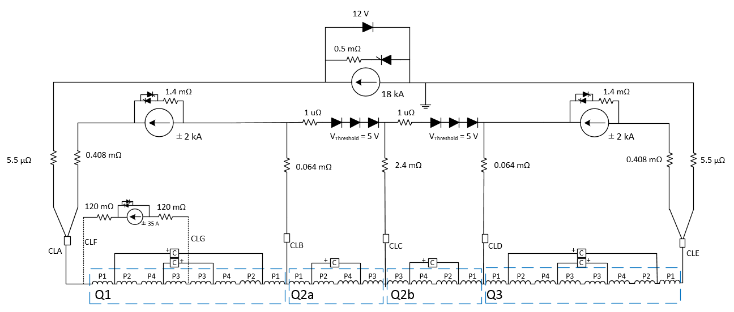
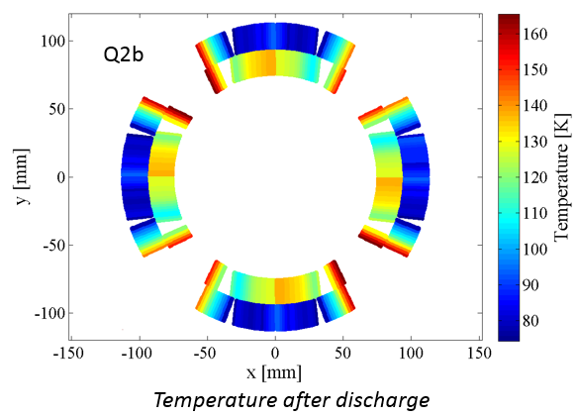
HL-LHC inner triplet RQX
  Circuit protected by CLIQ + QHs
  Already done:
    Validated magnet simulation models: (Emmanuele / Matthias, both LEDET + Comsol)
    Circuit simulations: TALES (Emmanuele), co-sim (Matthias, responsibility transferred to Emmanuele, Oct 2018)
  Challenges / issues: CLIQ/k-mod Feeders (?), superconducting links, cold diodes, quench heater insulation, effect of QHs and CLIQ on beam
  (Proposed) distribution of work:
    Main responsible person: Emmanuele
    Busbars: Matthias

Slide 4
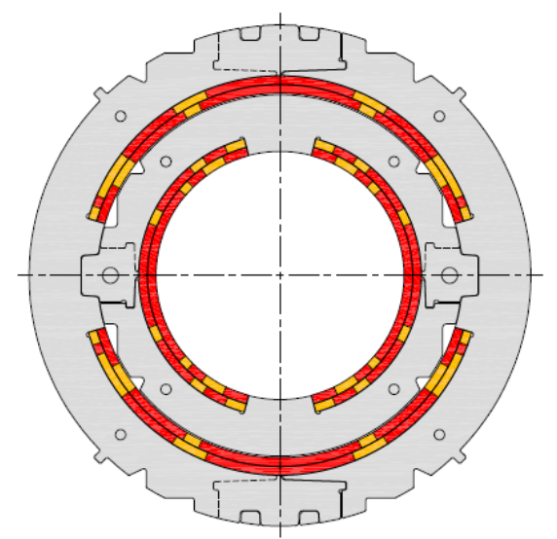
RCBXV/H (aka Spanish motors)
  Circuit protected by energy-extraction, crowbar (?), single magnet per circuit
  Status:
    Roxie simulation model available (Susana), questions on whether magnets are indeed self-protected
  Challenges / issues:
    For the shorter MCBXF magnets, busbar is solely protected by crowbar, even though from CERN perspective crowbar does not guarantee minimum resistance → Energy extraction to be added to baseline for all RCBXV/H circuits?
  (Proposed) distribution of work:
    Magnet study: Susana
    Busbar study: Matthias (in progress)

Slide 5
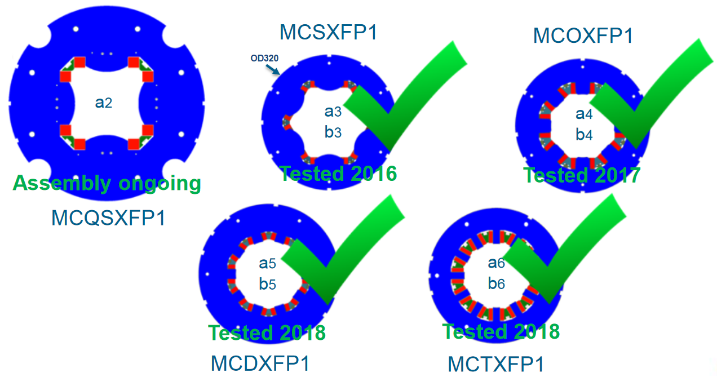
High order correctors
  Circuits self-protected, with exception of MCQSXFP1 (energy extraction), single magnet per circuit
  Status:
    Experimental studies on magnets highly advanced (aka, the quench behavior is already known)
    Validated QLASA simulation models done by INFN are available (Matthias)
  Challenges / issues:
    For the most part, these circuits are to be self-protected, requiring cryo-stable busbars (ordinarily discharge with crowbars)
  Proposed distribution of work:
    Magnet side: Michal W (Useful for developing Ansys 3D quench, given that experimental data is already available + INFN collaboration (Marco Prioli))
    Busbars: Matthias

Slide 6
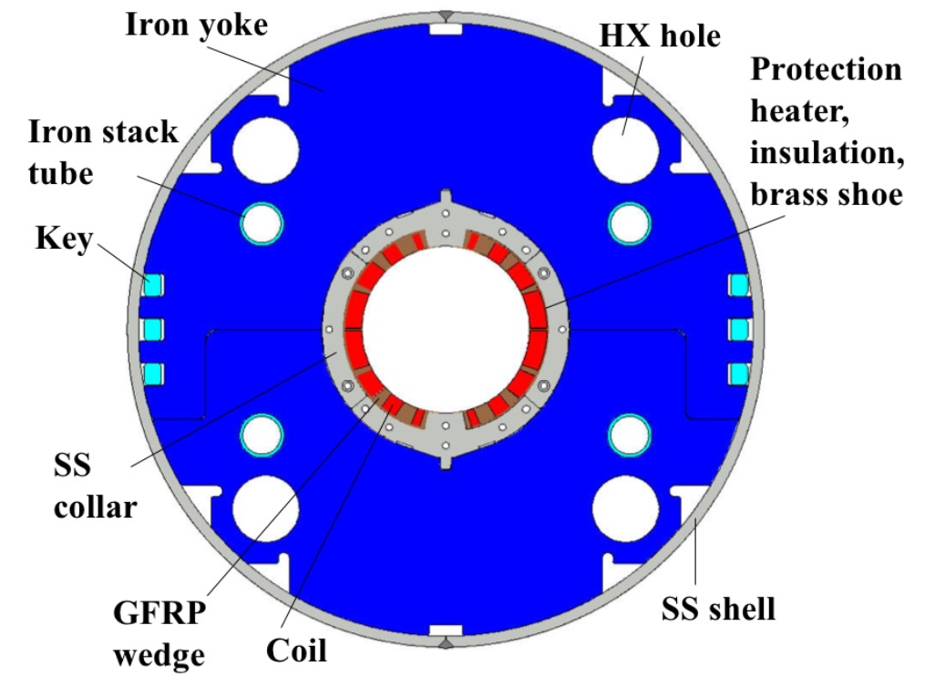
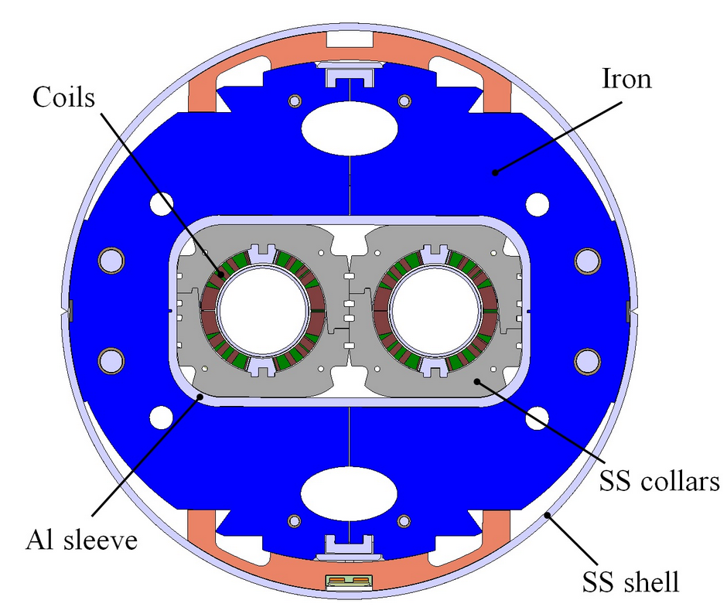
RD1 (aka D1) + RD2 (aka D2)
MBXF (D1)
MBRD (D2)
  RD1 and RD2 circuits, with a single magnet per circuit, protected by QHs on magnet
  (Proposed) distribution of work:
    Magnet side: Susana
    Busbars: Matthias
  These circuits seem to be in fairly good shape

Slide 7
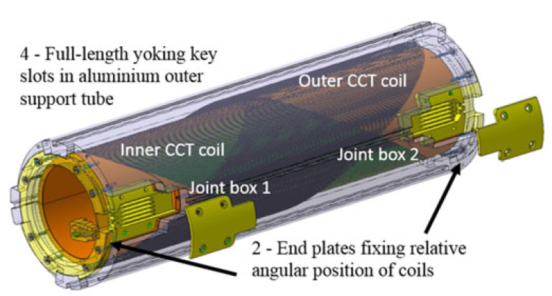
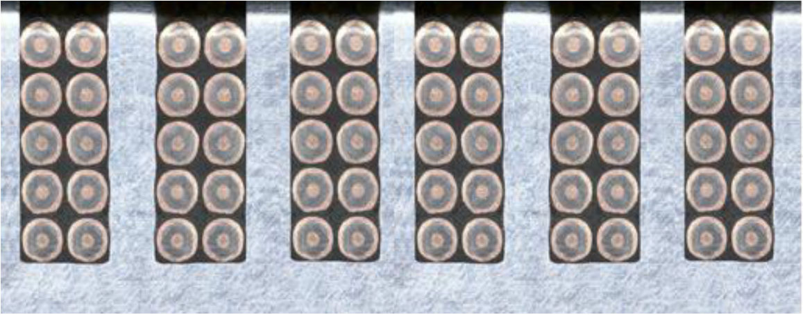
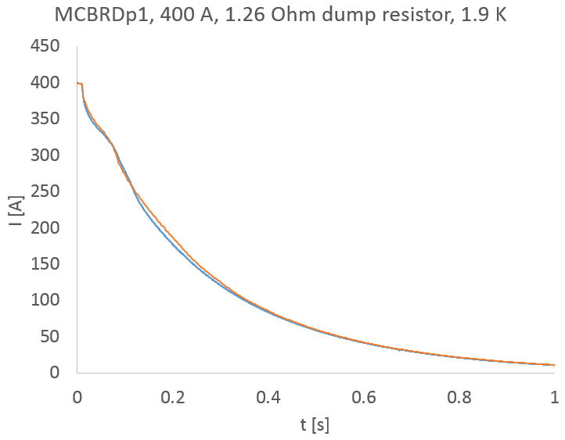
D2 orbit correctors (MCBRD CCT)
Coil cross-section
Insulated NbTi/Cu strand
Former
(aluminum alloy)
  Circuits (single magnet per circuit) protected by energy extraction + quench back in formers + current transformation to formers
  Status: Complex physics for relatively novel type of magnet, but experimental results are available (validation with respect to experimental data on-going)
  Multiple additional CCT magnet designs are underway
  (Proposed) distribution of work, magnet + busbar: Matthias
Meas vs Sim

Slide 8
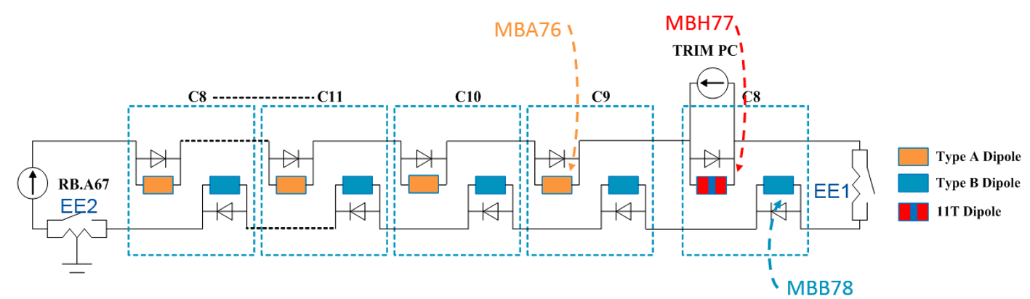
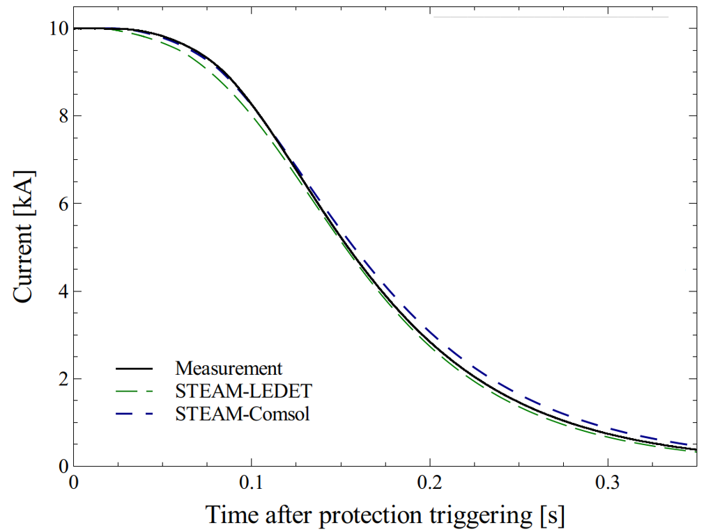
Modified RB
Modified RB circuit
  Circuits protected by QHs + EE
  Already done:
    Validated magnet simulation models available, both LEDET and Comsol (Matthias + Emmanuele)
    Circuit co-simulation (Michal), previous investigation of trim circuit (Matthias, transfer of responsibility in 2018)
  Issues / challenges:
    Quench heater insulation revised (revision of simulations?)
  (Proposed) distribution of work:
    Main responsible person: Michal
Simulation versus experimental observations on MBHDP102

Slide 9
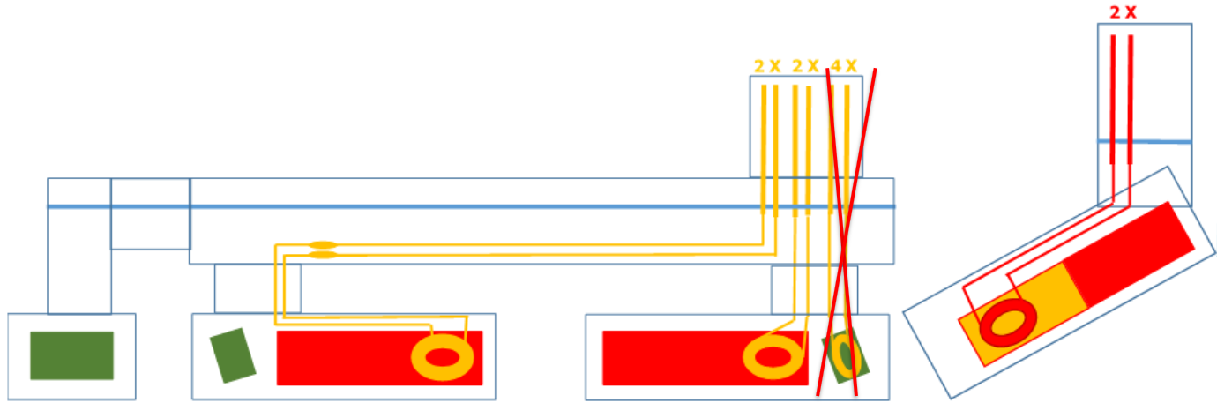
Hollow electron lens (currently not in the HL-LHC baseline)
CCT
Solenoids
Correctors
  Many different circuits + magnets, but single conductor type, protected by EE and crowbars
  Status:
    Previous work: Similar solenoid type modeled in QLASA (Edvard), Quench 2.7 (Matthias), but no validation
    Many magnets, some of which are (presumably) finalized
    Other components (busbars, current leads, etcetera) to be determined
  (Proposed) distribution of work:
    Light-weight conceptual study by Michal (tau = L/R, QL → T_{max}) where some circuits are solely protected by (not inherently reliable) crowbars and resulting risk to superconducting components is accepted

