Slide 1
WLCG Status Report
CERN-RRB-2019-054
Ian Bird
Computing RRB
CERN, 16th April 2019

Slide 2
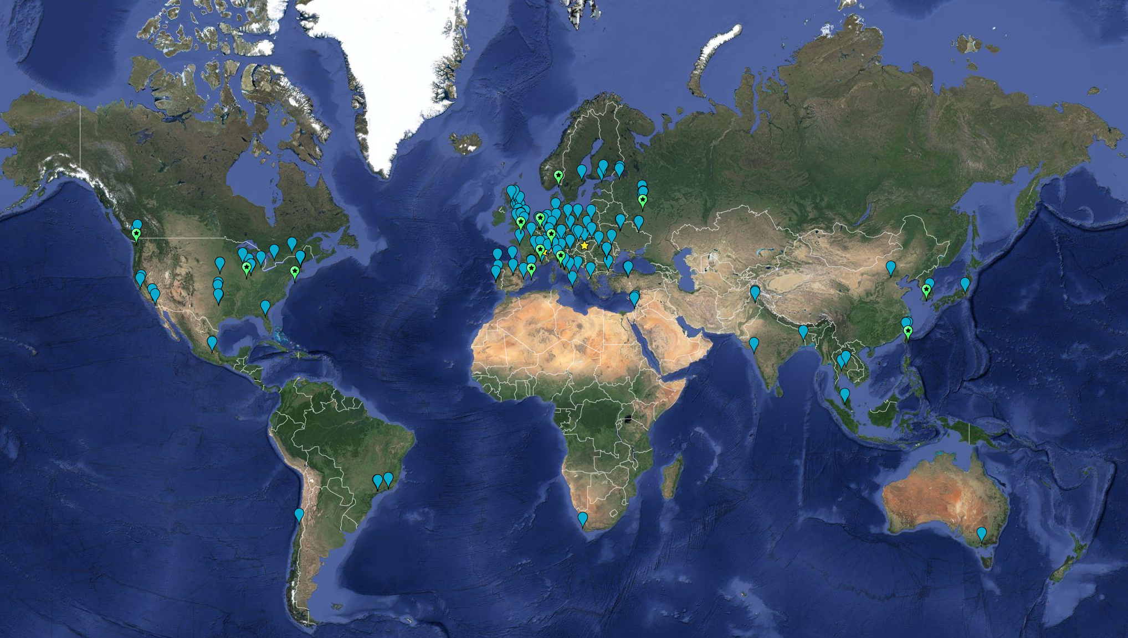
WLCG Collaboration
April 2019:
63 MoU’s
167 sites; 42 countries

Slide 3
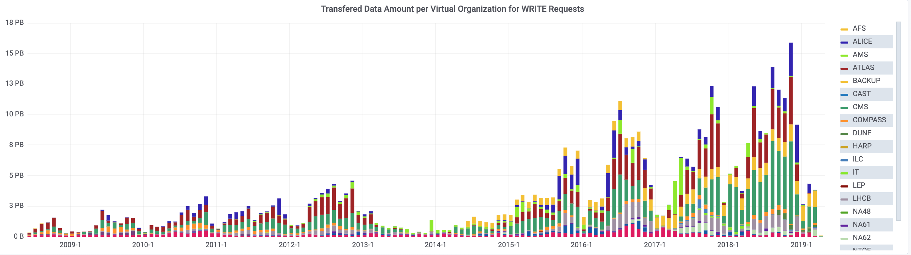
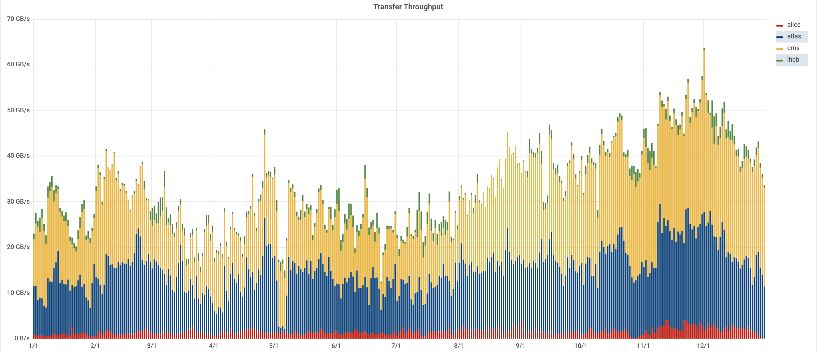
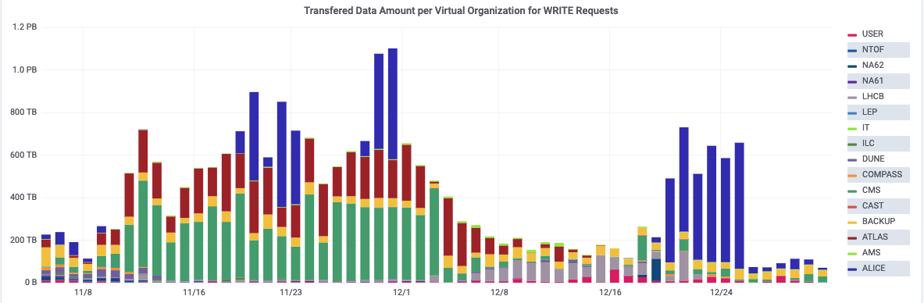
Data - 2018
2018: 88 PB
ATLAS: 24.7
CMS: 43.6
LHCb: 7.3
ALICE: 12.4
14 PB in August
inc. parked b-physics data
Data transfers
2018: 19.8 PB
ATLAS: 5.2
CMS: 7.7
LHCb: 1.2
ALICE: 5.7
HI Run
HI Run
18.6 PB in November

Slide 4
CPU Delivered
2018 pledges
New peak: ~270 M HS06-days/month
~ 860 k cores continuous

Slide 5
2019 Pledge situation – no change
2019 pledges wrt requests:
As given in REBUS

Slide 6
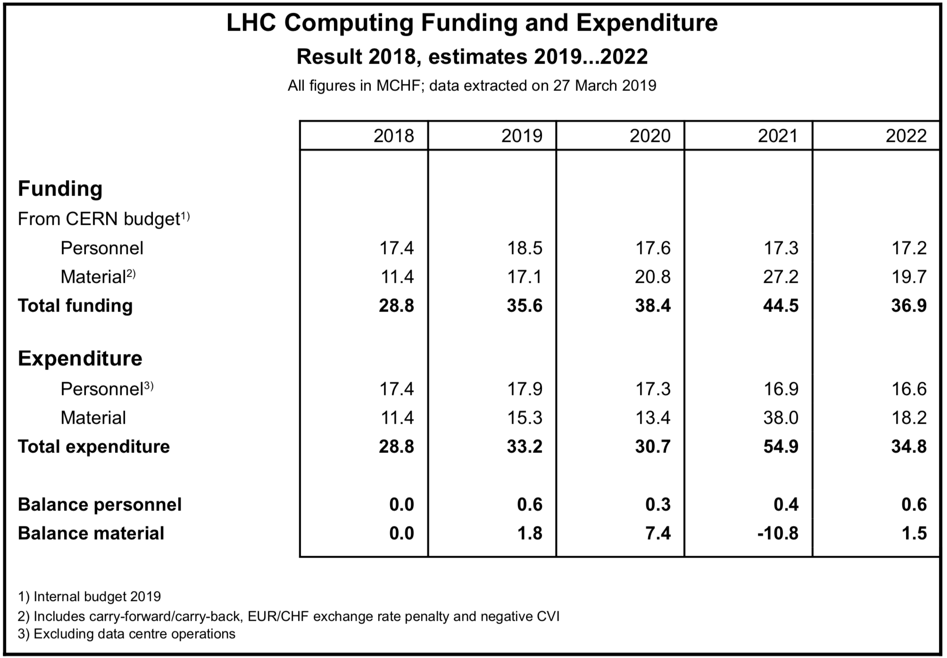
WLCG Funding & Expenditure
Personnel: balanced situation
Materials planning based on currently understood parameters:
CERN plan for 2019,20 is minimal purchases –
2021 assumes 1.3 x 2018 (partial year)
2022 assumes 1.5 x 2018
Cost extrapolations updated based on recent experience;
Large uncertainties and variations
Savings in LS2 have been re-profiled – overall balance for ramp up to Run 3 now OK
Assumptions on Run 3 running conditions have not changed – still many uncertainties

Slide 7
Tier 0 updates
The Wigner contract will end at the end of 2019
  Currently moving (some) equipment back to CERN – will keep operating during LS2
The Tier 0 is using spare container capacity originally purchased for LHCb
  This will provide the needed contingency during Run 3, but longer term will not be available

Slide 8
Longer term planning

Slide 9
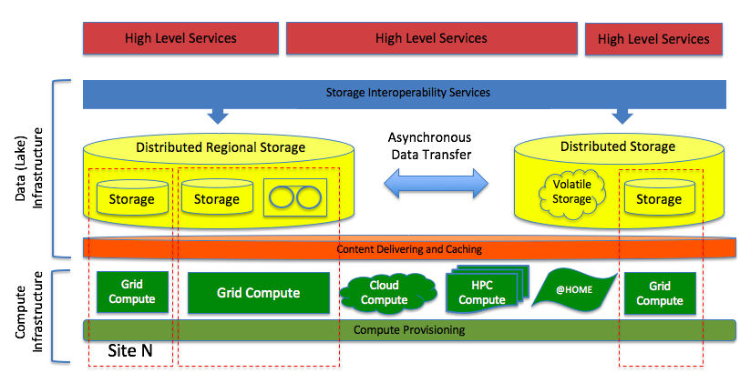
Workshop in JLAB in March
  WLCG, HSF, OSG
Collaborative discussions on long-term computing challenges
Focused around the CWP and WLCG strategy actions – all aspects, also including input from other HEP (& related) experiments
https://indico.cern.ch/event/759388

Slide 10
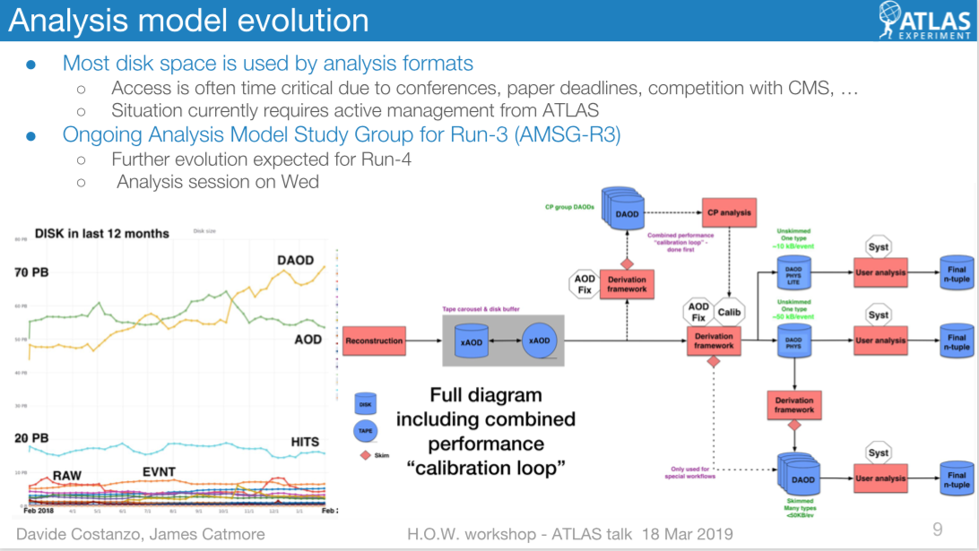
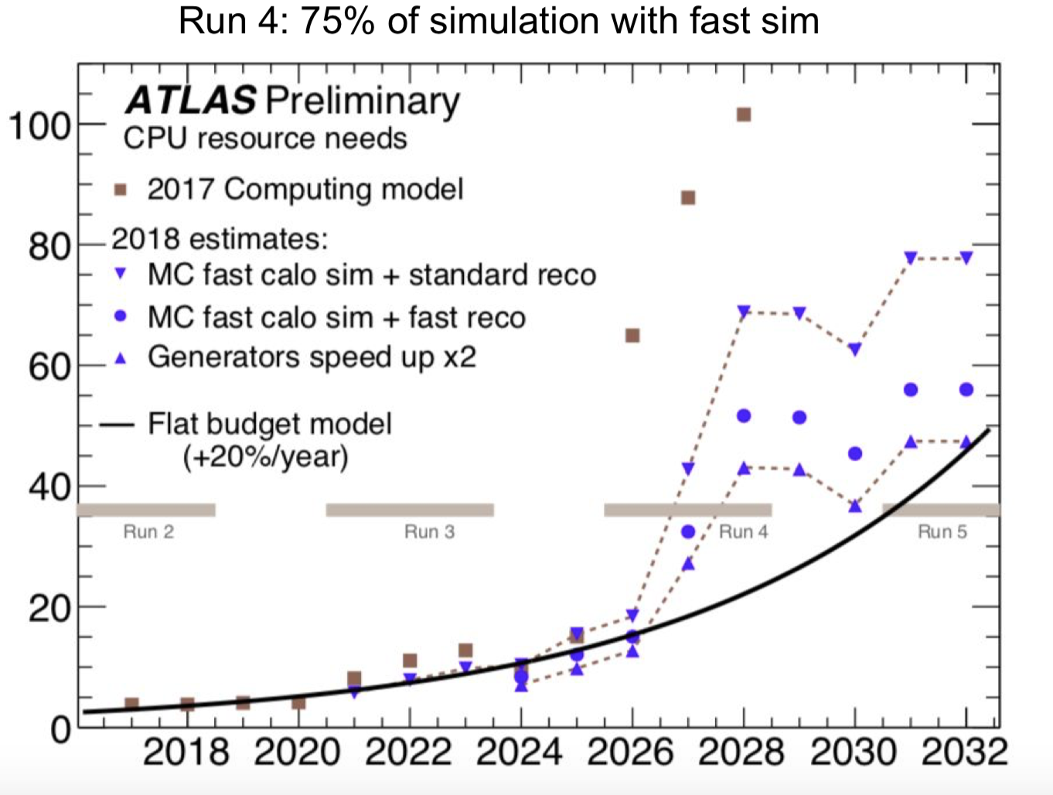
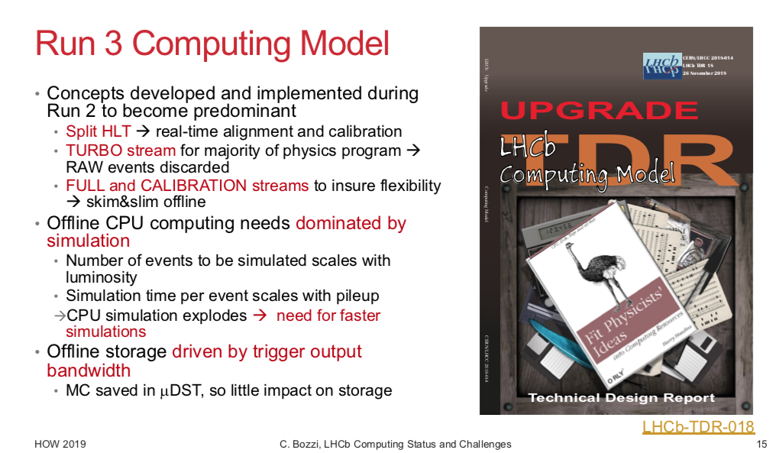
Run 4 Requirements
Lots of work in the experiments to manage the requirements for HL-LHC, significant improvements in the estimates

Slide 11
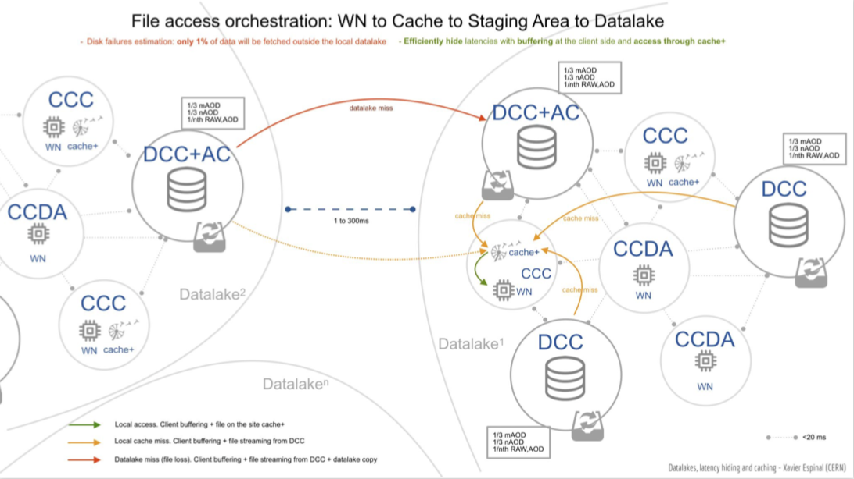
R&D projects - DOMA
Data Organisation, Management, Access
  3 groups – Access, 3rd party copy, QoS
  Investigates new workflows, e.g. based on tape carousel
  R&D to optimize data movements in data lake environment
  Supporting common DM solutions, e.g. Rucio etc
Access – propose a strawman model for content delivery system for distributed analysis
  Locality of processing not guaranteed
  Components identified – prototyping starting to show effect of network latency
3rd party copy – commissioning alternatives to gridFTP
  xroot and http/WebDAV as main alternatives
  Prototyping token-based authentication for
  storage solutions – we expect to replace X509
  infra with modern solutions such as OAuth2
  and federated identities – long term
  supportability
QoS – define solutions to optimize cost of
storage hardware –
  Define storage classes based on use cases
  DM systems can then optimize between
  performance, reliability, cost

Slide 12
DOMA – 2
Rucio now seems like a real potential common high-level DM tool
  ATLAS+CMS, DUNE, SKA are interested, will be part of ESCAPE prototype
Want to initiate discussions with national efforts to understand how they see storage evolving over the next 5 years
  How will archive storage look, how much consolidation and/or federation will there be, etc?
  Storage costs stagnating – potential to lost “cheap” tapes, future models may be very different
  All goes in the direction of needing a storage lake that serves data (streaming, caching, etc), rather than data distribution and management to expensive storage systems
Networking activity
  At protocol level, SDN, bandwidth on demand, etc.
  Together with SKA w.g.
WG on storage archiving
  Ongoing work
    ATLAS testing on tape carousels
    Investigations of xcache – proposing test deployments

Slide 13
Software-related aspects
The software challenges are key to addressing the current mismatch between requirements and affordability (given expected technology)
New working groups are active:
  Data analysis
  Detector simulation
  Reconstruction and software triggers
Physics event generator workshop was held in November
  Brought together generator community, experiments, programming experts
  Focused on long term needs of software and performance optimization
    Need to make NNLO and N3LO calculations feasible
  Set up and active HSF working group
ATLAS software is now open (Apache2); CMS software also licensed as Apache2 – was already open

Slide 14
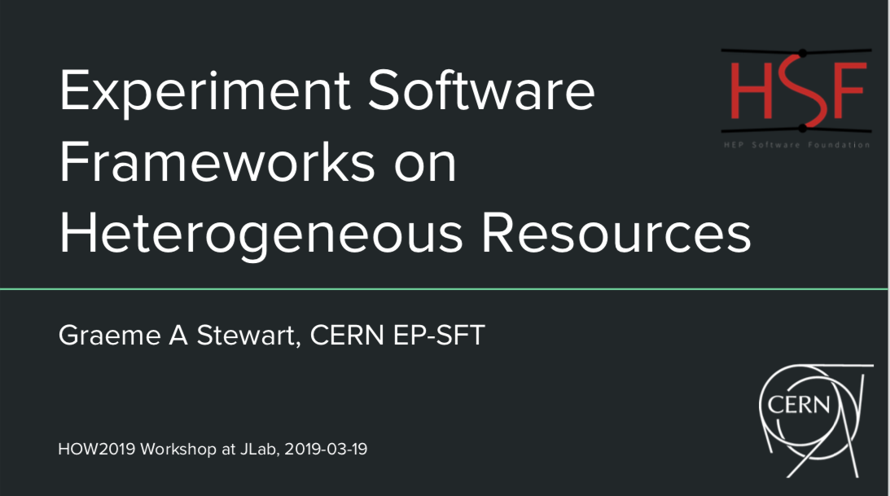
Heterogenous computing
Work invested in enabling straightforward access to new types of resource:
  HPC
  Clouds (inc. access to GPU and FPGA etc)
Recognition of the need to enable opportunistic use of (non-local) resources of many non-traditional types
  This is natural in a data-lake model (+ the need to make the software portable)
  Efficient remote delivery of data is essential
  Use of certain resource types for specific
  (suited) activities

Slide 15

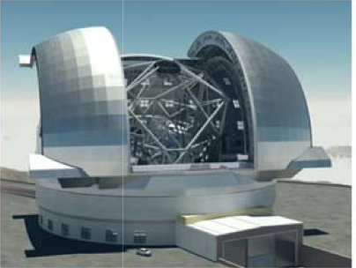
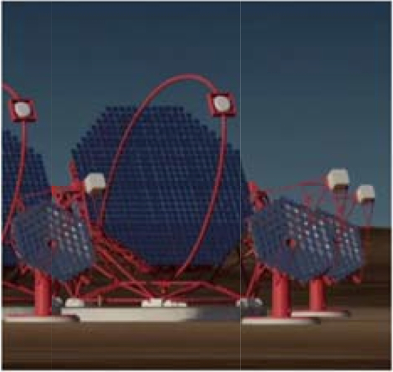
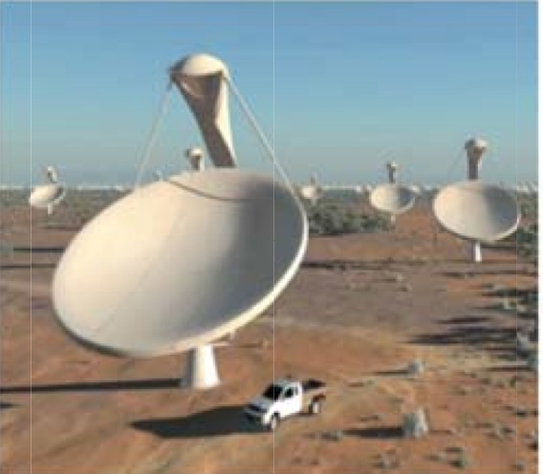
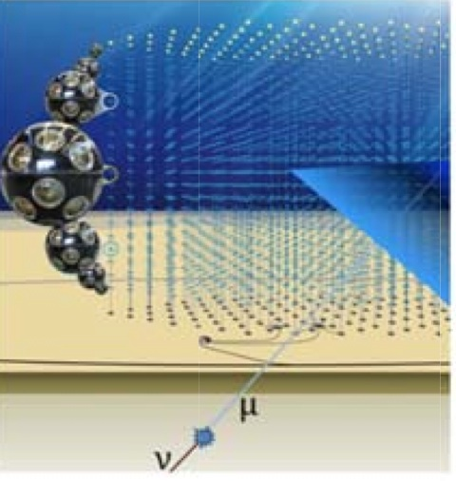
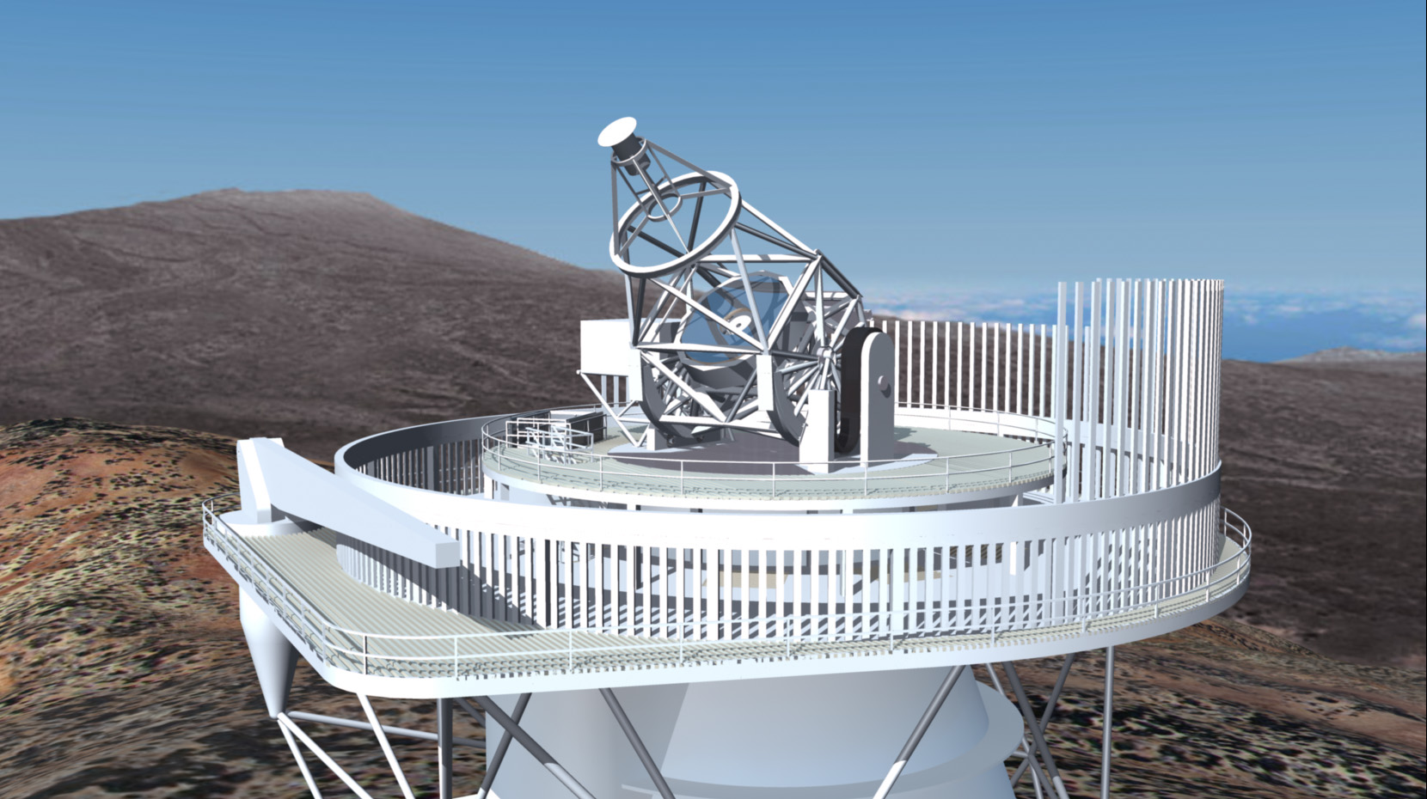
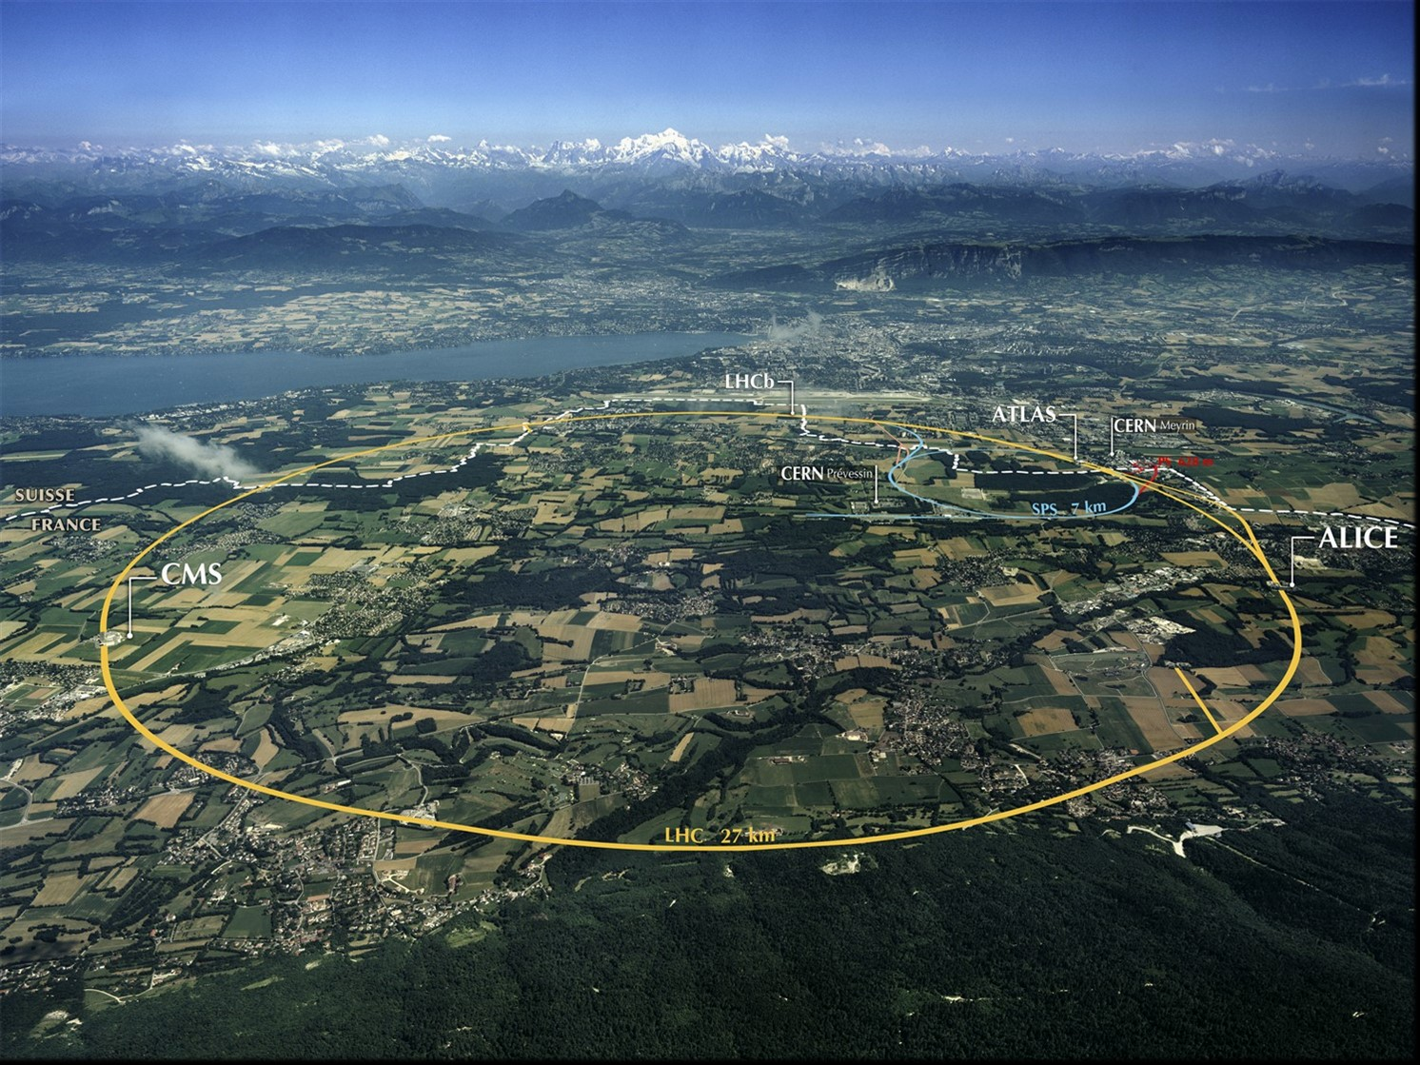
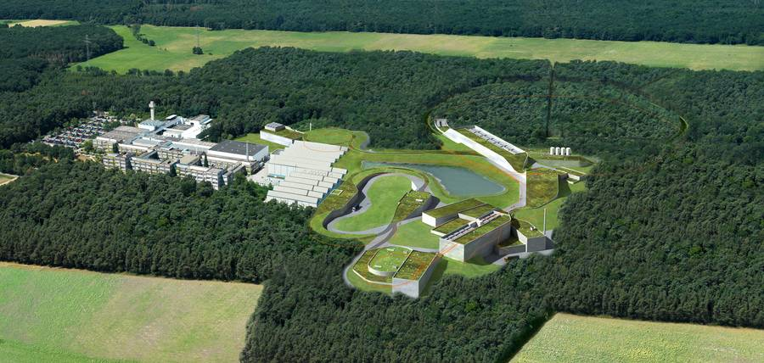
ESFRI Science Projects
HL-LHC SKA
FAIR CTA
KM3Net JIVE-ERIC
ELT EST
EURO-VO EGO-VIRGO
(LSST) (CERN,ESO)
Goals:
Prototype an infrastructure for the EOSC that is adapted to the Exabyte-scale needs of the large ESFRI science projects.
Ensure that the science communities drive the development of the EOSC.
Has to address FAIR data management, long term preservation, open access, open science, and contribute to the EOSC catalogue of services.
Work Packages
WP2 – Data Infrastructure for Open Science
WP3 – Open-source scientific Software and Service Repository
WP4 – Connecting ESFRI projects to EOSC through VO framework
WP5 – ESFRI Science Analysis Platform
Data centres (funded in WP2)
CERN, INFN, DESY, GSI, Nikhef, SURFSara, RUG, CCIN2P3, PIC, LAPP, INAF

Slide 16
Cost evolution – new concerns
Concern raised by several countries – looking at planning for next years
  The “20%” per year capacity improvement/[€$￡] does not seem realistic
Ongoing investigations – Cost Model working group looking at real costs where possible and trends
  Until now the outlook has been based on CERN figures tracked over last 20 years
  We have remarked that “Moore’s law” is no longer a reality
    But indications are that actual cost trends in several countries are significantly different from that of CERN
In addition, the dominating factors are market drivers, not technology
We enter a regime of unpredictable pricing, availability and evolution
  Forecasting costs over 5-10 years is not possible. We will have to update the outlook ~yearly
  “Flat budget” does not help understand what capacity may be available!

Slide 17
The WLCG Cost and Performance Modeling working group received numbers from several Tier 1 sites and the they show a similar picture:
- 20% is too optimistic
- The large variance points to strong site dependencies
Proposal for the future assumptions of cost improvements:
~10 % for CPUs
~15 % for disk space
~20 % for tape space (stays the same as before), BUT the future of tape per se is problematic !
There are strong tendencies in the computing models to ‘replace’ disk space with tape
Unfortunately this will be country/region/policy dependent & likely to change often

Slide 18
Conclusions
The 2018 pp run has been very smooth and productive, record levels of data acquired
  HI run will be a further step in performance
Planning for Run 3 and Run 4 is ongoing
  Still uncertainties in Run 3 needs and costs
  Longer term strategies set out
  R&D working groups are organized and active
Very concerned over outlook for costs and “flat budget” assumptions
  Costs are not only technology driven any longer

