Slide 1
LHC ENERGY AFTER LS2:
UPDATE AFTER 2018 TRAINING
OF SECTOR 12
CERN, 6th March 2019
LMC
E. Todesco, on behalf of Quench Behaviour Team
Based on HC results, steered by MP3 team www.cern.ch/mp3
Presentation on training data given by M. Pojer at LMC on December 2018 https://indico.cern.ch/event/780656/
with comments from F. Bordry, M. Jimenez, V. Mertens from accelerator sector
with comments from B. Petersen, J. Boyd and C. Schwick from experiments

Slide 2
SUMMARY
Prologue: the 600 quenches estimate
  Spread: three batches
  Distribution of quenches
  The fit of HC data
  Known unknowns of the estimate
New elements from training 12
  Recall of 12 history and composition
  The 1000 series behaviour
  The 2000 series behaviour
Training the LHC

Slide 3
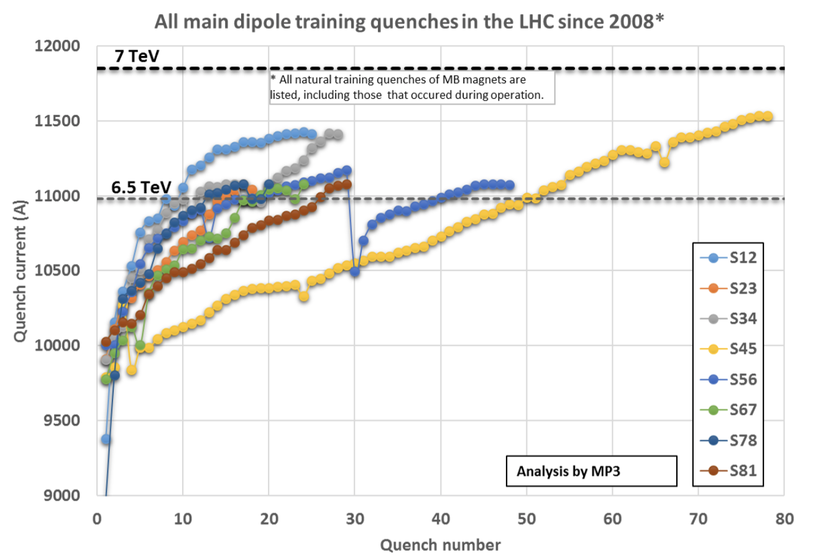
PROLOGUE
8 sectors reached 6.5 TeV with about 170 quenches
  3 sectors reached about 6.75 TeV with 50 more quenches
  Large difference in behaviour between different sectors
  I shall present the efforts to find some order in this chaotic plot

Slide 4
PHENOMENOLOGY FROM 2015-2017
3000 series dominates training (81% of quenches)
  A part of the production is quenching much more
  (« 3000 series slow ») and also has second quenches
    Points: quenches in 2015-2017
    Line: max current reached in 2015-2017
    Triangles: second quenches
3000 series fast
3000 series fast
3000 series slow
3000 series slow

Slide 5
PHENOMENOLOGY FROM 2015-2017
2000 series contributes to 16% of training
  Only the first part of the production is quenching
  No second quenches
    Points: quenches in 2015-2016 – Line: max current reached in 2015-2017
2000 series fast
2000 series slow

Slide 6
PHENOMENOLOGY
1000 series contributes to about 3% of training
  Very rare quanches here and there (5 out of 400 to go to 6.5 TeV)
  No second quenches
    Points: quenches in 2015-2016 – Line: max current reached in 2015-2017

Slide 7
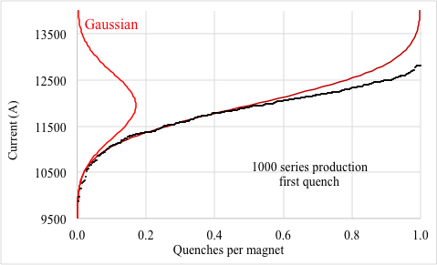
FIT RECALL
Training curves were found to be compatible with a Gaussian tail for low value of currents
  But the Gaussian is clearly unphysical and does not fit so well at large values of current

Slide 8
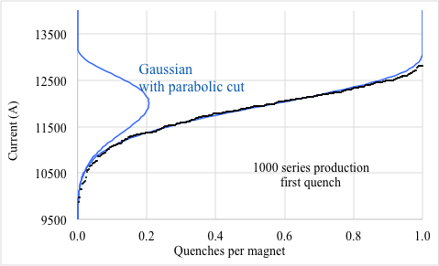
FIT RECALL
Quench distribution was fit with a Gaussian times a parabola
  P(x) = (x-μ)² exp [(x-μ)²/2σ] for x smaller than μ
  This fits well the set of data of SM18

Slide 9
FIT OF THE 3000 SERIES – SLOW PART
We then add the statistical error due to the finite size batch
Slow batch 3126-3300, 3376-3416 (total 215 magnets)
  1st quench
Trained>6.5 TeV
?

Slide 10
FIT OF THE 3000 SERIES – FAST PART
Fast batch 3000-3125, 3301-3375 (total 197 magnets)
  1st quench
?
Trained>6.5 TeV

Slide 11
FIT OF THE 2000 SERIES
Slow batch 2000-2200 (total 200 magnets)
  1st quench
Trained>6.5 TeV
?

Slide 12
FIT OF THE 3000 SERIES SLOW PART
SECOND QUENCH
Slow batch 3126-3300, 3376-3416 (total 215 magnets)
  2nd quench
Trained>6.5 TeV
?

Slide 13
FINAL ESTIMATE: UNKNOWNS
The estimate has some unknowns:
  No fit available for half of the magnet (the whole 1000 series and the second half of the 2000 series) since there are not enough quenches – we assumed 10% probability of quenching to 7 TeV
  The total or partial loss of memory after warm-up – we assumed total loss
  The position of the second quench – we assumed no second quench except for the slow part of 3000 series
  The lack of HC data above 6.75 TeV (no magnets were trained above this value in the LHC tunnel after installation – but all individually)
We go through these unknowns one by one

Slide 14
FINAL ESTIMATE: UNKNOWNS
Assumption on unknown parts of the production (all the 1000 series and half of 2000 series): 10% of the magnet will quench to reach 7 TeV
  An assumption based on the fact that only 7 out of 600 magnets quenched to 6.5 TeV (1%)

Slide 15
FINAL ESTIMATE: UNKNOWNS
Pessimitic side: we assume a total loss of memory after LS2
  This means that the 200 quenches done after LS1 are lost
  Otherwise from 600 we would go to 400 quenches
  Experience from part ten years
    For the only sector with relevant statistics (56) partial memory is observed (about 30% less quenches in second powering)
  In case of a total preservation of memory we would save 200 quenches – but we can say that this is excluded
    In the best case I can imagine we could save about 100 quenches

Slide 16
FINAL ESTIMATE: UNKNOWNS
Optimistic side: we assume that second quench is negligible for all batches except the 3000 slow
  Based on the observation that second quench
  enters the picture around the peak of the first quench

Slide 17
SUMMARY
Prologue: the 600 quenches estimate
  Spread: three batches
  Distribution of quenches
  The fit of HC data
  Known unknowns of the estimate
New elements from 12 training
  Recall of 12 history and composition
  The 1000 behaviour
  The 2000 behaviour
Training the LHC

Slide 18
SECTOR 12 TRAINING IN 2018
Sector 12 is a very special sector
  95 magnets of 2000 series (the fast ones, all after magnet 2200)
  50 magnets of 1000 series (many from the last part of the production)
  Very few (9) of the 3000 series
  Results were presented by M. Solfaroli, A. Verwej, M. Pojer in LMC, 5th December 2018
Unfortunately, we reached only 11.413 kA after 15 quenches
  Bad surprise: 15% of the 1000 magnets quenched for going from 11.080 A to 11.413 kA
    … and we assumed 10% to reach 12 kA, i.e. to make three times more
  But also a good suprise: the 2000 series
Training 12 above 6.5 TeV: first (and second) quenches
(M. Pojer for MP3)

Slide 19
RESULTS
Detail of 1000 series
  Abundance of quenches above 11.2 kA in the magnet after 1350
  The range above 11.2 kA was already well explored for the 1180-1230 magnets and partially sampled for 1050-1180
    In both cases we saw negligible quenches

Slide 20
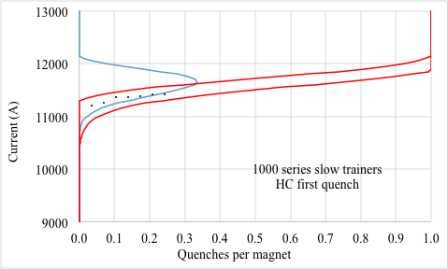
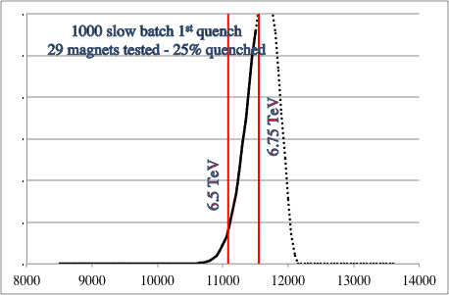
1000 SERIES
Slow batch 1350-1416 (total 66 magnets)
  This ditribution is terribly peaked (much smaller sigma) but the total number of the magnets of the batch is small
  The second quench could arrive well before 7 TeV
  But the set is small

Slide 21
2000 SERIES
Good suprise from 2000 series
  Sector 12 had 95 magnets from the second half of the 2000 series – only 2 quenches
    Points: quenches in 2015-2016 – Line: max current reached in 2015-20126
Data before December 2018
Data after December 2018

Slide 22
SUMMARY
Prologue: the 600 quenches estimate
  Spread: three batches
  Distribution of quenches
  The fit of HC data
  Known unknowns of the estimate
New elements from training 12
  Recall of 12 history and composition
  The 1000 behaviour
  The 2000 behaviour
Training the LHC

Slide 23
UPDATED ESTIMATE
Quench estimate to 7 TeV
560 ±50 ⁺⁰₋₁₀₀ +70 + ?
1000 slow batch
seen in 12.2018
Statistical error
Presented in 2018
and used in LS2 schedule
Memory
What is not yet seen

Slide 24
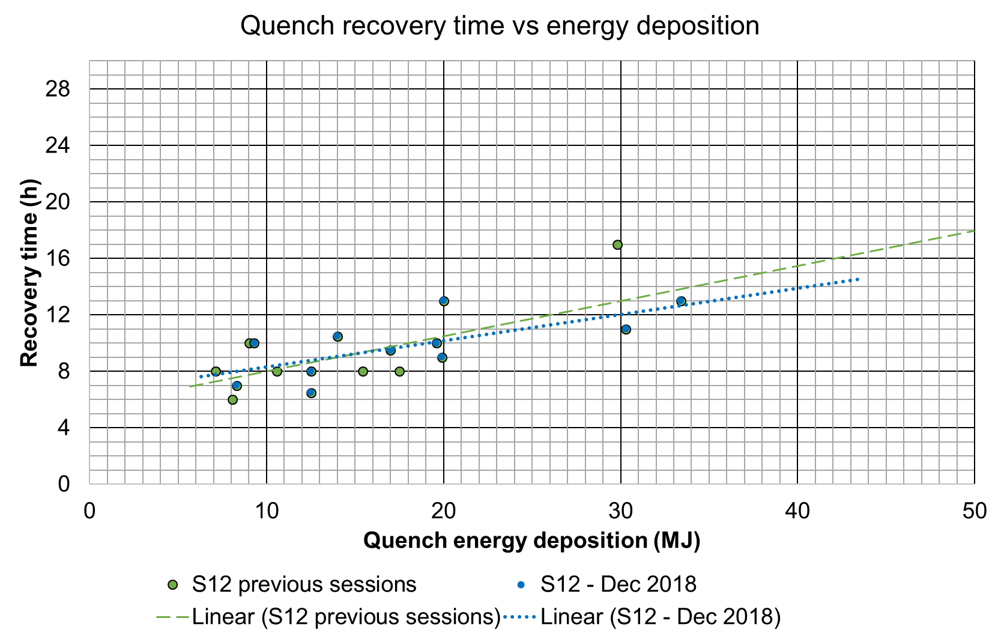
RECOVERY TIME AND TRAINING RATE
Typical recovery time of 8 hours confirmed
  Events with large energy deposition that happened in the past avoided
  Large, effective effort of MP3 to reduce number of secondary quenches
MP3 confirms the possibility of 3 quenches per day as a maximum rate, with 2 quenches /day as a rate that can be kept over several weeks
MP3 confirms the possibility of training numerous sectors in parallel (in principle up to 8)
Recovery time in training 34 and 45 above 6.5 TeV
(G. Ferlin et al.)
Recovery time in training 12 above 6.5 TeV in 2018
(G. Ferlin et al.)

Slide 25
SOME CONSIDERATIONS
No showstoppers are visible from hardware point of view to 7 TeV
  It could take more than 600 quenches, if phenomena as the 1000 series batch discovered in December would extend to other magnets
The LS2 schedule assumes 2 quenches/day, with the table of slide 12
  No margin for additional quenches
    With the training data of december 2018, order of 70 quenches should be added
  Many sector shall run in parallel
The main drawback is the risk associated to repetitive quenching
  We already did it 200 times – creating two diode shorts, both burned with bold but effective action
  We are consolidating all the diodes to solve this problem

Slide 26
SOME CONSIDERATIONS
About the MonteCarlo:
  Do we run into trouble if MonteCarlo is run at 7 TeV and we finally get only at 7-eps?
  Can we step back at 6.5 TeV and reuse the RunII MonteCarlo
(from B. Petersen)
(…), new MC needs to be generated by all experiments for Run-3 no matter what the choice of energy is. This is why the experiments would like to know the baseline energy for 2021, so they can start generated MC already next year.
If the energy reach turns out to be lower than expected in 2021, the experiments will eventually have to regenerate the MC samples, but they often do this anyway. It also doesn't mean the data can't be analyzed, just that it will take a bit more time to complete full studies.
I would therefore not take this as an argument to be overly conservative in the energy target for 2021.

Slide 27
SOME CONSIDERATIONS
Plan A: keep 7 TeV as a target
  Possible, but a margin of ~ 2 months should be considered
Plan B:
  Make all the possible training of LHC at the end of LS2 with the allocated time, to get more experience and data in the 6.5-7 TeV range
  Run at 6.5 TeV in 2021
  Finish the training in winter 2021-22 and go for 7 TeV in 2022

