Slide 1
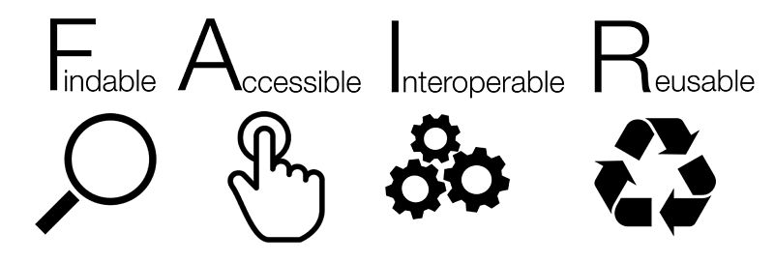


Accelerating Biomedical Research with an Emerging Internet of FAIR Data and Services
Michel Dumontier, Ph.D.
Distinguished Professor of Data Science
Director, Institute of Data Science

Slide 2
An increasing number of discoveries are using already available data

Slide 3
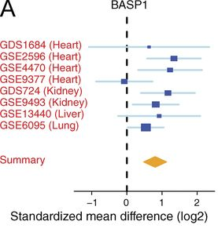
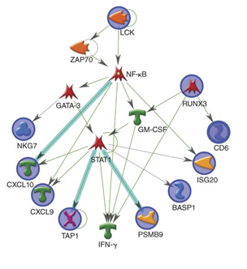

A common rejection module (CRM) for acute rejection across multiple organs identifies novel therapeutics for organ transplantation
Khatri et al. JEM. 210 (11): 2205
DOI: 10.1084/jem.20122709
Main Findings:
CRM genes predicted future injury to a graft
Mice treated with drugs against the CRM genes extended graft survival
Retrospective EHR analysis supports treatment prediction
Key Observations:
1. Meta-analysis offers a more reliable estimate of the magnitude of the effect
2. Data can be used to generate and support/dispute new hypotheses
Notes:
Abstract
Using meta-analysis of eight independent transplant datasets (236 graft biopsy samples) from four organs, we identified a common rejection module (CRM) consisting of 11 genes that were significantly overexpressed in acute rejection (AR) across all transplanted organs. The CRM genes could diagnose AR with high specificity and sensitivity in three additional independent cohorts (794 samples). In another two independent cohorts (151 renal transplant biopsies), the CRM genes correlated with the extent of graft injury and predicted future injury to a graft using protocol biopsies. Inferred drug mechanisms from the literature suggested that two FDA-approved drugs (atorvastatin and dasatinib), approved for nontransplant indications, could regulate specific CRM genes and reduce the number of graft-infiltrating cells during AR. We treated mice with HLA-mismatched mouse cardiac transplant with atorvastatin and dasatinib and showed reduction of the CRM genes, significant reduction of graft-infiltrating cells, and extended graft survival. We further validated the beneficial effect of atorvastatin on graft survival by retrospective analysis of electronic medical records of a single-center cohort of 2,515 renal transplant patients followed for up to 22 yr. In conclusion, we identified a CRM in transplantation that provides new opportunities for diagnosis, drug repositioning, and rational drug design.

Slide 4
However, significant effort is still needed to find the right dataset(s), make sense of them, and use for a new purpose

Slide 5
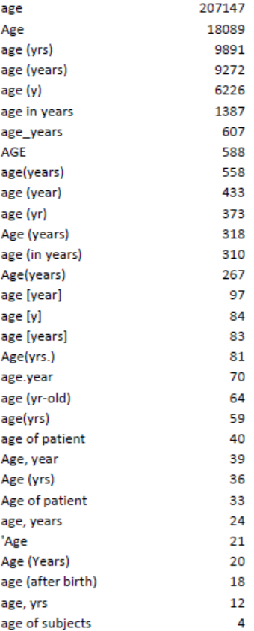
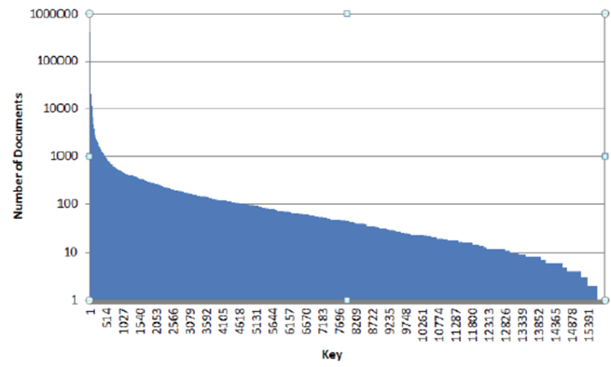
Poor quality experimental metadata frustrates reuse
Vast number of lexically unique keys (and values)

Slide 6
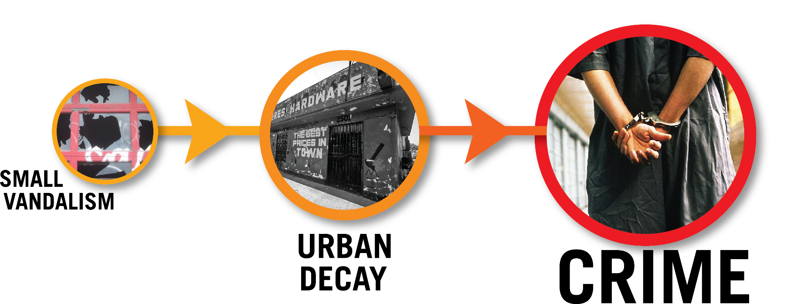



Broken windows theory
visible signs of crime, anti-social behavior, and civil disorder create an urban environment that encourages further crime and disorder, including serious crimes
Inadequate reusability theory
Poor quality metadata and the inaccessibility of original research data, make it less likely to reproduce original work, resulting in an ineffective translation of research into useful applications
Poor quality
metadata
Reproducibility
Crisis
Translational Failure

Slide 7
Our ability to reproduce landmark studies is abysmally low:
39% (39/100) in psychology¹
21% (14/67) in pharmacology²
11% (6/53) in cancer³
¹doi:10.1038/nature.2015.17433 ²doi:10.1038/nrd3439-c1 ³doi:10.1038/483531a
Most published research findings are false.
- John Ioannidis, Stanford University
PLoS Med 2005;2(8): e124.

Slide 8
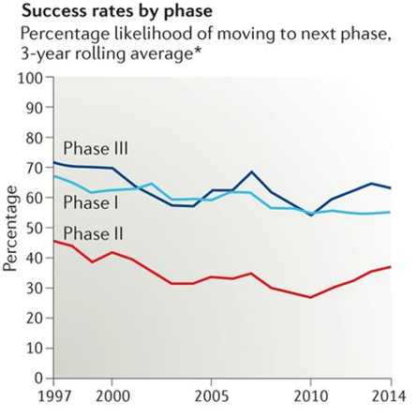
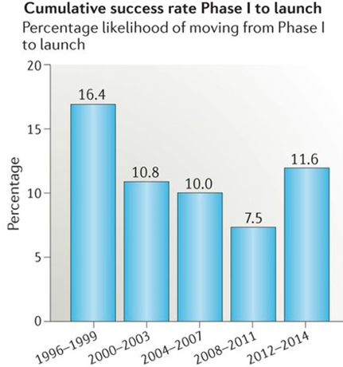
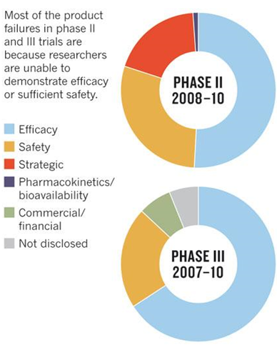

Slide 9
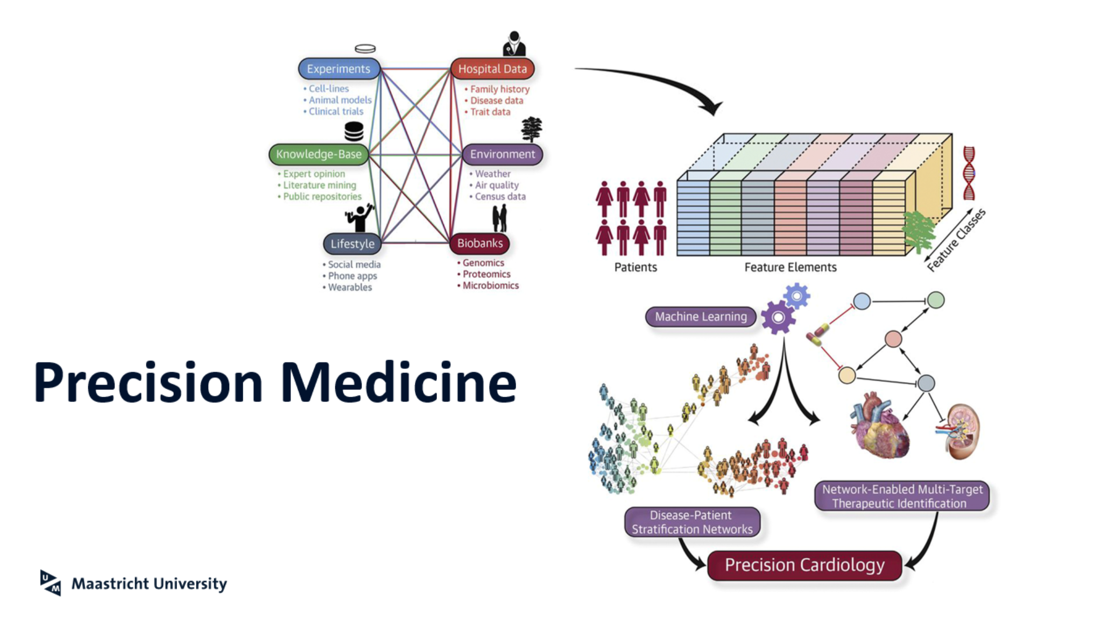

What hope do we really have to realize
?

Slide 10
It’s time to completely rethink how we perform
biomedical research

Slide 11
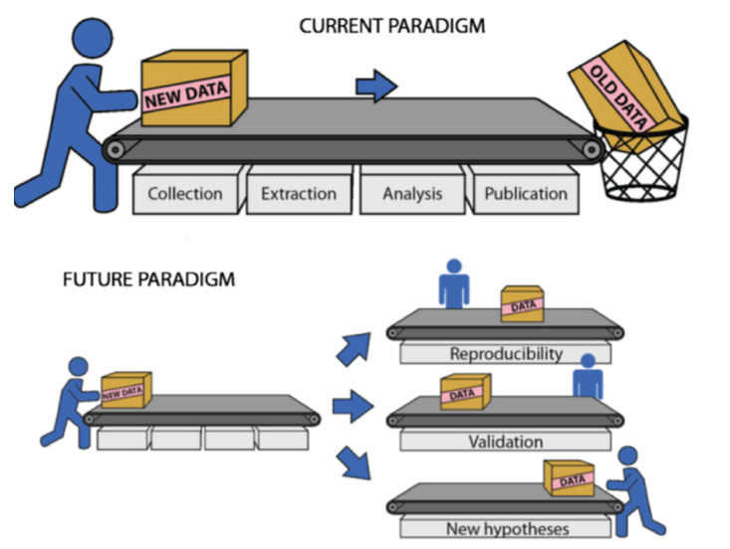
Lambin et al. Radiother Oncol. 2013. 109(1):159-64. doi: 10.1016/j.radonc.2013.07.007

Slide 12
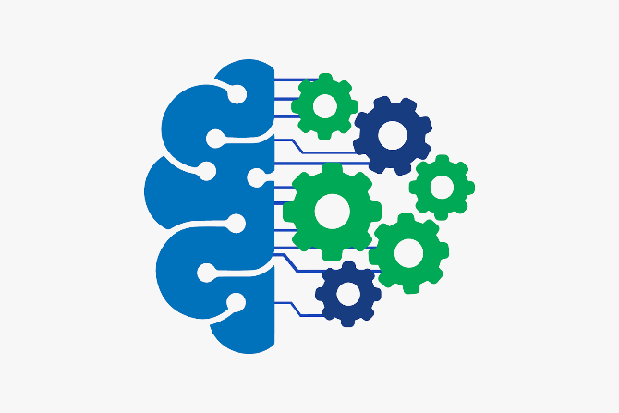

The Future lies in Human Machine Collaboration

Slide 13
We need a new social contract, supported by legal and technological infrastructure to make digital resources available to people and the machines we use

Slide 15
An international, bottom-up paradigm for the discovery and reuse of digital content
for people and the machines that they use

Slide 16
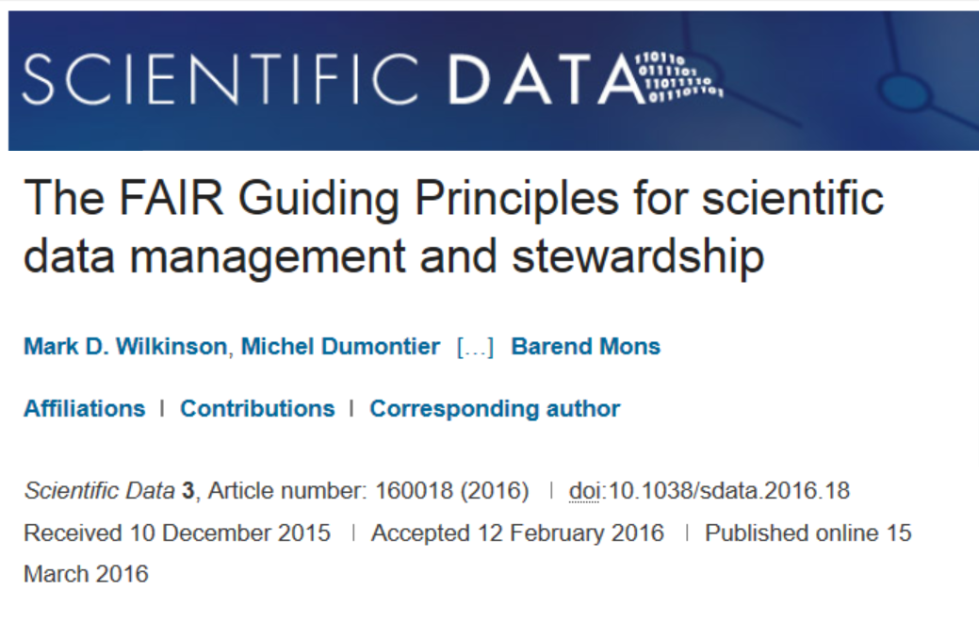
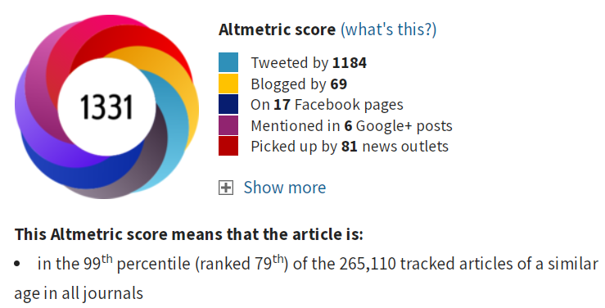
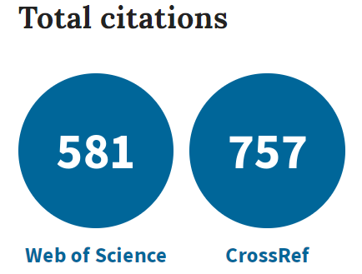
http://www.nature.com/articles/sdata201618

Slide 17
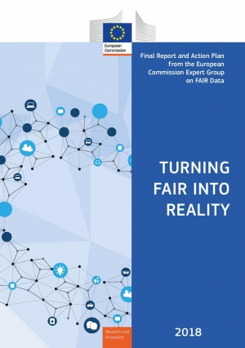
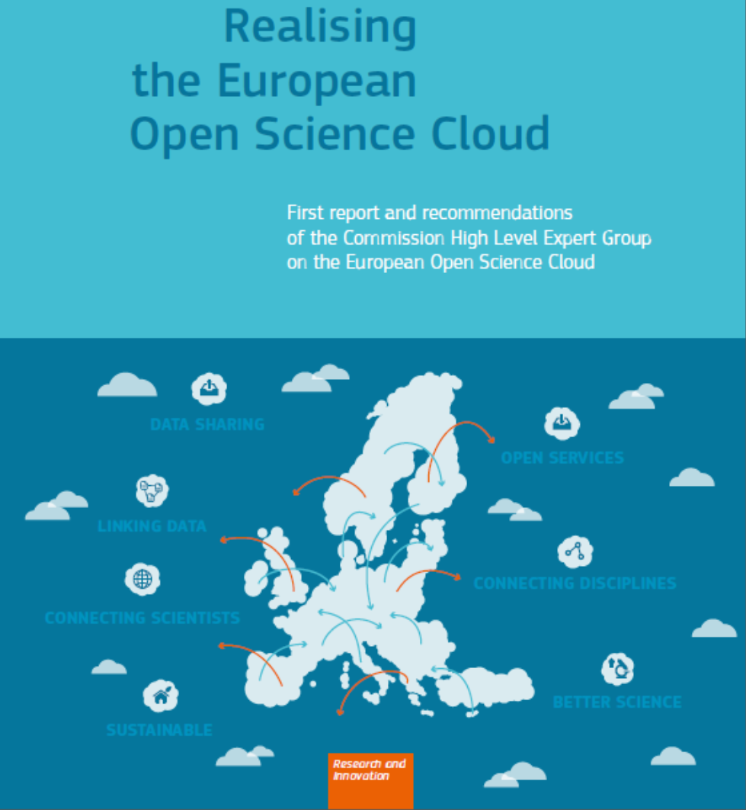
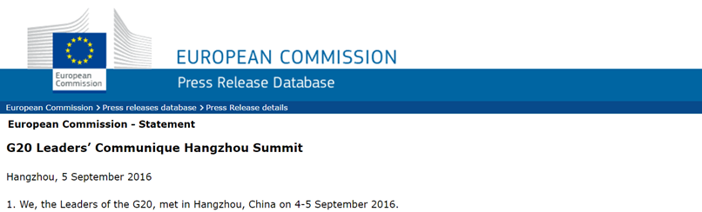
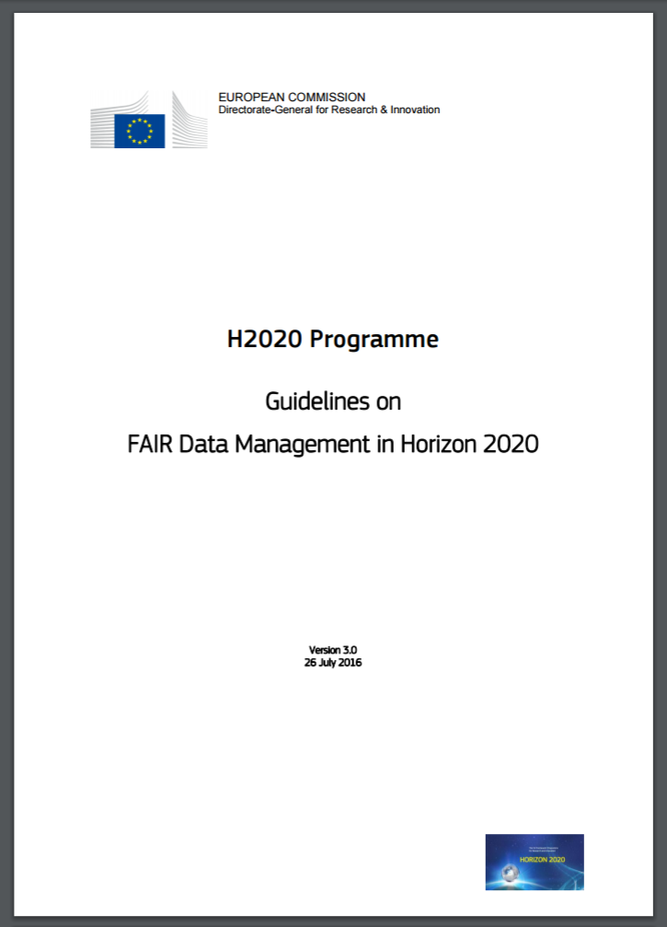
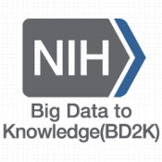
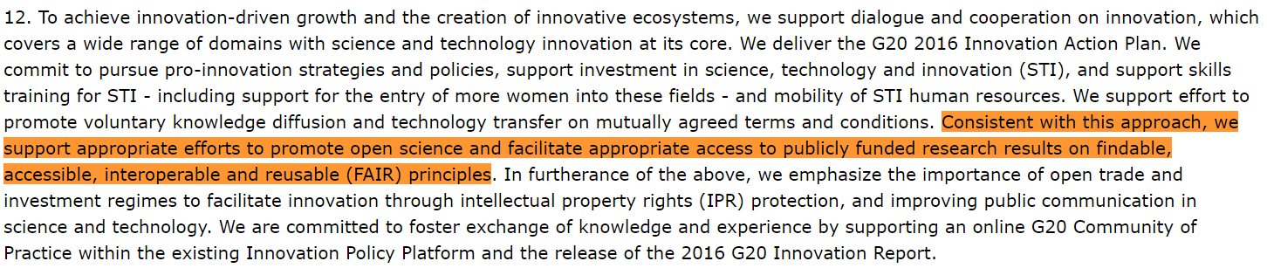

FAIR: Impact
Notes:
G20: http://europa.eu/rapid/press-release_STATEMENT-16-2967_en.htm
EOSC: https://ec.europa.eu/research/openscience/pdf/realising_the_european_open_science_cloud_2016.pdf
H2020: https://goo.gl/Strjua

Slide 18
FAIR in a nutshell
FAIR aims to create social and economic impact by facilitating the discovery and reuse of digital resources through a set of effective requirements:
  unique identifiers to retrieve all forms of digital content and knowledge
  high quality meta(data) to enhance discovery of digital resources
  use of common vocabularies to create shared meaning and facilitate search
  adherence to community standards for common representations
  detailed provenance to provide context and facilitate reproducibility
  registered in appropriate repositories to make sure they can be found
  social and technological commitments to realize reliable access
  simpler terms of use to clarify expectations and intensify innovation

Slide 19
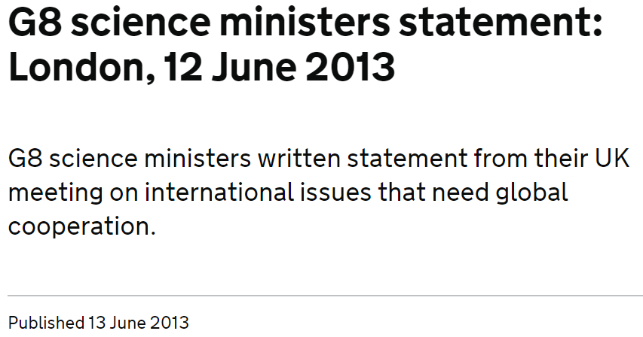
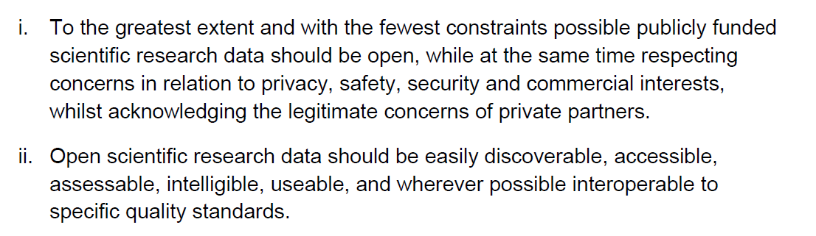

FAIR does not require Open. Open as possible
closed as is necessary
Notes:
https://www.gov.uk/government/publications/g8-science-ministers-statement-london-12-june-2013

Slide 21
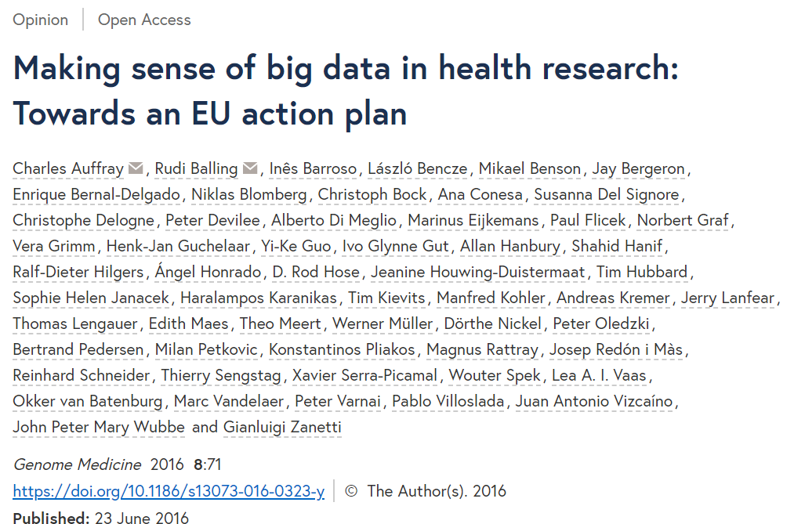

Slide 22
Let’s build the Internet of FAIR data and services

Slide 23
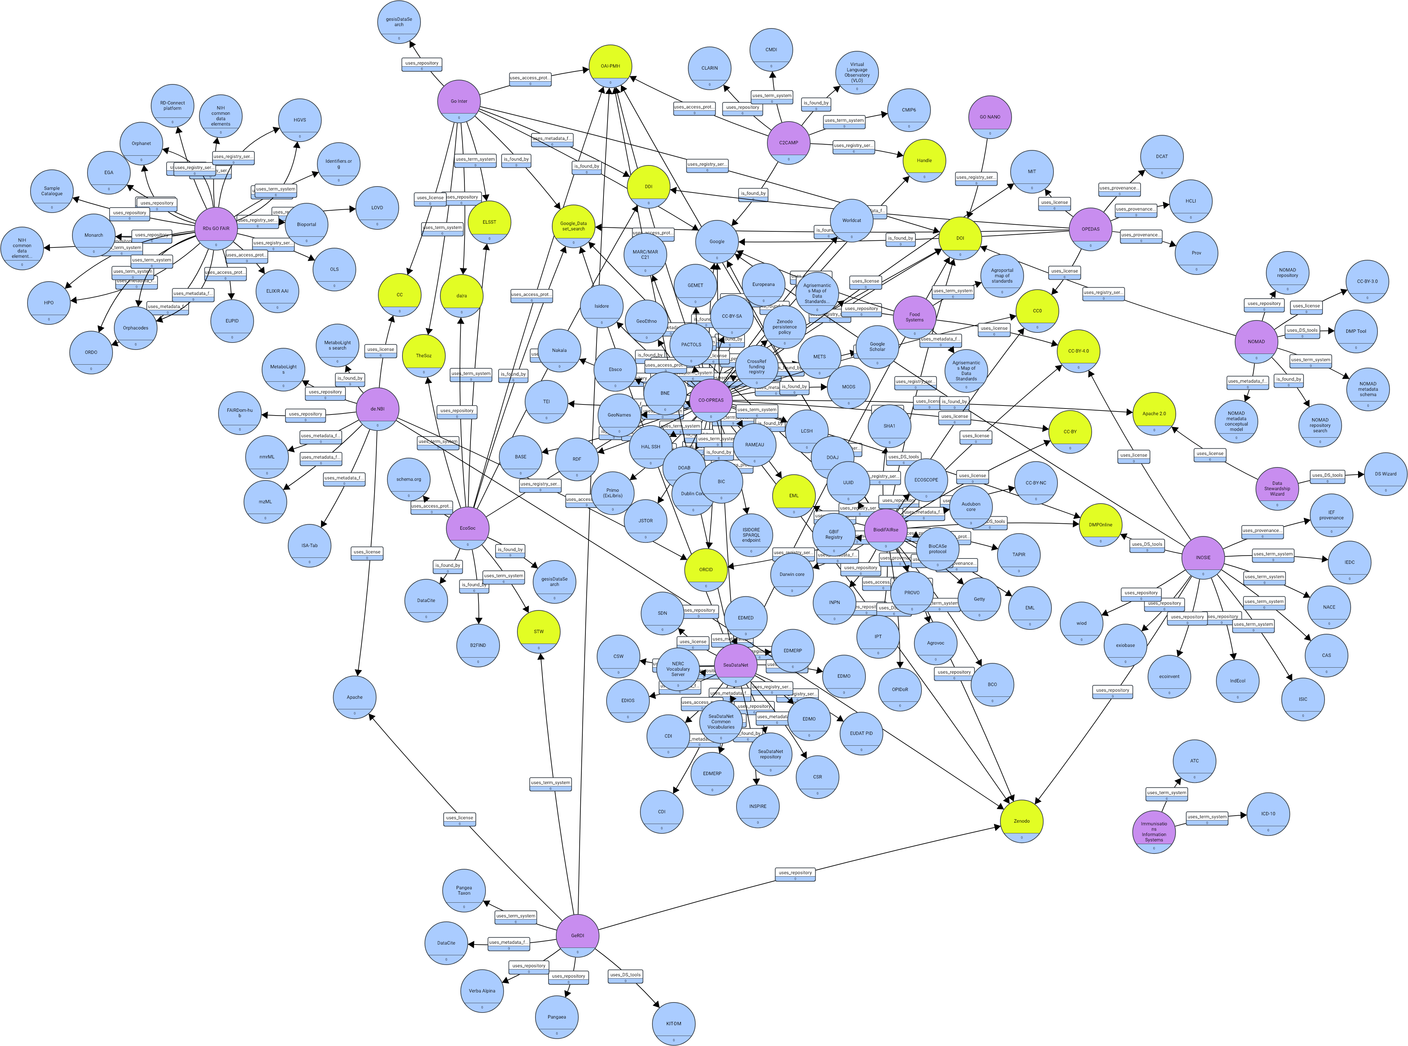

Your invitation to participate
https://osf.io/n7uwp/
erik.schultes@go-fair.org

Slide 24
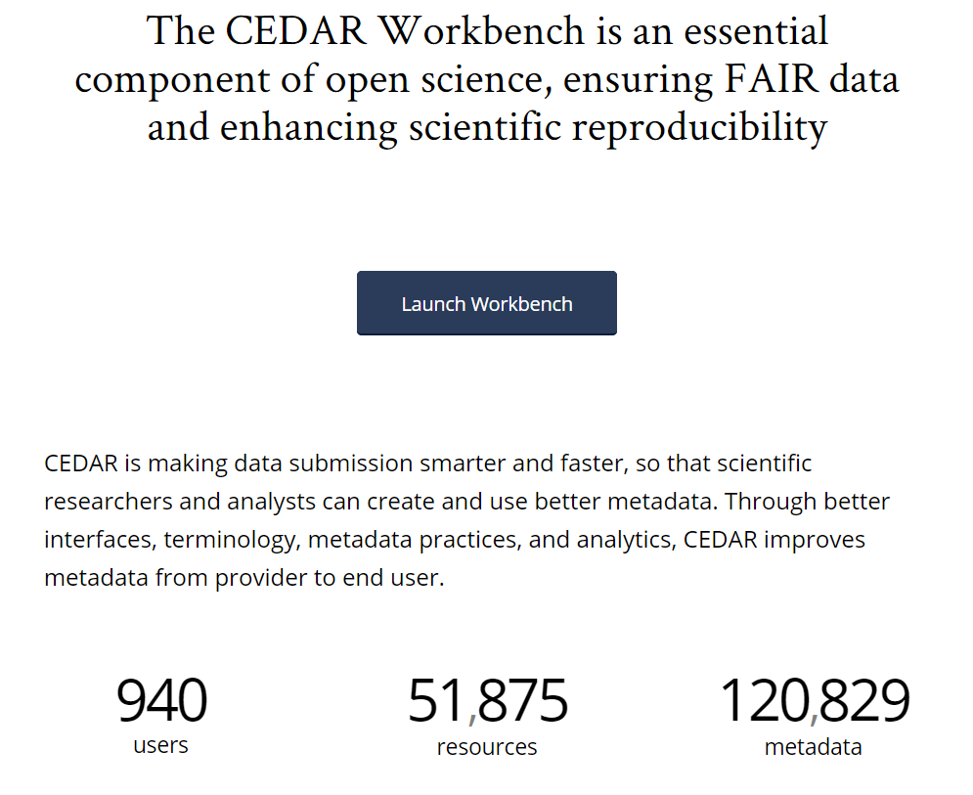
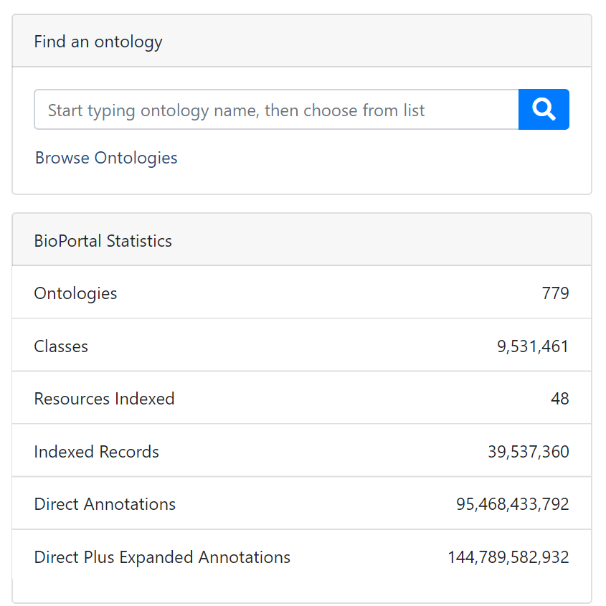
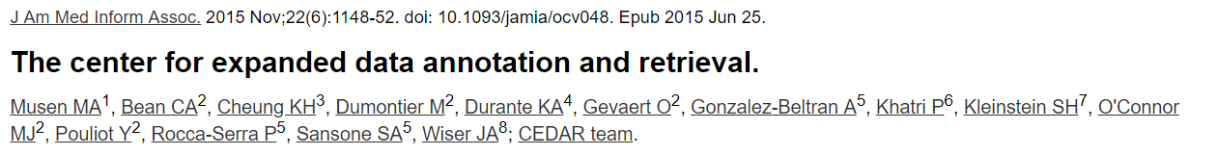

Slide 25
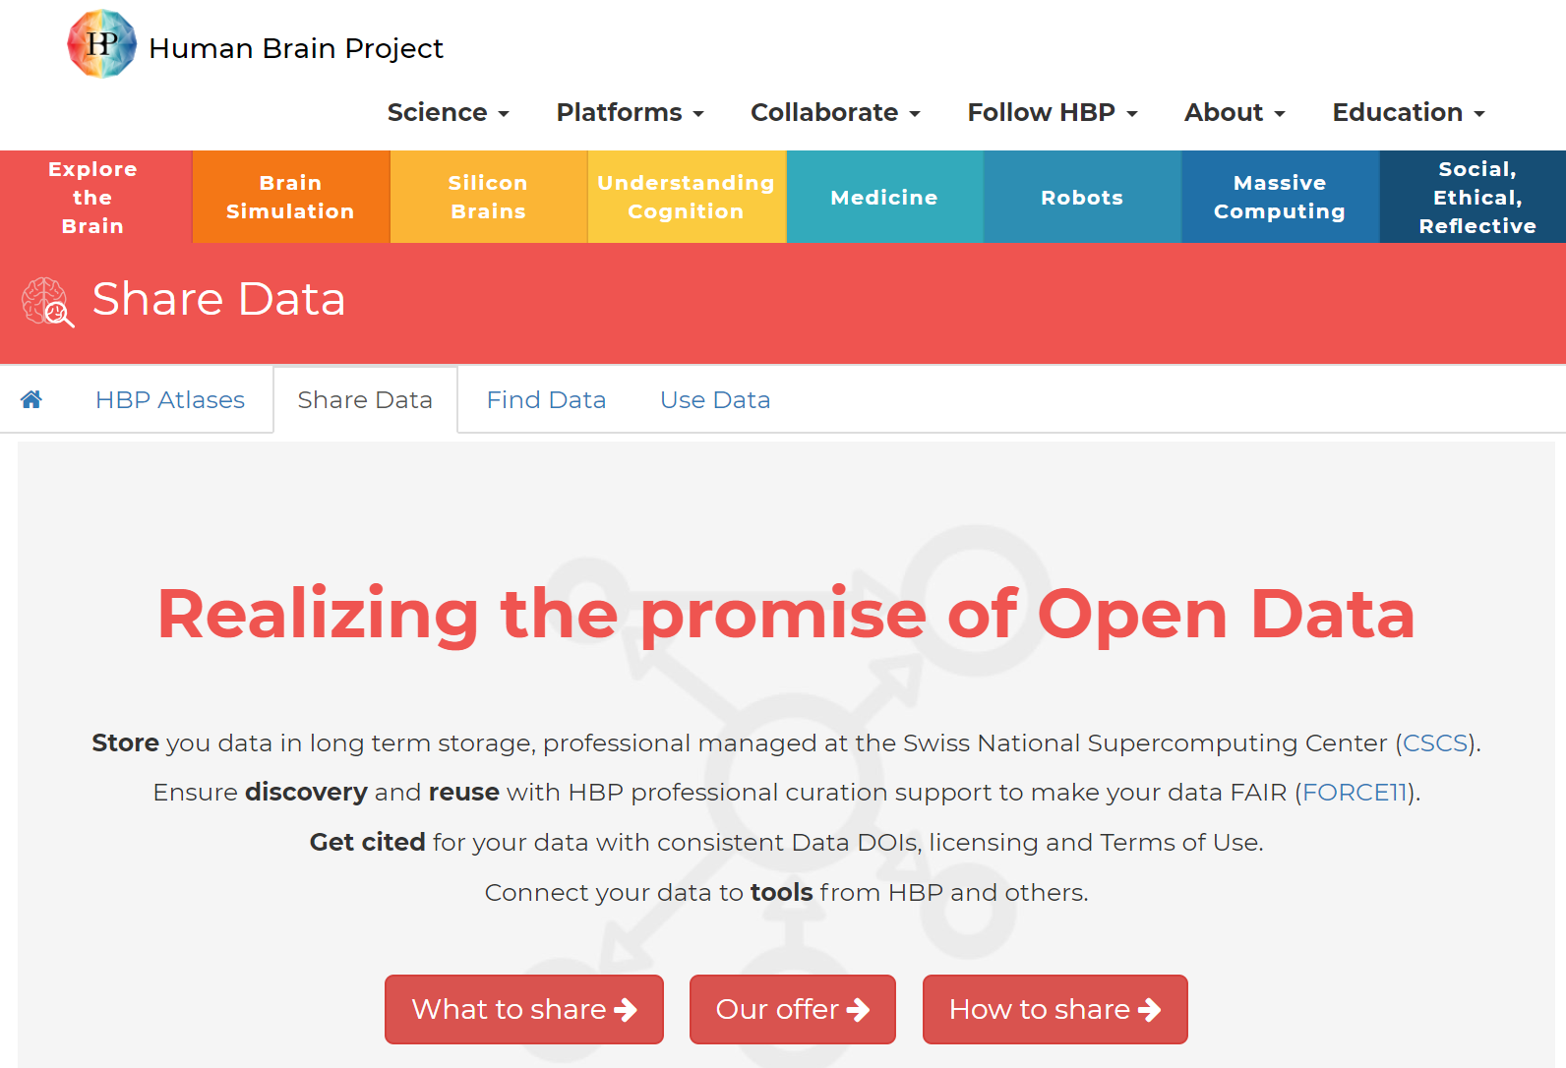


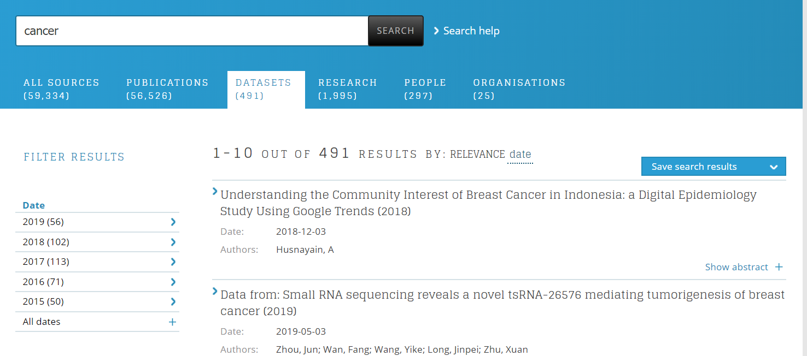

Slide 26


The Semantic Web
is a portal to the web of knowledge
standards for publishing, sharing and querying
facts, expert knowledge and services
scalable approach for the discovery
of independently constructed,
collaboratively described,
distributed knowledge

Slide 27
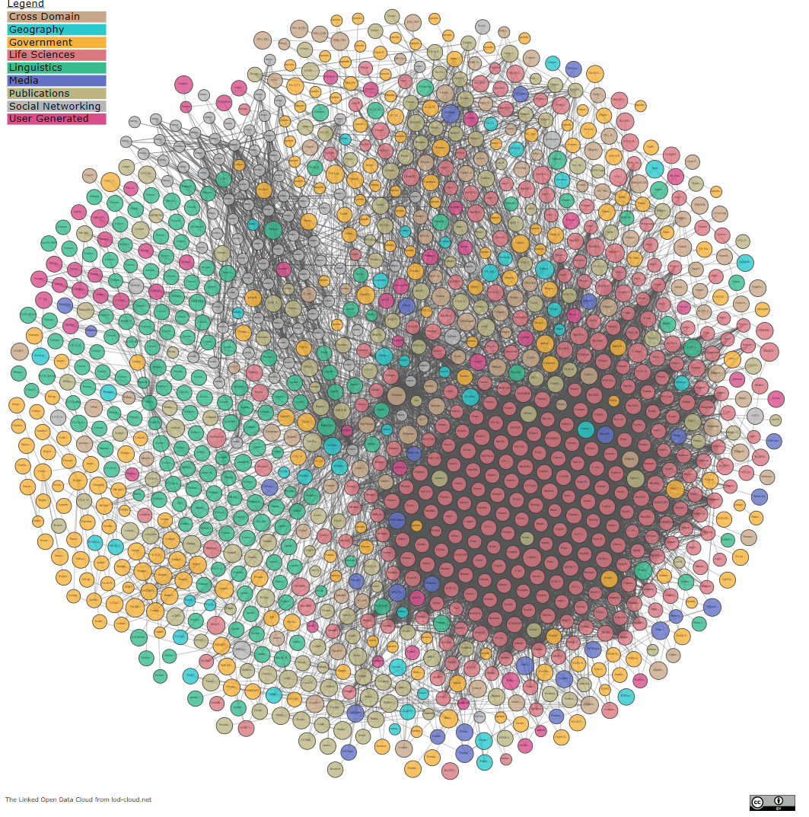
The semantic web community has built a massive open and decentralized knowledge graph

Slide 28

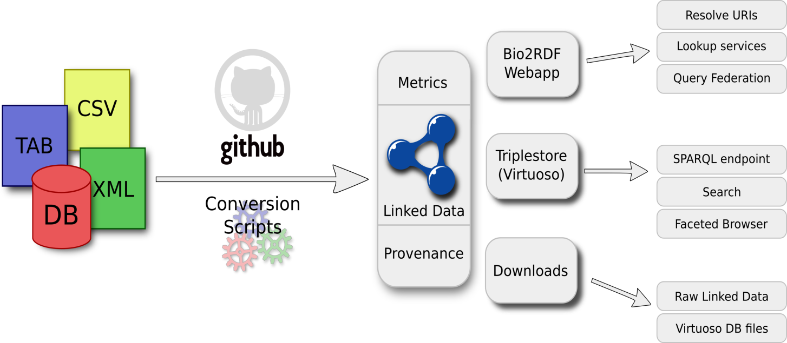
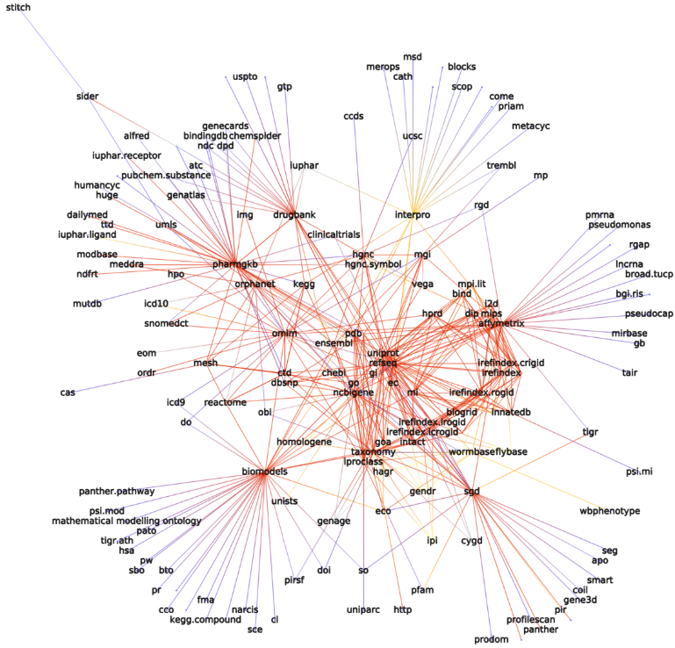
Bio2RDF is an open source project that uses semantic web technologies to make it easier to reuse biomedical data
Linked Data for the Life Sciences
chemicals/drugs/formulations, genomes/genes/proteins, domains
Interactions, complexes & pathways
animal models and phenotypes
Disease, genetic markers, treatments
Terminologies & publications
30+ biomedical data sources
10B+ interlinked statements
EBI, SIB, NCBI, DBCLS, NCBO, and many others produce this content
Alison Callahan, Jose Cruz-Toledo, Peter Ansell, Michel Dumontier: Bio2RDF Release 2: Improved Coverage, Interoperability and Provenance of Life Science Linked Data. ESWC 2013: 200-212
Notes:
The Bio2RDF project transforms silos of life science data into a globally distributed network of linked data for biological knowledge discovery.

Slide 29
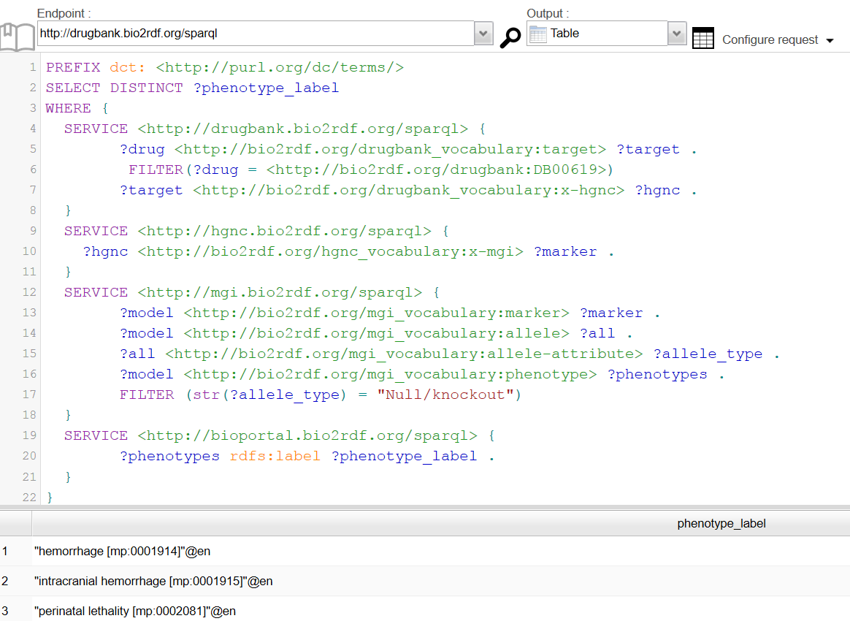
Query the distributed web of data (as envisioned by TBL?)
Phenotypes of knock-out mouse models for the targets of a selected drug (Imatinib)

Slide 30
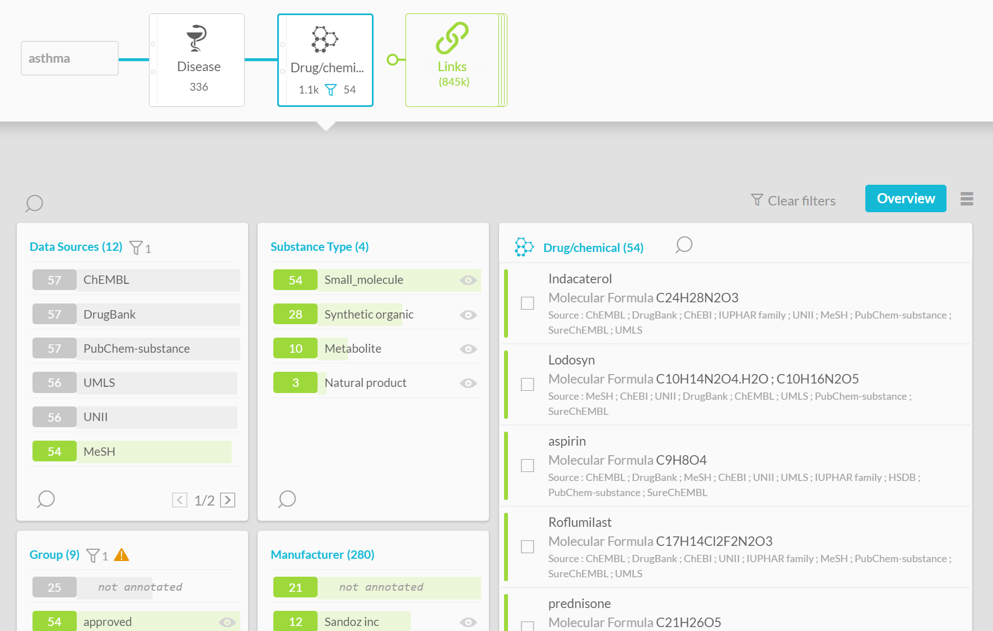

Find and explore data with effective user interfaces
Disclosure: I’m an advisor to OntoForce

Slide 31
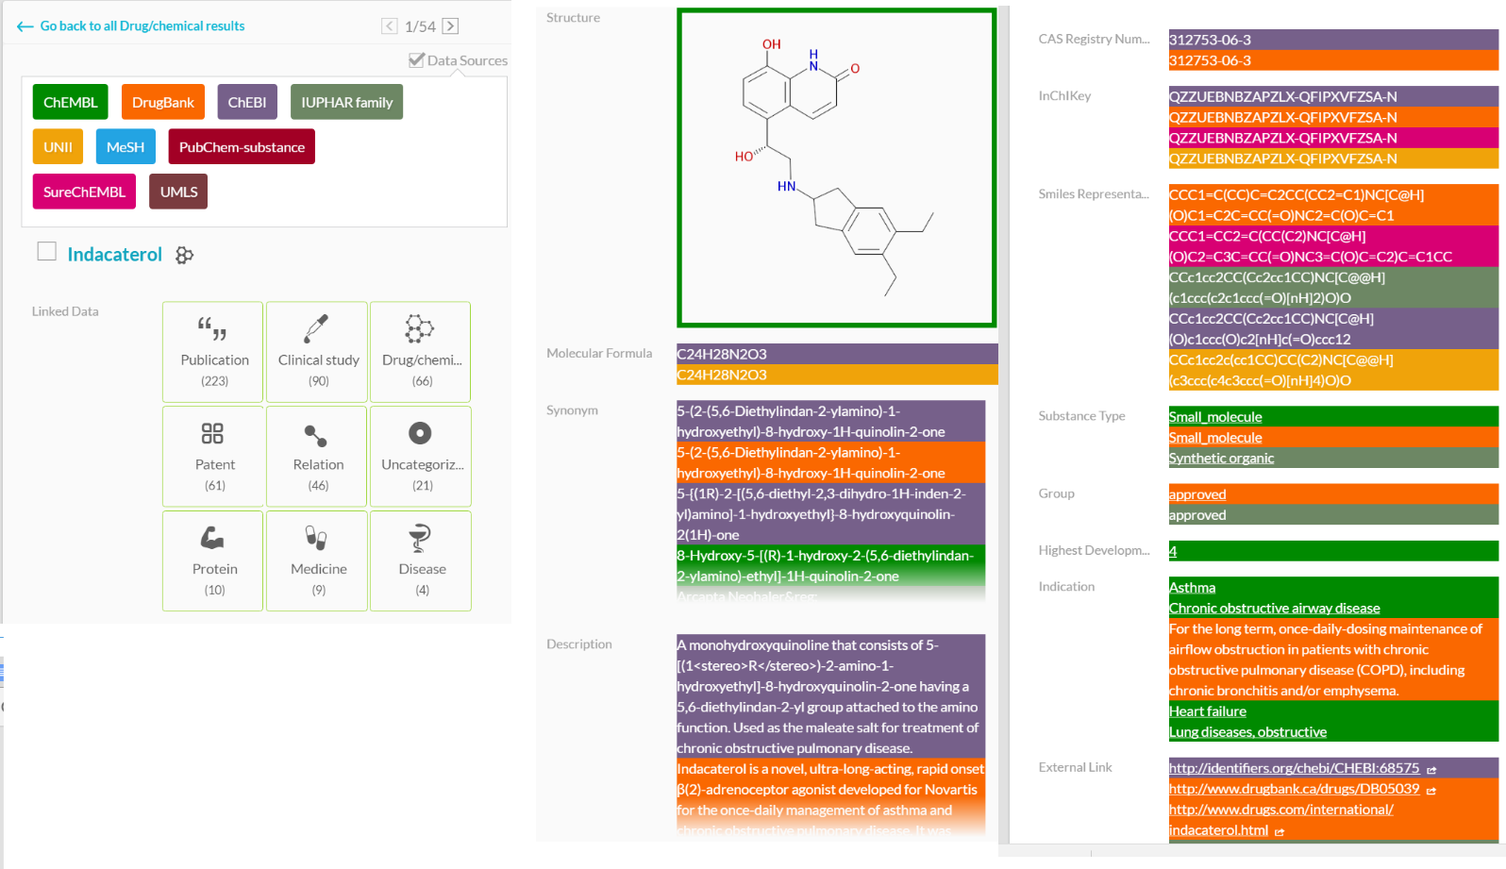
Examine the provenance behind the facts
Disclosure: I’m an advisor to OntoForce

Slide 32
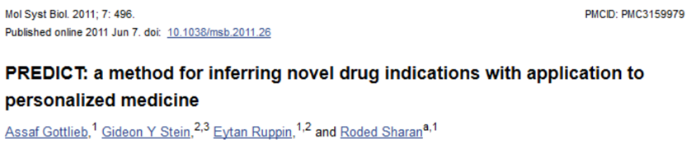
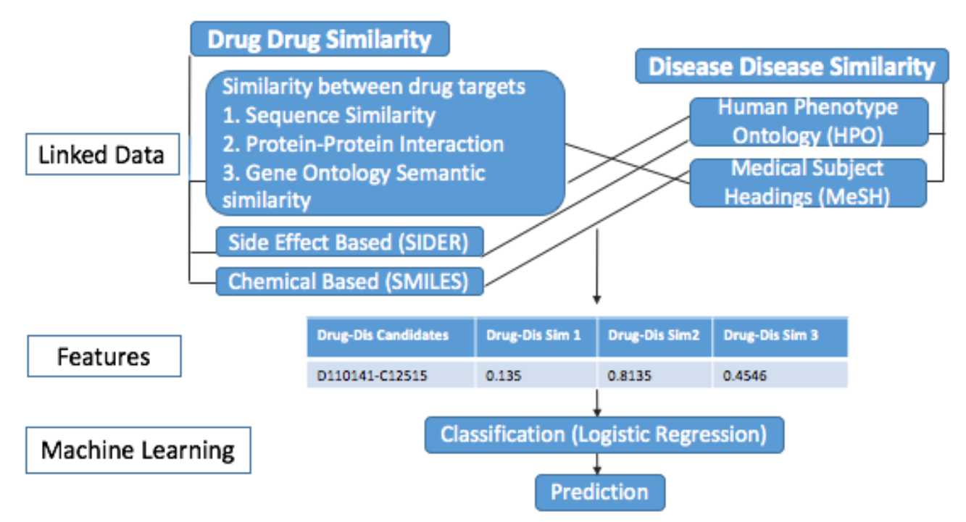
Reproduce computational results
AUC 0.91 across all therapeutic indications
Scripts not available. Feature tables available.
Result: ROCAUC 0.831 doesn’t quite match

Slide 33
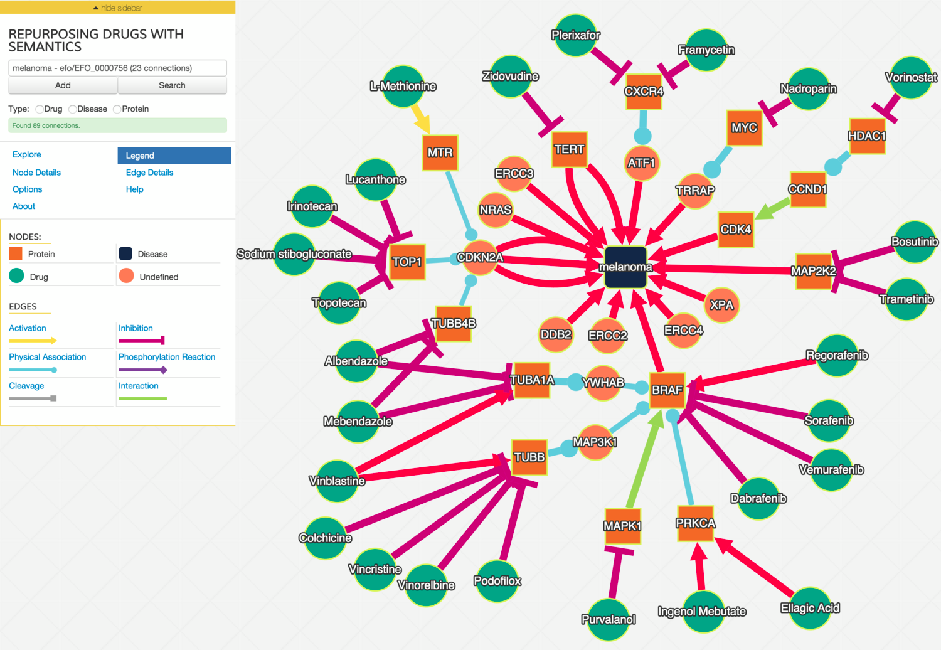
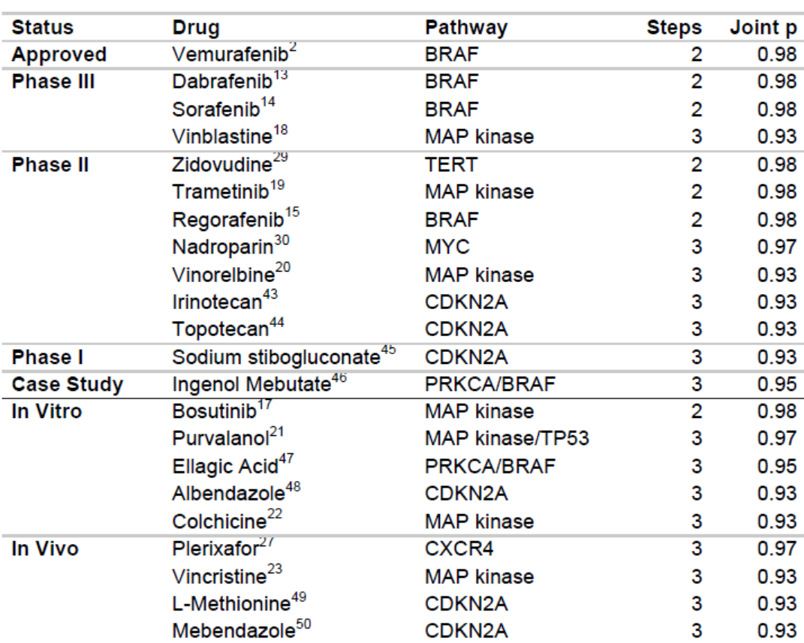
Build high quality knowledge graphs
by exploring a probabilistic semantic knowledge graph
And validate them against pipelines for drug discovery
Finding melanoma drugs through a probabilistic knowledge graph.
PeerJ Computer Science. 2017. 3:e106 https://doi.org/10.7717/peerj-cs.106

Slide 34


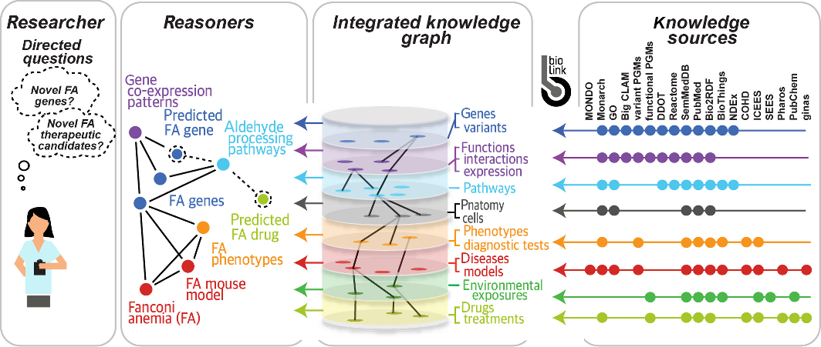

Slide 35
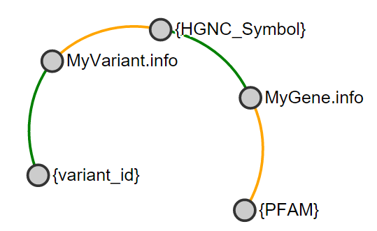
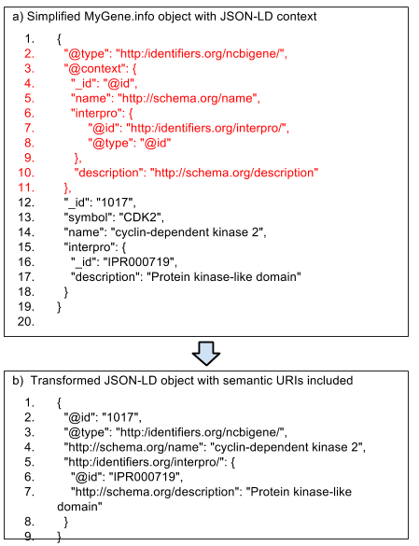

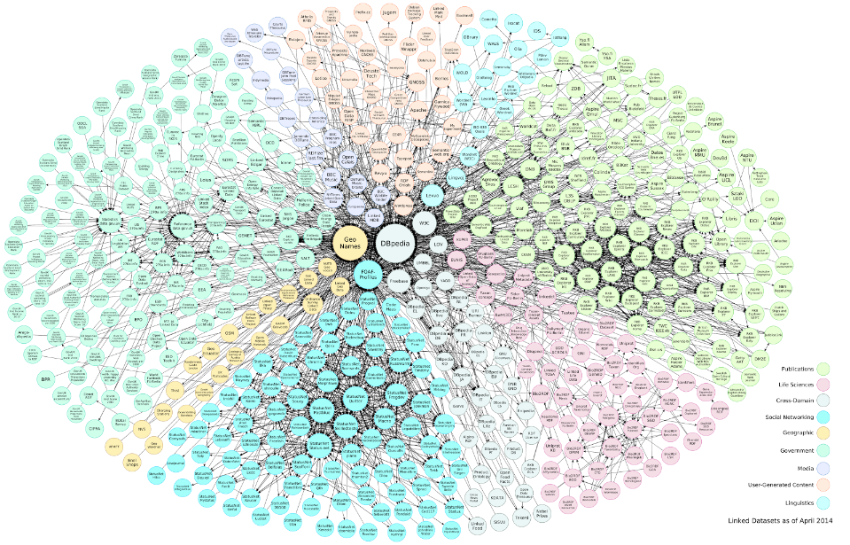

The Internet of FAIR data and services is a semantic knowledge system that enables agents to find and obtain relevant content
API
API

Slide 36

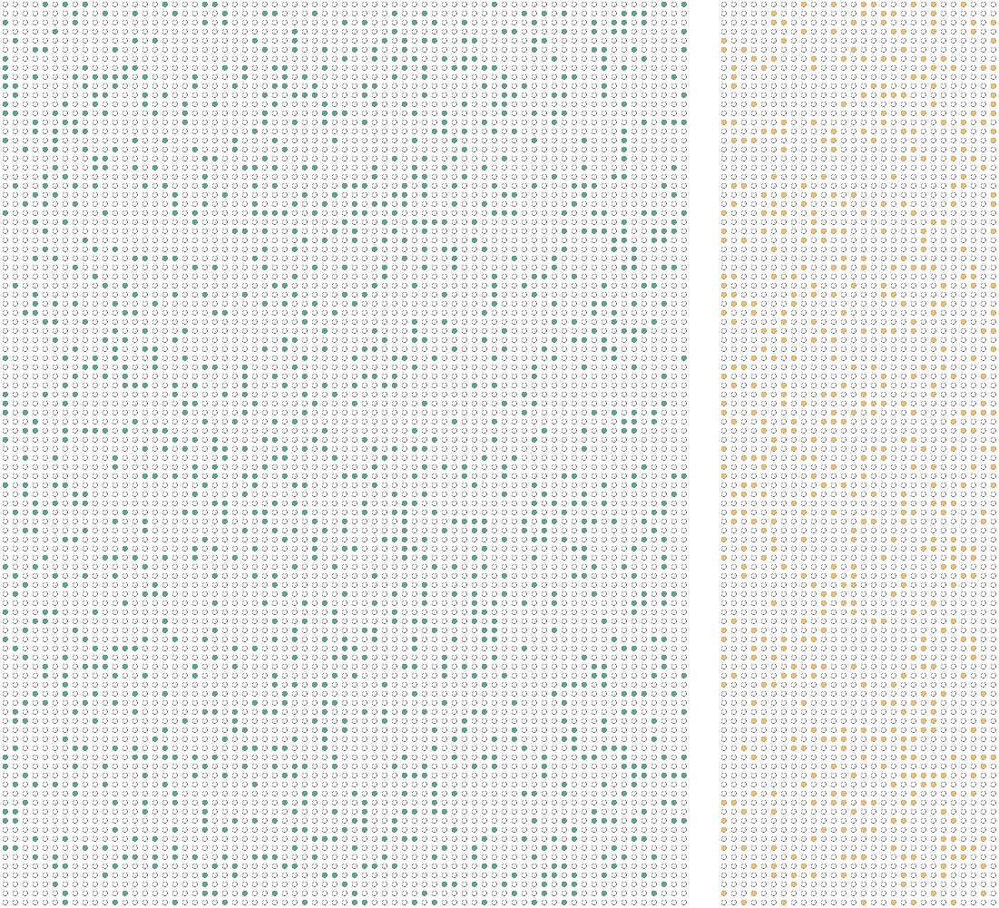


Mine distributed, access restricted datasets in a privacy preserving manner
Maastricht Study + MUMC
CBS
s
  Goal is to learn high confidence determinants of health in a privacy preserving manner over vertically partitioned data from the Maastricht Study and Statistics Netherlands. The data are made available through FAIR data stations that provide access to allowable subsets of data to authorized users of approved learning algorithms.
  Establish a new social, legal, ethical and technological infrastructure for discovery science in and across health and non-health settings, including scalable governance and flexible consent to underpin the responsible use of Big Data.

Slide 37
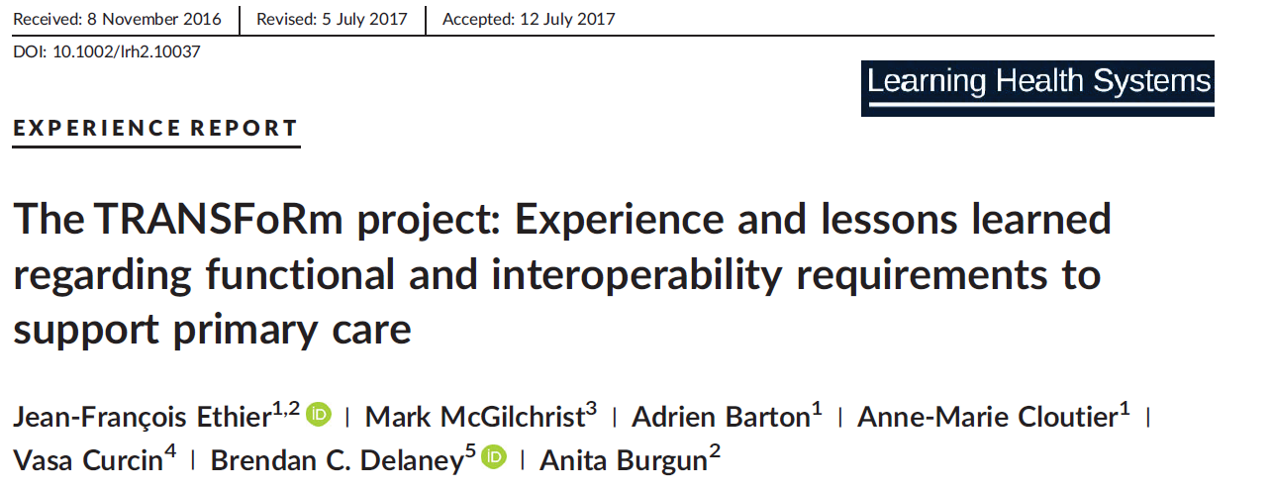
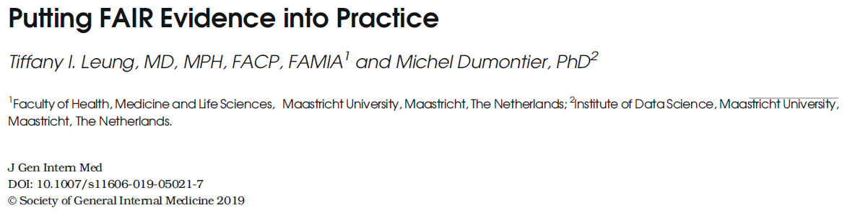
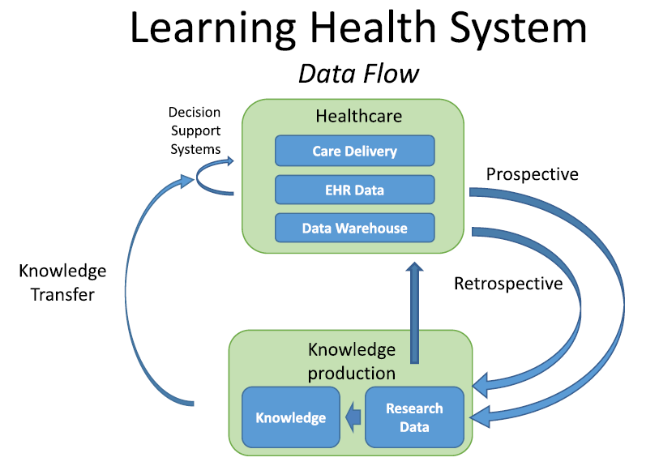
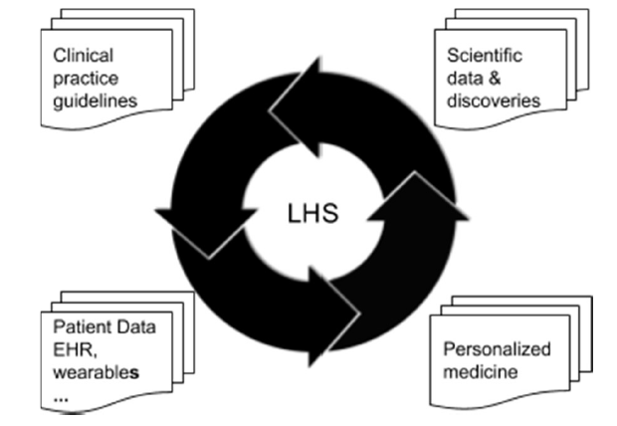

Slide 38
The future
of big data & AI health
Internet of FAIR data and services
Machine interpretable content enables users (people use machines to find and reuse content)
Distributed and privacy preserving data analysis
Bringing the model to the data for the analysis of sensitive data
Precision Medicine
Integration clinical and non clinical data (molecular to physiological, wearables/lifestyle, social media, consumer patterns), to improve diagnosis, care pathways, prognosis, treatments
Scalable Data-Driven Discovery Science
Agents leverage the internet of FAIR data and services to find gaps, negotiate experiments, and update knowledge models

Slide 39
Summary
FAIR represents a global initiative to enhance the discovery and reuse of all kinds of digital resources.
It demands a new social, legal, ethical, scientific and technological infrastructure that currently doesn’t exist in whole, but has to be built for and tested by various communities!
  Multi-modal health (and non health) data reuse in a privacy preserving manner
  Incentives, rewards and penalties are needed to maximize participation and utility
  Incorporating FAIR into every day work without sacrificing efficiency
Enormous benefits to be had, particularly in developing responsible data markets, accelerating data-driven biomedical research, transforming the success of clinical trials, and improving health outcomes of our citizens.

Slide 40
The mission of the Institute of Data Science at Maastricht University is to foster a collaborative environment for multi-disciplinary data science research, interdisciplinary training, and data-driven innovation .
We tackle key scientific, technical, social, legal, ethical issues that advance our understanding across a variety of disciplines and strengthen our communities in the face of these developments.
michel.dumontier@maastrichtuniversity.nl
Website: http://maastrichtuniversity.nl/ids

