Slide 1
Reflecting opportunities and risks – AI ethics and its broad range of issues
Dr. Thilo Hagendorff
University of Tuebingen
Cluster of Excellence Machine Learning
Notes:
“The goal would be to provide a balanced overview of the potential benefits of AI, but also of the possible risks and the related ethical constraints we should be aware of. The hope is that during the morning we could have a healthy discussion with the technologists and be prepared to manage future expectations.”
25 minutes talk & 5 minutes q&a

Slide 2
Dimensions of AI ethics
distance
events
irritation
orientation
t
Collingridge dilemma
proximity
point of ethical reflection
most effective

Slide 3
Dimensions of AI ethics
distance
events
irritation
orientation
t
Collingridge dilemma
proximity
point of ethical reflection
most effective

Slide 4
Dimensions of AI ethics
distance
events
irritation
orientation
t
Collingridge dilemma
proximity
point of ethical reflection
most effective

Slide 5
Dimensions of AI ethics
distance
events
irritation
orientation
t
Collingridge dilemma
proximity
point of ethical reflection
most effective

Slide 6
Dimensions of AI ethics
distance
events
irritation
orientation
t
Collingridge dilemma
proximity
point of ethical reflection
most effective

Slide 7
Dimensions of AI ethics
distance
events
irritation
orientation
t
Collingridge dilemma
proximity
point of ethical reflection
most effective

Slide 8
Dimensions of AI ethics
distance
events
irritation
orientation
t
Collingridge dilemma
proximity
point of ethical reflection
most effective

Slide 9
Dimensions of AI ethics
distance
events
irritation
orientation
t
Collingridge dilemma
proximity
point of ethical reflection
most effective

Slide 10
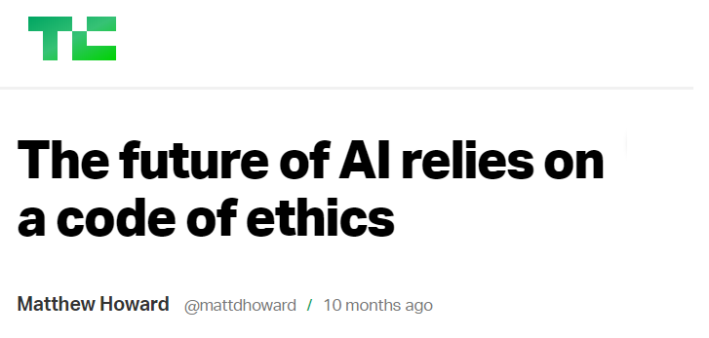
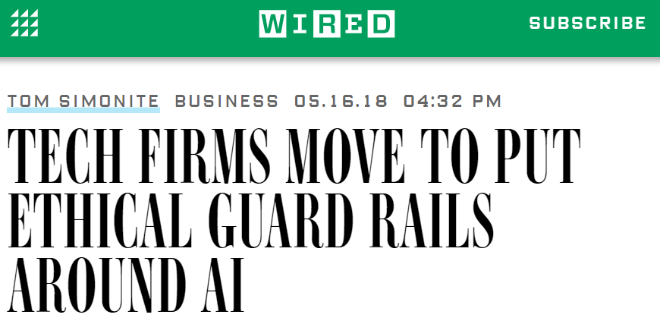
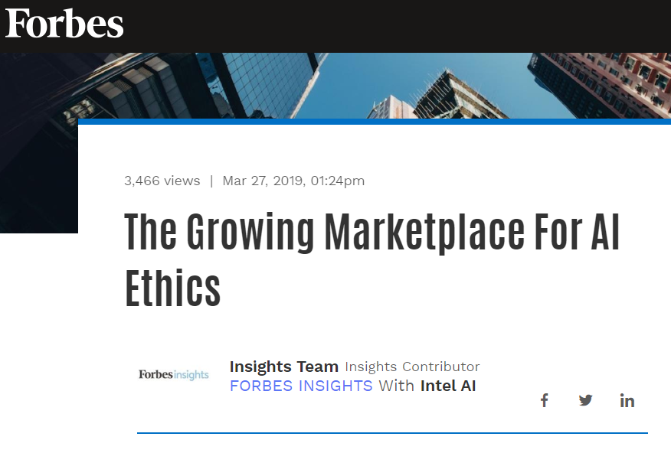
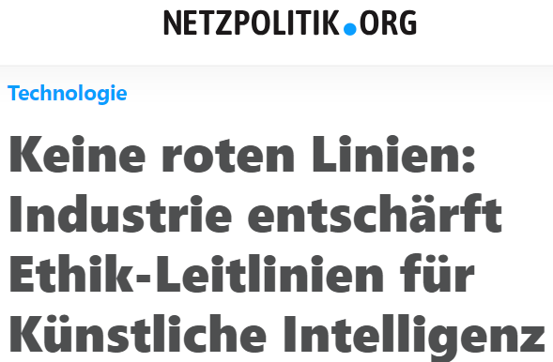
Demands for AI/ML Ethics
100 %
50 %
2013
2014
2015
2016
2017
2018

Slide 11
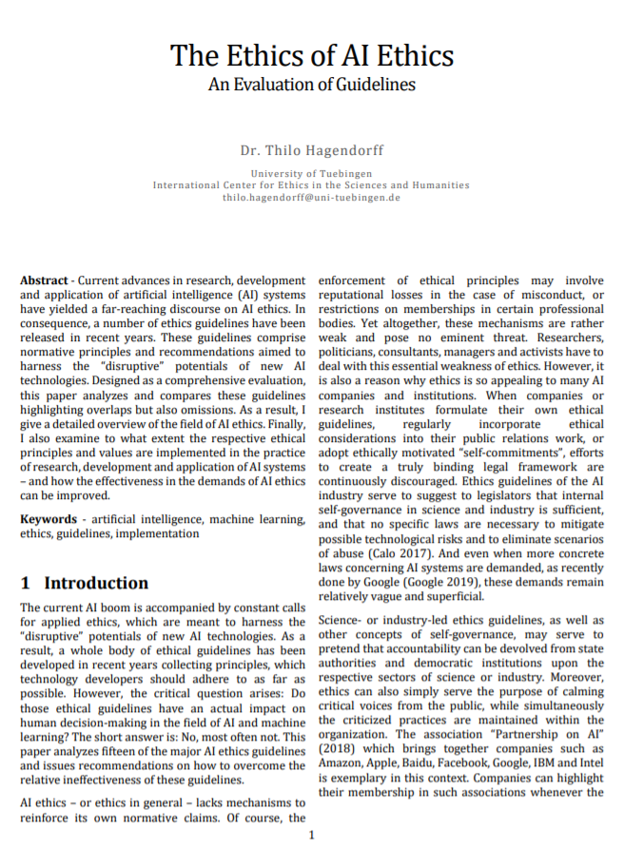
Guidelines
Hagendorff, Thilo (2019): The Ethics of AI Ethics. An Evaluation of Guidelines. in: arXiv:1903.03425v1, pp. 1–15.

Slide 12
Guidelines

Slide 13
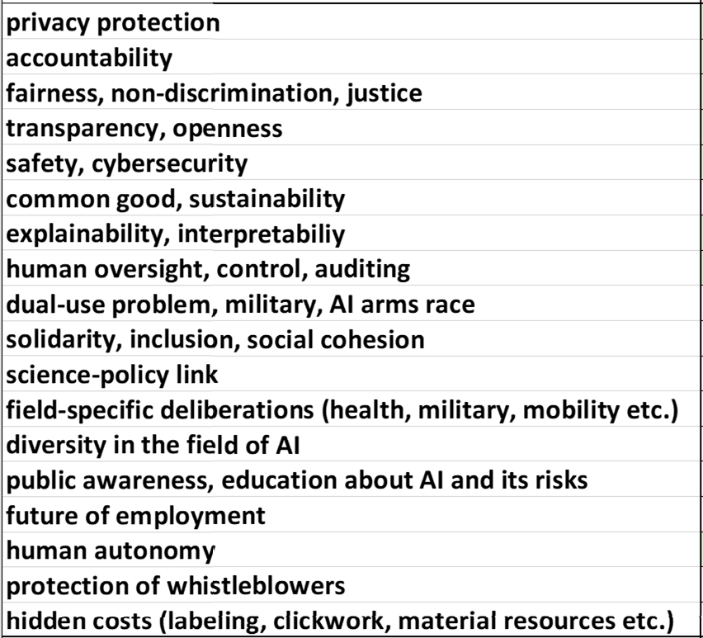
Guidelines

Slide 14
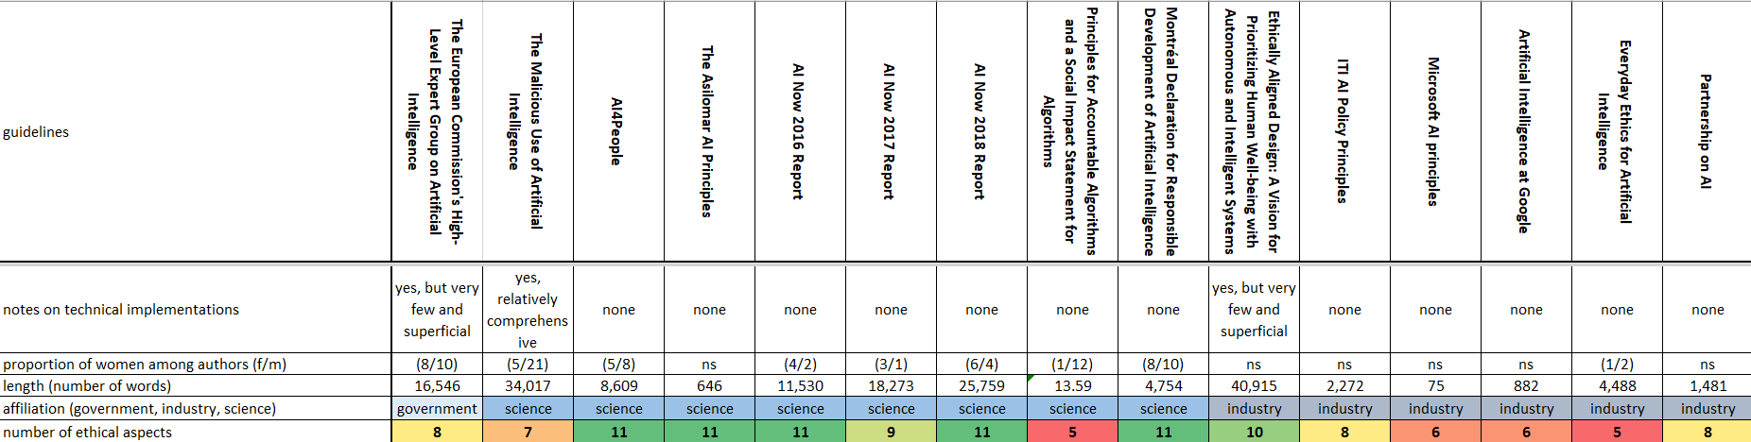
Guidelines

Slide 15
Guidelines

Slide 16
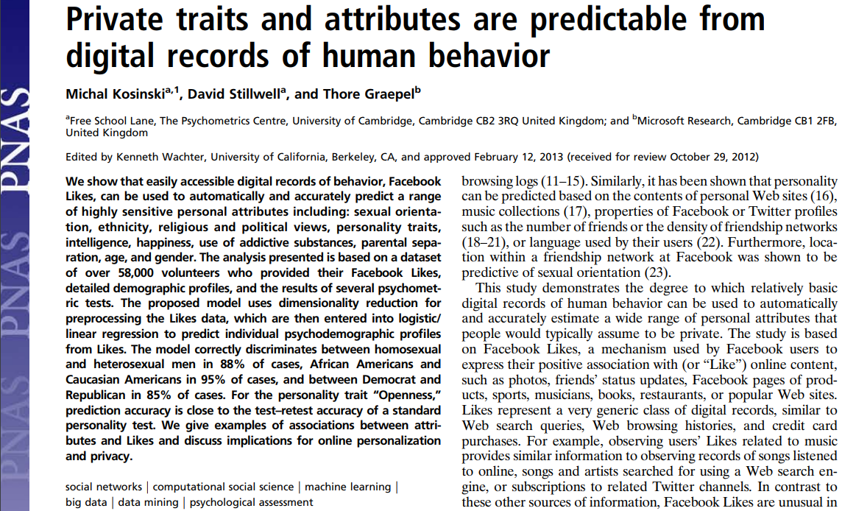
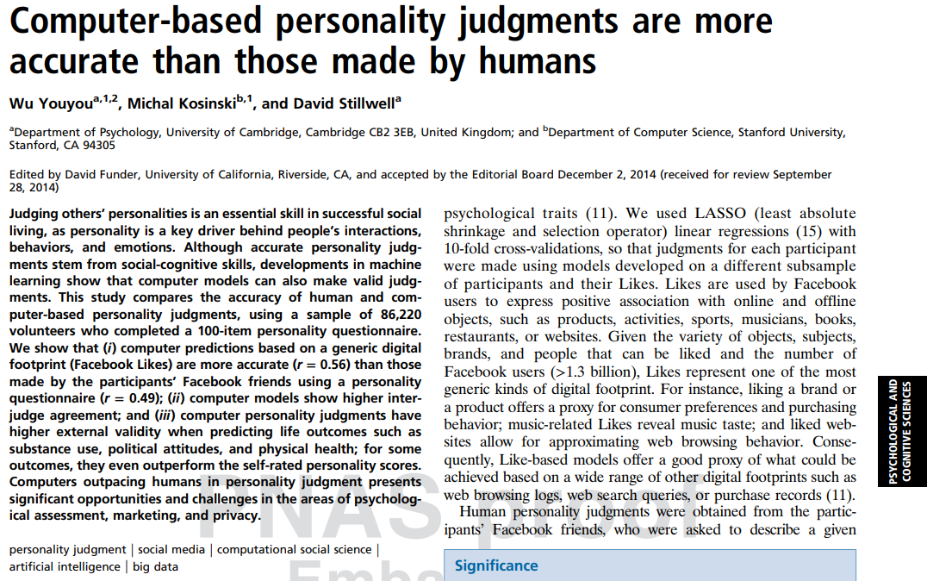
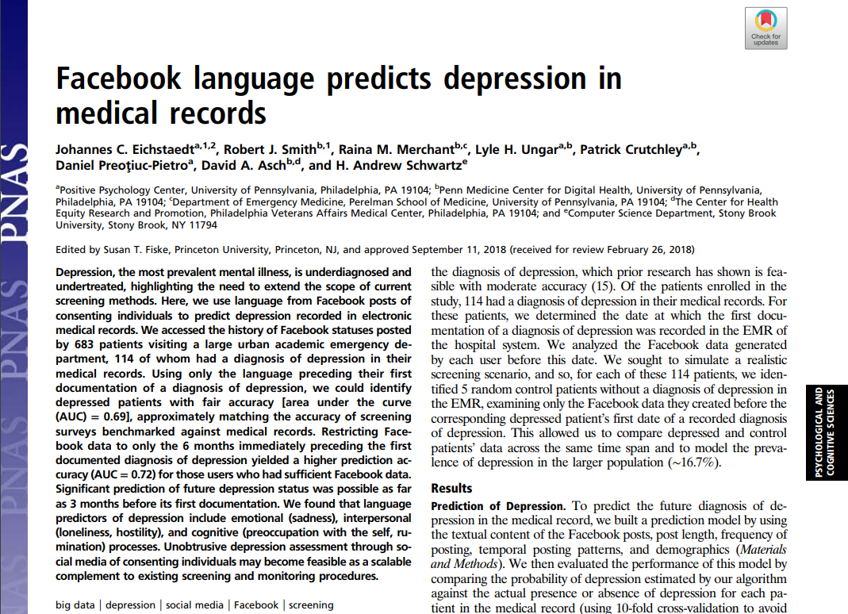
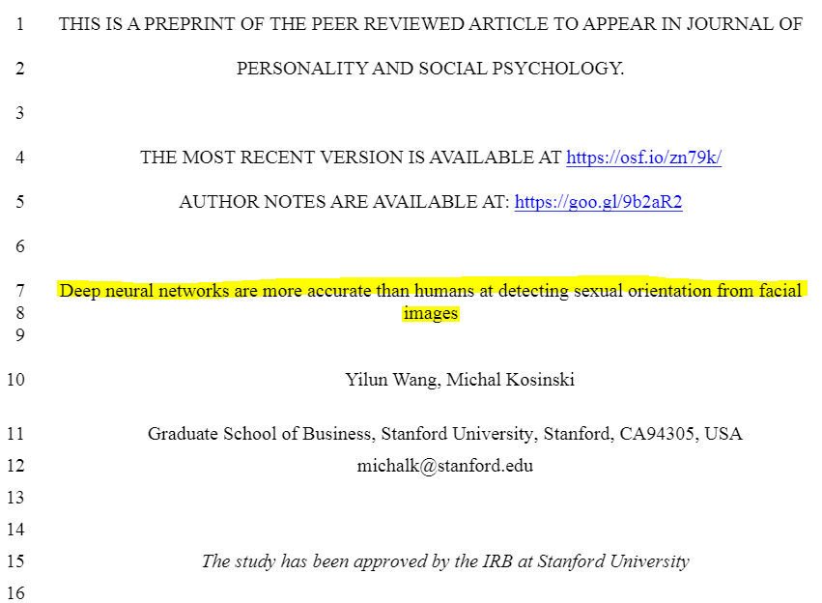

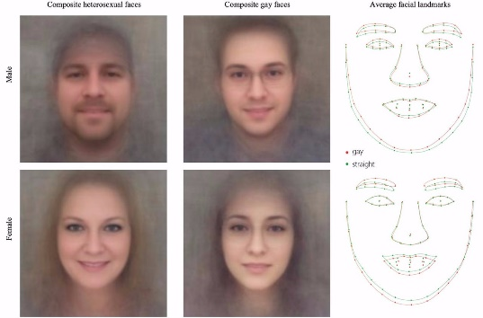
Privacy (14/15)
personality analysis, image recognition, disease prediction etc.

Slide 17
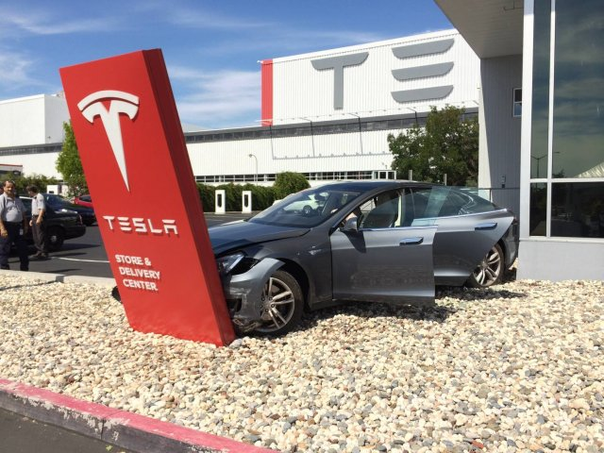
Accountability (13/15)
who can be held legally responsible?
AI systems as
“e-persons”

Slide 18
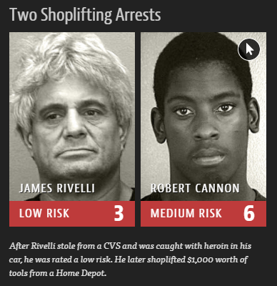
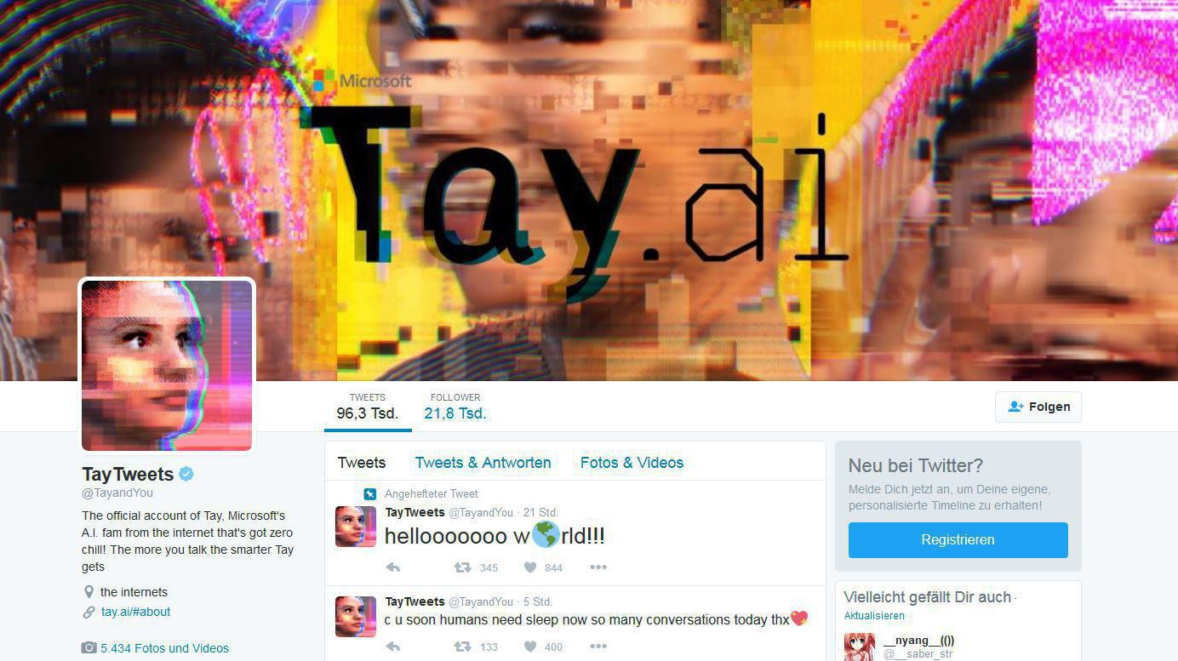

Fairness (13/15)
algorithmic discrimination
bias in training data
solutions provided by FAT ML community

Slide 19

Transparency (10/15)
problem of non-transparent organizations dealing with AI
information asymmetries

Slide 20
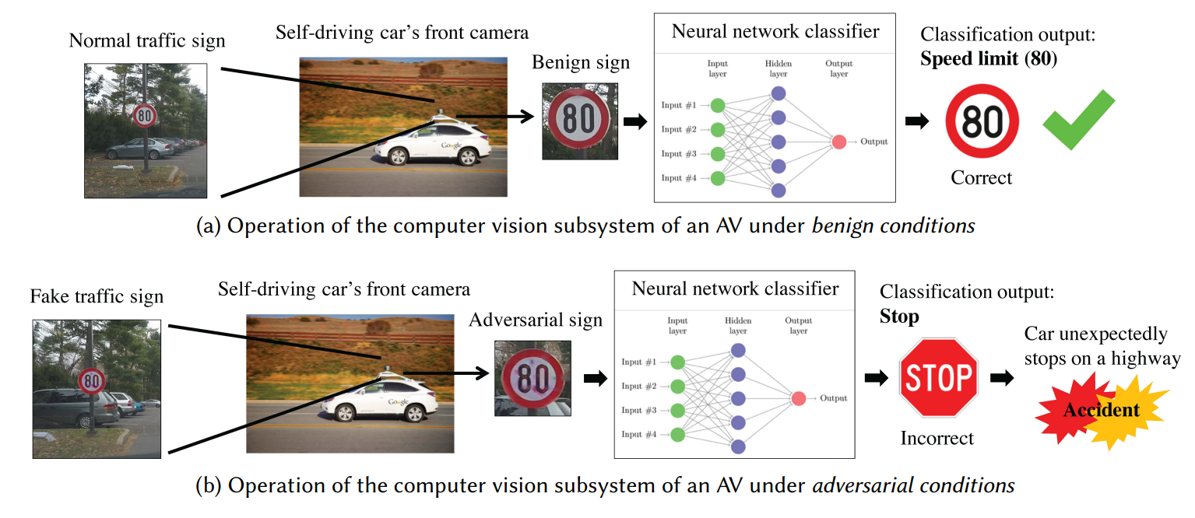
Safety (10/15)
dealing with security vulnerabilities
data poisoning attacks, adversarial examples etc.

Slide 21


Common good (9/15)
idea of AI fostering sustainability goals
AI4Good, Beneficial AI etc.

Slide 22
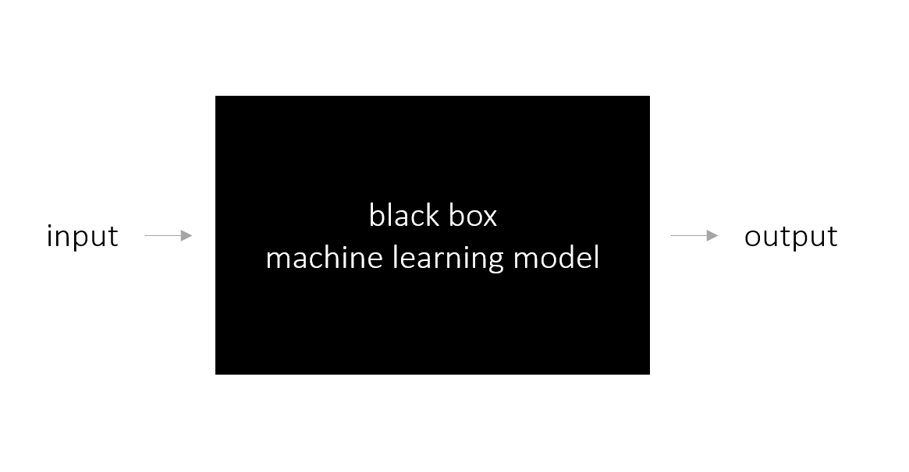
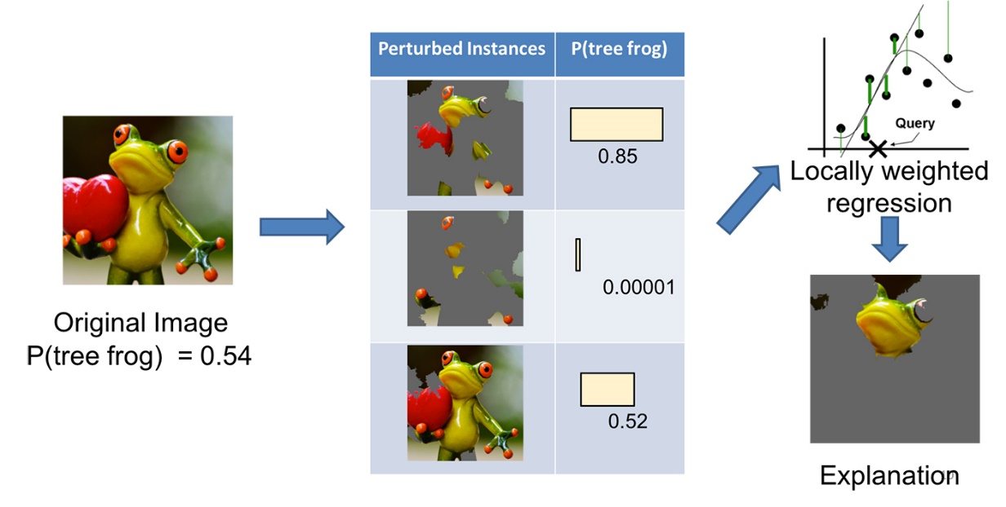
Explainability (8/15)
black box problems
XAI

Slide 23
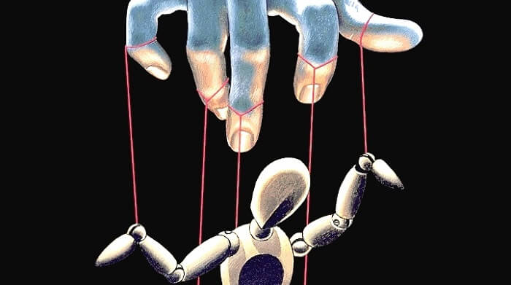
Human oversight (8/15)
developing auditing mechanisms
human in the loop

Slide 24
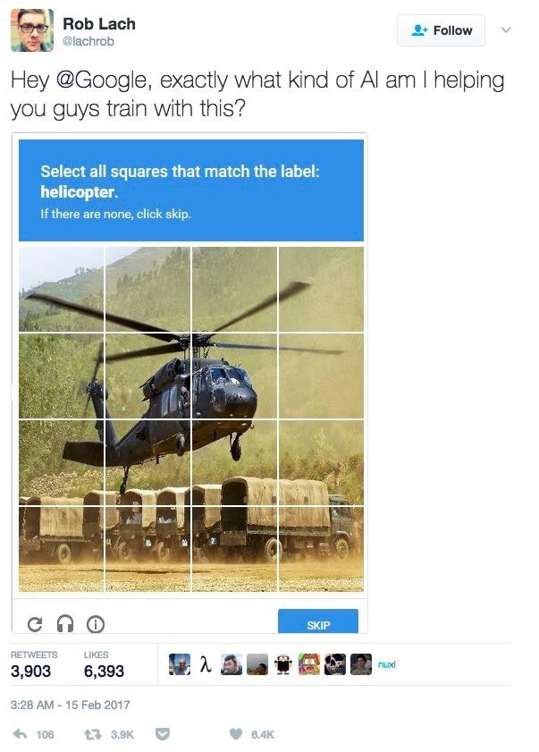
Dual-use problem (06/15)
machine learning as “general purpose technology”
opposing the military use of AI

Slide 25
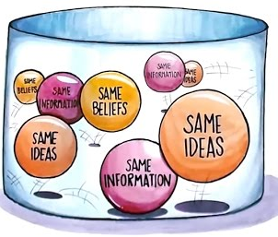
Solidarity, social cohesion (6/15)
AI and social media
speaking against filter bubbles, micro targeting, radicalization etc.

Slide 26


Science-policy link (5/15)
multistakeholder approach
connecting science, industry and politics

Slide 27
Field-specific deliberations (5/15)
AI in specific social systems or fields
medicine, military, mobility etc.
military
medicine
business
mobility

Slide 28
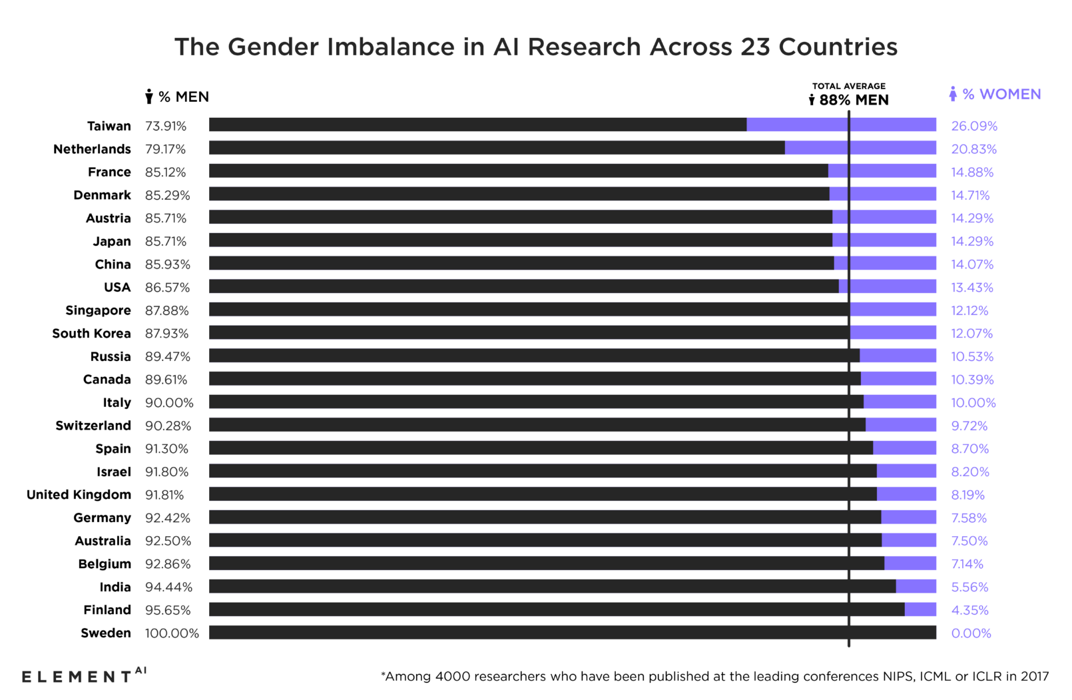
Diversity in the field of AI (5/15)
diversity crisis in the AI sector
statistics show blatant inequalities

Slide 29
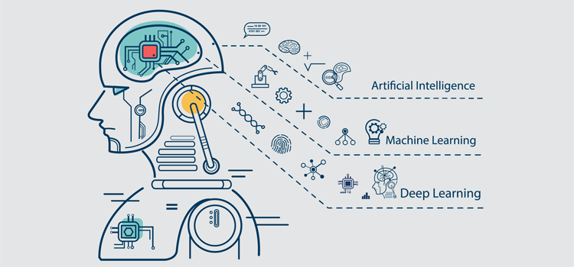
Public awareness, education about AI (5/15)
creation of educational curricula and public awareness activities

Slide 30

Future of employment (4/15)
ideas about robot taxes, universal basic income etc.

Slide 31

Human autonomy (4/15)
not using AI for behavior manipulation
nudging, micro targeting, personalized online advertising, captology, etc.

Slide 32

Protection of whistleblowers (2/15)
need for better protection

Slide 33
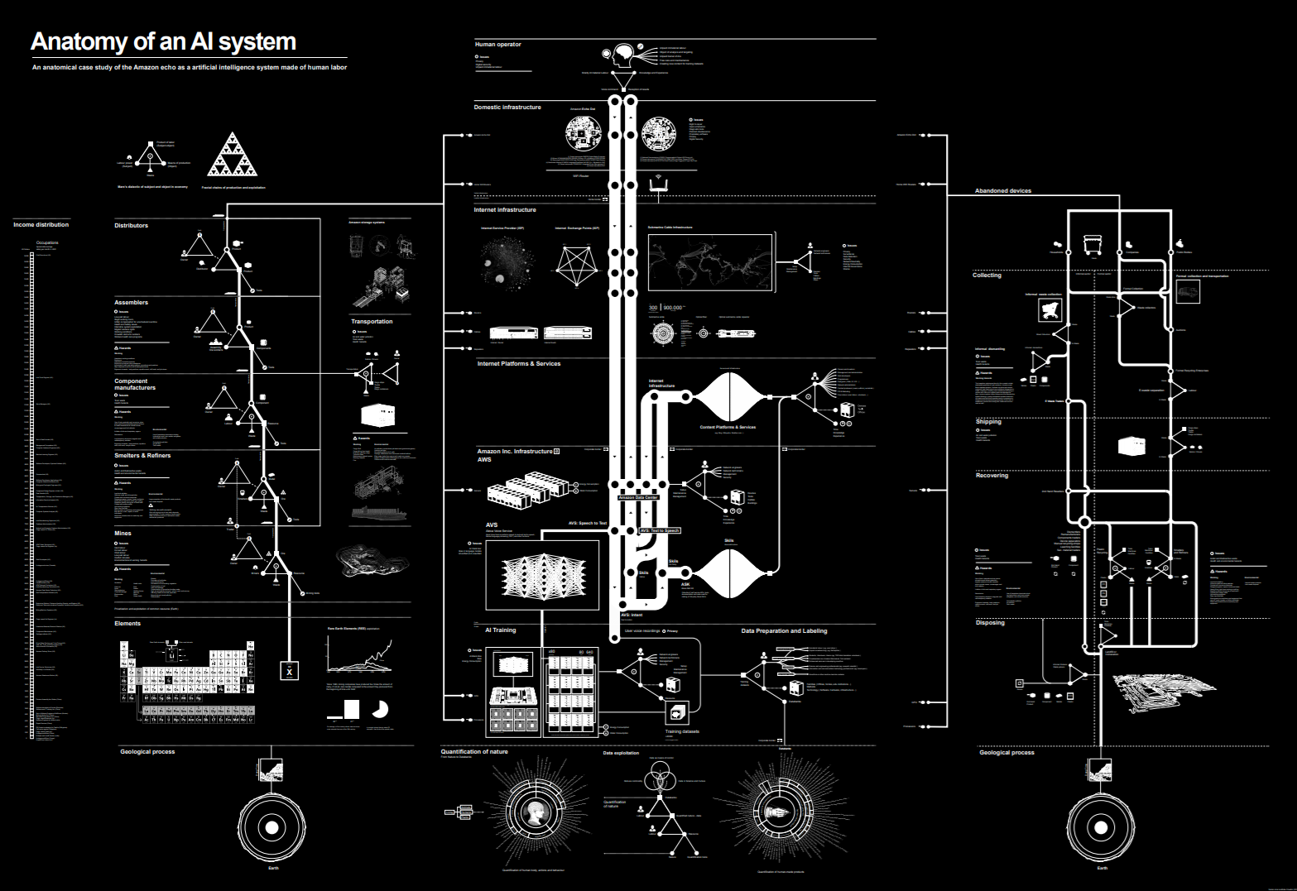
Hidden costs (1/15)
labeling factories (clickwork), content moderation, energy, material resources etc.

Slide 34
Guidelines

Slide 35
„Unethical“ behaviour (Kish-Gephart et al. 2010)
individual characteristics
moral development
idealism
machiavellianism
job satisfaction
education level
characteristics of the moral issue
concentration of consequences
magnitude of consequences
probability of effect
proximity
environment characteristics
egoistic ethical climate
benevolent ethical climate
code existence
code enforcement
appreciation of ethical behaviour
„unethical“ behaviour / intentions in organisations

Slide 36
Dr. Thilo Hagendorff
University of Tuebingen
Cluster of Excellence Machine Learning
thilo.hagendorff@uni-tuebingen.de
www.thilo-hagendorff.info

Slide 37
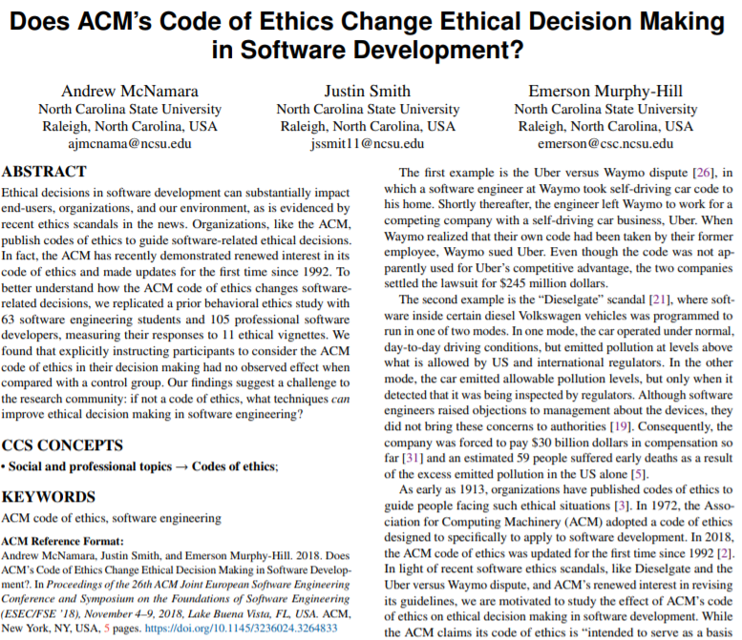
shortcomings of AI ethics
relative ineffectiveness of AI ethics
ethics as marketing
codes of ethics as compliance signals to prevent binding legal norms
figleaf function of ethics, stifling critical public discourses
Notes:
one problem the whole discourse about AI ethics has is that it lacks mechanisms to reinforce its own normative claims
the only thing to fear when violating ethical standards is a loss of reputation
or maybe restrictions on memberships in certain professional bodies etc.
but these mechanisms are rather weak and pose no eminent threat
all in all, ethics is relatively ineffective
and this ineffectiveness is not only evident on a theoretical level
one can also demonstrate that codes of ethics are have only minor effects on practice
what you can see on the slide is one study from McNamara et al. which investigated whether ethical guidelines bring about a change in individual decision-making
in brief, their main finding was that the effectiveness of guidelines is almost zero
in the experiment, 63 software engineering students and 105 professional software developers were scrutinized
first, they read the ethics guidelines of the ACM – the Association for Computing Machinery
then they were presented with eleven software-related ethical decision scenarios
the scenarios or vignettes ranged from user data collection, code quality, to honesty to customer etc.
and the sober conclusion of the study is – I quote: “No statistically significant difference in the responses for any vignette were found across individuals who did and did not see the code of ethics.”
a further problem is that many organizations are tempted or actually use ethics for marketing purposes or “whitewashing”
if, for example, companies set up ethics committees or if research consortia establish research groups on ethics, this has a positive outward effect
perhaps, though, the ubiquitous discourses on ethics discourage efforts to create a truly binding legal framework
codes of ethics may serve to suggest to legislators that internal self-governance is sufficient…
and that no specific laws are necessary to mitigate possible technological risks
a further aspect is that ethics can have a figleaf function
that means ethics discourses in industry and science simply stifle critical voices from the public…
while simultaneously, the criticized practices are maintained in the organization

Slide 38
Ethics - my approach (Hagendorff 2017)
ethics as a means of control
ethics as liberation
amorality,
uncontrolled behaviour, „state of nature“
adaptation to social environment,
determined routines
restriction, paternalism
scope of action
scope of action
freedom of decision
compliance with ethical principles of conduct
autonomy and freedom,
self-responsibility,
knowledge,
empathy
Notes:
the term ‘ethics’ stands for a plethora of theories and concepts, and I want to briefly introduce my approach or my theory of ethics since it differs significantly from traditional theories of ethics
ethics can either shrink or widen options for action
traditional ethical theories – the left side of the figure – assume that humans act in an amoral way as long as they are situated in the “state of nature”
then ethics comes along, defines how to measure right and wrong
and in the end, people act according to certain abstract ethical principles
those principles are in most cases inspired by utilitarianism or deontology
now the ethical approach on the left side which treats ethics as means of control is in my view obsolete

Slide 39
Ethics - my approach (Hagendorff 2017)
ethics as a means of control
ethics as liberation
amorality,
uncontrolled behaviour, „state of nature“
adaptation to social environment,
determined routines
restriction, paternalism
scope of action
scope of action
freedom of decision
compliance with ethical principles of conduct
autonomy and freedom,
self-responsibility,
knowledge,
empathy
Notes:
this is why I embrace the idea that ethics does not restrict but widen the scope of action
without ethical reflections, people are primarily just adapted to their social environment
they are more or less determined by group norms, their routines and so on
now what ethics does to equip people with knowledge and an apprehension or empathy for other sentient individuals – in my case, individuals who are in on or the other way affected by AI technologies
in the end, ethical knowledge can lead to greater autonomy
which also means that not the ethicist is the one separating right and wrong but every person for him- or herself
what the ethicist does is just to shed light on hitherto underrepresented issues

