Slide 1
Fabrication of Nb and Cu SPL cavities and required tools
CERN status
O. Capatina

Slide 2

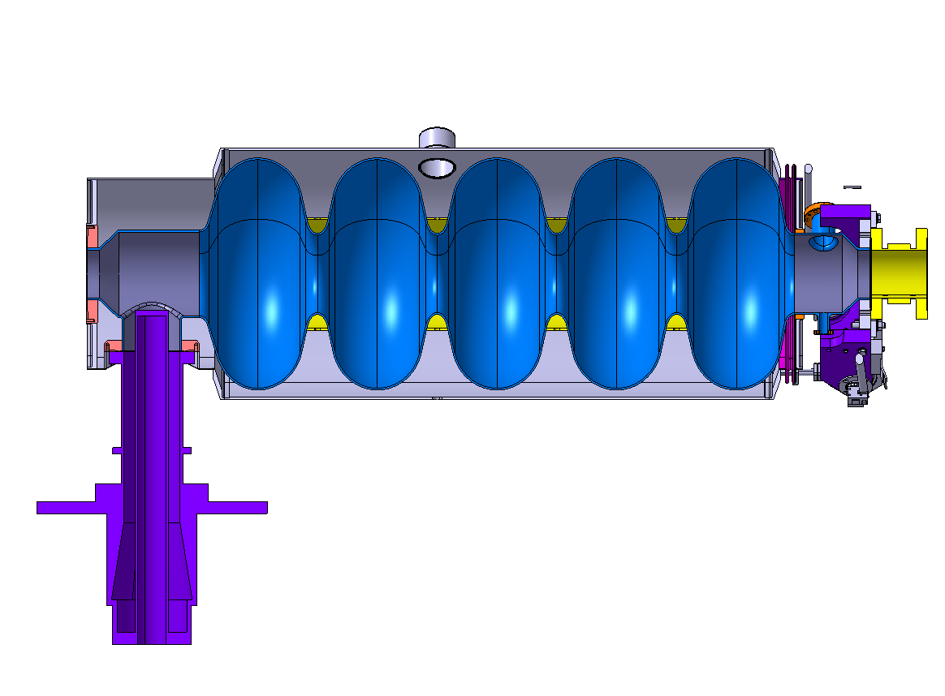
CERN status – NB cavity - General
sLHC
Design and quantities to be provided
  Nb cavity - 8 cavities to be provided
  Two types of He tank
    Tank Ti - 7 tanks to be provided
        HOM port position and diameter modified (36 mm internal)
        Nb thickness 3mm final value (after manufacturing)
    Tank Inox – 1 tank to be provided (for spare cavity)

Slide 3
CERN status - Nb cavity - Materials
sLHC
Materials
  Specifications - based on DESY spec:
    Nb
      Electrical properties
        RRR > 300 all but stiffening rings
        (RRR > 40 for stiffening rings)
      Chemical composition
        Chemical analysis - Content to be guaranteed
Ta ≤ 0.05 %
W ≤ 0.007 %
Ti ≤ 0.005 %
Fe ≤ 0.003 %
Si ≤ 0.003 %
Mo ≤ 0.005 %
Ni ≤ 0.003 %
        Content of interstitial elements - to be guaranteed
H2 ≤ 2ppm
N2 ≤ 10ppm
O2 ≤ 10ppm
C ≤ 10ppm

Slide 4
sLHC
CERN status - Nb cavity - Materials
Materials
  Specifications - based on DESY spec:
    Nb
      Grain size
        Grain size ASTM 6 or finer
        Local grain size ASTM 4.5
        Completely recrystallized structure – how to check?
      Mechanical properties at room temperature
        Tensile strength Rm > 140 N/mm2
        0.2% nonproportional elongation,
        50 < Rp0.2 < 100 N/mm2
        % elongation after fracture (using min 30mm gauge length)
        AL30 ≥ 30%
        Vickers hardness HV10 ≤ 60
          To be measured both orthogonal and parallel,
          diff < 20%

Slide 5
sLHC
CERN status - Nb cavity - Materials
Materials
  Specifications - based on DESY spec:
    Nb
      Quality of final product
        Clean conditions
        Free from defects: Defect definition for
          Surface defects
            Non niobium material
            Visible clusters from niobium oxides, segregation, cracks, blisters
            Scratches and marks of more than
              Roughness Rt ≥ 15 µm for RF side
              Rt ≥ 60 µm for back side
            Grease and finger prints
          Bulk
            Shrink holes, laminations and cracks
            Niobium oxide and non-niobium clusters

Slide 6
CERN status - Nb cavity - Materials
sLHC
Materials
  Specifications - based on DESY spec:
    Nb
      Tolerances
        Dimensions
          3.5 mm±0.1 mm (TBC) x TBD±1mm x TBD±1mm
        Surface flatness TBD
      Reception tests
        By supplier - all
        By CERN – Visual, Eddy current, tolerances (part)
    Ti : Ti grade 2 or Ti6Al4V-ELI
    NbTi and SS/Ti bimetallic transitions as already develop
  Furniture:
      Announced 3 months delay for Nb
      Nominal quantity + 10% is foreseen

Slide 7
CERN status - Nb cavity - Manufacturing
sLHC
Manufacturing Nb cavity
  First 2 cavities (1/3)
Task | External Company | CERN
Spinnnig of half-cells | X
Machining for iris and stiffening rings welding preparation |  | X
3D control |  | X
Degreasing |  | X
RF measurement of half-cell frequency |  | X
Ultrasonic cleaning; Etching (20 µm on each side) inner and outer surface, rinsed in de-ionized filtered hot water of 0.2µm max, dried in laminar airflow in clean room 1000 or better |  | X
3 µm chemical cleaning if storage time > 8h after previous step |  | X
EB welding of the iris from inside (within 8h from previous) |  | X
EB welding of stiffening rings |  | X

Slide 8
CERN status - Nb cavity - Manufacturing
sLHC
Manufacturing Nb cavity
  First 2 cavities (2/3)
Task | External Company | CERN
Inspection and dimensions control of “dumb-bell” |  | X
Frequency measurement of dumb-bell |  | X
Machining of both equator ends determined by evaluation of frequency |  | X
Ultrasonic cleaning; Etching (20 µm on each side) inner and outer surface, rinsed in de-ionized filtered hot water of 0.2µm max, dried in laminar airflow in clean room 1000 or better |  | X
Anodization of dumb-bell and inspection |  | X
Grinding if needed + 20 µm etching, rinsed, dried, anodized again |  | X
3 µm chemical cleaning |  | X
EB welding from outside of all equators (intermediate 3µm etching) |  | X

Slide 9
CERN status - Nb cavity - Manufacturing
sLHC
Manufacturing Nb cavity
  First 2 cavities (3/3)
Task | External Company | CERN
Resonator constrained against becoming shorter |  | X
Leak test |  | X
Inner surface, welds inspection, dimensions measurements |  | X
EP 150 microns |  | X
UHV annealing at 800°C |  | X
Field flatness measurement |  | TBD equipment Royal Holloway (?)
flash BCP 10 microns or final EP 30 microns |  | X
alcohol rinsing, drying in class 10 |  | X
UHV baking at 120° |  | X
HPR at 100 bars (6 times), drying in class 10 |  | X

Slide 10
CERN status - Nb cavity - Manufacturing
sLHC
Manufacturing Nb cavity
  Last 6 cavities (1/3)
Task | External Company | CERN
Spinnnig of half-cells | X
Machining for iris and stiffening rings welding preparation | X
3D control | X
Degreasing | X
RF measurement of half-cell frequency | X | Provides equipmt
Ultrasonic cleaning; Etching (20 µm on each side) inner and outer surface, rinsed in de-ionized filtered hot water of 0.2µm max, dried in laminar airflow in clean room 1000 or better | X
3 µm chemical cleaning if storage time > 8h after previous step | X
EB welding of the iris from inside (within 8h from previous) | X
EB welding of stiffening rings | X

Slide 11
CERN status - Nb cavity - Manufacturing
sLHC
Manufacturing Nb cavity
  Last 6 cavities (2/3)
Task | External Company | CERN
Inspection and dimensions control of “dumb-bell” | X
Frequency measurement of dumb-bell | X | Equip
Machining of both equator ends determined by evaluation of frequency | X
Ultrasonic cleaning; Etching (20 µm on each side) inner and outer surface, rinsed in de-ionized filtered hot water of 0.2µm max, dried in laminar airflow in clean room 1000 or better | X
Anodization of dumb-bell and inspection | X
Grinding if needed + 20 µm etching, rinsed, dried, anodized again | X
3 µm chemical cleaning | X
EB welding from outside of all equators (intermediate 3µm etching) | X

Slide 12
CERN status - Nb cavity - Manufacturing
sLHC
Manufacturing Nb cavity
  Last 6 cavities (3/3)
Task | External Company | CERN
Resonator constrained against becoming shorter | X
Leak test | X
Inner surface, welds inspection, dimensions measurements | X
EP 150 microns | X
UHV annealing at 800°C | X
Field flatness measurement | X | Equip
flash BCP 10 microns or final EP 30 microns | X
alcohol rinsing, drying in class 10 | X
UHV baking at 120° | X
HPR at 100 bars (6 times), drying in class 10 | X

Slide 13
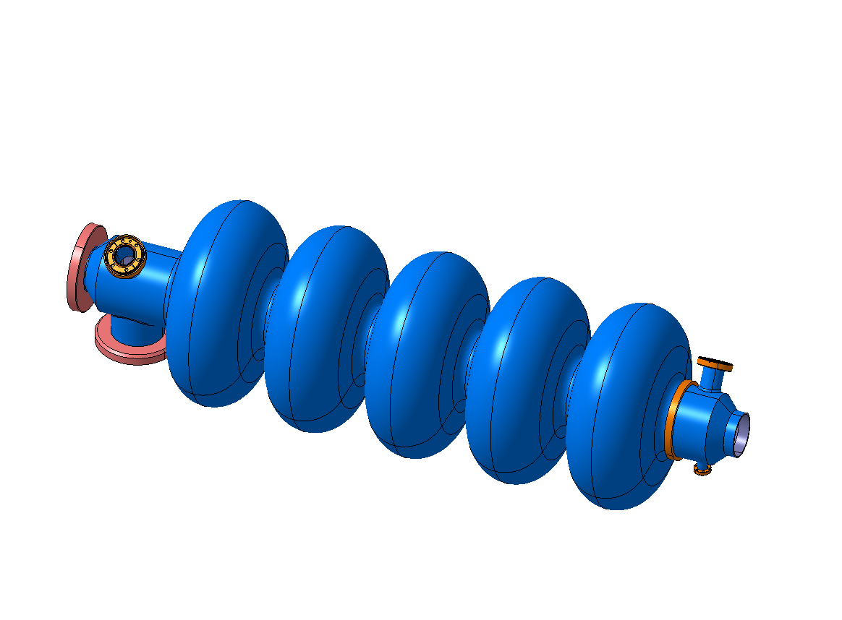
CERN status – Copper cavity
sLHC
Design
  Copper cavity(is) – Similar to Nb cavity to be manufactured for several tests purposes

Slide 14
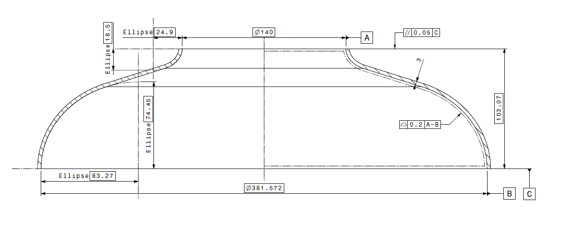
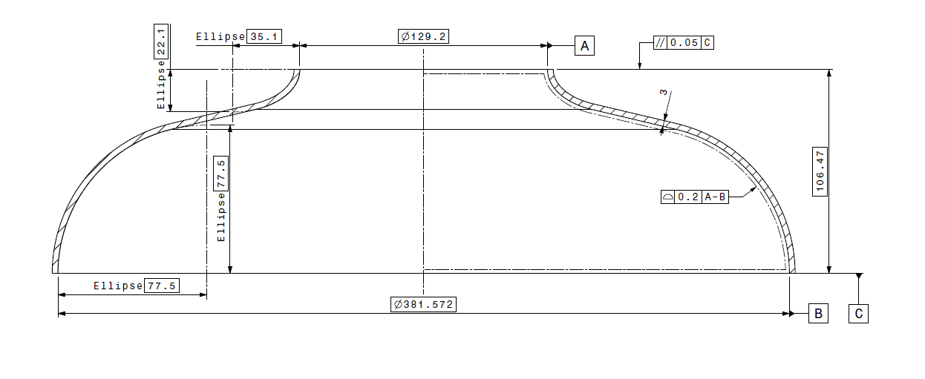
CERN status – Copper cavity
sLHC
Material for copper cavity
  Oxygen-Free High Conductivity (OFHC) Copper
  Start from 3.5 mm thick
Manufacturing
  Same tolerances as Nb cavities
  Same strategy as for the first 2 Nb cavities
    Spinning external companies
    EB welding, chemistry at CERN

Slide 15
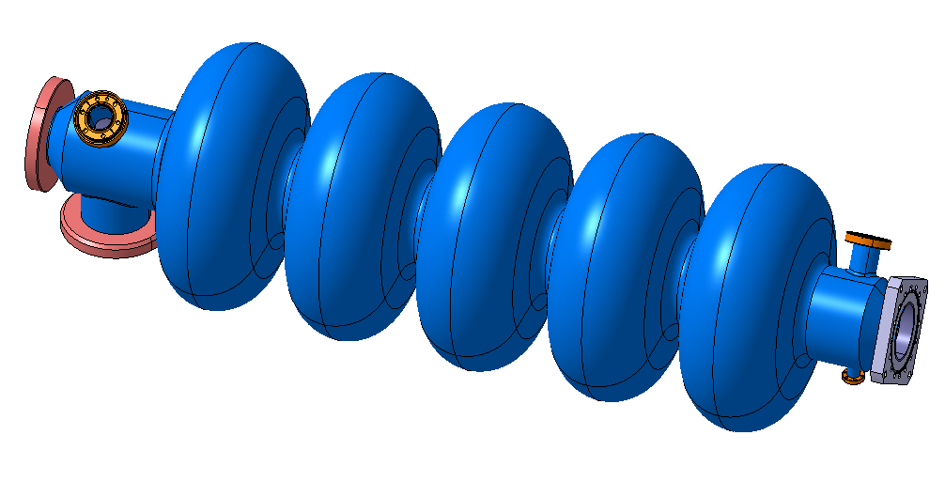
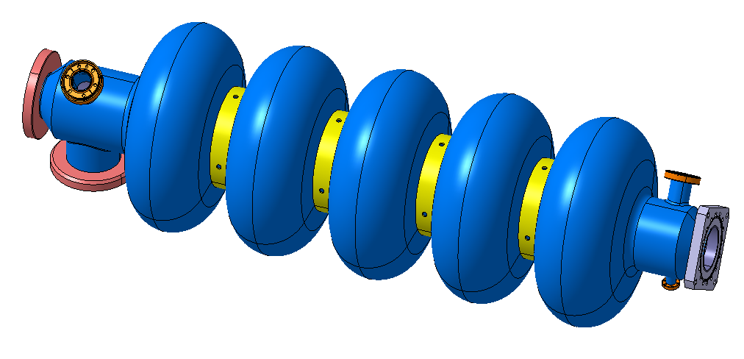
CERN status – Copper cavity
sLHC
Design and quantities to be provided - Proposal
  Copper cavity – 3 cavities to be provided (proposal)
              2 cavities for HOM tests
                1 for CERN tests
                1 for Royal Holloway London TBC
  1 cavity for EP
  (and Nb deposition?) tests
    With reinforcement rings

Slide 16
CERN status / stategy
sLHC
Discussions ?
Thank you

Slide 17
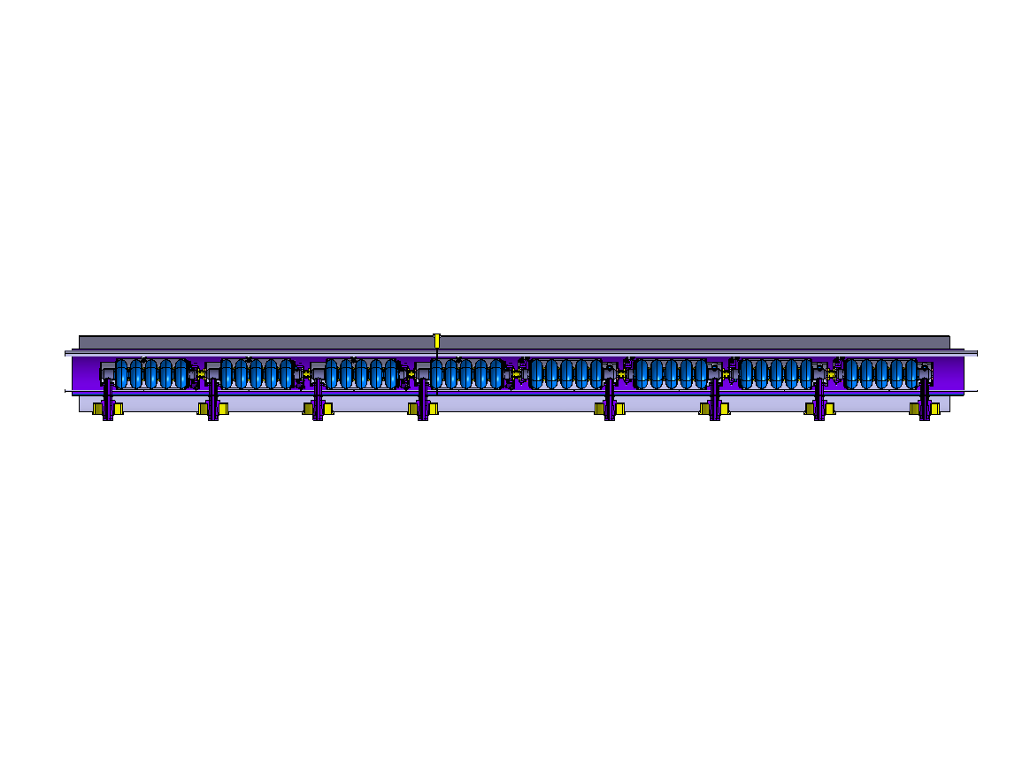
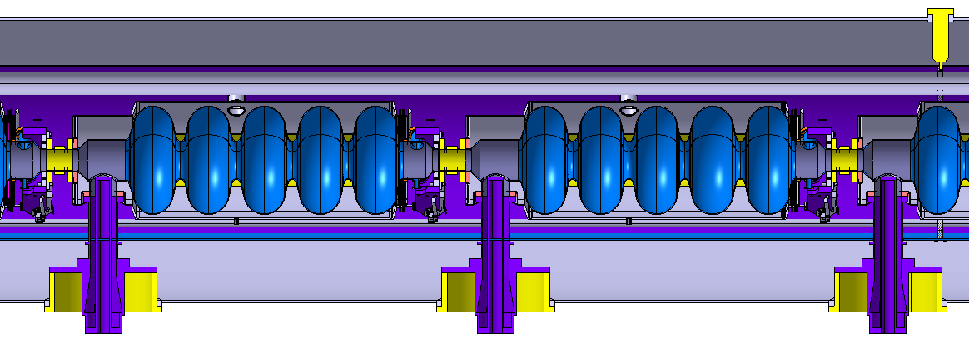
CERN status / stategy
sLHC

