Slide 1
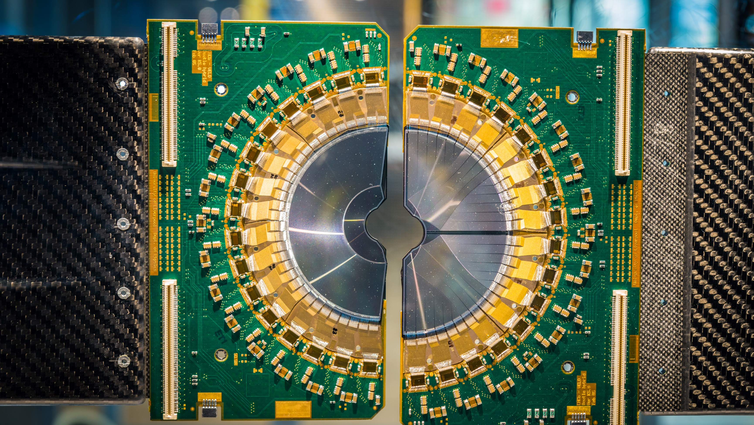

BIG SCIENCE
Liaisons with Industry
Sylwia Wójtowicz, Dariusz Bocian
www.big-science.pl
A venue where business meets science

Slide 2






The Polish ILO network:
Who we are?
ILO to ESS
Dariusz Bocian
dariusz.bocian@ifj.edu.pl
+48 12 662 84 63
ILO to ESO
Oskar Zdunek
ozdunek@space.biz.pl
+48 22 874 04 12
ILO to CERN & F4E
Sylwia Wójtowicz
wojtowicz@technologpark.pl
+48 78 187 18 10

Slide 3
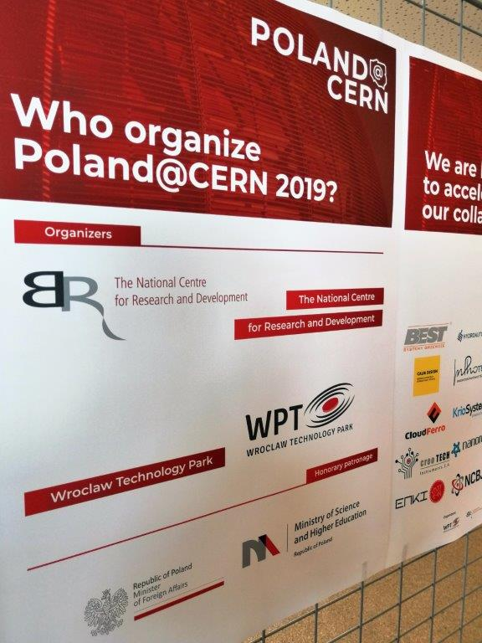





The Polish ILO network:
How we are organised
Polish Industry
High Technology Innovators
Scientific Community
Start-ups

Slide 4
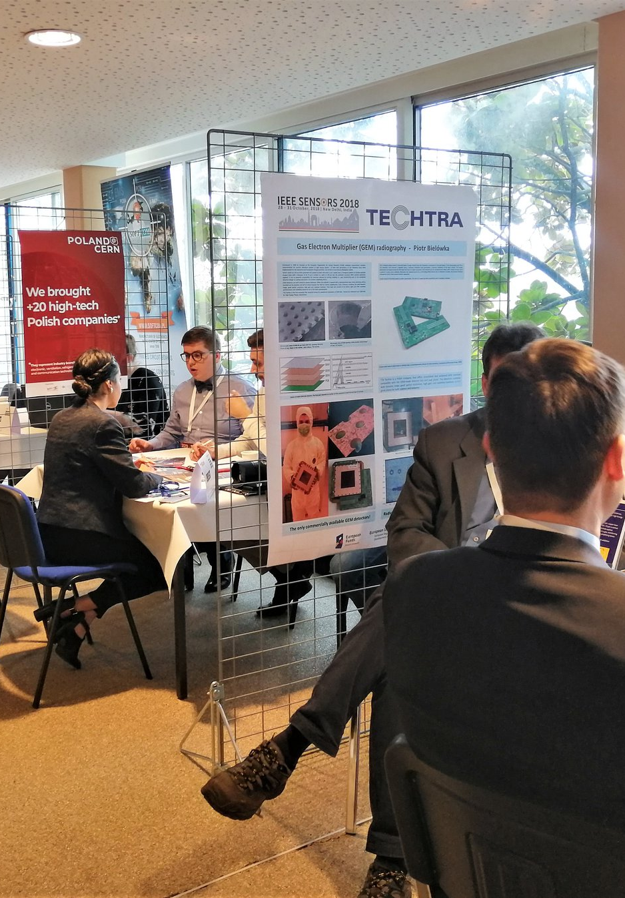
How we are working
Two-way flow of information:
  Presenting tenders to Polish companies
  Presenting the capabilities of Polish companies to the Big Science community
Financial support:
  Funding of selected activities provided by government
  Funding from private enterprise
  Occasional funding from projects for dedicated events

Slide 5
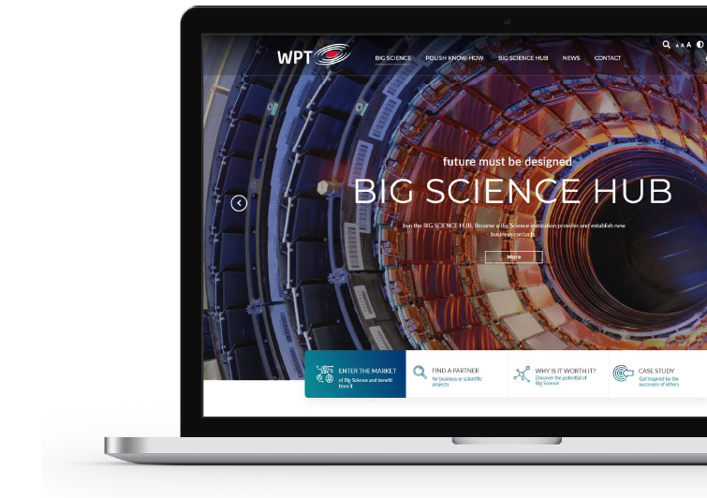

BIG SCIENCE
HUB
BIG SCIENCE HUB is a venue where business meets science. It is a platform enabling the flow of knowledge on how, where and with whom to establish relationships that drive measurable revenues.
We bring together companies and institutions involved in innovations and new technologies. They can find new cooperation partners and demonstrate their activities and gain insight into the potential of other businesses, universities and business environment institutions.
www.big-science.pl

Slide 6




Present the offer of a company or institution that you represent to potential business partners.
BIG SCIENCE
HUB
objectives
Find partners who will help you grow your business or who will enter into cooperation with you.
Seek contractors or service providers who will provide assistance in your project implementation.
Stay informed! Read news from market and find interesting tenders and announcements from Big Science institutions.
www.big-science.pl

Slide 7
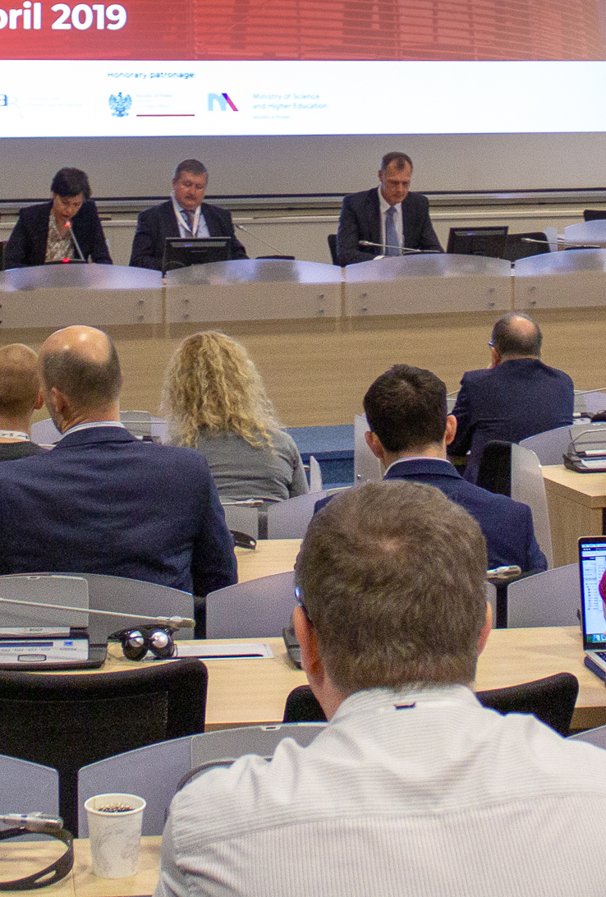


BIG SCIENCE HUB
it's not just a portal.
Let's create it together on:
It's a community.
www.big-science.pl

Slide 8

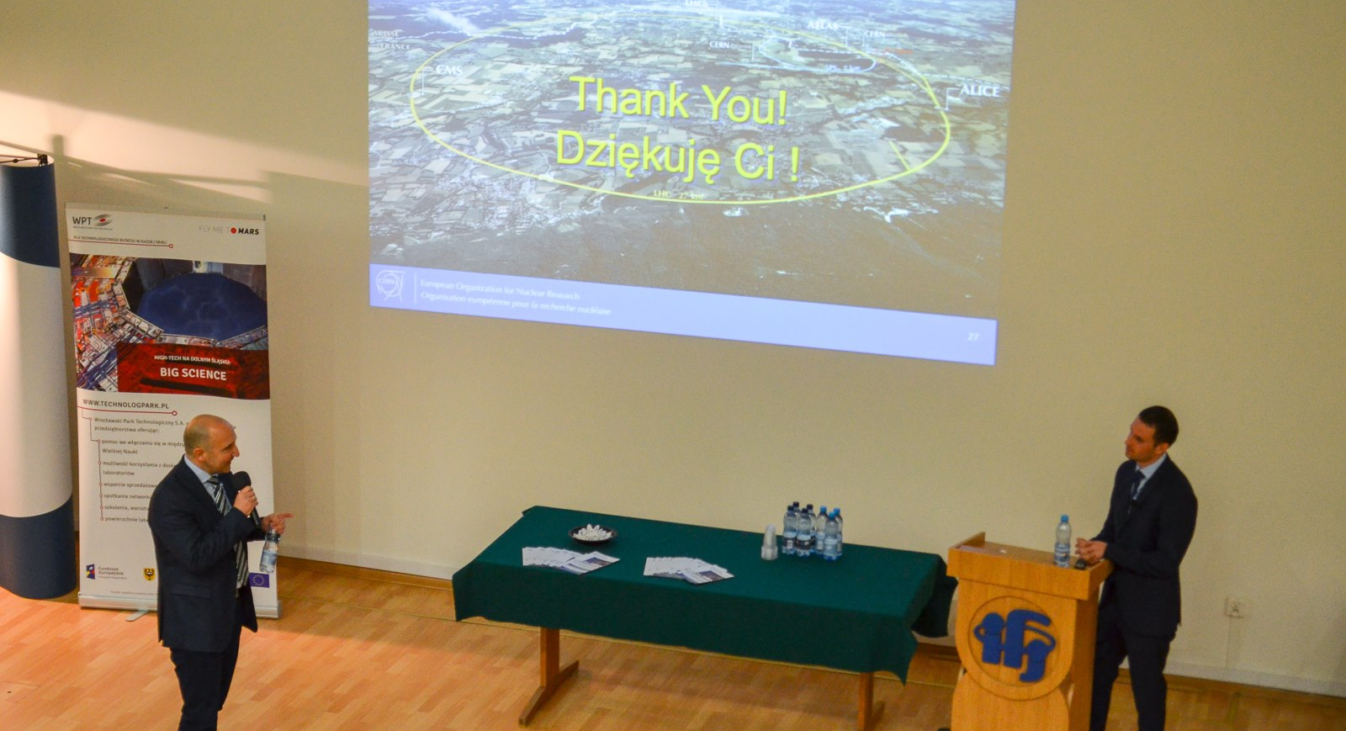


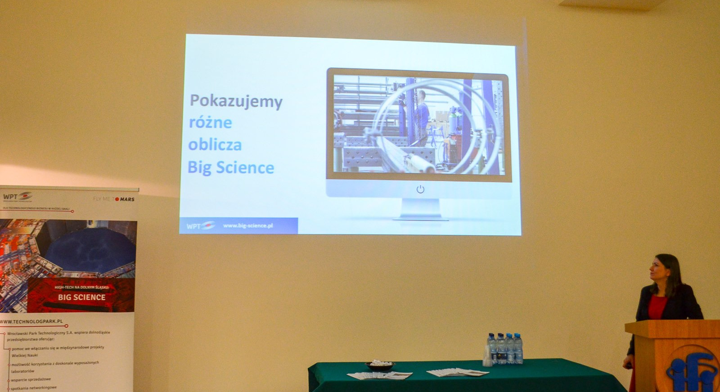
Nordine Azizi, CERN
Big Science Partner
& Industry Day
30.11.2018, IFJ PAN, Kraków
Mirko Menninga (ESS)
60+
participants
Sylwia Wójtowicz, ILO CERN
Representatives of purchasing departments of the largest Big Science centers: CERN, ESS, Fusion for Energy
20+ B2B meetings with Polish companies
www.big-science.pl

Slide 9

Poland&CERN
collaboration
+20
companies and institutions from polish high-tech sector
+120
networking meetings
of 60 polish participants with CERN representatives
www.big-science.pl

Slide 10
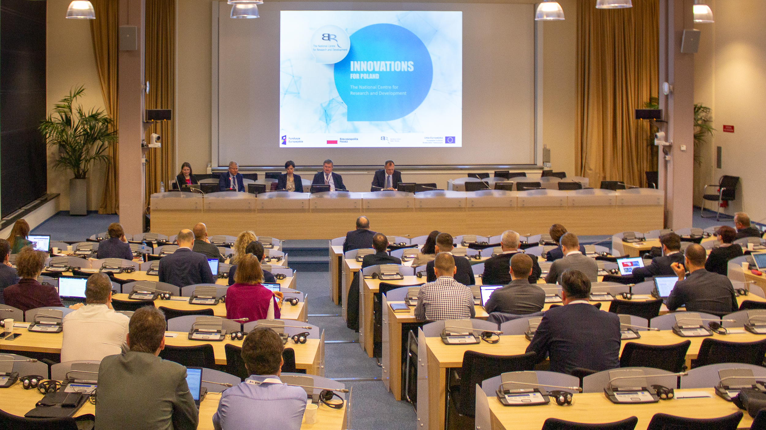
Poland@CERN 2019 was a great convenience for companies in establishing contact with specialists working at CERN. Undoubtedly, many of them have been attracted by variety of offers from companies and institutions that represent Polish business environment.
Piotr Bielówka, president of the Techtra company
”
We cooperated with CERN in the past, and Poland@CERN 2019 was a great opportunity for us to refresh our contacts with representatives of CERN. It was particularly useful for us to meet specialists who are directly responsible for the purchasing process at CERN.
Szymon Skrzypiec, OEM Sales Coordinator from Prevac
”
We are glad that Polish companies from the high-tech sector, are promoted in an organized way, as potential suppliers for CERN. I’m convinced that Polish engineers and enterprises can bring a lot to this kind of scientific and research institutions.
Zbigniew Lewandowski, Commercial Director and Jakub Soszyński, Head of the FrakoTerm Sales Department
”
www.big-science.pl

Slide 11

Poland&ITER
collaboration
After the success of Poland @ CERN 2019, we are launching the POLAND FOR ITER initiative, dedicated to increasing the number of collaboration established by Polish companies with Fusion for Energy (F4E).
Competency matrix of Polish high-tech sector is set to be our national offer for ITER. Thanks to it we will show that Polish companies and institutions have the potential to carry out even the most complex tasks for this project. The key is their collaboration.
www.big-science.pl

Slide 12
Poland & ESS collaboration
POLAND @ ESS 2020
We have launched the POLAND @ ESS 2020 initiative.
We will present the opportunities in European Spallation Source ERIC
to Polish companies and institutions.
The objective is to increase the number of Polish companies involved in construction of the European Spallation Source.
www.big-science.pl

Slide 13


Conference "Innovative Europe 2017
– Fly Me to Mars”
Wroclaw, 23-24.11.2017

Slide 14
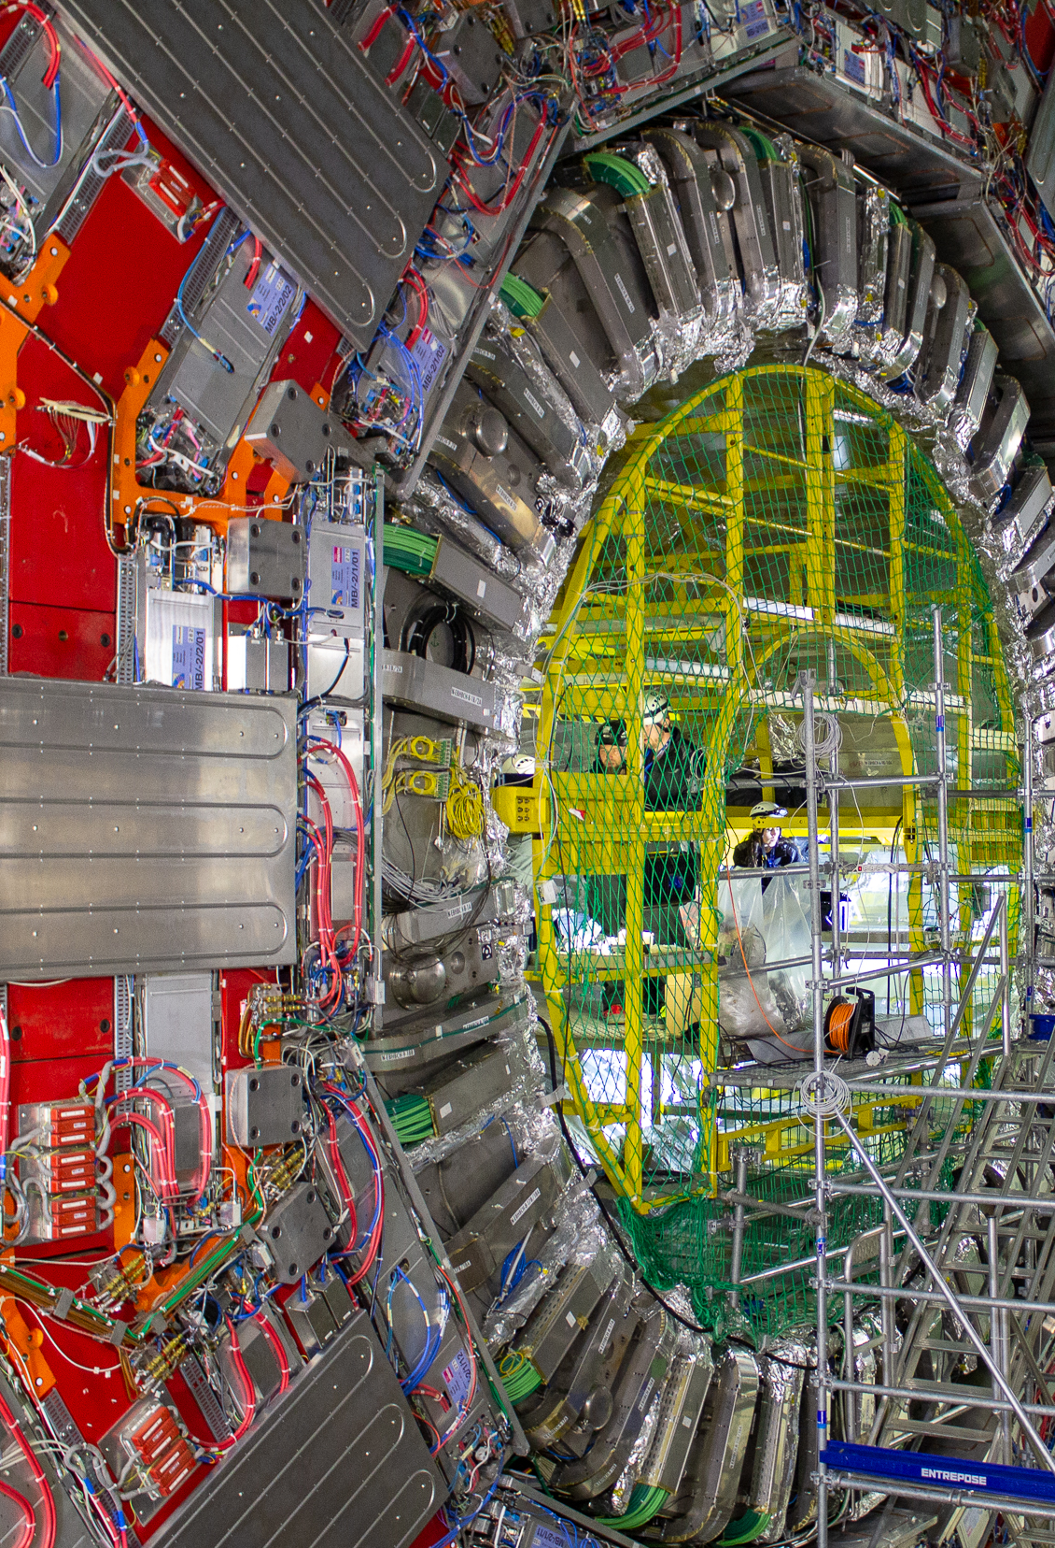


What’s
next?
www.big-science.pl

Slide 15
Thank you!
Let’s meet on:
www.big-science.pl
The coordinator and initiator of BIG SCIENCE HUB project is the Wroclaw Technology Park

