Slide 1

National Science Centre
Prof. Małgorzata Kossowska, Ph. D.
Head of the Council of the National Science Centre

Slide 2



  GENERAL INFORMATION
The National Science Centre (NCN) is a government executive agency set up to fund basic research in three scientific domains:
arts, humanities and social sciences
physical sciences and engineering
life sciences
Basic research is original experimental or theoretical research work that strives to expand knowledge of the fundamentals of phenomena and observable facts. It is not intended to have any direct commercial application or use.
The NCN regularly publishes calls for proposals for research projects, fellowships and post doctoral internships.

Slide 3

MISSION
OBJECTIVES
Financing the best projects in the area of basic research.
Supporting researchers starting their career in research.
Supporting researchers wanting to establish new research teams, including interdisciplinary endeavours capable of competing on the global stage.
Creating new employment opportunities in research projects.
Inspiring international cooperation in research.
Improving the quality of research
in Poland by means of a competition
-based system of funding opportunities, furthering the advancement of Polish research
on the international arena.

Slide 4
NCN TOTAL BUDGET
2011-2018
Total subsidy from the Ministry of Science and Higher Education (EUR)

Slide 5

Funding schemes
NATIONAL CALLS

Slide 6




2011-2018 NCN NATIONAL CALLS
100
89
18,432
7.7
B PLN
announced
calls
concluded
calls
awarded grants
awarded funds

Slide 7









NCN NATIONAL CALLS
Calls for research projects:
RESEARCHERS
AT THE BEGINNING
OF THEIR CAREER
RESEARCHERS WITH A DOCTORAL DEGREE
PRELUDIUM
SONATINA
SONATA
SONATA BIS
pre-doctoral candidates;
the opening of a doctoral degree awarding procedure is not a condition for submitting a funding proposal
doctoral degree obtained within 3 years before submitting the proposal
doctoral degree
awarded within 2 to 7 years
before submitting the proposal
doctoral degree
awarded within 5 to 12 years
before submitting the proposal
EXPERIENCED RESEARCHERS
NCN CALL WINNERS
OPEN TO ALL RESEARCHERS
MAESTRO
TANGO
OPUS
at least a doctoral degree,
pioneering research
implementation of deliverables
achieved under basic research
research projects,
including projects carried out
under international cooperation
and funding of research equipment
  Calls for fellowships, scholarships, research activities:
ETIUDA
UWERTURA
MINIATURA
scholarships for
doctoral candidates
fellowships in foreign research teamimplementing ERC grants
individual research activities aimed at conducting basic research

Slide 8


2011-2018 NCN GRANTS
– proposals submitted and qualified for funding
under NCN calls
20%
22%
Notes:
Physical Sciences and Engineering

Slide 9
2011-2018 NCN GRANTS
– success rate figures for HS, ST, NZ
MINIATURA 2 call, resolved in 2018-2019, was entirely included in 2018.
TANGO call was not included.

Slide 10
Funding schemes
INTERNATIONAL COOPERATION

Slide 11
NCN INTERNATIONAL CALLS IN 2011-2018
51
41
240
182.3
M PLN
announced
calls
concluded
calls
awarded grants
awarded funds

Slide 12






INTERNATIONAL CALLS
BILATERAL COOPERATION PROGRAMMES
BEETHOVEN
BEETHOVEN LIFE
DAINA
SHENG
in cooperation with German Research Foundation (DFG)
for Polish-German
research projects
in cooperation with German Research Foundation (DFG)
for Polish-German
research projects
in cooperation with Research Council of Lithuania (RCL)
for Polish-Lithuanian research projects
in cooperation with National Natural Science Foundation of China (NSFC)
for Polish-Chinese research projects
DIOSCURI
MOZART
ALPHORN
in cooperation with Germany’s Max Planck Society (MPG)
for funding the establishment of Centres of Scientific Excellence in Central
and Eastern Europe
in cooperation with Austrian Science Fund (FWF)
for Polish-Austrian research projects
in cooperation with Swiss National Science Foundation (SNSF)
for Polish-Swiss research projects

Slide 13




INTERNATIONAL CALLS
– MULTILATERAL COOPERATION
HERA – Humanities
  NORFACE – Social Sciences
  EqUIP – Humanities and Social Sciences
JPI AMR – antibiotic resistance
JPcofuND 2 – neurodegenerative diseases
ERA-CAPS – molecular biology of plants
CHIST-ERA – communication and information technologies
M-ERA – materials science
Solar-Driven Chemistry – photochemistry, photocatalysis
QuantERA – quantum technologies
BiodivERsA – biodiversity
ForestValue – forest management
SUGI – contemporary urban challenges
JPI EU + China – contemporary urban challenges

Slide 14

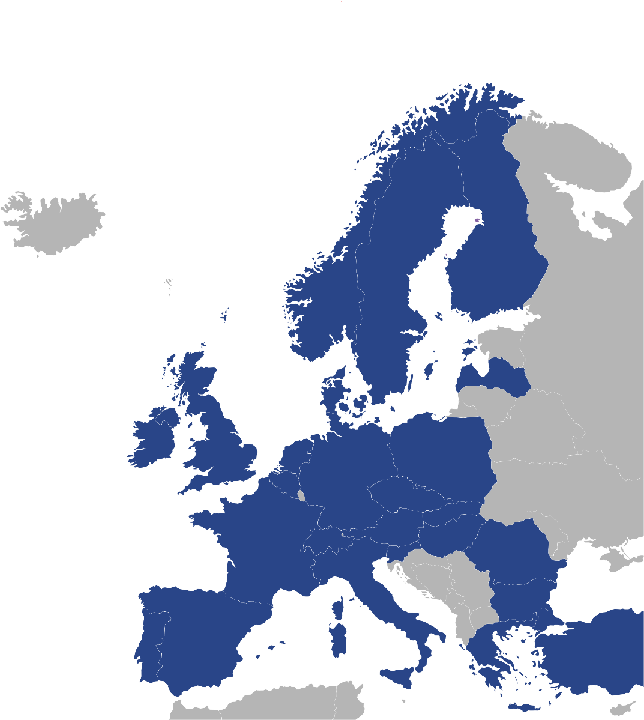
ERA-NET Cofund Programme co-ordinated by the NCN is the global largest network of agencies funding research in the field of quantum technologies made up of 32 organisations from 27 countries
Programme's budget is 34 M EUR
Austria – FWF, FFG
Belgium – FNRS, FWO
Bulgaria – NBSF
Czech Republic – MEYS
Denmark – IFD
Finland – AKA
France – ANR
Germany – BMBF, VDI-TZ
Greece – GSRT
Hungary – NKFIH
Ireland – SFI
Israel– MATIMOP
Italy – MIUR, CNR
Latvia – VIAA
The Netherlands – NOW
Norway – RCN
Poland – NCN, NCBR
Portugal – FCT
Romania – UEFISCDI
Slovakia – SAS
Slovenia – MIZS
Spain – MINECO-AEI
Sweden – VR
Switzerland – SNSF
Turkey – TUBITAK
The United Kingdom – EPSRC, InnovateUK

Slide 15
First QuantERA call – results
Submitted proposals:
number of all submitted proposals: 221
total budget of all submitted proposals: 236 M EUR
Funded projects:
number of funded projects: 26
value of funded projects: 32 M EUR
EC co-funding 11.5 M EUR
Results of Polish researchers:
number of funded proposals with teams from Poland: 9
success rate of Polish researchers (2 stage): 35 %
total budget of the proposals funded by the NCN: 1.56 M EUR
budget for the NCN from the EC 0.5 M EUR
Second QuantERA call – conclusion of the call in autumn 2019

Slide 16



INTERNATIONAL CALLS -
EEA FUNDS AND NORWAY GRANTS
“Research” Programme 3rd Edition of Norway Grants
Programme’s budget: 48.77 M EUR
Operator: National Science Centre:
Programme partner: Research Council of Norway
IDEALAB call for innovative, ground-breaking research projects that are a response to important social challenges, carried out in cooperation with teams from Norway, Iceland, and Liechtenstein, with a budget of 4.43 M EUR
GRIEG a call for Polish-Norwegian research projects, with special focus on polar research and research in the field of social sciences, with a budget of 37.34 M EUR
POLS call for research projects by foreign scientists
wishing to conduct research in Poland, with a budget of 7 M EUR

Slide 17
LEAD AGENCY PROCEDURE:
Central EUropean Science initiative (CEUS)
Science Europe Multilateral Lead Agency Task Force
Science Europe Multilateral Lead Agency Task Force
Switzerland: SNSF (LIDER)
Austria: FWF
Belgium: Research Foundation Flanders (FWO), F.R.S.-FNRS
Croatia: HRZZ
Germany: DFG
Finland: Academy of Finland (AKA)
France: ANR
Ireland: SFI
Luxemburg: FNR
Netherlands: NWO
Norway: RCN
Portugal: FCT
Sweden: FORMAS
United Kingdom: UKRI
Central EUropean Science initiative (CEUS)
Austria: FWF (LIDER)
Czech Republic: GACR
Poland: NCN
Slovenia: ARRS

Slide 18
NCN EXPERTS IN 2011-2018
– foreign experts
% of foreign experts involved in the project evaluation procedure
Ratio of the number of foreign reviews to all external reviews

Slide 19
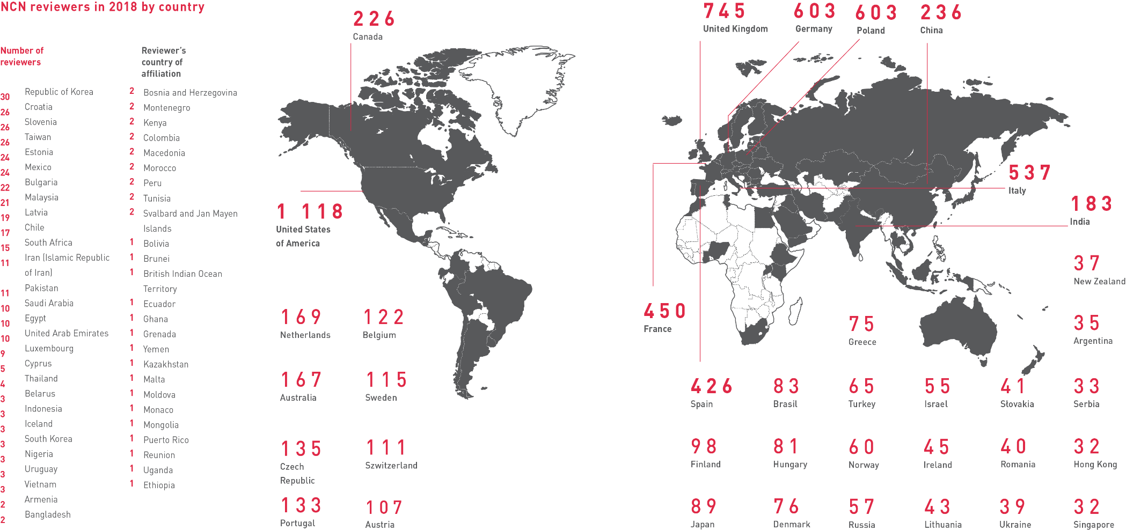
2018 NCN EXPERTS
– countries with research affiliation of foreign experts

Slide 20
Physics in NCN calls

Slide 21
PHYSICS IN NCN CALLS
ST2 BASIC COMPONENTS OF MATTER
Fields: physics of elementary particles, nuclear physics, physics of plasma, atomic physics, molecular physics, physics of gases, and optical physics
ST3 CONDENSED MATTER PHYSICS
Fields: structure, electron properties, liquids, nanoscience
ST9 ASTRONOMY AND SPACE RESEARCH
Fields: astrophysics, astrochemistry, astrobiology, the Solar System, planetary systems, stellar astronomy, galactic and extragalactic astronomy, space research and instruments
Notes:
Research projects in the area of physics are submitted in three discipline panels:

Slide 22
PHYSICS IN NATIONAL AND INTERNATIONAL CALLS
Results of NCN calls 2011 - 2018
ST panel | ST2 | ST3 | ST9
submitted proposals | 1633 | 1830 | 856
qualified proposals | 559 | 521 | 276
success rate | 34% | 28% | 32%
cost of funded projects | 319.307 M PLN | 311.415 M PLN | 165.837 M PLN
NCN calls: ETIUDA, FUGA, MAESTRO, MINIATURA, OPUS, PRELUDIUM, SONATA, SONATA BIS, SONATINA, SYMFONIA, TANGO, UWERTURA
International calls: BEETHOVEN, DAINA, HARMONIA, POLONEZ, UNISONO

Slide 23
OPUS – A NEW FORMULA
for research projects, including international projects:
carried out as international cooperation under a direct agreement with a partner or partners representing foreign research institutions
carried out as bilateral international programmes and initiatives
carried out as multilateral international programmes and initiatives
whereby Polish teams use large-scale international research infrastructure
Principles of evaluating:
evaluation of international cooperation in assessment of project feasibility
significance of international cooperation for the completion of the research project

Slide 24
OPUS – A NEW FORMULA
Advantages:
cost of construction or modernisation of research equipment is eligible for funding
better opportunities of building research teams by principal investigator
cost of salaries and scholarships are eligible for founding
additional remuneration for members of the research team
costs of business trips of the members of the research team are eligible for founding

Slide 25
More information at:
www.ncn.gov.pl
Thank you for your attention!

