Slide 1
Beam tube damping estimations for SPL cavity
W. Weingarten

Slide 2
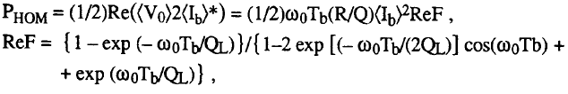
Power deposited by beam into a HOM (1/3)
From Yellow Report CERN-1992-03 CERN Accelerator School, page 338 f.
“- “sign missing

Slide 3
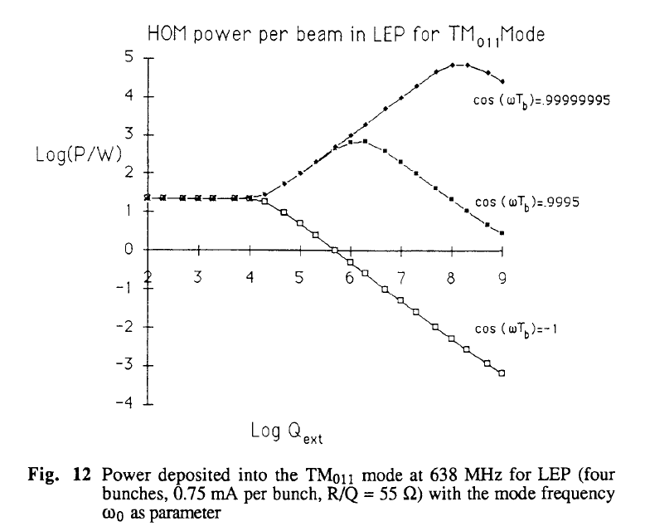
Power deposited by beam into a HOM (2/3)

Slide 4
Power deposited by beam into a HOM (3/3)

Slide 5
Preliminary simulations with SUPRFISH
for reference design cavity (asymmetric Saclay proposal)
for most “prominent” frequency bands taken from J.Plouin’s table
with absorbing material having ρ = 240 μΩ cm (high Al iron¹)
by only modifying the diameter of the beam tube
¹ ASM Metals Handbook--Volume 1, Tenth Edition

Slide 6
HOM (1) : list
#freq r/Q beta_opt Qo Rs_nOhm
692.459406 15.495341 0.55 5.87048e+10 4.58
695.691165 40.295848 0.63 5.85048e+10 4.60
699.762722 86.977902 0.71 5.82537e+10 4.62
703.121236 173.038043 0.81 5.80475e+10 4.64
704.420268 565.499512 1.00 5.8134e+10 4.65
1293.187800 3.150182 0.66 4.06538e+10 9.75
1303.568690 7.969888 0.72 4.01921e+10 9.86
1317.445320 17.344152 0.79 3.95608e+10 10.02
1329.742220 59.154893 1.00 3.9004e+10 10.16
1335.734260 107.744313 0.98 3.8525e+10 10.23
1450.724780 0.831396 0.92 5.06898e+10 11.62
1460.366080 1.999197 0.89 5.03429e+10 11.74
1474.206000 2.839266 0.85 5.03023e+10 11.92
1488.535980 2.701775 0.80 5.09436e+10 12.10
1499.066360 2.342662 0.73 5.20134e+10 12.24
Source: J. Plouin et al., 3rd SPL Collaboration Meeting11-13 November, CERN
Operating frequency mode (π) : f₀ = 704.4 MHz
No monopole HOM at 2f₀
1843.272060 0.209069 0.95 3.35164e+10 17.22
1858.324840 0.596186 0.91 3.26306e+10 17.47
1881.326440 1.603429 0.98 3.28434e+10 17.84
1911.484360 1.329645 0.94 3.31308e+10 18.33
1948.248770 1.819111 1.00 3.35394e+10 18.95
2000.236410 2.451434 0.98 3.13642e+10 19.84
2039.865120 1.377179 0.78 3.70143e+10 20.53
2072.798390 3.019703 0.83 3.349e+10 21.12
2086.249930 5.689452 0.88 3.00335e+10 21.36
2089.642160 19.164504 1.00 2.90251e+10 21.42
2111.640680 10.636820 1.00 2.94648e+10 21.82
2119.767790 8.476595 1.00 2.65214e+10 21.97
2138.944200 1.075819 0.95 2.94674e+10 22.33
2175.157760 1.744804 0.91 3.24669e+10 23.00
2219.889020 4.482180 0.97 3.46431e+10 23.86
2262.192880 7.529522 1.00 3.6688e+10 24.68
2290.061390 0.330347 0.85 4.00758e+10 25.23
Mode at 2111.64 MHz very near 3f₀
Cut-off frequencies for the mode TM010
Ø 80 mm : 2865 MHz
Ø 130 mm : 1763 MHz
Ø 140 mm : 1637 MHz
2464.607050 0.764947 0.95 2.5928e+10 28.82
2485.980300 1.514541 1.00 2.63647e+10 29.28
2512.576190 1.303253 0.96 2.84428e+10 29.86
2538.171130 8.505168 1.00 3.13472e+10 30.42
2559.022710 6.760250 0.99 3.40374e+10 30.88
2565.011240 2.855068 0.95 3.43392e+10 31.01
2639.339900 0.070686 0.90 2.41594e+10 32.69
2645.191100 0.071469 1.00 2.48068e+10 32.82
2650.937090 0.150348 1.00 2.47399e+10 32.96
2657.099030 0.275372 1.00 2.44513e+10 33.10
2721.471070 1.230228 0.96 2.23449e+10 34.60
2765.009700 0.249521 0.83 2.99369e+10 35.63
2781.989510 0.411752 0.87 2.61634e+10 36.04
2799.460470 0.229298 0.90 2.30615e+10 36.46
2809.660150 6.941103 1.00 2.09609e+10 36.71
List of monopole HOM calculated with Superfish between 0 and 3000 kHz
Axisymetric calculations

Slide 7
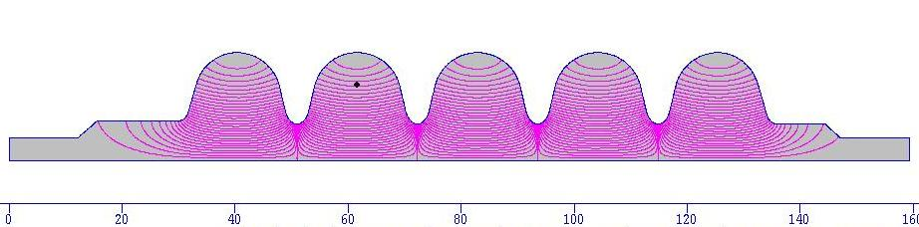
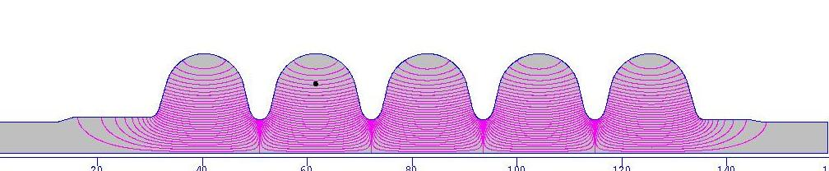
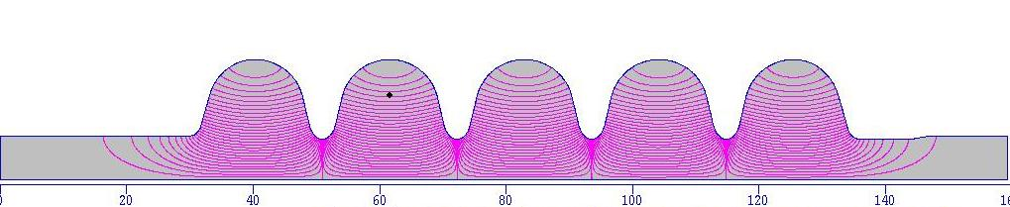
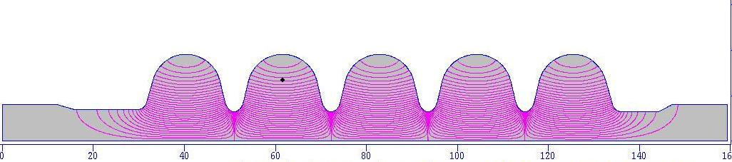
Different beam tube diameters investigated
Reference design (Saclay): Ø 8 cm
Beam tube Ø 12 cm
Beam tube Ø 14 cm
Beam tube Ø 16 cm

Slide 8
Q vs. f (1/6) for beam tube OR beam tube & taper being normal conducting
Beam spectral lines nf₀
f_{c} [GHz] = 23/diam [cm]
Cut off

Slide 9
Q vs. f (2/6) for beam tube OR beam tube & taper being normal conducting
Beam spectral lines nf₀
Cut off

Slide 10
Q vs. f (3/6) for beam tube OR beam tube & taper being normal conducting
Beam spectral lines nf₀
Cut off

Slide 11
Q vs. f (4/6) for beam tube OR beam tube & taper being normal conducting
Beam spectral lines nf₀
Cut off

Slide 12
Q vs. f (5/6) for beam tube OR beam tube & taper being normal conducting
Beam spectral lines nf₀

Slide 13
Q vs. f (6/6) for beam tube OR beam tube & taper being normal conducting
Forbidden frequency bands (nf₀ ± 10 MHz)

Slide 14
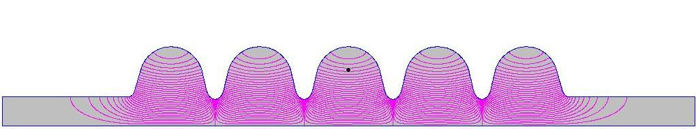
Q vs. f (symmetric geometry) (1/2)

Slide 15
Q vs. f (symmetric geometry) (2/2) for beam tube OR beam tube & taper being normal conducting
Forbidden frequency bands (nf₀ ± 10 MHz)
Cut off

Slide 16
Preliminary conclusion
Damping HOM via dissipation in beam tube is difficult for the specific resistive material studied (high Al iron)
Better damping with 12 or 14 cm Ø beam tube compared to reference design, especially for modes with f > 1800 MHz
The taper should be superconducting
Designing the cavity such that the HOM frequencies avoid the bunch spectral bands n·f₀ ± 10 MHz should keep the HOM power sufficiently low (< 100 mW for Q_{ext} > 5·10⁴)
Antenna HOM absorbers trimmed for 1300 and 1500 MHz seem to be needed
More comprehensive studies required

