Slide 1
NA: the future is colourful and dark
Mike Lamont
40 years SPS NA Physics Celebration
Acknowledgements: Gaia Lanfranchi, Lau Gatignon, Conventional Beams WG

Slide 2
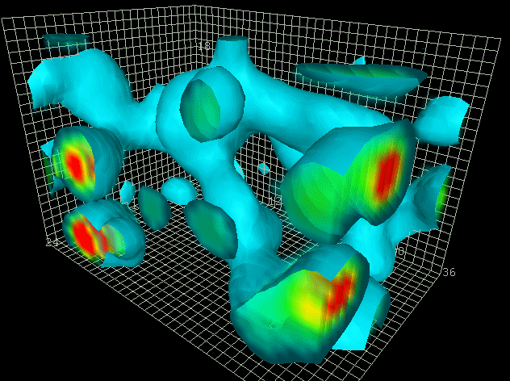
QCD
remains wonderfully intriguing
Action density:
4 dimensional structure of the long-distance aspects of the QCD vacuum
2.4 fm
Derek B. Leinweber http://www.physics.adelaide.edu.au

Slide 3
Higgs discovered with mass ~125 GeV.
No new particles found.

Slide 4
Stefania Gori

Slide 5
Direct detection – WIMP searches

Slide 6
Strong motivation to extend the search
Sub-eV: axions, axion-like particles
MeV – GeV: RH neutrinos below the EW scale, axion-Like Particles, Light Dark Matter
>>TeV: search for NP in clean and very rare flavour processes or in EDMs
Joerg Jaeckel

Slide 7

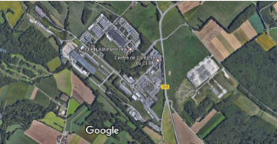
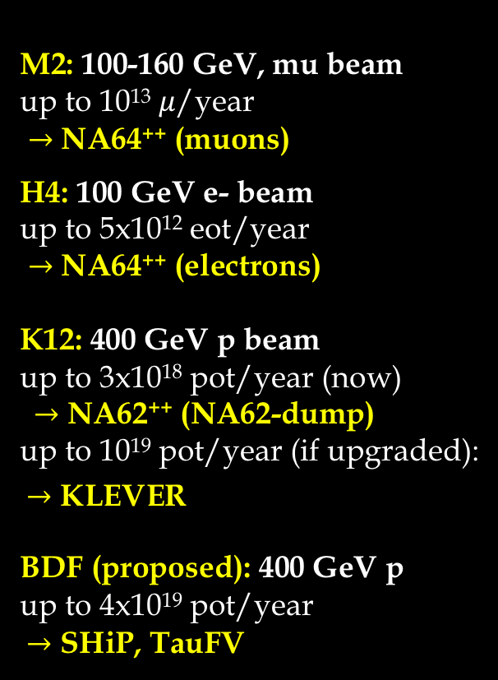
Beam lines available/proposed in the North Area
M2: 100-160 GeV, mu beam
up to 10¹³ $μ$/year
$→$ NA64⁺⁺ (muons)
H4: 100 GeV e- beam
up to 5x10¹² eot/year
$→$ NA64⁺⁺ (electrons)
K12: 400 GeV p beam
up to 3x10¹⁸ pot/year (now)
$→$ NA62⁺⁺ (NA62-dump)
up to 10¹⁹ pot/year (if upgraded):
$→$ KLEVER
BDF (proposed): 400 GeV p
up to 4x10¹⁹ pot/year
$→$ SHiP, TauFV
Compass
NA64++ @ M2
NA62++, KLEVER
SPS
NA64++ @ H4
SHiP, tauFV @ BDF
Highest energy proton, electrons and muon beams delivered for fixed target experiments in the world.

Slide 8
Conventional Beams at the North Area
Proposals followed by the CB WG - healthy mix of HS/QCD
NA61++ | Run NA61/SHINE at higher intensity and with better protection
NA64++ (e,h) | Increase electron flux and optimise hadron beams in the H4 line
NA64++ (u) | Study the possibility to install and run a NA64-like experiment with muons in EHN2
COMPASS++ | Study new requests from COMPASS, including a RF separated beam
MUonE | Study the possibility to implement the MuonE experiment in the M2 beam for operation with μ and e beams
NA62++ | Optimise conditions for NA62 in beam dump mode for Hidden Sector searches
KLEVER | Study a new beam for a K_{L} → pi0nunu experiment at very high proton flux in ECN3
DIRAC++ | Study implementation options for a DIRAC follow-up experiment at the SPS
NA60++ | Study implementation options for a NA60 follow-up experiment with heavy ion beams

Slide 9
Report in support of ESPP update

Slide 10
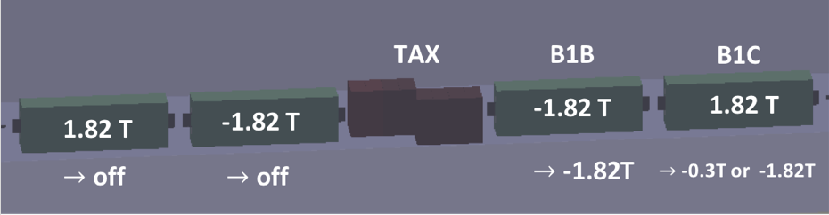
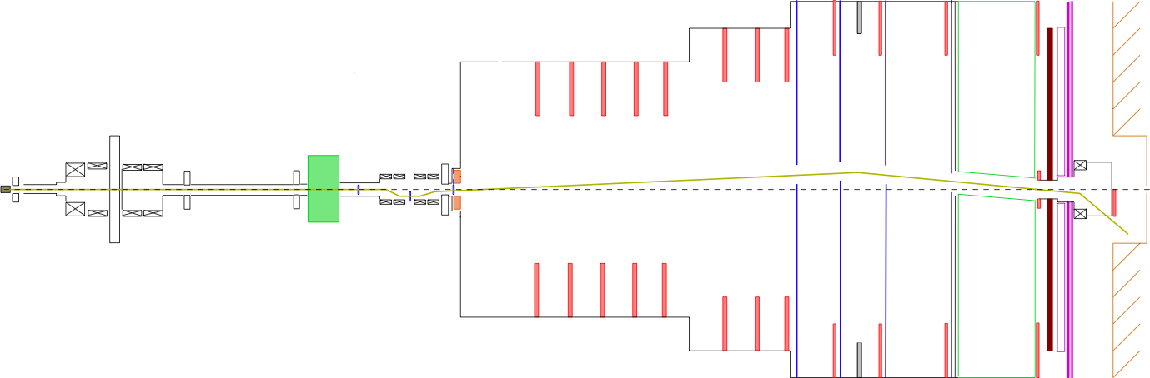
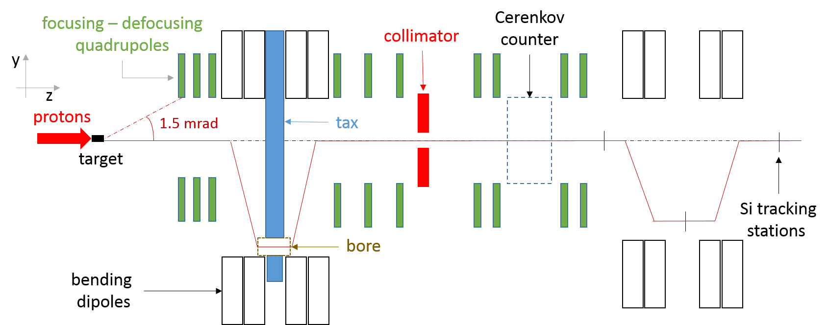
NA62++: dump mode
Transfer full proton intensity on TAX with T10 out and reduce flux of upstream pion and kaons decaying to muons.
Muons need to be efficiently swept as zero background from SM required.
Successful benchmarking of simulation with experimental data performed.
Configuration with closed TAXes and modified 1st achromat for optimum muon sweeping.
TAXes
Be target
HNL
A’
Dark Scalars
beam
ALPs
20 m
80 m
Marcel Rosenthal

Slide 11
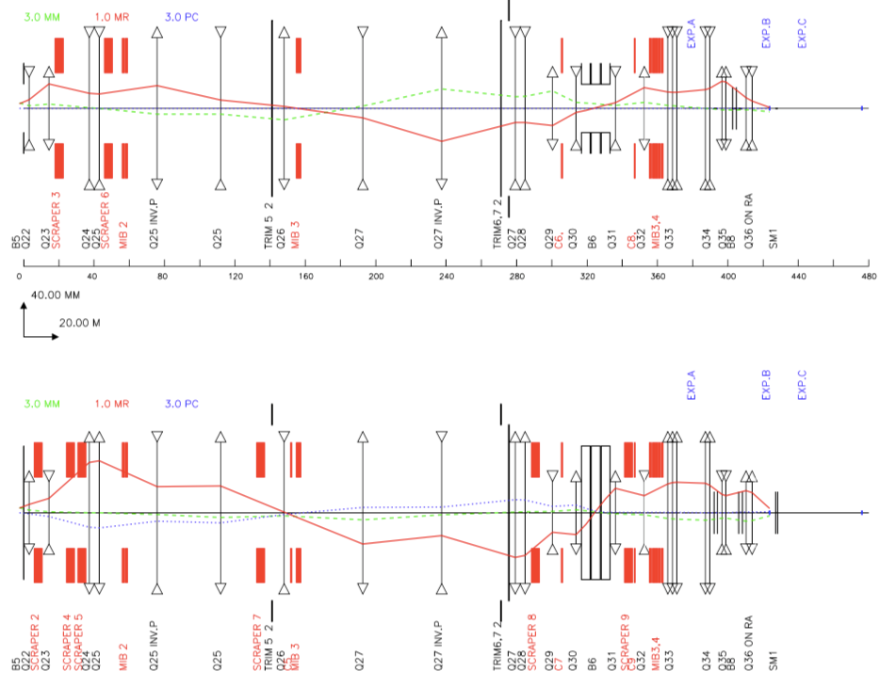
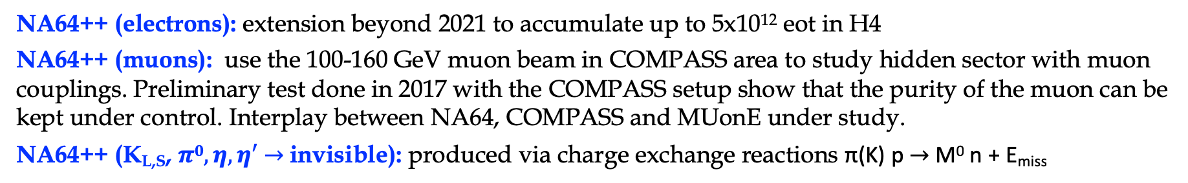
NA64++: electrons, muons and hadrons
NA64++ (electrons): extension beyond 2021 to accumulate up to 5x10¹² eot in H4
NA64++ (muons): use the 100-160 GeV muon beam in COMPASS area to study hidden sector with muon couplings. Preliminary test done in 2017 with the COMPASS setup show that the purity of the muon can be kept under control. Interplay between NA64, COMPASS and MUonE under study.
NA64++ (K_{L,S}, $π0, η, η′$ $→$invisible): produced via charge exchange reactions π(K) p $→$ M⁰ n + E_{miss}
NA64-mu - Phase 1:
  Upstream location identified in PPE211, compatible with current downstream COMPASS installations.
  Calculated optics that fulfil well user requirements.
  Study for optimisation of beam momentum measurement completed.
  Preliminary cost estimate ready for possible installation in ≧ 2021.
Phase 2: Optics ready, integration study continues…
Dipanwita Banerjee
Johannes Bernhard

Slide 12
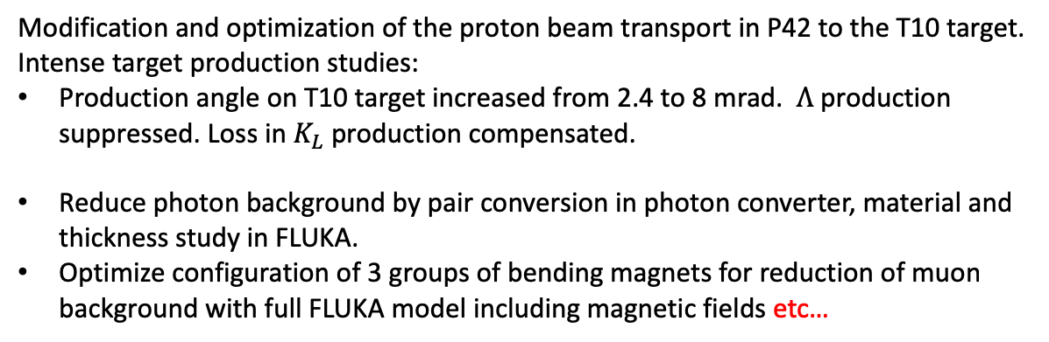
Maarten van Dijk et al
Neutral beam line – decidedly non-trivial
Modification and optimization of the proton beam transport in P42 to the T10 target.
Intense target production studies:
Production angle on T10 target increased from 2.4 to 8 mrad. $Λ$ production suppressed. Loss in $K_{L}$ production compensated.
Reduce photon background by pair conversion in photon converter, material and thickness study in FLUKA.
Optimize configuration of 3 groups of bending magnets for reduction of muon background with full FLUKA model including magnetic fields etc…
7 times higher than NA62:
upgrades to target area and transfer lines (RP, target, TAXes…) required

Slide 13
HSC
Gaia Lanfranchi

Slide 14
Beam Dump Facilities
BDFs ideal for exploring light super-weakly interacting particles and Light Dark Matter
  Luminosity (yield of π, K, D, B decay and photons):
    HL-LHC: ~10³⁵ cm⁻²s⁻¹ x 10⁷ s = 10⁴² cm⁻²
    SPS (1 m long high A/Z target): 4*10¹³ x 6*10²⁴ cm⁻³ x 10² cm x 10⁶ ~ 2*10⁴⁶ cm⁻²
    Superior luminosity compensates for lower energy (e.g. yield of charm hadrons ~10¹⁶@HL-LHC vs ~10¹⁸@SPS)
  Geometrical acceptance
  Long lifetimes
  Background suppression
muons
HNL
dump
Dark photons
SPS protons
muons, electrons
Dark Scalars
Light Dark Matter
neutrinos
Andrei Golutvin
Notes:
Lumi is 4 orders of magnitude higher while cross-section is only ~2 orders of magnitude less at E_CMS=27 GeV than at 13 TeV
Geometrical acceptance: large boost ensures good acceptance at BDF
Long lifetimes: BDF ideal for lower masses and weak couplings -- lifetime of HNLs goes as inverse of the 5th power of mass for instance
Background suppression: BDF configuration allow efficient filtering of background with shields

Slide 15
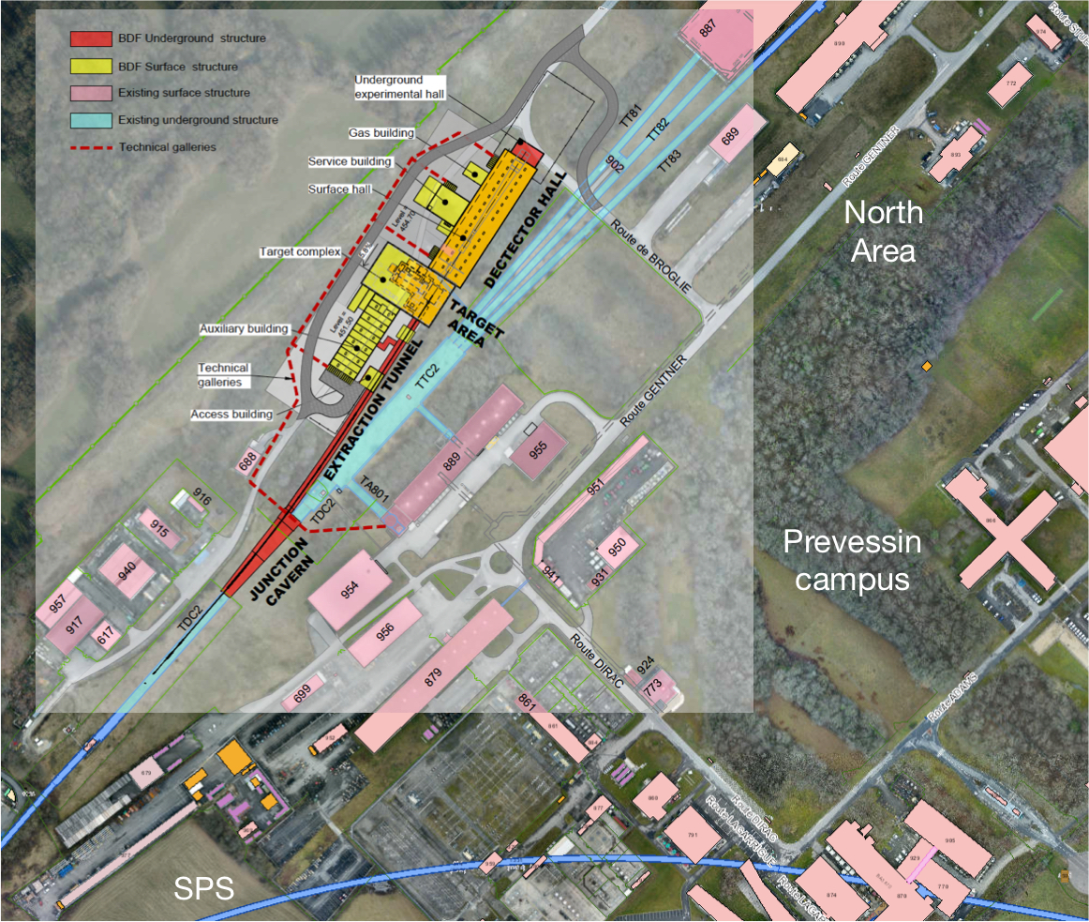
Existing users
Civil engineering
Geotechnical and hydrogeology of site
Radiation protection of personnel and environment
Target and target complex
355 kW average power
2.5 MW pulsed power
New beam line
Beam dilution
Re-construction of junction cavern
Switching into new beam-line
BDF
Beam delivery by SPS
Slow extraction with acceptable losses

Slide 16
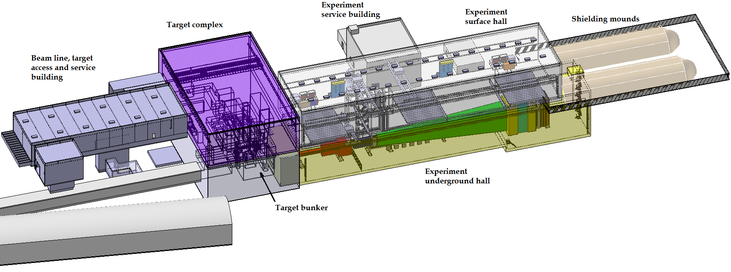
Target Complex & Experiment Hall
BDF Comprehensive Design Study in pre-publication
Pablo Santos Diaz

Slide 17
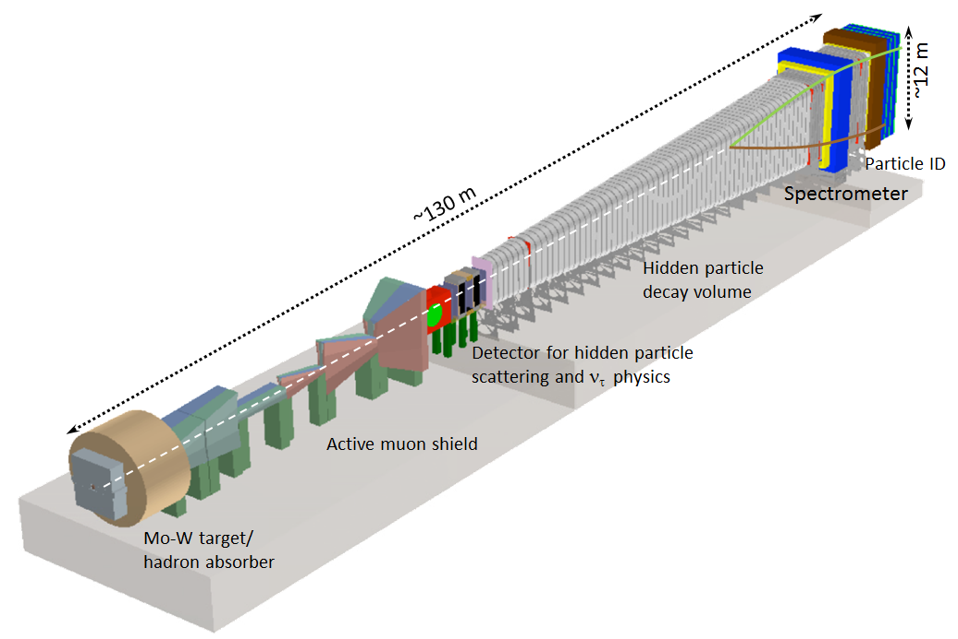
SHiP
Physics case based on 2x10²⁰ protons on target
(5 years of nominal operation)
Signal yields from >10¹⁸ D mesons, >10¹⁶ tau, >10²¹ photons (>100 MeV)
Dual detector system:
1. Search for HS decays (“HS detector”)
2. Neutrino physics and search for LDM recoil signatures (“SND”)
4e13 PoT/ 1 s spill

Slide 18
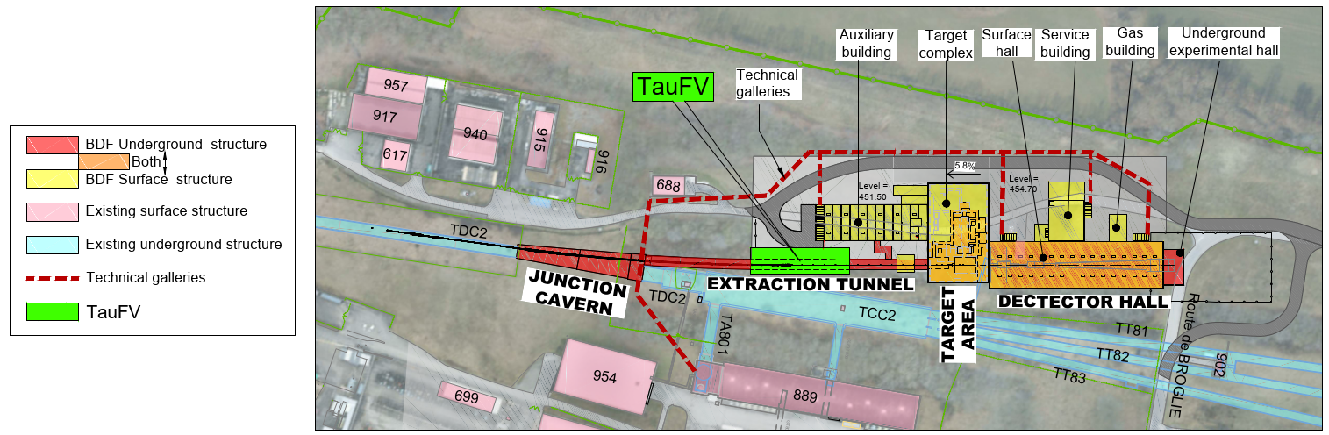
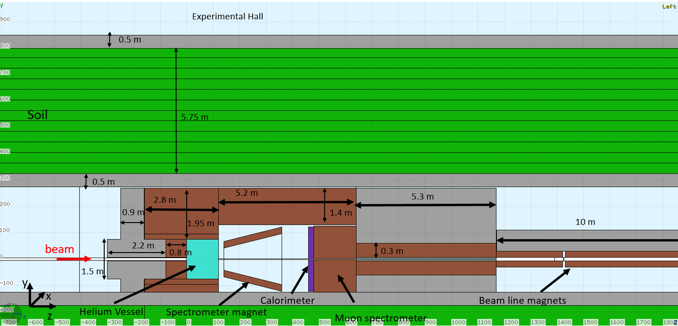
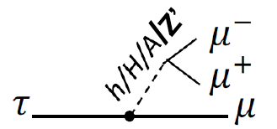
TauFV
Search for Lepton Flavour Violation and rare decays
Using a thin in-line target to intercept about 2% of the intensity delivered to the SHiP target, would have access to close to 8e13 tau lepton and 5e15 D₀ meson decays

Slide 19
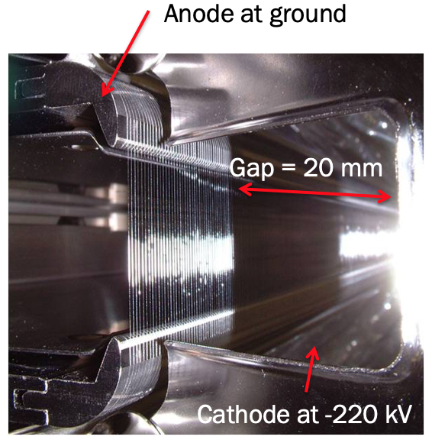
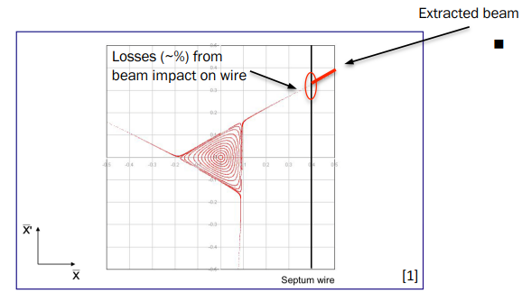
SPS beam – slow extraction
Beam loss from slow extraction is unavoidable and has to be controlled and optimized:
  Induced activation in Long Straight Section 2 (LSS2) increases in direct proportion to the beam loss on the septum

Slide 20
Losses/activation during slow extraction
SHiP request for POTs demands a factor of x 4 - 5 loss reduction to keep future activation levels in LSS2 comparable to today:
  4E19 POT for SPS BDF and ~ 1E19 POT for North Area parallel operation
4e19

Slide 21
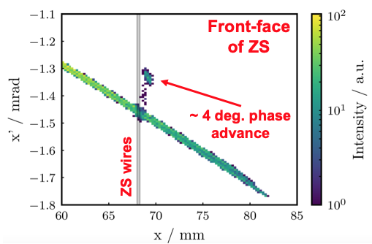
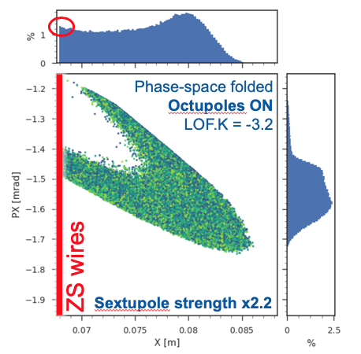
Major effort to reduce losses
Implementation of dynamic optics control (COSE) to hold separatrix stationary during spill
Thin bent crystal installed upstream ZS
  Crystal channeling creates depleted density region at ZS wires
Apply higher-order multipole fields during extraction:
  Reduce density of beam impinging the ZS wires: 35 – 45%
  At the expense of increasing extracted beam emittance
Driven and supported by the members of SPS-CASE WG and SLAWG
  Fruitful collaboration between a large number of groups and experimental collaborations!
  Dedicated R&D effort including 2 PhD thesis topics
Brennan Goddard, Matthew Fraser et al

Slide 22
Combining techniques
Crystal inserted and aligned with octupoles during afternoon of 1st November 2018:
Preliminary result:
In 2018, different loss reduction concepts were validated in MD tests:
  Included passive and active diffusers (crystal shadowing of ZS) and phase space folding
  Factor of ~ 3 - 4 loss reduction at ZS demonstrated
  Scope for further loss reduction improvement
nominal with COSE
Losses at ZS
~ 0.55 x 0.6 = 0.33
octupoles
channeling
angular scan 1
angular scan 2
The magic factor of 4 - 5 reduction to accommodate SHiP/BDF does appear to be in reach!
Matthew Fraser

Slide 24
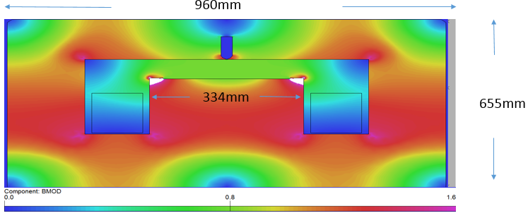
New laminated bipolar splitter/switch with reduced saturation
Jakub Kurdej

Slide 25
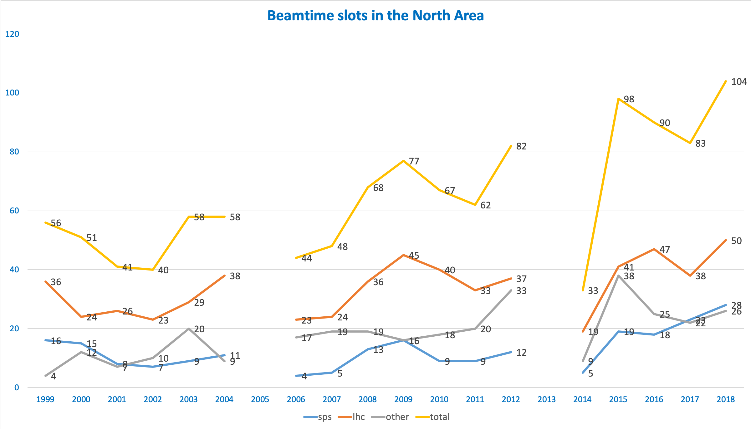
Henric Wilkens

Slide 26
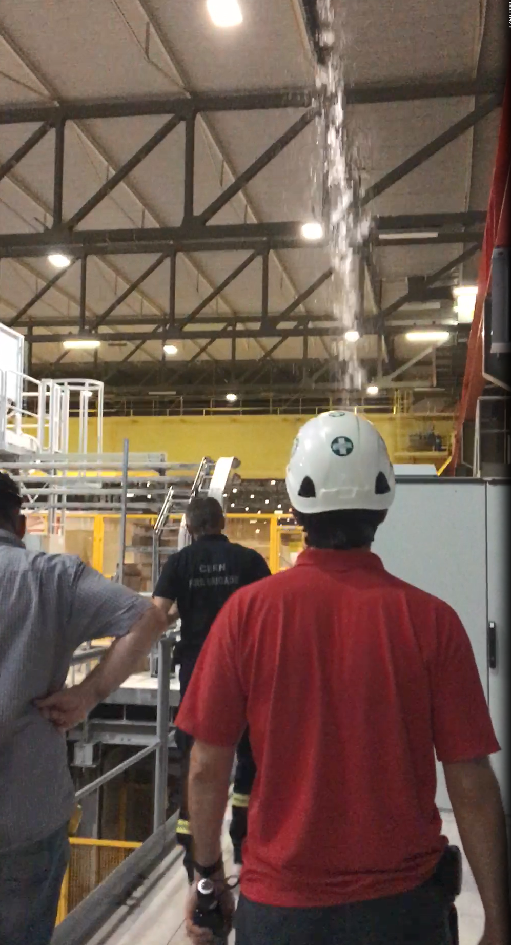
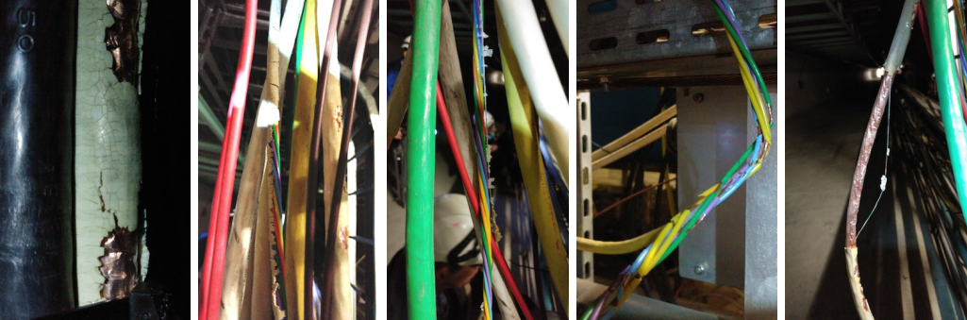
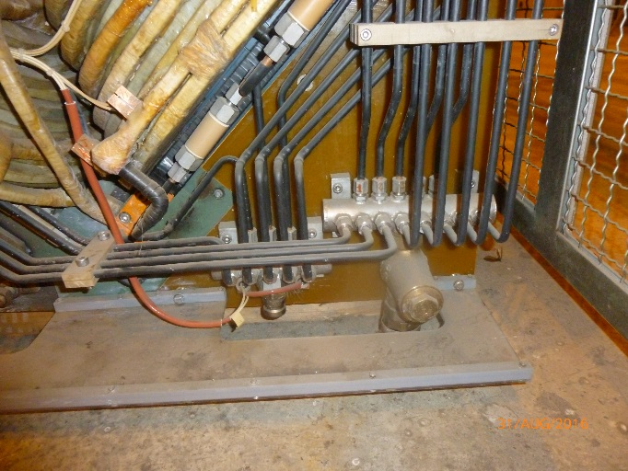
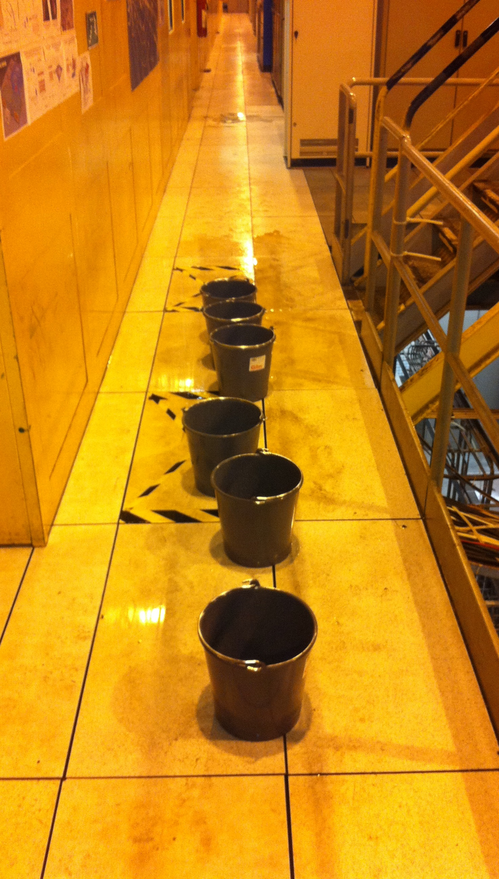
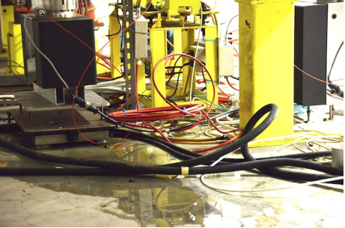
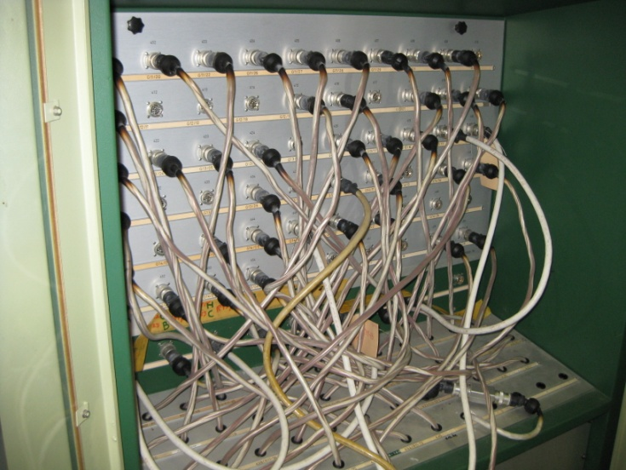
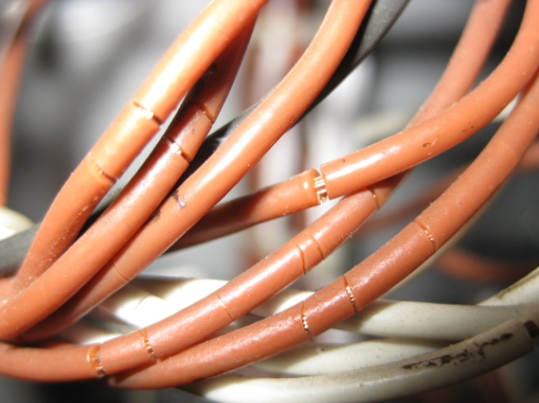
Some loving care and attention required!
Yacine Kadi

Slide 27
NA: the future is colourful and dark and interesting!
Physics motivation remains strong
  The North Area is an ideal place to search for Hidden Sector at with NA62, NA64, SHiP etc. in < O(10) GeV range
  Unique QCD possibilities
SPS is adapting well to the foreseen challenges
NA remains vitally important as a test facility

