Slide 1
Summary of urgent actions by BE-BI
J. Tan, I. Ortega, F. Roncarolo, L. Jensen
with the input of our BE and EN colleagues
March 1st 2019
EA-BI-WG

Slide 2
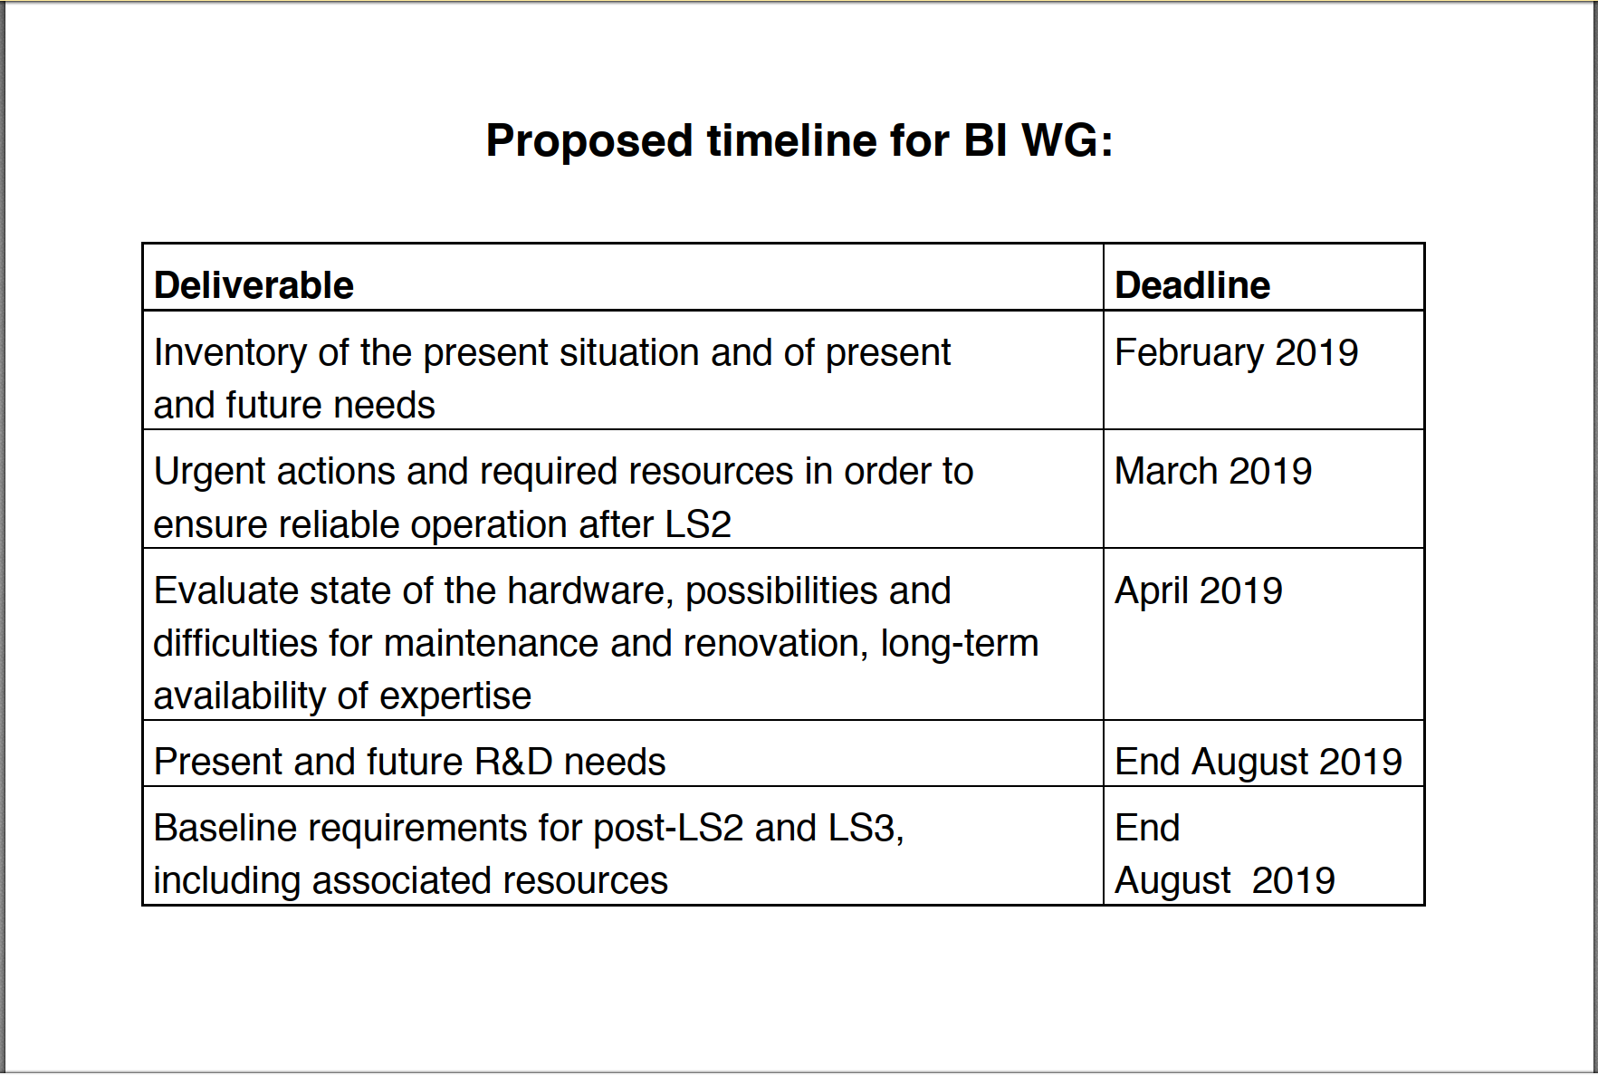
Courtesy L. Gatignon

Slide 3
Outline
East Area
North Area
Transfer lines of AD and ELENA

Slide 4
Urgent actions for East Area, & Primary lines
Instruments | To do | Action for LS2
XBPF | production, readiness for post LS2 start-up | BI-EA
XION, XWCA, XSCI | check status, readiness for post LS2 start-up | BI-EA
XCET | control board for relays, production, readiness for post LS2 start-up | BI-EA
Instruments | To do | Action for LS2
BLM | PS extraction lines (F61), find budget (40 kCHF) | EA-PE
BLM near targets | instead of Telescope, get green light then budget | EA-DC

Slide 5
Urgent actions for LSS2 and SPS Primary lines
System | Comments | Proposals
Calibration of BSI (SEM-foils) for intensity | No online calibration system (theoretical values) Surface effects observed (conditioning) | Analyse data stored during 2018 run PhD student to start during 2019
Servo-spill (intensity with BSI) | EPC takes over feed-forward (n*50Hz) | New acquisition system in BA2 (proposed sampling frequency 100kHz)
Intensity (PMT) | Existing BTV tank in TT20 | Check screens and PMT during LS2 Look into acquisition system
BLM, SEM, BTV | Existing systems in TDC2 | Replace cables for LS2+ -> LS3 running
Beam position (LSS2) | Non-linear correction (50+ mm) for bunched beams Interlock (dump) | Apply correction (software) Interlock specifications pending
Software | Settings per SPS user | Actively look at what is required
Cherenkov bar (F.Addesa’s presentation) | Fast longitudinal Spill acquisition | Exploring / prepare to test the OTR screen + PMT in TT20 Exploring the possibility to optimize the Cherenkov bar read-out electronics for further tests after LS2

Slide 6
Urgent actions for North Area
System | To do | Actions
XION, XDWC, XWCA, XWCM, XSCI | check status, calibration factors, readiness for post LS2 start-up | BI-EA

Slide 7
AD & ELENA : Profile measurement
Instruments | To do | Action for LS2
SEM (Hori detector) | readiness for post LS2 start-up | BI-EA

