Slide 1

Kaonic Deuterium X-Ray Measurements with the SIDDHARTA-2 Apparatus at DAΦNE
Marlene Tüchler
(on behalf of the SIDDHARTA-2 collaboration)
Joint Meeting of the APS and SPS, Zürich
August 27th, 2019

Slide 2

OUTLINE
Motivation: Kaonic Atoms
The SIDDHARTA-2 Apparatus
  Target Cell
  X-Ray Detection System
  Veto System
Conclusion
Outlook
M. Tüchler – APS & SPS Meeting, Zürich 2019

Slide 3
Motivation: Kaonic Atoms
M. Tüchler – APS & SPS Meeting, Zürich 2019

Slide 4
FORMATION OF KAONIC ATOMS
Cascade:
Auger electrons, X-rays
Absorption
by nucleus
K⁻ slows down
Captured by atom
Ground state
n=1
n=2
n=1
p
n=25
e⁻
X-ray
K⁻
M. Tüchler – APS & SPS Meeting, Zürich 2019

Slide 5
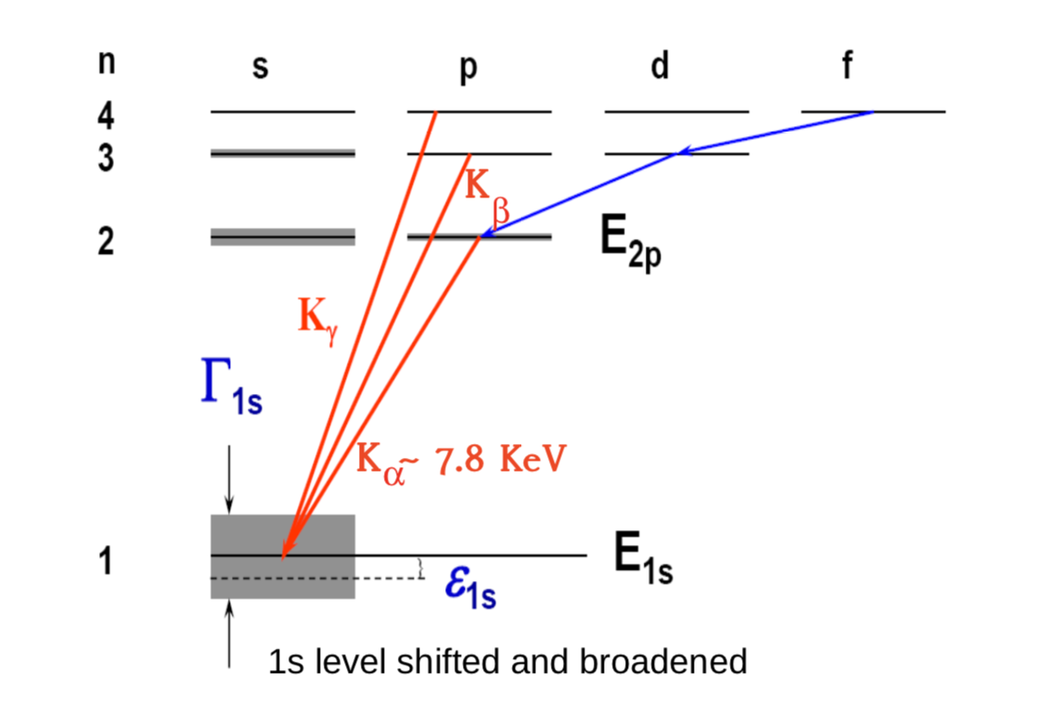
MOTIVATION: KAONIC ATOMS
Direct study of low-energy QCD with strangeness
Strong interaction: energy shift ε_{1s} and width Γ_{1s} of ground state - directly observable
ΔE = Emeasured - Eem
ΔE
M. Tüchler – APS & SPS Meeting, Zürich 2019

Slide 6
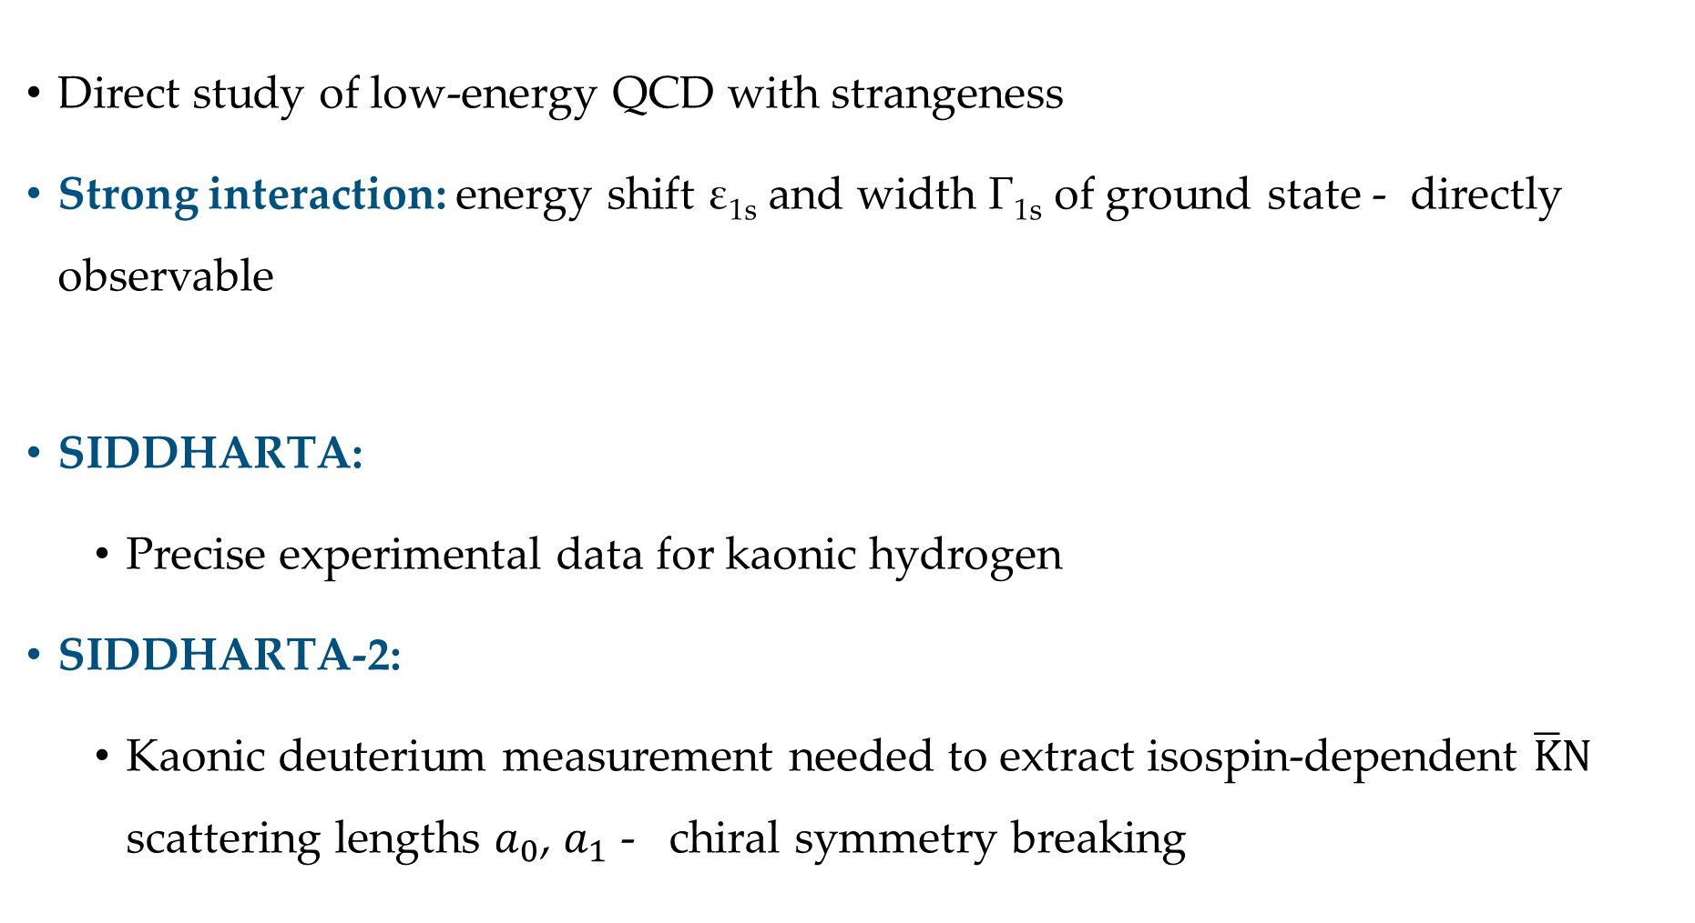
MOTIVATION: KAONIC ATOMS
Direct study of low-energy QCD with strangeness
Strong interaction: energy shift ε_{1s} and width Γ_{1s} of ground state - directly observable
SIDDHARTA:
  Precise experimental data for kaonic hydrogen
SIDDHARTA-2:
  Kaonic deuterium measurement needed to extract isospin-dependent $\overline{K}N$ scattering lengths $a_{0}$, $a_{1}$ - chiral symmetry breaking
M. Tüchler – APS & SPS Meeting, Zürich 2019

Slide 7
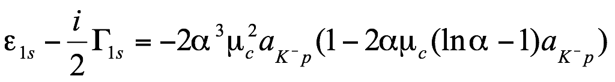

SCATTERING LENGTHS
Improved Deser-Trueman:
Isospin-dependent $\overline{K}N$ scattering lengths $a_{0}$, $a_{1}:$
$$a_{K^{−}p}= \frac{1}{2}\left[a_{0}+a_{1}\right]$$
$$a_{K^{−}n}=a_{1}$$
$$a_{K^{−}d}=\frac{k}{2}\left[a_{K^{−}p}+a_{K^{−}n}\right]+C=\frac{k}{4}\left[a_{0}+3a_{1}\right]+C$$
$k=\frac{4[m_{n}+m_{K}]}{[2m_{n}+m_{K}]}$
𝛂 … fine structure constant
µ_{C} … reduced mass of K⁻p system
M. Tüchler – APS & SPS Meeting, Zürich 2019

Slide 8
The SIDDHARTA-2 Apparatus
M. Tüchler – APS & SPS Meeting, Zürich 2019

Slide 9
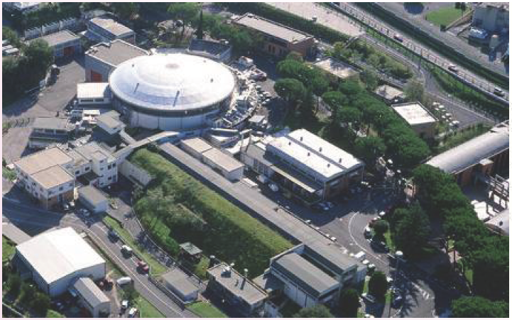
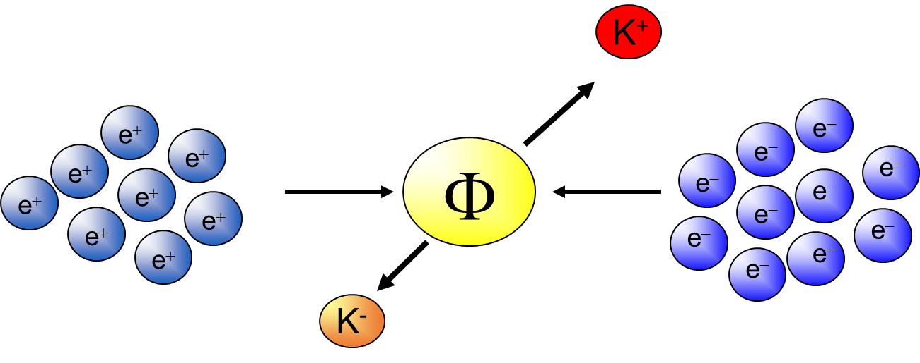
DAΦNE COLLIDER AT LNF
e⁺-e⁻
collider
operates at the centre-of-mass
energy of the Φ meson
mass m = 1019.413 ± 0.008 MeV
width Γ = 4.43 ± 0.06 MeV
Accu.
LINAC
Φ produced via e⁺e⁻ collision
σ(e⁺e⁻ → Φ) ~ 5 µb
→ monochromatic kaon beam
(127 MeV/c)
M. Tüchler – APS & SPS Meeting, Zürich 2019

Slide 10
MOTIVATION
Kaonic deuterium:
  Yield lower than K⁻p yield
  Width approx. 2× K⁻p width
  Large area X-ray detectors with good energy resolution
  Lightweight cryogenic gaseous target
  Veto system:
  Veto-1: Timing information
  Veto-2: Timing & spatial correlation of SDD-hit and Veto-2 hit
M. Tüchler – APS & SPS Meeting, Zürich 2019

Slide 11
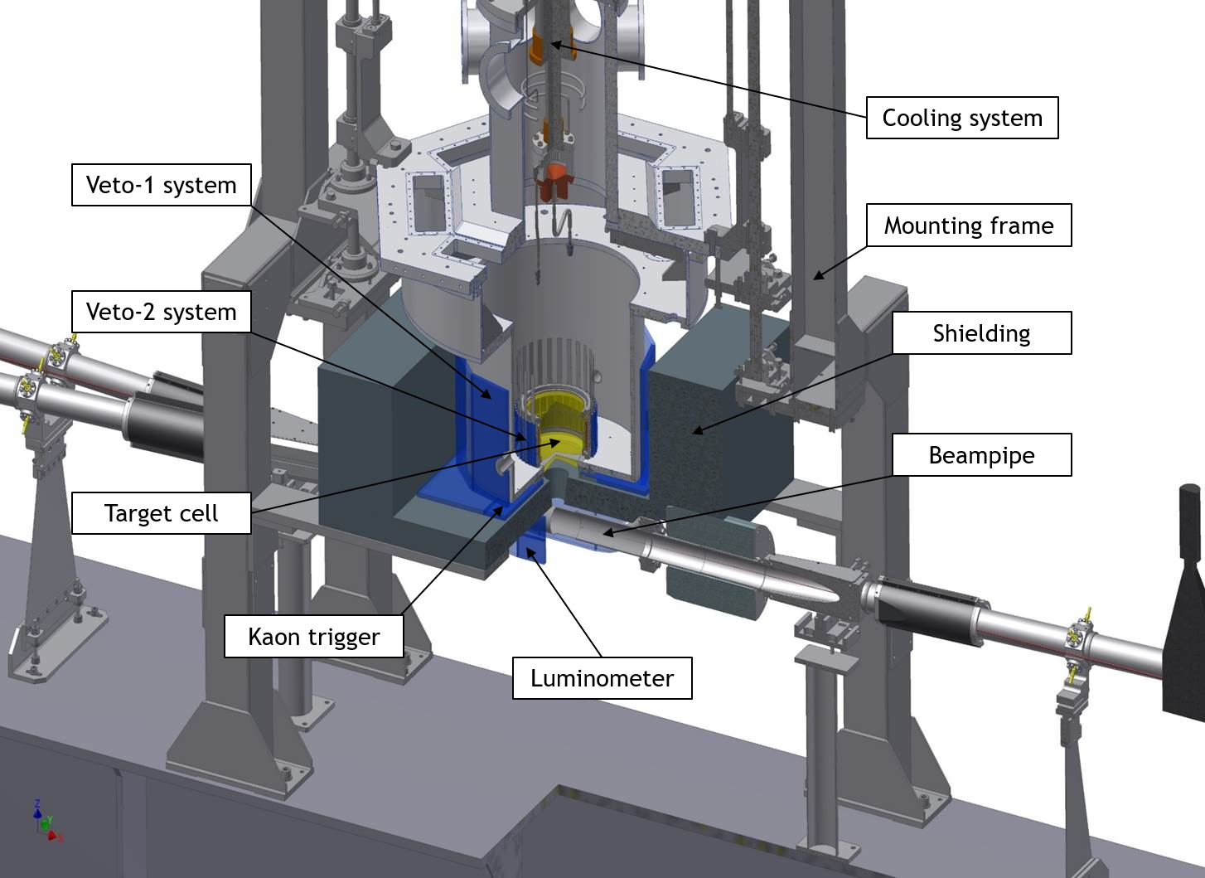
DETECTOR SYSTEM SIDDHARTA-2
M. Tüchler – APS & SPS Meeting, Zürich 2019

Slide 12
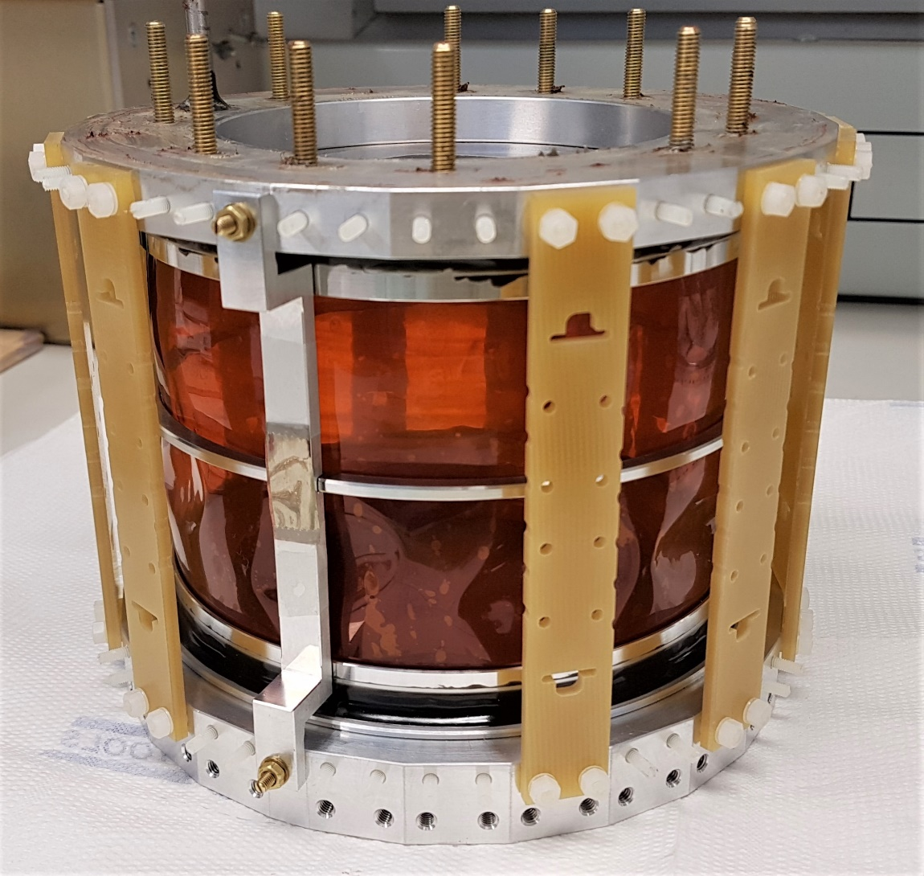
TARGET CELL
Lightweight - filled with gaseous deuterium
Kapton sidewalls
Operated at cryogenic temperatures (30 K at 0.3 MPa working pressure)
High X-ray transmission
Sufficiently high gas density
M. Tüchler – APS & SPS Meeting, Zürich 2019

Slide 13
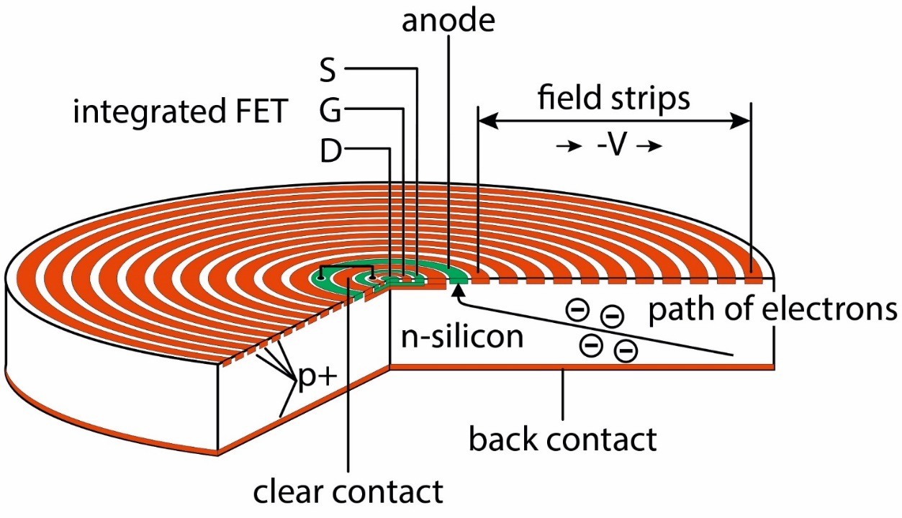
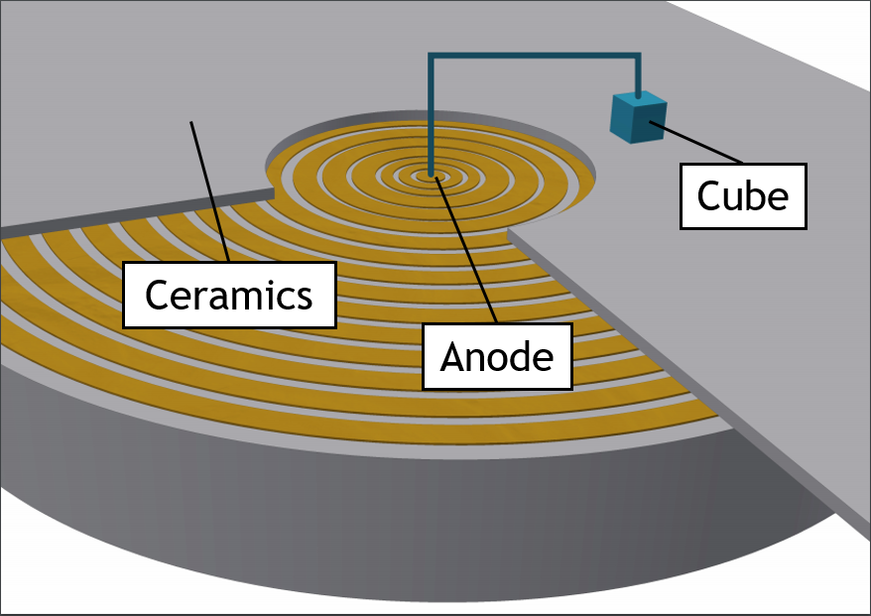
X-RAY DETECTORS - SDDs
SIDDHARTA
  JFET implemented on anode
  Active/total area ~ 25%
  Drift times ~ 800 ns
SIDDHARTA-2
  CUBE preamplifier on ceramic
  Active/total area ~ 75%
  Drift times ~ 300 ns
M. Tüchler – APS & SPS Meeting, Zürich 2019

Slide 14
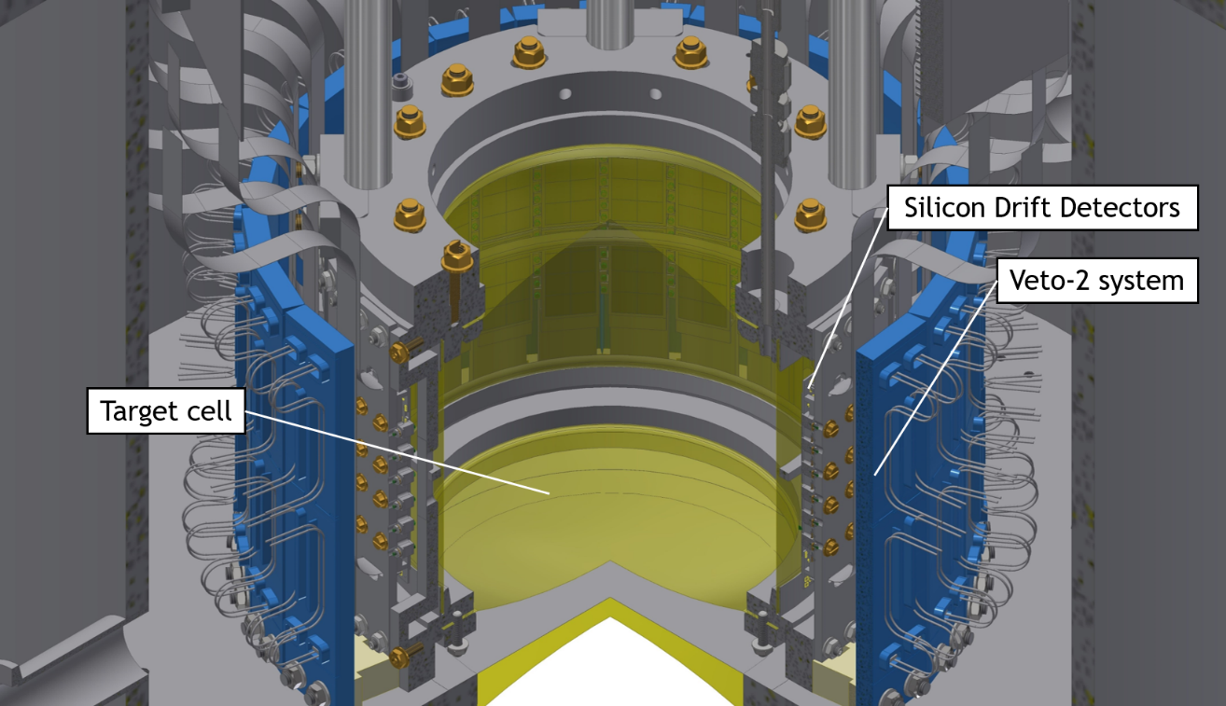
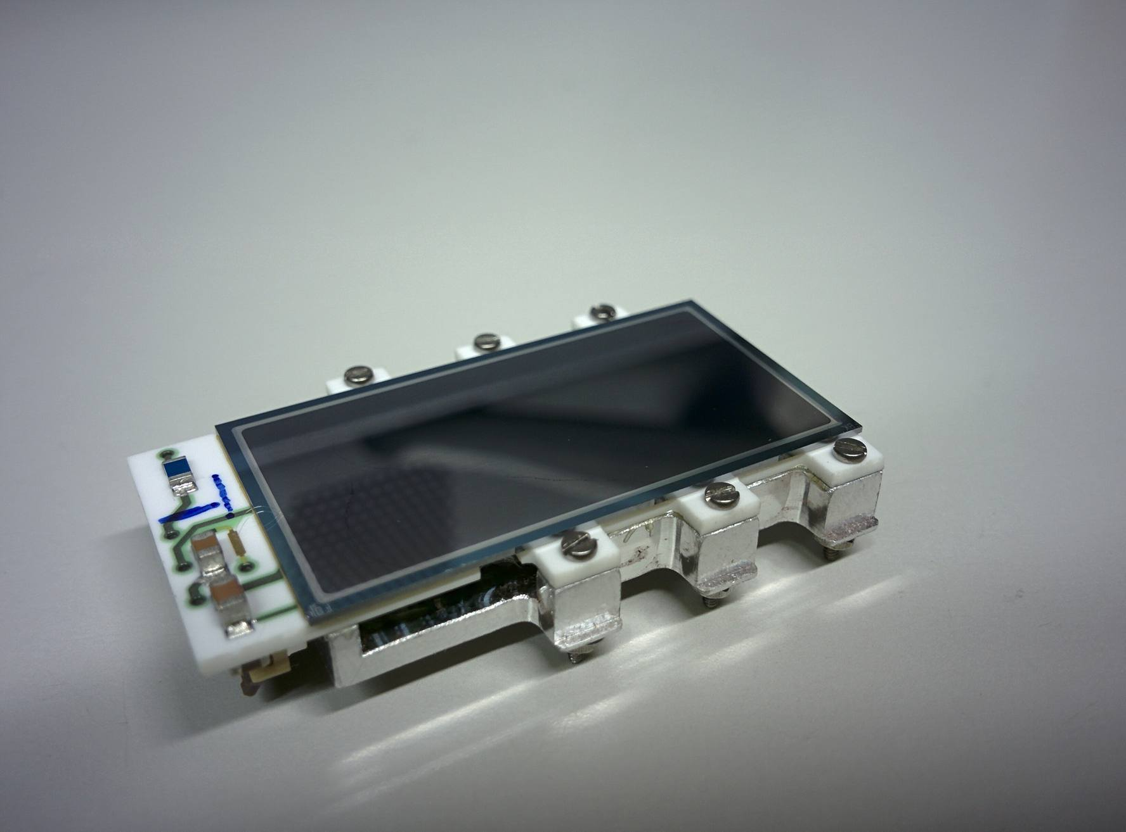
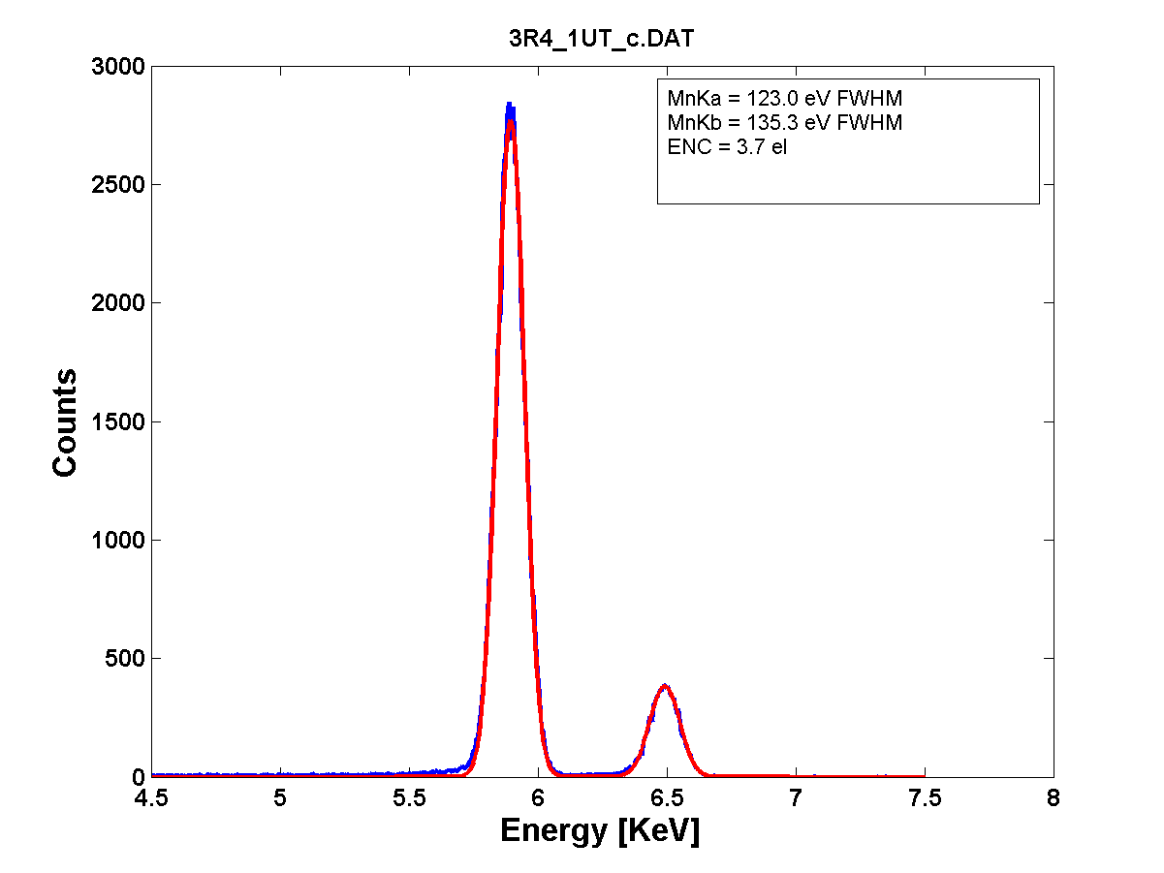
X-RAY DETECTORS - SDDs
SIDDHARTA-2
  48 arrays of 8 cells
  Each cell 8 × 8 mm² active area
  Energy resolution < 180 eV at 6 keV
SDD characteristics:
area/cell = 64 mm²
total area = 512 mm²
T = - 100°C
drift time < 500 ns
⁵⁵Fe spectrum
Counts
123.0 eV FWHM
Energy (keV)
M. Tüchler – APS & SPS Meeting, Zürich 2019

Slide 15
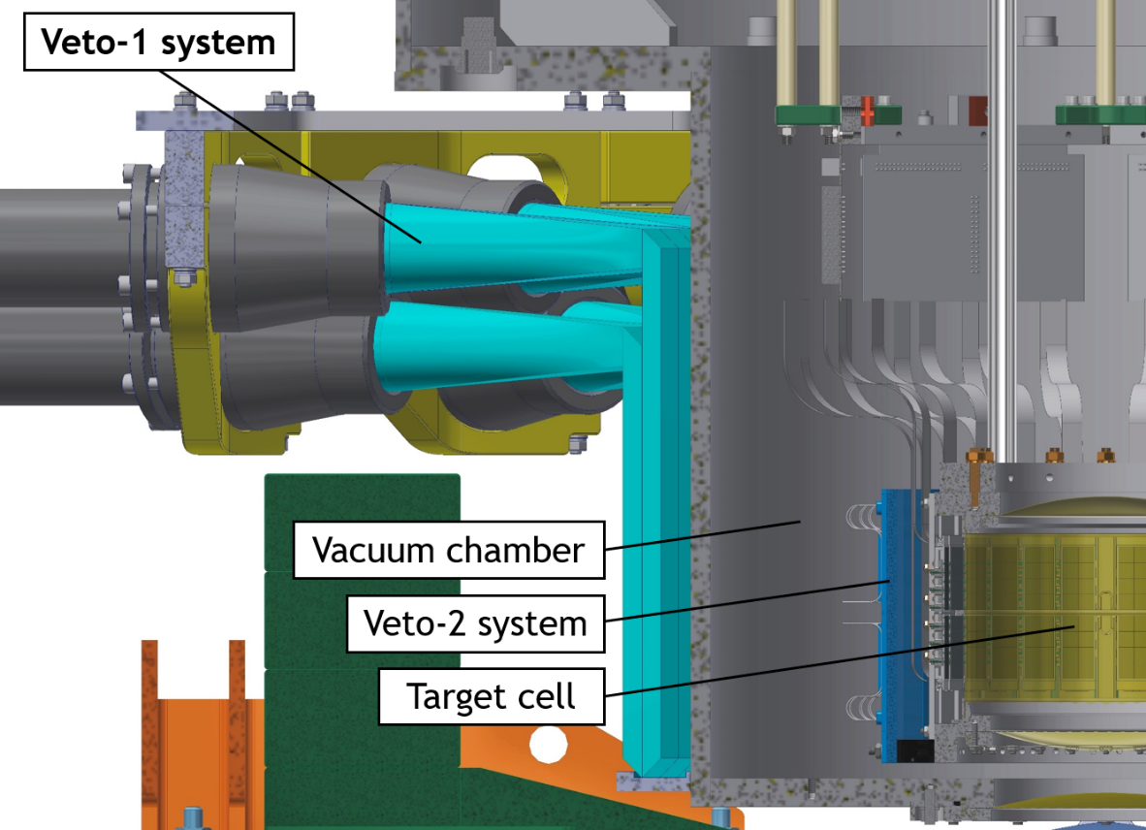
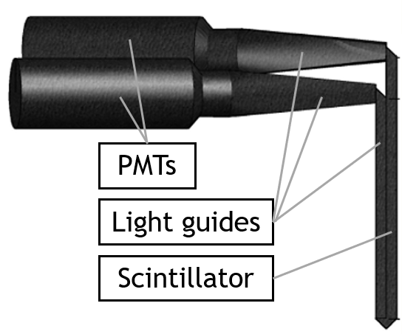
VETO-1 SYSTEM
Distinction between “real” and “false” kaon stops using timing information
Time resolution of < 500 ps required
12 detector units
Scintillator and light guide with photomultiplier read-out
Particle hit-position independent
M. Tüchler – APS & SPS Meeting, Zürich 2019

Slide 16
VETO-2 SYSTEM
SDD
π
large signal
M. Tüchler – APS & SPS Meeting, Zürich 2019

Slide 17
VETO-2 SYSTEM
SDD
π
large signal
π
signal in region of interest
M. Tüchler – APS & SPS Meeting, Zürich 2019

Slide 18
VETO-2 SYSTEM
SDD
π
large signal
π
signal in region of interest
π
delta-ray (knock-on e⁻)
M. Tüchler – APS & SPS Meeting, Zürich 2019

Slide 19
VETO-2 SYSTEM
SDD
π
large signal
π
signal in region of interest
π
delta-ray (knock-on e⁻)
π
secondary X-ray or e⁻
from setup
M. Tüchler – APS & SPS Meeting, Zürich 2019

Slide 20
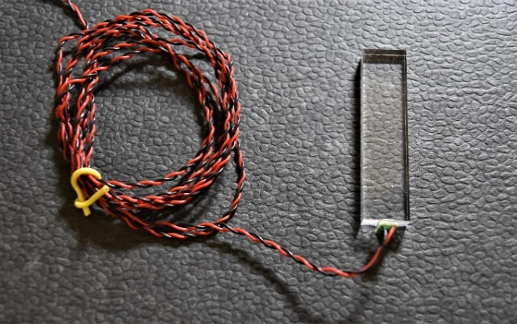
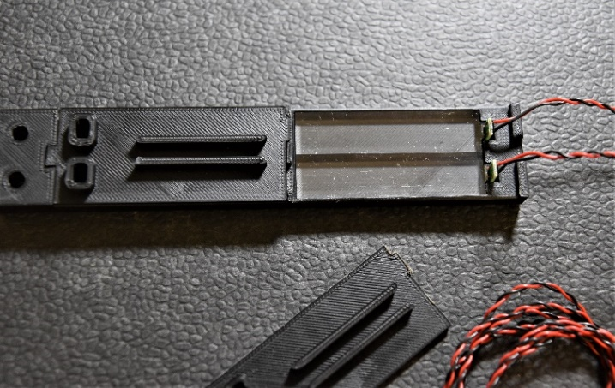
VETO-2 SYSTEM
Detector Setup:
  96 Silicon photomultipliers
  96 plastic scintillators
  3D-printed ABS boxes
Characterisation:
  Time resolution (293 ± 45) ps
  Detection efficiency (99.1 ± 0.2)%
M. Tüchler – APS & SPS Meeting, Zürich 2019

Slide 21
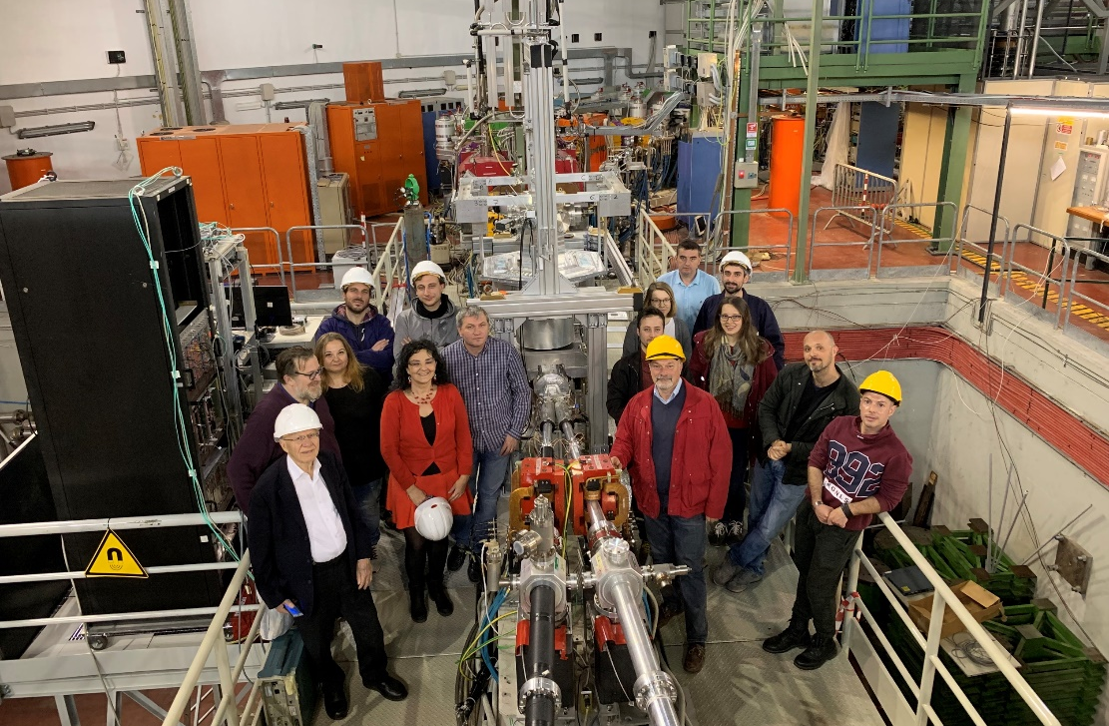
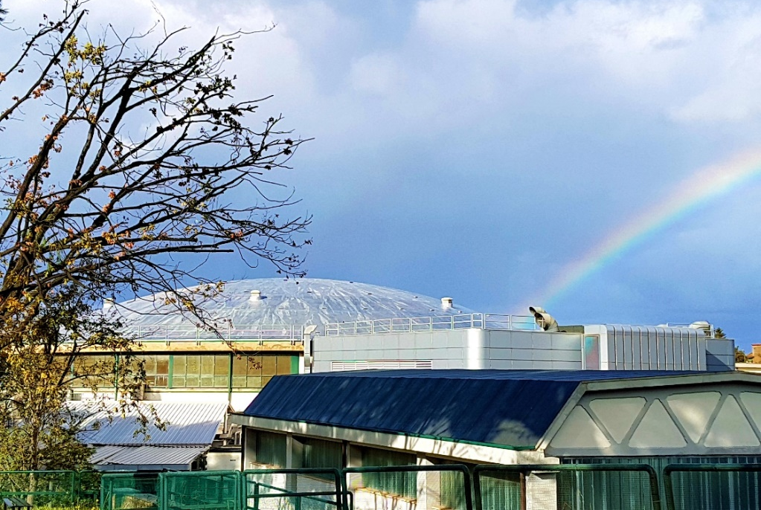
CONCLUSION & OUTLOOK
Kaonic atom studies at LNFrascati:
  Installation and commissioning at Frascati ongoing
  SIDDHARTINO: kaonic hydrogen and helium, background studies
  SIDDHARTA-2: Kaonic deuterium 2020
M. Tüchler – APS & SPS Meeting, Zürich 2019

Slide 22

Attachment
M. Tüchler – APS & SPS Meeting, Zürich 2019

Slide 23

FORMATION OF KAONIC ATOMS
Properties:
  m_{K}⁻ : 493.677 MeV
  Bohr energy levels and Bohr orbit:
    $$E_{n}=−\frac{μc^{2}}{2}{(\frac{Zα}{n})}^{2}$$
    $$r_{n}=\frac{ħ^{2}}{μe^{2}}\frac{n^{2}}{Z}$$
  Particle captured in highly excited state: $n_{X}∝n_{e}\sqrt{\frac{m_{X}}{m_{e}}}$
α… fine structure constant
μ…. reduced mass of moving particle
n… principal quantum number
M. Tüchler – APS & SPS Meeting, Zürich 2019

Slide 24
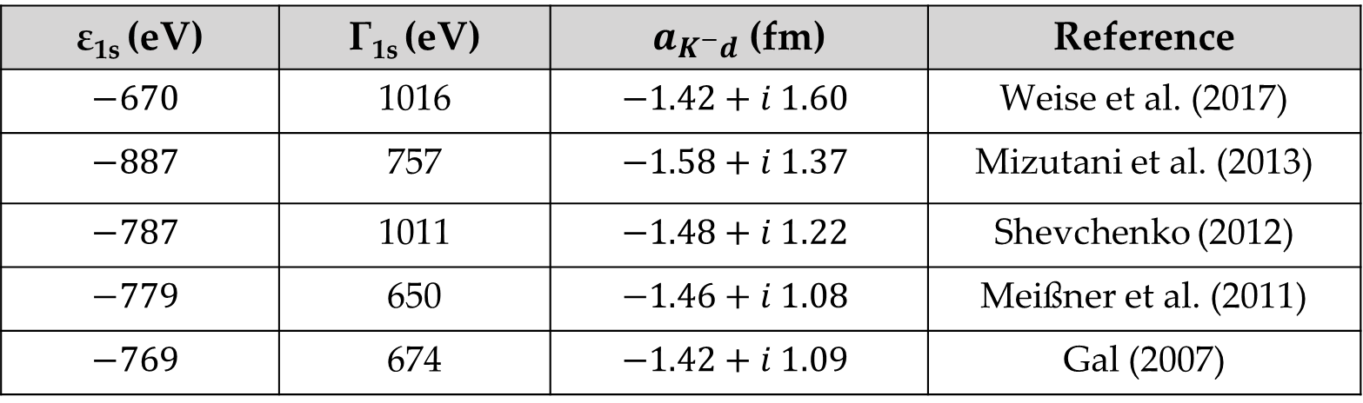
SCATTERING LENGTHS
Theoretical Predictions:
  Expected values for kaonic deuterium
ε_{1s} (eV) | Γ_{1s} (eV) | $a_{K^{−}d}$ (fm) | Reference
$$−670$$ | 1016 | $$−1.42+i 1.60$$ | Weise et al. (2017)
$$−887$$ | 757 | $$−1.58+i 1.37$$ | Mizutani et al. (2013)
$$−787$$ | 1011 | $$−1.48+i 1.22$$ | Shevchenko (2012)
$$−779$$ | 650 | $$−1.46+i 1.08$$ | Meißner et al. (2011)
$$−769$$ | 674 | $$−1.42+i 1.09$$ | Gal (2007)
M. Tüchler – APS & SPS Meeting, Zürich 2019

Slide 25
TIMING VETO-1
Time response of detector
Green: Events after detection of K⁺ in bottom scintillator of kaon monitor
Red: Events after detection of K⁻ in bottom scintillator of kaon monitor
Blue: Neither K⁻ nor K⁺ detected in bottom kaon monitor
Black: Sum of all events
Counts
Time (ns)
Direct stops in wall material
Products of K⁻ absorption in gas
M. Tüchler – APS & SPS Meeting, Zürich 2019

Slide 26
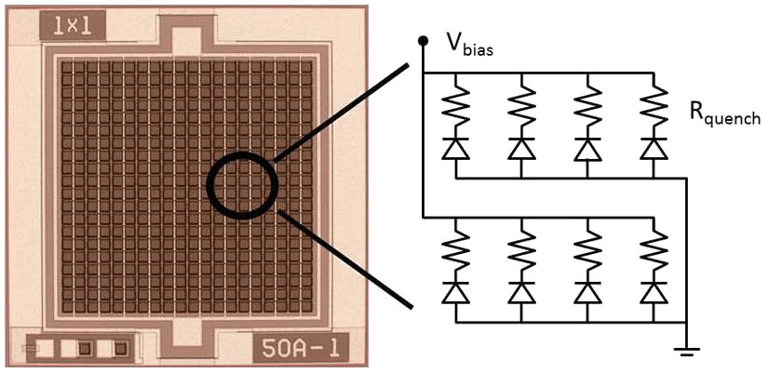
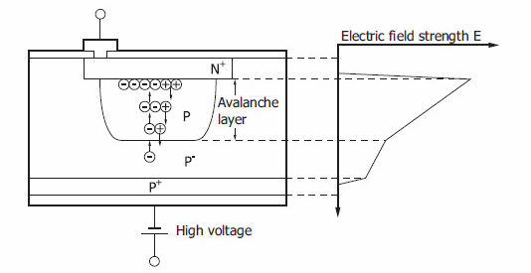
DETECTOR SETUP - SiPMs
  Array of Geiger-mode avalanche photodiodes (G-APDs)
  Geiger-mode: high S/N-ratio
  Active quenching resistors
Hamamatsu
microcell structure
M. Tüchler – APS & SPS Meeting, Zürich 2019
Notes:
https://www.ketek.net/sipm/technology/
https://www.ketek.net/sipm/technology/microcell-construction/
R_quench = 200 – 800 kOhm

Slide 27
DETECTOR SETUP - SiPMs
SiPM vs PMT:
 | SiPM | PMT
Supply Voltage | 20 – 100 V | 1000 - 3000 V
Gain | 10⁵ - 10⁷ | 10⁴ - 10⁹
Quantum Efficiency | max. 80% | 25% - 40%
Rise Time | < 1 ns | 0.5 – 3.5 ns
Sensitive to B-fields | no | yes
M. Tüchler – APS & SPS Meeting, Zürich 2019
Notes:
https://www.ketek.net/sipm/technology/
https://www.hamamatsu.com/resources/pdf/etd/PMT_handbook_v3aE.pdf

Slide 28
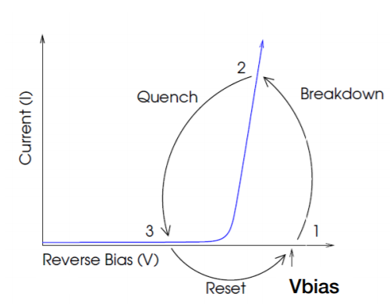
DETECTOR SETUP - SiPMs
M. Tüchler – APS & SPS Meeting, Zürich 2019
Notes:
https://www.sensl.com/downloads/ds/TN%20-%20Intro%20to%20SPM%20Tech.pdf

Slide 29
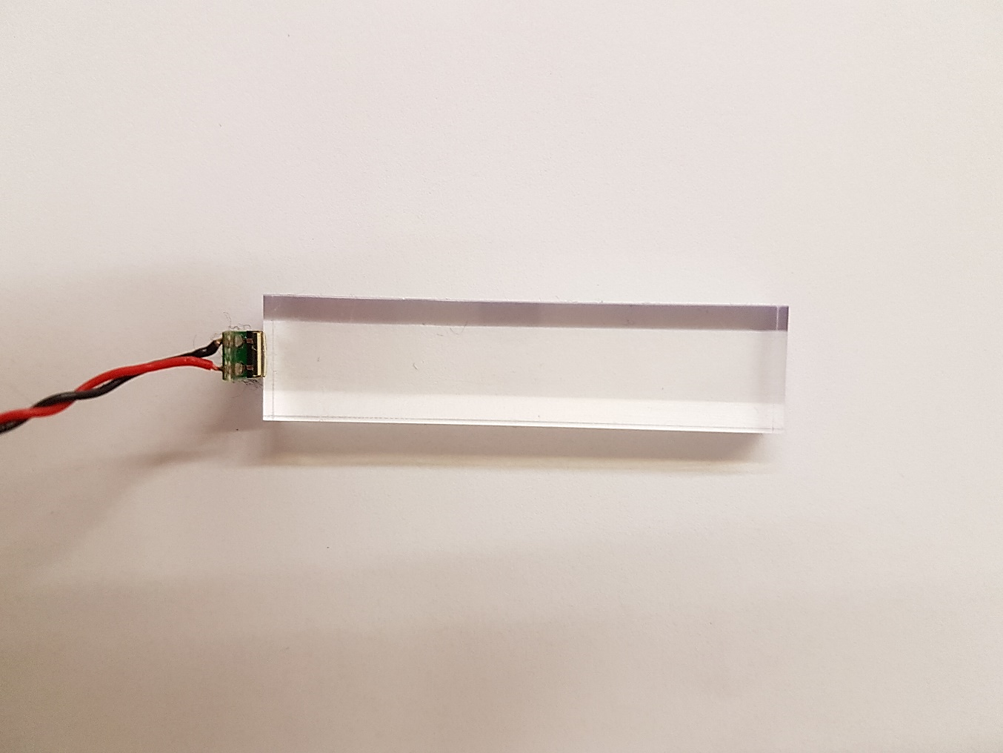
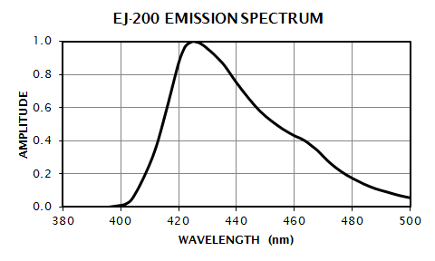
VETO-2 DETECTOR SETUP
SiPMs
  FBK-AdvanSiD (Trento)
  Near-UV operation (420 nm)
  Active area 4 x 4 mm²
Scintillators
  EJ-200 plastic scintillators
  50 x 12 x 4 mm³
  Wavelength of maximum emission 425 nm
M. Tüchler – APS & SPS Meeting, Zürich 2019
Notes:
Hier lassen oder in den Anhang?

Slide 30
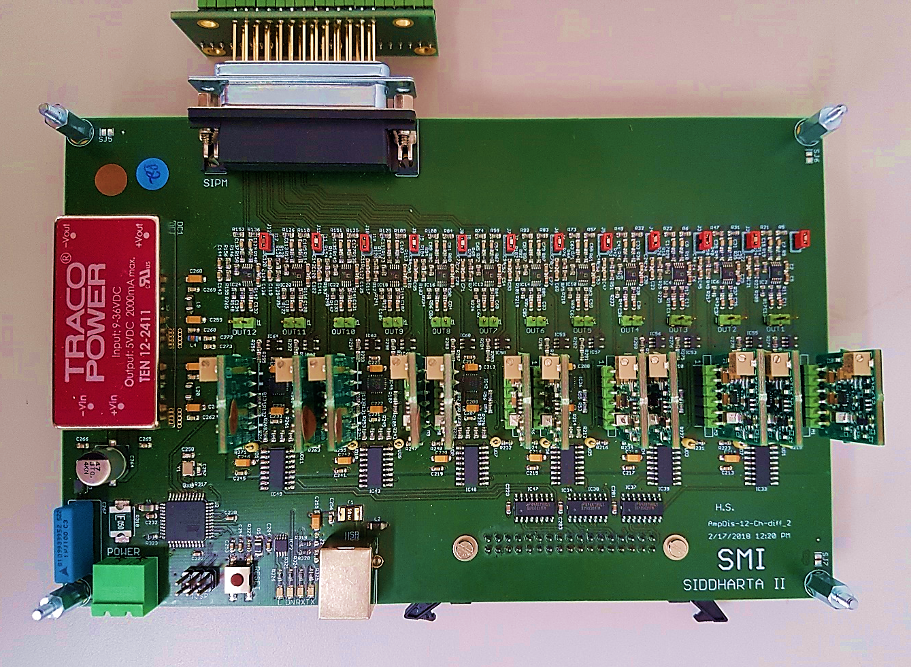
VETO-2 DETECTOR SETUP
Amplification Boards
  12 channels with analogue (DS) and digital output (LVDS)
  Digital: Time over Threshold
  Gain and threshold: remotely adjustable
M. Tüchler – APS & SPS Meeting, Zürich 2019

Slide 31
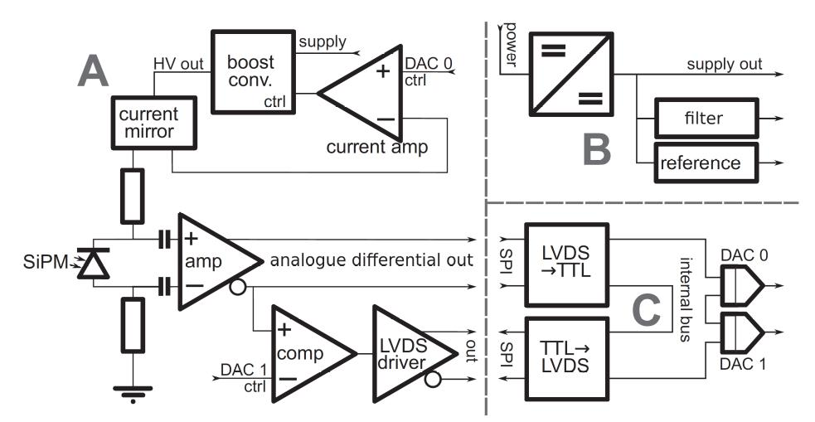
AMPLIFIER BOARDS
Sauerzopf C. et al. (2016) Nucl. Instrum. Meth. Phys. Res. A 819 163–166
M. Tüchler – APS & SPS Meeting, Zürich 2019

Slide 32
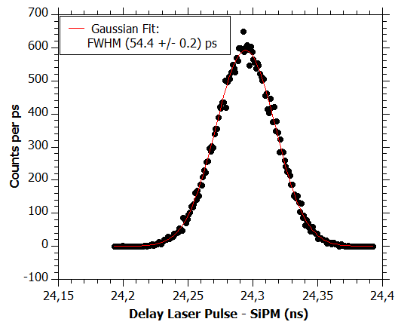
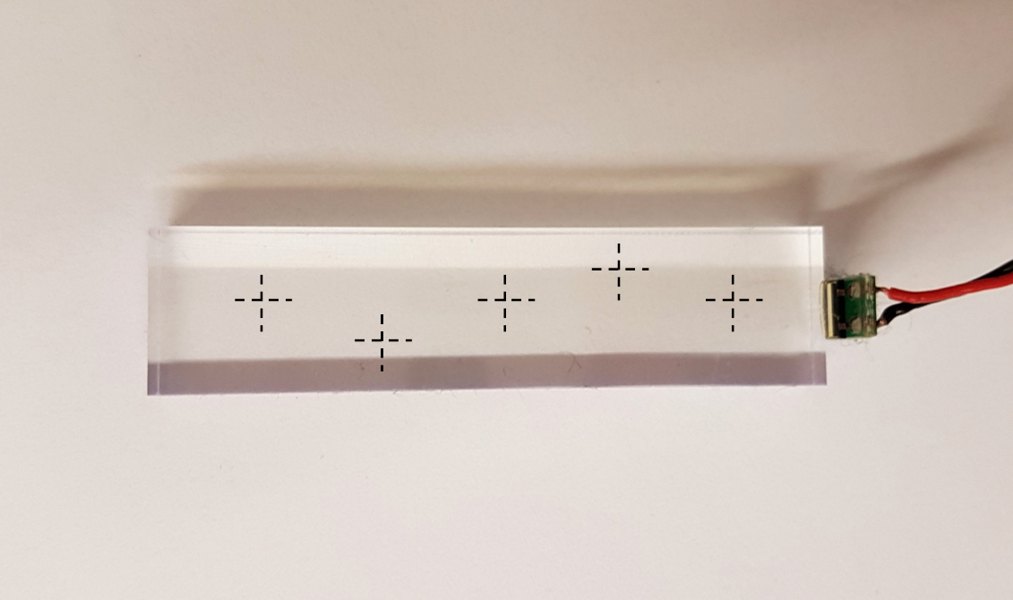
VETO-2 CHARACTERISATION
Time Resolution
  Diode laser (450 nm) on three or five positions
  Time delay between laser pulse – SiPM signal
M. Tüchler – APS & SPS Meeting, Zürich 2019

Slide 33
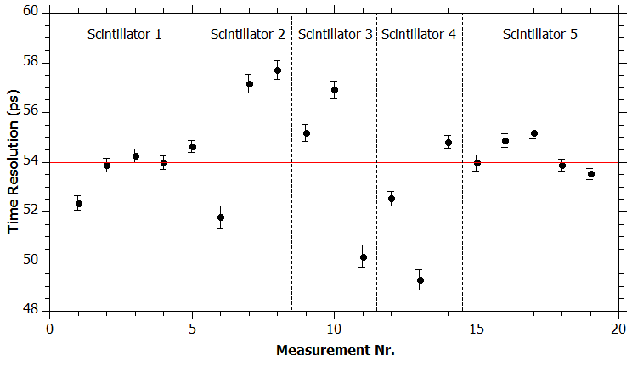
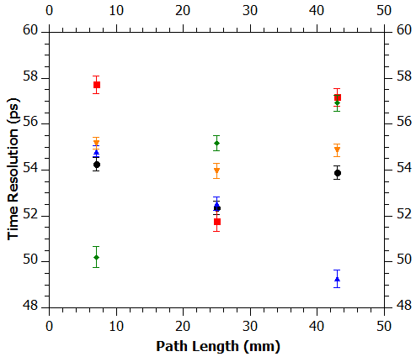
VETO-2 CHARACTERISATION
Time Resolution
  No systematic trend in position dependency
  Average local time resolution (FWHM): (54 ± 2) ps
  Average time resolution of Veto-2 system (FWHM): (293 ± 45) ps
M. Tüchler – APS & SPS Meeting, Zürich 2019

Slide 34
VETO-2 CHARACTERISATION
Detection Efficiency
  Cosmic rays
  Stack of four scintillator-SiPM tiles
  Pulse height spectra
  Coincidence between outer detectors
Scintillator
SiPM
Cosmic Ray
M. Tüchler – APS & SPS Meeting, Zürich 2019

Slide 35
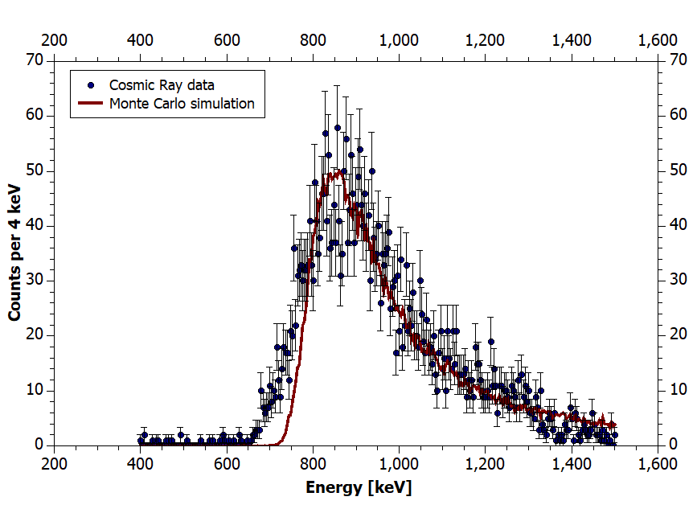
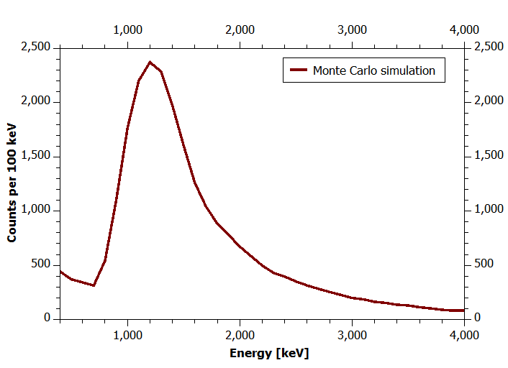
VETO-2 CHARACTERISATION
Detection Efficiency
  Detection efficiency of (99.1 ± 0.2)%
Cosmic data + MC simulation
MC simulation: K⁻N decay products
M. Tüchler – APS & SPS Meeting, Zürich 2019
Notes:
Muons normally distributed between 150 & 700 MeV/c bzw. Σ±π ∓, Σ0π 0 , Λπ−, Σ0π− and Σ−π0 → n, p, π, γ

Slide 36
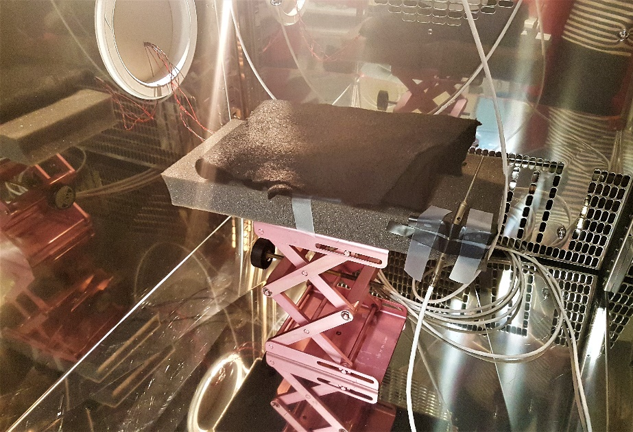
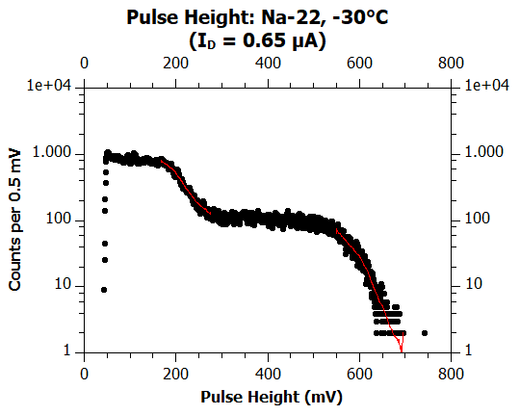
VETO-2 CHARACTERISATION
Temperature studies of Detectors
  SiPMs in climate chamber with Na-22 source
  Amplification board outside at constant temperature
  Pulse height spectra from T = -40°C to +40°C
Compton edge
M. Tüchler – APS & SPS Meeting, Zürich 2019
Notes:
Na-22: 511 keV, 1275 keV γ

Slide 37
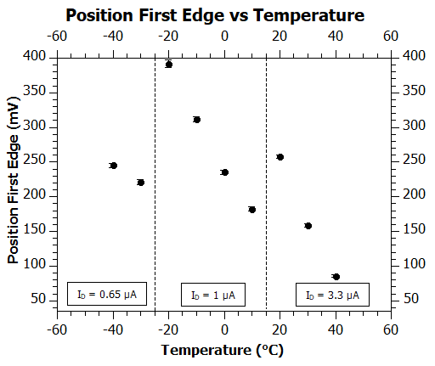
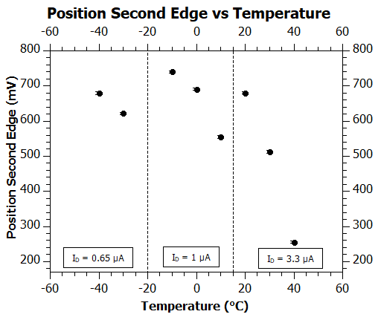
VETO-2 CHARACTERISATION
Temperature studies of Detectors
M. Tüchler – APS & SPS Meeting, Zürich 2019

Slide 38
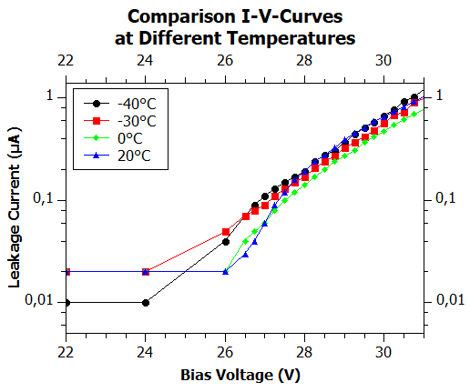
VETO-2 CHARACTERISATION
Temperature studies of Detectors
M. Tüchler – APS & SPS Meeting, Zürich 2019
Notes:
0.5 V difference between -40 and 20 degrees

Slide 39
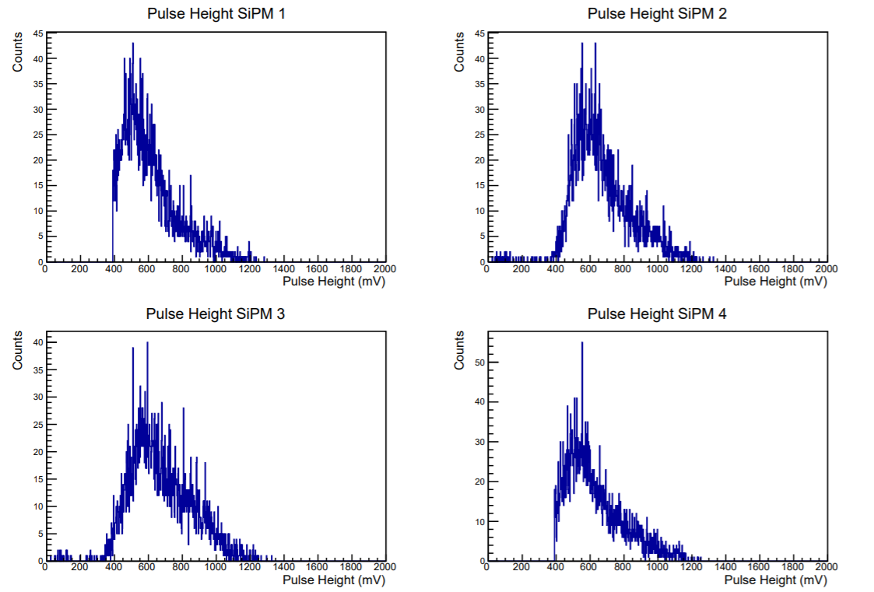
VETO-2 CHARACTERISATION
Detection Efficiency
M. Tüchler – APS & SPS Meeting, Zürich 2019

Slide 40
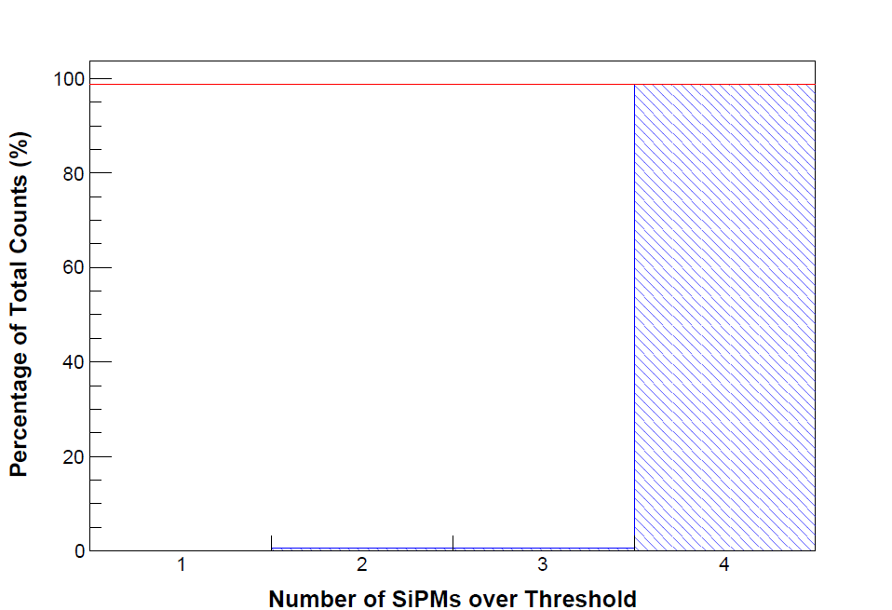
VETO-2 CHARACTERISATION
Detection Efficiency
  Multiplicity: (98.8 ± 0.2)% for four detectors
M. Tüchler – APS & SPS Meeting, Zürich 2019

Slide 41
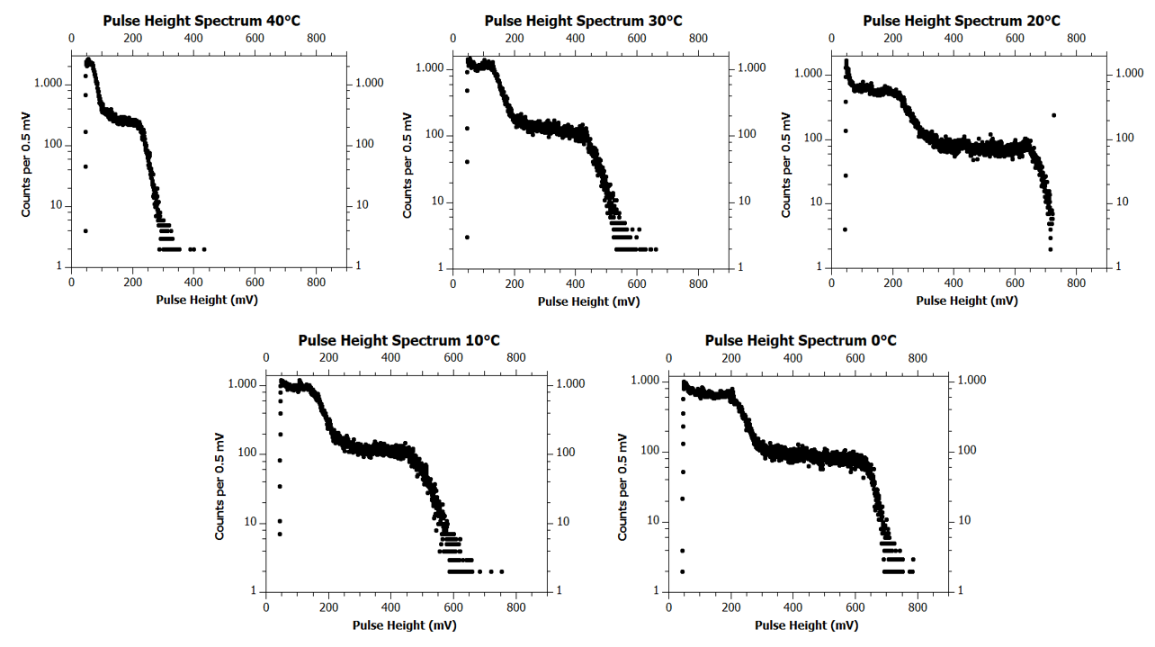
VETO-2 CHARACTERISATION
Temperature studies of Detectors
M. Tüchler – APS & SPS Meeting, Zürich 2019

Slide 42
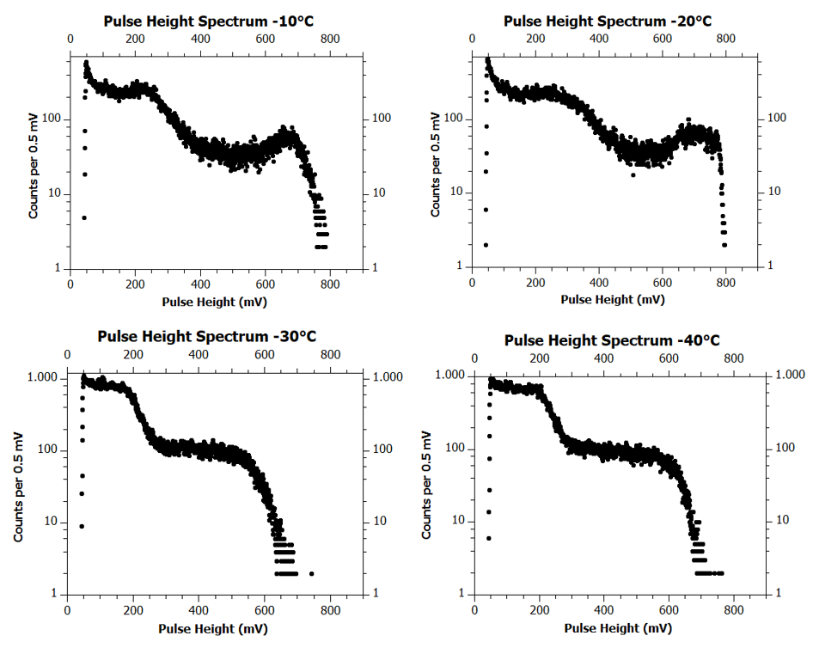
VETO-2 CHARACTERISATION
Temperature studies of Detectors
M. Tüchler – APS & SPS Meeting, Zürich 2019

Slide 43
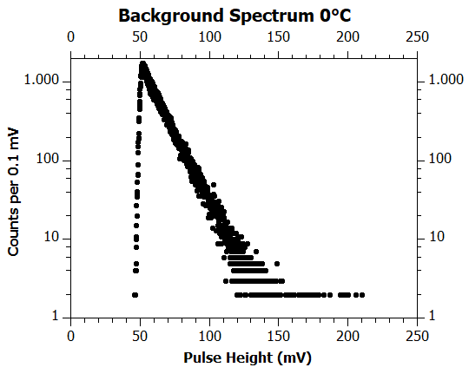
VETO-2 CHARACTERISATION
Temperature studies of Detectors
M. Tüchler – APS & SPS Meeting, Zürich 2019

Slide 44
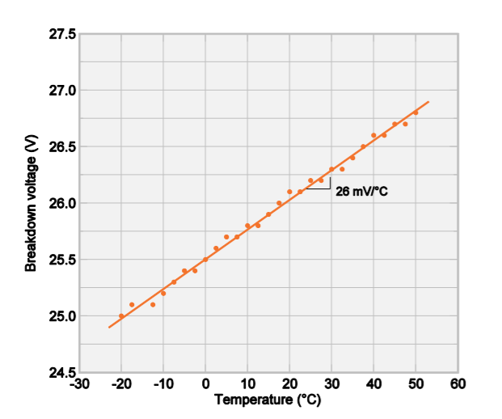
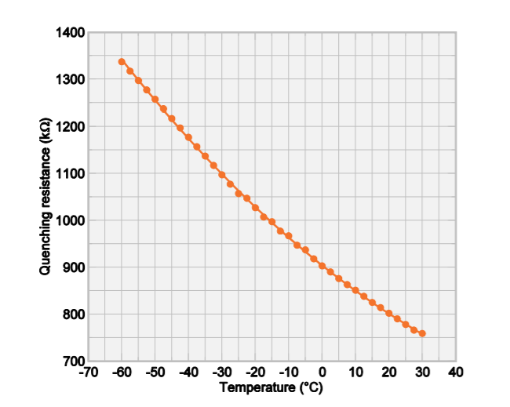
VETO-2 CHARACTERISATION
Temperature studies of Detectors
AdvanSiD. NUV SiPMs Datasheet (Rev.9). www.advansid.com/products/product-detail/asd-rgb-nuv-4s-p (Accessed 12.03.2019)
M. Tüchler – APS & SPS Meeting, Zürich 2019

Slide 45
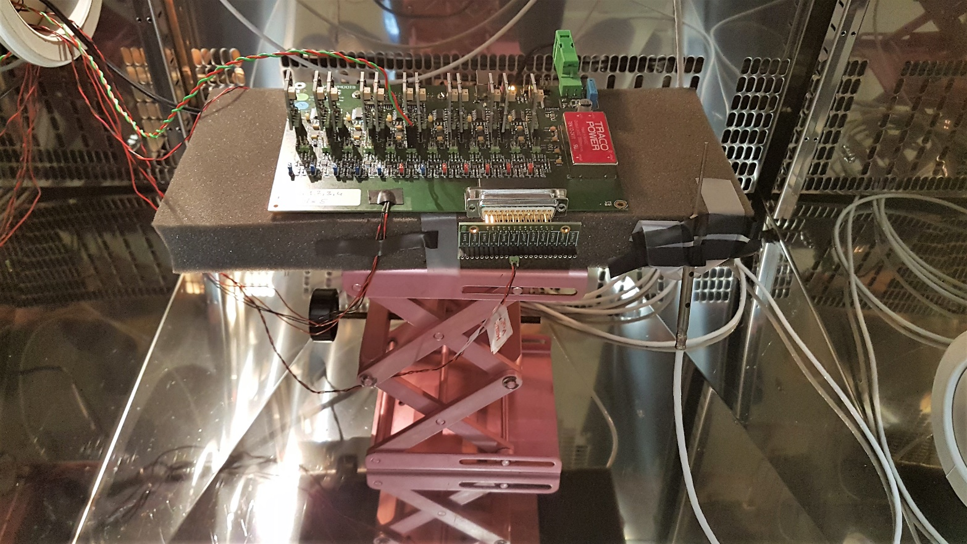
VETO-2 CHARACTERISATION
Temperature studies of Amplification Boards
  Amplification board in climate chamber
  SiPM with Na-22 source outside at constant temperature
  Pulse height spectra at T = (10, 20, 30, 40)°C
M. Tüchler – APS & SPS Meeting, Zürich 2019

Slide 46
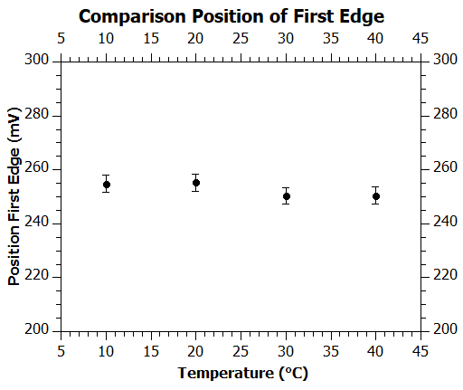
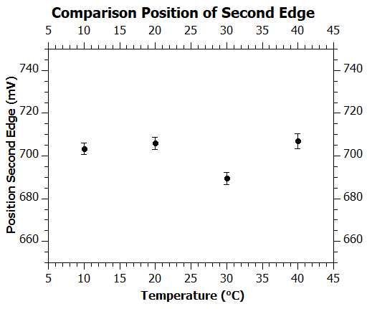
VETO-2 CHARACTERISATION
Temperature studies of Amplification Boards
Comparison Position of First Compton Edge
Comparison Position of Second Compton Edge
M. Tüchler – APS & SPS Meeting, Zürich 2019

Slide 47
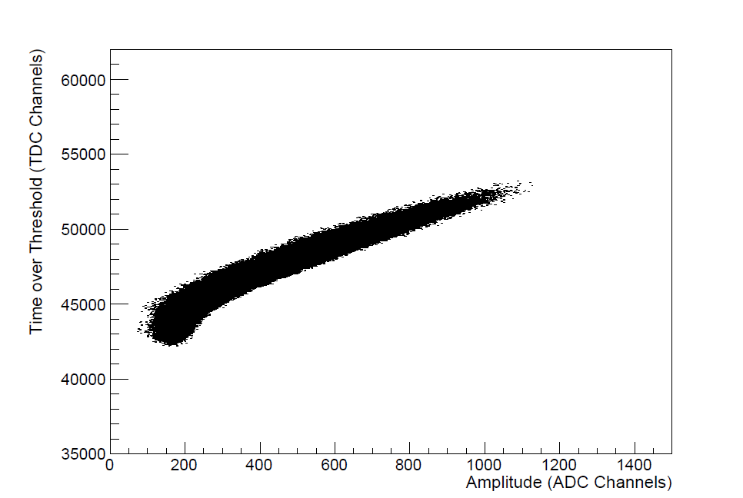
VETO-2 CHARACTERISATION
Correlation of ToT and Amplitude
M. Tüchler – APS & SPS Meeting, Zürich 2019

Slide 48
REFERENCES
Griffiths, D. J.: Introdution to elementary particles. Weinheim, Wiley-VCH, 2008
Backenstoss, G.: Pionic Atoms. Annual Review of Nuclear Science, 1970, 201(1), 467-508
Gotta, D. et al.: Pionic Hydrogen. Physics Procedia, 2011, 17, 69-76
Meißner U.-G., Raha U., Rusetsky A.: Spectrum and Decays of Kaonic Hydrogen. Eur. phys. J. C, 2004, 35, 349
Bazzi, M. et al.: Preliminary study of kaonic deuterium X-rays by the SIDDHARTA experiment at DAFNE. Nuclear Physics A, 2013, 907, 69-77
www.ketek.net/sipm/technology/working-principle/ (15.08.2018)
www.ketek.net/sipm/technology/device-parameters/ (15.08.2018)
M. Tüchler – DK-PI, Vienna 2019

