Slide 1
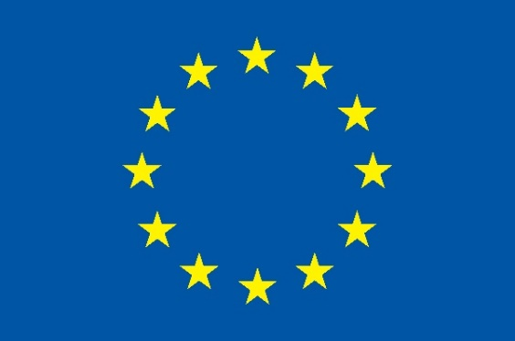

ASACUSA’s Ramsey spectrometer for hyperfine spectroscopy
Amit Nanda*
*on behalf of the ASACUSA collaboration
Stefan Meyer Institute for Subatomic Physics
Vienna
Joint Annual Meeting of the SPG and ÖPG, 26 - 30 Aug 2019
Universität Zürich

Slide 2
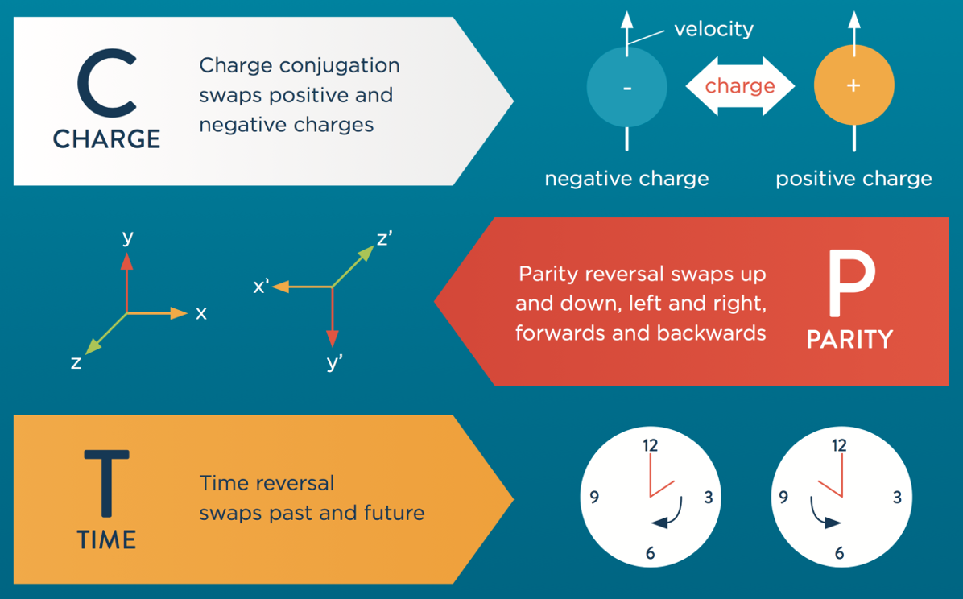

Motivation
CPT symmetry: a cornerstone of QFT
CPT is being tested in different physical systems:
  Leptonic sector: g-factor measurements
  hadronic sector: neutral Kaon mass comparison
  Nuclei: $q/m$ ratio of anti-helium and anti-deuteron
Source: http://antimattermatters.s3-website-eu-west.amazonaws.com/buildingblocks.html
Antihydrogen: only accessible system purely consisting of antimatter. Study of its internal structure offers a very sensitive test of CPT.
Standard Model Extension: a framework!

Slide 3
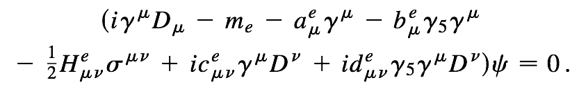
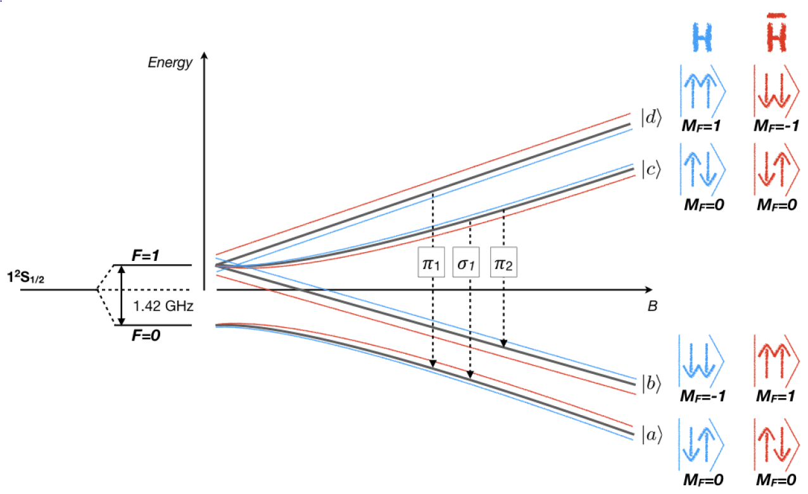
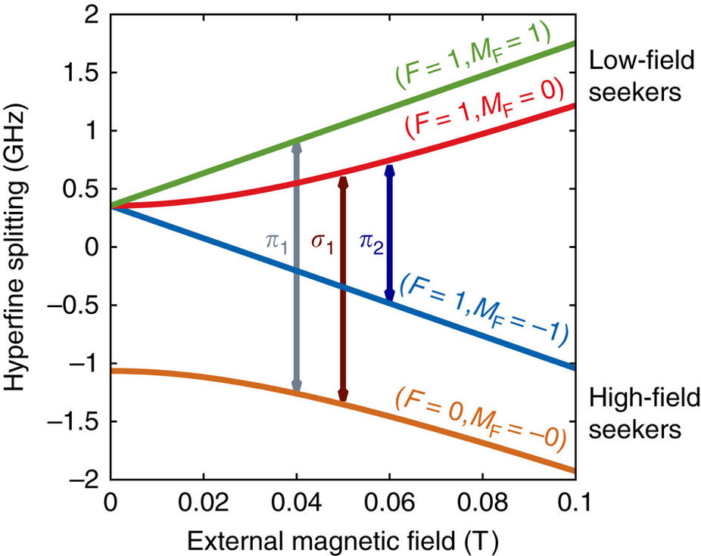
Hyperfine Structure
Modified Dirac equation: inclusion of effective operators for Lorentz Violation
SM Dirac eqn.
CPT & Lorentz violation
Kostelecký VA, Vargas AJ. Phys. Rev. D 92, 056002 (2015)
Lorentz violation
Frequency Shift

Slide 4
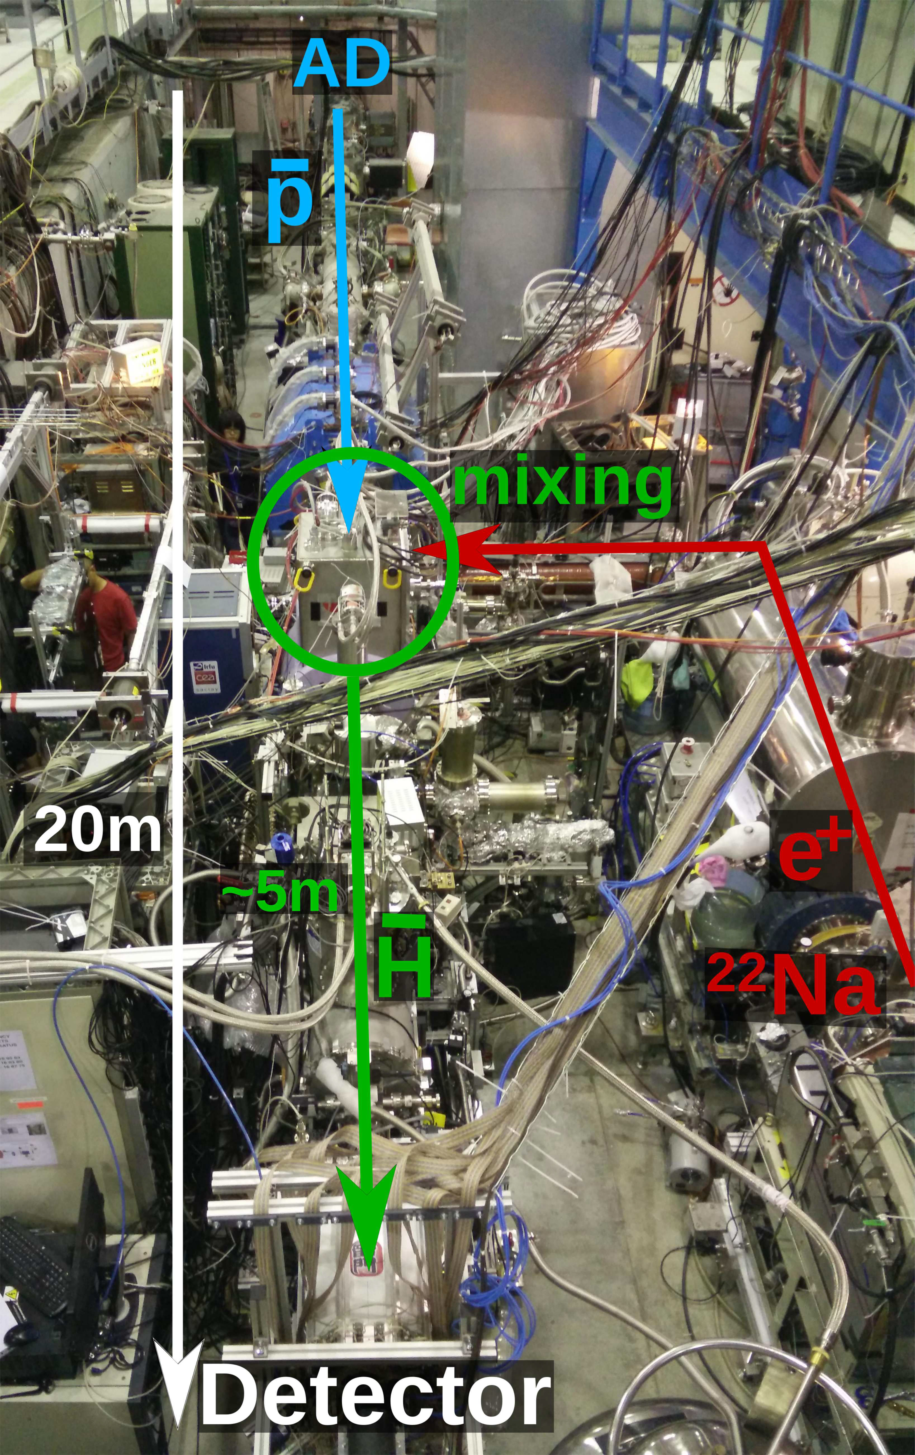
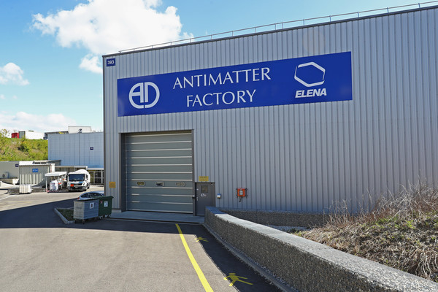
The ASACUSA experiment
Atomic Spectroscopy and Collisions Using Slow Antiprotons

Slide 5

Antihydrogen beam in ASACUSA-CUSP
$\overline{H}$ formation: 3-body recombination process
Double cusp: 2 pair of antihelmholtz coils
Focused and polarized beam of antihydrogen
$\overline{H}$ detection: BGO disk and hodoscope for secondary pions
  Scintillaing bars and fibres coupled to SiPMs
2010: Synthesis of Cold antihydrogen in CUSP trap
2014: A source of antihydrogen for inflight hyperfine spectroscopy
2016: First antihydrogen quantum states scan in a field free region
Y. Enomoto et. al, Phys. Rev. Lett. 105, 243401 (2010)
Kuroda, N. et. al, Nat. Commun. 5, 3089 (2014)
C. Malbrunot et. al, Phil. Trans. A 376(2116) , Mar 2018

Slide 6
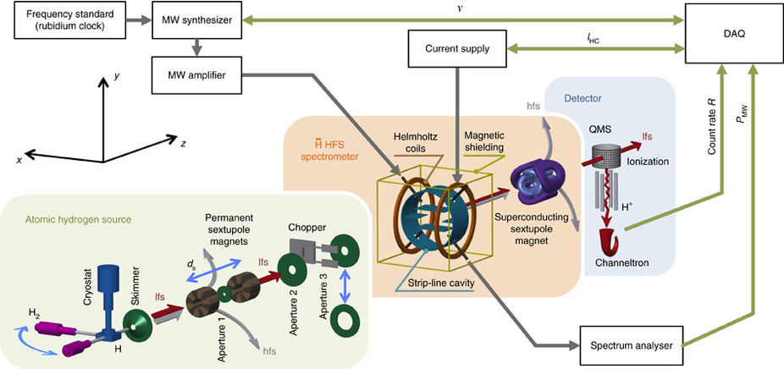
Hydrogen beam set-up
Schematic of the set up
Cavity and analysis superconducting sextupoles

Slide 7
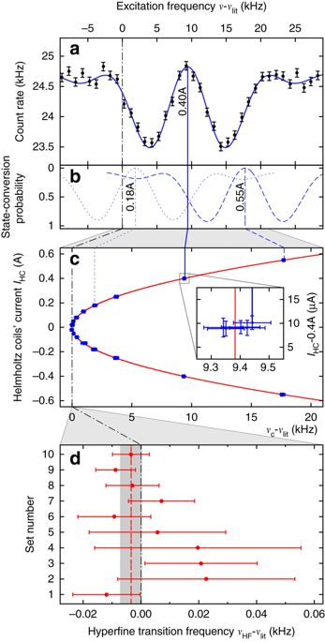
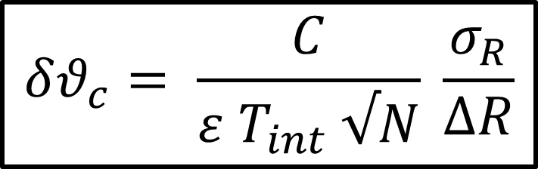
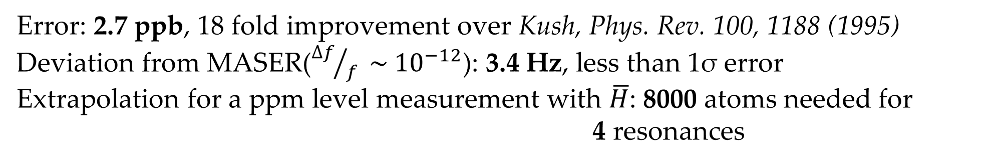
Hydrogen beam - Results
$$θ_{HF}=1 420 405 748.4 \left(3.4\right)\left(1.6\right)Hz$$
Error: 2.7 ppb, 18 fold improvement over Kush, Phys. Rev. 100, 1188 (1995)
Deviation from MASER(${∆f}/f \sim {10}^{−12}$): 3.4 Hz, less than 1σ error
Extrapolation for a ppm level measurement with $\overline{H}$: 8000 atoms needed for 4 resonances
$$δθ_{c}= \frac{C}{ε T_{int} √N} \frac{σ_{R}}{∆R}$$
Error bar at datapoint
Count rate drop
No. of data points
Interaction time
Robust lineshape fit: amplitude of oscillatory field, velocity and velocity spread
Lineshape dependent factor

Slide 8
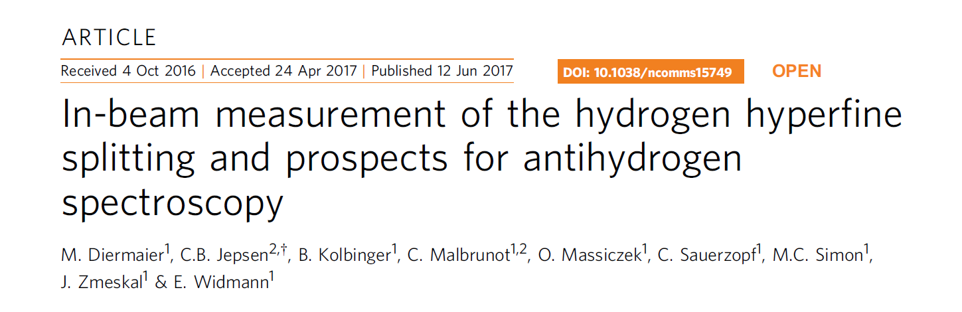
Hydrogen beam - Results
$$θ_{HF}=1 420 405 748.4 \left(3.4\right)\left(1.6\right)Hz$$
Error: 2.7 ppb, 18 fold improvement over Kush, Phys. Rev. 100, 1188 (1995)
Deviation from MASER(${∆f}/f \sim {10}^{−12}$): 3.4 Hz, less than 1σ error
Extrapolation for a ppm level measurement with $\overline{H}$: 8000 atoms needed for 4 resonances
$$δθ_{c}= \frac{C}{ε T_{int} √N} \frac{σ_{R}}{∆R}$$
Error bar at datapoint
Count rate drop
No. of data points
Interaction time
Robust lineshape fit: amplitude of oscillatory field, velocity and velocity spread
Lineshape dependent factor

Slide 9
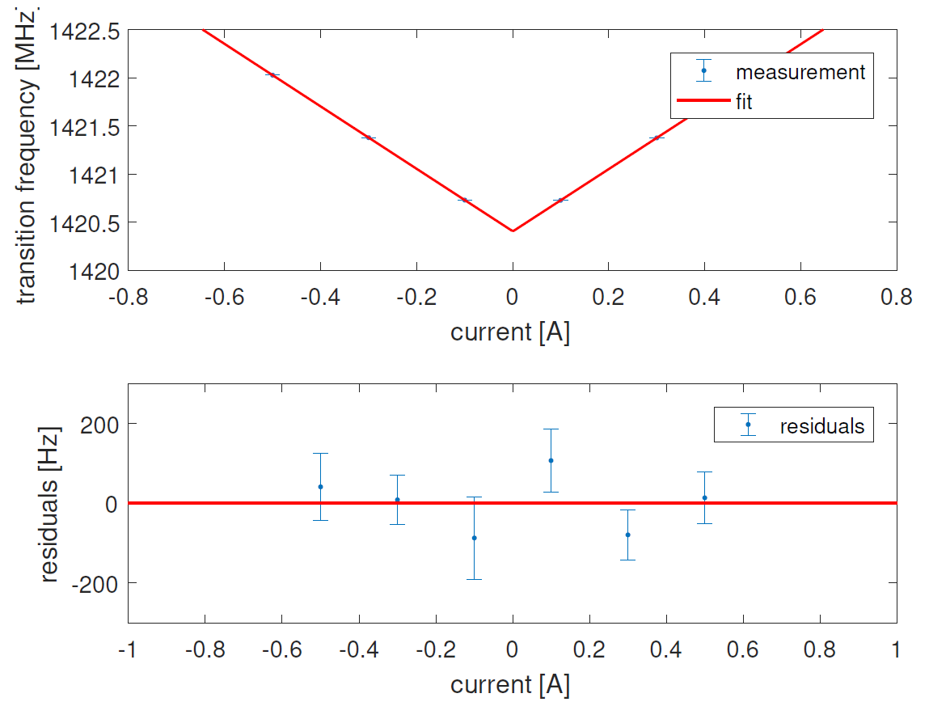
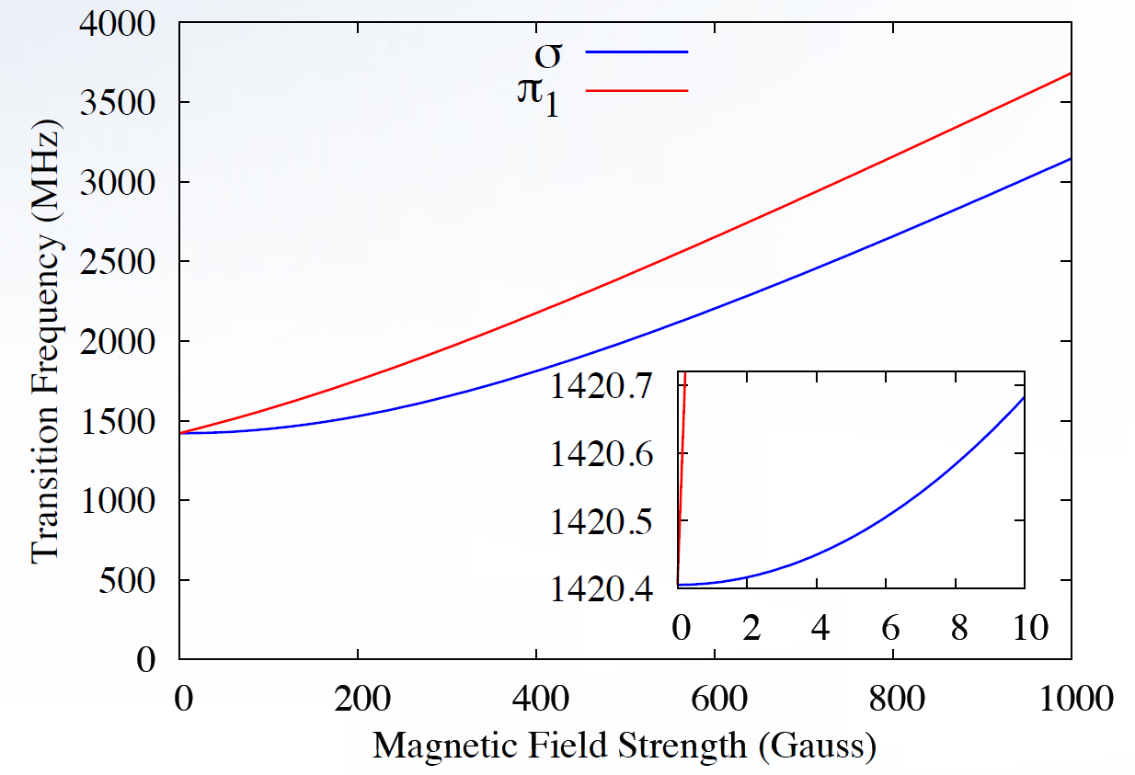
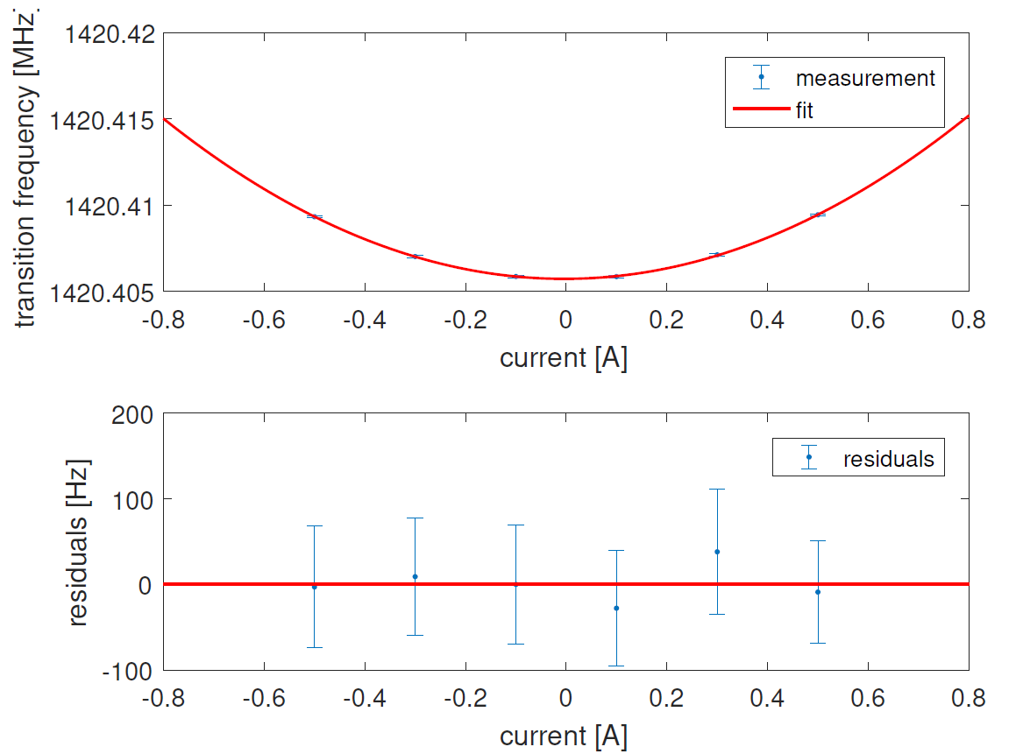
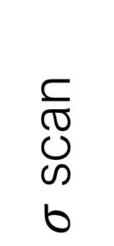
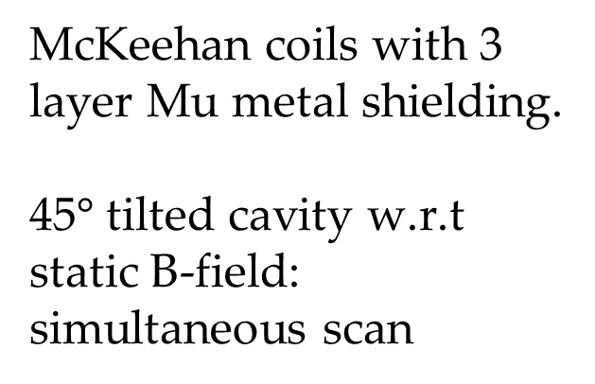
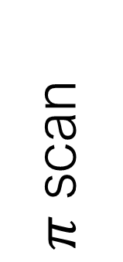
$π$ - measurement
$π$ scan
McKeehan coils with 3 layer Mu metal shielding.
45$°$ tilted cavity w.r.t static B-field: simultaneous scan
$σ$ scan
Linear dependence and highly sensitive to B-field inhomogeneity

Slide 10
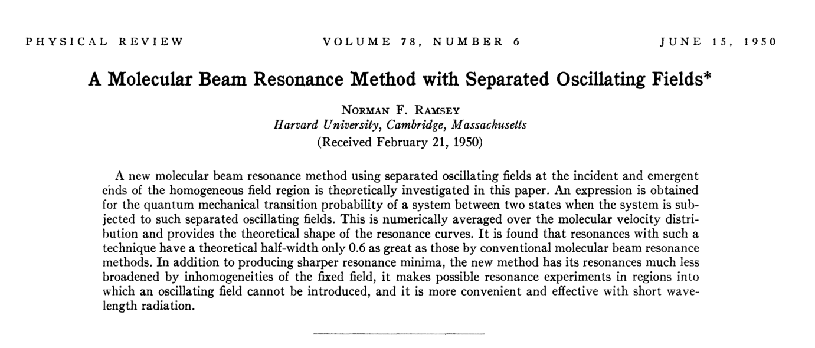

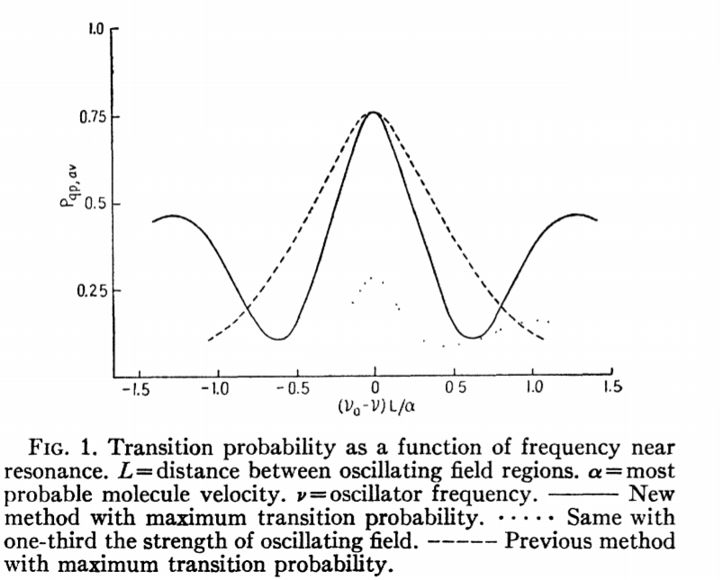
Rabi to Ramsey
Separated Oscillatory Fields
Resolution:
Improved resolution and resonance peak shape is unaffected by static B-field non-uniformities.

Slide 11
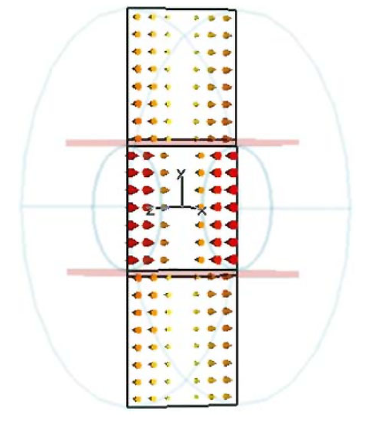
Strip line cavity
Double peak structure simply because of cavity geometry.
Amplitude of microwaves inside the cavity: cosine like along the beam axis

Slide 12
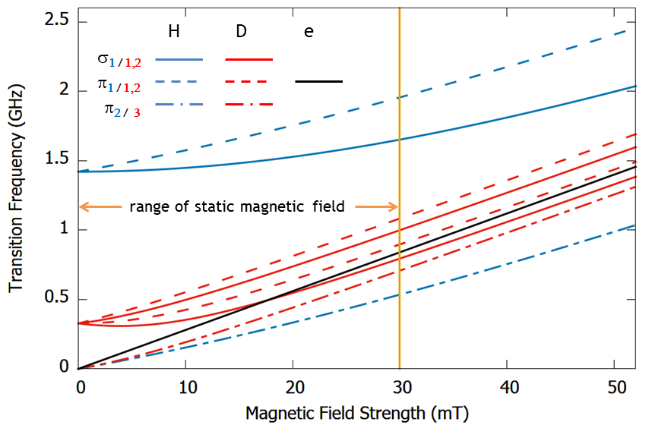
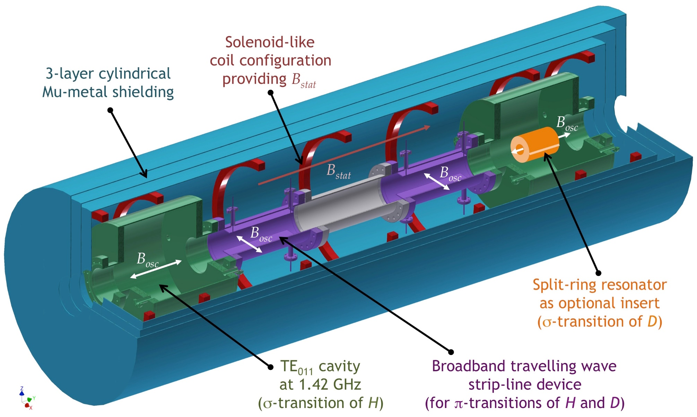
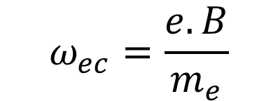
Planned design of Ramsey apparatus
Linear dependence of electron cyclotron frequency: magnetic field calibration
$$ω_{ec}=\frac{e.B}{m_{e}}$$

Slide 13
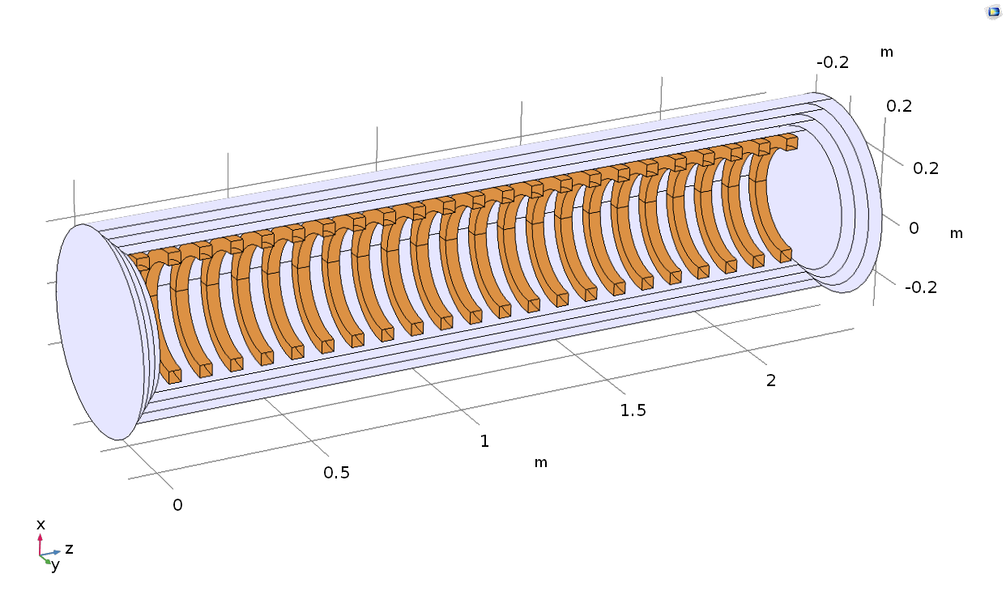
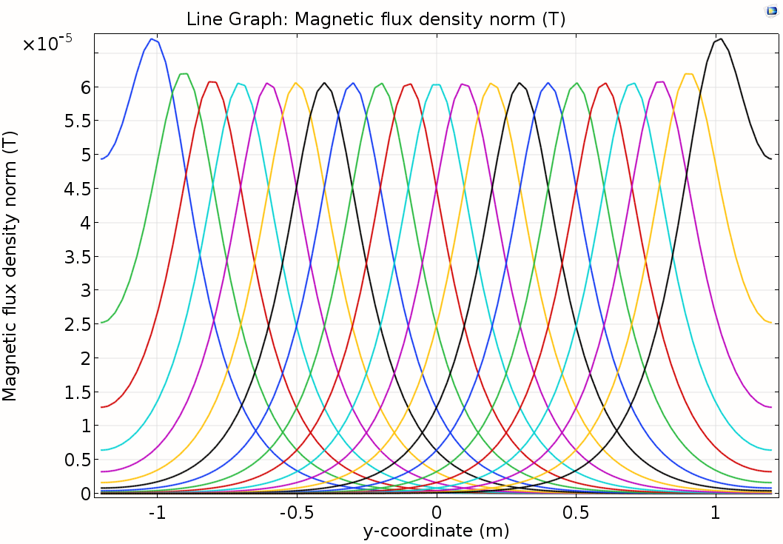
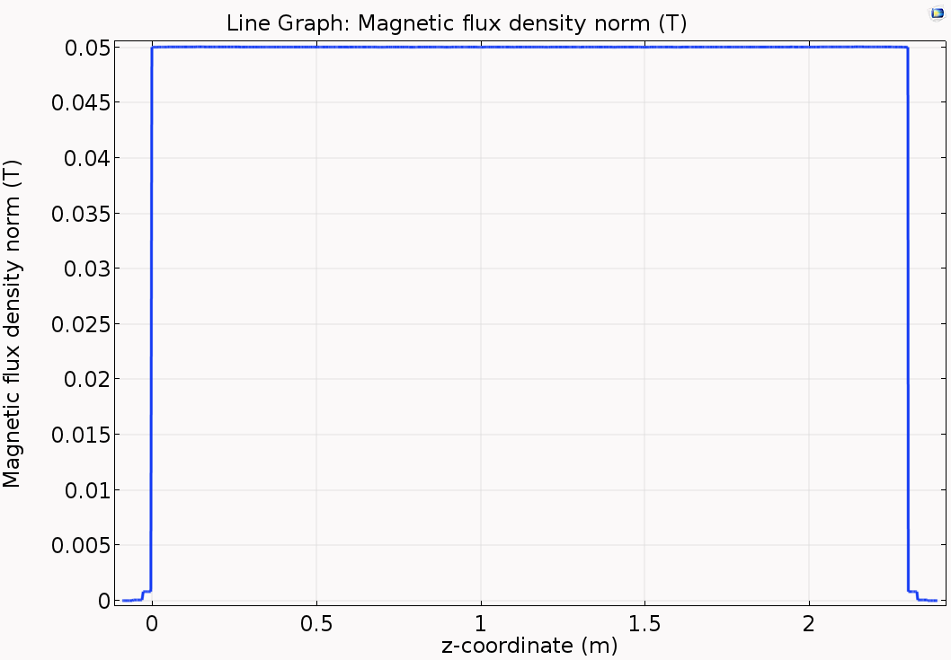
Static Magnetic field coils
23 coils housed inside a 3 layer shielding
Parametric sweeps: radius of the coils, distance between the coils
2D simulations and Matrix inversion technique to find optimum no.of turns for each coils
Homogeneity is better than 100 ppm in simulations along the cental axis in a 4 cm diameter

Slide 14
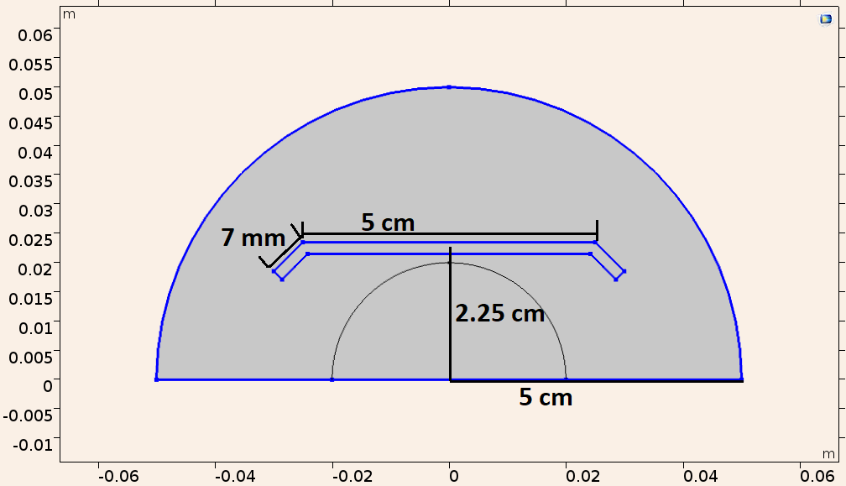
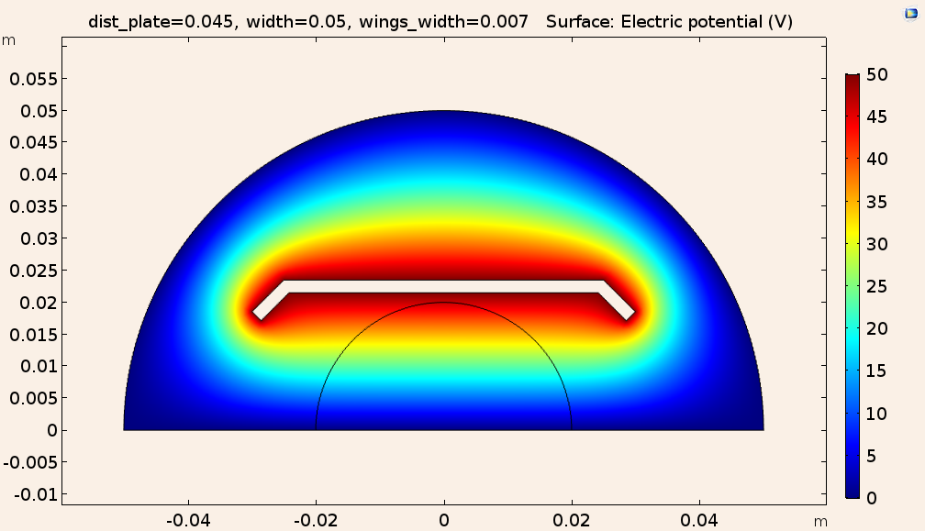
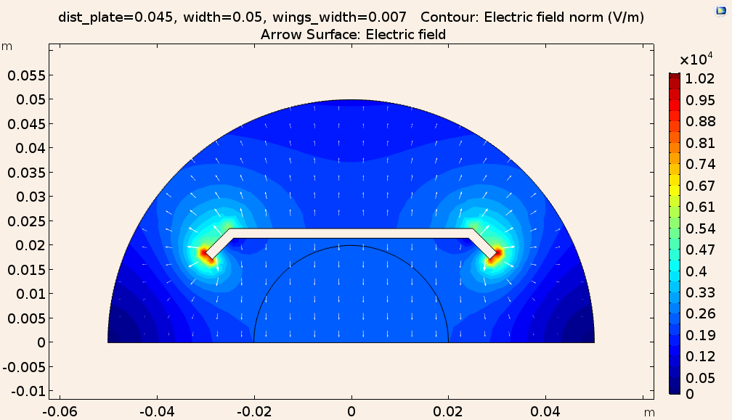
Stripline structure
geometry
Electric potential
Electric fields, contour plot
2D electrostatics study: 50 ohm structure
Parametric sweeps: width of plates, distance from centre, wings with, thickness
Line integration of surface charge density: Charge per unit length
  Charge (per unit length)/terminal volatge (50V, in this case) = capacitacne (C0) per unit length (evaluated in pF/m)
Impedance (Z0) = 1/[c*C0], c = 299 792 458 m/s
E-field homogeneity ~ 0.5%

Slide 15
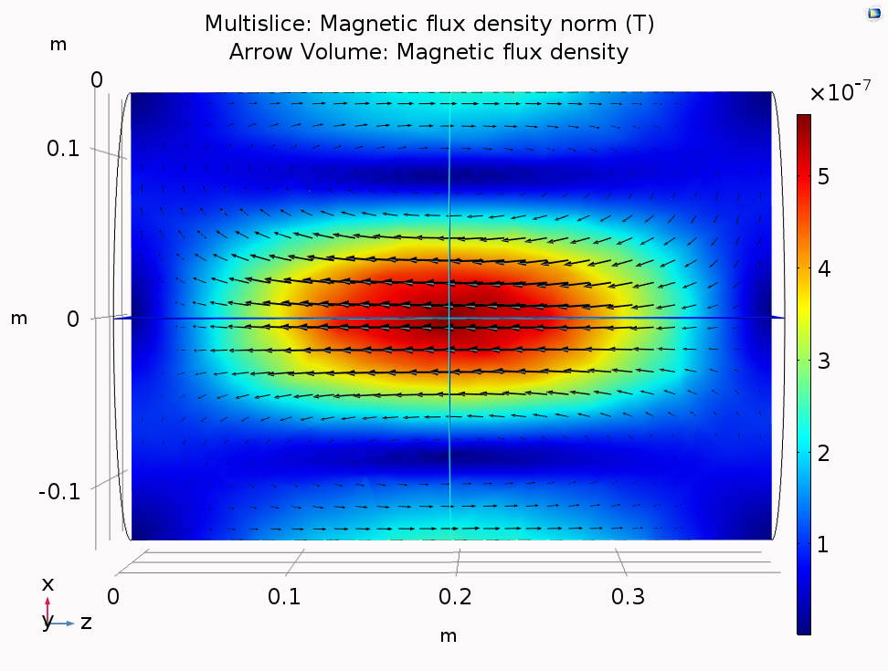
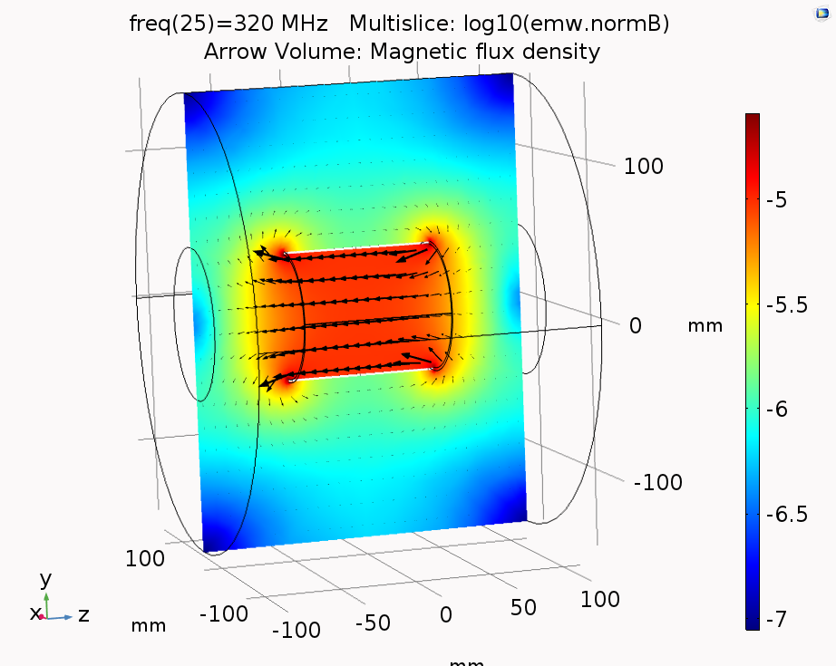
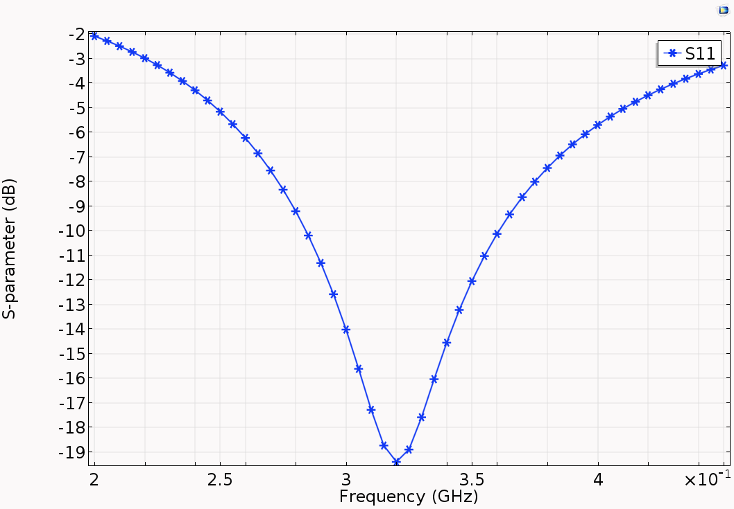
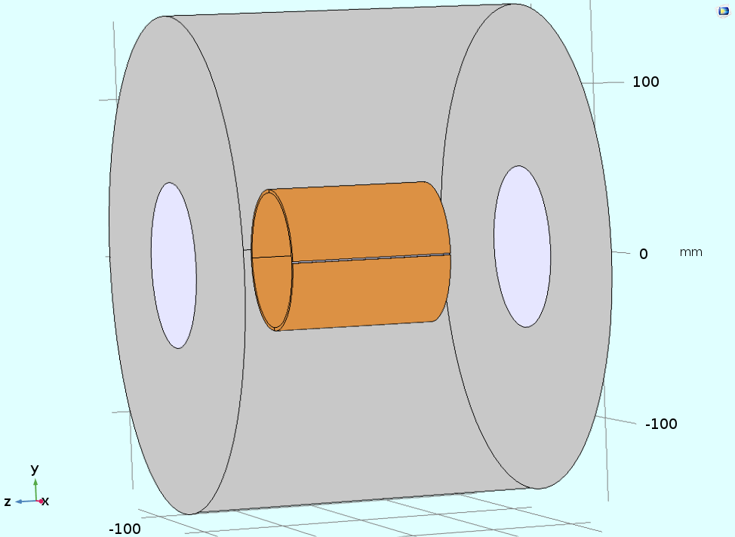
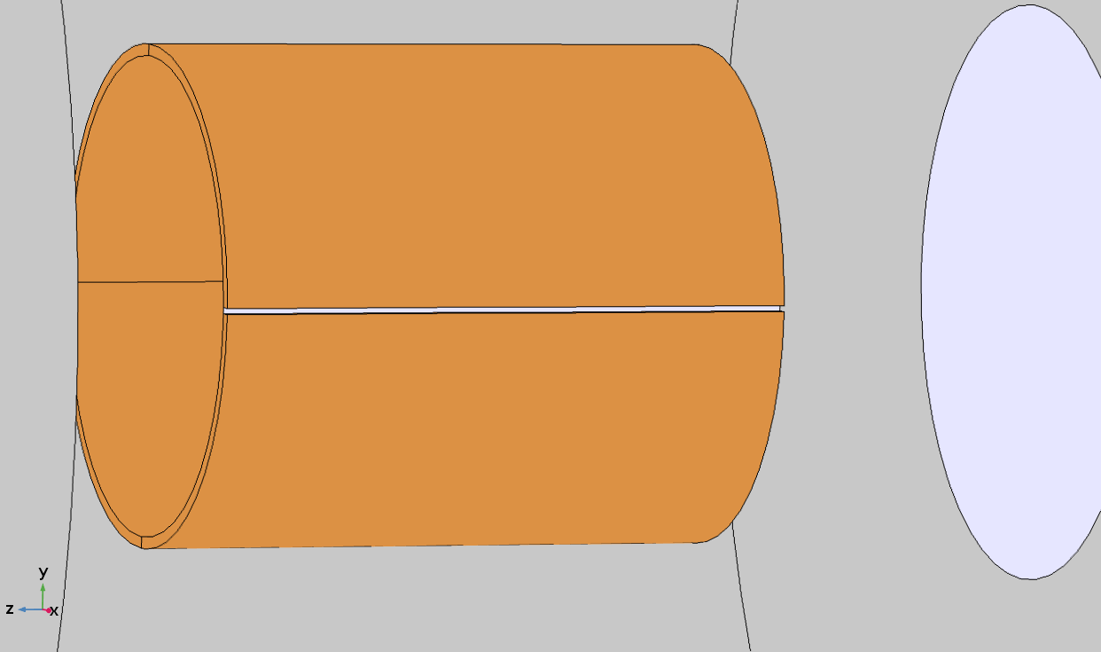
Split Ring Resonator
Aluminium Shield, 150mm diameter, 224 mm long
Air boundaryat the ends
Copper split ring cylinder, 38mm inner diameter, 100mm long
Slit gap used as lumped port
B-field in TE011 cavity
B-field in split ring resonator

Slide 16

Summary
Production and source of antihydrogen beam in ASACUSA
Best in-beam determination of GS-HFS of hydrogen: commissioned spectroscopy apparatus
Observation of $π_{1}$ transition: constrain coefficients of SME
Design for an upgrade: Ramsey technique, planned apparatus
Simulations of microwave devices and coils
Outlook
Feedthrough to stripline transition
TE110 cavity: coupling and excitation
Design for coils cooling
Isolation of different microwave regions, mesh at the ends : reflections?
Double stripline structure: single device, but with racetrack coils
Geant4 simulations including the full beamline – lineshape calcualtion

Slide 17











Acknowledgements
This project has received funding from the European Union’s Horizon 2020 research and innovation programme under the Marie Skłodowska-Curie grant agreements Nos 721559 AVA and 748826 ANGRAM. This work has been supported by the European Research Council under European Union’s Seventh Framework Programme (FP7/2007-2013)/ERC Grant agreement (291242), the Austrian Ministry of Science and Research, the Austrian Science Fund (FWF): W1252-N27, a Grant-in-Aid for Specially Promoted Research (24000008) of MEXT and a RIKEN Pioneering Project. http://www.cern.ch/ASACUSA

Slide 18
Thank you!

Slide 19
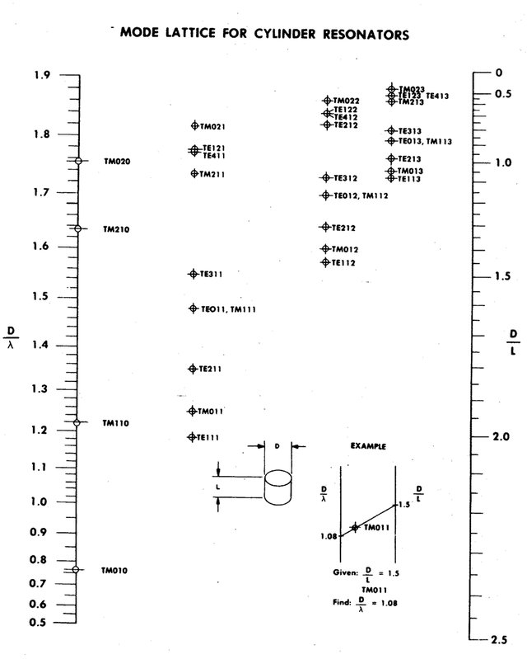
Mode chart

