Slide 1
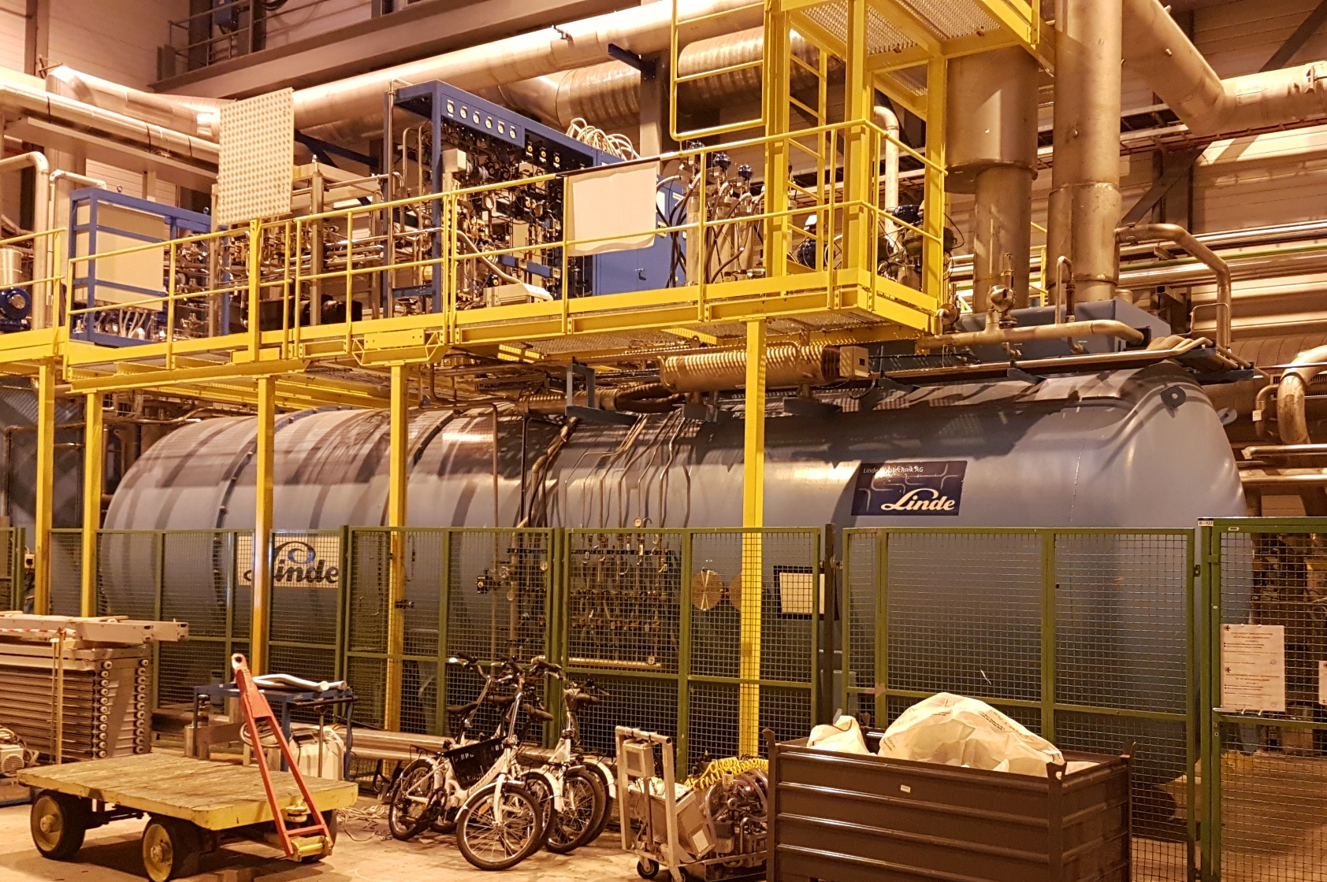
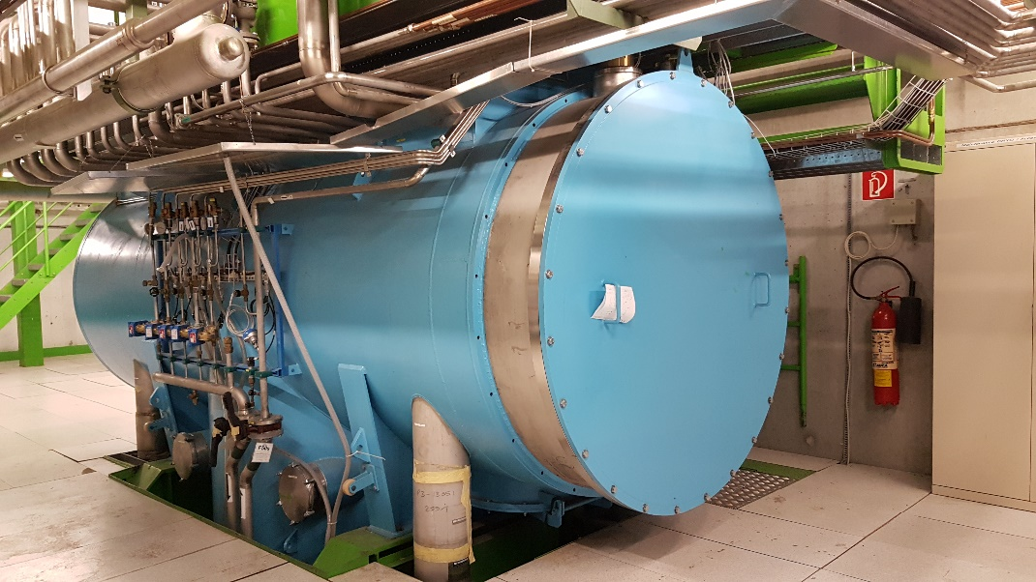

Upgrade ex-LEP Refrigerator for HL-LHC @ P4 F723/TE/HL-LHC WP-12_HSE Project HSE Activities
E. Monneret / TE-CRG-ME
CERN HL-LHC 5th March 2019 EDMS #XXXXX

Slide 2
CONTENT
Overview
Scope of Work
Schedule and Main Milestones
H.S.E. activities

Slide 3
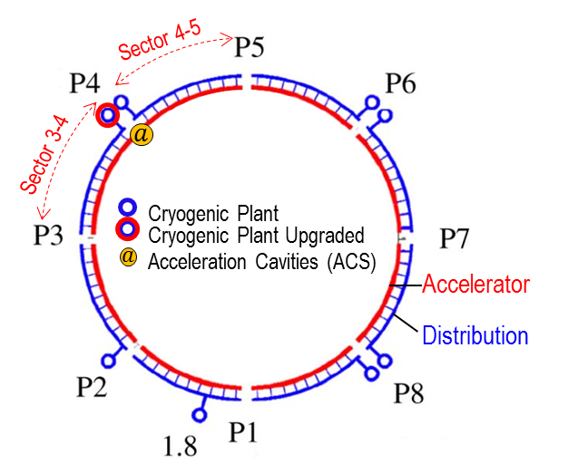
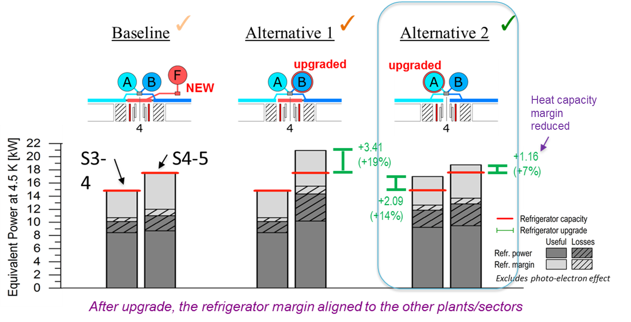
Upgrade Overview
Overview
HL-LHC Baseline & Studies
HL-LHC project require additional overall cryogenic capacity
LHC Point 4 (P4) feature is an additional heat load coming from existing superconducting RF cavities
2015 – HL-LHC Baseline
A new refrigerator for a budget of ~11MCHF
2016 – Alternative study 1
An upgrade of the LHC refrigerator and the distribution for a budget of ~9MCHF
2017 – Alternative study 2
An upgrade of the ex-LEP refrigerator without modification of the distribution
The sector 3-4 fed by the ex-LEP refrigerator becomes the weakest point of LHC for the production of cryogenic refrigeration power
2018 – Contract with Linde KT for the Upgrade – +2kW@4.5K (+14% capacity) @ Budget ~3.8MCHF
LHC

Slide 4
Upgrade Requirements
How to provide +2kW@4.5K for LHCA @P4
No modification of the compressor station QSCA
No modification of the CB’s heat exchangers
No modification of the cryodistribution
Replacement of 7 turbines (new Linde model – TED)
Modification of 1 existing turbine
When it is required
Capacity for LS3 but to smooth CRG workload and minimize risk to be done during LS2

Slide 5
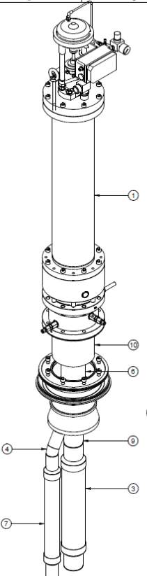
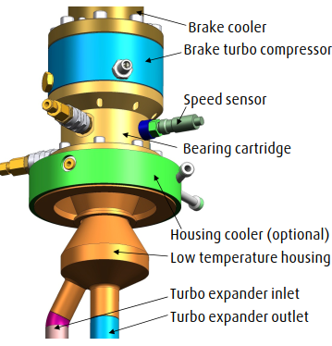

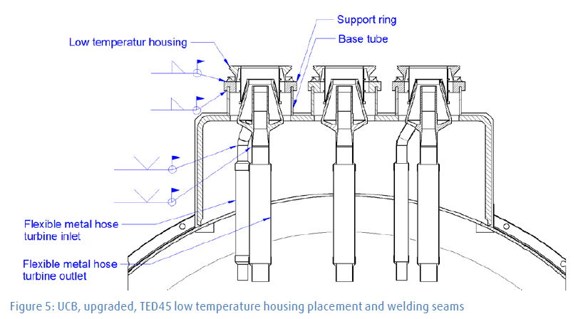
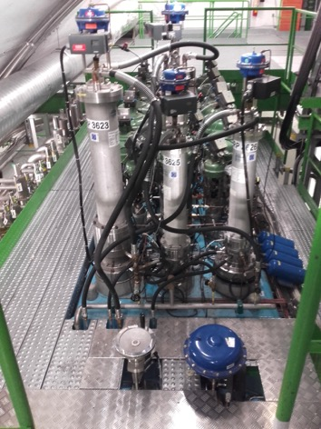
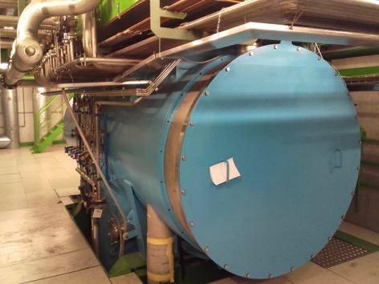
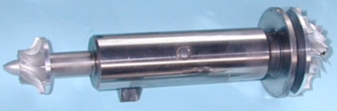
Upgrade Scope
Principle of the capacity upgrade: to replace 8 turbines by new type (more efficient)
This requires exchange of turbine housings & instrumentation
Linde Kryotechnik, original designer and supplier in 90’s.
Upgrade late in 90’s (WCS)
CB’s upgrade in 2005.
New turbine housings and instrumentation
Upper CB: 4 TU’s
Surface
Shaft
Cavern
Cut view of existing cold box
Spares and repairs: to ensure availability as all helium refrigerators
Lower CB: 4 TU’s

Slide 6
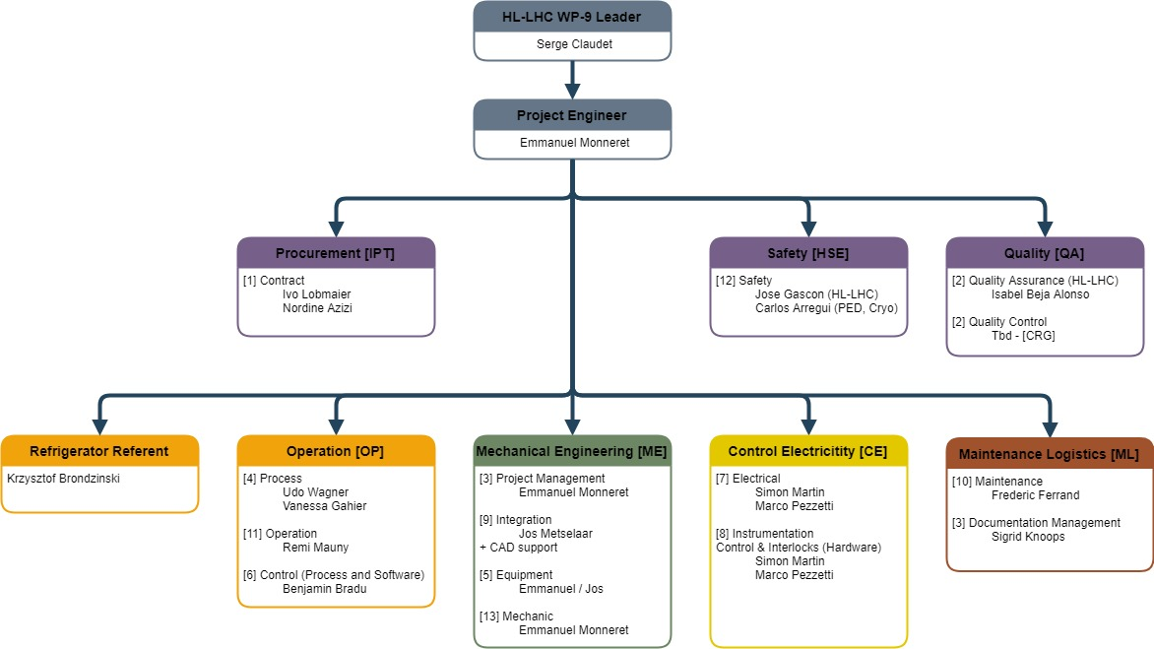
Team Organization

Slide 7
Schedule - Milestones
Project Phases
Design Q1/Q2 2019
Manufacturing Q2/Q3 2019
Installation Q4 2019
Commissioning Q2 2020
Next Milestones
Preliminary Design Review (PDR) & turbines MRR – mid March 2019
CB’s Helium leak test & Internal inspection @CERN LHC-P4 – early April 2019

Slide 8
HSE (Safety) Activities
Pressure Equipment
Mechanical design
New Equipment: According to PED and relatives standards integrated in original (~25 years old) equipment
Contractor (LKT) will design, manufacture and test the new equipment in accordance to regulation
Contractor will not be responsible for the global equipment (after integration in existing CBs)
Directive and Norm: PED and ISO/EN norms (piping, vessels,…)
CERN will have to make the overall validation
What is required during design / Manufacturing-Installation / Test / Operation / Maintenance / Decommissioning ?
Pressure test (1,25 vs 1,43) ?

Slide 9
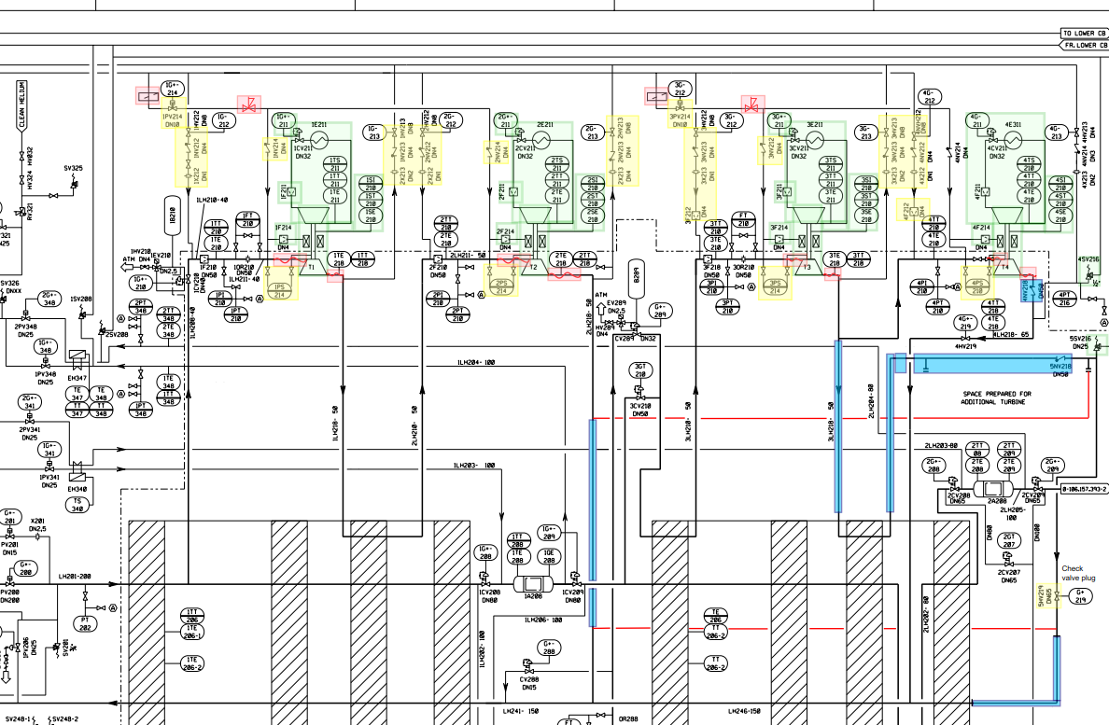

HSE (Safety) Activities
Ex. Upper Cold Box
Change all turbines
Modification of piping to re-use a valve (5HV219) – Add a “close” volume (use existing SV)

Slide 10
HSE (Safety) Activities
Other activities
Electrical design (in charge of CERN if any)
Instrumentation (LKT only provide instrument)
Control & Interlocks (implemented by CERN)

Slide 11
HSE (Health) Activities
Job identified as of today
Welding, gridding
Working in confine space
Working with Pressure gas (N₂, Ar, He)
Working with MLI (Multi layer insulation)
Transport of Load (~200kg) / opening of cold box (~1 ton flange)
Specific procedure and adequate personal protection will be used + CERN required training

Slide 12
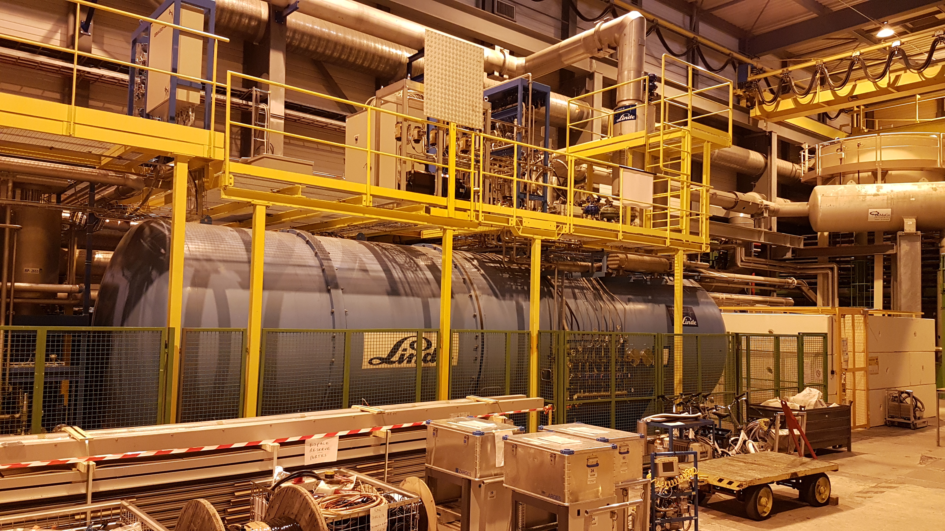
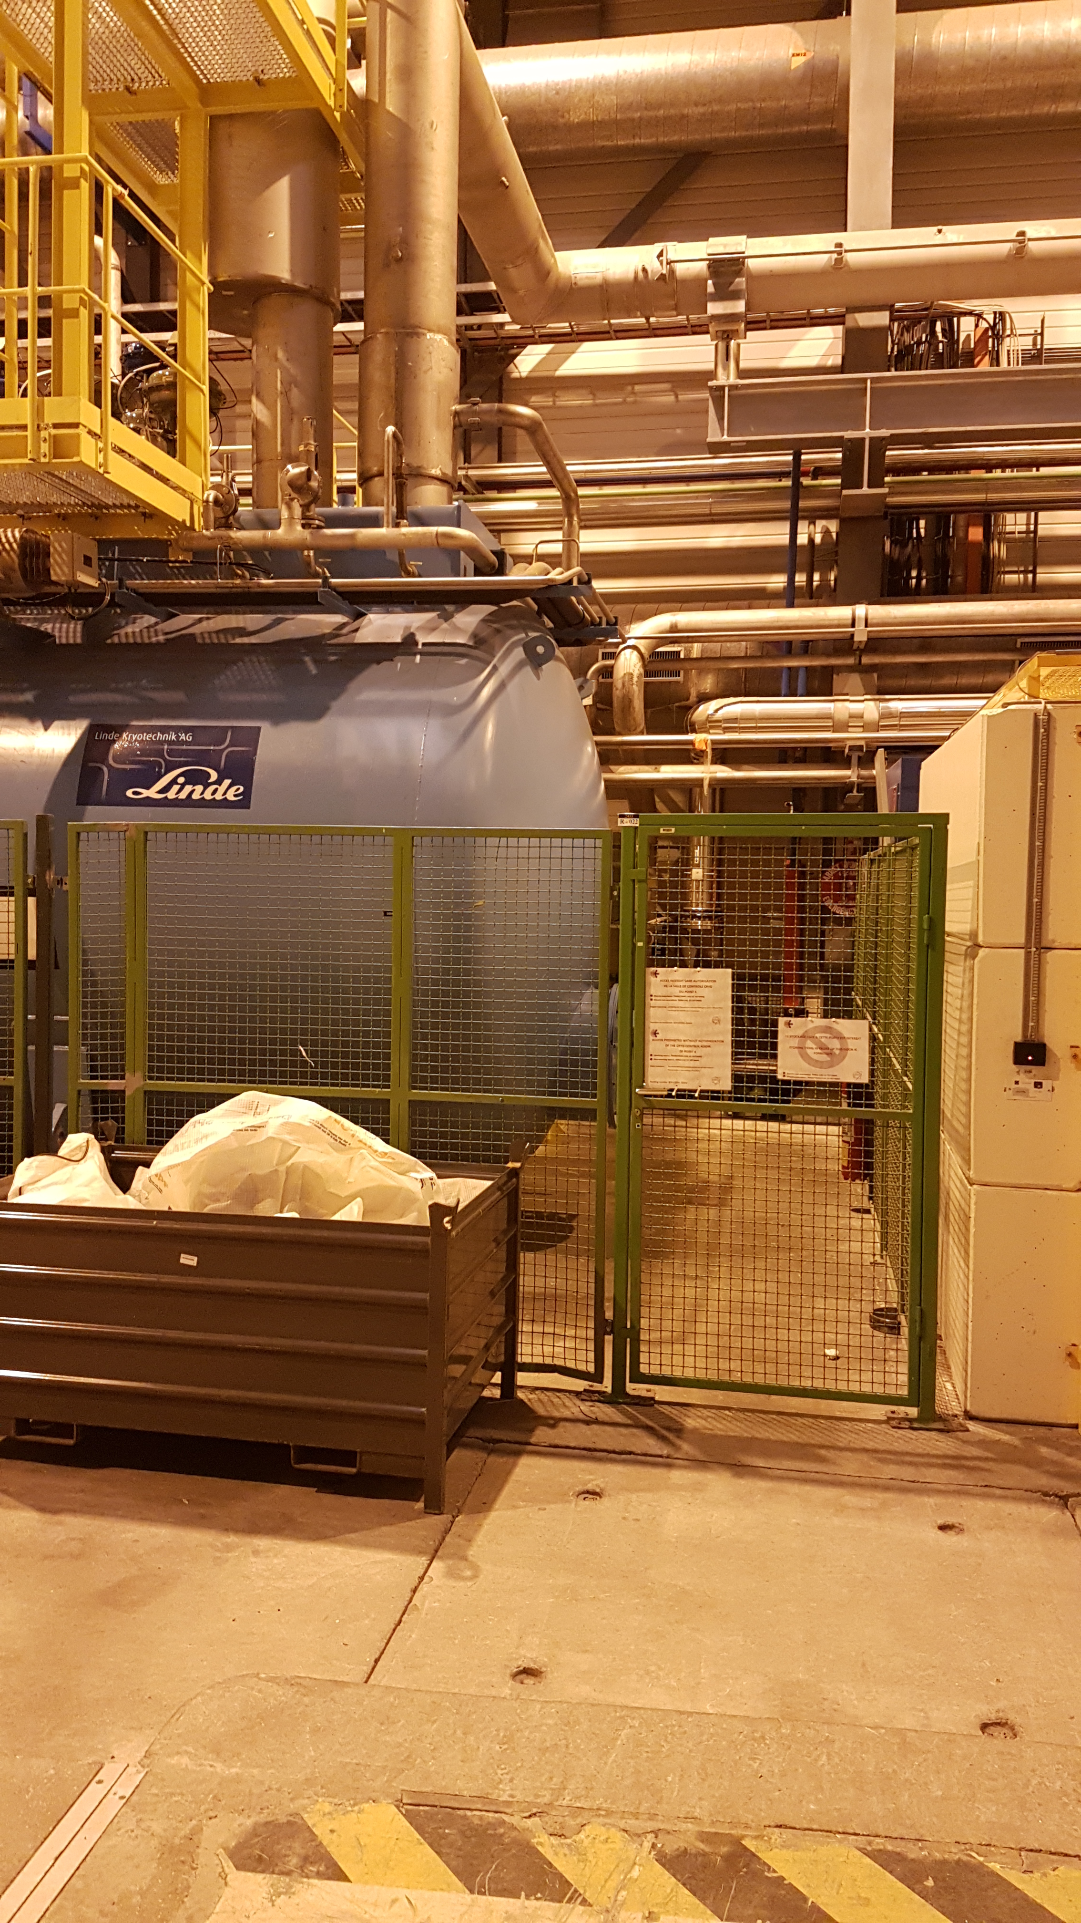
HSE (Health) Activities
Confined space activities – Upper cold box
H. Recommendation?
Full CB diameter flange
But limiting opening (~10cm)
~Ø200 Flange on opposite side (Vacuum pump port)
Ø600 Manhole

Slide 13

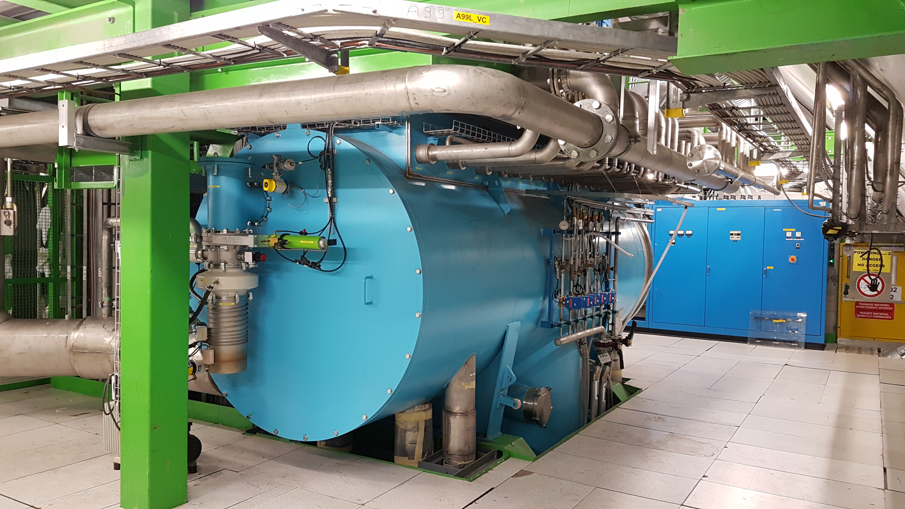
HSE (Health) Activities
Confined space activities – Lower cold box
H. Recommendation?
~Ø2000 Flange to be dismounted
Ø2000 Flange to be dismounted

Slide 14
HSE (Environmental) Activities
Dismounting activities – Recycling
CERN Tech Spec. Req.: “List of dismounting equipment with the recycling option”, e.g:
Stainless steel piping, cables, instruments
Pressure vessels (HX turbines)
Do we need to trace the material?
Limited pollution (?) / No oil, no adsorbant, etc.
Radiation (?) – in the cavern

Slide 15
Summary
An introduction to the Upgrade project of the refrigerator at LHC-P4
Pressure equipment design and test
Health actions for workers

Slide 16
Thanks for you attention Let’s start the project

