Slide 1
The Advanced Virgo detector: control, noise hunting and data quality to improve its sensitivity
stability?
David Cohen dcohen@lal.in2p3.fr
Supervisor: Nicolas Arnaud
Laboratoire de l’Accélérateur Linéaire, Orsay, France – Groupe Virgo
CNRS/IN2P3, Université Paris-Sud
Tuesday the 28th of May, 2019

Slide 2



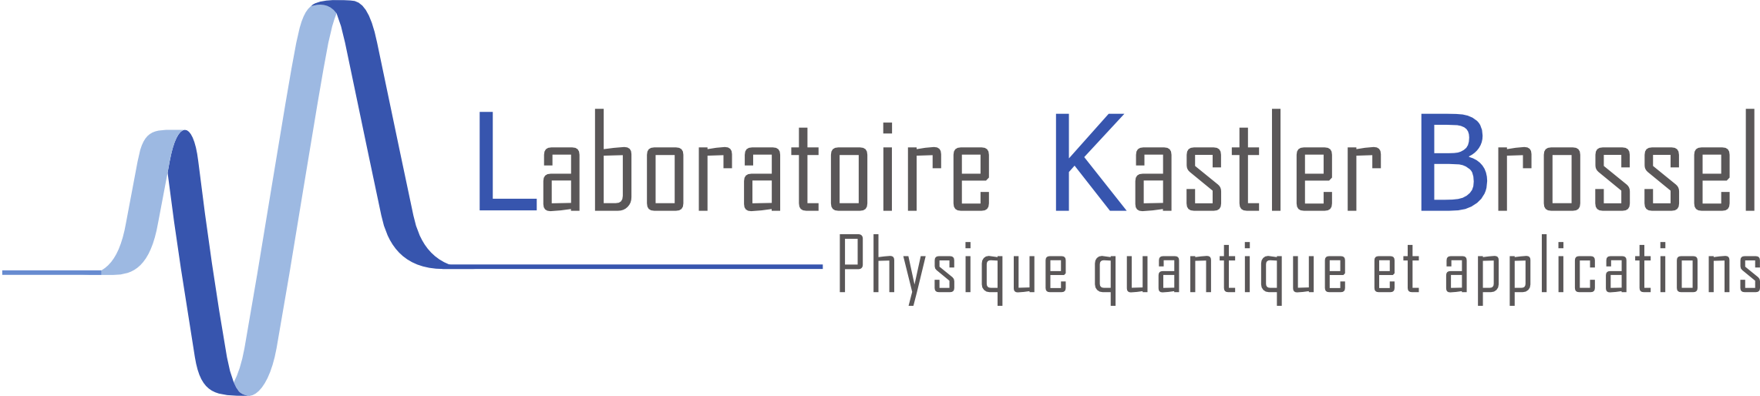
The Advanced Virgo detector: control, noise hunting and data quality to improve its sensitivity
Optomechanical parametric instabilities study for Virgo
with:
Annalisa Allocca, Pisa/INFN Pisa
Paola Puppo, INFN Roma
Gilles Bogaert, Artemis
Thibaut Jacqmin, LKB
Help develop a web page interface to list all the losses of lock (control) of the automatic control system.
David Cohen dcohen@lal.in2p3.fr
Supervisor: Nicolas Arnaud
Laboratoire de l’Accélérateur Linéaire, Orsay, France – Groupe Virgo
CNRS/IN2P3, Université Paris-Sud
Tuesday the 28th of May, 2019

Slide 3
Introduction
Gravitational waves basics
How to detect gravitational waves
Detections

Slide 4
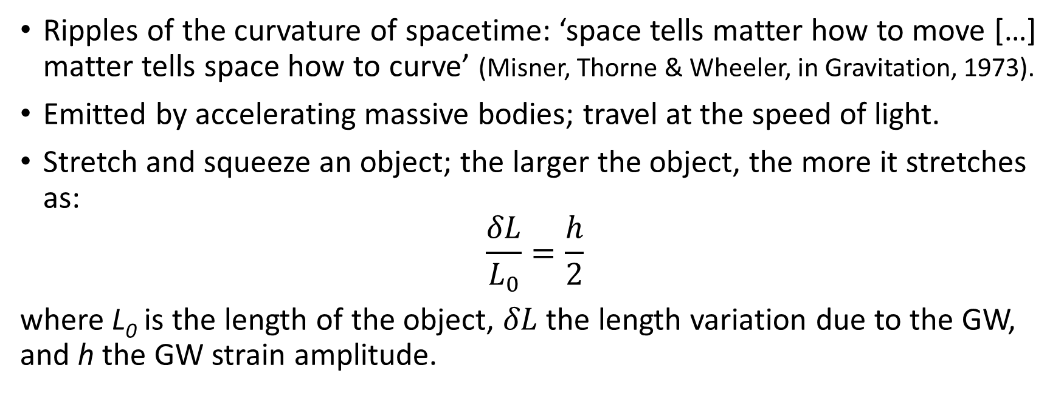
Gravitational waves (GW): basics
Ripples of the curvature of spacetime: ‘space tells matter how to move […] matter tells space how to curve’ (Misner, Thorne & Wheeler, in Gravitation, 1973).
Emitted by accelerating massive bodies; travel at the speed of light.
Stretch and squeeze an object; the larger the object, the more it stretches as:
$$\frac{δL}{L_{0}}=\frac{h}{2}$$
where L₀ is the length of the object, $δL$ the length variation due to the GW, and h the GW strain amplitude.

Slide 5
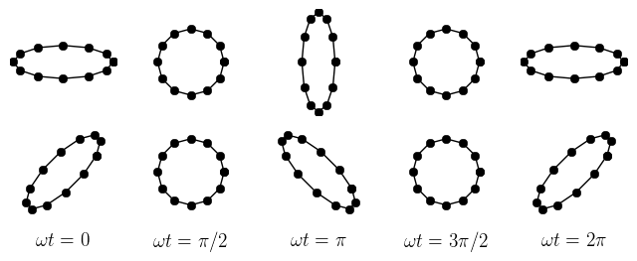

Gravitational waves (GW): basics
Transverse waves; 2 polarisations.
+ polarisation
$×$ polarisation

Slide 6
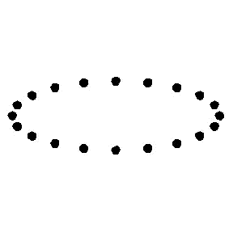
Gravitational waves (GW): basics
Transverse waves
➔similar to tidal effect
+ polarisation

Slide 7
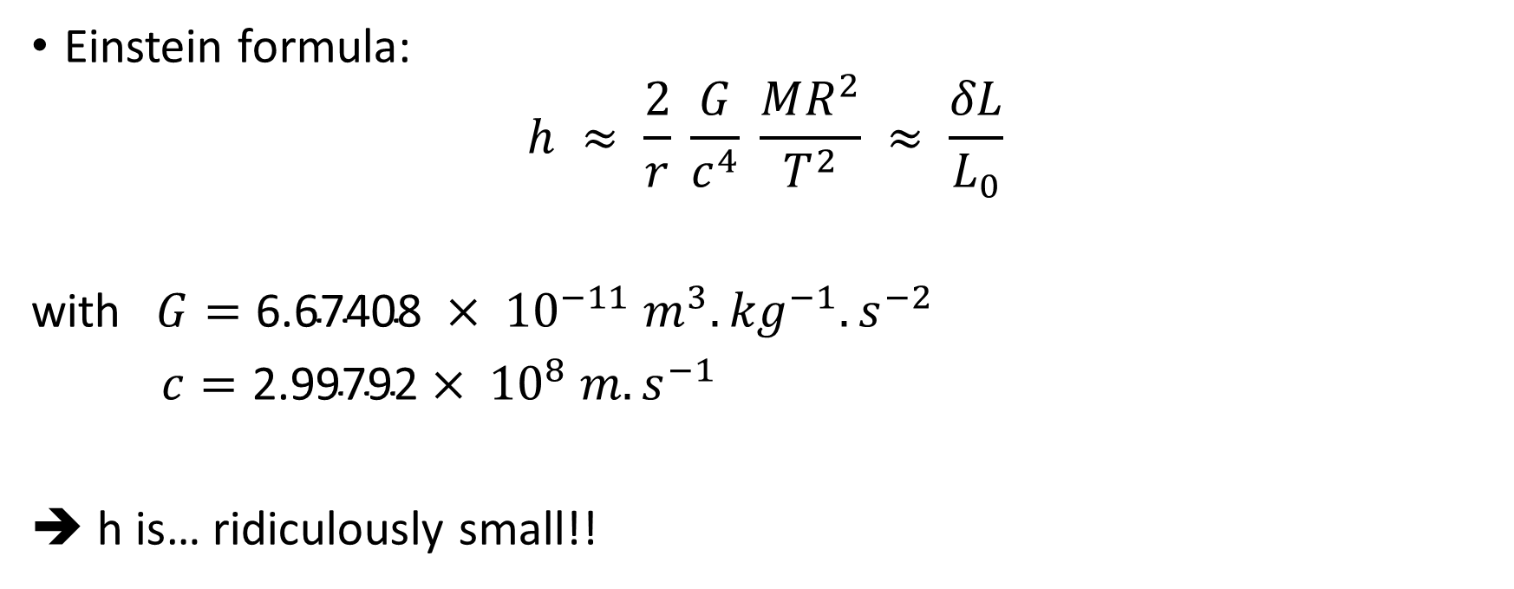
GW strain amplitude
Einstein formula:
$$h ≈ \frac{2}{r} \frac{G}{c^{4}} \frac{MR^{2}}{T^{2}} ≈ \frac{δL}{L_{0}}$$
with $G=\text{6.67}\text{40}\text{8} × {10}^{−11} m^{3}.{kg}^{−1}.s^{−2}$
$c=\text{2}\text{.}\text{99792}× {10}^{8} m.s^{−1}$
➔ h is… ridiculously small!!

Slide 8
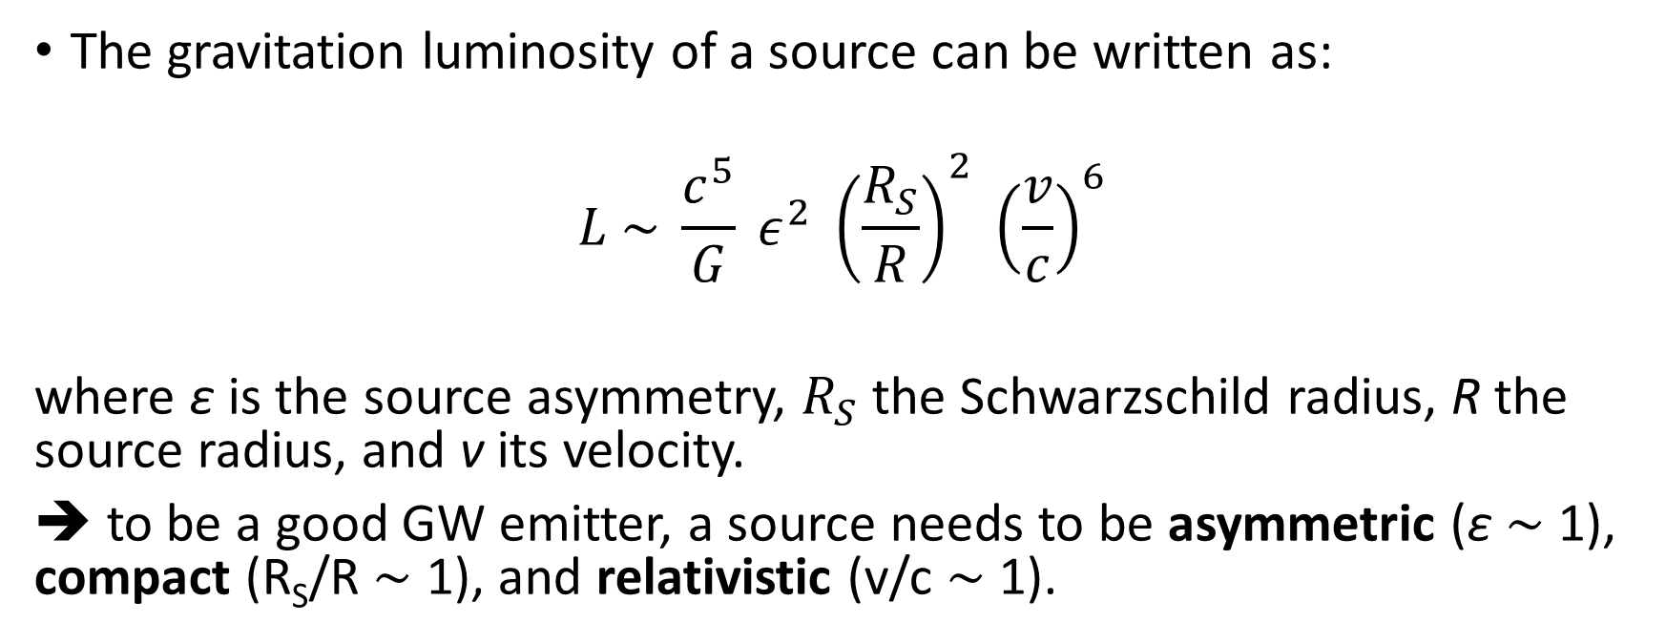
Sources luminosity
The gravitation luminosity of a source can be written as:
$$L \sim \frac{c^{5}}{G} ε^{2} {\left(\frac{R_{S}}{R}\right)}^{2} {\left(\frac{v}{c}\right)}^{6}$$
where ε is the source asymmetry, $R_{S}$ the Schwarzschild radius, R the source radius, and v its velocity.
➔ to be a good GW emitter, a source needs to be asymmetric (ε $\sim$ 1), compact (R_{S}/R $\sim$ 1), and relativistic (v/c $\sim$ 1).

Slide 9
Outline
Introduction
  Gravitational waves basics
  How to detect gravitational waves?
  Detections
Three-mode parametric instabilities

Slide 10
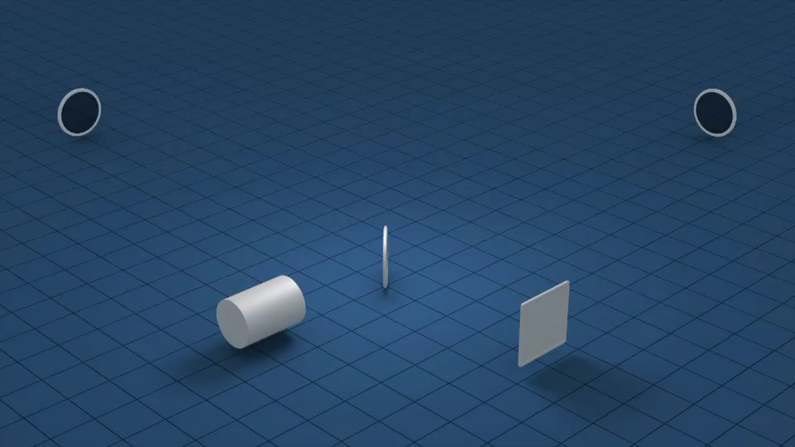
Ground-based interferometer for GW detection

Slide 11
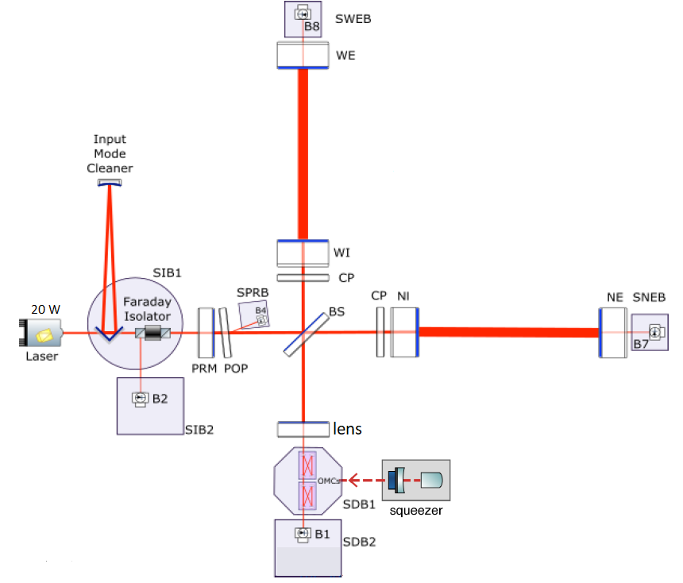
What is Virgo?
Michelson interferometer (ITF)
→ direct detection of gravitational waves
3 km arms with Fabry-Perot cavities to increase the light path
Working point @ dark fringe (destructive interferences)
Power Recycling mirror that reflects the light back to the ITF increasing the power in the ITF
Real-time active control of the working point:
Sensing: photodiodes
Actuation: mirrors, suspensions, laser
Large optics (mirrors) contained in superattenuator towers (inverted pendulums)
Small optics (telescopes, photodiodes) on suspended benches
Laser:
wavelength = 1064 nm
input power = 12-25 W continuous

Slide 12
Outline
Introduction
  Gravitational waves basics
  How to detect gravitational waves?
  Detections
Three-mode parametric instabilities

Slide 13
Observation Runs
For any GW detector, observation phases last for a certain time, called an Observation run.
Between two Observation runs, GW detectors are upgraded.
All the events recorded so far come from the Observation run 2 (O2) that lasted from 30 November 2016 (Virgo joined on 1 August 2017) to 25 August 2017.
Since 1 April 2019, O3 has started and will last for a whole year. At present, only potential candidates to GW events have been recorded and one will need several months for confirmation.
http://www.virgo-gw.eu/#news_o3_start

Slide 14
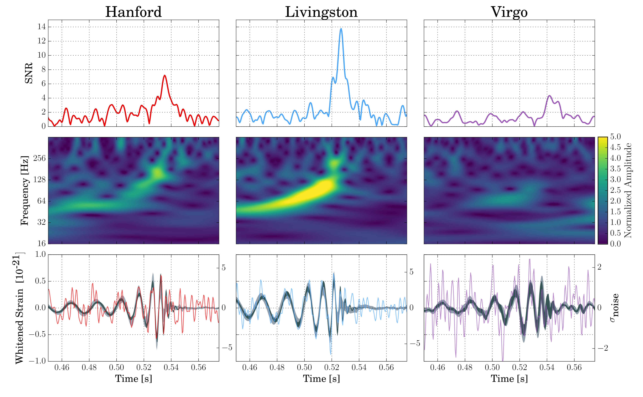
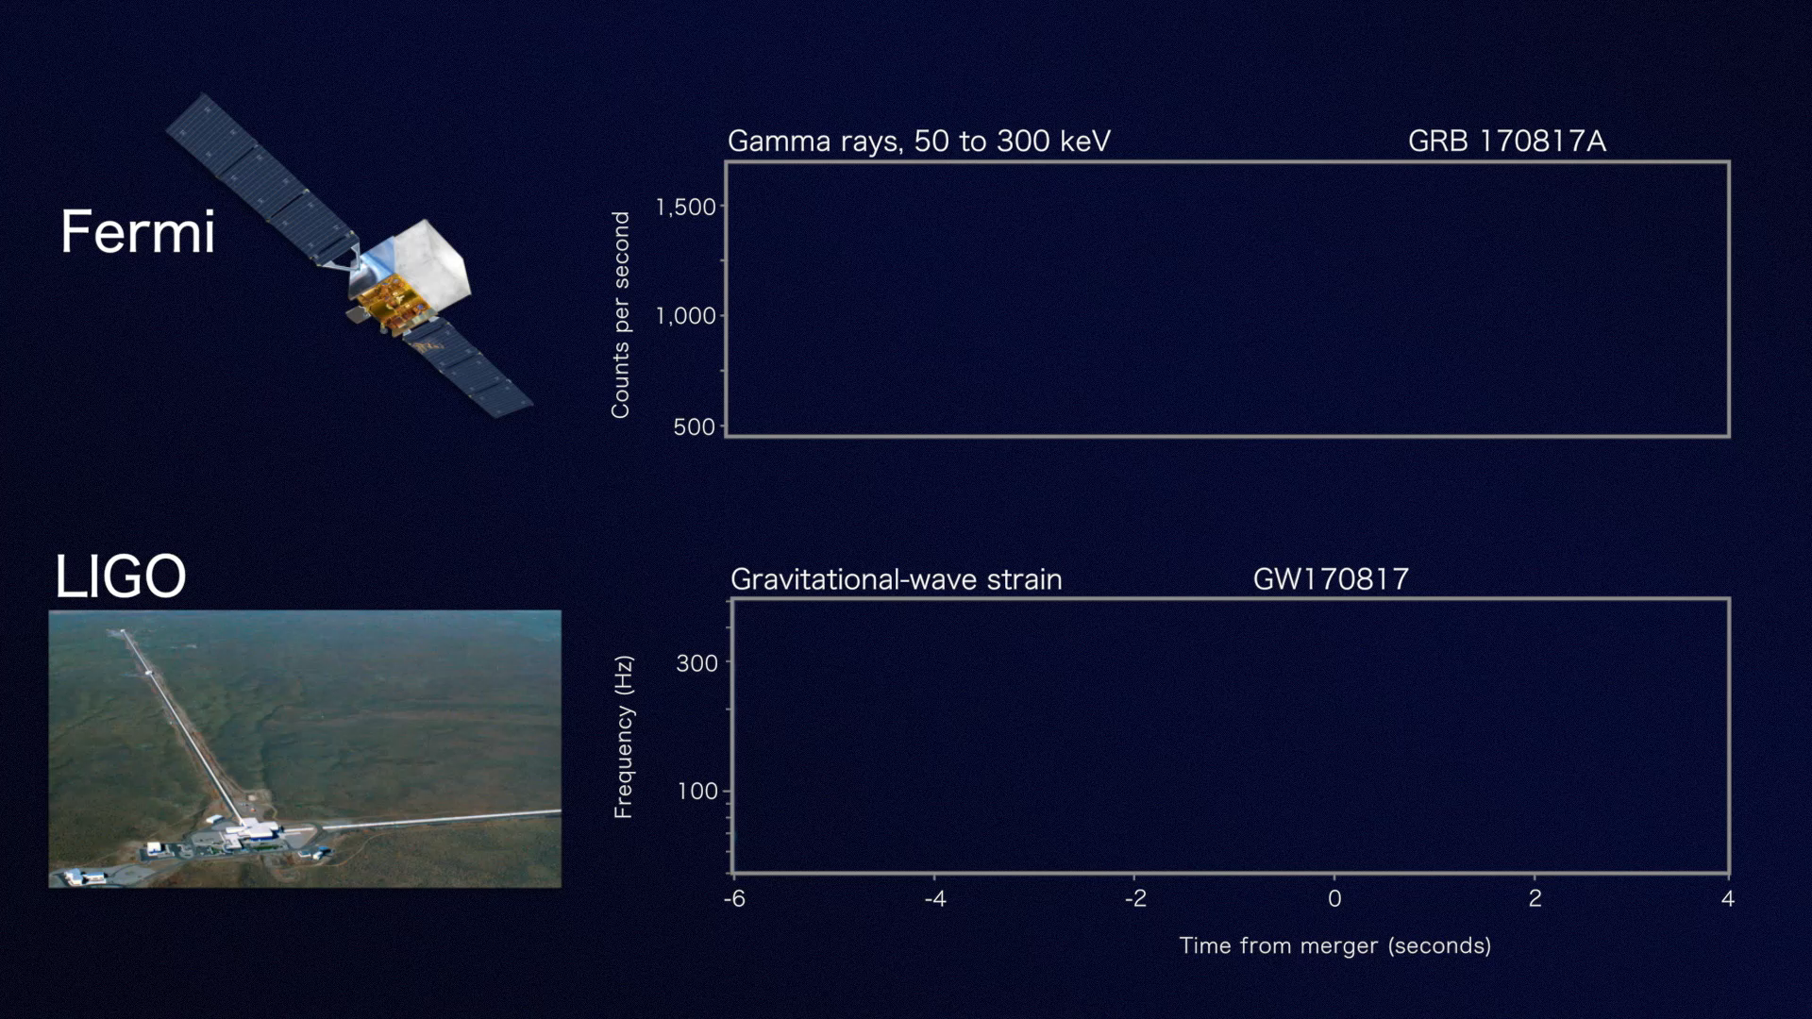
Detections
GW170814: the first triple detection (LIGO + Virgo) of a binary black hole merger

Slide 15
Three-mode parametric instabilities
AKA only ‘parametric instabilities’ (PI)

Slide 16
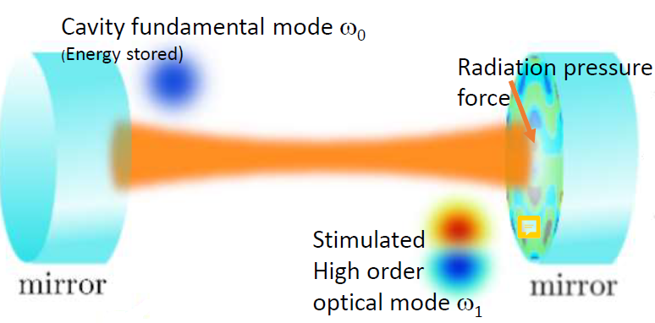
3-mode interaction

Slide 17
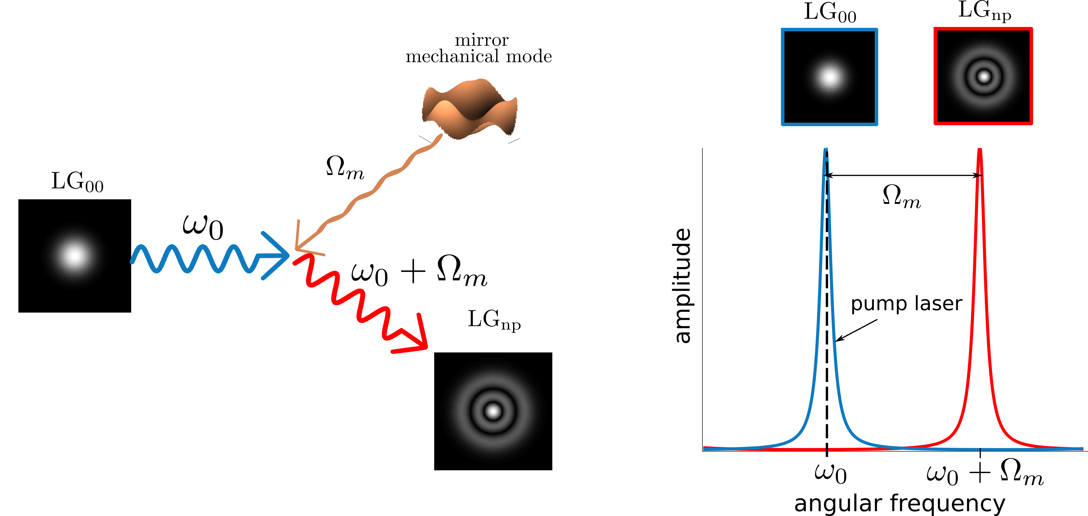
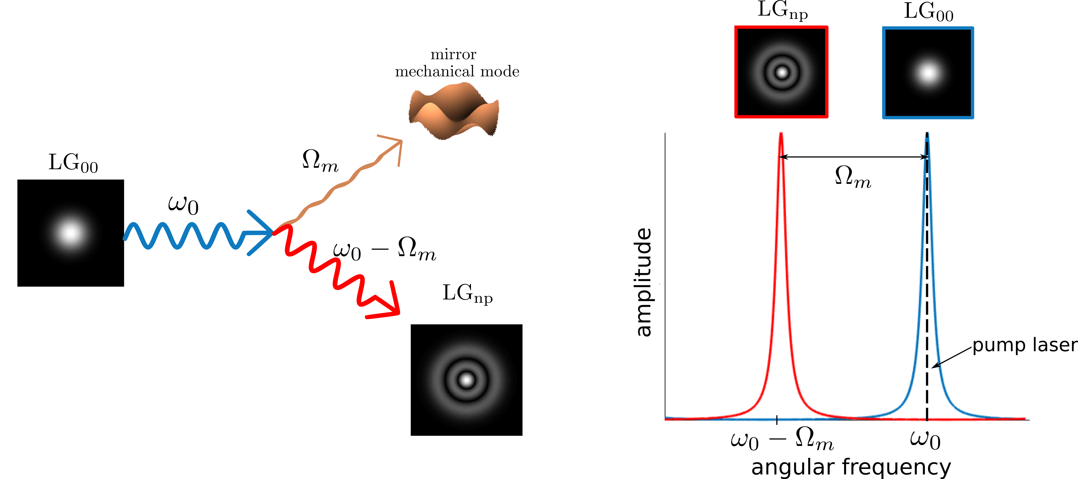
3-mode interaction
Anti-Stokes process: cooling
Stokes process: heating

Slide 18
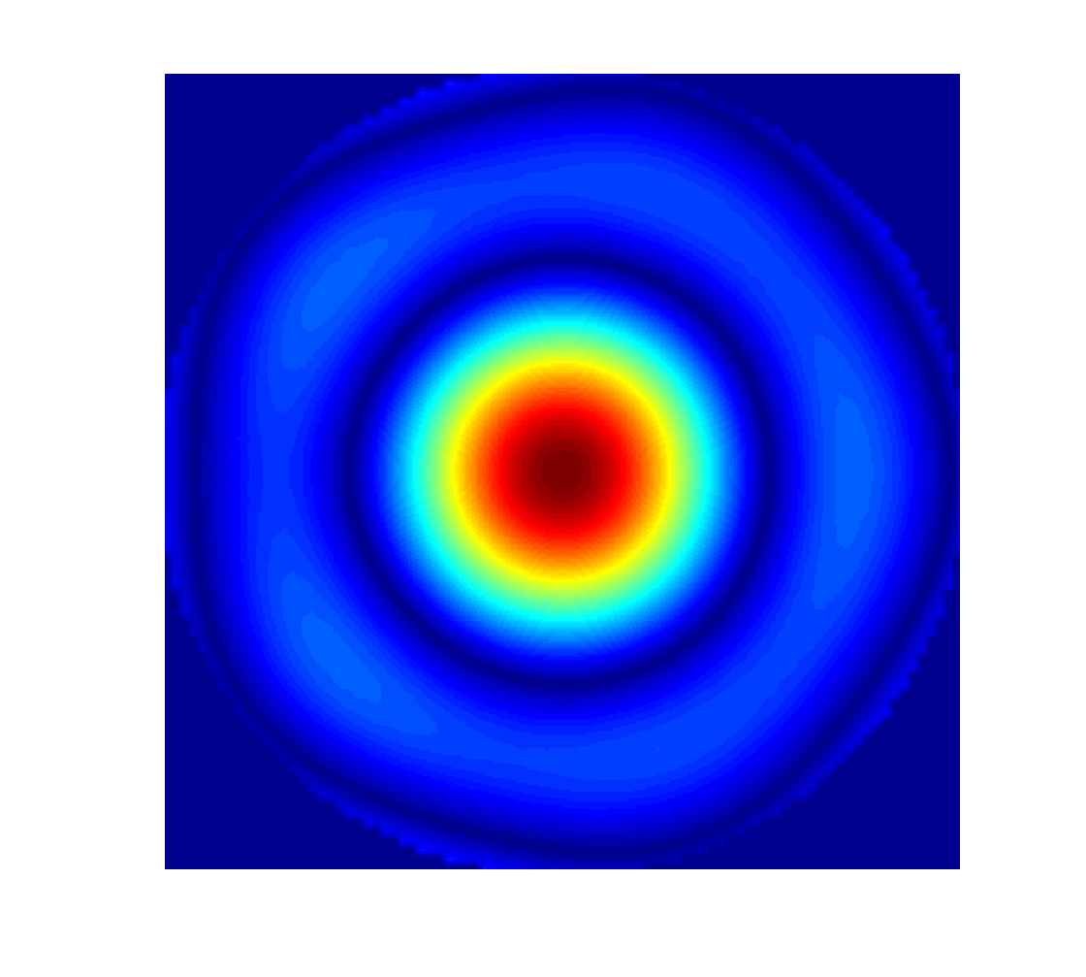
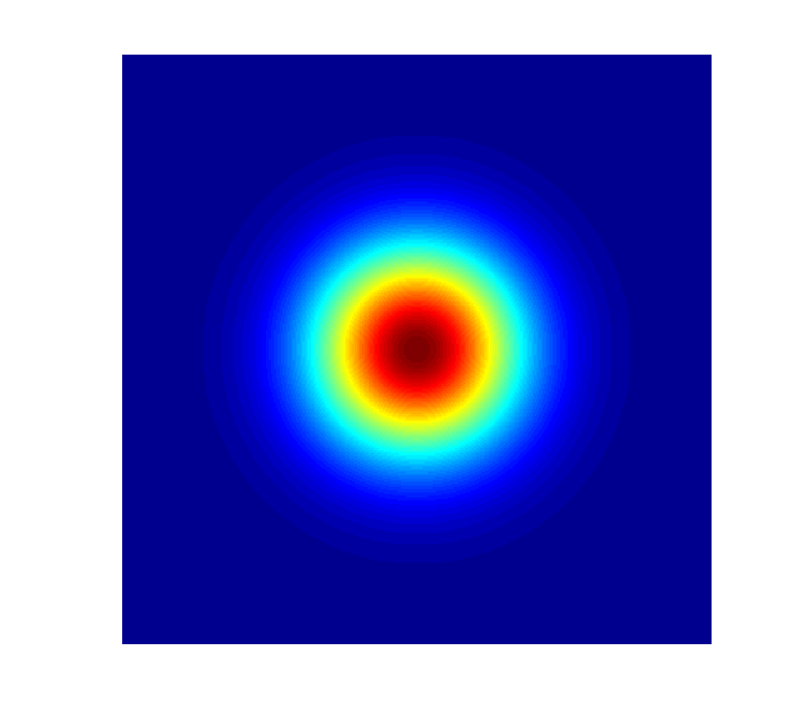
Mechanical and optical modes overlap
Mechanical mode
Optical mode

Slide 19

Parametric gain
optical gain (function of mechanical mode frequency, cavity lengths, Gouy phase, mirror reflectivities)
$$R_{m} ∝P \sum_{all beam modes n}{{\left\{optical gain\right\}}_{n} ×} {\{overlap\}}_{n, m}$$
power travelling through the arm (Fabry-Perot cavity)
spatial overlap between optical mode and mechanical mode

Slide 20
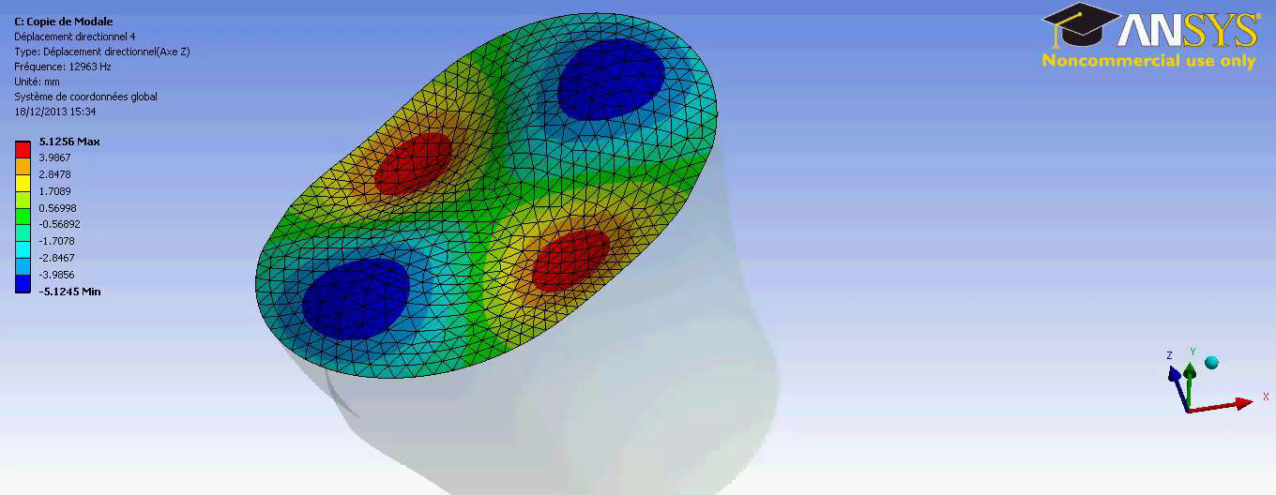
Mechanical modes computation

Slide 21
Homemade code for PI computation
Analytical method taken from Evans et al. "A general approach to optomechanical parametric instabilities." Physics Letters A374.4 (2010): 665-671
Matlab Oriented Object Programming (OOP) code
+
Graphical User Interface (GUI)

Slide 22
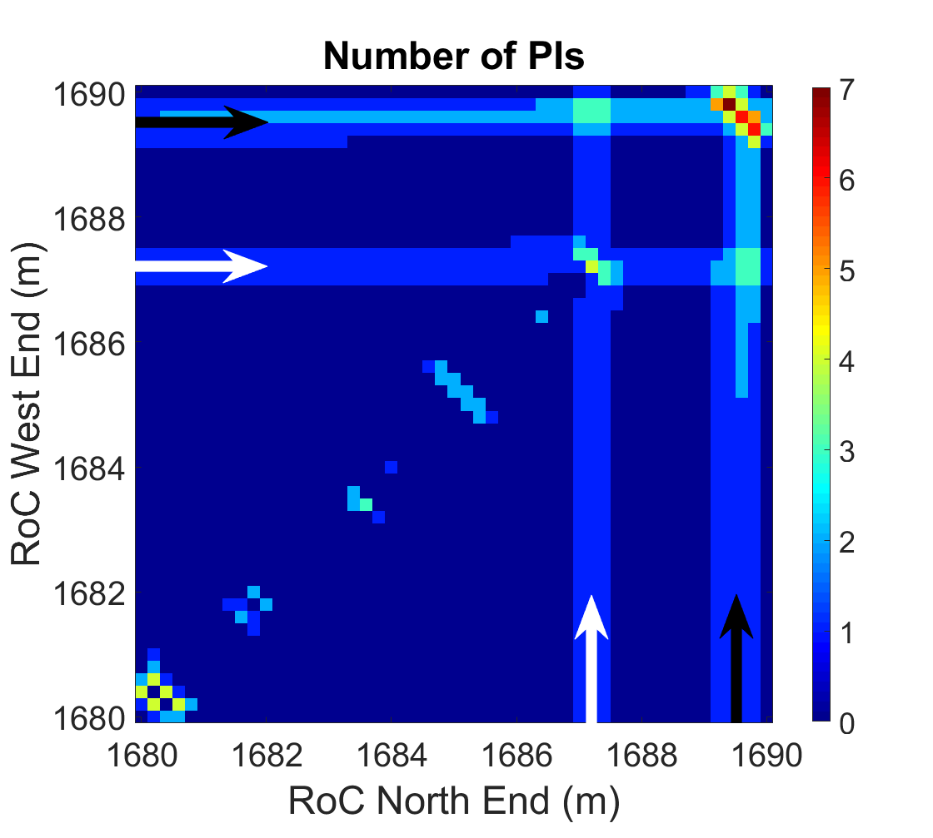
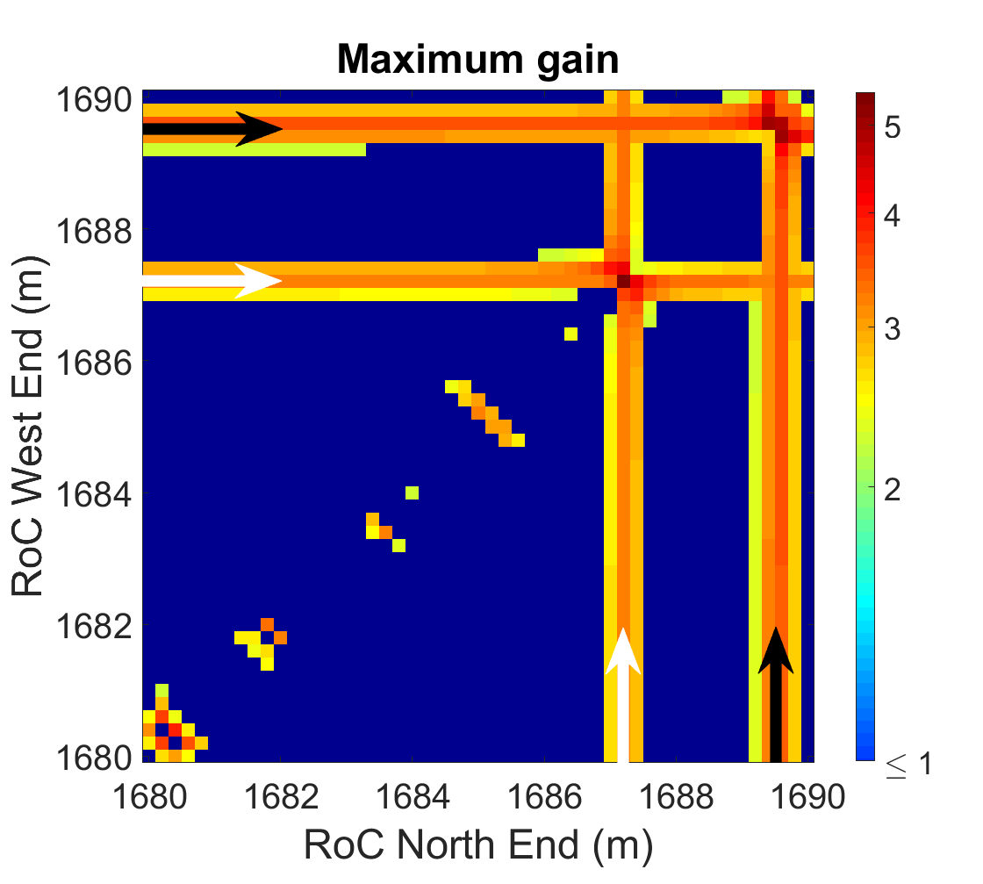
What kind of results do we get?
We make the mirrors radii of curvature vary to take uncertainties into account.
White arrows: 24.381 kHz
Black arrows: 24.629 kHz

Slide 23
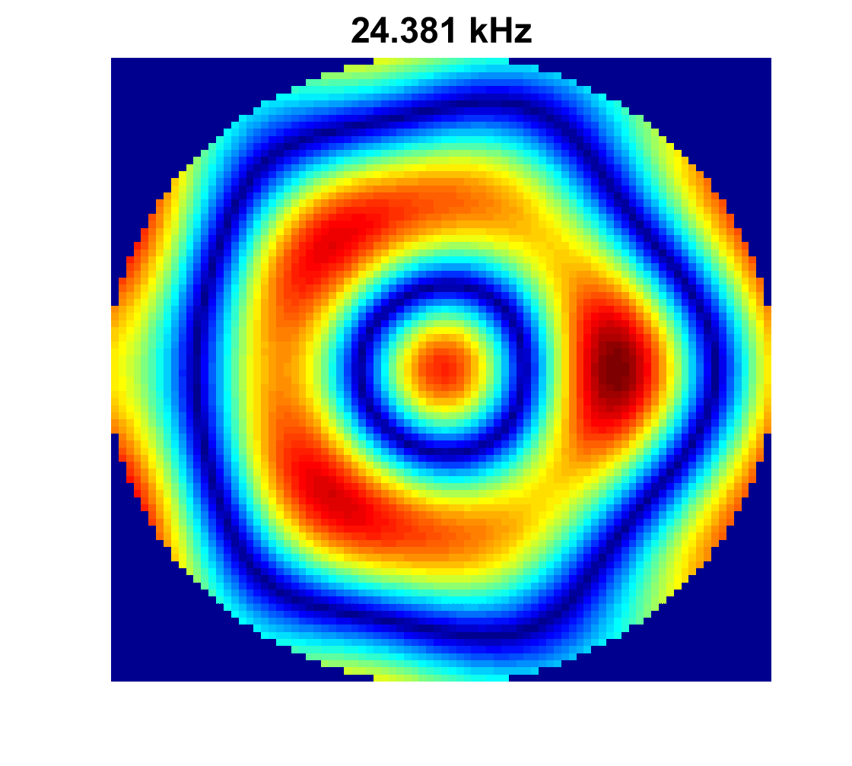
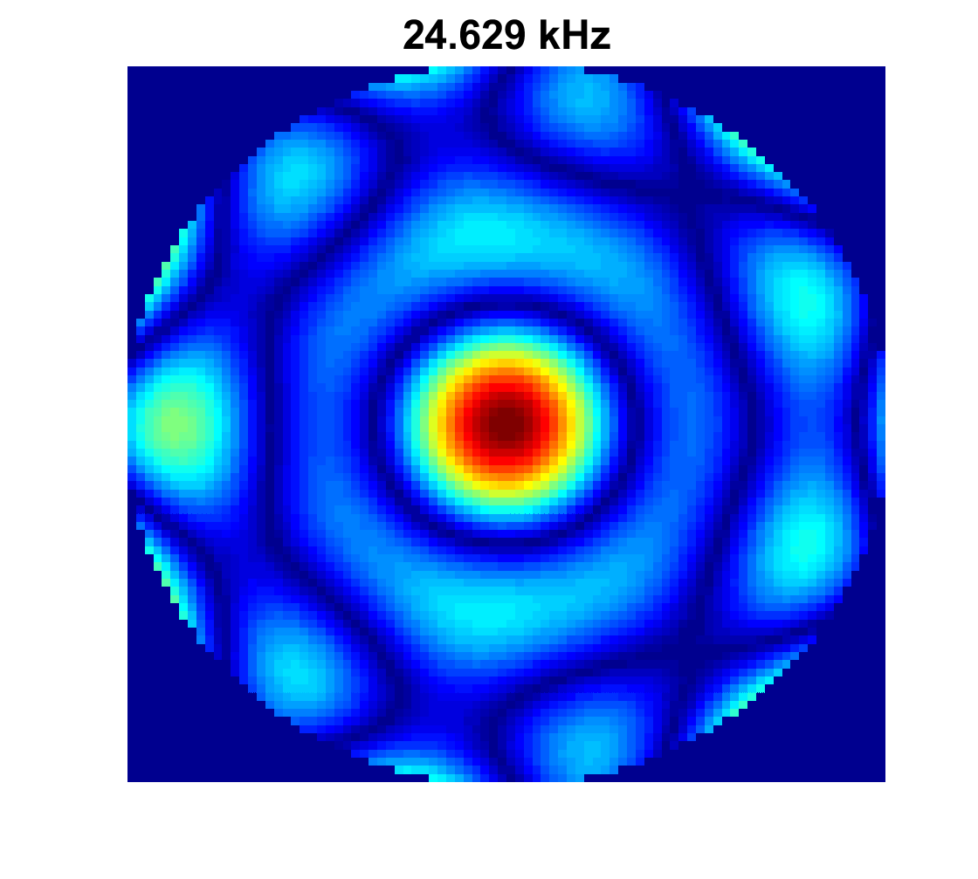
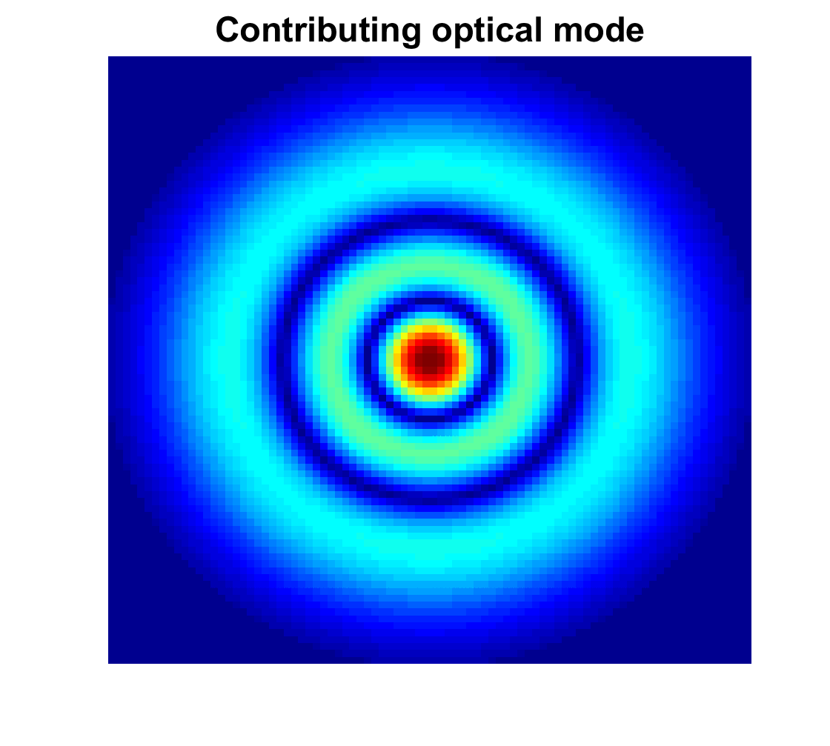
What kind of results do we get?
Mecha mode @ 24.381 kHz
Mecha mode @ 24.629 kHz
Main contributing optical mode

Slide 24
Ongoing and next steps
Various simulations w/ different configurations…
  With thermal effects
  With real maps of mirrors
… to foresee the next upgrades following the current observation phase:
  Laser power increase
  Another mirror will be added, thus creating a new optical cavity to take into account in the computation of the instabilities

Slide 25
Spare slides

Slide 26
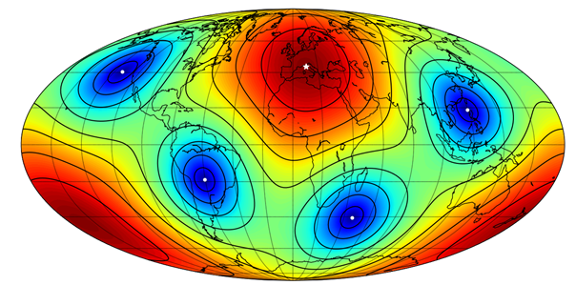
Virgo’s eyes
The redder the map, the better the reception; the bluer the map, the blinder Virgo.
All the ground-based interferometers for GW detection have a similar antenna map: best receptions orthogonal to the ITF, worst ones on the plan of the ITF particularly those from the internal and external bisectors.

Slide 27
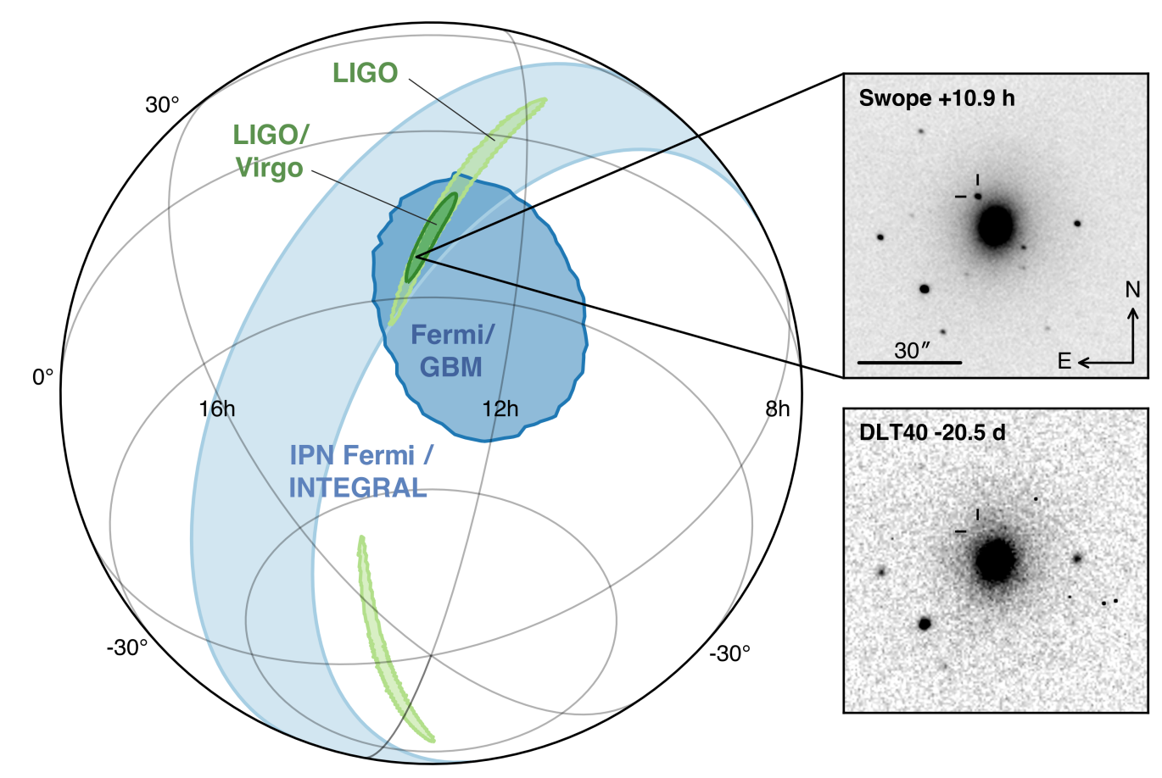
Detections
GW170817: the first discovery of a binary neutron star coalescence followed the observation of its optical counterpart, thanks to the accurate 3D LIGO-Virgo localisation of the source

Slide 28
Multimessenger detection

Slide 29
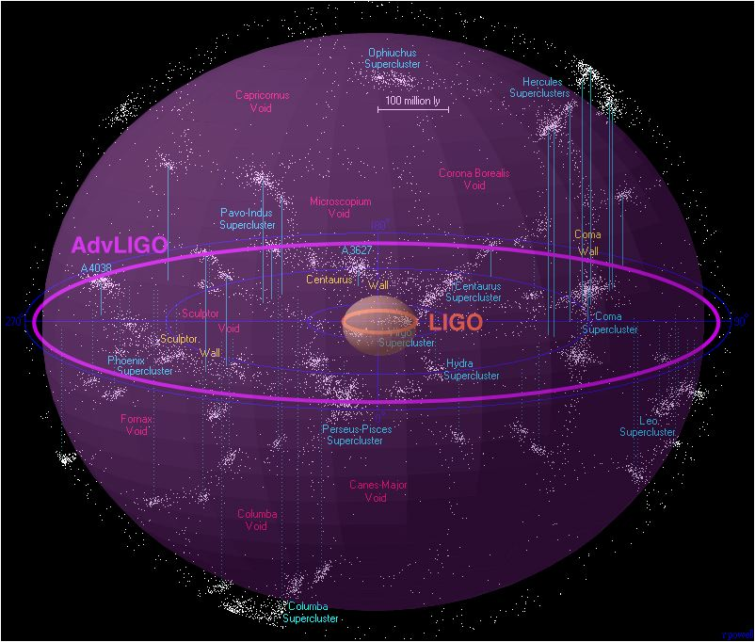
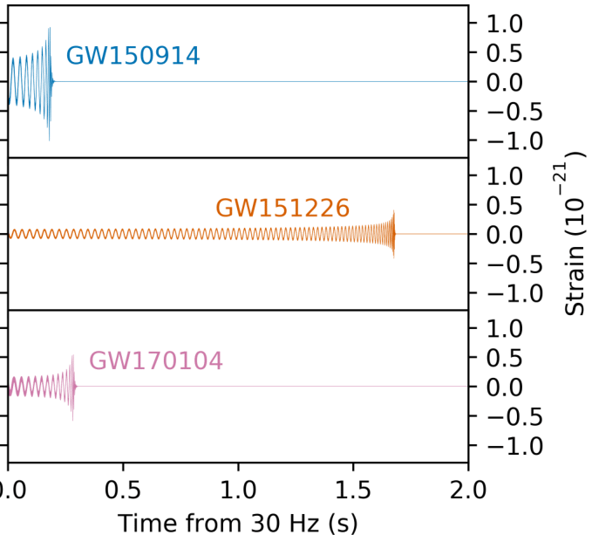


The importance of volume x time
observable volume $∝$ {observable range}³
GW event duration order of magnitude $\sim$ 1s

Slide 30
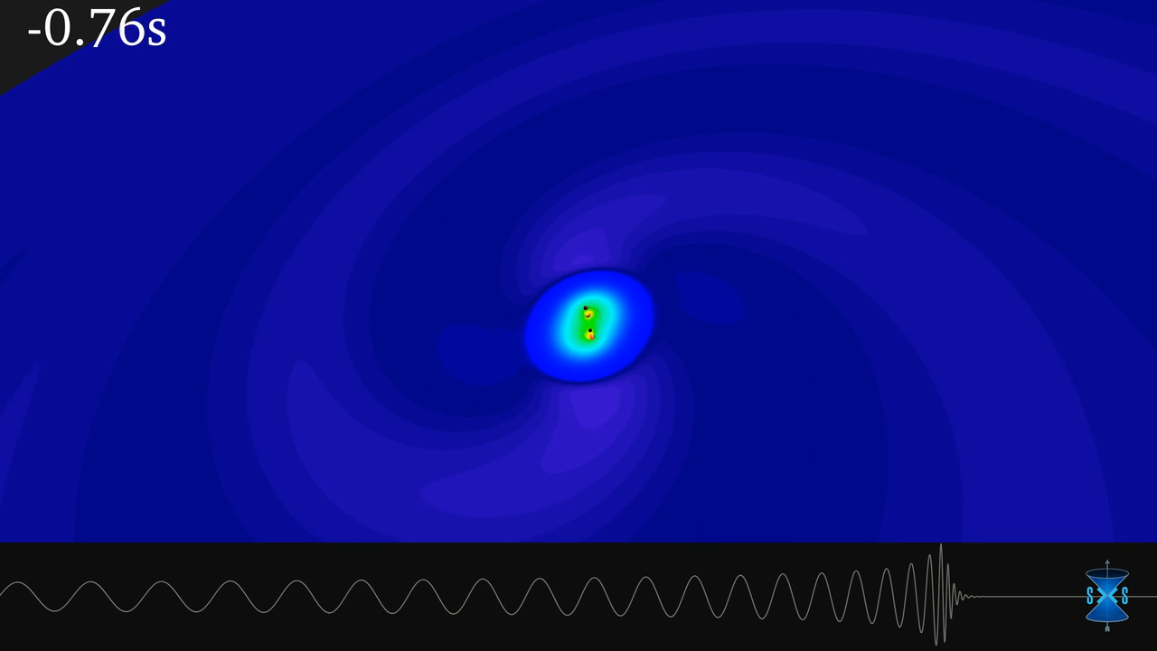
Binary Black Hole merger

Slide 31
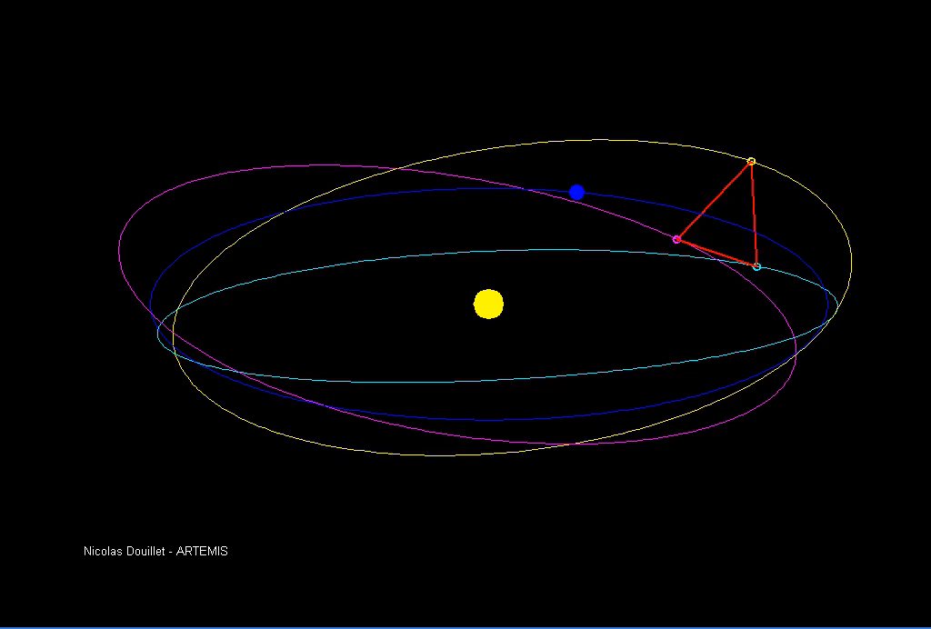
LISA motion

Slide 32
Other results
Maybe real mirrors, SRC, thermal
Or/and the maps of the real mirrors
The q factors plot
…. On verra

Slide 33
Optomechanical parametric instabilities study for Virgo
David Cohen dcohen@lal.in2p3.fr
Supervisor: Nicolas Arnaud
Laboratoire de l’Accélérateur Linéaire, Orsay, France – Groupe Virgo
CNRS/IN2P3, Université Paris-Sud
Tuesday the 28th of May, 2019

