Slide 1
Recap EL - Building 107
C. PATOU (EN-EL-DDO)

Slide 2
Summary
3D Model – General
3D Model – Details
Networks Complexities
Key numbers
Evolution
Safety and PAL

Slide 3
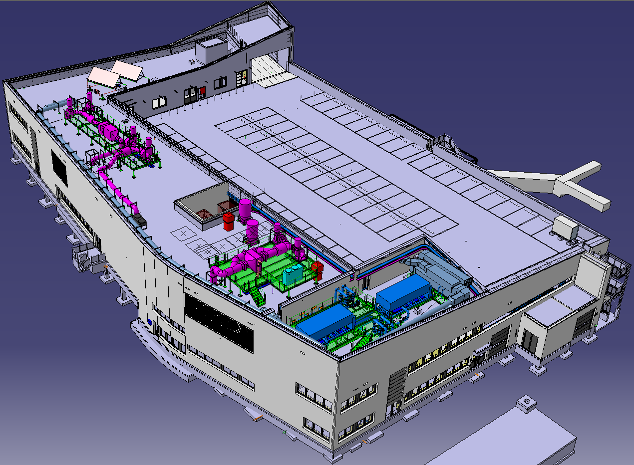
3D Model - General

Slide 4
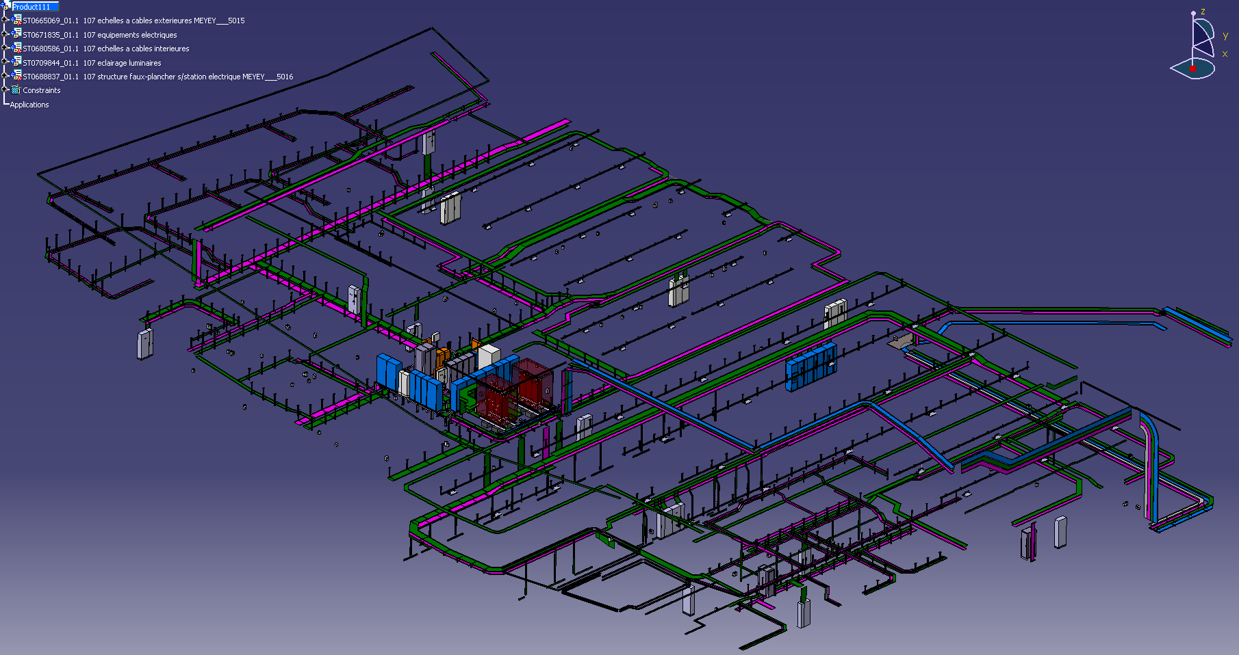
3D Model - General

Slide 5
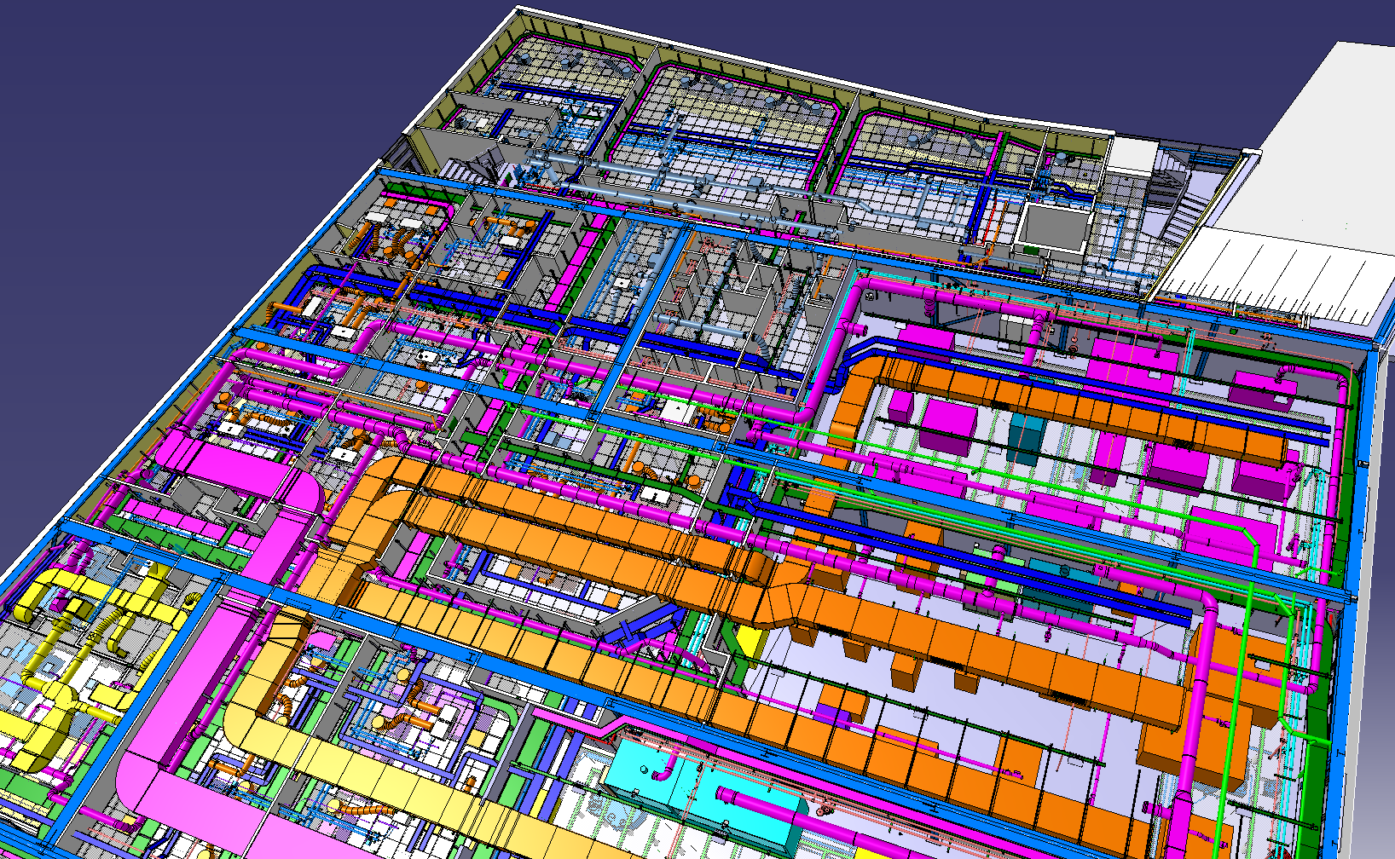
3D Model - General

Slide 6
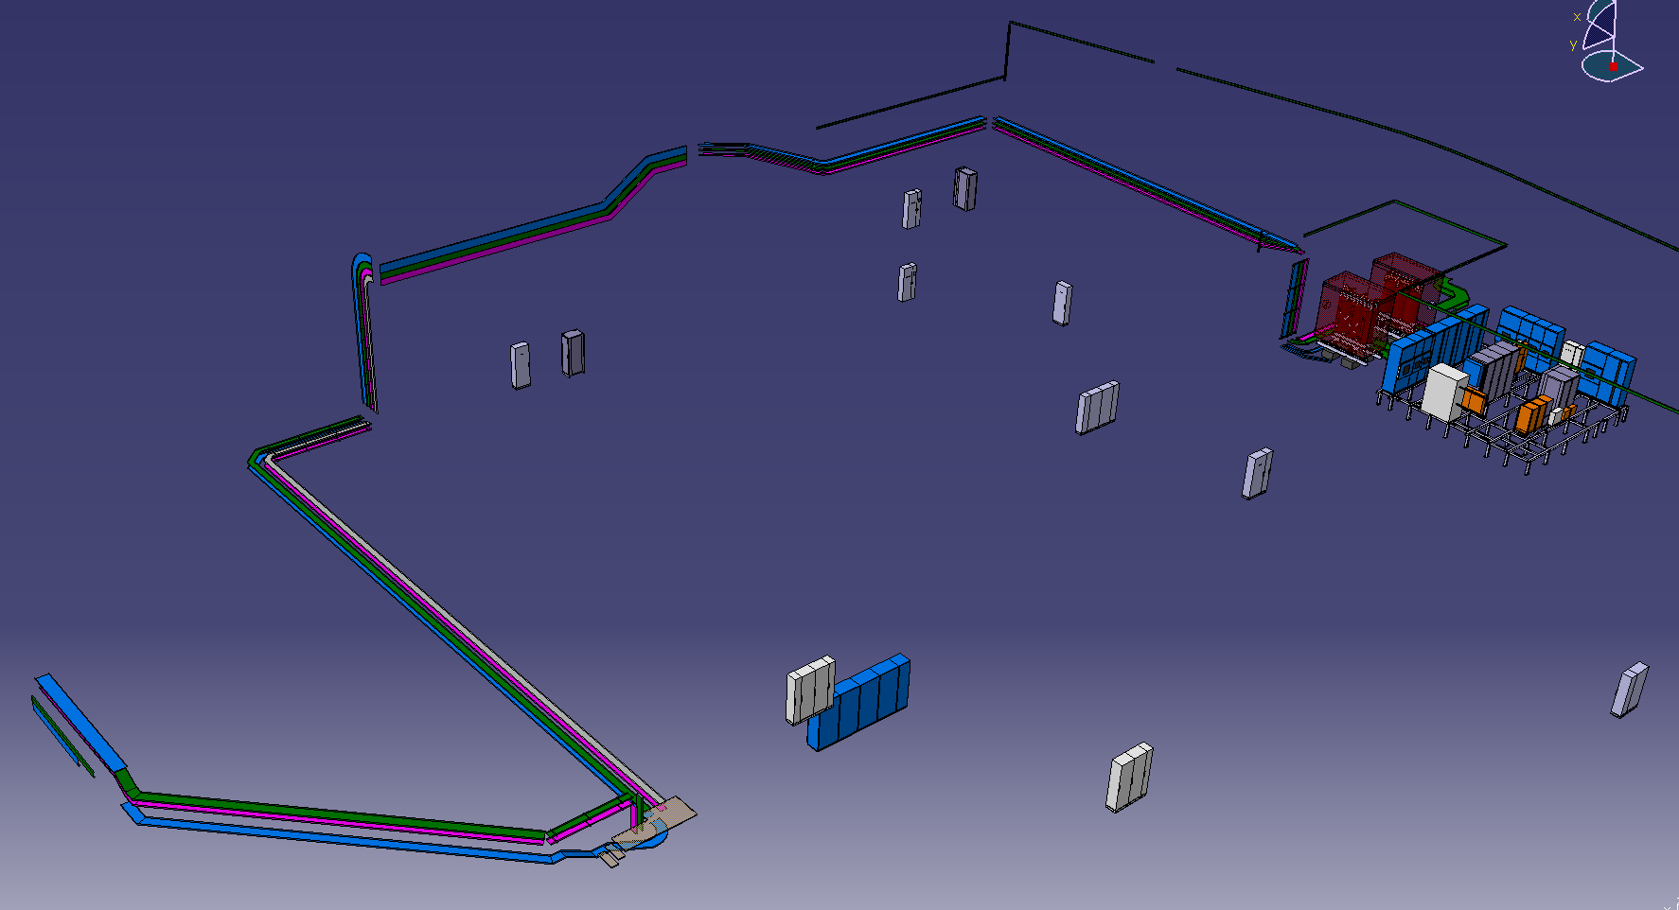
3D Model - Details
From ME15 Substation to Building 107 Transformers
145 m For One Cable Ladder
435 m For All Cable Ladder

Slide 7
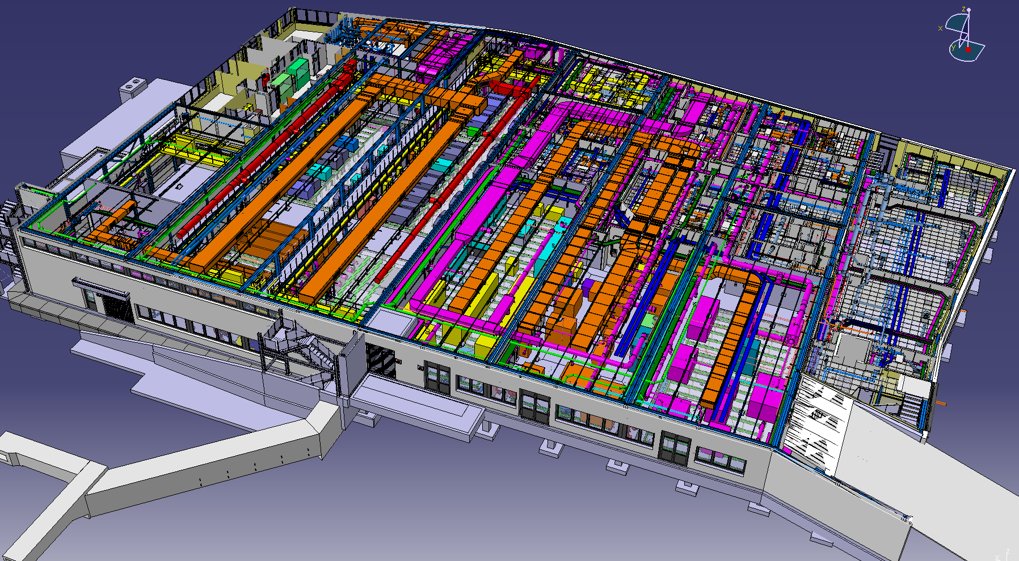
3D Model - Details

Slide 8
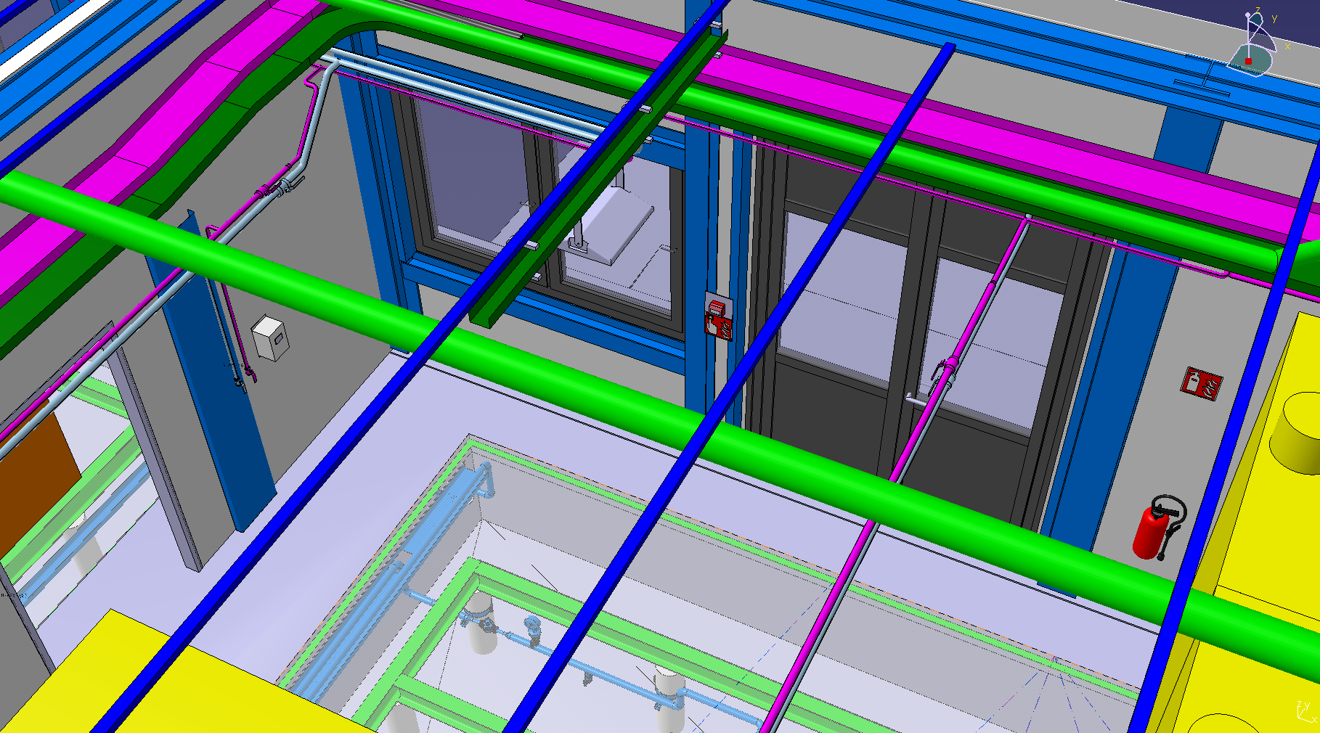
3D Model - Details

Slide 9
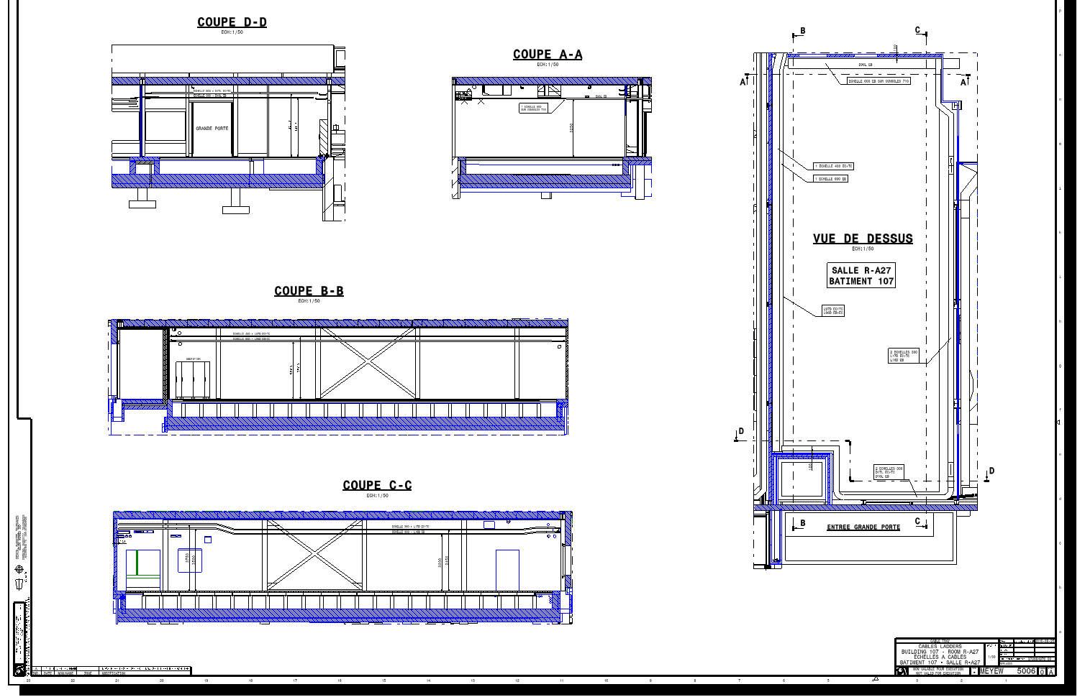
3D Model - Details

Slide 10
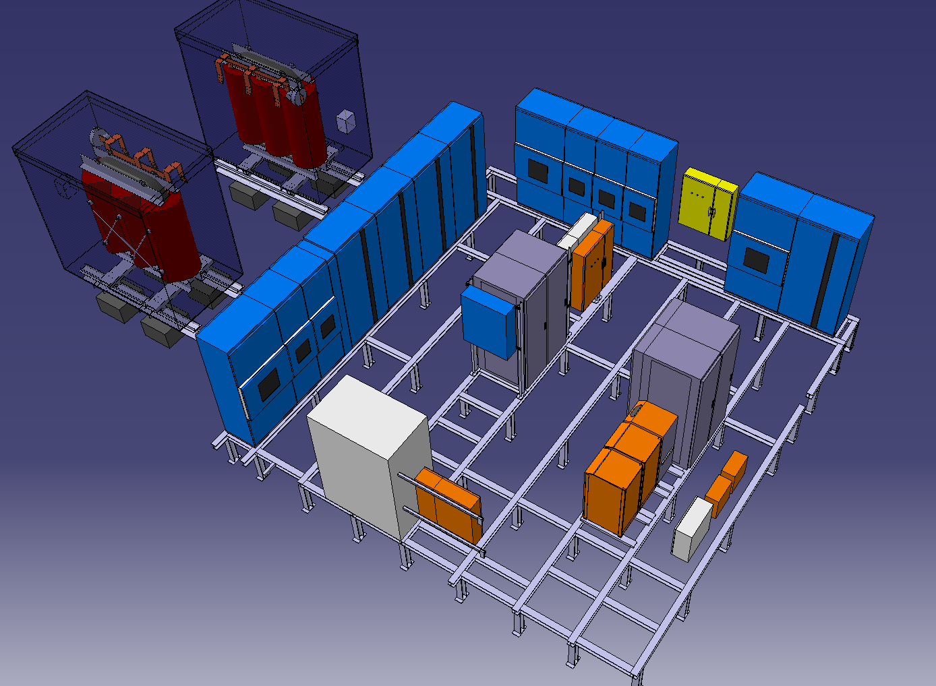
Networks Complexities

Slide 11
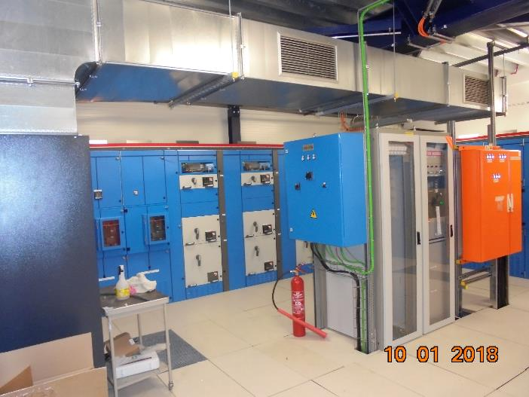
Networks Complexities

Slide 12
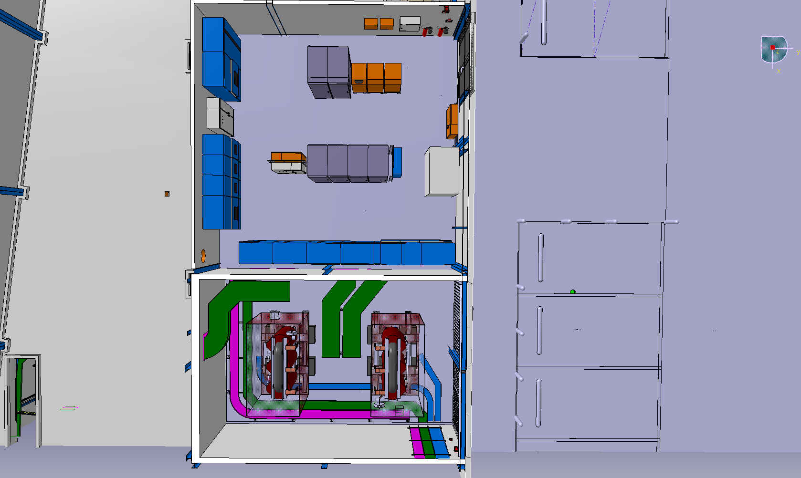
Networks Complexities
Approximatively 27 t of Electrical Material in this area

Slide 13
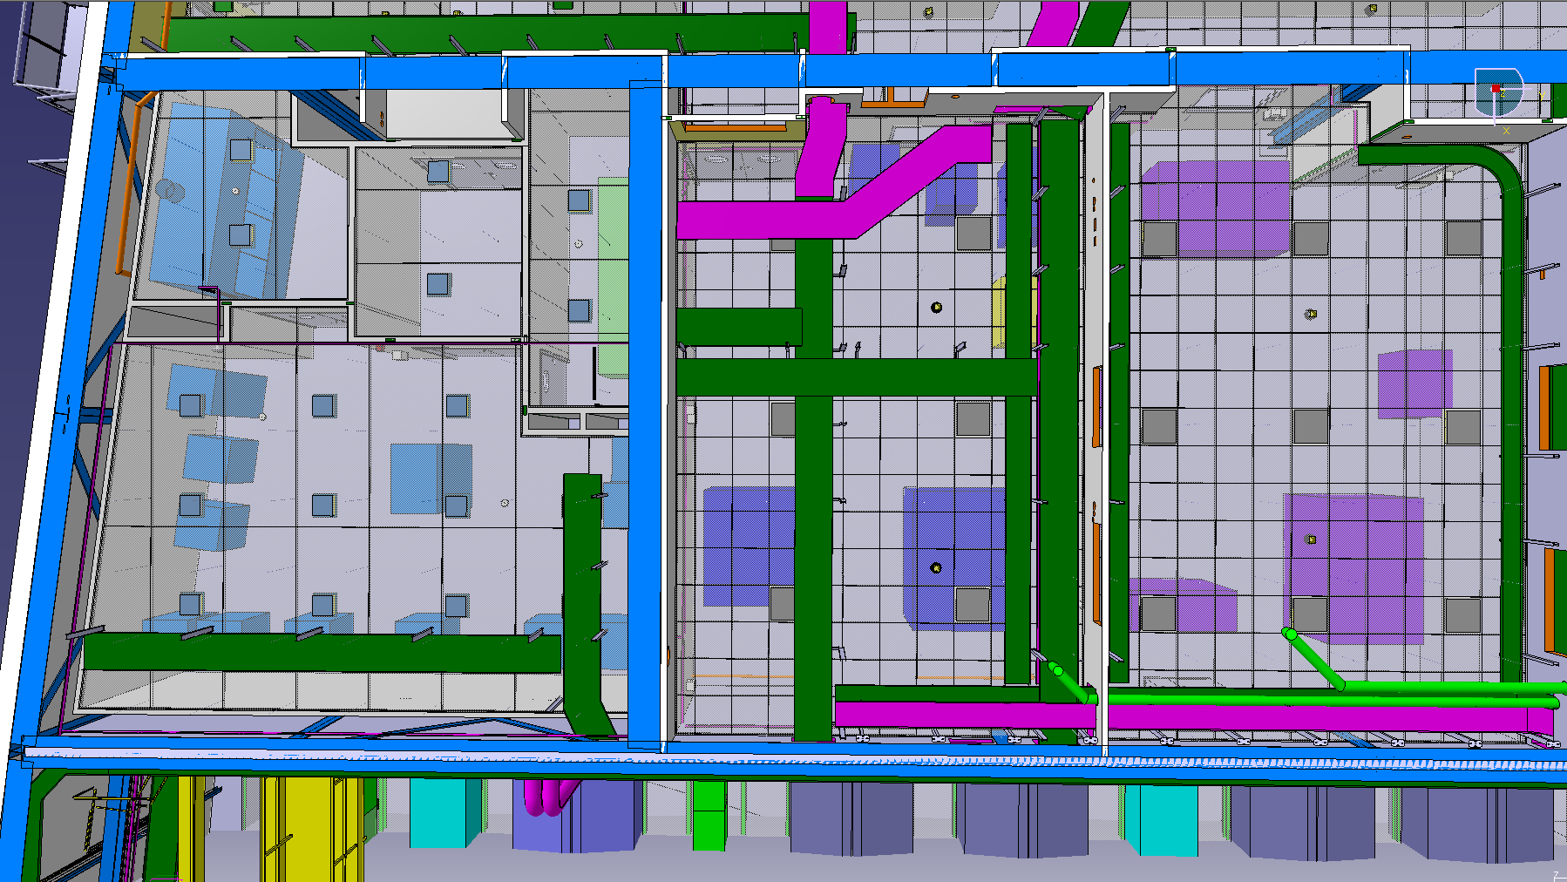
Networks Complexities

Slide 14
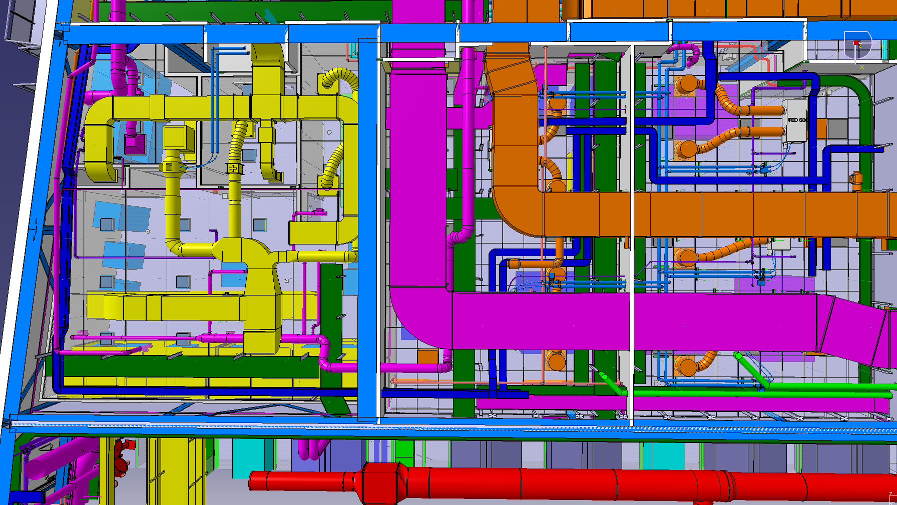
Networks Complexities

Slide 15
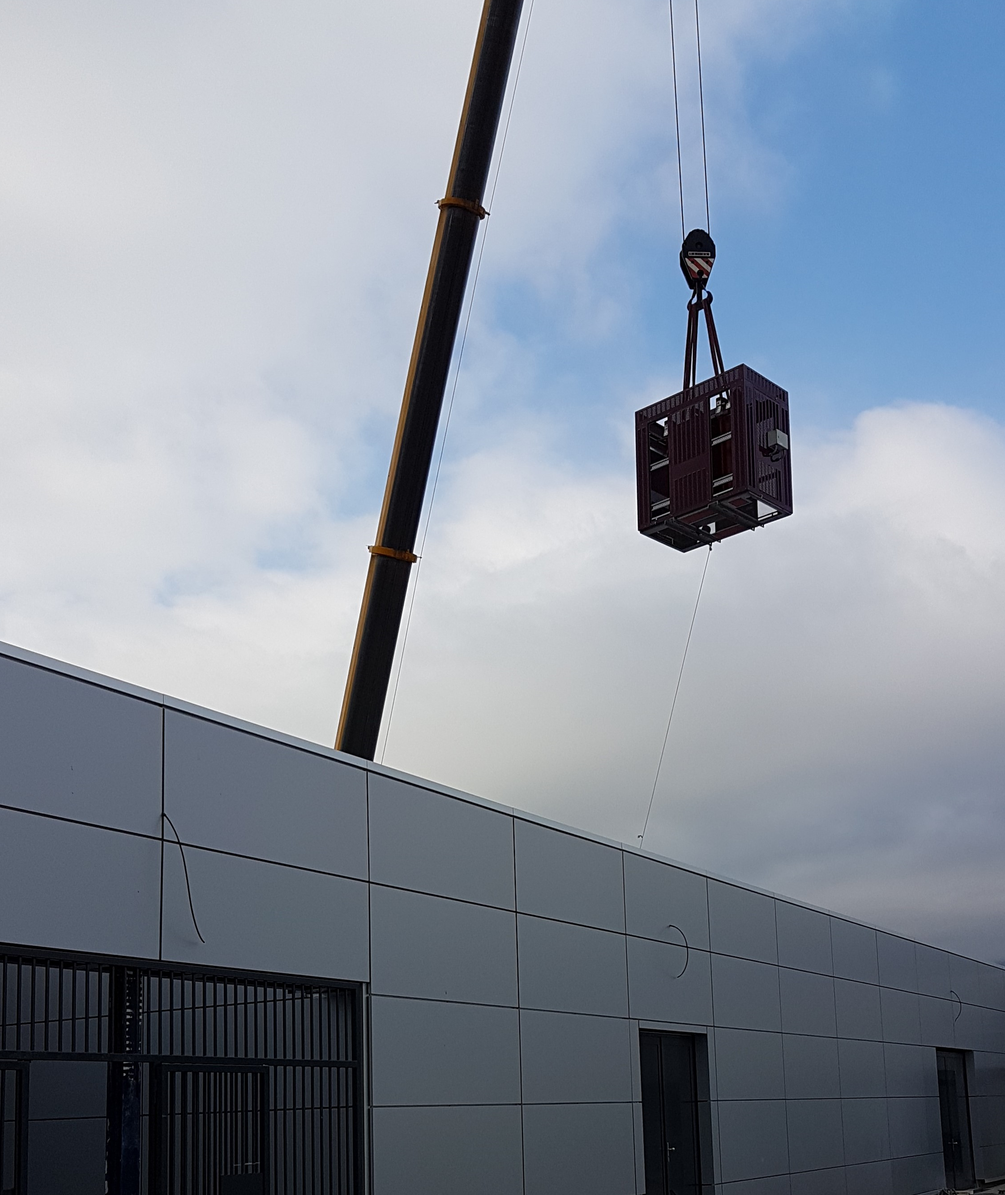
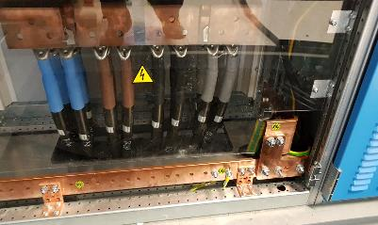
Key numbers
EL Activities
3M CHF
14 months of study
18 months of construction
2 transformers – 4MVA installed
21 Switchboards
500 circuit breakers
Over 200 of cable ladders representing more than 3km (14 cable ladder drawings)
Over 50 km of cables
Over 1100 functional positions
Over 400 LED Lights

Slide 16
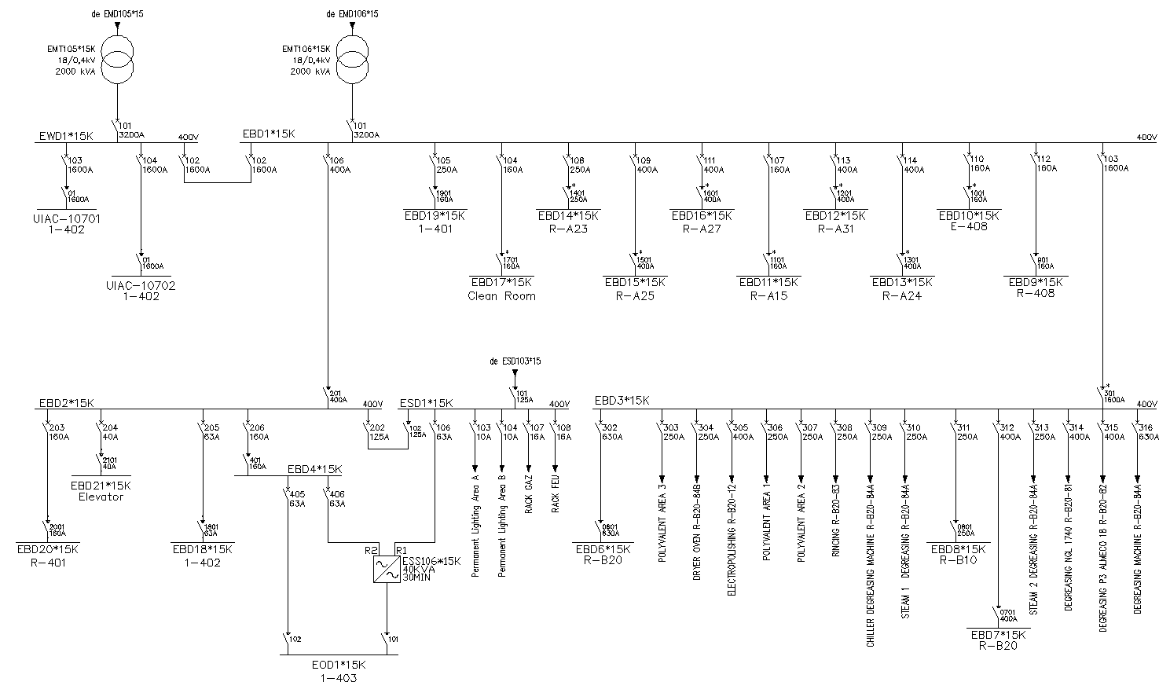
Electrical Network

Slide 17
Emplacement des tableaux EN-EL Zone EMD (+1er étage) – PCB - EMD
Building 107_ Fin Installation
C. Patou - February 2019

Slide 18
Emplacement des tableaux EN-EL Zone SF (+ Mezzanine)
Building 107_ Fin Installation
C. Patou - February 2019

Slide 19
Description «EL» des zones
Activité Grounding + Lightning:
- Installation foudre
- Toiture
Building 107_ Fin Installation

Slide 20
Description «EL» des zones
Activité global de la zone:
- Connexion équipements, Installation service généraux et éclairages, Arrivée générale, Cheminement de câbles et Installation tableaux électrique.
Building 107_ Fin Installation

Slide 21
Description «EL» des zones
Activité global de la zone:
- Connexion équipements, Installation service généraux et éclairages, Arrivée générale, Cheminement de câbles et Installation tableaux électrique
Building 107_ Fin Installation

Slide 22
Description «EL» des zones
Activité global de la zone:
- Connexion équipements, Installation service généraux et éclairages, Arrivée générale, Cheminement de câbles et Installation tableaux électrique
Building 107_ Fin Installation

Slide 23
Power Evolution
Estimated power requirements
EMD Area: 200 kVA
PCB Area: 810 kVA
SF Area: 740 kVA (+375 kVA in Spare)
Only for Powering all machines
Nearly 200 kVA estimated for LED Lights

Slide 24
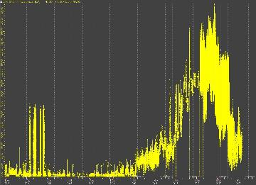
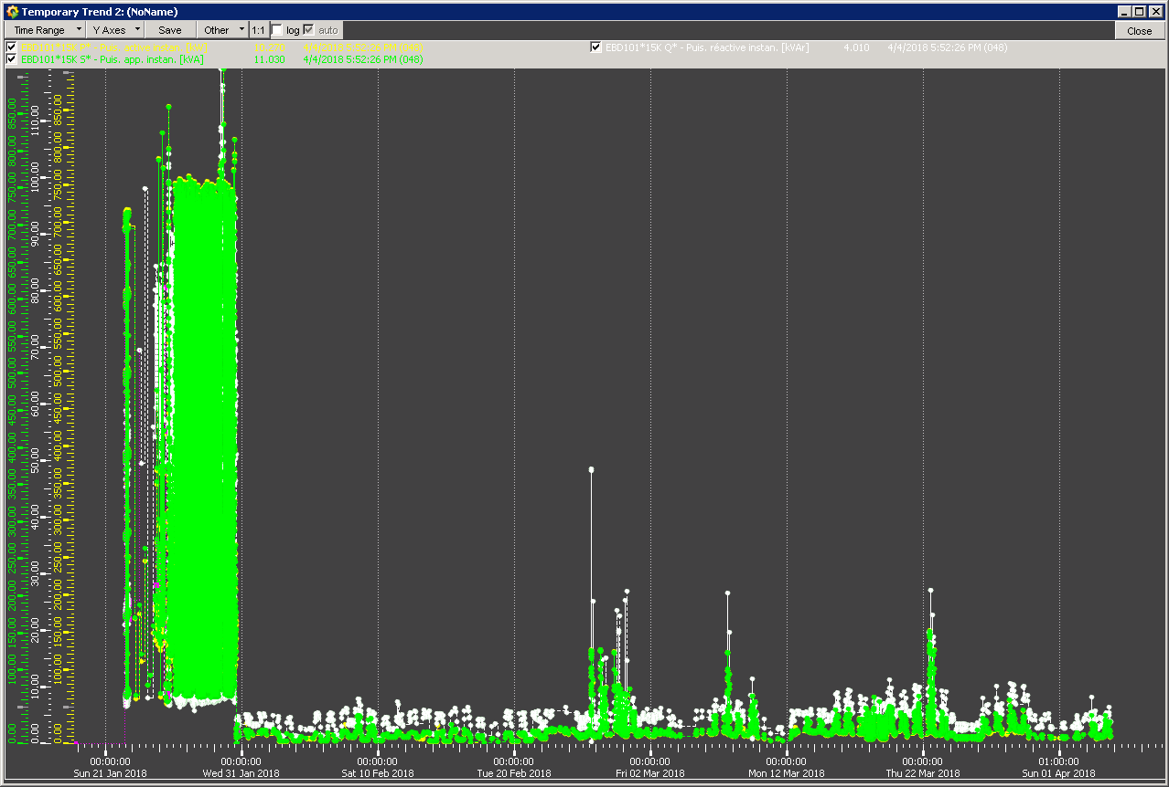
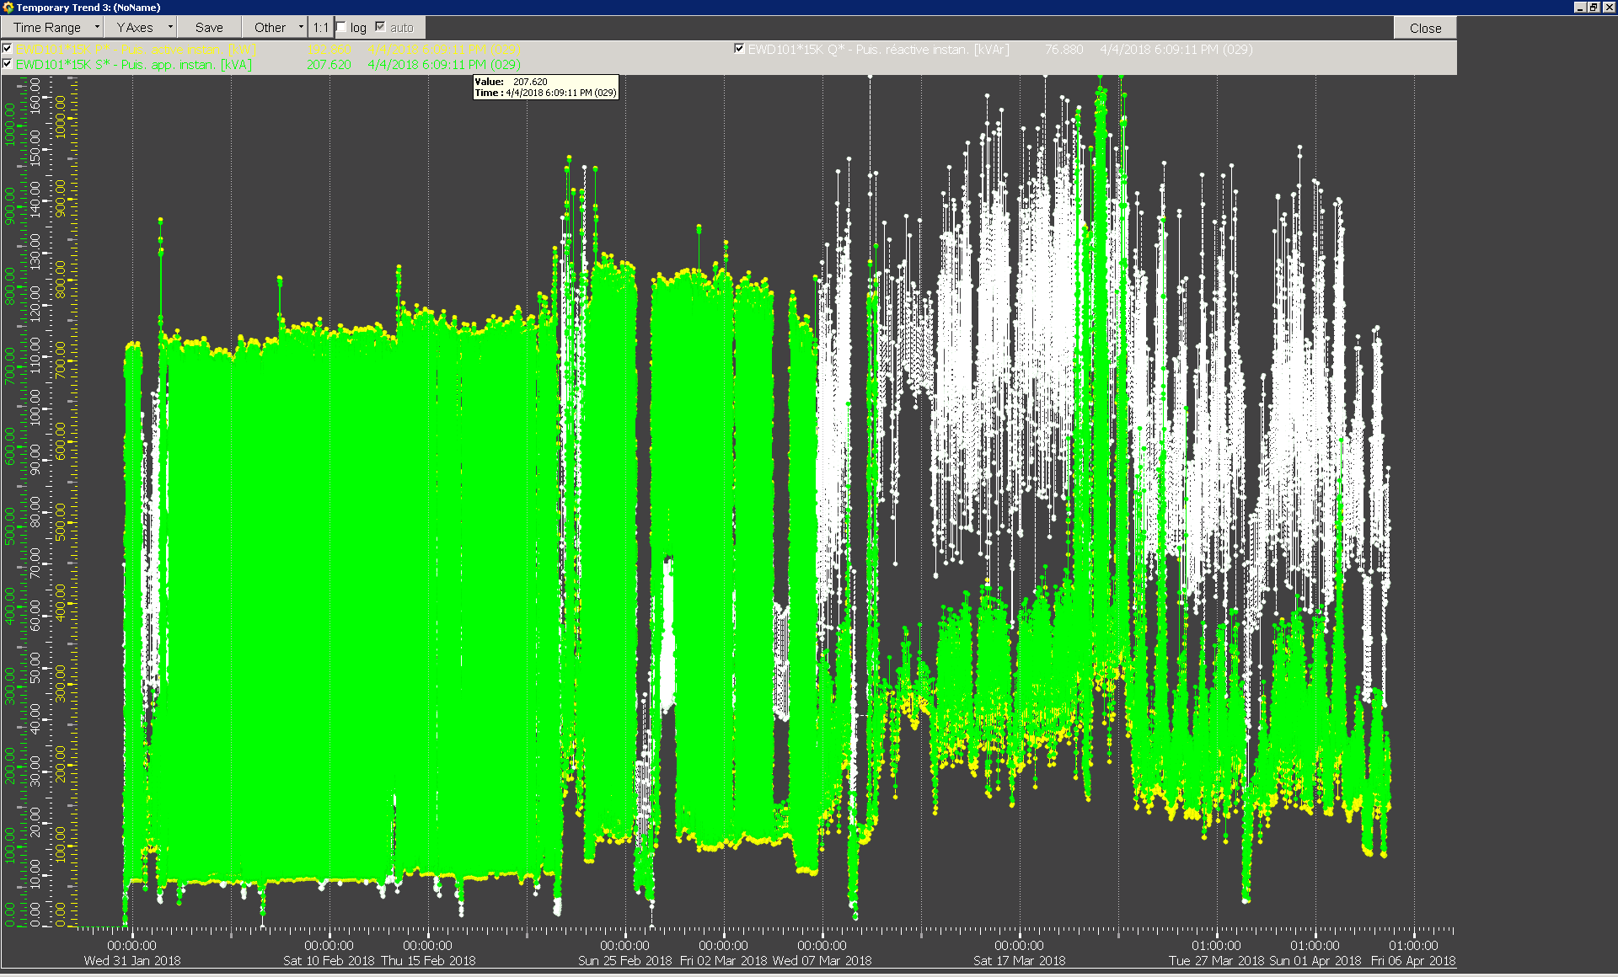
Power Evolution
Power Evolution from Provisional feeder from ME15
Power Evolution from EMT106*15K
Power Evolution from EMT105*15K

Slide 25
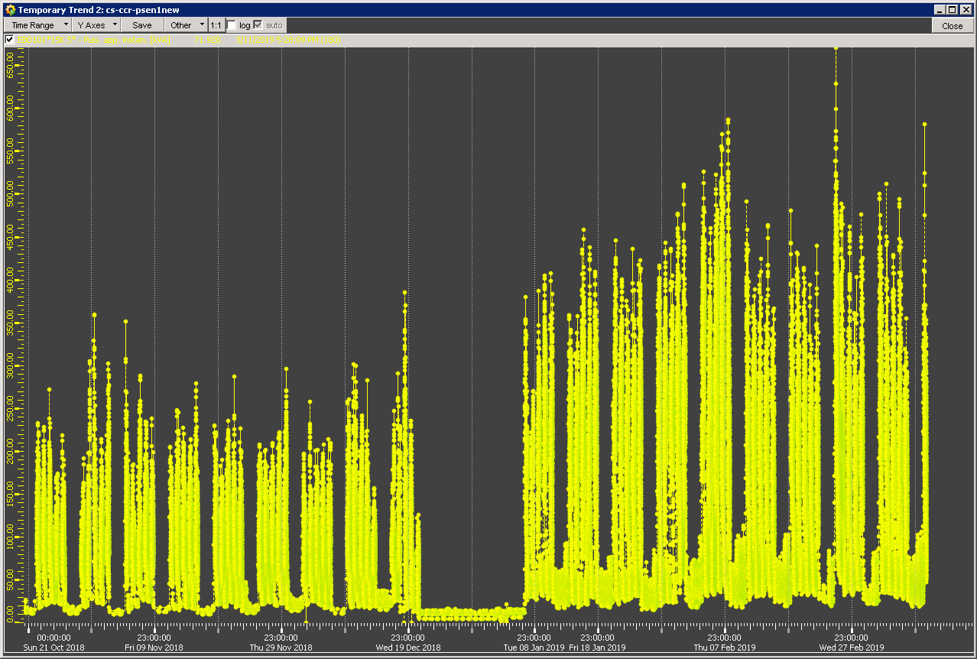
Power Evolution – General Services

Slide 26
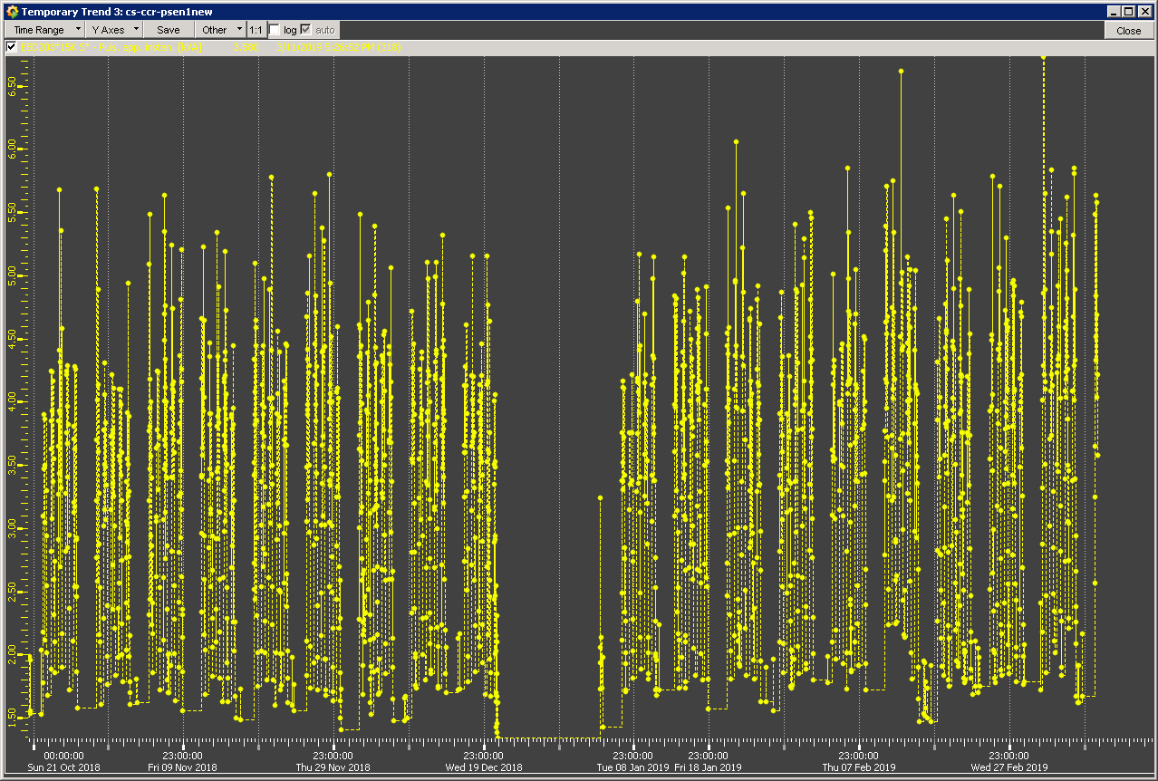
Power Evolution – GND Offices

Slide 27
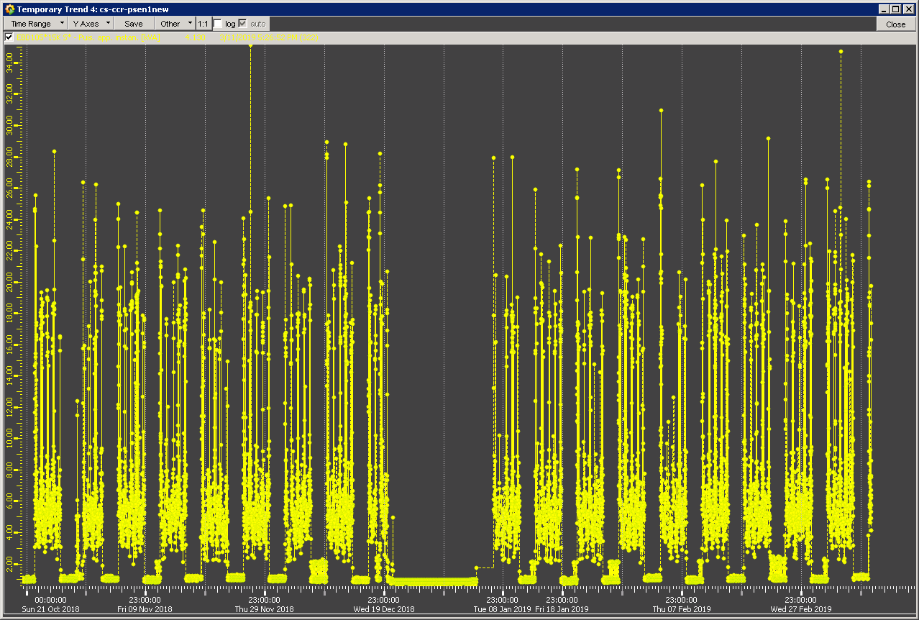
Power Evolution – EMD 1st Floor

Slide 28
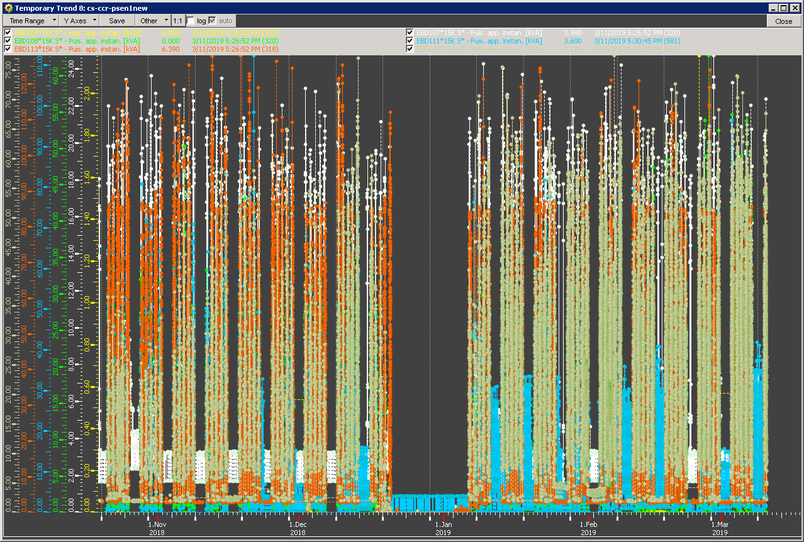
Power Evolution – PCB

Slide 29
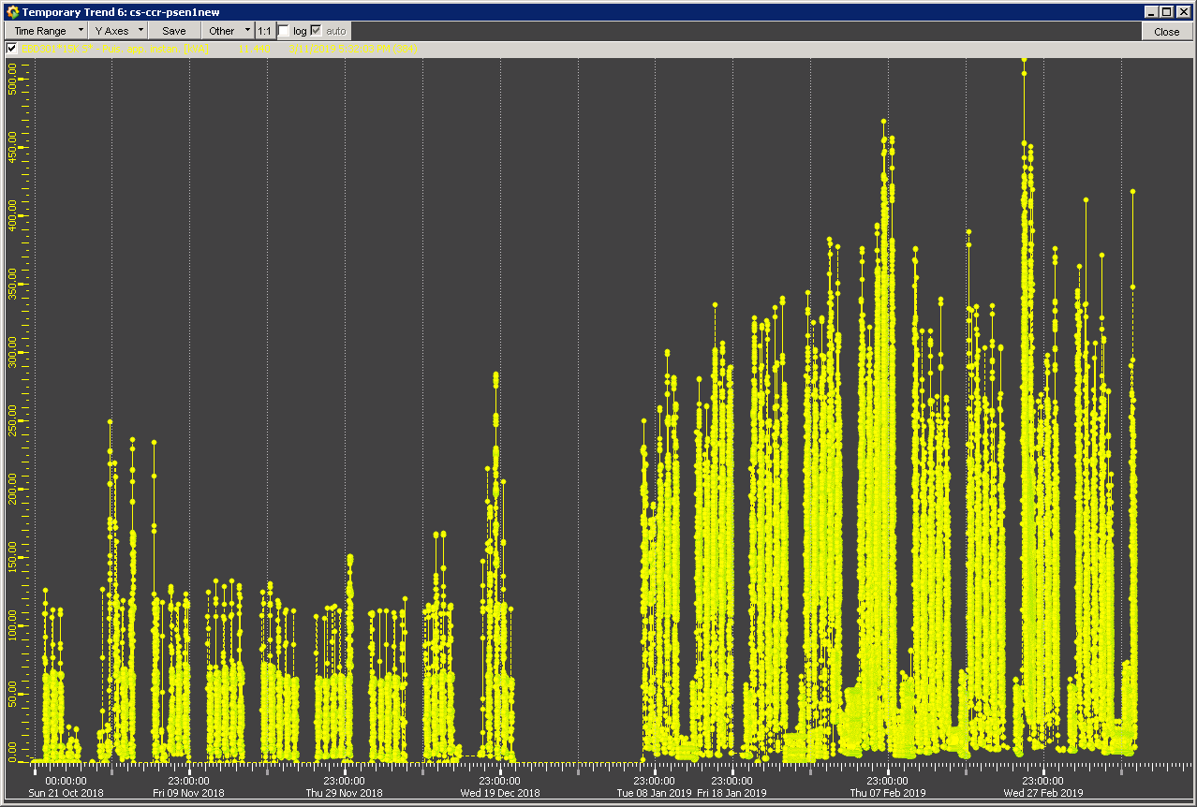
Power Evolution – SF Area

Slide 30
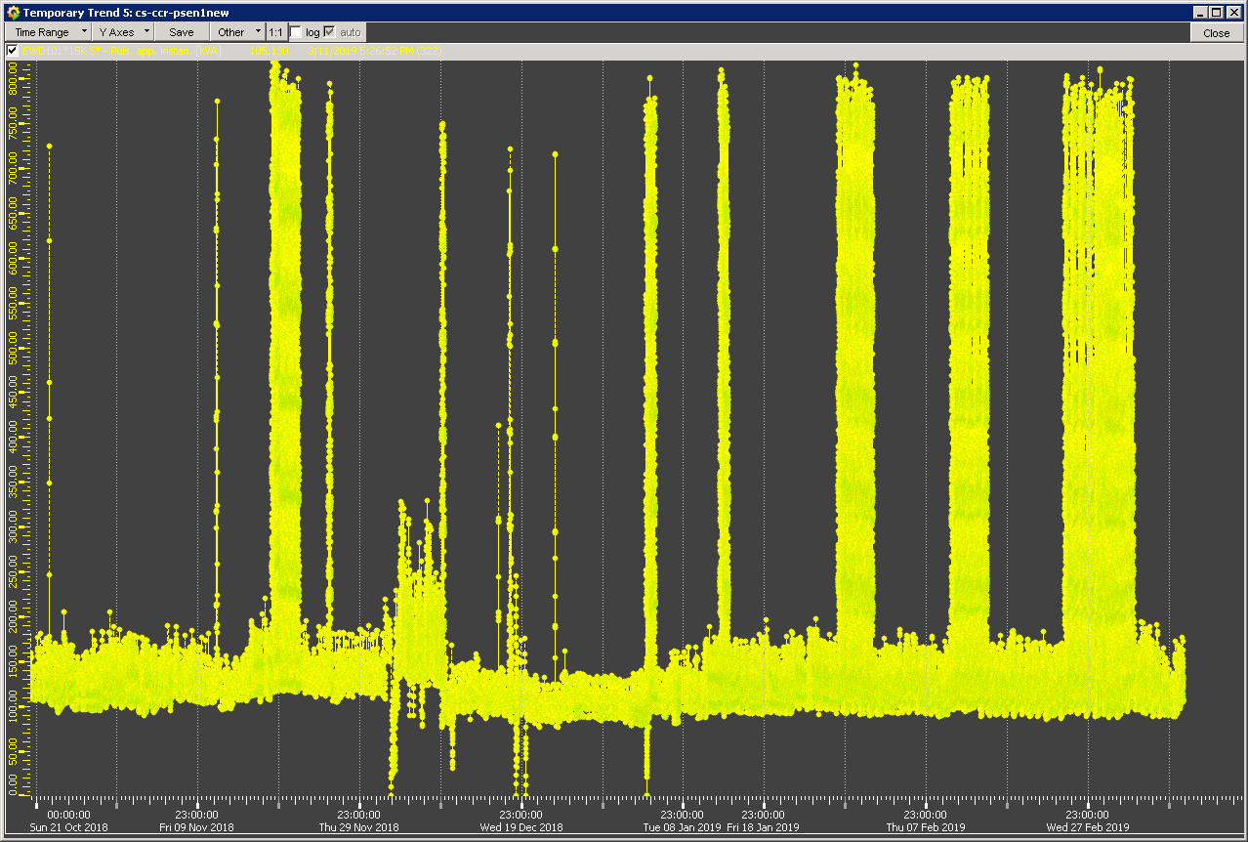
Power Evolution – Cooling & Ventilation

Slide 31
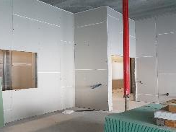
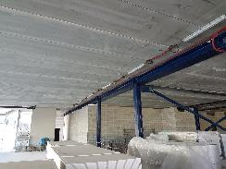
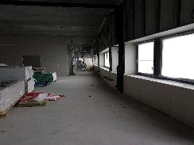
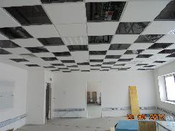
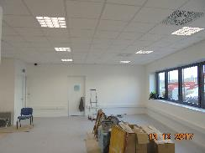
Evolution
Electricity evolution of room R-A06 (for instance)

Slide 32
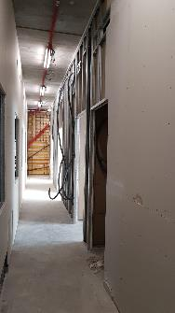
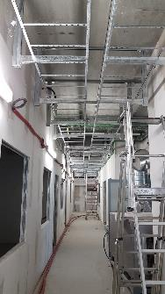
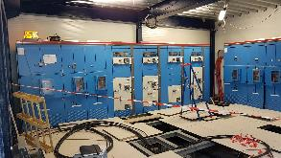
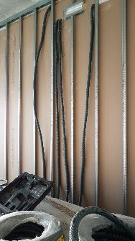
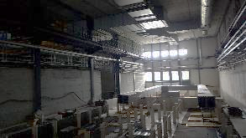
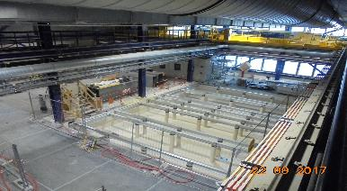
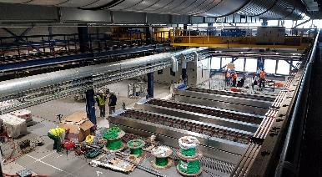
Evolution

Slide 33
Safety and PAL
Over 350 Daily reports from SMB
46 VIC
Over 70 Safety reports from DEKRA
Over 50 PPSPS or PHS
3 Major accidents
2 Minor accidents
3 PALs from EL(1 in 2016, 2 in 2017)
1 A2 Code for EL
Notes:
1 Incendie
1 chute de hauteur (Bras cassé)
1 chute de matériel de grande hauteur (détérioration des câbles et de la toiture)

Slide 34
To Sum Up
For The Building
1 part dedicated to electronic cards design office
1 part for surface finishing
1 cleanroom
1 part dedicated to workshop development
1 part dedicated to manufacturing and treatment of printed circuit boards
For EN-EL
1 Substation
Type II Lightning protection system
3 Type I Switchboard
1 Type II Switchboard
17 Type III Switchboard
3 Inspection visits from French and Swiss Authorities
Meetings dedicated For The Project (Per week)
1 For the Project Management (2h)
1 For the Project Field Follow up (2h)
1 For Integration (2h)
1 For Scheduling 3 weeks activities (3h)
1 For EN-EL site follow up with COMSA (2-3h)
For The EL Project Follow up
Around 2000 pictures
Over 80 EDMS Files
65 CDD Drawings
Over 3500 of studies files written
Over 11Gb of data

Slide 35
Special thanks to
Gabriel, Jean, Bruno, Henry, Pawel, Rémy, Matthieu, Adrien, Bertrand, Vincent, Mathieu, Jean-Philippe, Jean-Marc, Daniel, Patrick, Mickael, Jean-Claude and sorry to forget some people from EL for their support and participation during this project!
Thank you!

