Slide 1
LIU-PS TCM 4
Edouard Grenier-Boley on behalf of EN-STI

Slide 2
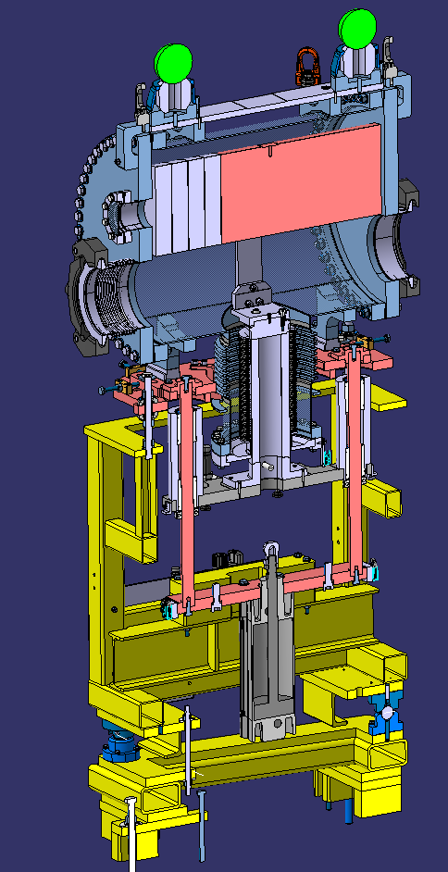
Budget – LIU PS Beam Stoppers
Allocated Budget for Beam Stoppers ➔ 200 kCHF for LIU BS
  The estimation turned out to be under evaluated for 5 beam stoppers (BTP+F16)
  2 spares were not initially included
Estimation for 7x vacuum chamber → 110 KCHF
  Overhead vacuum chamber → 170 KCHF EDH 7582797
  Reduction of spare number -1 → 140 CHF EDH 7630124
    Gain of 30 kCHF (potential additional gains in metrology)
    Over-cost of 30-40 kCHF
  Additional costs partly due to 316LN 3D forged requirement.
Focus on component standardisation to reduce costs
Big efforts with suppliers to optimise machining & standard components
  E.g. total of 150 kCHF with the first offers
    59 kCHF after reducing cost with different suppliers
    Gain of 90 KCHF
Joint manufacturing with East Area Consolidation (quantity reducing cost)
5+1 Stoppers will cost 260-270 kCHF total

Slide 3
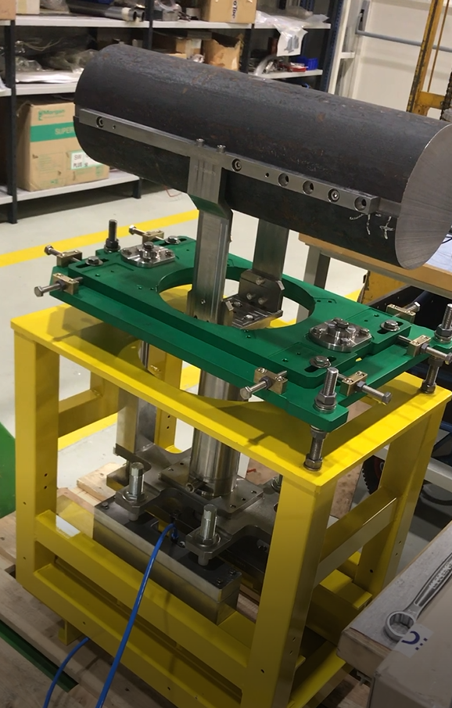
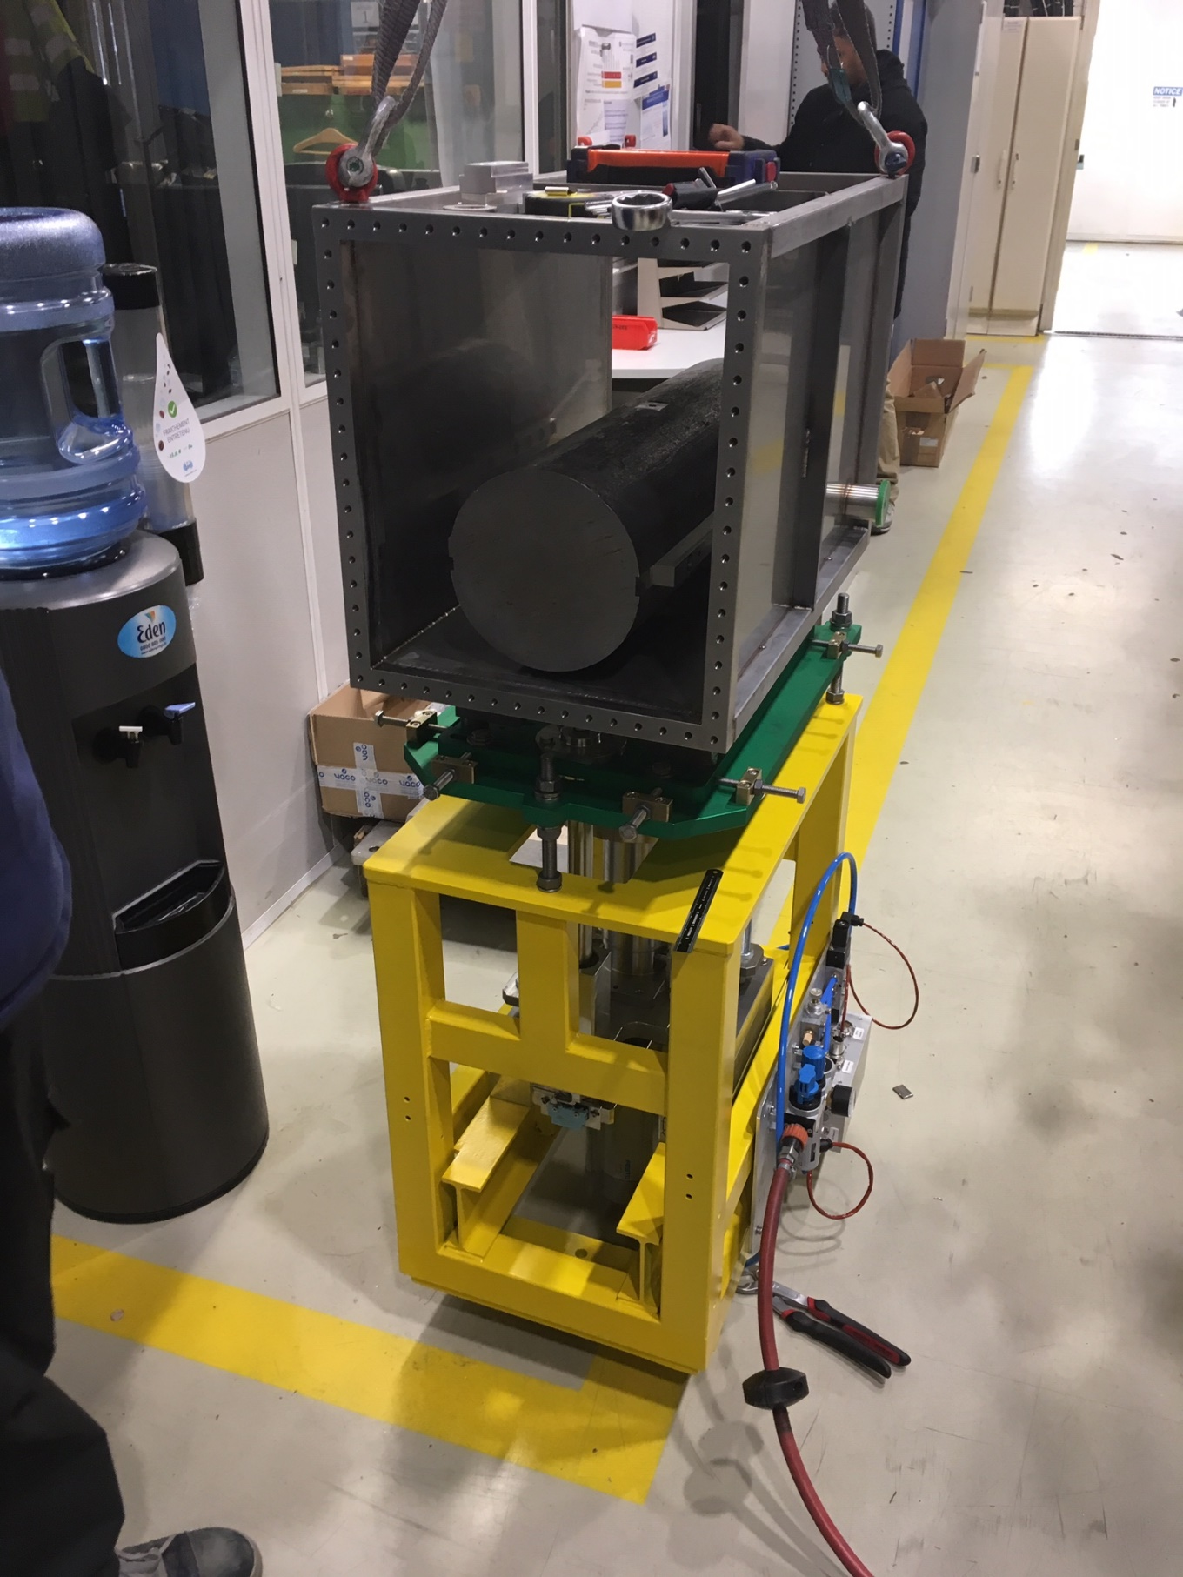
Functional Prototype
10,000 cycles already done
30 years of operation

