Slide 1
Welcome address
Rupert Leitner on behalf of organizers

Slide 2
Welcome all to the Colloquium Prague v19 „Towards the CP violation in neutrino Physics“
Thank you very much for taking part in the event
The Colloquium is jointly organized by:
David Wark, University of Oxford
Miloš Lokajíček, Institute of Physics of Czech Academy of Sciences, Prague
Rupert Leitner, Charles University, Prague
With a great support of other collegues: Nina Tůmová, Lukáš Fiala, Vít Vorobel, Karel Soustružník and others
Today we start the fifth edition after Prague v11, v13, v15 and v17

Slide 3
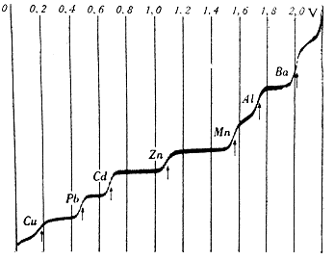
The Venue
J. Heyrovský Institute of Physical Chemistry of the AS CR

Slide 4
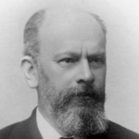
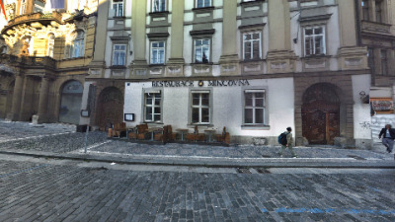
A Story related to Neutrino physics
Family of Wolfgang Pauli comes from Prague
Grandfather of Wolfgang Pauli, Jacob Pascheles (1839-1897) was a publisher and bookseller, he lived in Old Town Square, is buried in Prague Jewish cemetery in Prague-Žižkov.

Slide 5
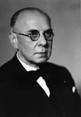
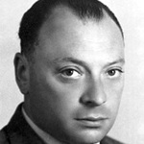
Wolfgang Pascheles (1869-1955) - son of Jacob Pascheles and father of Wolfgang Pauli, was a classmate of Ludwig Mach, the son of famous physicist Ernst Mach at the German Old Town High Scool in Prague.
Seven years after he has finished the School, Franz Kafka has started studies at the same School.
Wolfgang Pascheles has finished Medicine at Prague University. He has changed his family name to Pauli and moved to Vienna to continue his prestigious scientific career.
Also Ernst Mach moved to Vienna and he became a godfather of Wolfgang Pauli born in Vienna in 1900.
No Time to be Brief: A Scientific Biography of Wolfgang Pauli
Charles P. Enz

Slide 6
Let me welcome you all and your colleagues
to come to Prague
in 9 months from now to attend
ICHEP 2020
40th International Conference on High Energy Physics to be held
30 July – 5 August 2020 in Prague,
Czech Republic

