Slide 1
A root macro for tracking sim
F. Bedeschi
FCC-ee Physics Meeting
CERN, February 28, 2019
Outline
The need
The core
Implementation
Examples
Fast simulation
Examples
Conclusions

Slide 2
The need
IDEA tracking system still evolving
Need fast turn around in evaluation of various options
  Easy implementation of modified geometry
  Easy change of detector performances
Need realistic input for fast simulation
  Full covariance matrix
  Dependence on pt and polar angle

Slide 3
The core (1)
Track fit χ² linearized in the fit parameters:
  d/d* = predicted/measured distance of track from wire or pixel
  p = track parameters
  S = covariance of all measurements: resolution & MS
    MS → worse resolution and non diagonal correlation terms
Track parameter resolution depends on S and derivatives:

Slide 4
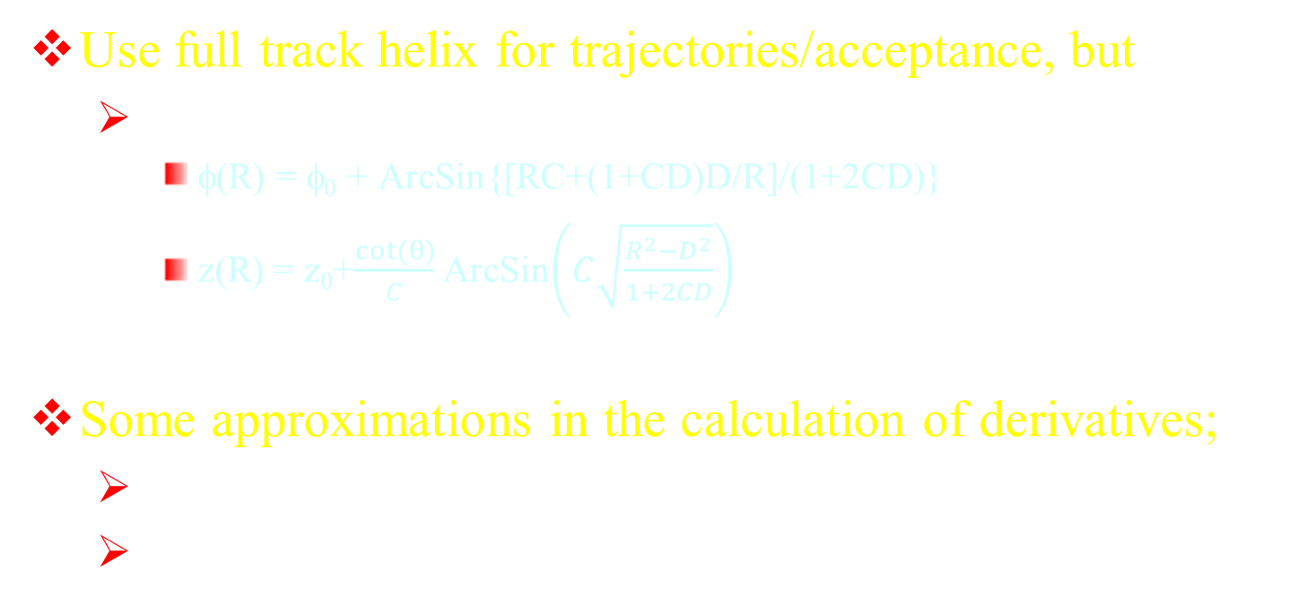
The core (2)
Use full track helix for trajectories/acceptance, but
  Keep only first outgoing branch
    φ(R) = φ₀ + ArcSin{[RC+(1+CD)D/R]/(1+2CD)}
    z(R) = z₀+$\frac{cot⁡(θ)}{C}$ ArcSin$\left(C\sqrt{\frac{R^{2}−D^{2}}{1+2CD}}\right)$
Some approximations in the calculation of derivatives;
  CD<<1, |D| <<R
  OK also for low momentum track

Slide 5
Implementation (1)
SolGeom class:
  Fills geometry and draws it
    Draws also the material
  Each sub-detector can be turned on or off
  All layers either:
    Measurement or inert (for MS)
    Measurement is axial (Rφ), small angle stereo or 90 deg. (Rz)
    Cylinder shell (const R) or disk (constant z)
  Can write geometry to a text file
  Can be initialized by reading text file

Slide 6
Implementation (2)
Typical SolGeom geometry block

Slide 7
Examples (1)
Initialize geometry and draw it
→ material plot

Slide 8
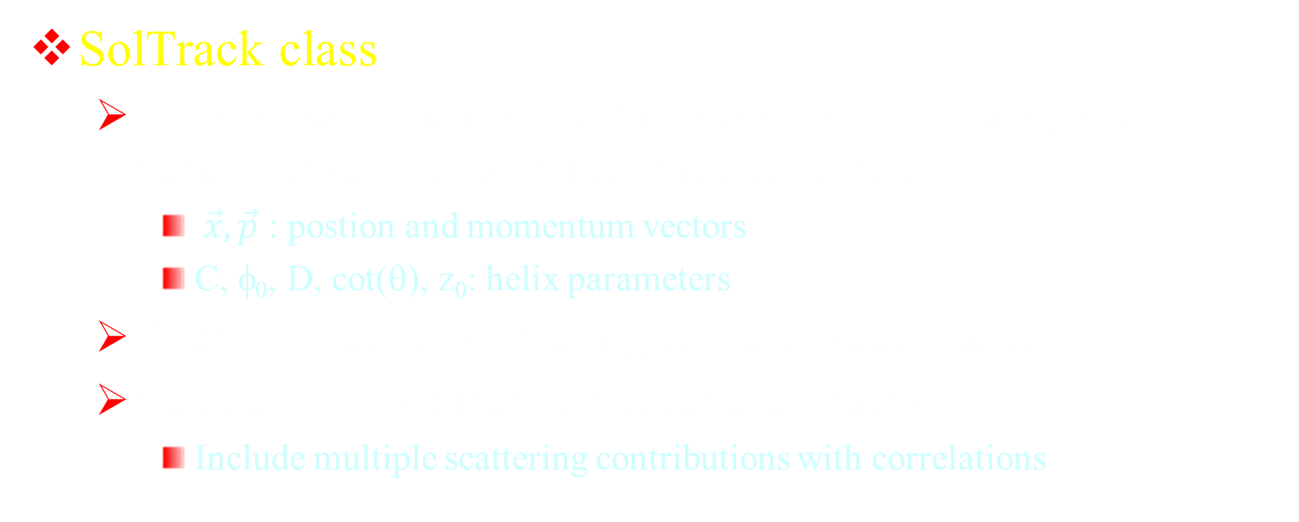
Implementation (3)
SolTrack class
  Initialize with a geometry (SolGeom type) and two possible parameterizations (with automatic conversion):
    $\vec{x}, \vec{p}$ : postion and momentum vectors
    C, φ₀, D, cot(θ), z₀: helix parameters
  Finds intersection with any given layer (acceptance)
  Calculates helix parameter covariance matrix
    Include multiple scattering contributions with correlations

Slide 9
Examples (2)
Draw a track:

Slide 10
Examples (3)
Compare resolution plots with full simulation (red = fast)
45 deg
90 deg

Slide 11
Make it faster
SolTrack calculation of covariance matrix slow
  Involves inversion of matrix ~ 120x120
Solution:
  Store pt-polar angle grid of matrices in .root file
  Get any matrix by interpolation over 2D-grid
Implementation with class SolGridCov

Slide 12
SolGridCov
Methods:
  Creates TTree with covariance matrix branches
  Calculates covariance matrices at nodes with SolTrack
  Interpolates covariance matrix for any pt–polar angle
    C = C₁₁(1-t_{pt})(1-t_{th})+C₁₂(1-t_{pt})t_{th}+C₂₁t_{pt}(1-t_{th})+C₂₂ t_{pt} t_{th}
    t_{pt} = (pt-pt_{min})/(pt_{max}-pt_{min}), t_{th} = (th-th_{min})/(th_{max}-th_{min})
    Protect positive definitness
  Write/Read covariance matrix grid to file

Slide 13
Examples (4)
Resolution comparison (90 degree)
From grid
From SolTrack

Slide 14
Application to simulation
Class ObsTrk:
  Takes input perfect track → observed track
    Conversion to helix parameters
    Smear helix parameters according to appropriate covariance matrix
      Use Choleski decomposition

Slide 15
Example (5)
Application in invariant mass calculation in Pythia generated events

Slide 16
Example (6)
Higgs recoil from HZ (Z→μ⁺μ⁻) – 0.1% COM energy σ

Slide 17
Conclusion (1)
Simple ROOT based classes to simulate tracking system resolution
  Easy to change configuration
  Perfect to compare options
Used to feed Fast Sim a realistic covariance
  Could be included inside DELPHES
Validated on full simulation
Demonstrated on specific physics process

Slide 18
Conclusions (2)
Additional work:
  Agree on baseline geometry and resolutions
  Generate several geometry/covariance files for comparisons
    CLD, CepC baseline, variations of IDEA baseline for optimization purposes
  Use for physics studies involving tracking only
Quite possible now for Oxford and FCC week
Need dedicated student to converge rapidly
All software described here can be found in
  https://www.pi.infn.it/~bedeschi/RD_FA/Software/

