Slide 1
Gamma Factory ion beam dynamics
Alexey Petrenko (Budker INP)
Gamma Factory meeting at CERN, March 26, 2019.

Slide 2
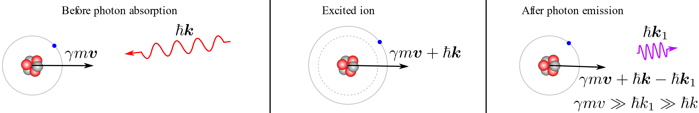

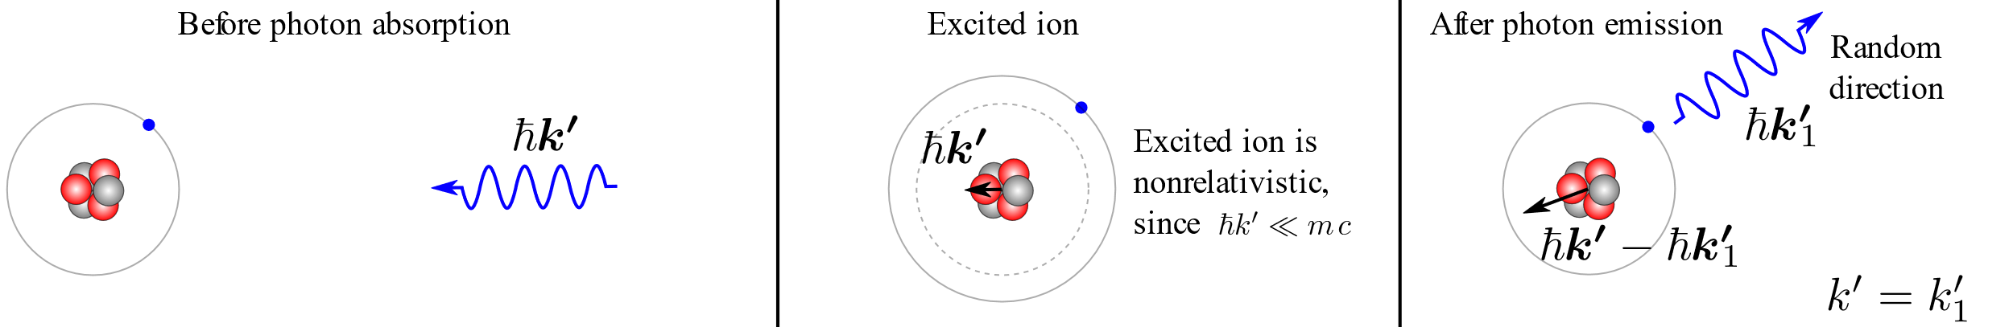
Laser-ion interaction kinematics
In the lab frame:
In the ion’s frame:
What is the effect of radiation emission on the ion beam dynamics?
Longitudinal cooling: because energy loss grows with ion energy.
Transverse cooling: because all components of ion momentum are lost due to the photon scattering but only the longitudinal component is restored in the RF resonator.
Longitudinal heating: because energy loss per emission is random due to the random direction of photon emission in the ion’s frame of reference.

Slide 3
The LHC H-like Pb example:
Ion charge Z = 81, mass A = 208, γ = 2719, p_{z} = 526.5 TeV/c,
ℏω′ = 69 keV (Lyman-alpha line), laser ℏω = 12 eV (98 nm),
emitted gamma ℏω_{1,max}= 373 MeV, typical angle of emission θ₁ ~ 1/γ ~ 0.3 mrad.
Typical transverse kick due to gamma emission:
p_{x}/p_{z}~ ℏω′/p_{z}c ~ 69 keV / 527 TeV ~ 10^{‒7} mrad.
Typical transverse beam parameters at the LHC interaction point for example:
Transverse beam size = 0.026 mm, angular spread = 0.026 mrad (10⁵ times higher).
Typical energy spread in the beam is Δp/p ~ 10^{‒4}, while the average δp_{z} due to the photon emission is 200 MeV/c => δp_{z} / p_{z} = 200 MeV / 527 TeV = 3.7· 10^{‒7} => Δp/δp ≈ 300, and even with one scattering per turn the longitudinal effects will be significant in ~100-1000 turns.

Slide 4
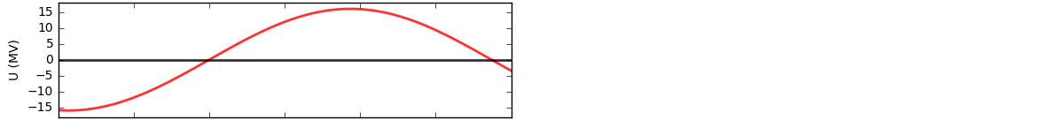
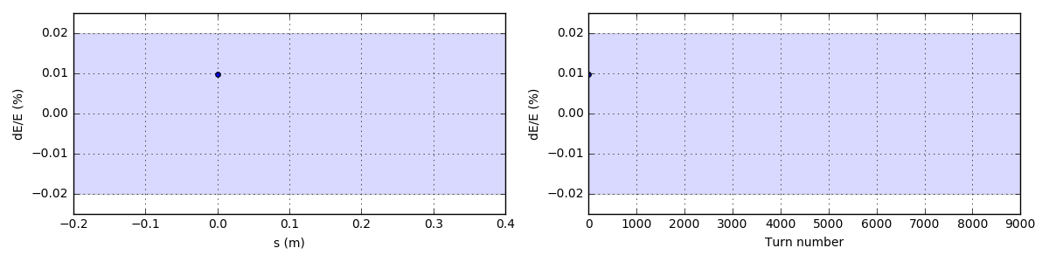
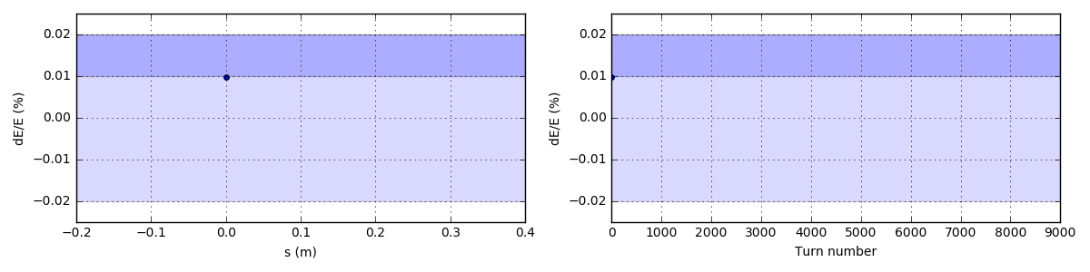
Longitudinal laser cooling is important to stabilize the ion motion:
The important effect of photon emissions on ion beam dynamics is in the energy loss of the partially stripped ion. This energy loss is randomly distributed from 0 to 400 MeV in this case of Pb ion with one remaining electron in the LHC. This randomness excites uncontrolled growth of synchrotron oscillations leading to a loss of ion from the RF-bucket:
4.0 scatterings
per ion
per turn
The synchrotron oscillations can be stabilized by a small change in the spectral distribution of the laser beam (or by adding another low-power laser):
4.4 scatterings
4.0 scatterings
per ion
per turn
Simulation details: http://www.inp.nsk.su/~petrenko/misc/ion_cooling/animations/

Slide 5
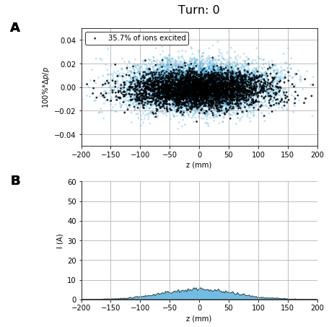
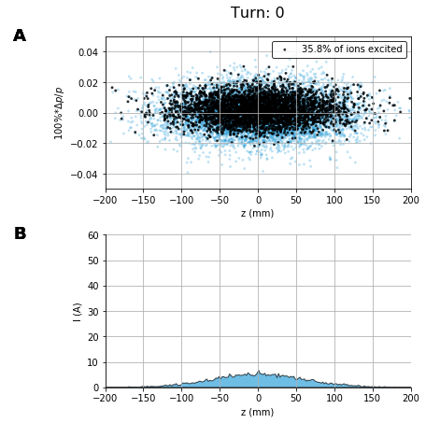
The longitudinal beam dynamics is quite sensitive to imbalance of energy radiated at Δp>0 vs Δp<0:
Fourier-limited Gaussian laser pulse with σ(Δω/ω) = σ(Δp/p) centered on p₀(1±0.5Δp/p)
Laser waist size w₀ = 2σ_{x,y} = 40 μm, energy = 42 μJ.
Slightly shorter central laser wavelength:
Slightly longer central laser wavelength:
Black dots – excited ions, blue dots – not excited ions.

Slide 6
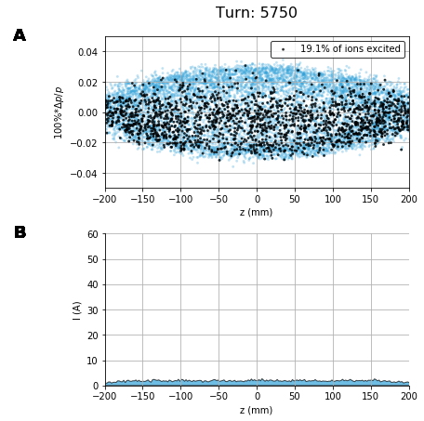
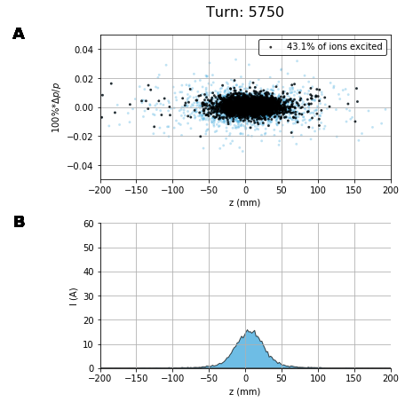
The longitudinal beam dynamics is quite sensitive to imbalance of energy radiated at Δp>0 vs Δp<0:
Fourier-limited Gaussian laser pulse with σ(Δω/ω) = σ(Δp/p) centered on p₀(1±0.5Δp/p)
Laser waist size w₀ = 2σ_{x,y} = 40 μm, energy = 42 μJ.
(0.5 sec.)

Slide 7
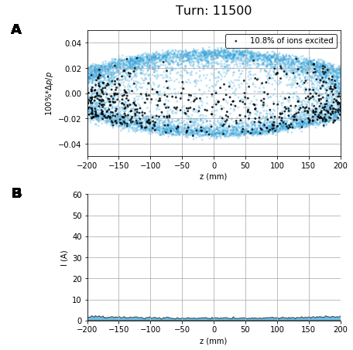
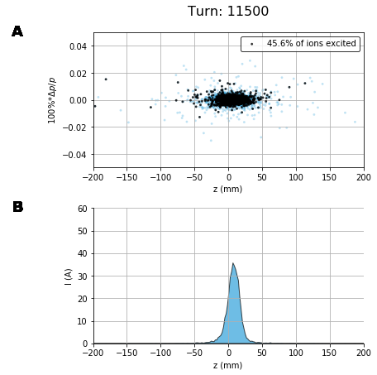
The longitudinal beam dynamics is quite sensitive to imbalance of energy radiated at Δp>0 vs Δp<0:
Fourier-limited Gaussian laser pulse with σ(Δω/ω) = σ(Δp/p) centered on p₀(1±0.5Δp/p)
Laser waist size w₀ = 2σ_{x,y} = 40 μm, energy = 42 μJ.
(1 sec.)

Slide 8
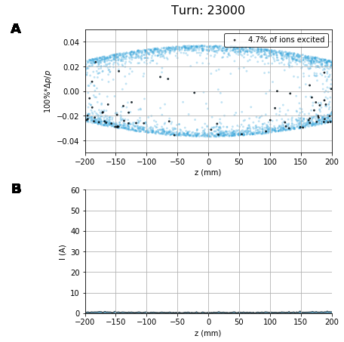
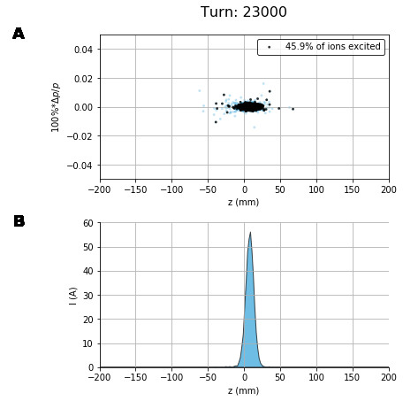
The longitudinal beam dynamics is quite sensitive to imbalance of energy radiated at Δp>0 vs Δp<0:
Fourier-limited Gaussian laser pulse with σ(Δω/ω) = σ(Δp/p) centered on p₀(1±0.5Δp/p)
Laser waist size w₀ = 2σ_{x,y} = 40 μm, energy = 42 μJ.
(2 sec.)
Maybe a good approach would be to introduce heating in the middle while limiting the Δp growth with a barrier. This can be done by alternating the cooling and heating regimes or using a laser with a complicated frequency profile (or two lasers).

Slide 9
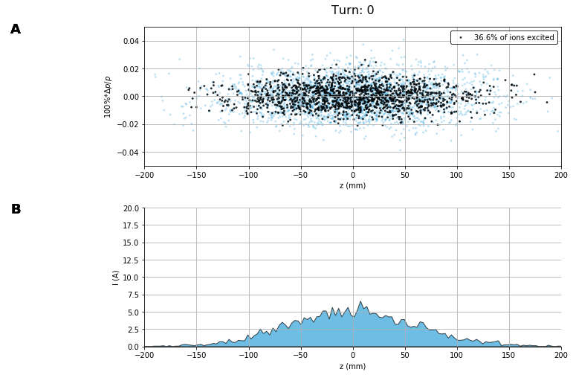
Fourier-limited Gaussian laser pulse with σ(Δω/ω) = σ(Δp/p) centered on p₀(1+0.05Δp/p)
Laser waist size w₀ = 2σ_{x,y} = 40 μm, energy = 42 μJ.

Slide 10
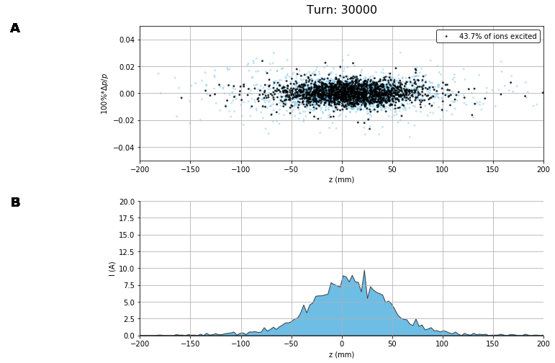
Fourier-limited Gaussian laser pulse with σ(Δω/ω) = σ(Δp/p) centered on p₀(1+0.05Δp/p)
Laser waist size w₀ = 2σ_{x,y} = 40 μm, energy = 42 μJ.
(2.7 sec.)

Slide 11
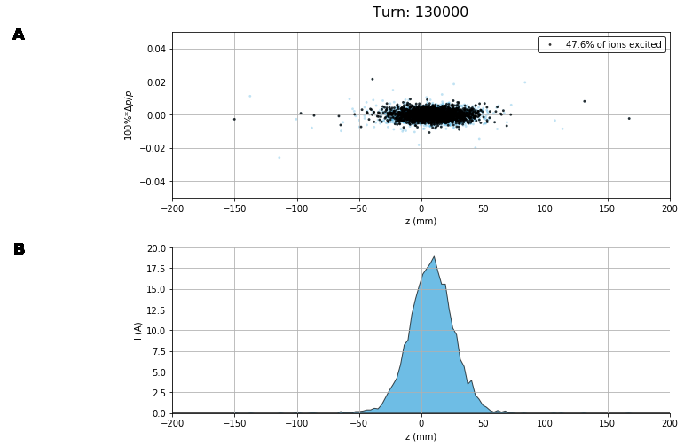
Fourier-limited Gaussian laser pulse with σ(Δω/ω) = σ(Δp/p) centered on p₀(1+0.05Δp/p)
Laser waist size w₀ = 2σ_{x,y} = 40 μm, energy = 42 μJ.
(11.7 sec.)

Slide 12
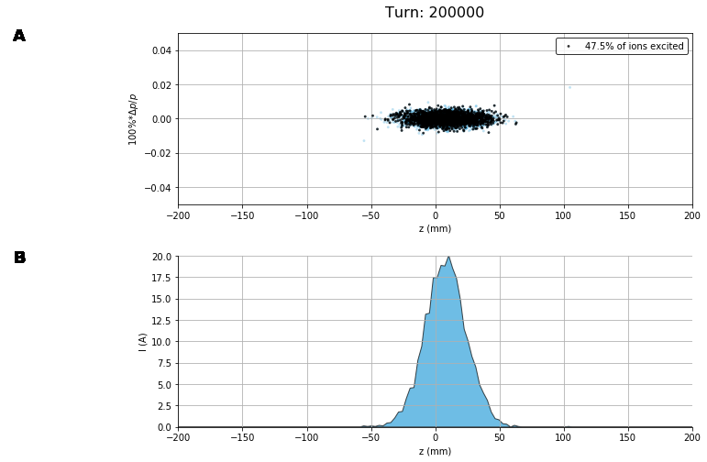
Fourier-limited Gaussian laser pulse with σ(Δω/ω) = σ(Δp/p) centered on p₀(1+0.05Δp/p)
Laser waist size w₀ = 2σ_{x,y} = 40 μm, energy = 42 μJ.
(18 sec.)

Slide 13
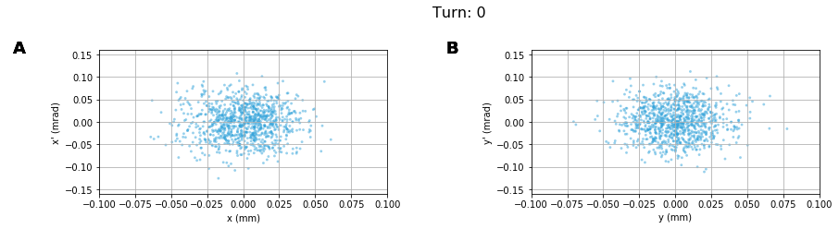
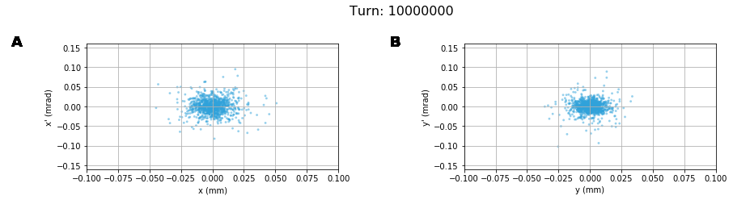
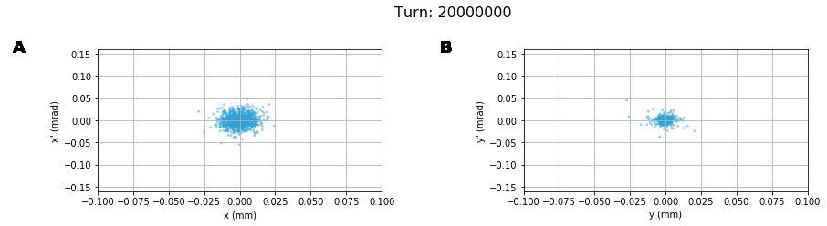
Transverse cooling is much slower:
https://anaconda.org/petrenko/lhc_psi_beam_vs_laser
(15 min.)
(30 min.)
Cooling time ~ time to radiate the full ion energy: 530 TeV / (0.5 * 190 MeV) = 5.6e6 turns (8.5 min)

Slide 14
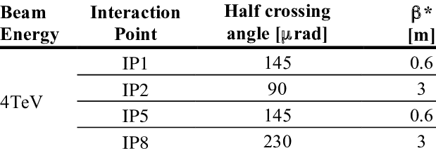
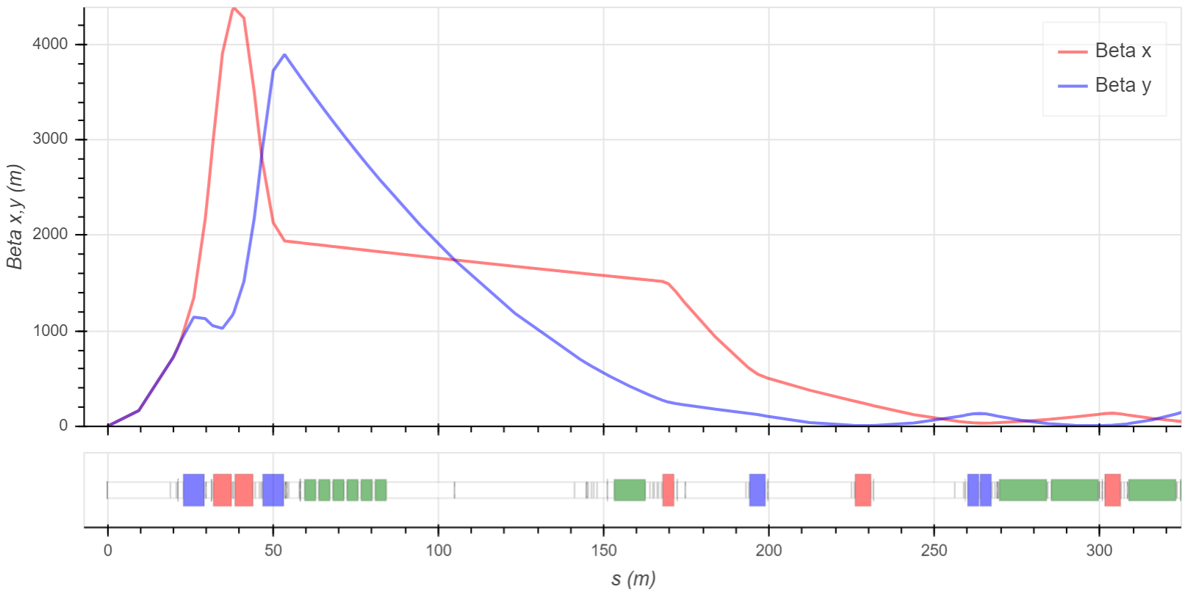
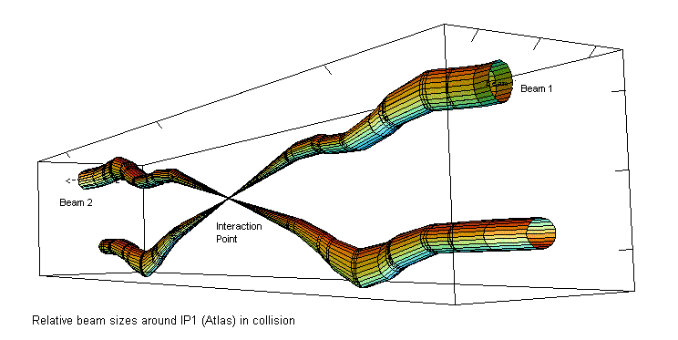
Interaction region:
http://accelconf.web.cern.ch/accelconf/ipac2013/papers/mopwo046.pdf
Beta-function at the center of the IP1 (ATLAS) = 0.6 m.
0.3 mrad (IP1), 0.5 mrad (IP8)
https://lhc-machine-outreach.web.cern.ch/lhc-machine-outreach/collisions.htm
SC quads
(1.1 mrad MBRC)
Normal-conducting dipoles (0.19 mrad each, 1.13 mrad with 6 dipoles)
(5.1 mrad Main Dipoles)
https://apetrenko.blob.core.windows.net/lhc/LHC_optics.html

Slide 15
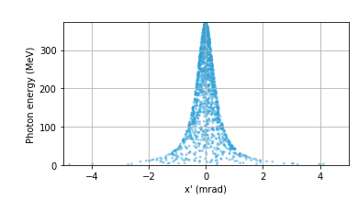
Interaction region:
Angle-energy plot of emitted gamma-photons:
Laser
Ions
~0.3 mrad * 100 m = 3 cm
Gamma-photons
SC quads
(1.1 mrad MBRC)
Normal-conducting dipoles (0.19 mrad each, 1.13 mrad with 6 dipoles)
(5.1 mrad Main Dipoles)

Slide 16
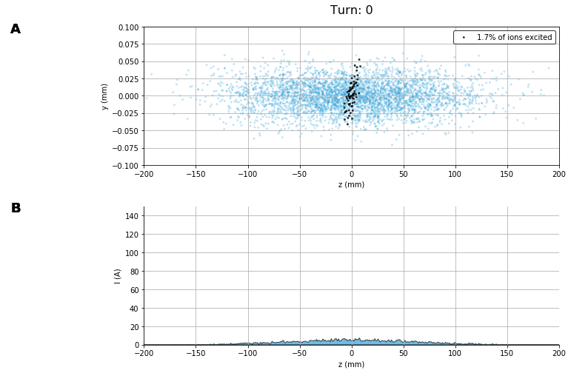
Interaction with 1 degree crossing angle:

Slide 17
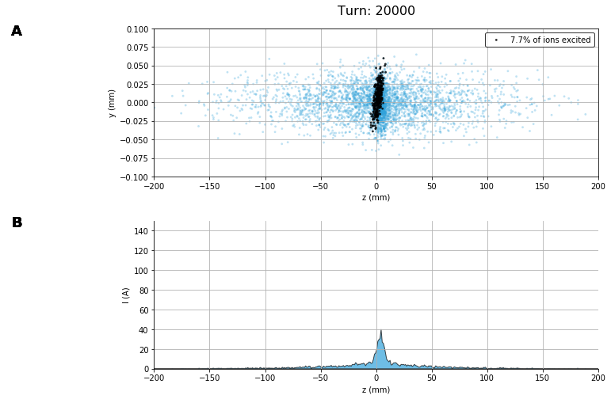
Interaction with 1 degree crossing angle:
(1.8 sec.)

Slide 18
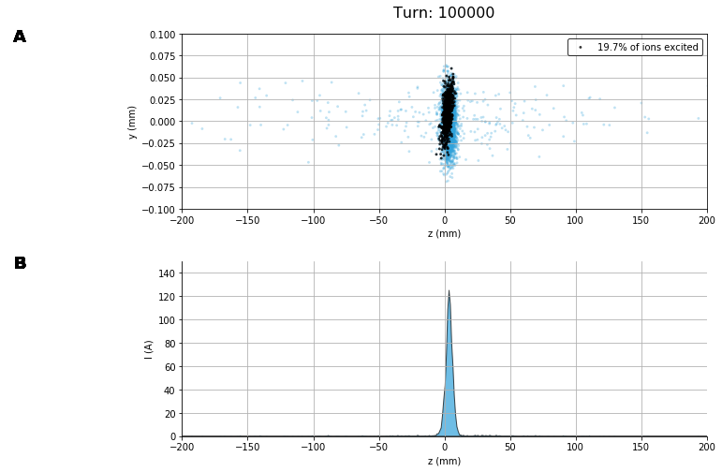
Interaction with 1 degree crossing angle:
(9 sec.)

Slide 19
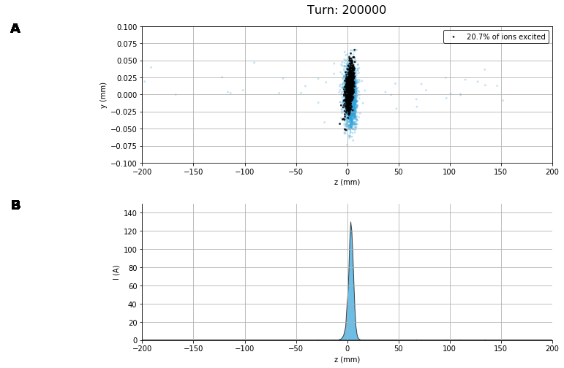
Interaction with 1 degree crossing angle:
(18 sec.)
Fast longitudinal cooling allows to compress the bunch and increase the geometric overlap.

Slide 20
Conclusions:
Understanding and control of the fast longitudinal cooling/heating is critically important for the stable operation of a Gamma Factory.
Transverse cooling can help to reduce the laser power requirements.
Longitudinal cooling can be helpful with laser crossing at some angle.
Questions to study next:
Collective instabilities
Intra-Beam Scattering
Detailed laser-ion beam interaction region including laser input and gamma-radiation output.

