Slide 2
SPS aspects
Gamma Factory meeting
March 2019
Y. Dutheil, B. Goddard, F. Velotti

Slide 3
Layout
SPS operational considerations
Phase 1 : resonance finding
Phase 2 : photon flux optimization
Phase 3 : cooling demonstration
Accurate resonant energy measurement
Conclusion

Slide 4
Operational considerations
The SPS may run in two different modes
  Coasting mode where the beam is injected, accelerated and maintained for any length of time
  A cycled mode where the beam is maintained for up to 10/20s
Cycled operation is favored as it allows multiple user to use the SPS in parallel
  Cycles (up to 10/20s) with a repetition rate of 30/60s
  Phase 1 resonance finding could make best use of cycled operation
Coasting mode imposes the dedication of the SPS to the experiment
  Allocated in shifts of 8/10 hours for up to maybe 3 shifts per year
  Considered for end of phase 2 + phase 3

Slide 5
Phase 1, resonance finding
Multiple dimension overlap required to achieve excitation
  Horizontal & vertical positions matching
  Energy matching
  Time matching
All dimensions need simultaneous overlap to induce ion excitation and observe the emitted photons
  Ion-laser interaction off the resonance cannot be observed

Slide 6
Phase 1, resonance finding : procedure
Use a cycled SPS
  Relaxed time constraints as it is operated in parallel with other users
  SPS systems functions are preloaded
  Beam shape (optics) and position cannot be changed during the cycle based on observations (feedback)
Systematic scanning in 4 dimensions of the parameters space
  Fully automatized, from parameter set to beam and instrumentation recording. Intrinsically possible to be done with the SPS control but requires development time

Slide 7
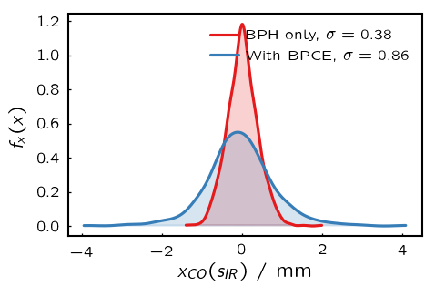
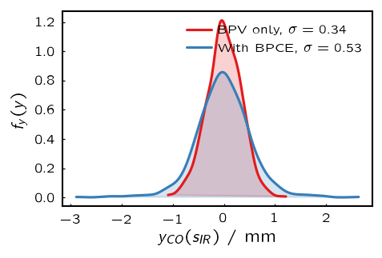
Phase 1, resonance finding : beam position
Beam position accuracy is dominated by BPMs and quadrupole misalignment while reproducibility is limited by magnet field an current changes
  Preliminary estimations place the beam position accuracy to ~0.5mm in both planes and its reproducibility to less than ~0.2mm/0.05mm for horizontal and vertical planes.
  Initial resonance finding may require a scan of the ion beam position by up to 2.5mm or 5 steps of 0.5mm in each plane for a total of 25 positions.
Beam position may be changed within 10ms allowing the space to be scanned within 0.25s
Once the maximum overlap position is identified the reproducibility should have a small, but non negligible, effect

Slide 8
Phase 1, resonance finding : ion beam energy
Beam energy accuracy is dominated by the uncertainty on the integrated dipole field along the beam trajectory
  Accounting for ion beam energy accuracy, stability and interaction angle preliminary estimation places the upper bound of the uncertainty at 0.1%
  Reproducibility of the energy should be better than 0.03%, small compared with the laser bandwidth of 0.1%
Energy of the beam may be changed Constant-Optics scaling
  was recently developed for slow extraction and allows energy change independent from beam optics or position
  We consider a scanning of the energy over a range of ±0.1%, in 10 steps
  Each energy step could take 10ms so the complete energy scan may take 0.1s

Slide 9
Phase 1, resonance finding : ion bunch timing
Laser pulse is up to 100ps at 40MHz and Ion bunch is 210ps, at most at 13MHz
  Initial overlap cannot be known but reproducibility should be very good and much lower than the ion bunch length of 210ps
Systematics scanning of the timing will be needed for initial resonance finding
  Specifics and procedure to be discussed as it depends on the approach agreed to synchronize the laser to the ion bunch

Slide 10
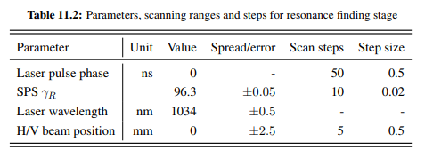
Phase 1, resonance finding : scanning plan
Scanning if 4 dimension
  25 steps in transverse beam position
  10 steps in energy
  For instance 10 steps in timing
  Total of 2500 sets, possibly explored in as little as 25s if we consider 10ms per setting
Cycled operation would make even such large number of machine settings easily explored
  Will require a full automation of the machine setting generation and clean recorded data storage
  Photon detection system capable of measuring ~0.1% of maximum flux within 10ms

Slide 11
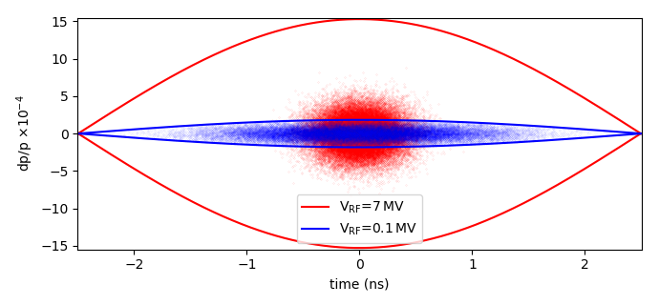
Phase 1, resonance finding : dilution plan
In addition or instead of systematic scanning one could consider beam dilution to achieve the first ion excitation
  In the transverse plane the existing damper could be used to increase the transverse beam size up to the machine acceptance of ~42x18mm at the IR
  In the time dimension, the voltage could be reduced to increase the bunch length up to the bucket length of 5ns
This technique is limited by the
instrumentation, in particular the
photon detection system
  Details and limits will can only be discussed
  once the photon detection system will have been
  decided
Constant emittance

Slide 12
Phase 2 : optimizing the photon flux
Phase 2 aims at optimizing the ion beam excitation and photon production
  To maintain resonant conditions for arbitrary long times
  To reliably reproduce optimum resonant conditions
  To reliably target specific parts of the beam in energy
In practice phase 1 will produce one set of optimum machine settings
  Systematic scanning near this set will provide the optimum machine setting
  Continuous measurement will provide information on stability and reproducibility
Switch to coasting SPS operation
  Do we expect more stability and reproducibility issues ?
  Do we need to consider a live feedback system (on ion momentum, timing and position) to maintain the resonant condition?

Slide 13
Phase 3 : cooling demonstration
Using coasting operation and long flat-top times (~100s)
We could consider using the existing wall current monitor to observe the longitudinal cooling. It has a resolution of 5ps and enough sensitivity to detect the ion beam
Can we consider observing cooling with cycled SPS operation and up to 20/30s flat-top?

Slide 14
Accurate transition energy measurement
The accurate measurement of the resonant energy mainly depend on the understanding of all the systematics influencing the ion beam energy
No specific steps is foreseen but much of the work will be carried on in parallel such as energy calibration using two different partially striped ion species.

Slide 15
Cycled/coasting operation decision tree (disregarding laser considerations)
Phase 3 with cycled SPS
Yes
No need
for feedback
Can cooling be detected within ~30s
Yes
Photon production stable over 30s flat-top operation?
No
Need
feedback
system
Phase 3 needs coasting SPS
No
*Machine parameters cannot be changed in cycled operations

Slide 16
SPS parameters
Continuously updated parameter table available on the SharePoint Workspace
  https://espace.cern.ch/PBC-acc-GammaFactory/default.aspx
  https://espace.cern.ch/PBC-acc-GammaFactory/Documents%20tracked/PoP_parameters_table.xlsx?Web=1
  Version controlled so anyone can change it directly

Slide 17
Conclusion
A path to the PoP experiment is proposed and so far no show-stopper has been identified
  Work on the controls, data logging and operational software can start now for tests after the shutdown, in 2021
Next steps :
  Detailed specifications of the controls and operational software capabilities
  Precisely quantify beam position and energy accuracy and reproducibility. Some measurements with beam can be done in 2021

Slide 18
Thank you

