Slide 1
The MCBC and MCBY LHC magnet consolidation
Daniel Schoerling
Luca Bottura, Francesco Cerutti, Glyn Kirby, Sandrine Le Naour, Alexandre Louzguiti, Daniela Sousa, Sandra Tavares, Jean-Philippe Tock
28 February 2019

Slide 2
Content
Magnets discussed in this presentation and expected radiation load
Radiation testing
Design of MCBC/MCBY
Procurement strategy
New spare magnets, requirements

Slide 3
MCBC and MCBY corrector magnets
MCBC
MCBY

Slide 4

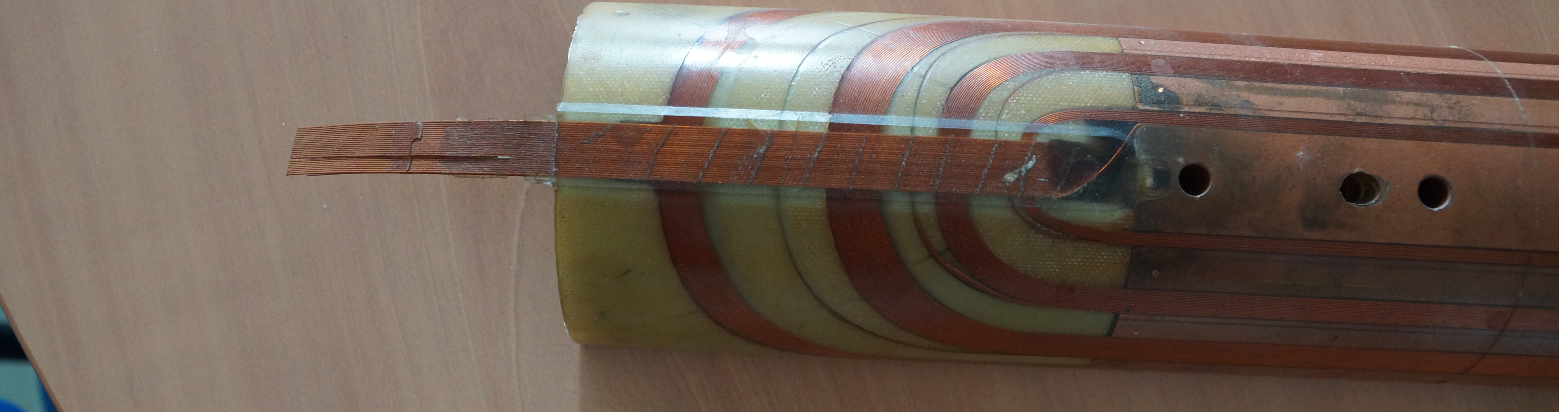
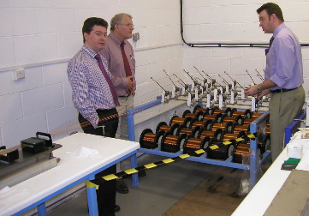
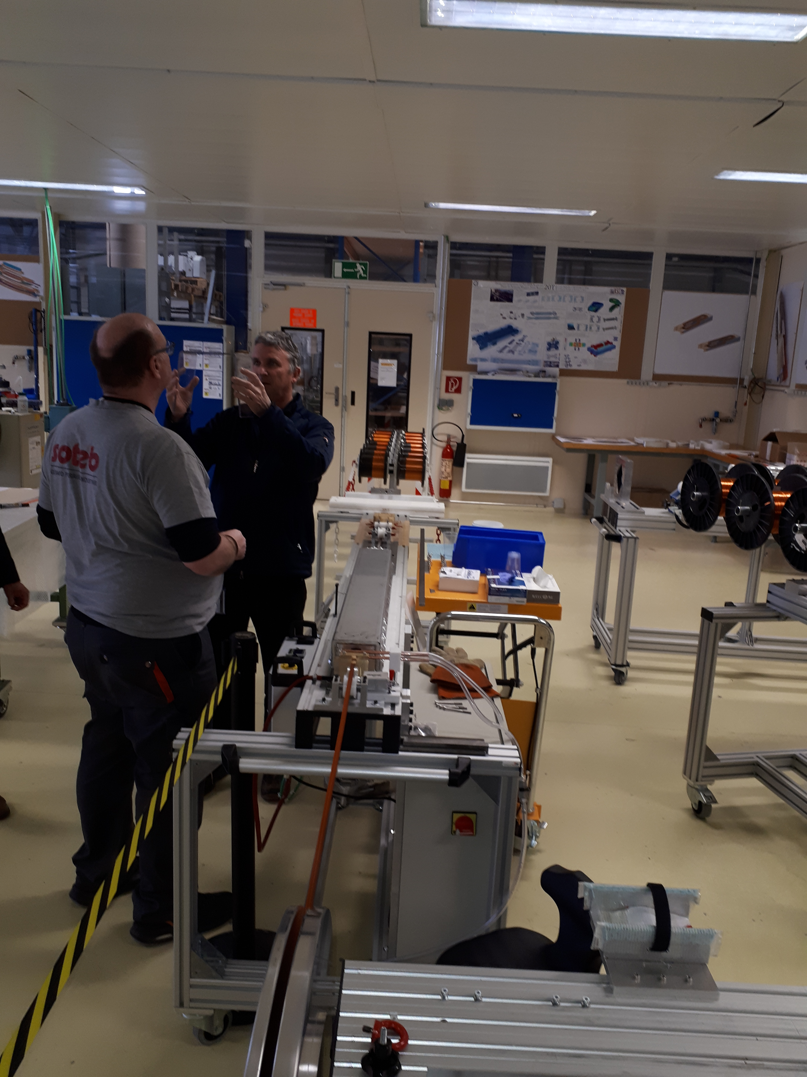
Some words on how they were produced
Round wire was insulated and rolled down to a rectangular wire
Ribbon cable, made with a custom-made machine and epoxy: CY1300 (95 pbw) and DY026 (5 pbw) supplied by Ciba-Geigy Polymers
Coil winding with ribbon cable (cos-theta coils, one layer)
Coil impregnation with Araldite GY 285 (Bisphenol F, 100 pbw) supplied by Ciba-Ceigy, mixed with hardener Texaco D400 (57 pbw)
Assembly of the coil and wrapping with ISOPREG 2704 sheet from Isovolta, curing time 15 h at 120°C. and squeezing out the epoxy to increase the glass fraction within the bandage to approximately 60 % by volume.
Assembly of scissor laminations and Al shrinking cylinder

Slide 5
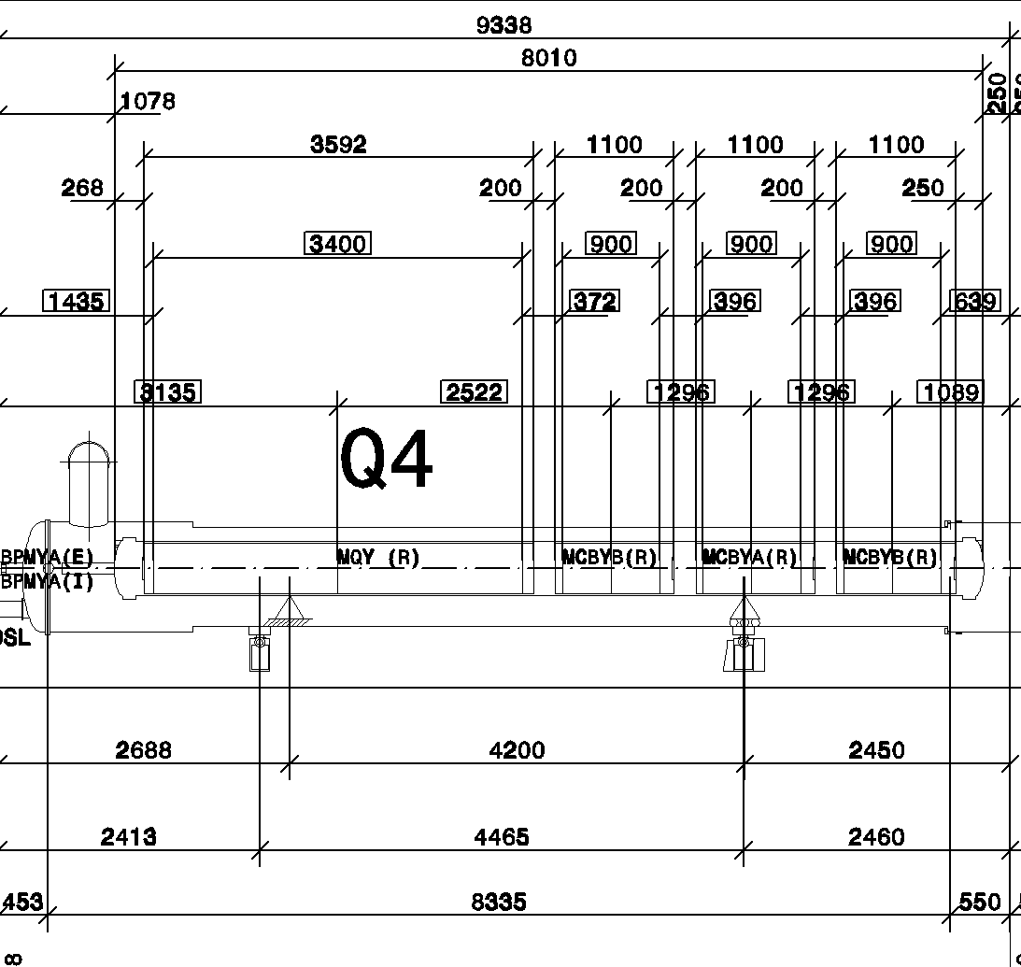
Expected radiation load MCBY
Gamma irradiation foreseen doses
Around 5 MGy after 3300 fb⁻¹
Between 1 and 5 MGy
4 MCBY are currently operated with limited current:
Q4R8 (RCHYH4.R8B1),
Q5R8 (RCBYHS5.B8B1),
Q4L5 (RCBYS4.L5B1),
Q5L4 (RCBYS.L5B1).

Slide 6
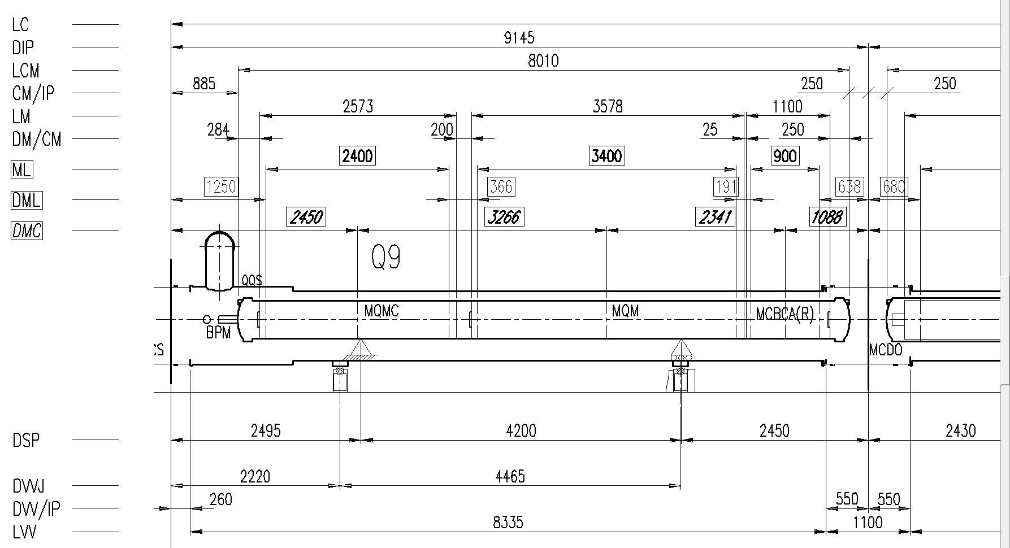
Expected radiation load MCBC

Slide 7
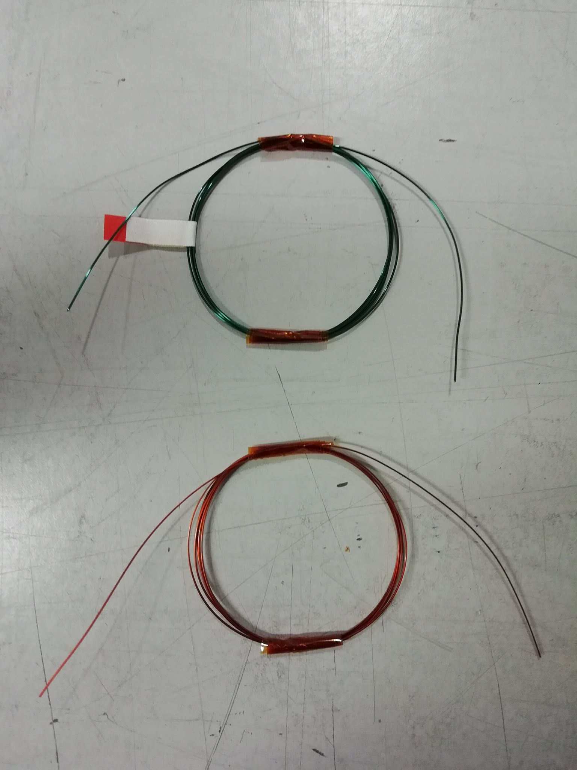
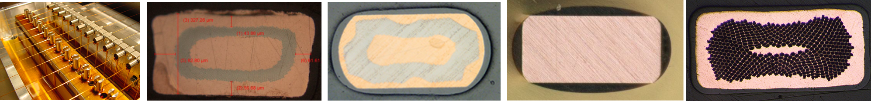
Breakdown voltage of gamma irradiated strands
Strands have been irradiated with gamma rays up to 5 MGy at BGS / Fraunhofer INT facility (DE)
  Samples = 1m of strand spooled in several turns of 5 cm-diameter
  Samples gamma irradiated in several steps (0, 1, 2.5 and 5 MGy), 3 samples per step
  Breakdown voltage of the samples was measured in water (all samples were successfully tested with 1 kV before irradiation)
LHC wire was produced by applying the insulation on a round wire and then rolling it with a 4-roller process to the final rectangular shape
Different wire insulation schemes are currently under test, only few companies could be identified which produce this very small rectangular wire (out of standard)
Nb-Ti is sensitive to temperature (curing temperature are typically higher than degradation limit)
Polyvinyl Acetal (PVA) enamel
super-PI enamel (a polyimide)

Slide 8
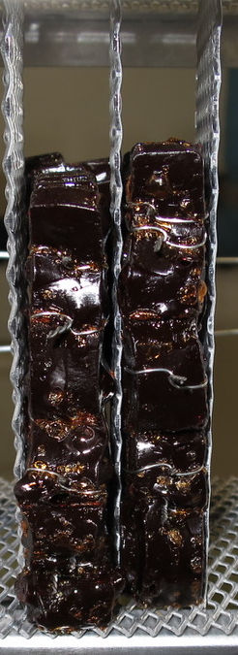
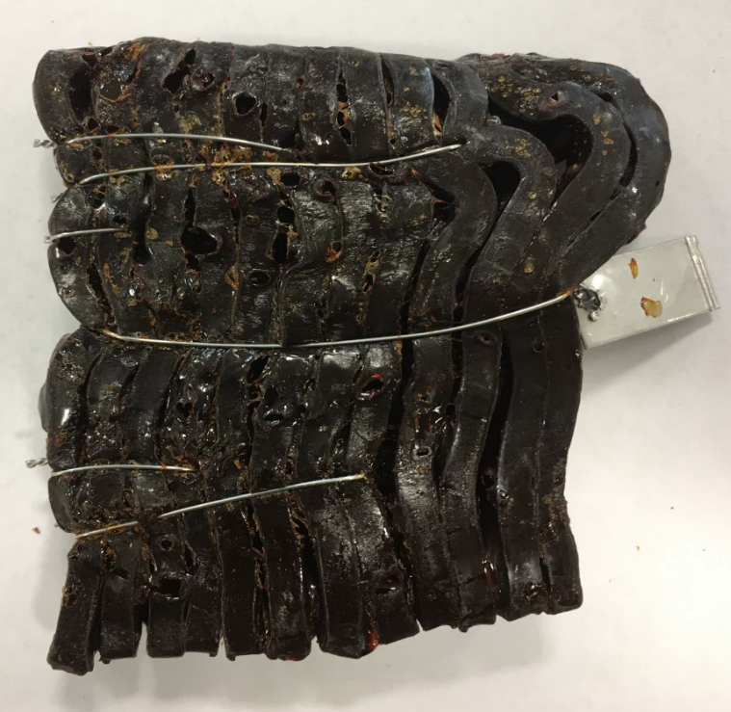
Plans for insulation system selection
Albert Ijspeert remembered that at the time of LHC construction one magnet with the same technology was irradiated, but never tested. Today, it is hard to reproduce samples with the same characteristics
4 insulation systems to be selected: Enamel insulation, epoxy for Ribbon production, epoxy for impregnation and epoxy/pre-preg for assembly of coils: For each system 2-3 options have been identified by TE-MSC
Testing (mechanical, dielectric depending on requirements) of each option is foreseen (0, 2.5 5, 10 MGy)
Additional testing under vacuum and different temperatures (4 K, ~70 K, ~300 K) is under discussion with TE-MPE
Combined test of enamel insulation with epoxies is foreseen to exclude negative effects from epoxy on enamel
Conclusion: With the available information, one has to assume that the MCBC/MCBY withstand 1 but not 2.5 MGy.
Courtesy of Sandra Tavares and Daniela Sousa
Araldite F + Jeffamine D400 after 20 MGy (different epoxy but similar hardener)

Slide 9
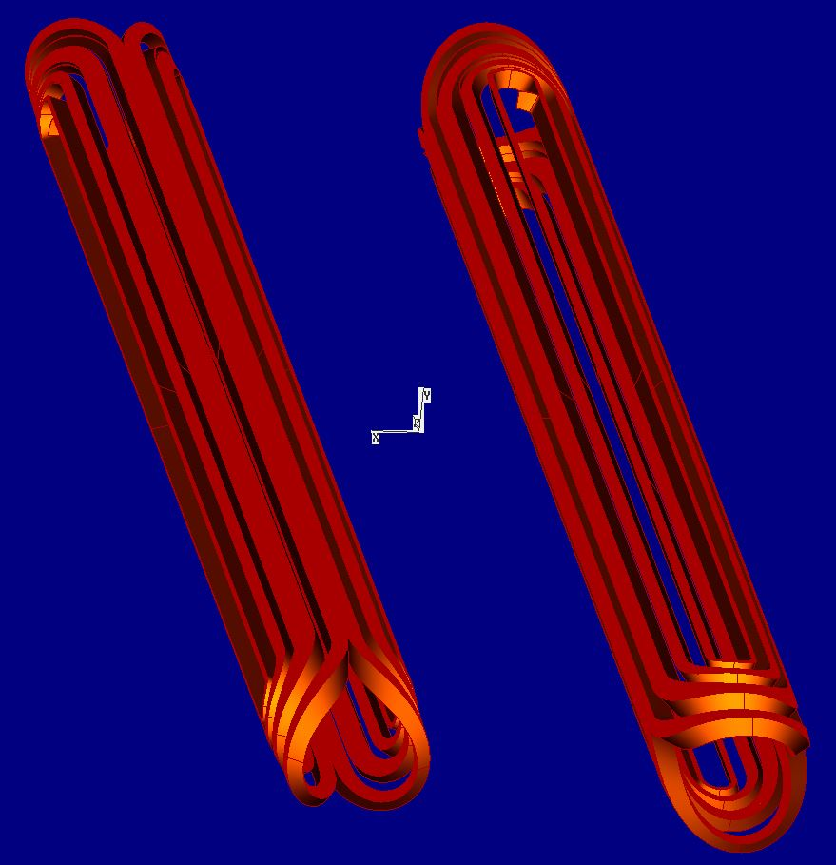
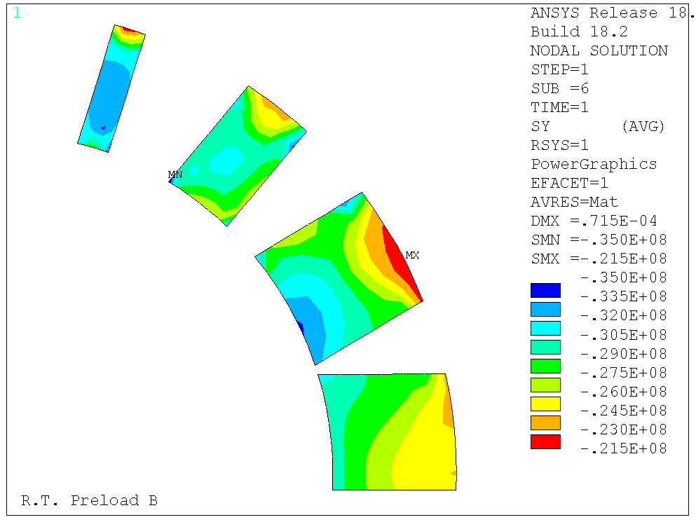
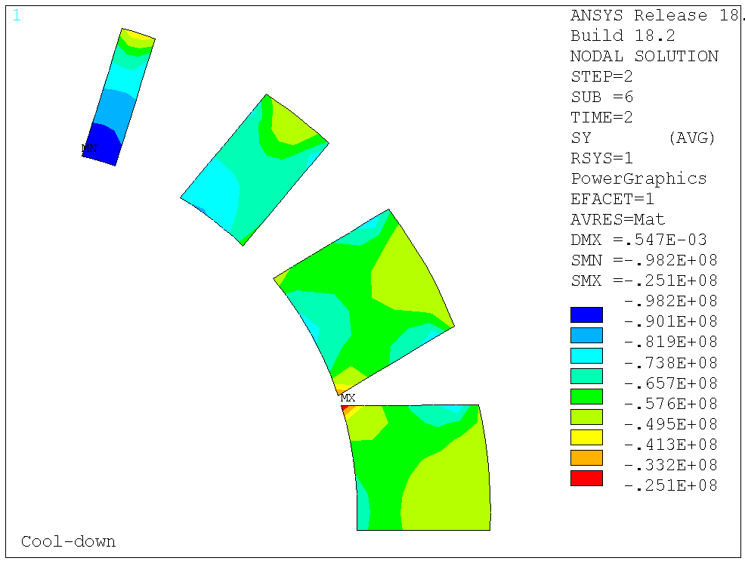
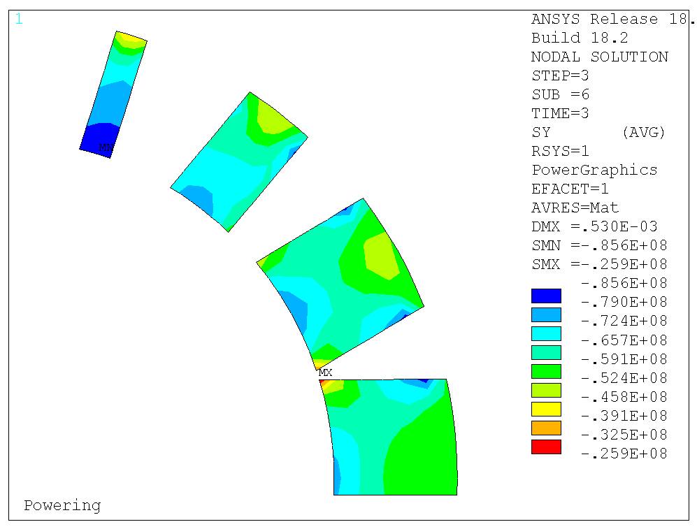
Status of MCBC/Y design
Original drawings do not follow new ISO standard: Therefore it was decided to re-do the drawings, ongoing
Different versions of end spacer designs have been found -> not clear which one is the file used for the construction of the magnets
  3D Roxie re-done (now with differential geometry)
  Mechanical 2D ANSYS model redone
Technical specification is available (update for radiation hardness
and scope required)

Slide 10
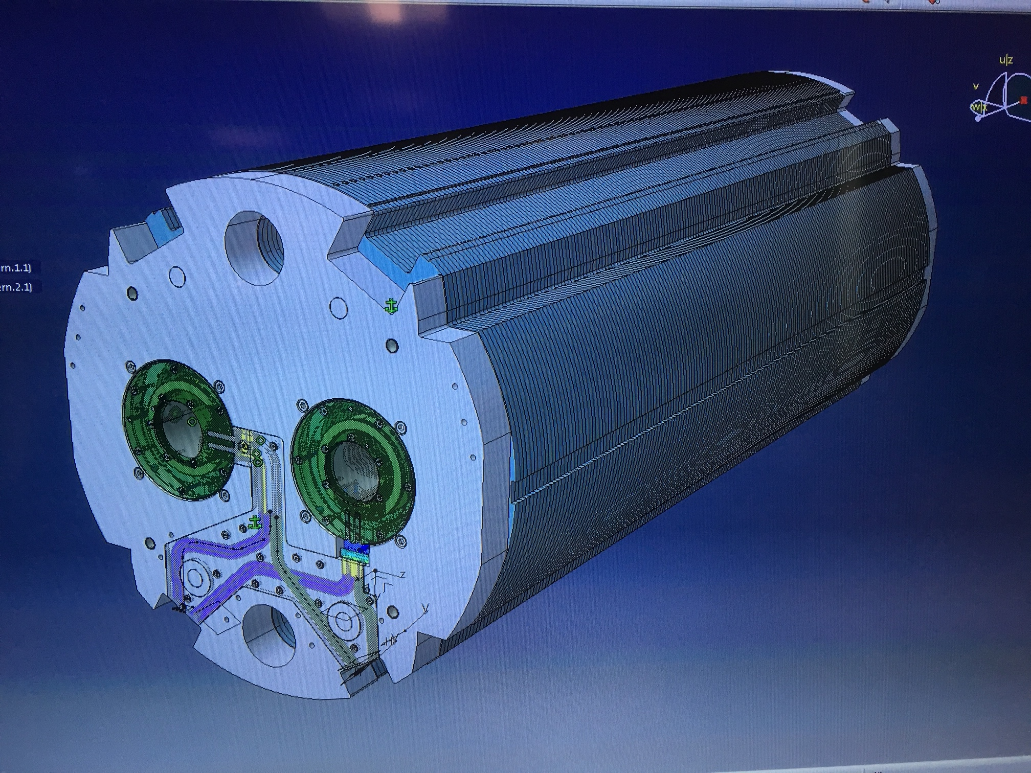
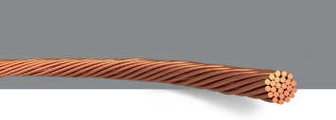
Procurement strategy: Is CCT an option?
The use of magnets of the CCT design is under discussion. Many turns to keep the nominal current ~100 A. Also the conceptual design would likely require energy extraction for protection. Current CCT design has a nominal current of 450 A.
University of Uppsala has expressed their interest in exploring the CCT option in detail taking into account the specific requirements for these spare magnets in terms of operating current and protection. The CCT may promise an efficient and cheaper production for a small series of magnets compared to the cos-θ, as it requires less tooling
One possibility would be using a rope conductor with small insulated wires ∅0.3 mm (open questions: detailed design, production, protection, etc.)
The results of this study would become available earliest 2022, in case funding is made available (answer to funding request is expected latest in December 2019)
Elektroisola

Slide 11
New spare magnets, scope and requirements
Other alternatives should be studied and further testing could be beneficial
We propose to procure only MCBY magnets, as they have similar parameters, except for the aperture, which is larger:
  MCBC can be replaced with MCBY + shielding → one order of magnitude smaller radiation load expected on the magnet
  Only one type of magnet to be procured → cost benefit
  Integration study on-going: no showstopper expected
  Power converter and power circuit seems compatible, but final confirmation pending from TE/EPC
Spare MCBY magnets to be procured should be radiation resistant up to ~10 MGy
  Polyimide enamel insulation
  Epoxy selection to be evaluated
33(+2) MCBY magnets might need to be changed (2 in LS3, 8 in LS4 (tbd), etc.) depending on the outcome of the discussions and further testing

