Slide 1
Experimental Area Beam Intercepting Devices –
Motion control and actuation
Mark Butcher and Mario Di Castro for EN/SMM
15/03/2019

Slide 2
Introduction
EN-SMM responsible for the motion control systems of the motorised Beam Intercepting Devices (BIDs) in the North and East areas
EN/EA or EN/STI are responsible for the mechanics depending on device

Slide 3
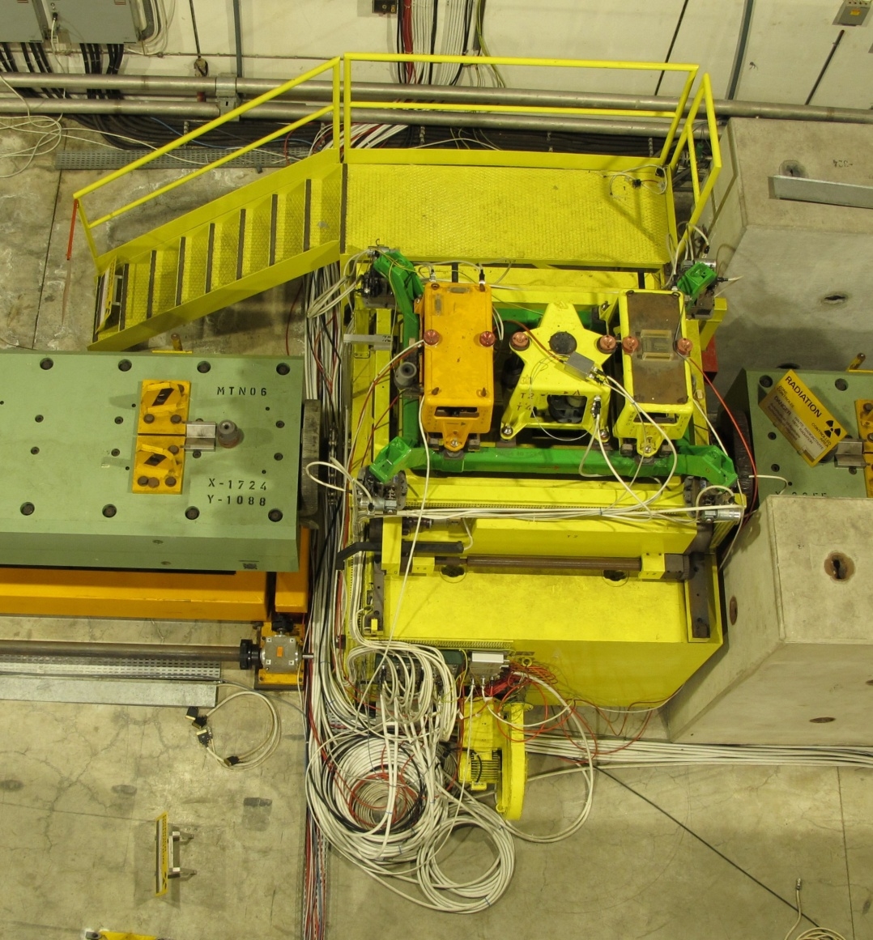
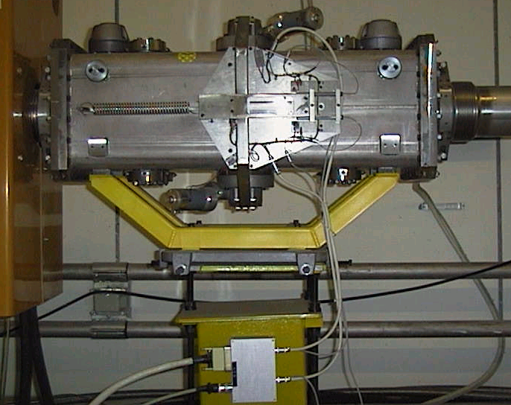
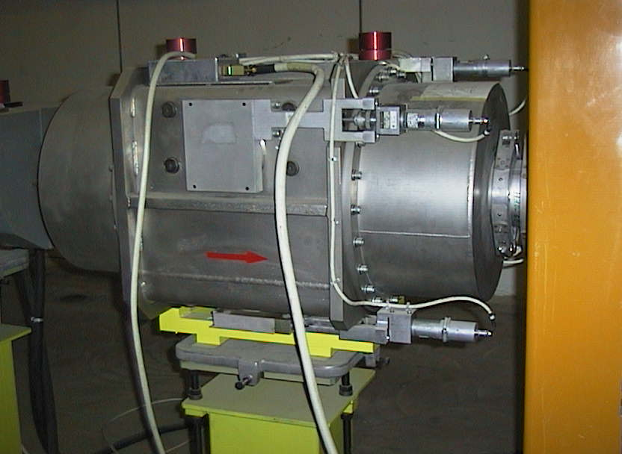
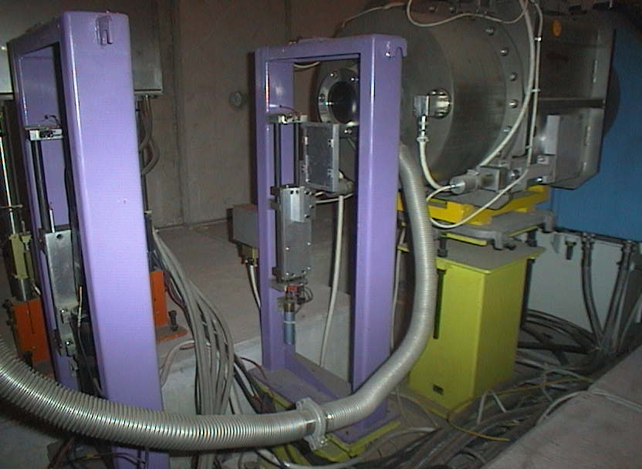
Devices
XCSH/V
NA Targets
XCON
XCHV

Slide 4
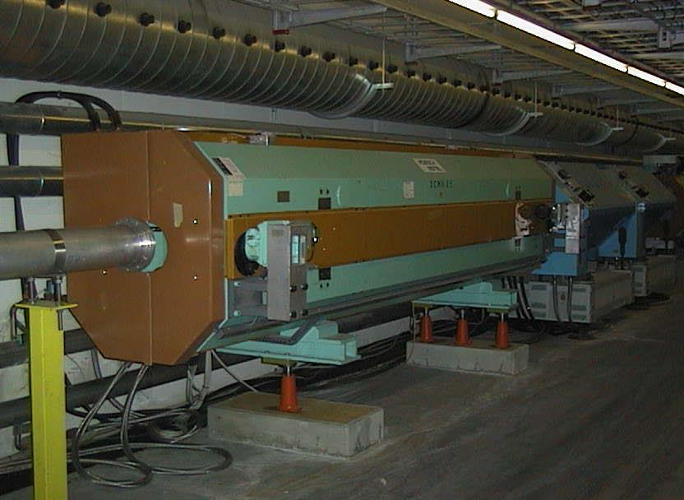
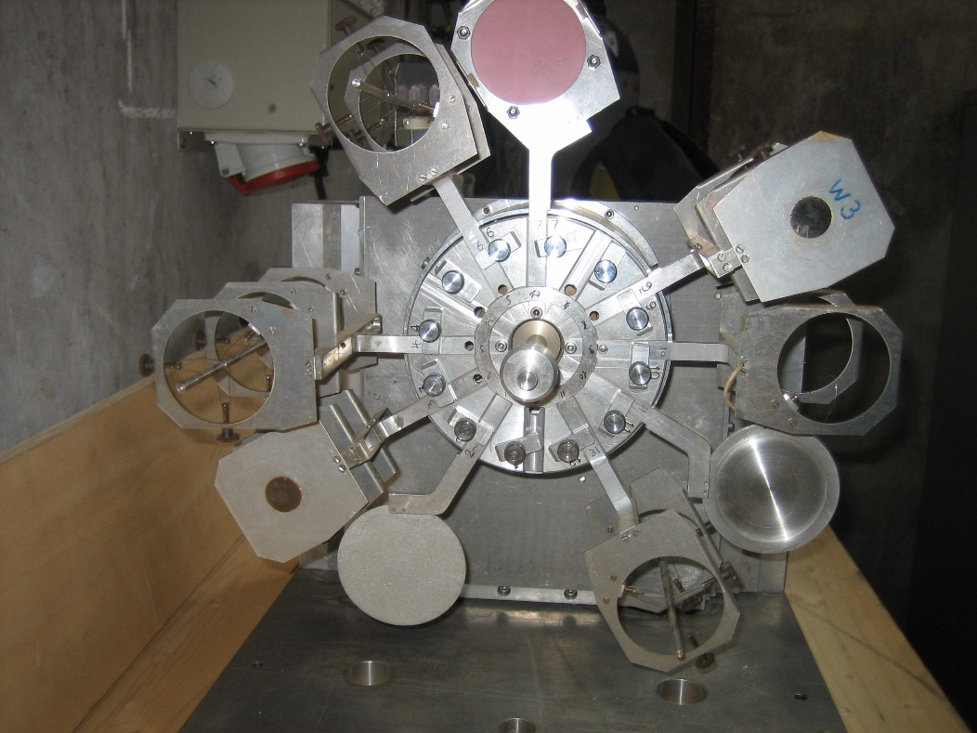
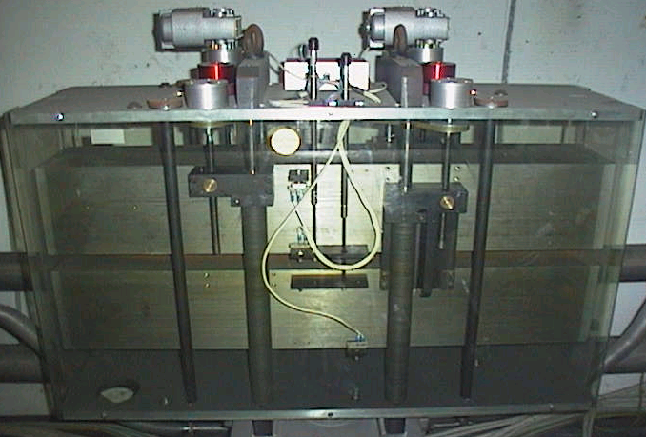
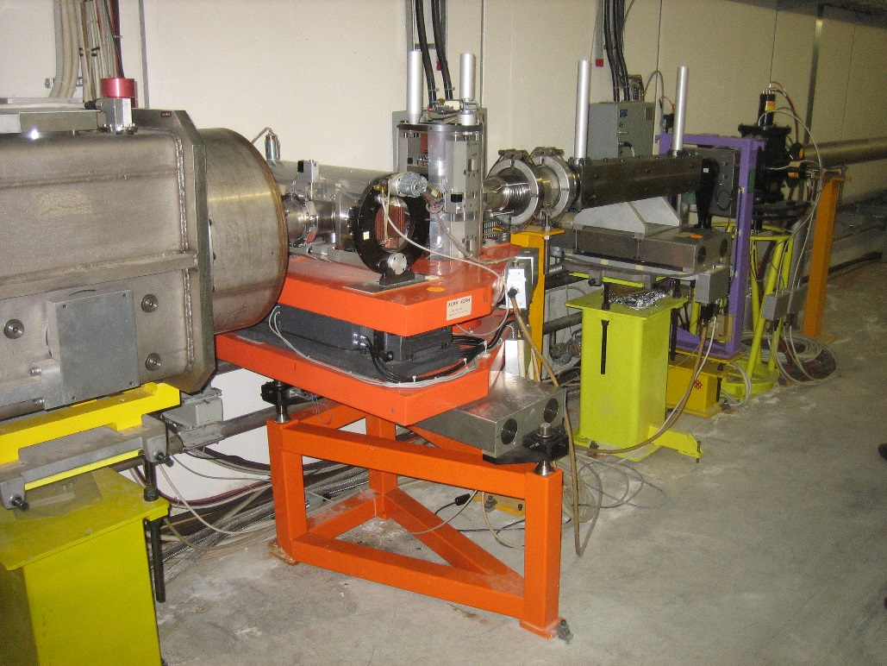
Devices
XCMH/V
MultiTarget
XCBV
Microcollimator

Slide 5
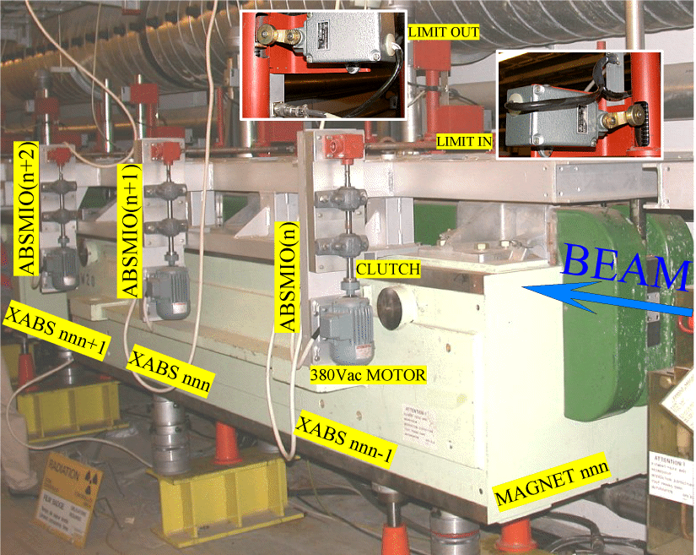
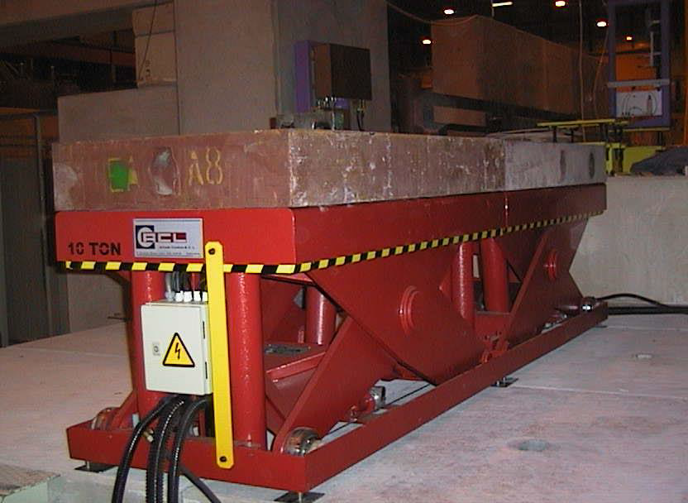
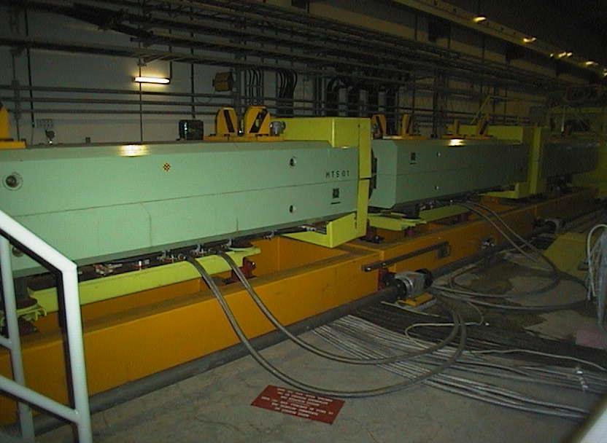
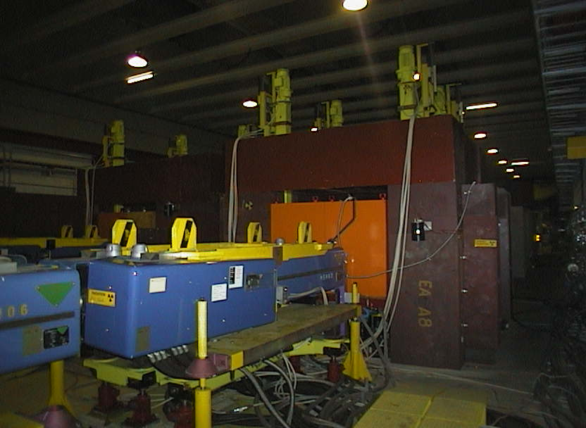
Devices
XABS
XTDV
XSPL
XTAX

Slide 6
North Area
>110 Devices in the North Area Complex
  15 ‘XTAX-type’ Large AC Motor (2-4 kW) devices
    15 motorised axes
  20 Smaller AC Motor (≈ 0.2 kW) devices
    50 motorised axes
  65 Brushed DC Motor devices
    155 motorised axes
  Others
    6 XTDVs
    Micro-collimator
    1 Dump Control
    1 XTAX Cooling Monitoring
  4 Target stations (3 main axes each)
All consolidated since 2008

Slide 7
East Area
9 Brushed DC motor devices (XCON and XCHV)
  30 motorised axes
2 MultiTargets (designed by EN/STI)
To be consolidated during LS2.

Slide 8
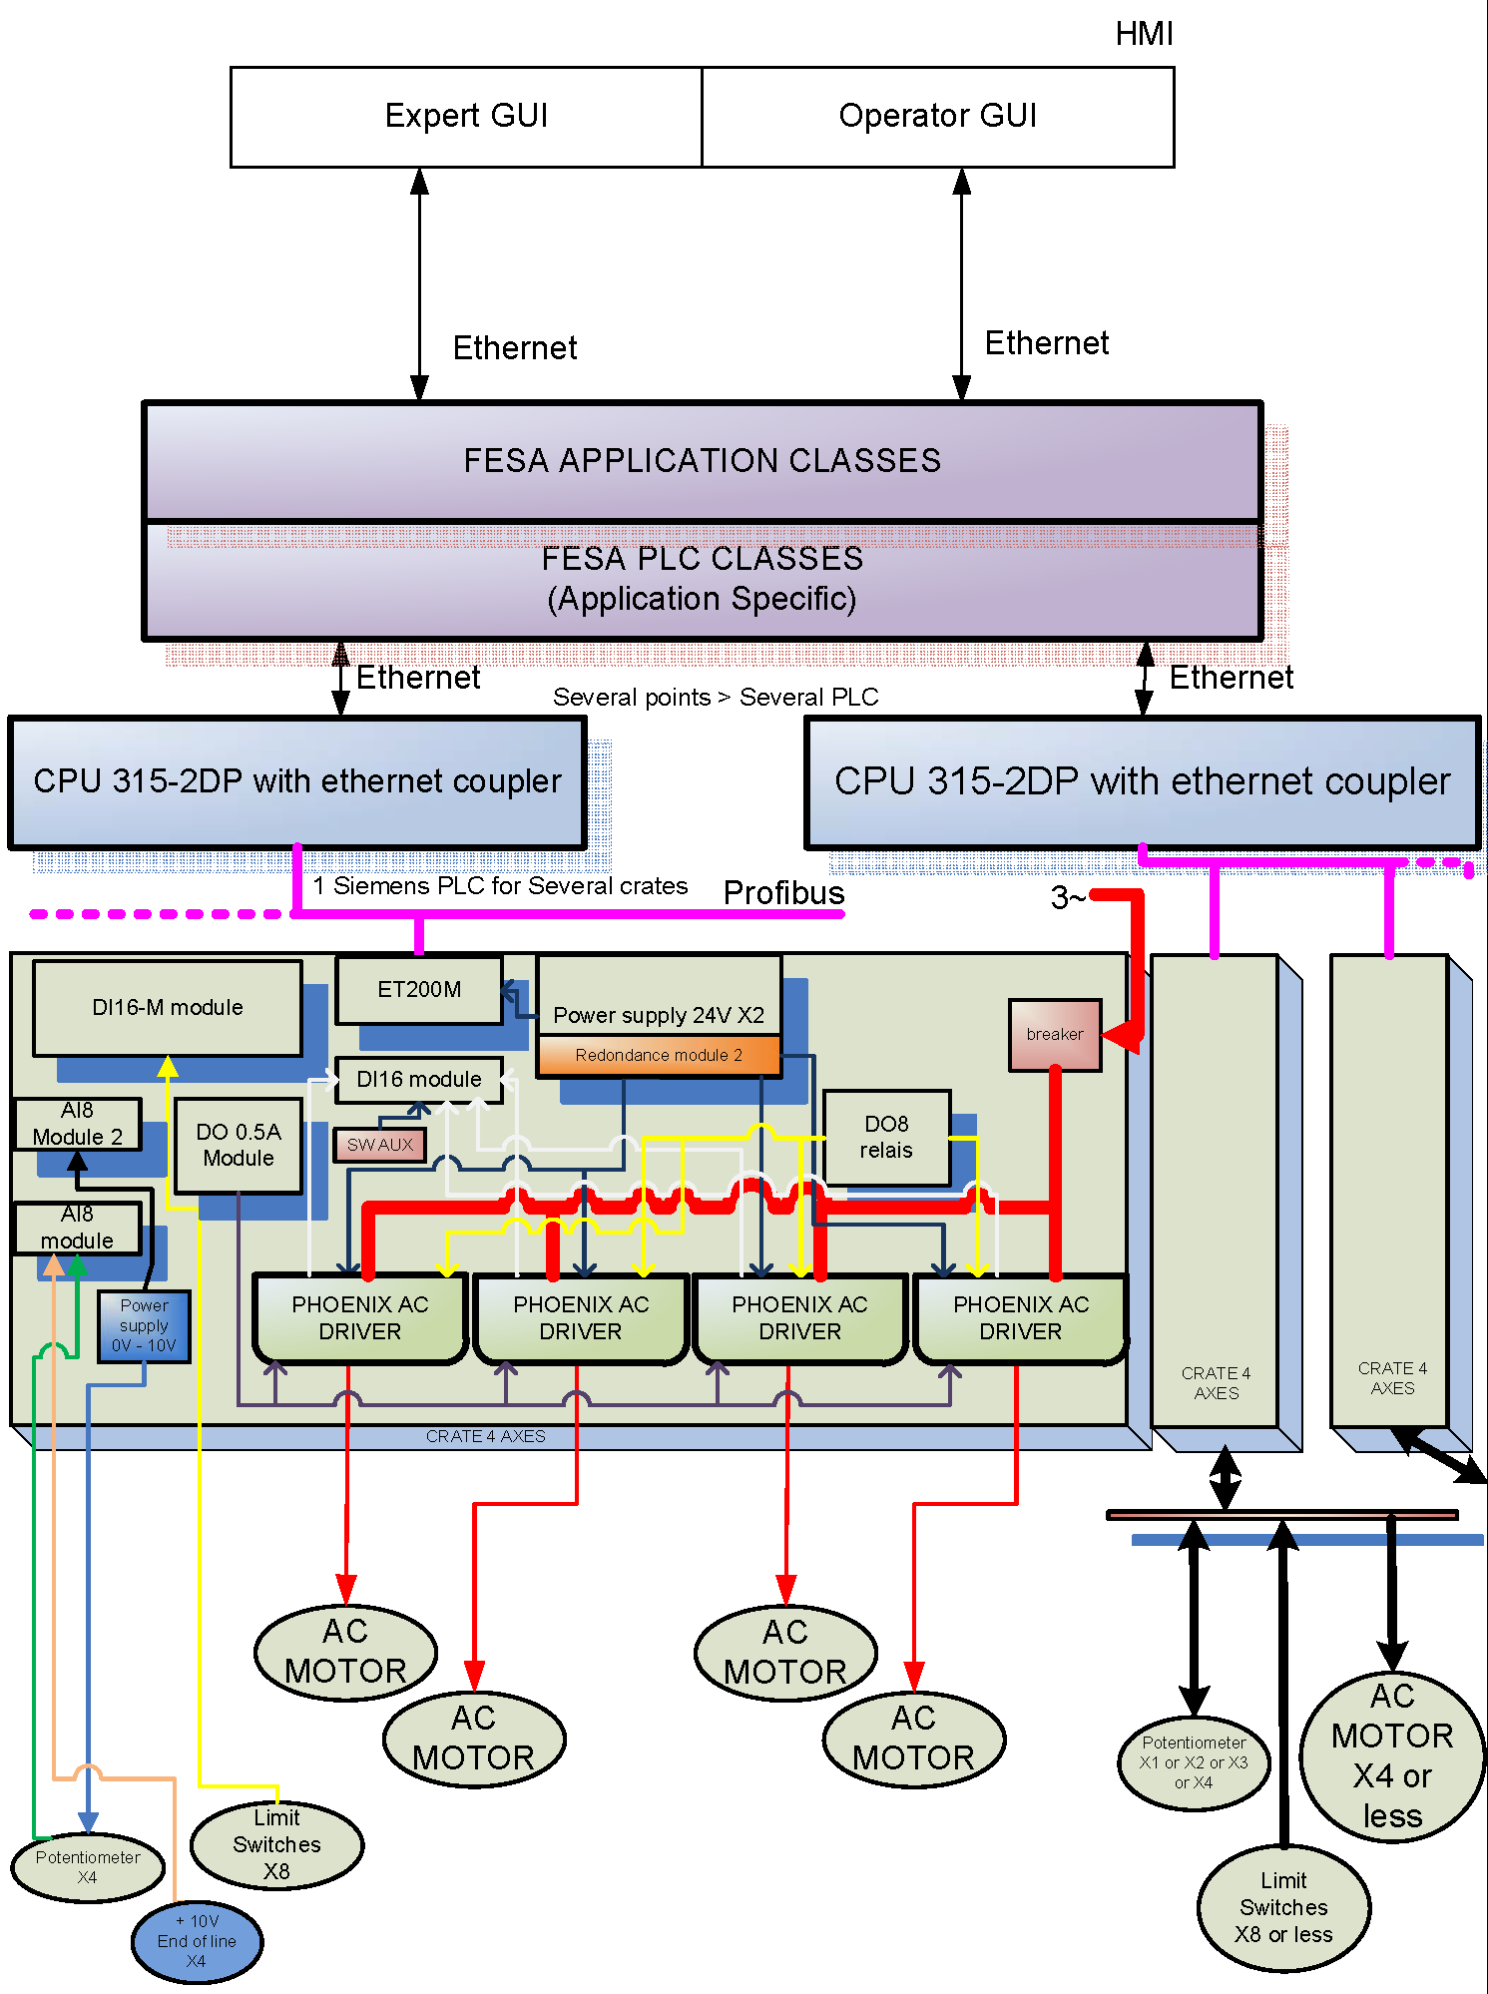
Typical Control Architecture
Control system:
Low-level real-time either:
  Siemens PLC
  National Instruments PXI
High-level communication level:
  FESA class
Actuators:
  AC, DC and Stepper motors
Position sensors:
  Potentiometers
  Resolvers
  LVDTs (like LHC Collimators)
Features:
Positioning precision of +/-100µm
Remote diagnostics
Full remote control
Alarms
Logging to CALS

Slide 9
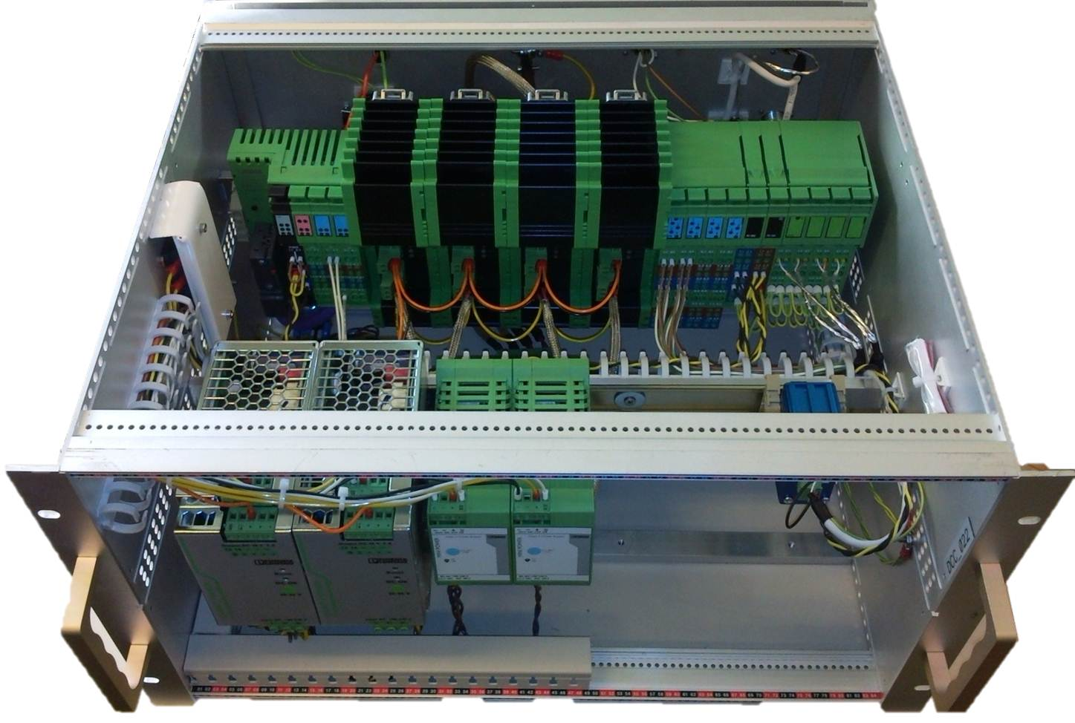
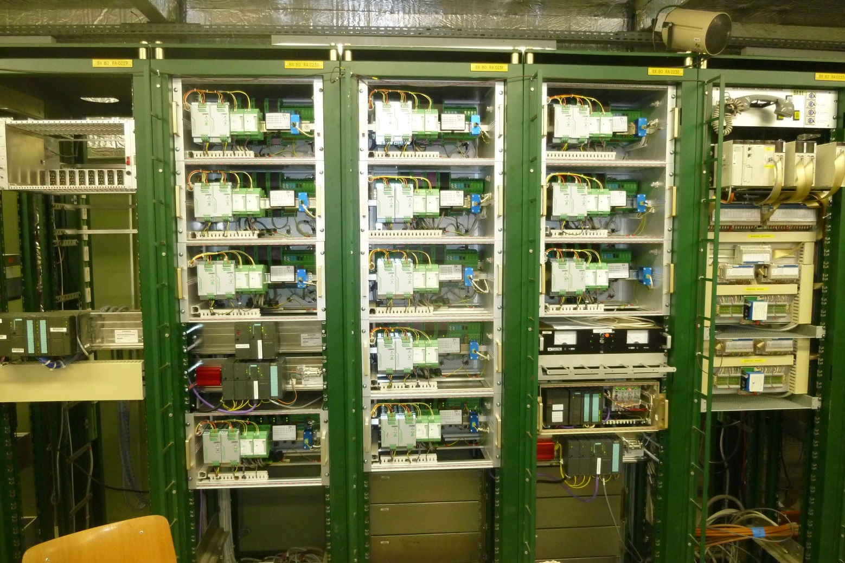
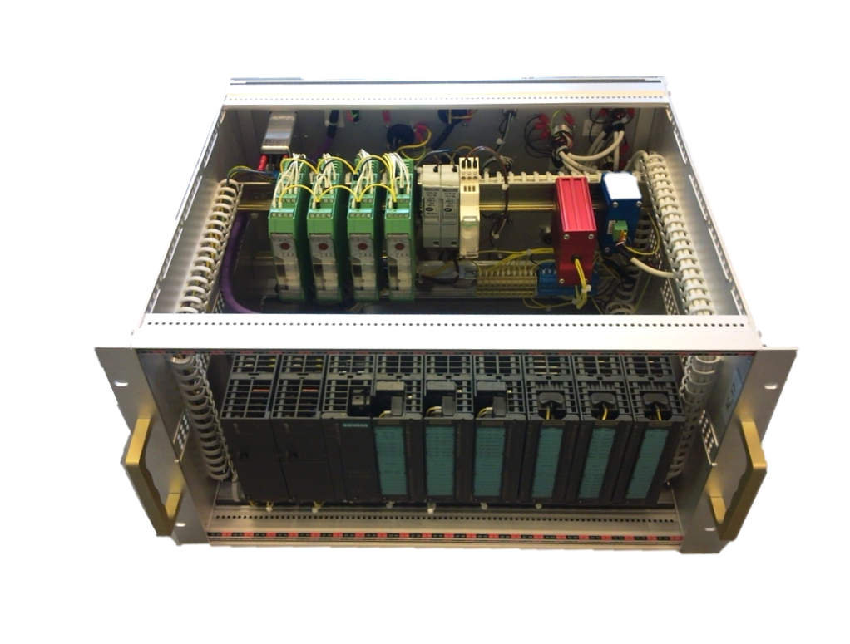
Typical North Area Control Racks
Control systems of DC devices in TT81 and TT82
Racks RA0230 to RA0233

Slide 10
Status
North Area
  Majority of devices already consolidated, annually maintained and supported by EN/SMM piquet✔
  Spare levels at 25% ✔
  During LS2:
    Investigate target LVDT interference
    Microcollimator to be consolidated in 2020 to use same control architecture as other NA devices
    XTAX (P4 TAX 043.018/20 and P6 TAX 062.052/54) will be modified to be compatible with the new access system

Slide 11
Status
East Area:
  XCHV, XCON control system to be consolidated during LS2 to have similar architecture to North Area
  2 new MultiTargets will be built (by EN/STI) and installed during LS2 and the control system consolidated.
  Planning coordinated with the East Area consolidation project organisation.

Slide 12
Thank you!

