Slide 1
Resources for urgent actions by BE-BI
J. Tan, I. Ortega, F. Roncarolo, L. Jensen
with the input of our BE and EN colleagues
March 15th 2019
EA-BI-WG

Slide 2
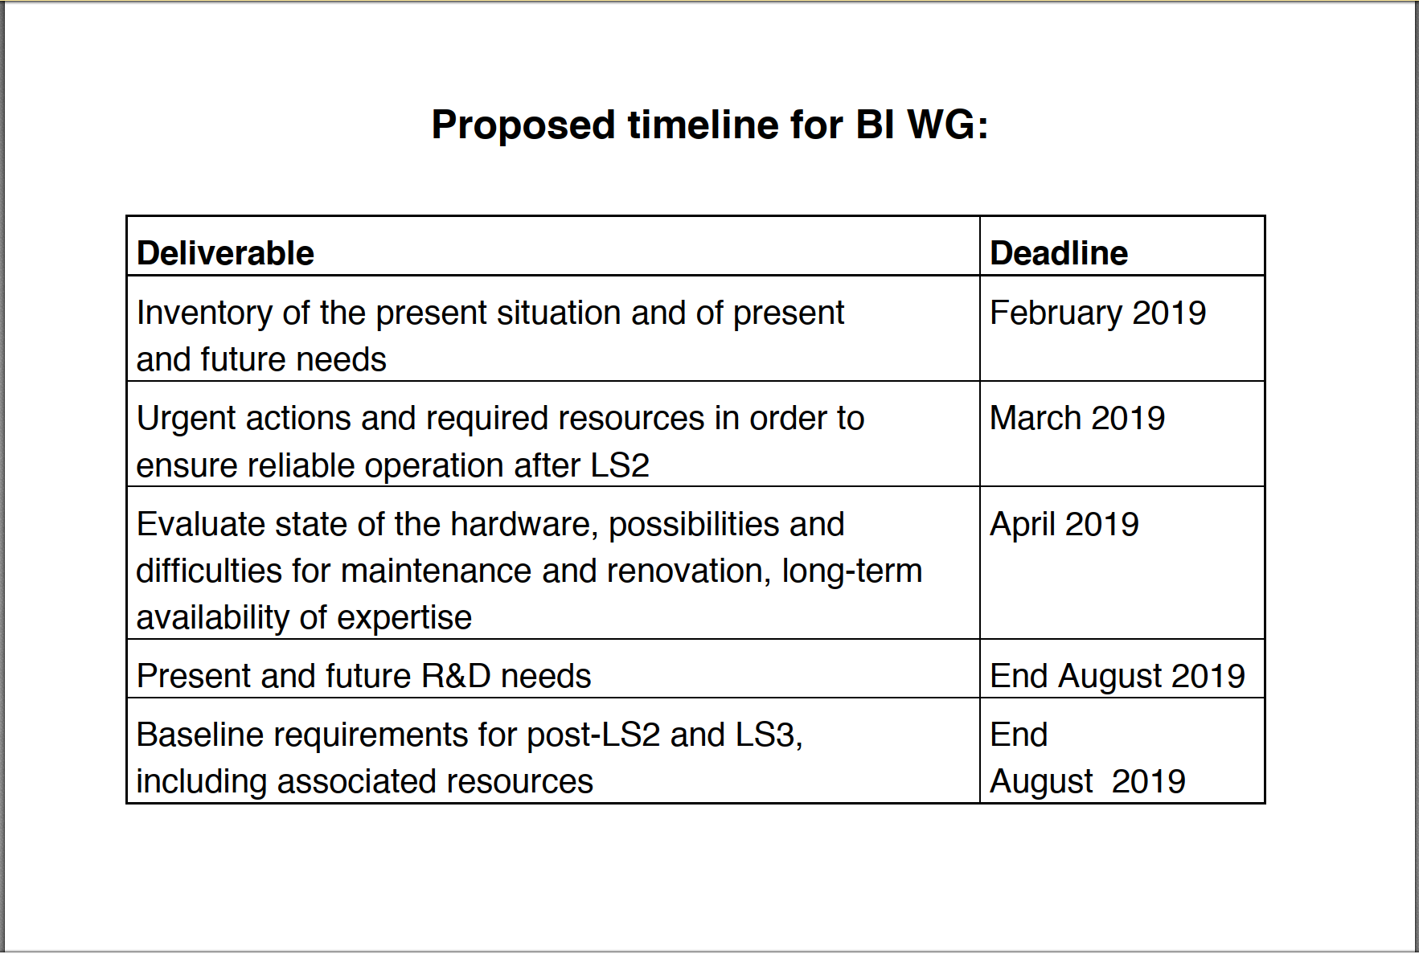
Courtesy L. Gatignon

Slide 3
Outline
East Area
North Area
Transfer lines of AD and ELENA

Slide 4
Urgent actions for East Area
Instruments | Actions for LS2 : BI-EA | BI Resources
XBPF | production, readiness for post LS2 start-up | BI WP in EA Cons. : 60kCHF I.Ortega Ruiz
XCET | control board for relays, production, readiness for post LS2 start-up | BI WP in EA Cons. : 8kCHF J.Tan, S.Deschamps, W.Devauchelle
XION, XWCA, XSCI | check status, readiness for post LS2 start-up | J.Tan, S.Deschamps, W.Devauchelle
Instruments | Actions for LS2 : EN-EA | EN-EA Resources
BLMs for F61, F62, T08 | 6 units (+1 optional for F63) | New cost estimate being defined
BLMs instead of Telescope | 8 units

Slide 5
Urgent actions for LSS2 and SPS Primary lines
System | Comments | BI Proposals for LS2 | BI Resources
Calibration of BSI (SEM-foils) for intensity | No online calibration system (theoretical values) Surface effects observed (conditioning) | Analyse data stored during 2018 run PhD student to start during 2019 | Federico Roncarolo / Lars Jensen New student to be selected
Servo-spill (intensity with BSI) | EPC takes over feed-forward (n*50Hz) | New acquisition system in BA2 (proposed sampling frequency 100kHz) | Ewald Effinger Lars Jensen
Intensity (PMT) | Existing BTV tank in TT20 | Check screens and PMT during LS2 Look into acquisition system | Stephane Burger / Enrico Bravin
BLM, SEM, BTV | Existing systems in TDC2 | Replace cables for LS2+ -> LS3 running | Stephane Burger Michel Duraffourg Ewald Effinger
Beam position (LSS2) | Non-linear correction (50+ mm) for bunched beams Interlock (dump) | Apply correction (software) Interlock specifications pending | Andrea Boccardi / Athanasios Topaloudis Kevin Shing Li (OP) / Francesco Velotti (OP)
Software | Settings per SPS user | Actively look at what is required | Verena Kain OP / Matthew Fraser ABT
Cherenkov bar | Fast longitudinal Spill aqn. | Exploring / prepare to test the OTR screen + PMT in TT20 Exploring the possibility to optimize the Cherenkov bar read-out electronics for further tests after LS2 | See Intensity (PMT) above Federico Roncarolo with EN-STI

Slide 6
Urgent actions for North Area
System | Actions for LS2 : BI-EA | BI Resources
XION, XDWC, XWCA, XWCM, XSCI | check status, calibration factors, readiness for post LS2 start-up | J. Tan, S. Deschamps, W. Devauchelle Budget being assessed.

Slide 7
AD & ELENA : Profile measurement
Instruments | Actions for LS2 : BI-EA | BI Resources
SEM (Hori detector) | readiness for post LS2 start-up | J. Cenede + new electronic engineer + new software staff

