Slide 1
Iteration on fast spill detector
Inaki Ortega on behalf of BE-BI

Slide 2
Francesca Addesa’s presentation on a Fast Spill Detector brought up a device that BE-BI already has in TT20 for a similar purpose -> the Fast Servo Spill

Slide 3
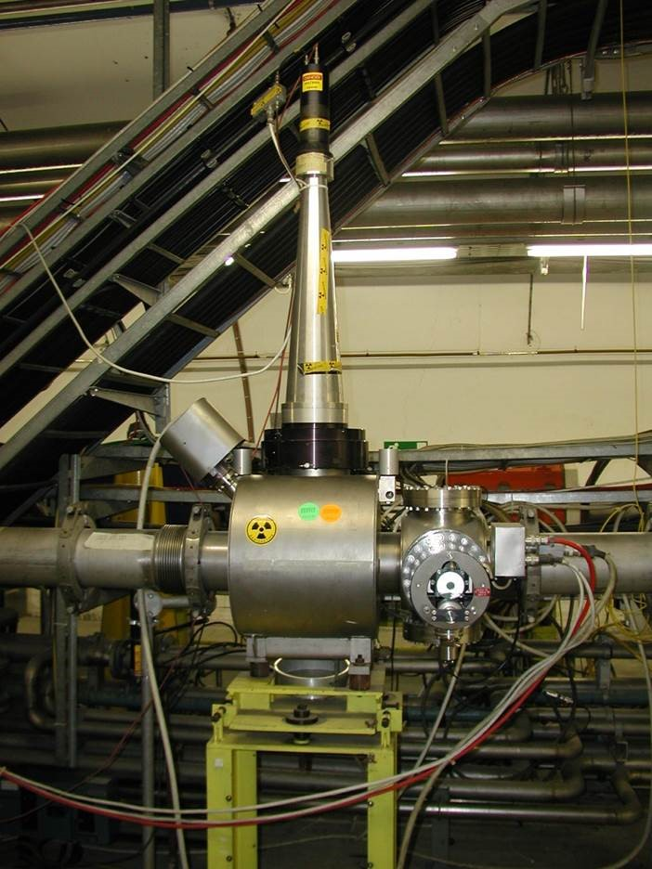

Slide 4
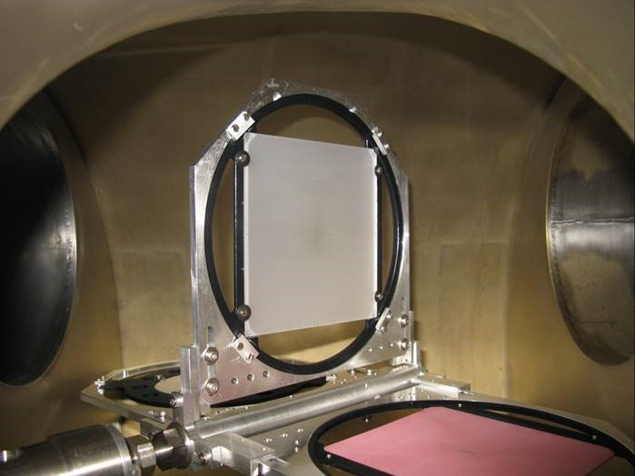
Screens of BTV-210212 used for the Fast Servo Spill
Position 0: out
Position 1: Alumine (1ms)
Position 2: Quartz (20ns)
Position 3: CSI (1ms)

Slide 5
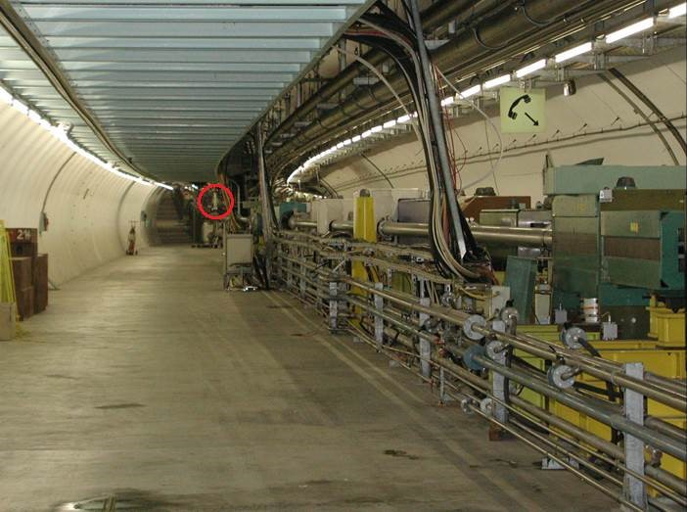
Not far from Francesca Addesa’s Cherenkov bar

Slide 6
The last check was done by E. Effinger during 2012’s TS under request (of BE-OP?) – this is the only and last recorded request for the Fast Servo Spill.
Things done:
- Verified status of the cone.
- Checked HV and signal cables.
- PMT signal connected to a scope – test measurement on the 10 of January 2013.

Slide 7
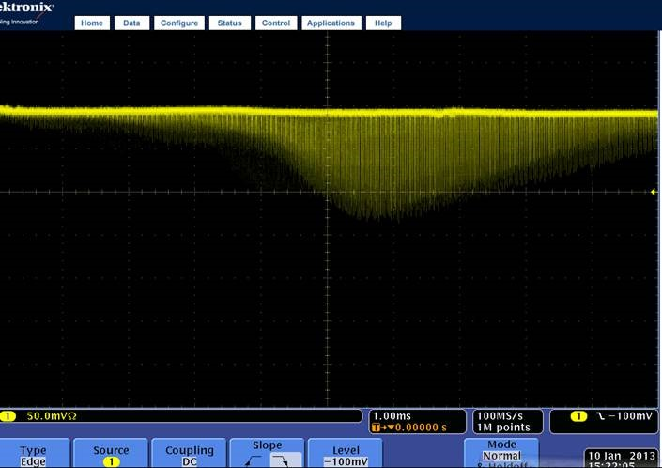
Same signal, different time scales

Slide 8
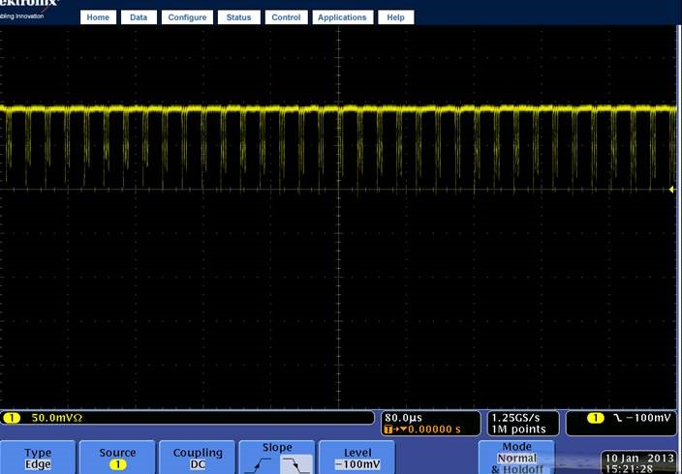

Slide 9
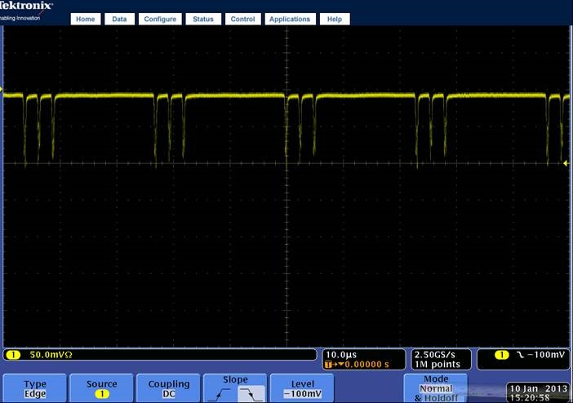

Slide 10
What next?
An OTR screen would be faster than a Cherenkov radiator – would the detection efficiency be enough to reach the specification of 200 MHz?
  BE-BI has agreed to do a calculation to estimate the number of photons recovered from an OTR screen.
Converge towards device specifications:
  200 MHz for standard operation – 400 MHz would allow to see the harmonics.
  BDF – 1 GHz??
Investigate faster PMTs?
Investigate other geometries to get a full beam coverage
  Bars?
  Fibre grid?
Test with present systems after LS2
  Francesca’s device
  Fast Servo Spill with improved readout and possibly an OTR screen.

