Slide 1

III NICA DAYS 2019, International scientific and engineering conference associated with the IVth MPD Collaboration Meeting and V Slow Control, 21 -25 October 2019 hosted by Warsaw University of Technology.
Average high energy neutron flux distribution in the Quinta sub-critical assembly irradiated with proton beam of 0.66 GeV energy applying the actinide spectral index method.
Marcin Szuta¹V.A. Voronko², V.V. Sotnikov², A.A. Zhadan²,
E. Strugalska-Gola¹, M. Bielewicz^{1,3}
1. National Centre for Nuclear Research, 05-400 Otwock-Świerk, Poland
2. National Science Center “Kharkov Institute of Physics and Technology”, Kharkov, Ukraine;
3. Joint Institute for Nuclear Research, 141980 Dubna, Russia
1

Slide 2
Average high energy neutron flux distribution in the Quinta sub-critical assembly irradiated with proton beam of 0.66 GeV energy applying the actinide spectral index method.
Outline
1. Introduction
1.1. Fast neutron fluency measurement methods.
1.2. Metallic natural uranium as activation detector foil.
2. Experimental part.
2.1. Subcritical assembly Quinta
2.2. Location of activation detector foils in the Quinta sub-critical assembly.
2.3. Measurement.
2.3.1. Irradiation details.
2.3.2. Results
3. Comparison of current and earlier neutron fluencies evaluation.
4. Conclusions
5. References
2

Slide 3
1. Introduction
1.1. Fast neutron fluency measurement methods.
The fast neutron fluence measurement method consists in utilizing neutron irradiated actinide samples for estimating neutron fluence and average neutron energy inside the volume of samples.
The idea of the actinide spectral index method is to search the neutron energy (E_{d}) for the ratio (α(E_{d})) of fission cross section (σ_{f}(E_{d})) to capture cross section (σ_{c}(E_{d})) of the selected actinide isotope from the nuclear data base that is equal to the measured ratio (α_{m}) of fissioned (N_{yf}) and captured (N_{yc}) actinide isotopes (spectral indexes) [1, 2]:

Slide 4
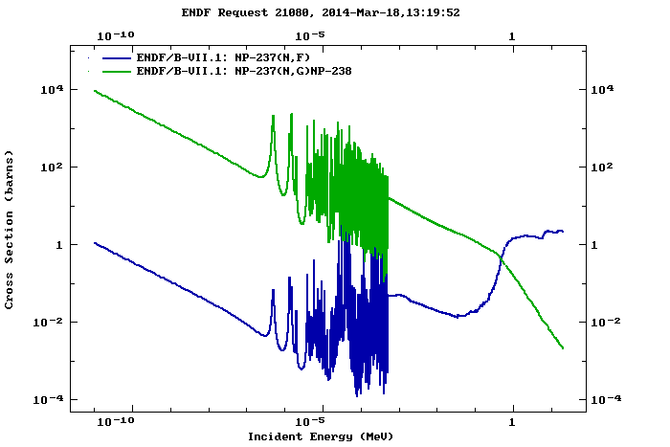
1. Introduction
1.1. Fast neutron fluency measurement methods.
It is useful to look closely at the ratios α = σ_{f} / σ_{c} of the capture and fission cross section of the Np.-237 isotope.
The fission/absorption ratios are consistently higher for the fast-neutron spectrum. Thus, in a fast spectrum, actinides are preferentially fissioned, not transmuted into higher actinides.
Fig. 1a. Cross-sections of Np-237(n,g)Np-238 and Np-237(n,f) reactions.

Slide 5
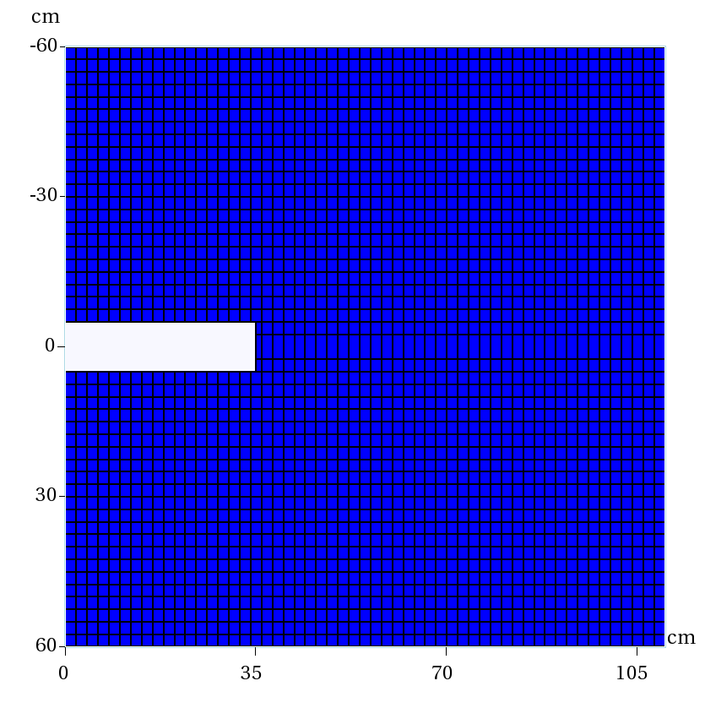
1. Introduction
1.1. Fast neutron fluency measurement methods.
R = 60 cm, L= 110 cm, k_{eff} ~ 0.23
(V.S. Pronskich et al. // Annals of Nuclear Energy. 2017, v. 109, p. 692-697)
Neutron spectrum in uranium target MCNPX, 8 GeV deuterons
Most of the neutrons in the neutron spectrum generated in the uranium target are concentrated in the energy range from tens of keV to ~ 100 MeV
238U(n,f) – neutron energy > 1 MeV
The neutron spectrum also contains a fast component, which is essential for transmutation via fast fission and other reactions.
n/(cm2*deuteron)
Neutron Energy, MeV
Neutron Energy, MeV
M. Szuta
National Centre for Nuclear Research, Poland

Slide 6
1. Introduction
1.1. Fast neutron fluency measurement methods.

Slide 7
1. Introduction
1.1. Fast neutron fluency measurement methods.
The amount of neutron induced fissioned (N_{yf}) and neutron captured actinide isotopes (N_{yc}) in the actinide sample of volume V_{p} can be expressed:
(1)
(2)

Slide 8
1. Introduction
1.1. Fast neutron fluency measurement methods.
Two different equations for fissioned (N_{yf}) and captured (N_{yc}) actinide isotopes should give the same average neutron flux value what is a proof for correct measurements.

Slide 9
1. Introduction
1.2. Metallic natural uranium as activation detector foil
Since metallic natural uranium consists of uranium-238 (99.2752%), uranium-235 (0.7202%), and a very small amount of uranium-234 so the irradiated detector foil introduces an additional error in the measurement of the average neutron flux and neutron fluency.
Since the measurements of the amount of fissions in the irradiated natural uranium foil constitute the sum of U-238 and U-235 fissions, Eq. (1 ) must be modified. In contrast, the measurement of neutron captures is based on the measurement of the amount of Pu-239 produced (see Eq.(3)). So the Eq. (2) does not have to be modified since neutron captures are not taken into (considered) account by U-235.
(3)

Slide 10
1. Introduction
1.2. Metallic natural uranium as activation detector foil

Slide 11
1. Introduction
1.2. Metallic natural uranium as activation detector foil

Slide 12
1. Introduction
1.2. Metallic natural uranium as activation detector foil

Slide 13
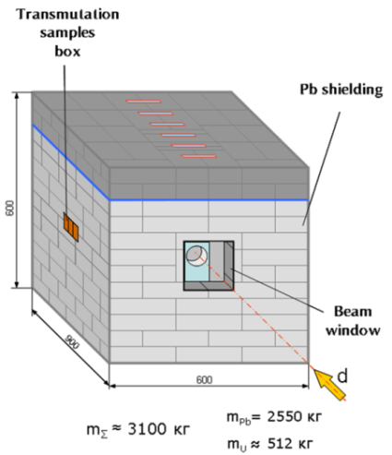
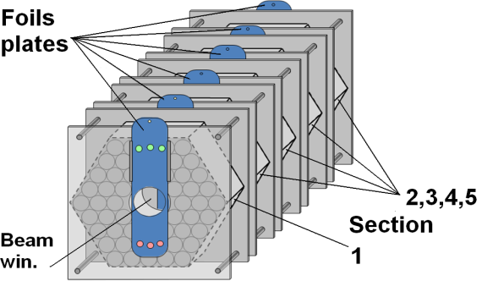
2. Experimental part.
2.1. Subcritical assembly Quinta

Slide 14
2. Experimental part.
2.1. Subcritical assembly Quinta
Dimensions of Quinta assembly.

Slide 15
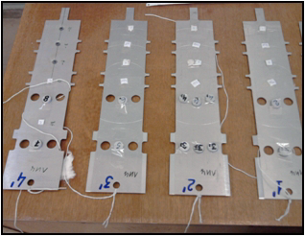
2. Experimental part.
2.1. Subcritical assembly Quinta
Sections № 2,3,4,5
Секция № 1
Детекторные пластины
5
5
1
2
2
3
3
4
4
Sections № 2,3,4,5
The layout of the uranium foils location on the detector plate. Each plate have 5 positions at the different distances..
5 R = -80 mm
1 R = 0
2 R = 40 mm
3 R = 80 mm
4 R = 120 mm
Location of the detectors on the plate
Uranium detectors were fixed on the detector plates in dependence on the distance from primary beam axes – 0, 4, 8 and 12 cm.
The dimensions of the foils – diameter 8 mm, thickness 1 mm, weight 1 g.
M. Szuta
National Centre for Nuclear Research, Poland

Slide 16
2. Experimental part.
2.2. Location of activation detector foils in the Quinta sub-critical assembly.
The location coordinates of all of 23 uranium detectors are shown in Table 1 relative to the axis of the target (along the radius R of the uranium target and along the axis of the target Z).

Slide 17
2. Experimental part.
2.3. Measurement.
2.3.1. Irradiation details.
The Quinta target was irradiated with a pulsed proton beam of 0.66 GeV energy extracted from the Phasotron accele-rator, located at the JINR.
Total number of protons of the irradiation is equal to 8.5 10¹⁴ during the time of irradiation equal to 20580 seconds (5h 43 min).
Prior to the irradiation, several polaroid films were placed on the front of Quinta to ensure the proton beam was striking in the centre of the beam window.

Slide 18
2. Experimental part.
2.3. Measurement.
2.3.2. Results
After the end of irradiation, the uranium foils were taken out from the target to measure γ-spectra using HPGe detectors. Measurement of gamma-ray spectra of irradiated foils was performed in 4 hours after the end of irradiation (more than 10 half-lives of ²³⁹U). In this period 99.9% of ²³⁹U nuclei have decayed to ²³⁹Np.
The number of fissions was determined by yield of gamma-lines 743.36 keV (93%), 364.49 keV (81.5%), 529.9 keV (87%), and 293.3 keV (42.8%) of fission fragments ⁹⁷Zr – 5.7%, ¹³¹I – 3.6%, ¹³³I – 6.3%, ¹⁴³Ce – 4.3%. respectively.
The number of neutron radiation capture reactions was determined by the yield of -line with energy of 277.6 keV 𝛾-line (I=14.44%) accompanying decay of 239Np (see Eq. 3) [3, 4].

Slide 19
2. Experimental part.
2.3. Measurement.
2.3.2. Results
The tables below (Table 2 and Table 3,) show the results of measurements of the fission numbers and the number of capture reactions per 1 deuteron and per 1 g of natural uranium.

Slide 20
2. Experimental part.
2.3. Measurement.
2.3.2. Results
The tables below (Table 2 and Table 3,) show the results of measurements of the fission numbers and the number of capture reactions per 1 deuteron and per 1 g of natural uranium.

Slide 21
2. Experimental part.
2.3. Measurement.
2.3.2. Results
Having the measured number of fissions and captures in the natural uranium foils we get (obtain) the spectral indexes (see Table 4).

Slide 22
2. Experimental part.
2.3. Measurement.
2.3.2. Results
Having in turn the measured spectral index equal to ratio of average fission and average capture cross section we can evaluate the average neutron flux in the location of the actinide sample using the measured amount of fissioned and captured actinide isotopes.
This is done by applying the try and error method where we look for the neutron energy for which the ratio of fission cross section to capture cross section of the selected actinide isotope from the nuclear data base is equal to the measured ratio of fissioned and captured actinide isotopes.
Since the measured ratio is defined as the ratio of average fission and capture cross sections so the retrieved distinct fission and capture cross sections for the distinct neutron energy from the nuclear data base (ENDF/B-VII.1) describe the average values.

Slide 23
2. Experimental part.
2.3. Measurement.
2.3.2. Results

Slide 24
2. Experimental part.
2.3. Measurement.
2.3.2. Results
Fig. 2. Average neutron energy distribution versus target length for four different radiuses.

Slide 25
2. Experimental part.
2.3. Measurement.
2.3.2. Results
Table 6. Average fission and capture cross section distribution for ²³⁸U[barn].

Slide 26
2. Experimental part.
2.3. Measurement.
2.3.2. Results
Table 7. Average fission and capture cross section distribution for ²³⁵U[barn].

Slide 27
2. Experimental part.
2.3. Measurement.
2.3.2. Results
The average fission and capture cross sections for ²³⁸U[barn] and ²³⁵U[barn] presented in Table 6 and Table 7 are corresponding to individual elements of Table 5 in which average neutron energies are given at the location of the natural uranium foils.
The obtained values for average fission and capture cross sections let us to evaluate the neutron fluencies distribution and average neutron flux distribution in the sub-critical assembly Quinta by help of the equations (Eq. 4 and Eq. 5) . These are collected in Table 8, (Fig. 3) and Table 9 (Fig. 4).

Slide 28
2. Experimental part.
2.3. Measurement.
2.3.2. Results
Table 8. Average neutron flux distribution [x 10⁹ cm⁻² s⁻¹].

Slide 29
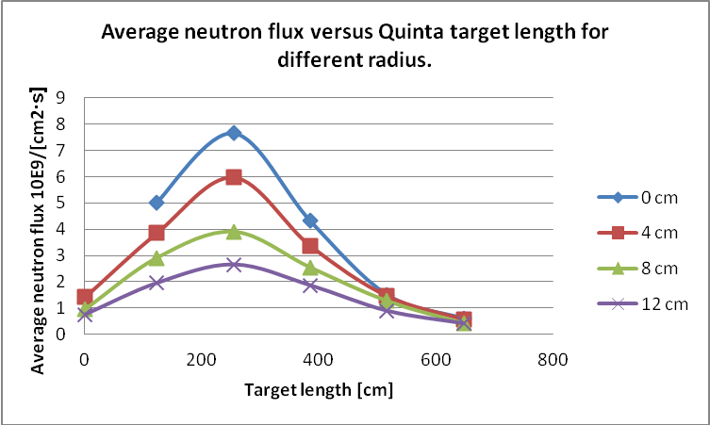
2. Experimental part.
2.3. Measurement.
2.3.2. Results
Fig. 3. Average neutron flux distribution versus target length for four different radiuses.

Slide 30
2. Experimental part.
2.3. Measurement.
2.3.2. Results
Table 9. Neutron fluency distribution [x 10¹³ cm⁻²].

Slide 31
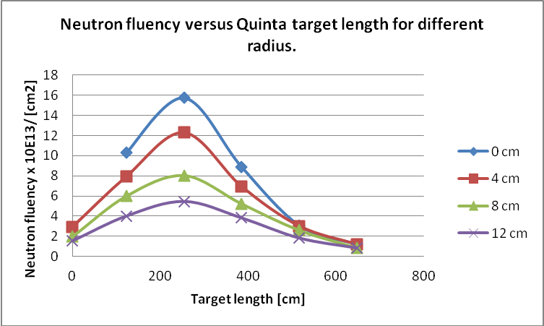
2. Experimental part.
2.3. Measurement.
2.3.2. Results
Distribution of 23 natural uranium samples in the whole volume of deeply sub-critical Quinta assembly let us to determine the volumetric distribution of average neutron flux of a specified average energy what in turn it let us to determine the optimal place in the assembly for incineration of the actinide.
So far, such measurements are not performed in the world.
Fig. 4. Neutron fluency distribution versus target length for four different radiuses.

Slide 32
3. Comparison of current and earlier neutron fluencies evaluation.
The experimental results presented in [1, 2] also concerned the estimation of neutron fluencies by actinide spectral index method with the difference that earlier Np-237 was applied [1]. The same Quinta target was irradiated with the same pulsed proton beam of 0.66 GeV energy extracted from the Phasotron accelerator with the difference that in the current evaluation applying the natural uranium ( ^{nat}U)[2]. The total number of protons of the irradiation was equal to 8.5 10¹⁴ during the time of irradiation equal to 20580 seconds (5h 43 min). In the earlier experiment [1] the total number of protons of the irradiation was equal to 7.78 10¹⁴ during the time of irradiation equal to 11890 seconds (5h 15 min). It means that the neutron fluencies in the current evaluation should be higher.
In the earlier work [1 ] of evaluation we have processed the experimental data of irradiated Np- 237 actinide samples and silicon detectors directly placed on sections 2 and 4 of the target of QUINTA assembly (see Fig. 5) without lead shield-reflector. So we can compare only two points of the current work U₁₄ and U₃₄ (see Table 1) which are 4 cm below the surface of the sections.

Slide 33
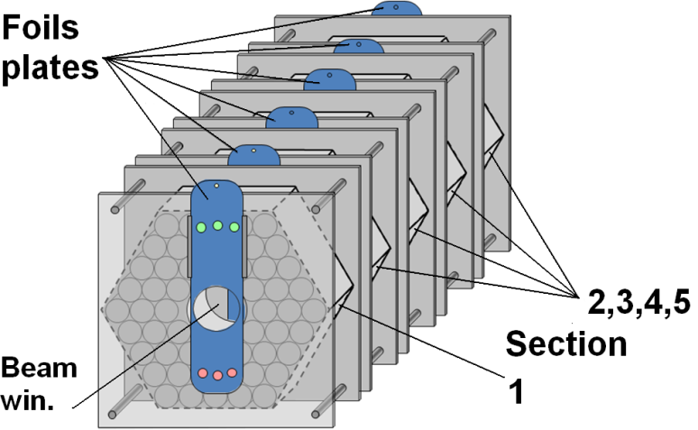
3. Comparison of current and earlier neutron fluencies evaluation.
We have processed the experimental data of irradiated Np- 237 actinide samples and silicon detectors directly placed on sections 2 and 4 of the QUINTA setup (see Fig. 5) without lead shield-reflector.
These samples (Np-237) were 16 cm from the source of the neutron spallation source, what is about 4 cm further than the compared samples of natural uranium U₁₄ and U₃₄
Np.-237 +silicon detektor
Proton beam
Natural uranium sections 1,..,5
Fig. 5 Target of QUINTA assembly.

Slide 34
3. Comparison of current and earlier neutron fluencies evaluation.
We can expect that the evaluation of neutron fluencies can be close to each other. The neutron fluency at the position U₁₄ is equal to 4.015 10¹³ cm⁻² while at its counterpart is equal to 1.88 10¹³ cm⁻² and at the position U₃₄ is equal to 3.826 10¹³ cm⁻²while at its counterpart is equal to 1.197 10¹³ cm⁻² (see Table 10).
Table 10. Compilation of neutron fluencies measured by two methods for two experiments in terms of average neutron energy.

Slide 35
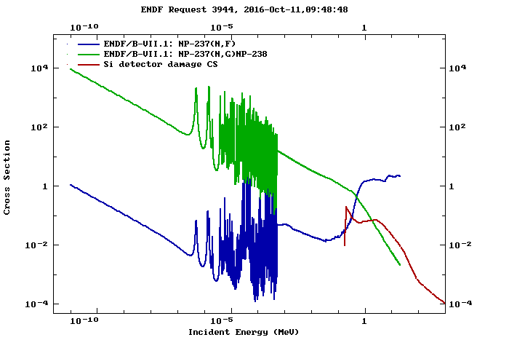
3. Comparison of current and earlier neutron fluencies evaluation.
Neutron damage in the silicon detector placed in certain neutron spectrum collects the damage from whole spectrum starting from neutron energy as a threshold equal to 170 KeV to very high energy about 50 MeV irrespectively of its energy (see Fig. 6 – red line). It is an additive process. So the reverse dark current in the silicon detector is proportional to the average damage done by the neutrons of actually existing neutron spectrum in this range.
Fig. 6. Cross section of neutron inducing damage in the silicon detector (red curve) and cross sections of neutron inducing fission and capture on Np-237 minor actinide.

Slide 36
3. Comparison of current and earlier neutron fluencies evaluation.
Thus, we can further conclude that since the fluence of neutrons is comparable in both experiments (see Table 10), a significant part of the fluence of neutrons comes from the energy range of 0.9 - 2.0 MeV.

Slide 37
4. Conclusions
Actinide samples and planar silicon detectors can be used as neutron fluency detectors especially in the high neutron energy range that is difficult to measure.
Both the natural uranium and the neptunium 237 actinides can be applied as high energy neutrons fluencies detectors.
Since the measurements of fluence of neutrons by the spectral index method using natural uranium and neptunium 237 and the silicon detector method are quantitatively comparable to some extent, we can conclude that a significant part of the measured fluence of neutrons comes from the neutron energy range 0.9 - 2.0 MeV.

Slide 38
4. Conclusions
In the case of irradiation of Am-241 under the conditions described above, the spectral index should reach about 4, which also indicates that the incineration of this actinide will be effective.
It is widely known that the average neutron energy during the process of fission is about 2 MeV but during the process of spallation is about 3 MeV.
The quotient of cross sections for fission and capture for these neutron energies (1, 2 and 3 MeV) gives information on incineration of minor actinides. This is clearly seen in Table 11 where are collected the mentioned parameters for these neutron energies extracted from the data base ENDF/B-VII.1.

Slide 39
4. Conclusions
The minor-actinide-bearing blanket (MABB) concept [5, 6] is based on irradiation of such blankets containing a significant quantity of minor actinides in a solid solution mixed with uranium oxide which is to be located in radial blankets on the periphery of the outer core in a sodium-cooled fast reactor (SFR).
Inside in the structure of fuel the average neutron flux can be very close to the average energy of fission neutrons what ensure that the incineration efficiency is within the range of 8 – 27 times higher for Np-237 and 4 - 23 times higher for Am-241 than production of next actinides (see Table 9 – previous slide).

Slide 40
4. Discussion.
Table 11. The fission/absorption ratios in function of neutron energy for neptunium 237 and americium 241.
Neutron energy [MeV] | Fission cross section σ(n,f) [barn] | Capture cross section σ(n,γ) [barn] | σ(n,f)/ σ(n,γ)
Np-237
1.0 2.0 3.0 | 1.4587 1.7001 1.6609 | 0.17277 0.06090 0.032674 | 8.43213 27.9664 50.8339
Am-241
1.0 2.0 3.0 | 1.2615 1.8498 1.85973 | 0.292707 0.07717 0.02145 | 4.30977 23.9701 86.6827

Slide 41
5. Referencs
[1] M. Szuta, S. Kilim, E. Strugalska-Gola, M. Bielewicz, N.I. Zamyatin, A. I Shafronovskaya, S. Tyutyunnikov; Comparison of two fast neutron fluence measurement methods based on Np237 fission to capture ratio measurement (spectral index) and a reverse dark current measurement of planar silicon detector; XXIII International Baldin Seminar on High Energy Physics Problems – “Relativistic Nuclear Physics & Quantum Chromodynamics”; Russia, Dubna, September, 2016.; Baldin ISHEPP XXIII; EPJ Web of Conferences 138 10006 (2017), DOI: 10.1051/epjconf/201713810006
[2] M. Szuta, S. Kilim, E. Strugalska-Gola, M. Bielewicz, N.I. Zamyatin, A. I Shafronovskaia, S. Tyutyunnikov; Impact of average neutron energy on the fast neutron fluency measurement by Np237 fission to capture ratio and reverse dark current of planar silicon detector methods.;XXIV International Baldin Seminar on High Energy Physics Problems – “Relativistic Nuclear Physics & Quantum Chromodynamics”; Russia, Dubna, September, 2018 Baldin ISHEPP XXIV; EPJ Web of Conferences 204, 0 (2019) https://doi.org/10.1051/epjconf /201920404002
[3] M.Yu. Artiushenko, V.A. Voronko, K.V. Husak, M.G. Kadykov, Yu.T. Petrusenko, V.V. Sotnikov, D.A. Irzhevskyi, S.I. Tyutyunnikov, W.I. Furman, V.V. Chilap; Investigation of the spatial and energy distributions of neutrons in the massive uranium target irradiated by deuterons with energy of 1…8 GeV; ISSN 1562-6016. ВАНТ. 2013. №6(88) 170 - 174
[4] M.Yu. Artiushenko, A.A. Baldin, A.I. Berlev, V.V. Chilap, O. Dalkhajav, V.V. Sotnikov, S.I. Tyutyunnikov, V.A. Voronk1, A.A. Zhadan; Comparison of neutron-physical characterictics of uranium target of assembly „QUINTA” irradiated by relativistic deuterons and ¹²Cnuclei; ISSN 1562-6016. ВАНТ. 2016. №3(103)

Slide 42
5. References.
[5] B. Valentin, H. Palancher, C. Yver, V. Garat, S. Massara, “Heterogeneous Minor Actinide Transmutation on a UO2 blanket and on (U,Pu)O2 fuel in a SFR – Preliminary design of pin and assembly”, Proc. Int. Conf. GLOBAL 2009, Paris, France, Sept. 6-11, 2009.
[6] Syriac BEJAOUI, Elio D’AGATA, Ralph HANIA, Thierry LAMBERT, Stéphane BENDOTTI, Cédric NEYROUD, Nathalie HERLET, Jean-Marc BONNEROT ; Americium-Bearing Blanket Separate-effect Experiments:MARIOS and DIAMINO Irradiations; Proceedings of GLOBAL 2011 Makuhari, Japan, Dec. 11-16, 2011 Paper No. 503621

Slide 43
Thank you for the attention.
43

