Slide 1
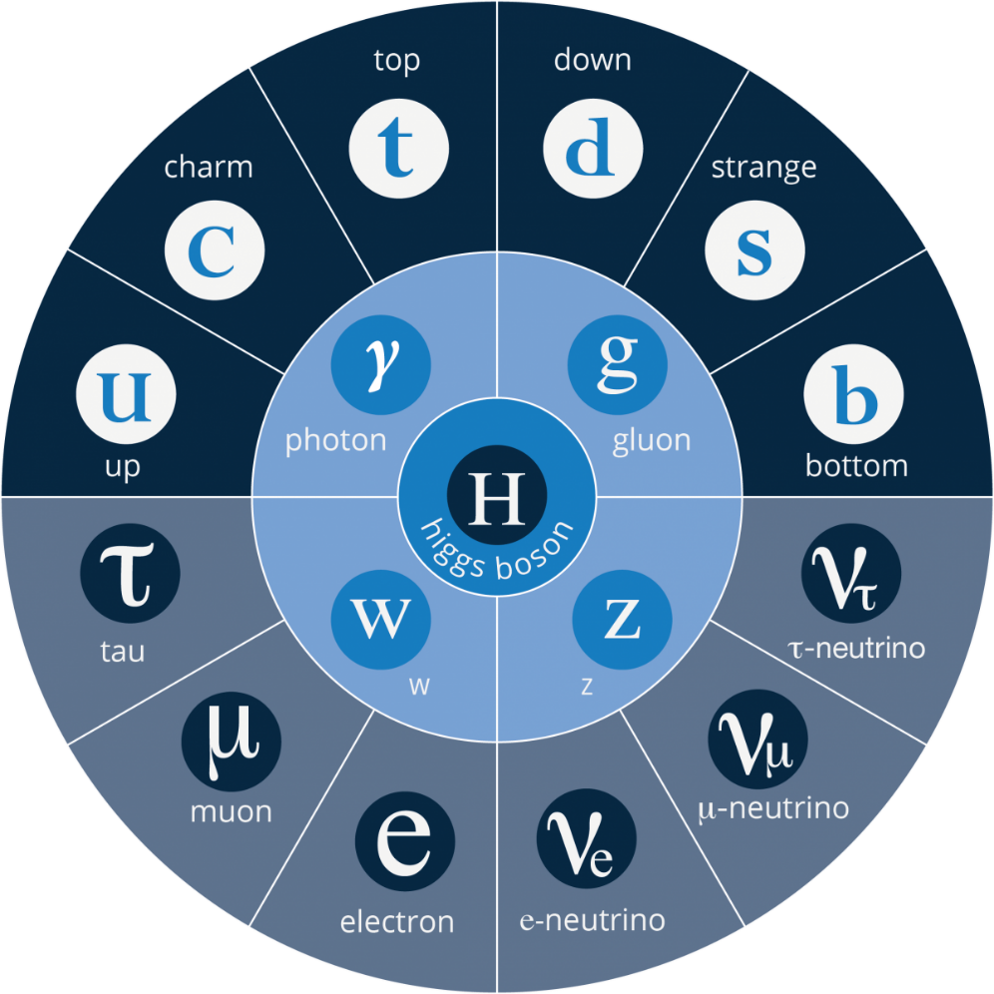
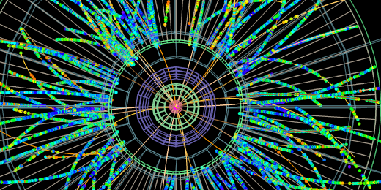
The standard model for the structure of matter
Or:
Why all this fuss?
Isobel Kolbé
isobel.Kolbe@cern.ch

Slide 2



Who am I?
BSc. Physics from the University of Pretoria (2014)
MSc. and Ph.D. from the University of Cape Town (2015, 2018)
Visiting CERN (not a member of staff/ fellow)

Slide 3

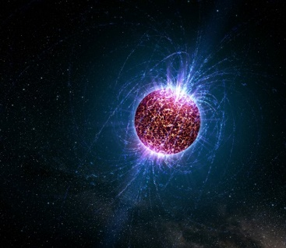
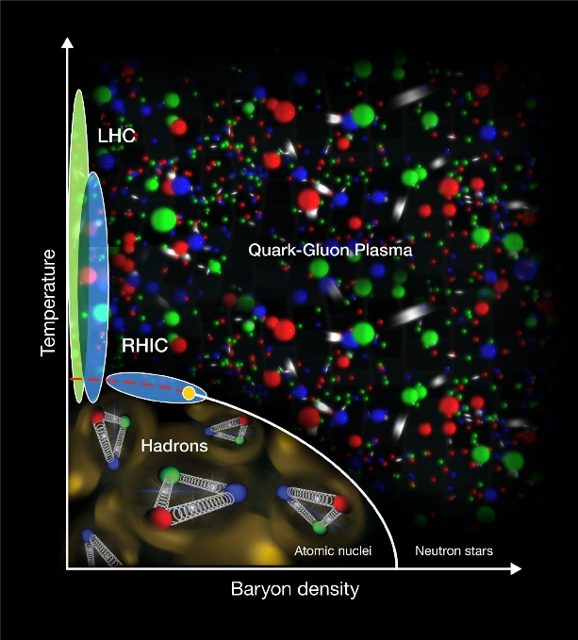
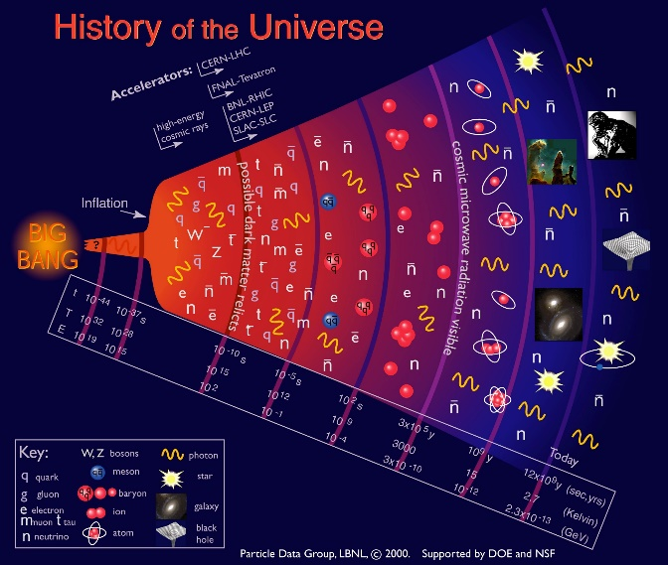
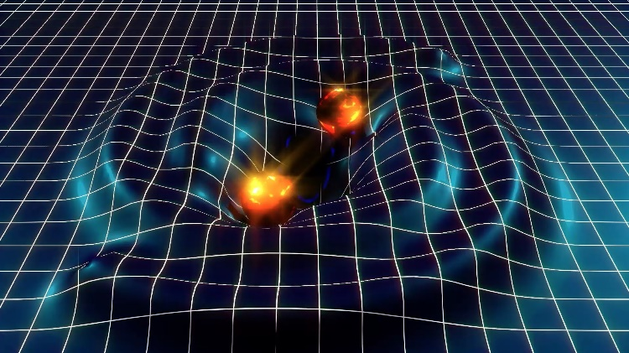
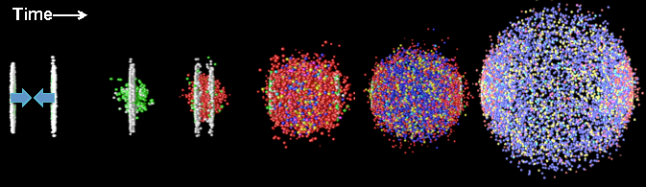
Not a lecture

Slide 4

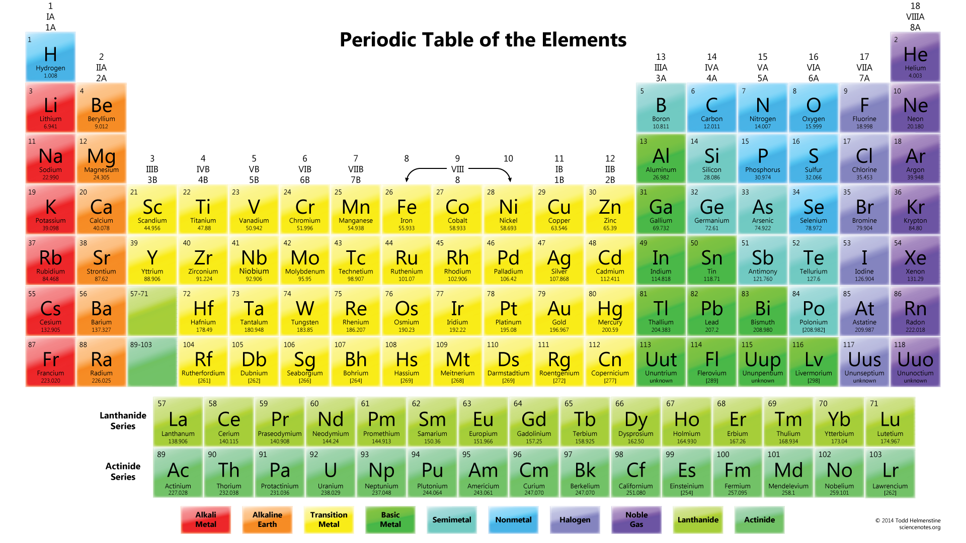
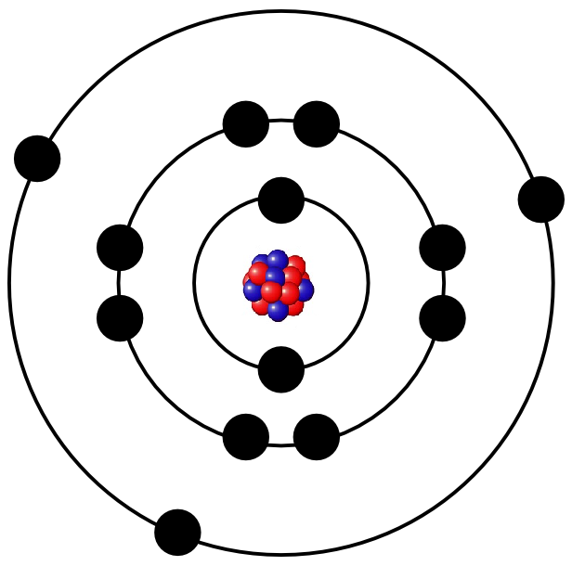

Slide 5
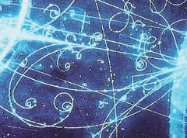
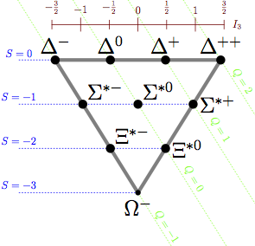
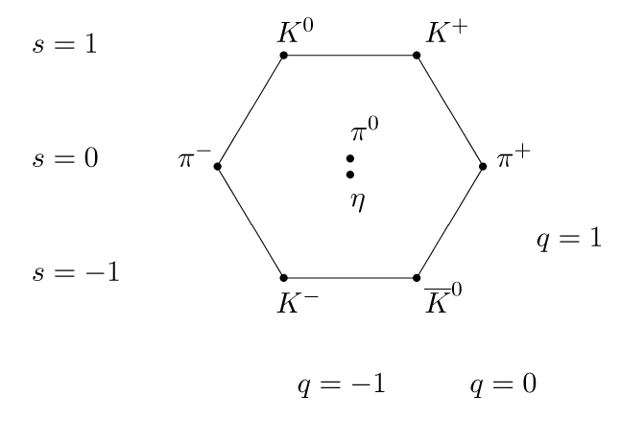
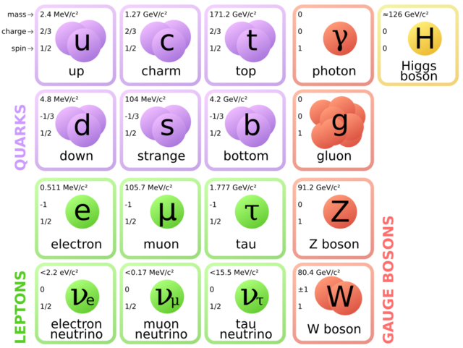
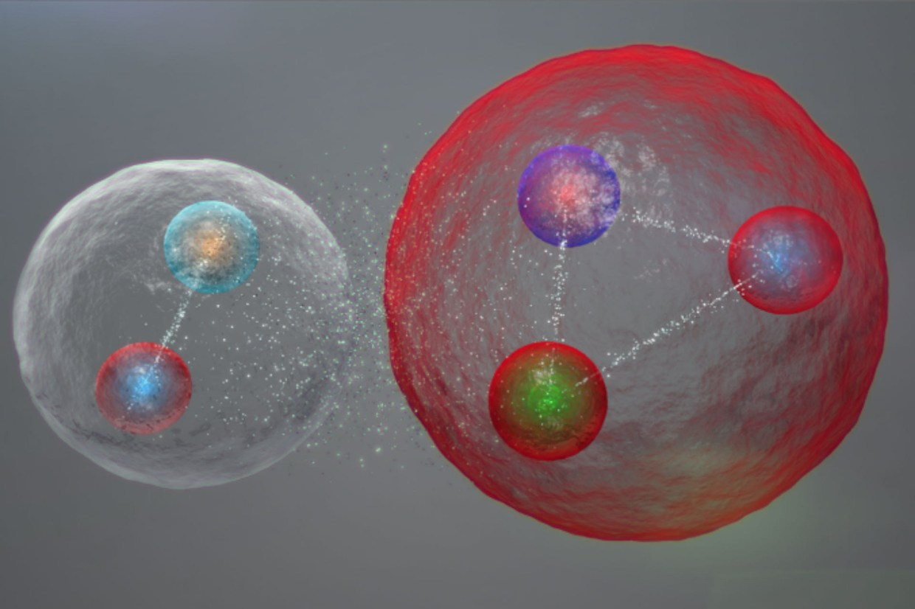
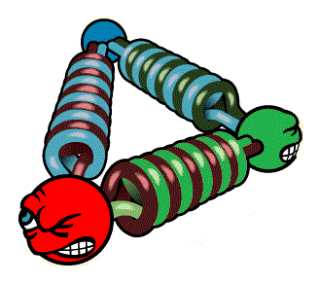

Slide 6
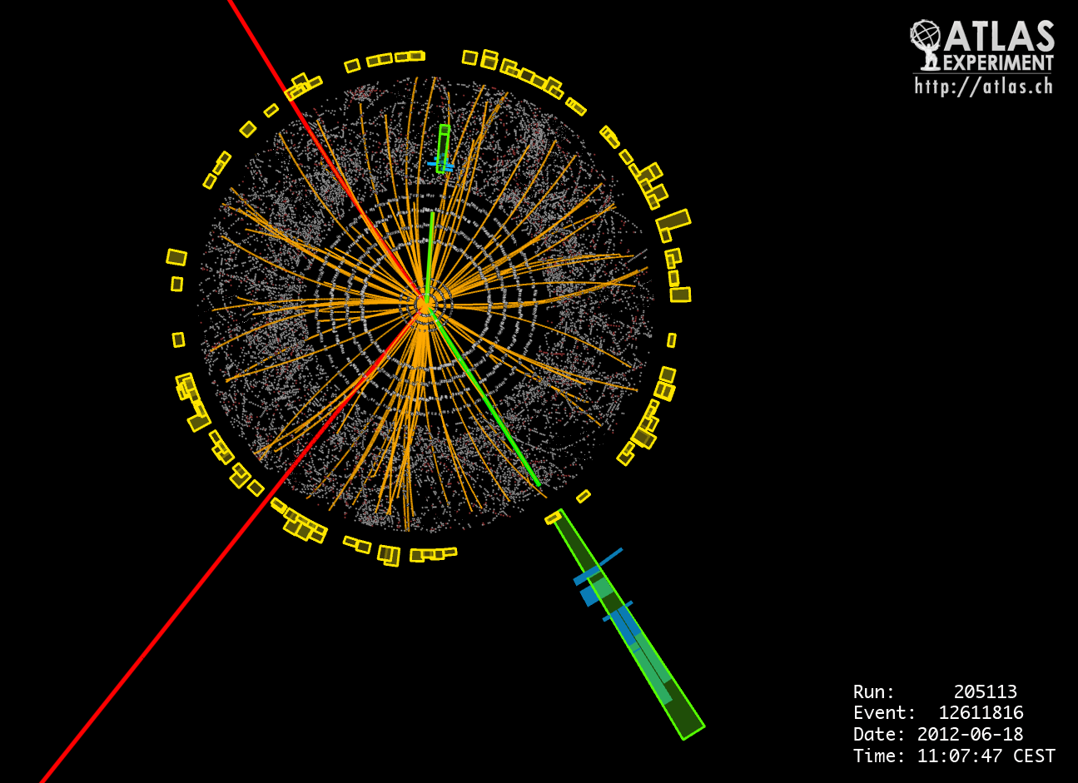
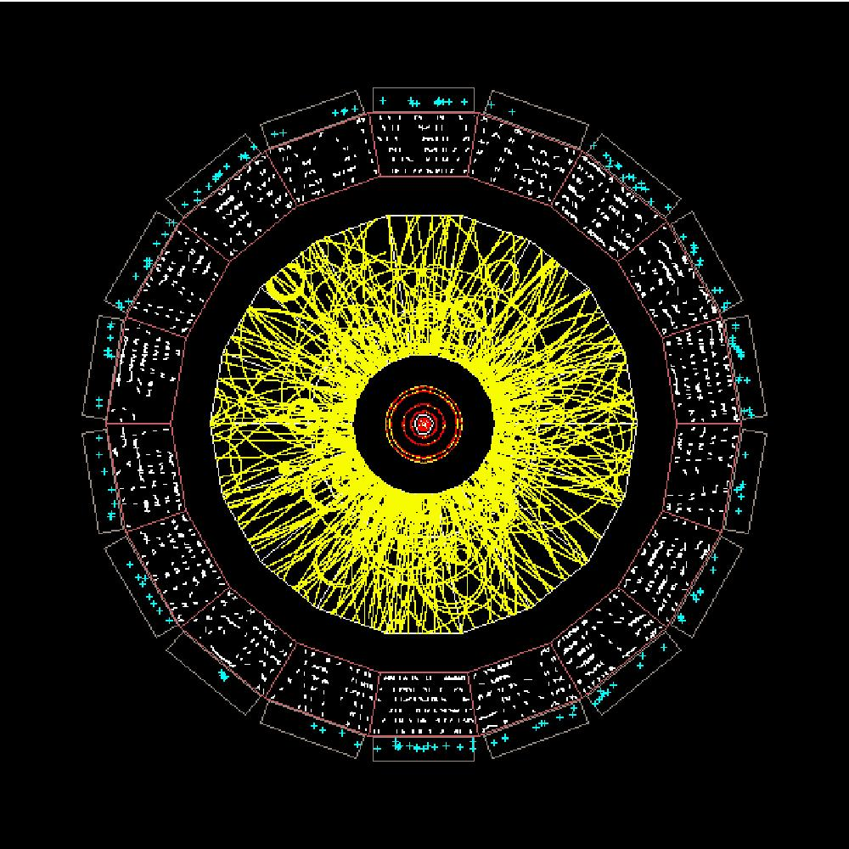

Slide 7
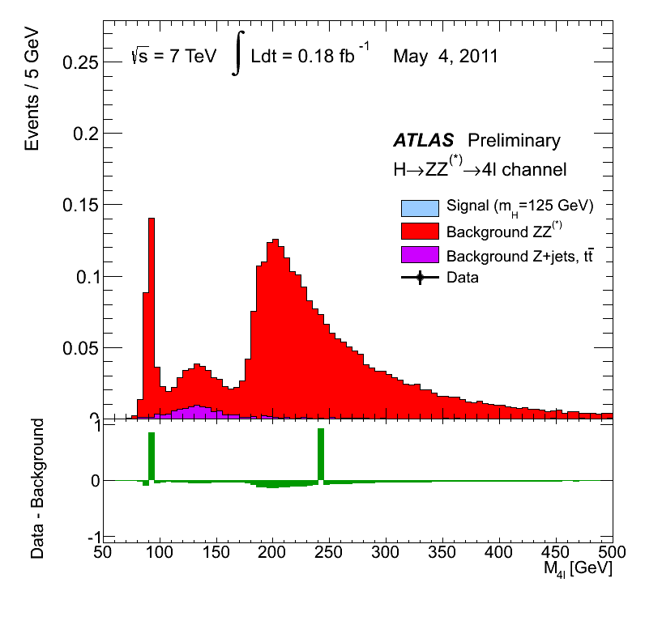

Slide 8

Today – Cold – Newtonian Gravity, General Relativity
Too hot for e⁻ to bind – E/M (atomic) Plasma physics
Too hot for nuclei to bind – Nuclear/Particle Physics
Too hot for quarks to bind – standard model physics

Slide 9
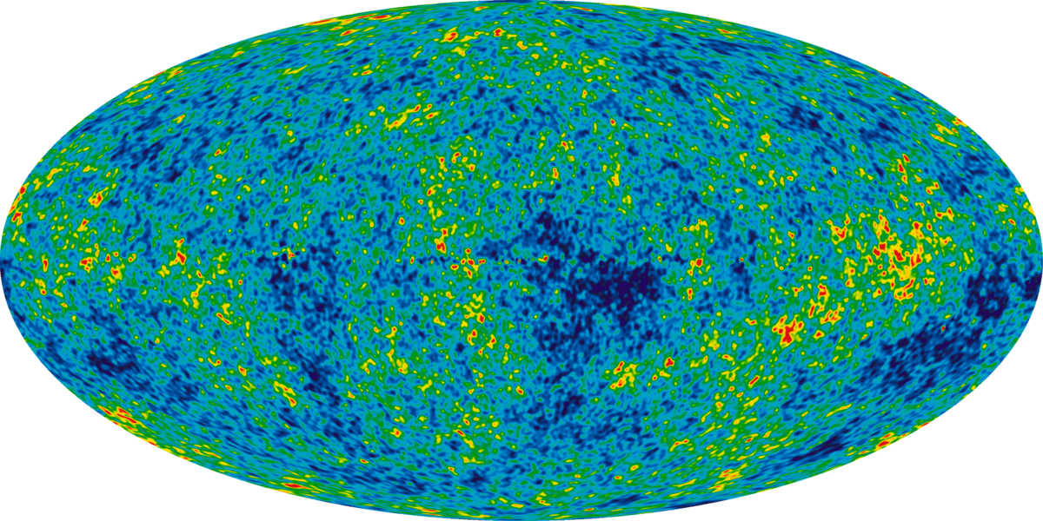

Slide 10
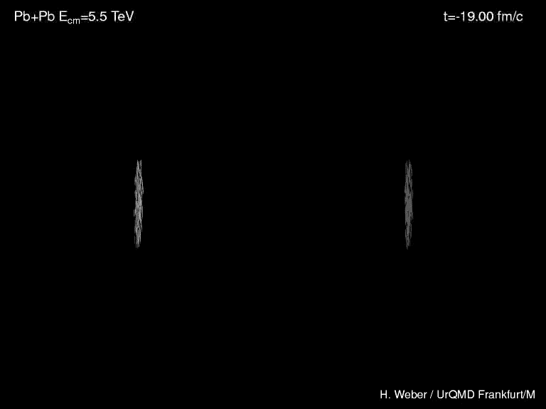

Slide 11
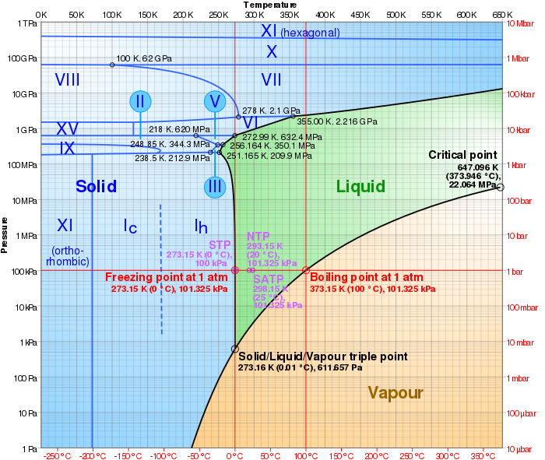

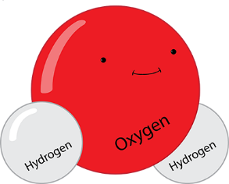

Slide 12
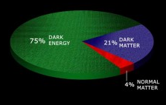
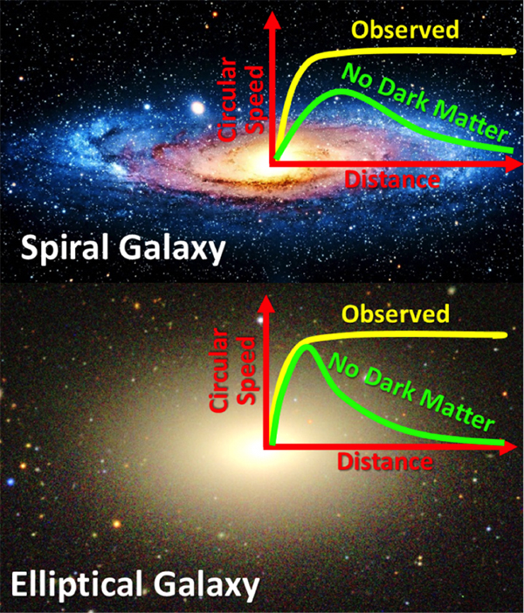
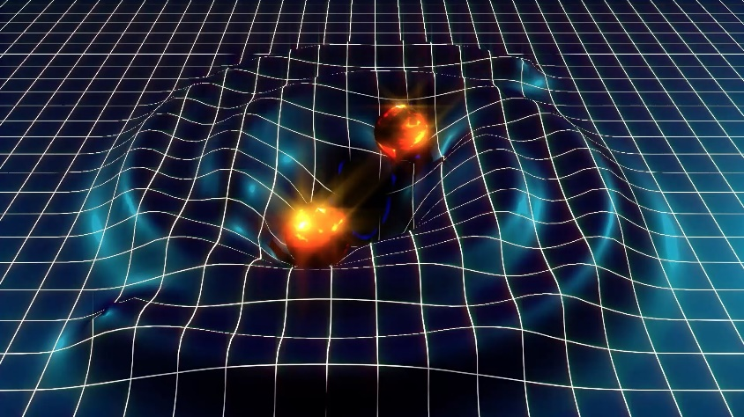
What don’t we know?
Dark energy
Dark matter
Gravity vs the standard model
Why is gravity so weak?
Why is there more matter than anti-matter?
Beyond the black hole horizon
QCD confinement

Slide 13


Qestions?

Slide 14
Backup slides

Slide 15
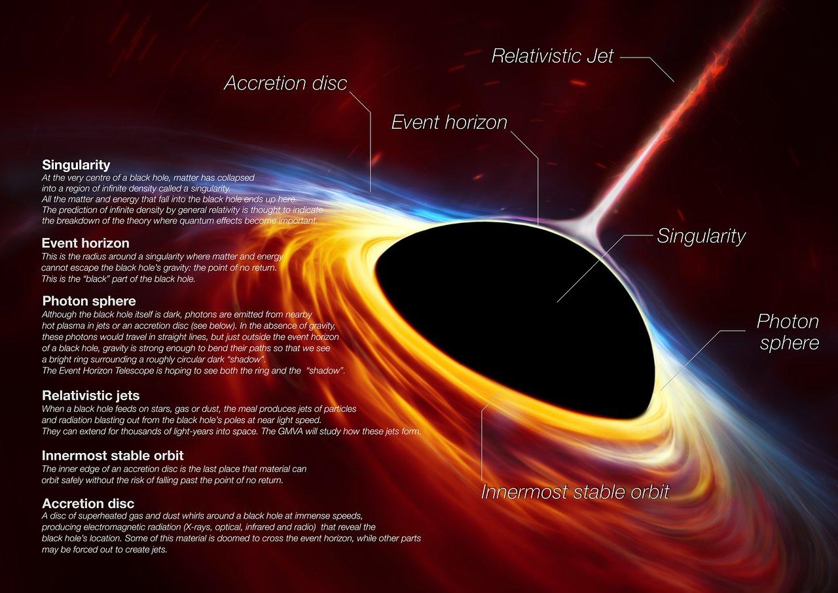

Slide 16
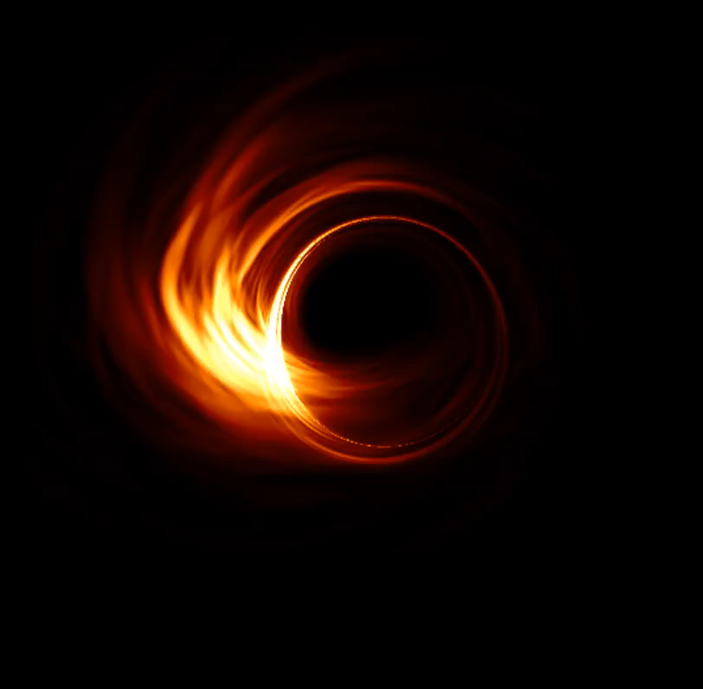

Slide 17
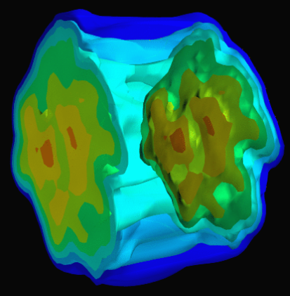
Flow
ϕ
Low momentum particles
Medium interactions
Initial geometry

Slide 18
Jet Quenching and Particle Suppression
High momentum particles
Medium interactions
Modification of pp particles vs AA signal

Slide 19
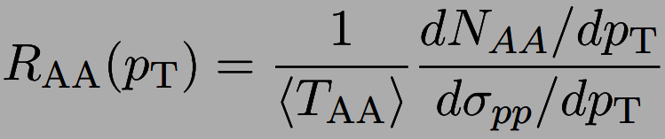
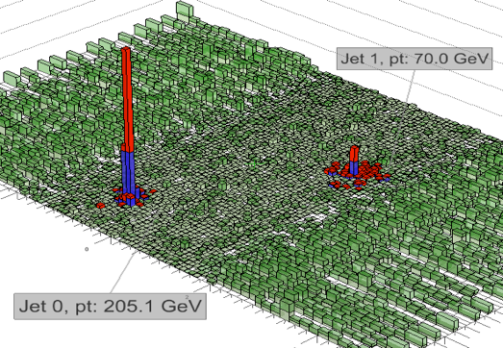
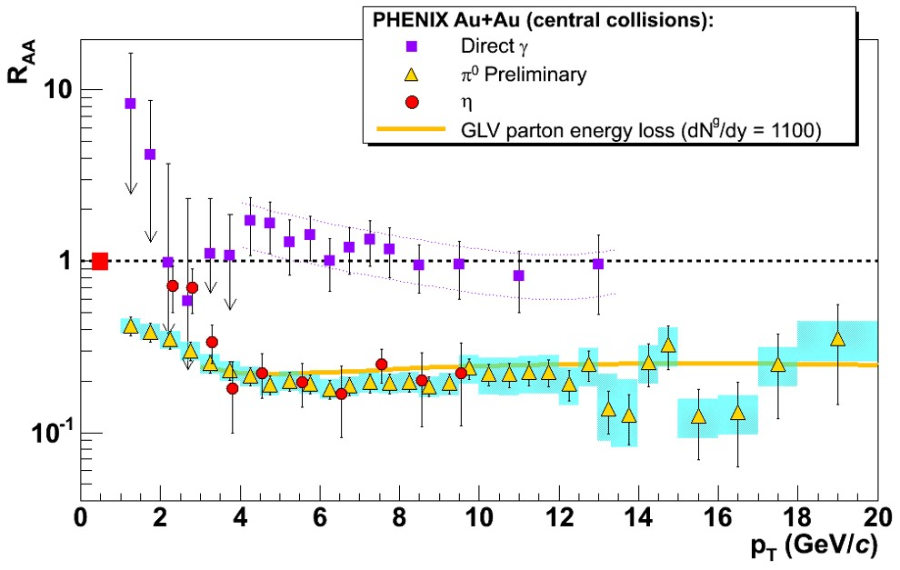
Heavy ion results
CMS PbPb 2.76 TeV, Nov. 2010. PRC 84 (2011)

