Slide 1
XLS project meeting
Helsinki 2019
Monday 1st to Thursday 4th of July, 2019

Slide 2
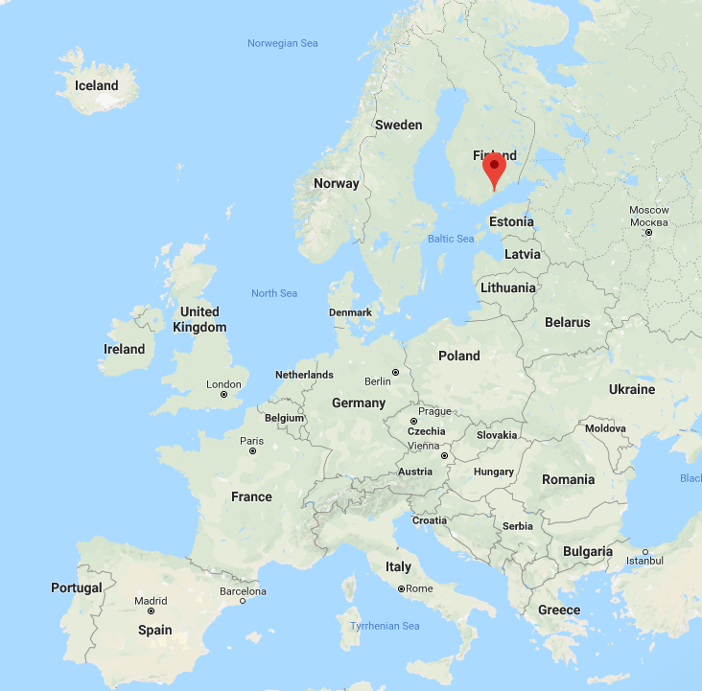
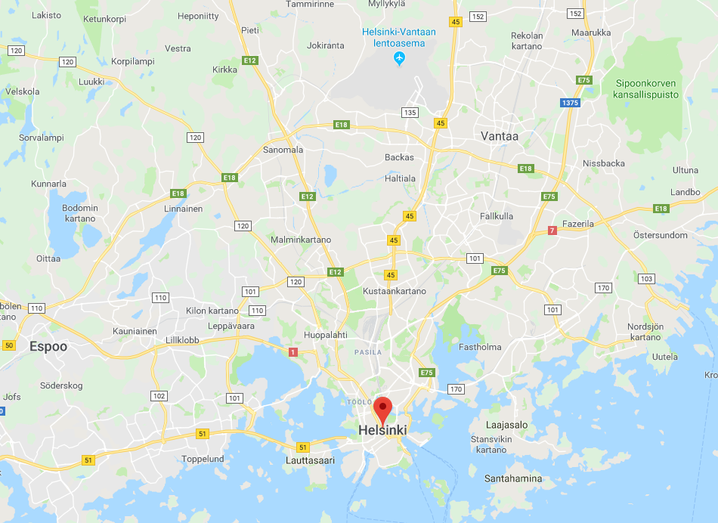
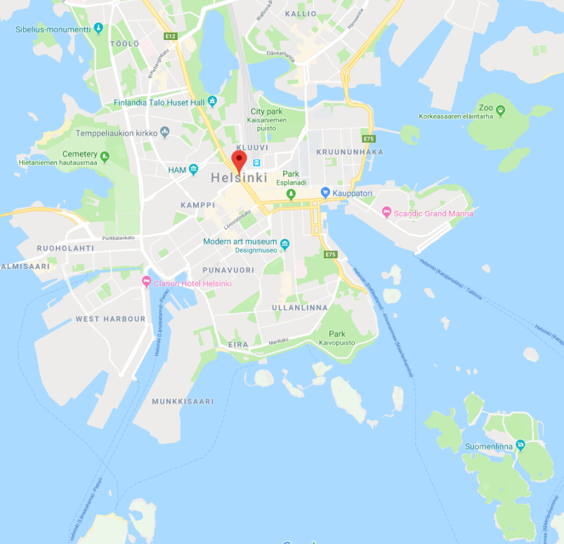
Content
Arriving to Helsinki
Hotel
Venues
Visit-dinner
Airport

Slide 3
Arriving to Helsinki
Flight times to Helsinki: from Gva 3h+1, London 2h50+2, Barcelona 4h+1, Roma 3h20+1
  Random arrival times;
  Geneva (6:20) via Munich 11:55
  Geneva (7:20) via Amsterdam 13:10
  London 12:25
  Copenhagen 12:15
  Barcelona (7:30) 12:35
  Paris 11:30
  Berlin 12:10
  Stockholm 13:10
  Frankfurt 13:15
  Roma 15:40 (direct), 11:55 via Munich (6:00), 13:10 via Amsterdam (6:30)
  Geneva 22:55 (only one daily direct flight to Helsinki, 11:00/19:00 from Gva, alternate days)
Helsinki airport app. 15 km from Helsinki City Center
Commuting train from airport to Helsinki every 10 mins. 30mins travel time, 5€ (4,20€ with mobile app.)
Finnair City bus, every 20 mins, 6.90€, 25 mins travel time to railway station
Taxi

Slide 4
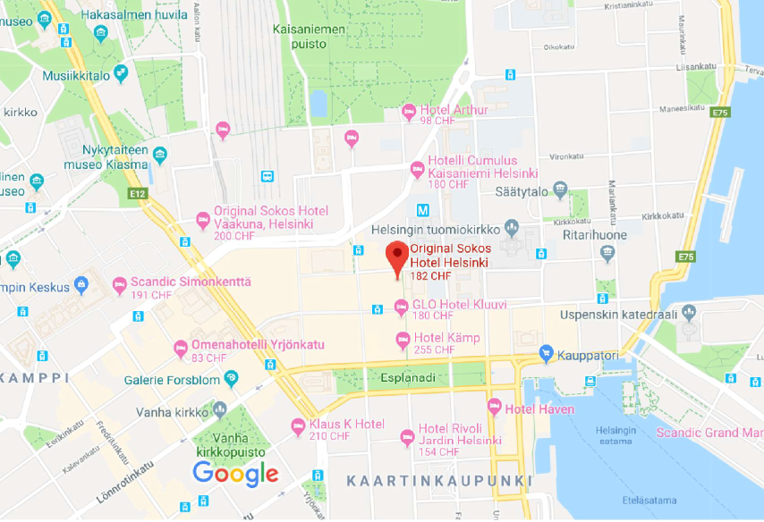
Hotel reservation
Reservation done at Original Sokos Hotel Helsinki 1st to 4th of July, 2019
https://www.sokoshotels.fi/en/helsinki/sokos-hotel-helsinki
  50 single rooms 128€/night (148€/double)
    Including:Breakfast, wifi, guest sauna
    City center, 200m to railway station (connections to airport)
Railway station
  Reservation conditions
  - 25% unreserved rooms released on 3rd of May
  - 50% unreserved rooms released on 17th of May
  Automatic release on 31st of May at 8am

Slide 5
Meeting venue
Preferably University city campus (university pricing)
  Limited opening hours in July, some buildings closed, some open only 9-15/16
  Forest house
  https://tilavaraus.helsinki.fi/fi/keskusta/metsatalo-unioninkatu-40
  Porthania (mainly auditoriums)
  https://tilavaraus.helsinki.fi/fi/keskusta/porthania-yliopistonkatu-3
  Minerva building, Minerva square, 80 plcs, multipurpose venue
  https://tilavaraus.helsinki.fi/fi/siltavuorenpenger/minerva-siltavuorenpenger-5
  Economicum, places for 52
  https://tilavaraus.helsinki.fi/fi/economicum/economicum-arkadiankatu-7/economicum-sh3-4
  Viikki campus
  https://tilavaraus.helsinki.fi/fi/viikki/ee-rakennus-agnes-sjobergin-katu-2/ee-rakennus-sali-a2096-sh11-12
  https://tilavaraus.helsinki.fi/fi/viikki/laboratoriorakennus-koetilantie-5
  https://tilavaraus.helsinki.fi/fi/viikki/infokeskus-korona-viikinkaari-11
  Kumpula campus, mainly auditoriums
  https://tilavaraus.helsinki.fi/fi/kumpula/physicum-gustaf-hallstromin-katu-2/physicum-sali-e207
  Meilahti campus, mainly auditoriums
  https://tilavaraus.helsinki.fi/fi/meilahti

Slide 6
Meeting venue
Commercial alternatives
hotels: Arthur City Center, meeting
https://venuu.fi/tilat/hotel-arthur-maen-sali
Hanasaari, meeting+accomodation
https://www.hanaholmen.fi/
Sofia, meeting+accomodation
https://sofia.fi/en/home/
Hotel Rantapuisto, meeting+accomodation
https://www.rantapuisto.fi/en/
Suomenlinna, ruutikellari, meeting
https://venuu.fi/tilat/suomenlinna-ruutikellari

Slide 7
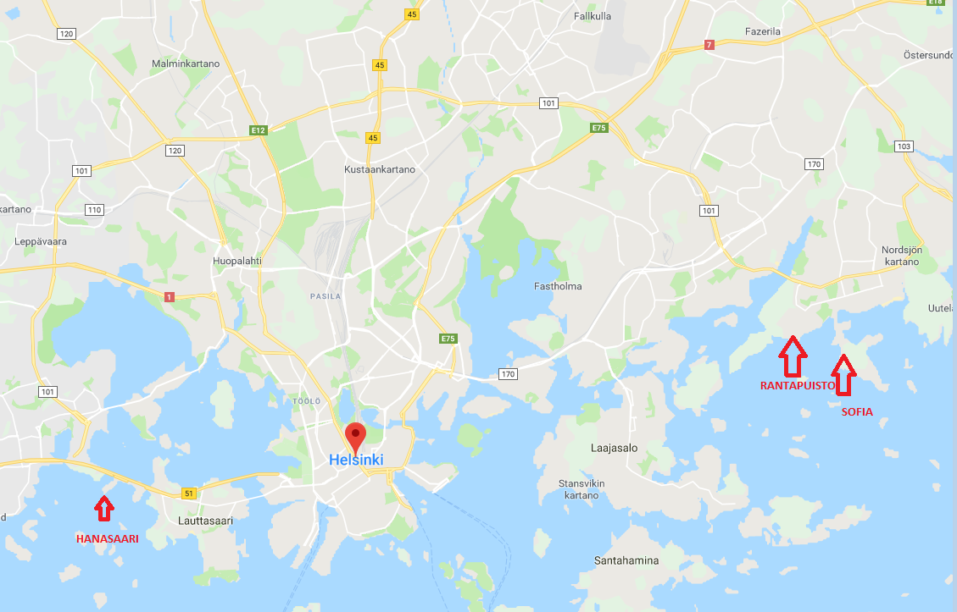
Meeting hotels by the sea
Hanasaari, metro station app. 1,1 km, bus stop 400m
Rantapuisto, metro station 1.7 km, bus stop 600 m
Sofia, metro station 2.5 km, bus stop 0 m (36 mins from City Center Metro+bus)

Slide 8

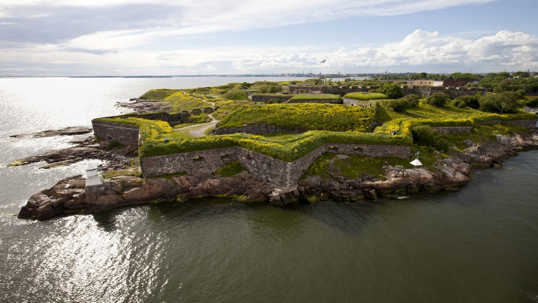
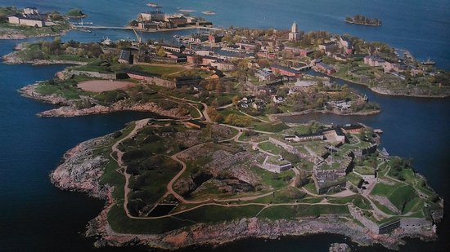
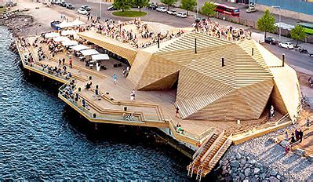
Visit+dinner
Suomenlinna, Fortress in front of Helsinki
  https://www.suomenlinna.fi/en/
  Ferry from market square 15 min.
  World heritage site
  Tour around 1-2 hours (guided tour 11€/p?)
  Dinner at restaurant Walhalla http://www.restaurantwalhalla.com/en/
  Other islands
Dinner sightseen cruise 2.5h, Helsinki by the sea+dinner
  https://www.ihalines.fi/languages/dinner-cruises/
Other venues (not for whole group or dinner)
  Löyly, public sauna and restaurant http://www.loylyhelsinki.fi/en/front-page/
  Allas sea pool+saunas at City Center http://www.loylyhelsinki.fi/en/front-page/

