Slide 1
e-Cooling measurements at LEIR 2018
A. Saa Hernandez, H. Bartosik, M. Zampetakis
N. Biancacci
D. Gamba, A. Latina

Slide 2
Motivation
Electron Cooler is an essential component of LEIR:
To enable beam storage: reduce the transverse and longitudinal emittances of the ion beam (high charge state: Pb 54+, low injection energy: β_{rel} = 0.094)
To enable beam accumulation: drag mean energy of each injected pulse to accommodate next injection
Several measurements during 2018

Slide 3
Motivation
Electron Cooler is an essential component of LEIR:
To enable beam storage: reduce the transverse and longitudinal emittances of the ion beam (high charge state: Pb 54+, low injection energy: β_{rel} = 0.094)
To enable beam accumulation: drag mean energy of each injected pulse to accommodate next injection
Several measurements during 2018
to characterize the cooling force and benchmark simulations of new code
  Already discussed in the previous meeting (https://indico.cern.ch/event/774322/contributions/3217585/attachments/1776825/2889336/Ecool_and_Elens_2019_01_10.pdf)

Slide 4
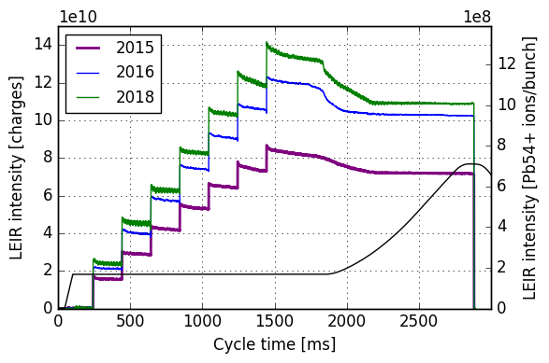
Motivation
Electron Cooler is an essential component of LEIR:
To enable beam storage: reduce the transverse and longitudinal emittances of the ion beam (high charge state: Pb 54+, low injection energy: β_{rel} = 0.094)
To enable beam accumulation: drag mean energy of each injected pulse to accommodate next injection
Several measurements during 2018
to characterize the cooling force and benchmark simulations of new code
to try to overcome intensity limitations
  Ion-acceleration with Ecooler
  Cooling of bunched beams
  Studies of equilibrium emittances

Slide 5
Motivation
Electron Cooler is an essential component of LEIR:
To enable beam storage: reduce the transverse and longitudinal emittances of the ion beam (high charge state: Pb 54+, low injection energy: β_{rel} = 0.094)
To enable beam accumulation: drag mean energy of each injected pulse to accommodate next injection
Several measurements during 2018
to characterize the cooling force and benchmark simulations of new code
to try to overcome intensity limitations
  Ion-acceleration with Ecooler
  Cooling of bunched beams
  Studies of equilibrium emittances
Electron cooling
RF capture

Slide 6
Motivation
Electron Cooler is an essential component of LEIR:
To enable beam storage: reduce the transverse and longitudinal emittances of the ion beam (high charge state: Pb 54+, low injection energy: β_{rel} = 0.094)
To enable beam accumulation: drag mean energy of each injected pulse to accommodate next injection
Several measurements during 2018
to characterize the cooling force and benchmark simulations of new code
to try to overcome intensity limitations
  Ion-acceleration with Ecooler
  Cooling of bunched beams
  Studies of equilibrium values
Electron cooling
RF capture
Equilibrium
values
Heating processes no longer compensated, emittances blow up
Interplay of heating and cooling processes

Slide 7
Motivation
Electron Cooler is an essential component of LEIR:
To enable beam storage: reduce the transverse and longitudinal emittances of the ion beam (high charge state: Pb 54+, low injection energy: β_{rel} = 0.094)
To enable beam accumulation: drag mean energy of each injected pulse to accommodate next injection
Several measurements during 2018
to characterize the cooling force and benchmark simulations of new code
to try to overcome intensity limitations
to indirectly measure e- beam parameters and create maps to prepare beams with given specifications

Slide 8
Motivation
Electron Cooler is an essential component of LEIR:
To enable beam storage: reduce the transverse and longitudinal emittances of the ion beam (high charge state: Pb 54+, low injection energy: β_{rel} = 0.094)
To enable beam accumulation: drag mean energy of each injected pulse to accommodate next injection
Several measurements during 2018
to characterize the cooling force and benchmark simulations of new code
to try to overcome intensity limitations
to indirectly measure e- beam parameters and create maps to prepare beams with given specifications
* Discussion on measurable parameters:
  We pretty much cannot measure any e- beam parameter… at least directly
  Instead we can measure its effects on the ion beam!
    Intensity: Beam Current Transformer (BCT)
    Position: Beam Position Monitors (BPM)
    Beam size (→ emittances) : Ionization Profile Monitor (IPM)
    Revolution Frequency (→ momentum): longitudinal Schottky
    Longitudinal profile (when bunched): tomoscope
Measurements along full cycle
Sampling rate: BCT → 1ms, IPM → 5ms, schottky, tomo → variable, ms order
Measurement resolution depends on beam intensity
No clear limitations from this side

Slide 9
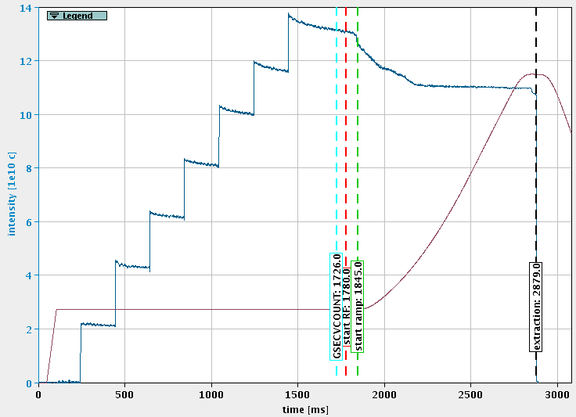
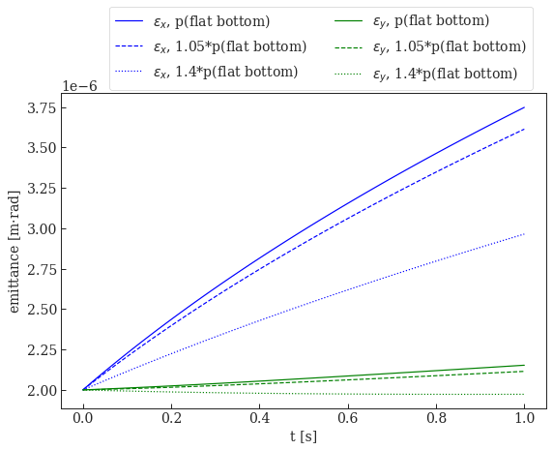
Ion acceleration with the Electron Cooler
Losses after RF capture, stabilized after t ≈ 2100 ms
p(t=2100 ms) ≈ 1.4 p(flat bottom)
Hypothesis: assume losses are caused by IBS, how much would the emittance blow-up decrease for a higher p?
(arbitrary inputs)

Slide 10
Ion acceleration with the Electron Cooler
Losses after RF capture, stabilized after t ≈ 2100 ms
p(t=2100 ms) ≈ 1.4 p(flat bottom)
Could we do the RF-capture at a higher p?
Linac3 could not inject at a higher energy, so we would need to accelerate the ions without RF during the (no-longer) flat bottom by means of the Electron Cooler
Hypothesis: assume losses are caused by IBS, how much would the emittance blow-up decrease for a higher p?
(arbitrary inputs)

Slide 11
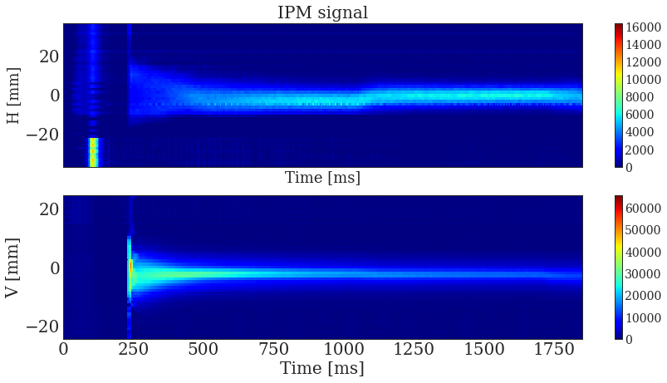
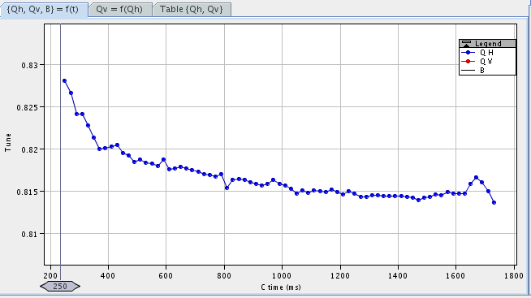
Ion acceleration with the Electron Cooler
How to?
increase e- gun voltage → increase e- velocity → via momentum exchange drag the ion beam to higher momentum
Measurements from cooling force useful for optimum settings
synchronize momentum and Bfield, and also quadrupoles, sextupoles, and dipole correctors. Ensure ion beam stays cooled, orbit centered and tune constant → trick: use LSA-knob Brho_dot + fine tuning
tune measured during cooling-acceleration
→ additional correction needed

Slide 12
Ion acceleration with the Electron Cooler
Results
We do indeed accelerate the ion beam!
revolution frequency
reduce dp/p with cooling
injection
h=99
drag ion beam
harmonic 100
Longitudinal
Schottky
h=98
h=97
h=96
time
h=95
p_{final} = 0.3582
Limit comes from duration of “injection plateau” and slow thermalizing process
6%
p_{initial} = 0.3378

Slide 13
Ion acceleration with the Ecooler
Results
No losses during cooling-acceleration
No losses during RF-capture by simply adjusting RF
No losses during RF acceleration, but ramp had to be adjusted
Beam could be extracted
However:
similar emittance blow-up for higher final p
→ Too small p increase!

Slide 14
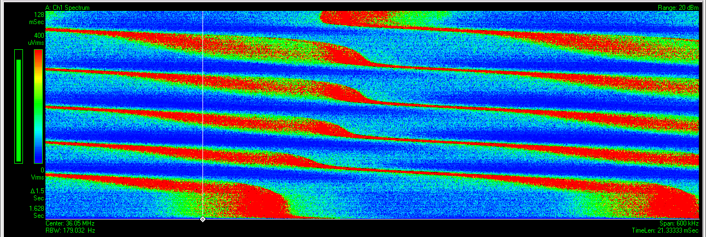
Ion acceleration with the Ecooler
That simple? well...
Actually quite fast to set up.
However first tests with very fast and large gun voltage increase failed to drag the full beam. Implemented as step – plateau – step
revolution frequency
Longitudinal
Schottky
time
No losses,
however large momentum spread and emittance increase

Slide 15
Cooling of bunched beams
Losses after RF capture, electron cooler switched off earlier…
Better if we do the RF-capture earlier and switch Electron Cooler off later?
Pros:
Compensate heating effects (IBS, space-charge), which create losses
Cons:
Cooling a bunched beam instead of a coasting one → damping in all 3 planes → more compressed beam, may create even stronger heating effects

Slide 16
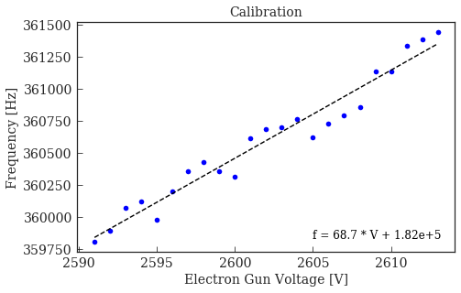
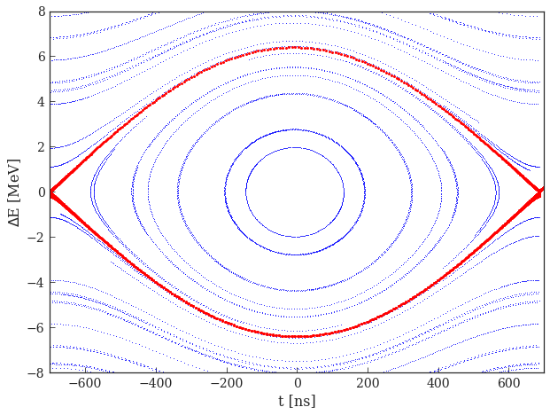
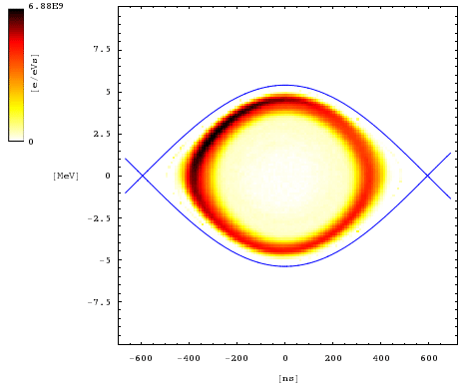
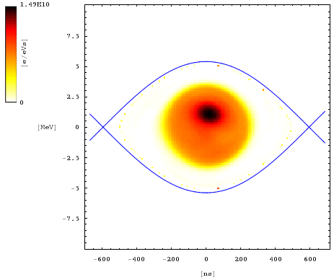

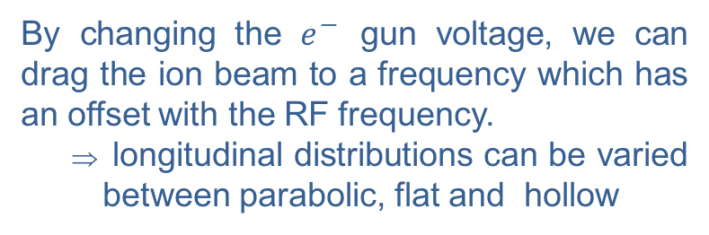
Cooling of bunched beams
By changing the $e^{−}$ gun voltage, we can drag the ion beam to a frequency which has an offset with the RF frequency.
  longitudinal distributions can be varied between parabolic, flat and hollow
$$Ion equivalent energy of the electrons$$

Slide 17
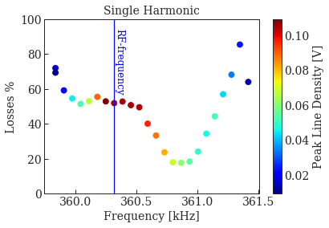
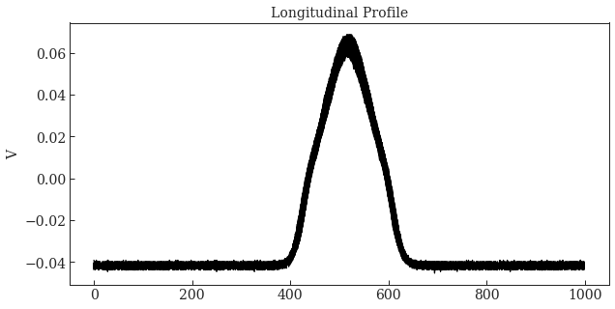
Cooling of bunched beams
We measured the losses between the start of RF and the start of ramping (400 ms), as a function of rev. frequency set by the Ecooler
Peak Line
Density

Slide 18
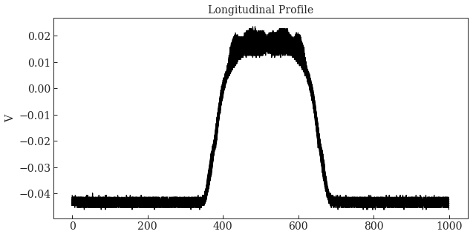
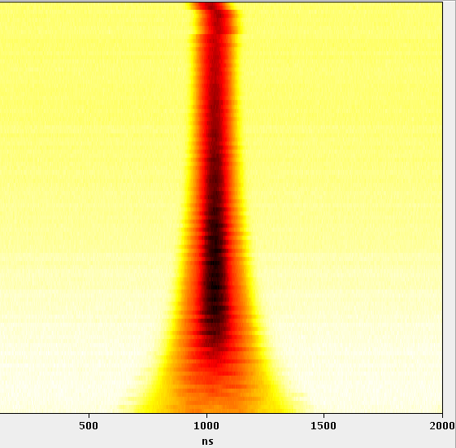
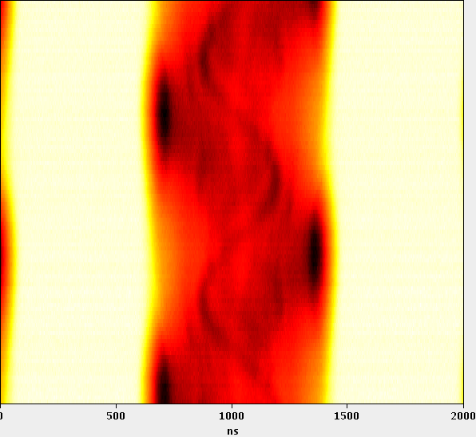
Cooling of bunched beams
We measured the losses between the start of RF and the start of ramping (400 ms), as a function of rev. frequency set by the Ecooler
Profiles for minimum losses
Profiles for central case

Slide 19
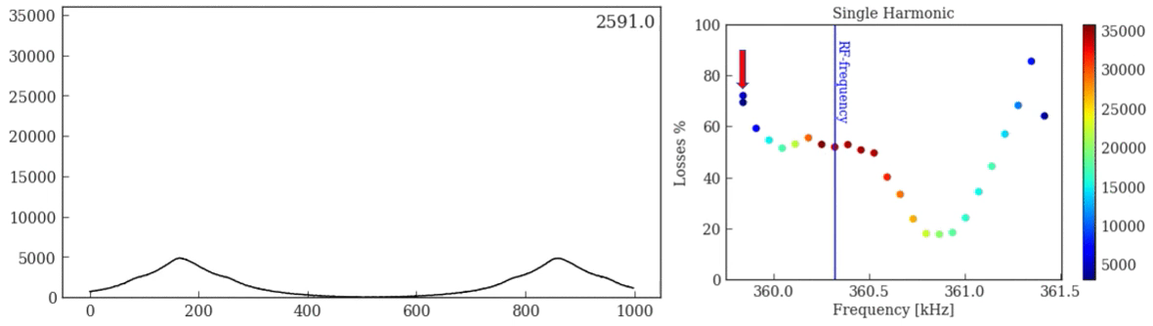
Cooling of bunched beams
We measured the losses between the start of RF and the start of ramping (400 ms), as a function of rev. frequency set by the Ecooler
*Colorbar not calibrated.

Slide 20
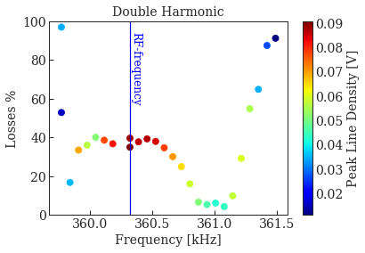
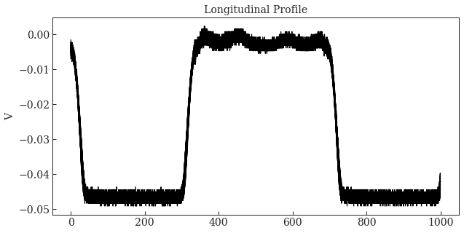
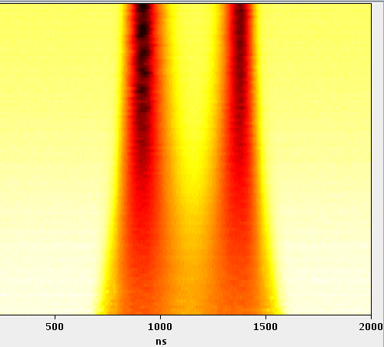
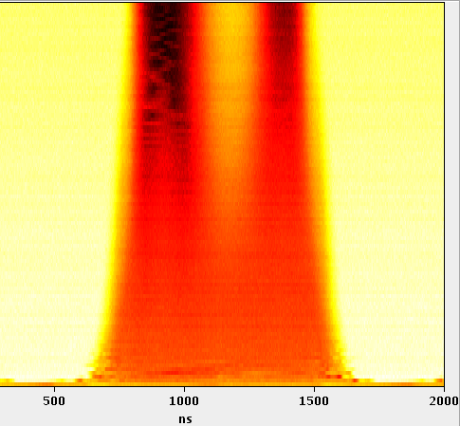
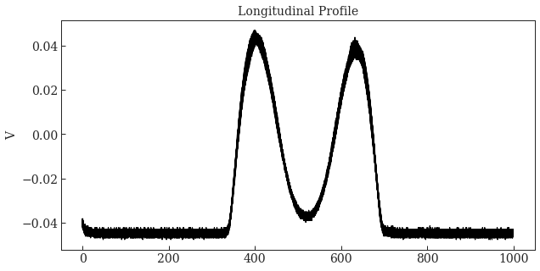
Cooling of bunched beams
Same measurements setting the RF cavity to h2+4 settings: minimum losses < 4% → similar to standard case for equivalent intensities (~3e10 total charges = low intensity)
Profiles for minimum losses
Profiles for central case

Slide 21
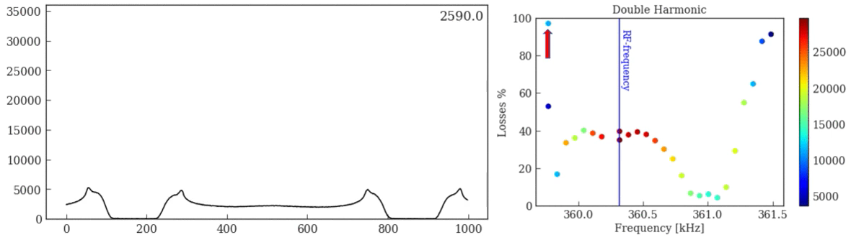
Cooling of bunched beams
Same measurements setting the RF cavity to h2+4 settings: minimum losses < 4% → similar to standard case for equivalent intensities (~3e10 total charges = low intensity)

Slide 22
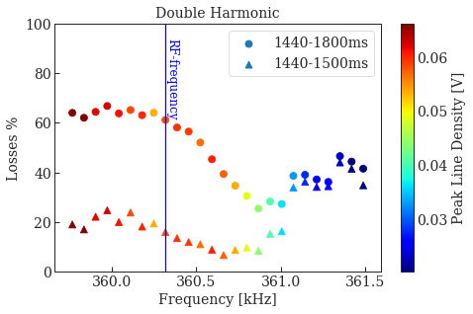
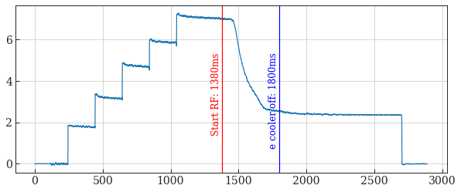
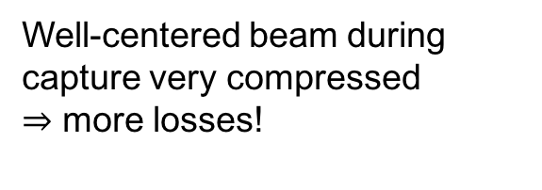
Cooling of bunched beams
For higher intensities (~6.5e10 total charges)
Initial losses during offset capture of a high intensity beam
Well-centered beam during capture very compressed
$⇒$ more losses!
Intensity (1e10 charges)
Time (ms)

Slide 23
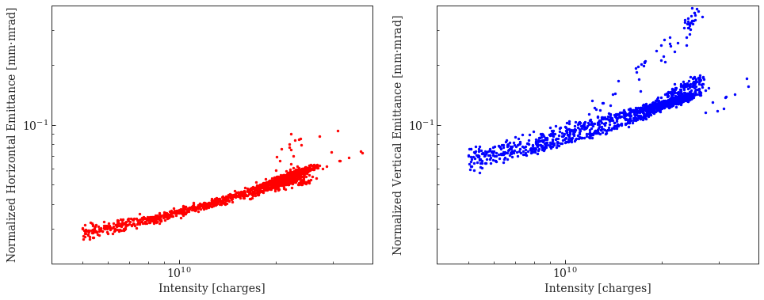
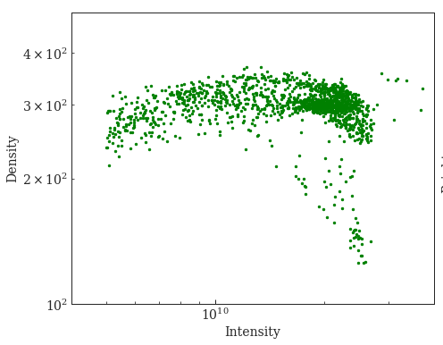
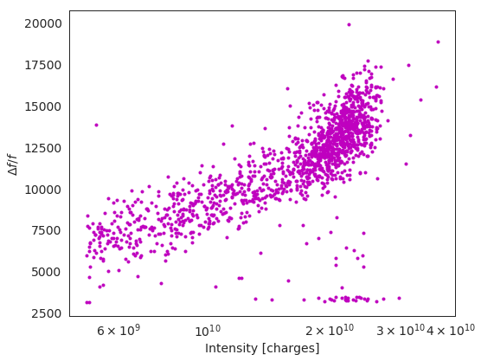
Studies of equilibrium values: as a function of intensity
Vary ion beam intensity by mis-steering a corrector (BHN10) in the transfer line

Slide 24
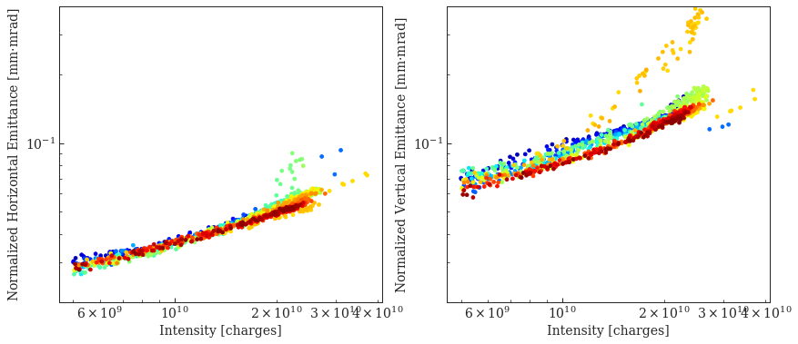
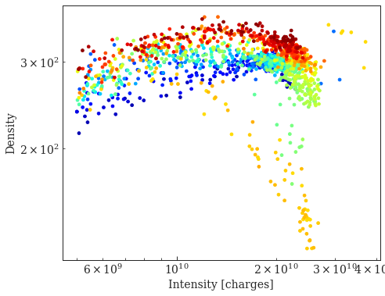
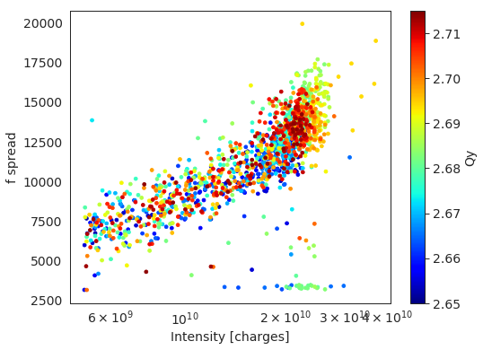
Studies of equilibrium values: as a function of intensity and tune
Vary ion beam intensity by mis-steering a corrector (BHN10) in the transfer line

Slide 25
Studies of equilibrium values:
as a function of intensity and tune
Let’s look in more detail:
ε ~ I^{n} consistent with measurements at other labs (Ti²²⁺, Kr³⁶⁺, Xe⁵⁴⁺, Au⁷⁹⁺, U⁹²⁺ measured at GSI) for IBS dominated regime…
but then emittance blow up and losses should be similar for all tunes and we had already observed that was not the case

Slide 26
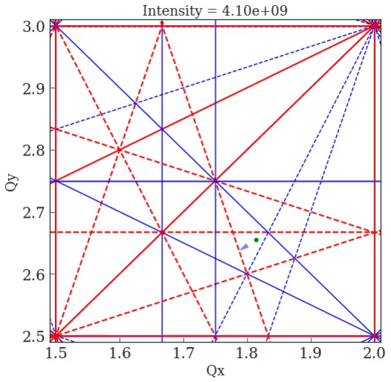

Studies of equilibrium values:
as a function of intensity and tune
Let’s look in more detail:
ε ~ I^{n} consistent with measurements at other labs (Ti²²⁺, Kr³⁶⁺, Xe⁵⁴⁺, Au⁷⁹⁺, U⁹²⁺ measured at GSI) for IBS dominated regime…
but then emittance blow up and losses should be similar for all tunes and we had already observed that was not the case
emittance dependence on WP, above a threshold intensity!
→ Space charge dominates for certain tunes and intensities (ongoing studies)
Equilibrium values studies not only to characterize cooling process but also dominant heating processes!

Slide 27
Studies of equilibrium values: as a function of ion beam position
Scan equilibrium emittances as a function of orbit bumps (offset/angle)
Indirect measurement of e-beam position
Create “cooling maps” to guide us in the preparation of beams with certain specifications
Calibrate bump knob
(here H_offset=0, H_angle=0)
Electron
Cooler
Electron
Cooler

Slide 28
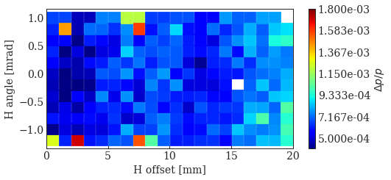
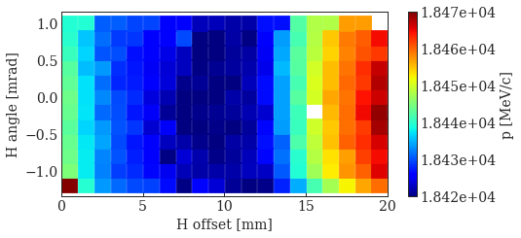
Studies of equilibrium values:
as a function of ion beam position
Scan equilibrium emittances as a function of orbit bumps (i.e. on the e-ion overlap)
Scan range: limited by intensity losses < 20%
Zero-orbit e- beam
Some observations:
Increasing emittance with abs(angle) → expected
10 mm offset between center of e-beam and zero-orbit ion beam
Vertical emittance independent of H-angle → expected
Vertical emittance increases as e-ion overlap decreases
Momentum dependence with e-ion overlap
Momentum spread not that sensitive (further analysis may be required)

Slide 29
Studies of equilibrium values:
as a function of ion beam position
Scan equilibrium emittances as a function of orbit bumps (i.e. on the e-ion overlap)
Scan range:
limited by intensity losses < 20% and by vertical correctors strength (smaller than in H plane)
(horizontal orbit set to maximum cooling: H_offset = 10 mm, H_angle = 0 mrad)
Some observations:
Horizontal emittance independent of V-angle → expected
Vertical emittance not very sensitive to vertical bump, except for very large offsets
Measurements repeated:
For different electron currents: 210, 340 and 430 mA
For different transverse beam profiles: parabolic, flat, hollow

Slide 30
Conclusions
Very successful year from the point of view of the MDs in LEIR (performed many cooling-related measurements, quite some data still to be analyzed).
“Exotic” ideas tested to try to overcome intensity limitations in LEIR. Successfully implemented, did not help overcoming limitations, but better characterized (SC, IBS).
Detailed characterization of e-cooling as a function of ion beam position that helped us preparing beam with given specifications.

Slide 31
Extra: tests to measure directly the e-beam position with a scope

Slide 32
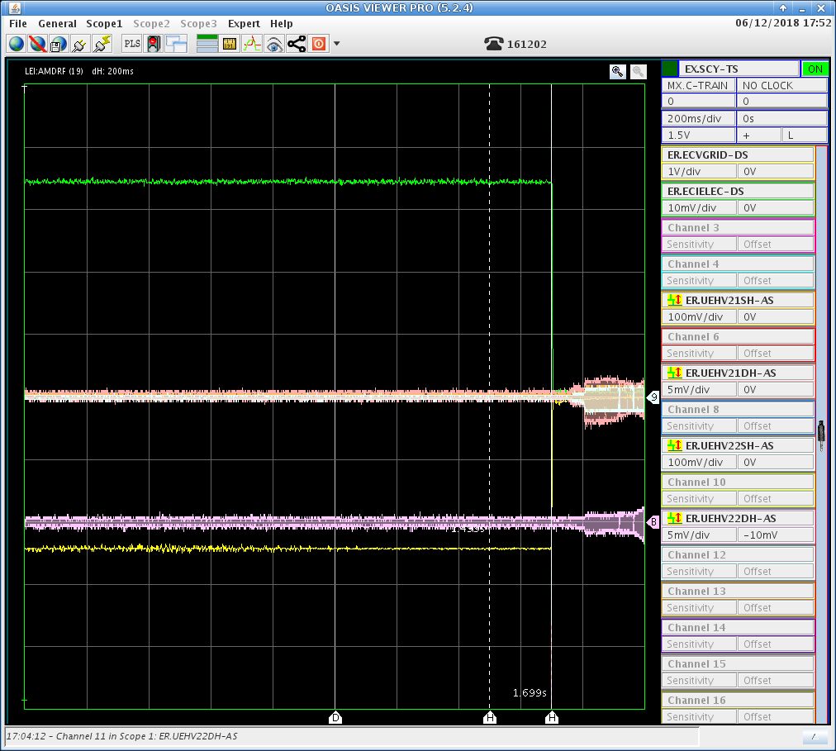
Measurements of the electron beam position?
Monitor with a scope the signal from gun and grid voltage from e-cooler and sum and difference signals from a pick-up inside e-cooler
RF capture, bunched beam
Coasting beam
Switch off Electron Cooler:
Use “switch” to avoid decaying gun voltage
→ Measure signal not present for e- dc-beam

Slide 33
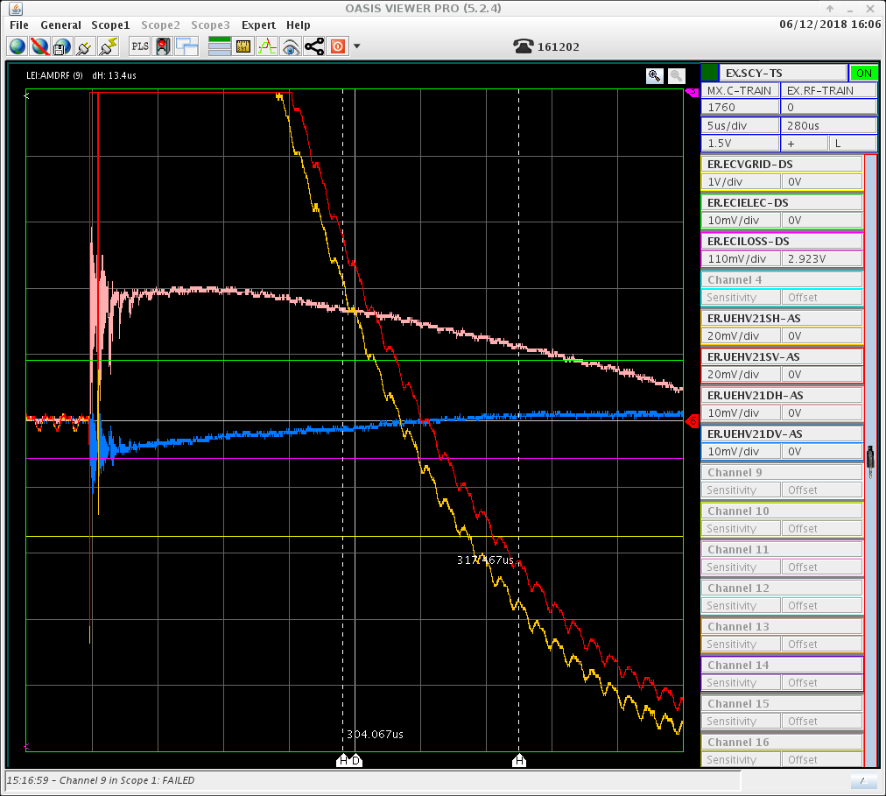
Measurements of the electron beam position?
Advance RF capture to get signal from bunched beam
Zooming in to 5us/div to look in detail at the signal
Electron signal (modulated by bunched ion beam)
Bunched ion beam
Switch off Ecooler

Slide 34
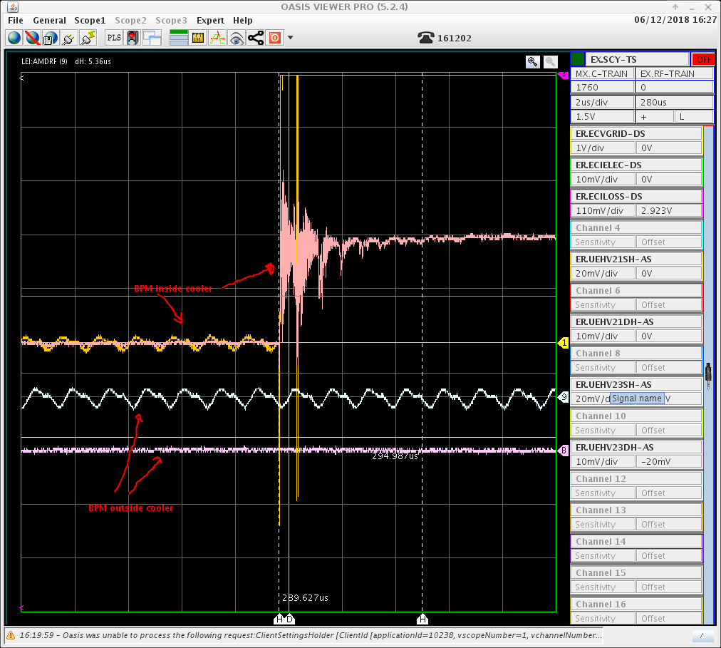
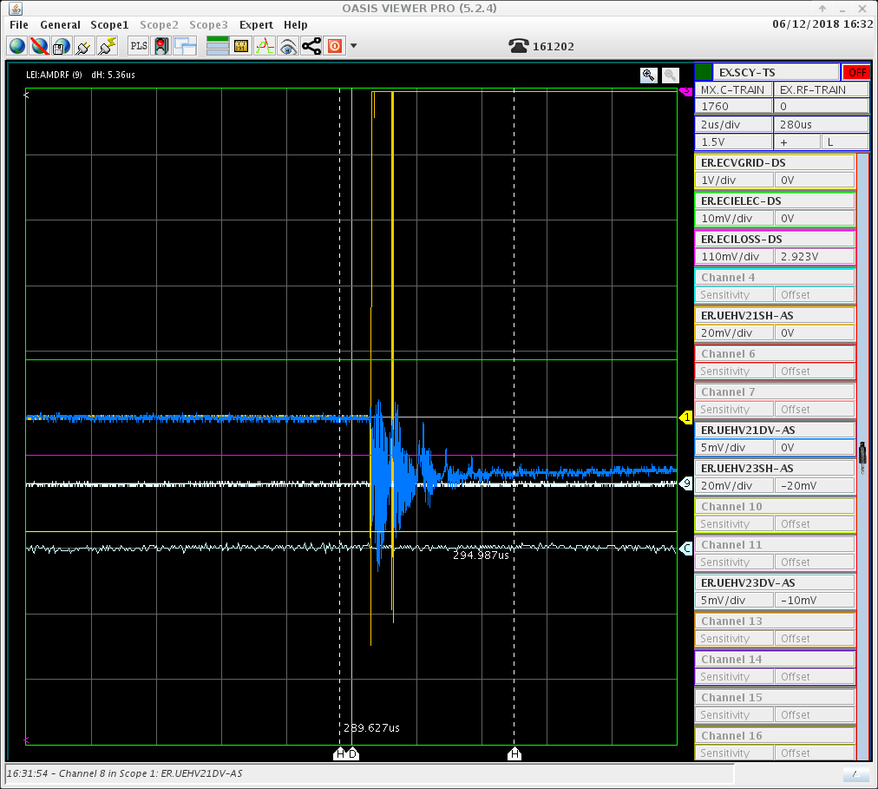
Measurements of the electron beam position?
Compare signals from a pick-up inside e-cooler and one outside
With ion beam
Without ion beam

Slide 35
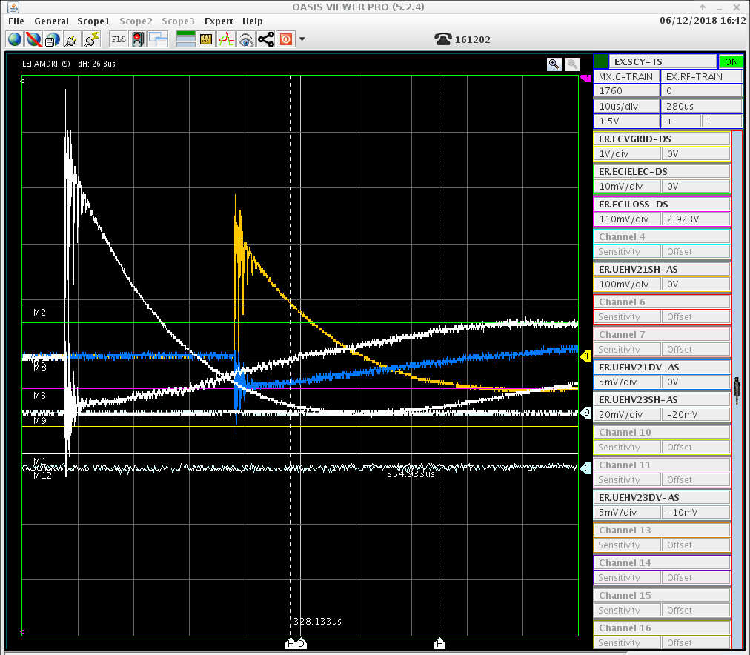
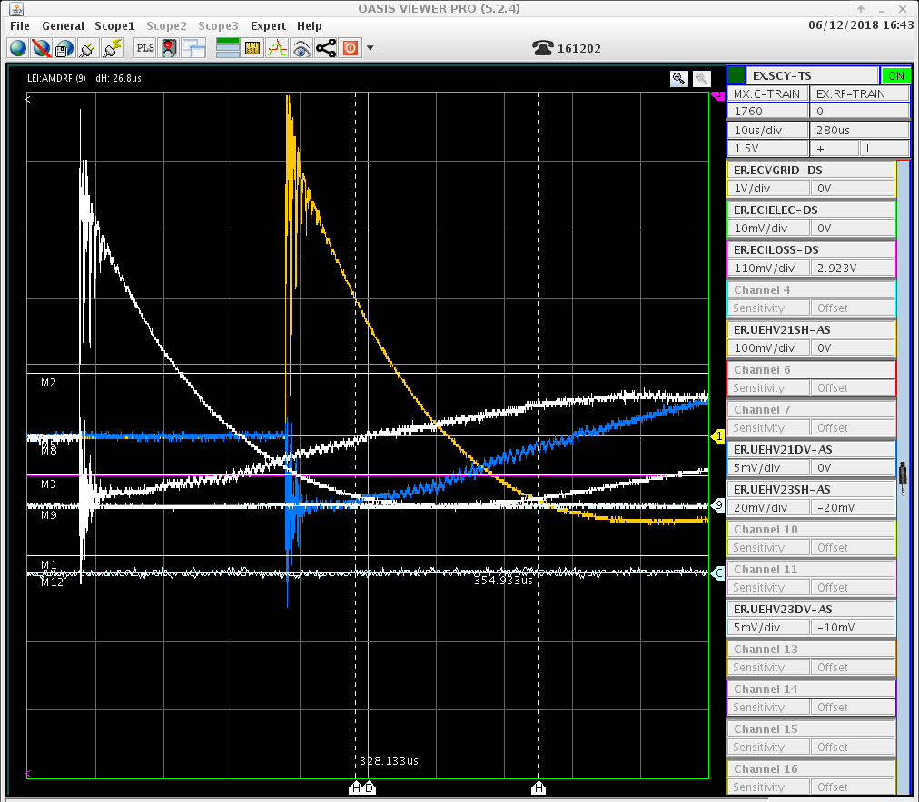
Measurements of the electron beam position?
Different amplitude proportional to electron beam current?
White signals: reference for 340 mA default case
Reducing current from e-cooler to 210 mA Increasing current from e-cooler to 430 mA

Slide 36
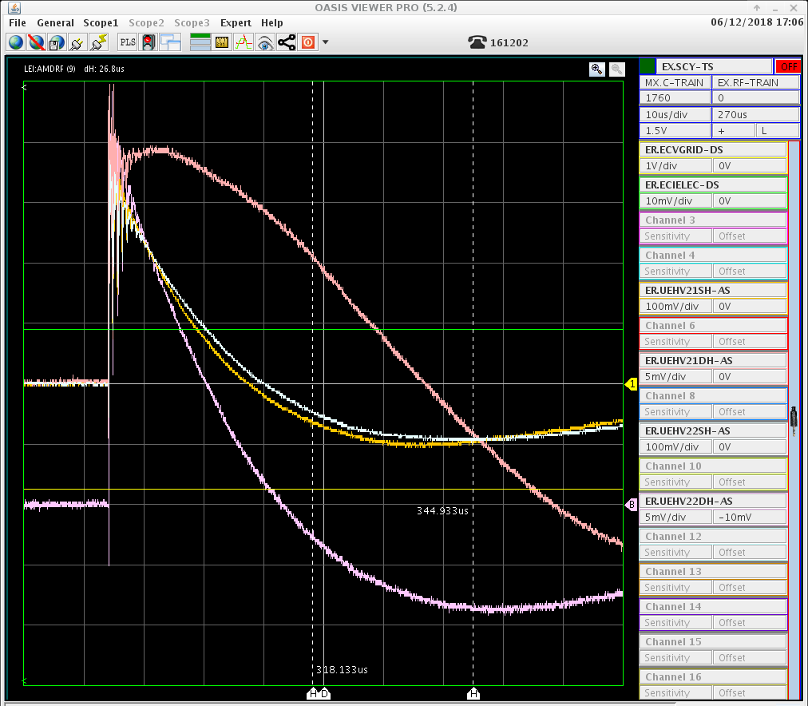
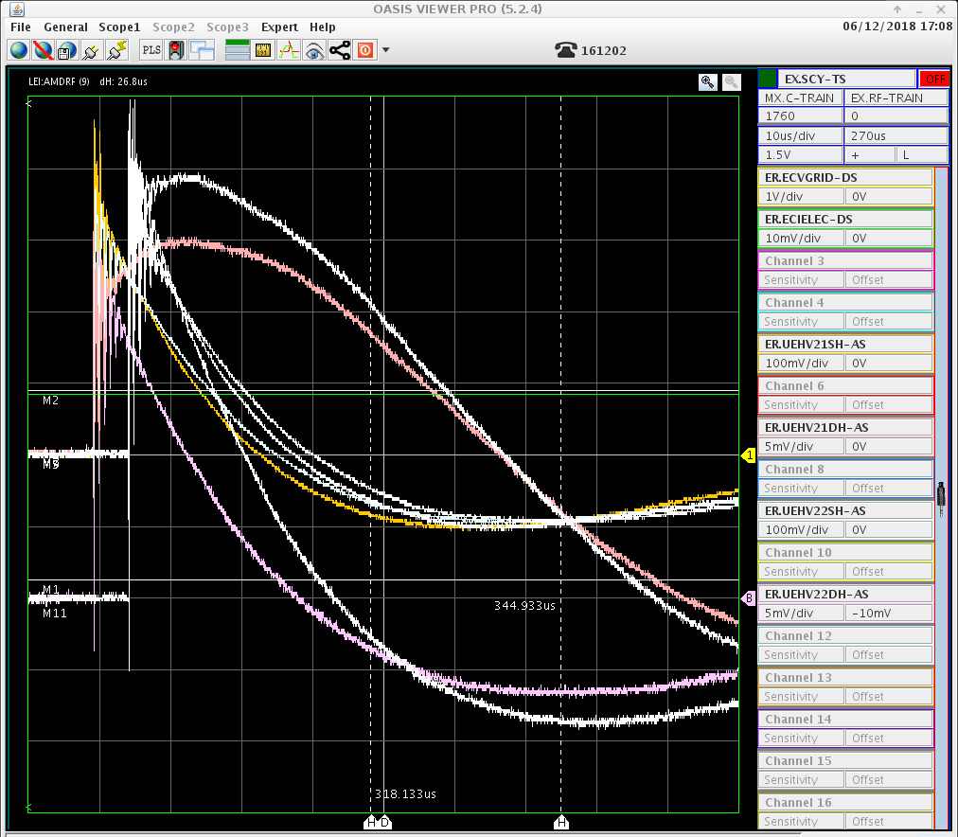
Measurements of the electron beam position?
Sum and difference signals of the two Horizontal pick-ups inside Ecooler
Changing (slightly and very carefully!) a coil inside the cooler: 3A → 2A
Additional: measurements while switching OFF filament by A. Frassier (at beginning of shut down) confirm measured signal from e-beam

Slide 37
Measurements of the electron beam position?
Conclusions:
Signal from e-beam when Electron cooler switched off, proportional to beam current and varies with coil current
  Can it be calibrated?
  Any other measurement possible?
Crazy idea (just for discussion):
Retractable screen inside electron cooler for e- position + distribution measurements?
    Could stand high e-current? If only for smaller e-currents, should we expect same results?
  Space between solenoid sections? Otherwise: screen just outside + let e-beam go through? High radiation levels in open hall?

Slide 38
Thank you for your attention!

