Slide 1
Simulation and code development plans for LS2
Andrea Latina
Acknowledgments and credits:
Nicolò Biancacci, Davide Gamba, Angela Saa Hernandez,
Michalis Zampetakis, Simon Hirlander. A.Frassier, G.Tranquille.
Javier Résta Lopez, Bianca Veglia (University of Liverpool)
E-beams meeting - 13-3-2019

Slide 2
Cooling at LEIR
The Electron Cooler is essential for LEIR operation, but it’s complex and with limited diagnostics → instead characterized by studying the effects on ion beam
We want to use simulation tools and dedicated experiments to understand the performance limitations and overcome them.
Not many “simple” codes either… measurements to benchmark the newly developed Electron Cooling module of the code RF-Track.
NB, DG, ASH, MZ, BV, JRL and myself, started a series of meetings on “Beam Dynamics and Electron Cooling”, now part of this project
https://indico.cern.ch/category/10717/

Slide 3
Outline of this presentation
Theory and simulations
  New ideas, new code [ AL ]
  Benchmark against other codes [ BV ]
  Benchmark against measurements [ AL, NB, DG ]
New studies to be performed
  Simulation work
  Code development
Resources available
Notes:
Teoria e simulazioni fatte fin'ora (e.g. allineamento, corrent, profili, singola iniezione, multi-iniezione etc..),
Misura della forza (e.g. effetto del rise time)
set di misure fatte (e.g. allineamento, corrente, profili) e ove possibile confronto con simulazioni
identificare i parametri chiave (presenti e/o mancanti), e.g. relative impact of different parameters, e.g. angle vs position
planning delle simulazioni in LS2 (e.g. confronto 200ms vs 150ms injection rate: fattibile?)
* EC, IBS, SC
planning del lavoro sul codice
chi lavora su cosa (e quanto puo’).
RESOURCES:
NB =
DG = Supervisione Bianca su Betacool[ ELENA ]
AL = ??%
MZ = 100% (?)
BV = Liverpool PHD Student, su ELENA and LEIR data analysis
New PhD Student ? Analisi dati / simulazioni (SC + impedances) + code development

Slide 4
EC: Theory and simulation
Physics of electron cooling:
Some good references are in my previous presentations
Two aspects are important:
Model of the binary cooling force: “single ion – many electrons”
Inclusion of the electrons’ thermal effects
Example of “single ion – many electrons” cooling force:
V.V. Parkhomchuk: Nucl. Instrum. Meth. Phys. Res. A 441, 9 (2000)
The new code (RF-Track) implements:
A sound theoretical model of the binary cooling force
A virtually exact integration of the electrons’ thermal effects

Slide 5
RF-Track simulation:
Hybrid-Kinetic Model
Full 6D multi-particle ion simulation + electron plasma
The electrons’ parameters are stored on a 3D grid mesh: each cell carries
  Electron density and velocity
  Local magnetic field
This enables the simulations of realistic conditions:
Hollow / parabolic beams
Misalignments ions / electrons / magnetic fields

Slide 6
RF-Track simulation:
Hybrid-Kinetic Model

Slide 7
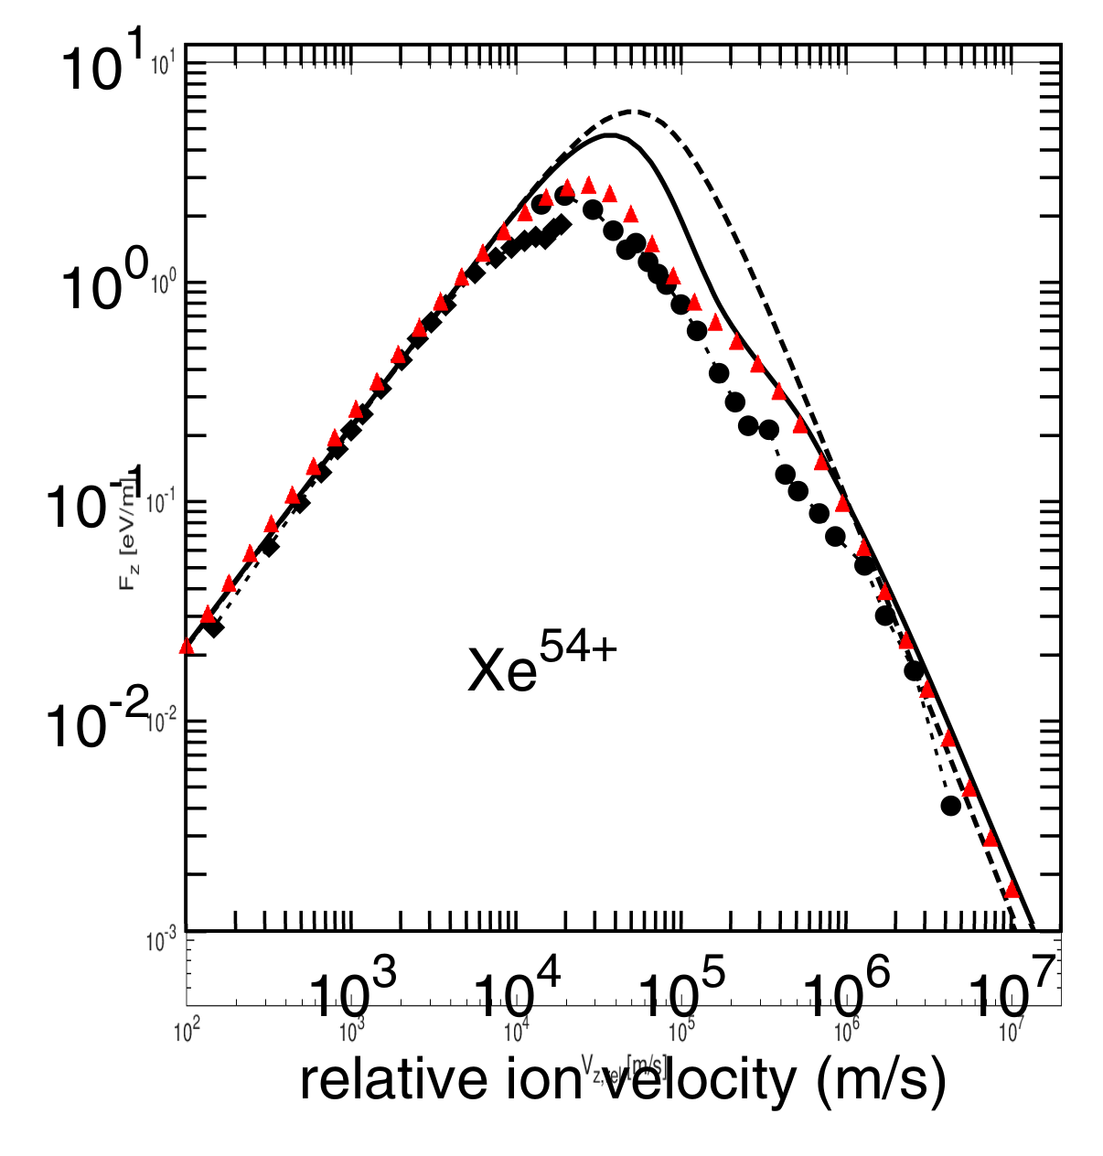
Benchmark against literature
ESR Ring (GSI):
Longitudinal cooling force for various fully stripped Xe⁵⁴⁺ ions as function of the relative ion velocity with respect to the rest frame of the electron beam.
Black marks: experimental data.
Solid curve: binary collision approximation.
Dashed curve: Parkhomchuk’s empiric formula (BETACOOL).
Red triangles: RF-Track

Slide 8
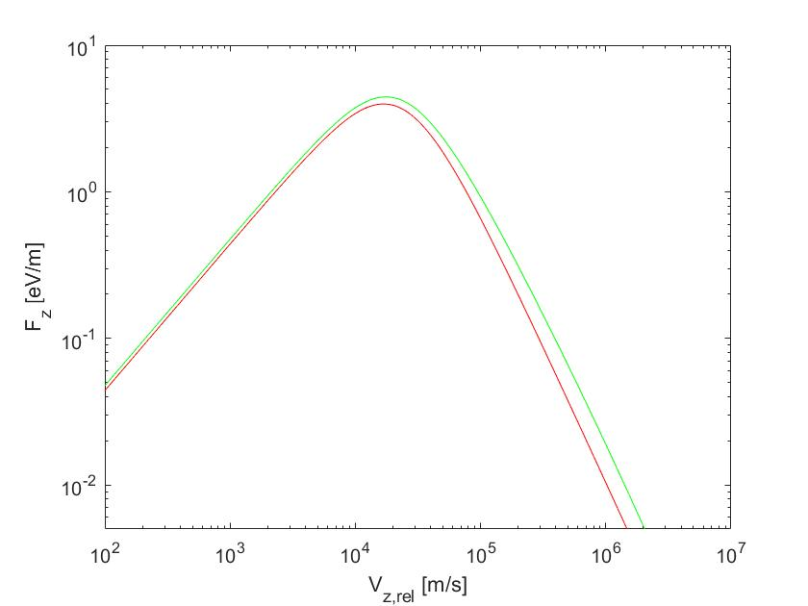
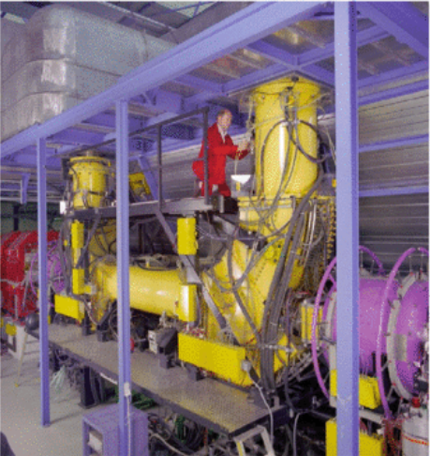
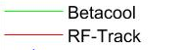
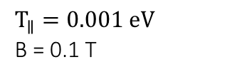
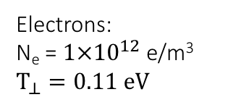
“Single-ion” cooling force at ESR (GSI)
BETACOOL vs RF-Track Simulation
Ions:
A = 131.2 proton mass (Xenon)
Q = 54⁺
Electrons:
N_{e} = $1×{10}^{12}$ e/m³
$$T_{⊥}=0.11 eV$$
$$T_{∥}=0.001 eV$$
B = 0.1 T
B. Veglia

Slide 9
Measurement of the cooling force

Slide 10
Benchmark against measurements
Simulation setup:
Pb ions
Q = 54+
𝛽 = 0.0943; 𝛽𝛾 = 0.0947
Initial geometric emittance = 7 mm.mrad
Initial P spread = Stacked gaussians, ±10⁻³
Cooler (fitted to match measurements)
Ne = 4e13 e/m³
T⟂ = 0.01 eV ; T∥ = 0.001 eV
Note: the e⁻ current depends on the electron beam size
Measurements performed with Nicolò B., Davide G.

Slide 11
Consistency check:
Simulation of the measurement
Analytic formulæ: Simulated force

Slide 12
Dependence from the electron current
The fact that the peak shifts with the current, indicates that something more happens. E.g.
Electron gun rise time?
Electron beam profile?
Other effects?
Measurements performed with Nicolò B., Davide G.

Slide 13
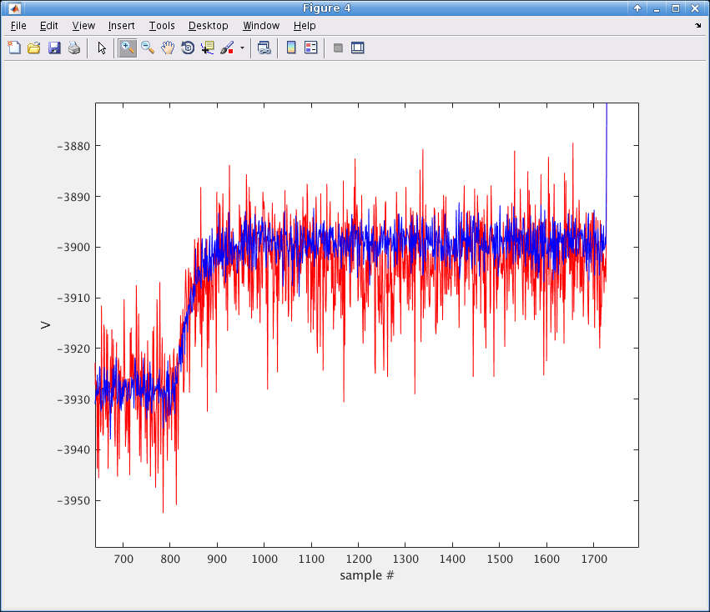
Effects of the electron gun rise time
Measured rise time is of the order of 100 ms (one sample every ms in the LHS plot)
(eLogBook: 14/05/2018)
Conclusion: we need to feed the simulation with a reasonable rise time and then estimate the cooler parameters

Slide 14
Studies of equilibrium values
[Simulation]

Slide 15
On-going and new studies
  Analysis of existing data and verification in simulation:
    E.g. Various electron currents, Emittance angle – position scans, bunched beams
  Simulation studies:
  Interplay between cooling and heating
    IBS, SC, Ion stripping [ Michail, Bianca, Angela ]
    Impedance [ Nicolò, Andrea ]
  Impact of other machine parameters:
    e.g. impedance, coupling, etc. [ Nicolò, Andrea ]
    Bunched beam? [ Michail, Angela ]
  New studies:
    Performance simulations and parameters optimisation for ELENA ?
    Performance simulations and parameters optimisation for AD ?
  Code review and development:
    Link: pyheadtail <-> RF-Track (EC),
    BLonD^{(*)} <-> RF-Track (EC)
    Review of IBS models: SIRE, MAD-X, …
    Implementation of IBS (kinetic model) into RF-Track
    (*) Longitudinal tracking code
Notes:
ntra-beam scattering in RF-Track (e chissà Intra-beam stripping se troviamo evidenza che esiste)
* Impedance in LEIR + cooling (Nicolò sta facendo calcoli preliminari)
* Simulazioni di bunched beam?
* Simulazioni di ELENA?
* Simulazioni e ottimizzazione del nuovo cooler per AD?

Slide 16
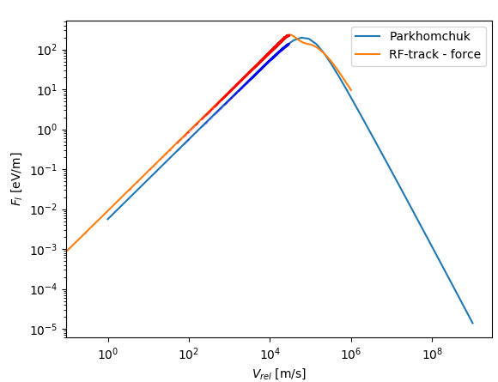
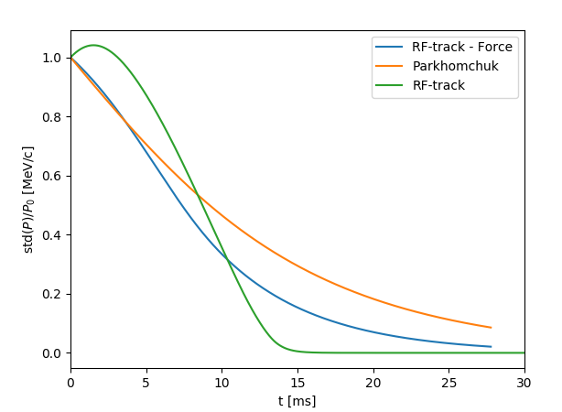
Integration RF-Track - PyHEADTAIL
Very preliminary result, work ongoing
First step to the integration to pyheadtail
Credits: Nicolò B. and AL

Slide 17
From Electron-Cooling to Electron Lenses Simulation
﻿The EC simulation considers
  Scattering ion-electrons (friction force)
  Ions self-fields in free space
It ignores:
  Electrons self-fields
  Electrons dynamics in plasma electrons are considered as rigid (i.e., their state parameters are constant)
In order to simulate E-lens one should also consider
  The self-fields created by the electrons (mostly magnetic)
    Need to extend the electron plasma simulation (some work needed)
  The effect of the ion bunch on the electron plasma
    Implement the Euler's equations of fluid dynamics (some work needed)
  To complete the picture: the shieling effect of the electrons on the ions self-fields (some work needed)
Resource needed:
  My time or the help of 1 person with good programming/simulation skills and good physics background

Slide 18
Resources for LEIR EC Studies
  A fraction of:
  Andrea
  Nicolò
  Davide [ELENA, AD]
  Post-Docs:
  Angela (not for long…)
  Students:
  Michail [100%]
  Bianca Veglia (University of Liverpool, already half-way)
  New PhD student?

Slide 19
Conclusions and next steps
  We have simulation tools that allow us to simulate electron coolers
  Initial benchmarks give expected results. Detailed studies can start.
  We have performed many different measurements, but most of them haven’t yet been reproduced in simulations (mainly because of lack of resources).
  Limited resources -> we’ll need to prioritise studies, and possibly get some additional help.
  We need to fully conclude on the cooler parameters that would best fit our observation (force, effect of currents, cooling maps, rise time), to be then safe to extrapolate to interesting cases (e.g. 150ms injection repetition rate vs 200ms presently used) .
  The code can be used for ELENA and AD.
  With some extensions, also for Electron lenses.

