Slide 1
Higgs boson mass measurements
W. Verkerke (Nikhef)

Slide 2
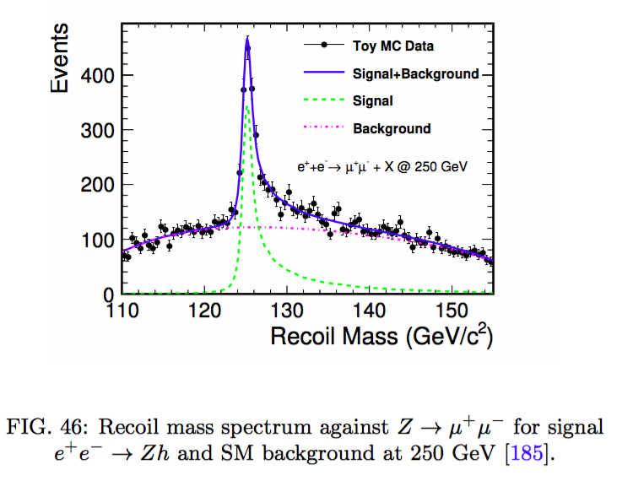
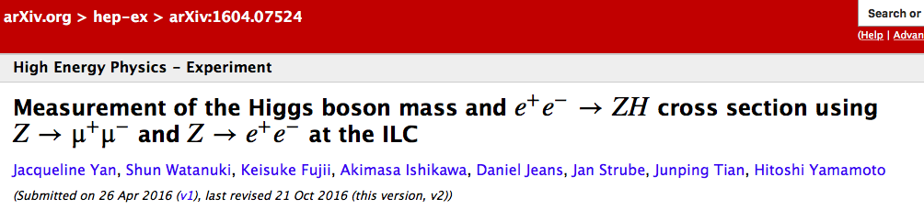
ILC
Measurement of recoil mass in ZH at 250 GeV
(From March 8th long report), refers to 2016 dedicated paper
250 fb-1 of 80/30 polarized beam:
dM_{H} = 37/41 MeV (dep on LR/RL)
Ultimate (‘20 year running’)
dM_{H} = 14 MeV

Slide 3

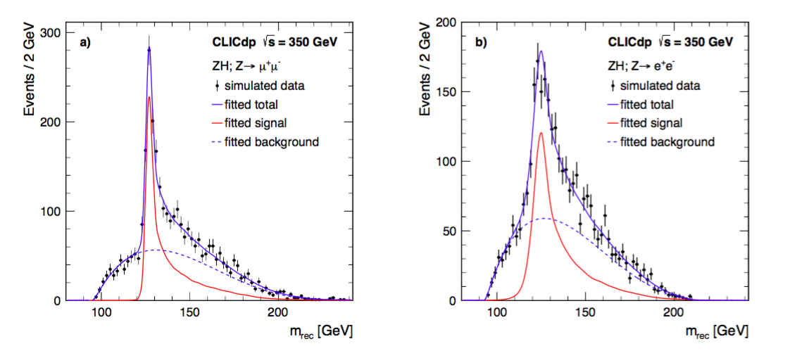
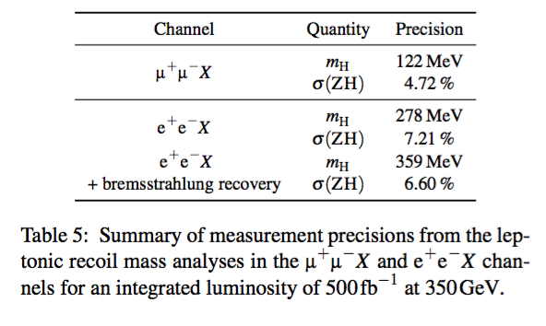
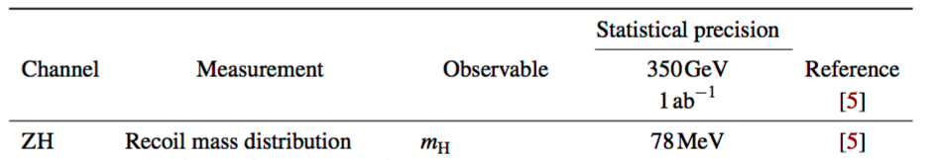
CLIC 350
Source document arXiv:1608.07538
Also uses recoil mass method
  In leptonic Z channel at sqrt(s)=350 GeV, 500 fb-1
Summary document arXiv:1812.01644 states in summary table
a simple sqrt(2) scaling from the number above for 1 ab-1

Slide 4
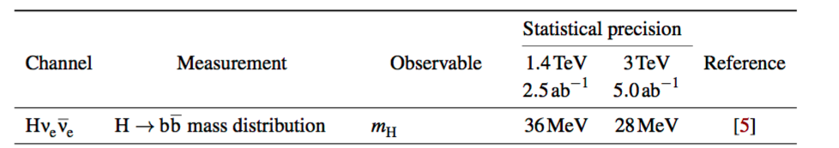
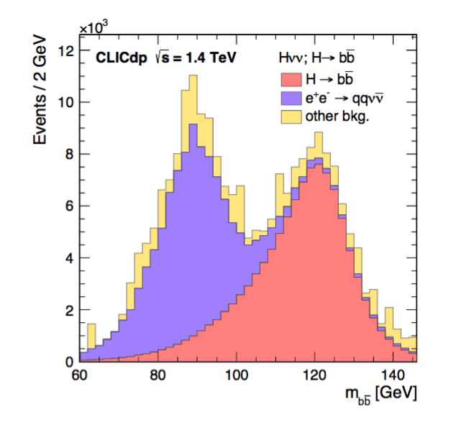
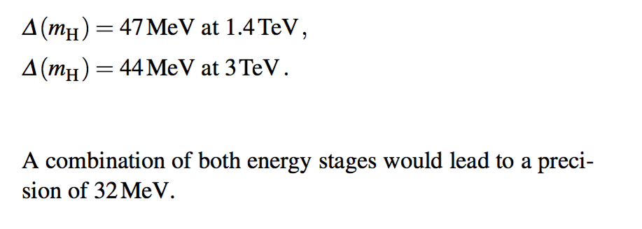
CLIC 1400/3000
From arXiv:1812…
From [5] = arXiv:1608.07538
assumes 1.5 ab⁻¹, 2 ab⁻¹ for 1.4/3.0 TeV
stat-only precision,
combination below
is ‘simple average’
“An uncertainty on the jet energy scale of
3.5 × 10⁻⁴ leads to a systematic uncertainty on the
Higgs mass similar to the statistical error at 3 TeV.”

Slide 5
CLIC 1400/3000
From arXiv:1812…
Statements on the b-jet scale calibration
σ(Zνeνe)×BR(Z → bb) = 276fb leads to an expected number of events for calibration which is slightly larger than the signal event sample.
To improve the precision further, additional high-statistics Z boson samples would be needed.
Generator-level studies show that e±γ → Ze±;Z → bb with a cross section about one order of magnitude larger compared to the signal process is a promising channel for this purpose.
From [5] = arXiv:1608.07538
assumes 1.5 ab⁻¹, 2 ab⁻¹ for 1.4/3.0 TeV
stat-only precision,
combination below
is ‘simple average’
“An uncertainty on the jet energy scale of
3.5 × 10⁻⁴ leads to a systematic uncertainty on the
Higgs mass similar to the statistical error at 3 TeV.”

Slide 6
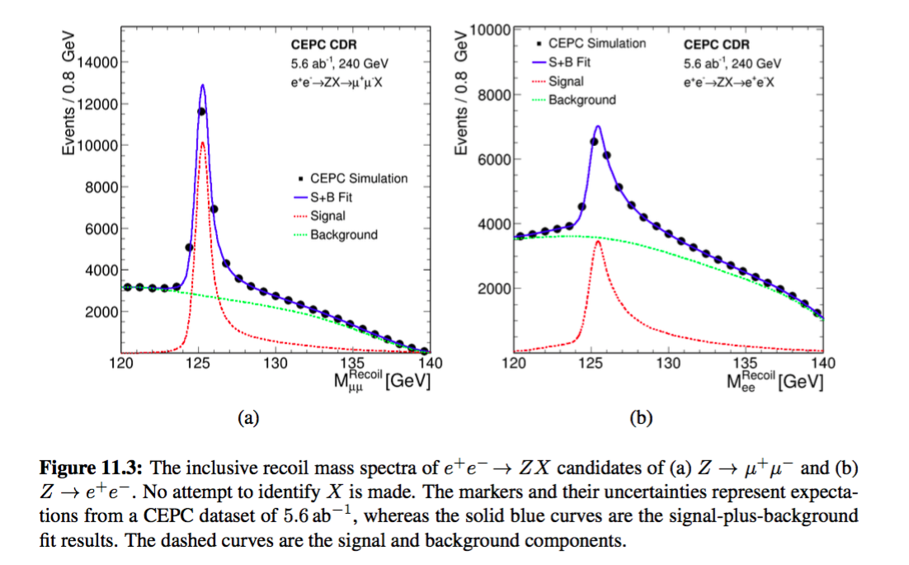
CEPC
Source – Conceptual Design Report 2.0 – 240 GeV/5.6 ab⁻¹
  Recoil mass method
“The Higgs boson mass can be determined with precision of 6.5 MeV and 14 MeV
from the Z → μ+μ and Z → e+e decay modes, respectively.
After combining all channels, an uncertainty of 5.9 MeV can be achieved.”

Slide 7
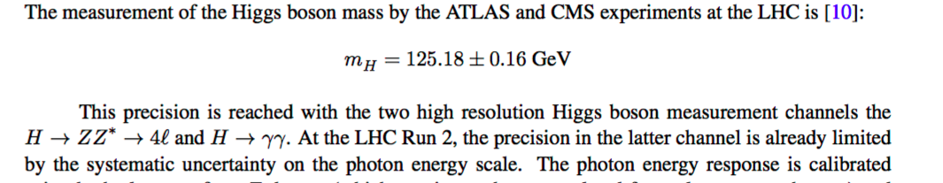
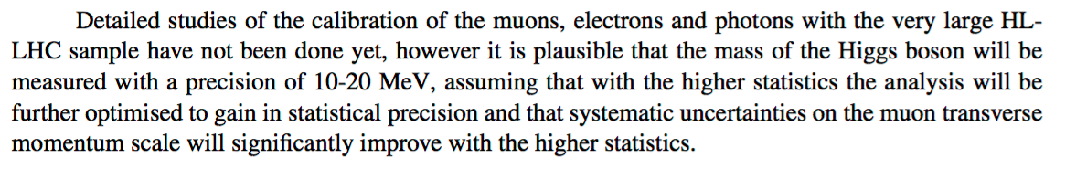
HL-LHC
From Yellow Report: delta(mH) in LHC-Run2 = 160 MeV
Furthermore it states…precision of 10-20 MeV in reach at HL-LHC

Slide 8
Summary
Table of results presented in this talk
No numbers provided by FCC, but FCC-ee should perform
comparably to CEPC based on luminosity
Accelerator | Energy | Lumi | delta(mH)
ILC | 250 | 250 fb⁻¹ | 37/41 MeV
ILC | 250 | ‘20 years’ | 14 MeV
CLIC | 350 | 500 fb⁻¹ | 110 MeV
CLIC | 1400 | 2.5 ab⁻¹ | 36 MeV*
CLIC | 3000 | 5 ab⁻¹ | 28 MeV*
CEPC | 240 | 5.6 ab⁻¹ | 5.9 MeV
HL-LHC | 14 | 3 ab⁻¹ | 10-20 MeV **
* Systematics apply, but not included (may be comparable to stats)
** ‘Plausibly in reach’ based on LHC-Run2 precision of 160 MeV

