Slide 1
The Kappa Framework – implementation adopted by the group
W. Verkerke (Nikhef)

Slide 2
Kappa-framework - generalities
Introductory notes on use of kappa formalism
  Follow kappa framework formalism as described in (e.g.) YR3.
  K-framework clearly not ultimate/ideal framework for high-precision interpretation of future Higgs data, but chosen to be used because it’s well-known, most current LHC-Higgs results are formulated in it, it can effectively capture the performance of (future) detectors well in similar ways → useful for side-by-side comparisons.
  K-framework only captures a subset of the future accelerator Higgs data, notably not self-couplings, and information learned from polarization(?) runs.
  Ignored here, but included in EFT fits.
Choices made in parameterization – maximum flexibility
  7 parameters for coupling modifiers of W,Z,t,b,c,τ,μ
  3 parameters for effective couplings to g,γ,Zγ
  (i.e. don’t resolve loops in expected SM contributions)
  Up to 2 parameters that allow for BSM contributions to Higgs width
  𝛤​_{H}/​ 𝛤​_{H}^{S​M}​ = 𝛴(k_{​j}²​ ​×BR_{j}​^{S​M})​ /(1-BR_{B​SM})​ explicitly distinguishing
  ‘invisible’ from ‘untagged’ contributions: BR_{BSM}=BR_{inv}+BR_{unt}
    At any collider BR_{inv} can be constrained from various H→invisible reconstructions
    At lepton colliders Higgs total width can (also) be measured, constraining BR_{inv}+Br_{unt}, and thus effectively BR_{unt}
    NB: BR_{unt} will also absorb the effect of unmeasured Higgs decays where the coupling deviates from the SM value (i.e. if k_{c} is not equal to one, but not explicitly measured, its effect will be absorbed also in BR_{unt})

Slide 3
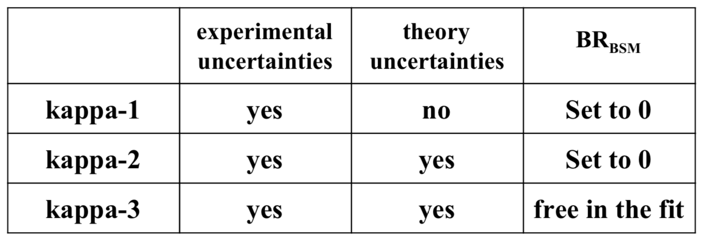
Kappa-framework – scenarios for each FA standalone
Define multiple scenarios of kappa fits with goal to estimate various contributes to uncertainties
  Statistical + experimental systematics
  Theoretical uncertainty
  Uncertainty due to Higgs width assumptions
To this end define three fitting scenarios
  In all three scenarios BR_{inv} is always floated (and constrained from invisible decays)
  BR_{unt} in k-3 will more strongly constrained for FA that measure total width
  HL-LHC has multiple scenarios for theory systematic uncertainties – we choose to use ‘S2’
  Is precise scope of ‘theory uncertainty’ well established for all FA?
BR_{unt}
Effect of theory
uncertainties
Effect of width
uncertainty

Slide 4
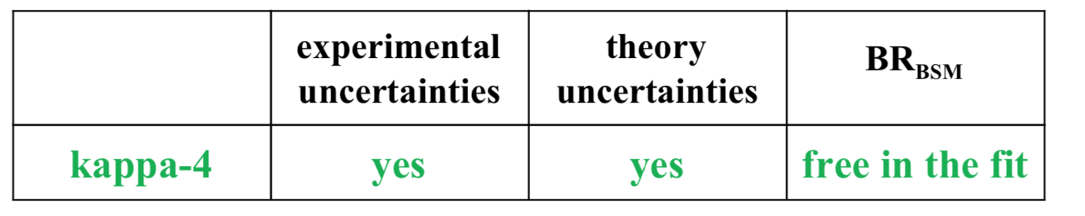
Kappa-framework – scenarios for HL-LHC+FA
In addition to stand-alone characterization of each FA, also rerun scenario 3 in combination with HL-LHC → Scenario 4
  Largest impact expected for rare decay couplings in lepton FA
  (where HL-LHC will continue to make significant impact)
Some open points for discussion
  How does this relate to 10y/ultimate discussion for FA’s → I imagine we run kappa-4 for both scenarios
  What about FCCee/hh? Do we also consider both the
  HL-LHC+FCC-hh and the HL-LHC+FCC-ee+FCC-hh scenarios?
Effect of
HL-LHC
BR_{unt}

Slide 5
Kappa-framework – some other technical choices made
Using Jorge’s Bayesian framework → Bayesian credible intervals reported instead of Frequentist confidence intervals.
  In limit of (close-to) Gaussian distribution probably not important
  It may make a small difference for upper limits on BR_{inv},BR_{unt} → I propose we just report it and don’t do any further work on this
ATLAS+CMS HL-LHC combination is ‘BLUE’ combination and not a full likelihood combination. We make (only) likelihood-level combinations
  Some level of discrepancy is therefore inevitable between L-combination in our results and official HL-LHC results
  Compounding issue is definition of theory systematic uncertainty from covariance matrix variants.
  All HL-LHC + FA combinations will effectively be with L-combination of ATLAS+CMS. Need to be clear about this (I assume that we will in any case show scenarios 1,2,3 for HL-LHC standalone)

