Slide 1
WP4: Task3 - Modulator and Klystron technology
Update
Discussion with T. Anno from CANON ETD
  klystron E37113(C) with different operation conditions for variable repetition rate is available (repetition rate limited by collector dissipation )
  6.2 MW peak power, 175 kV, 115 A
  received proposal of the specifications for X-band 6 MW klystron and accessories
  pulse changes with variable repetition rate :
 | 400 pps | 500 pps | 750 pps | 1000 pps
Pulse width ¹ | 7.5 us | 6.0 us | 4.0 us | 3.0 us
Pulse width RF ² | 5.0 us | 3.5 us | 1.5 us | 0.5 us
¹ Pulse width (duration) measured between the 75% points of the beam voltage pulse.
² Pulse width RF is measured between the 3 dB points of the RF output pulse.

Slide 2
JEMA interested in development higher rep rate modulators
2 modulators for IFIC Valencia (S-band, but for the modulator the frequency of the tube is not an issue)
Specifications:
  150kV 110A , 16.5 MW peak power , 10us maximum pulse length, rep rate 400Hz
They could consider TWIN modulator but point out the it saves mainly space :
  One control
  One pulse transformer (somewhat larger but not twice the size)
  Smaller oil tank
  Power electronics only a small benefit

Slide 3
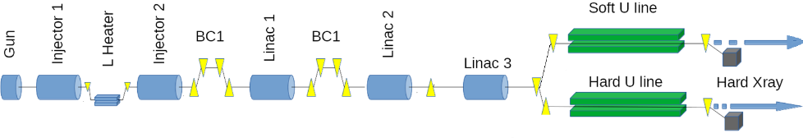
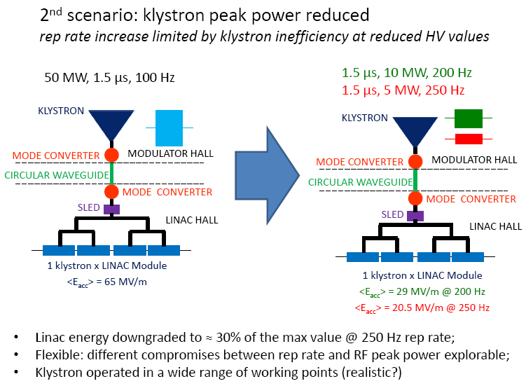
WP4: Task3 - Modulator and Klystron technology
Soft FEL
Linac energy gain : 2 GeV
Repetition rate 1000 Hz
Smart solution : use the same 20 high-power RF units as in Hard FEL case
… but as studies of Frascati groups shown it does not scale well
Rep rate increase is limited by klystron inefficiency outside working point

Slide 4
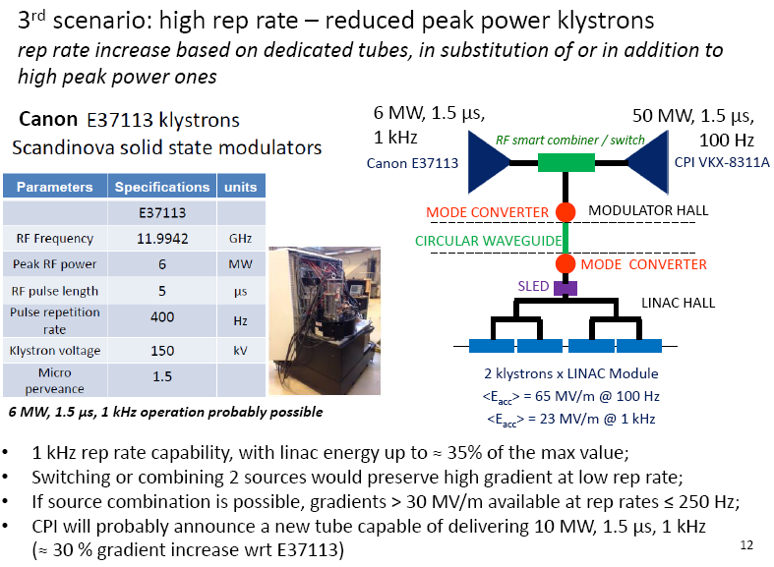
WP4: Task3 - Modulator and Klystron technology
Soft FEL
Linac energy gain : 2 GeV
Repetition rate 1000 Hz
Repetition rate can be increase based on dedicated tubes,
in substitution of or in addition to high peak power ones
Same modulator for 2 tubes only possible is the voltage is the same for both
Means 2 klystrons and 2 modulators per Linac module

Slide 5
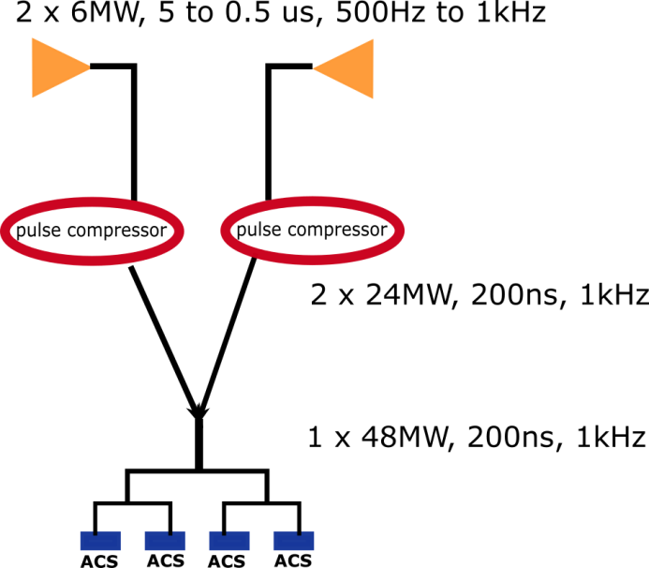
WP4: Task3 - Modulator and Klystron technology
Smart solution might be out of reach
We should prepare two schemes
Soft FEL
High repetition rate achievable with Canon tubes (or CPI when they appear)
Pulse shortening will reduce the compression rate, but the flexibility with repetition rate of the tube is big advantage

Slide 6
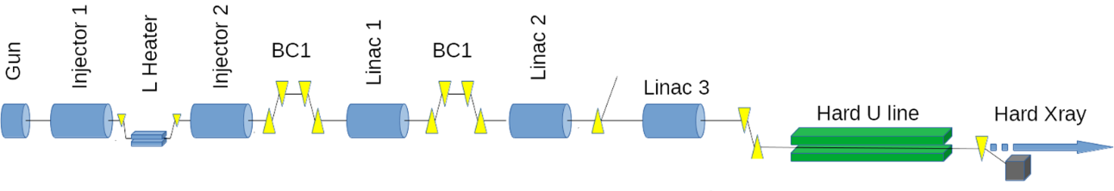
WP4: Task3 - Modulator and Klystron technology
Hard FEL
Baseline for RF unit:
1 modulator
1 klystron -> 50 MW, 1.5 us
1 SLED compressor -> ~160 MW
4 ACS modules -> 65 MV/m gradient
Repetition rate 100 Hz
Linac energy gain : 4.5 GeV
Power per single structure from klystron 10 MW
Total: 20 RF units

Slide 7
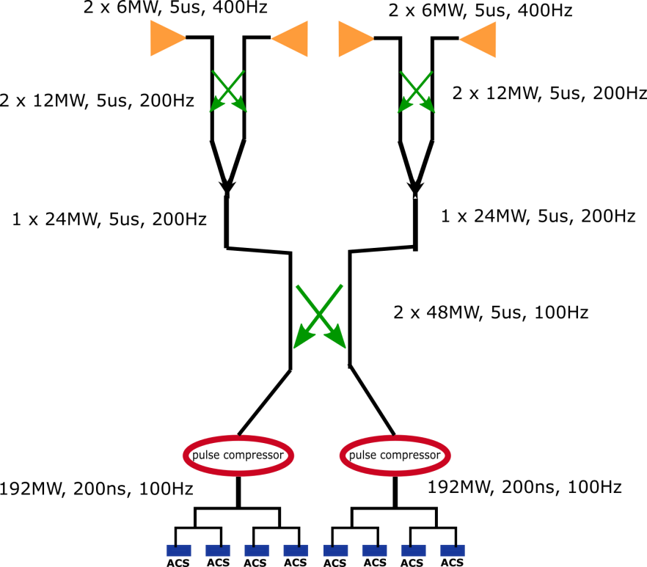
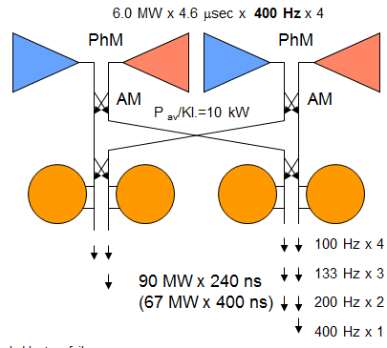
WP4: Task3 - Modulator and Klystron technology
Alternative if we want to use the same tubes
low rep rate … modular system à la X-Box3 switching
X-Box3
We should push for dual-X-band modulator

Slide 8
