Slide 1
WP4: RF systems
Update on the 36 GHz and 48 GHz power sources
Liang Zhang, Laurence Nix, Wenlong He, Li Wang & A.W. Cross
on behalf of research teams of
Department of Physics, SUPA, University of Strathclyde, Glasgow, G4 0NG, UK
Electronic Engineering Department, UESTC, Chengdu, China

Slide 2
Outline
36GHz 2 MW gyroklystron simulation results
36 GHz 3 MW gyroklystron simulation results
48 GHz 1.5 MW studies

Slide 3
36 GHz, 2 MW gyro-klystron design
Voltage (kV) | 95 | Current (A) | 45
Velocity ratio | 1.3 | Drive power (W) | 200
Beam guide radius (mm) | 2.3 | Magnetic field (T) | 1.33
Result
Power (MW) | 1.9 | Bandwidth | 0.3%
Efficiency | 44% | Gain (dB) | 39 (max 42)

Slide 4
36 GHz 3 MW gyroklystron design
Voltage (kV) | 150 | Current (A) | 45
Velocity ratio | 1.4 | Drive power (W) | 400
Beam guide radius (mm) | 2.3 | Magnetic field (T) | 1.46
result
Power (MW) | 3.0 | Bandwidth | 0.3%
Efficiency | 44% | Gain (dB) | 39 (max 42)
Similar configuration but with a higher operating voltage
  it is challenging to Increase the current using an MIG, it will reduce the beam quality, reducing the interaction efficiency

Slide 5
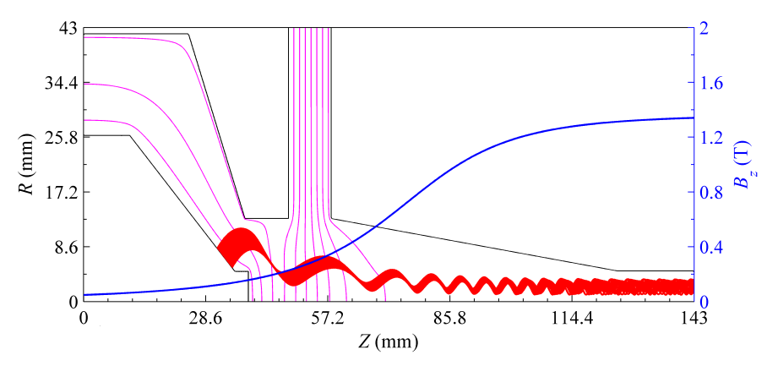
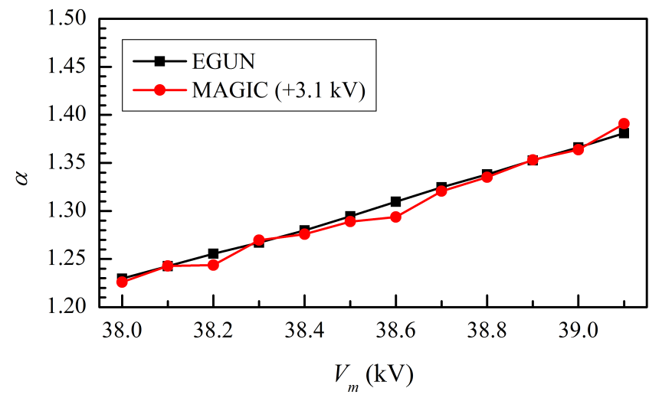
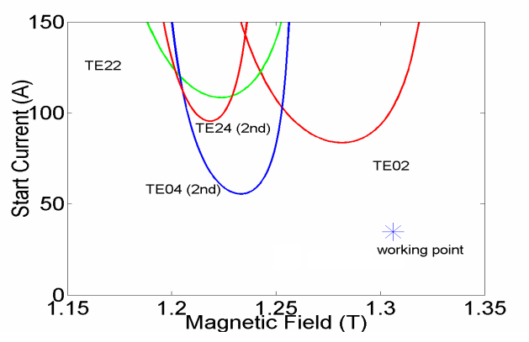
36GHz simulation results
Need to avoid the oscillations at high beam current.
Choose the proper magnetic field strength.

Slide 6

48 GHz 1.5 MW Gyroklystron
A 4-cavity gyro-klystron was studied.
Higher order mode TE02 was considered to have larger dimensions.
Challenges:
Higher frequency, smaller dimensions has limit in the beam current due to the space charge effect.
More challenges in the thermal management due to the smaller cavity dimensions.
The previous nonlinear model was not able to provide accurate prediction on the interaction efficiency, due to:
  Field is not entirely cutoff at the drift region.
  Mode conversion happens at the discontinuities.

Slide 7
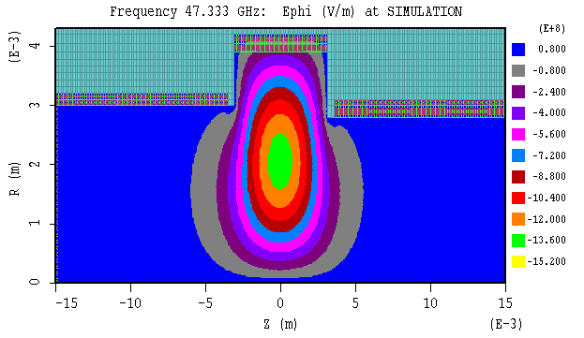
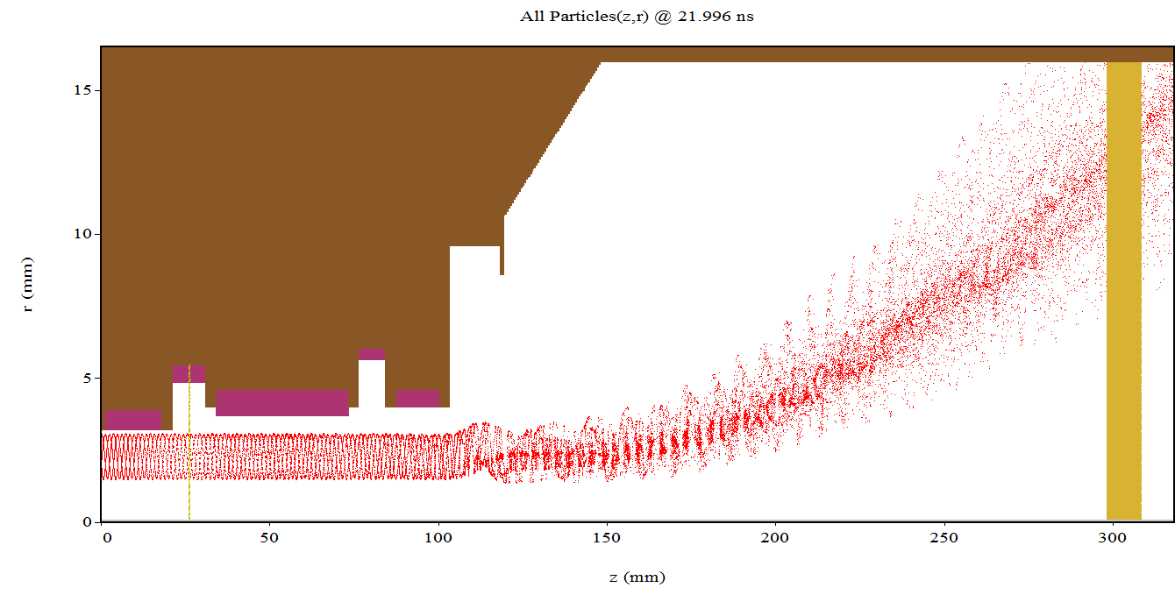
Recent progress
Improved model is under development and is tested.
In parallel, a 3-cavity similar configuration with the 36 GHz one is being simulated.

Slide 8
Deliverable
Software
MATLAB:
  linear small gain simulation
  self-consistent nonlinear code
CST microwave studio
  3D EM eigen solver, Cavity eigen mode
EGUN
  2D Particle tracking simulator, electron gun design
OPERA
  3D Particle tracking simulator, verify electron gun design
MAGIC
  2D/3D Particle-in-cell simulation
  MIG gun simulation
ANSYS
  thermal analysis

Slide 9


Acknowledgement
This work is supported by the European Commission Horizon 2020 Project “CompactLight” (777431-XLS), and the State Scholarship Fund from the China Scholarship Council and the STFC, UK (Cockcroft Institute Core Grant)
Thank you for your attention!

Slide 10
