Slide 1

Future Circular Collider
Designing a Future Circular Collider: Challenges & Perspectives
Dr. Michael Benedikt (CERN)

Slide 2

Discoveries by colliders
Standard Model
Particles and forces
LHC:
Higgs-boson
SppS:
Z-boson
W-boson
Tevatron:
top-quark
PETRA:
gluon
SPEAR:
charm quark
tau lepton
Colliders are powerful instruments in High Energy Physics
for particle discoveries and precision measurements
Notes:
New slide from Davide.
Showing that conductor development is launched at international level, Russia, Japan, (Korea and Europe in preparation)
Underline importance of that development as main cost driver for the hadron collider machine.

Slide 3
Still many open questions
    Standard model describes known matter, i.e. 5% of the universe!
    what is dark matter?
    what is dark energy?
    why is there more matter than antimatter?
    why do the masses differ by more than 13 orders of magnitude?
    …
Known Matter 4.9%
Dark Matter 26.8%
Dark Energy 68.3%
galaxy rotation curves, 1933 - Zwicky
Notes:
New slide from Davide.
Showing that conductor development is launched at international level, Russia, Japan, (Korea and Europe in preparation)
Underline importance of that development as main cost driver for the hadron collider machine.

Slide 4
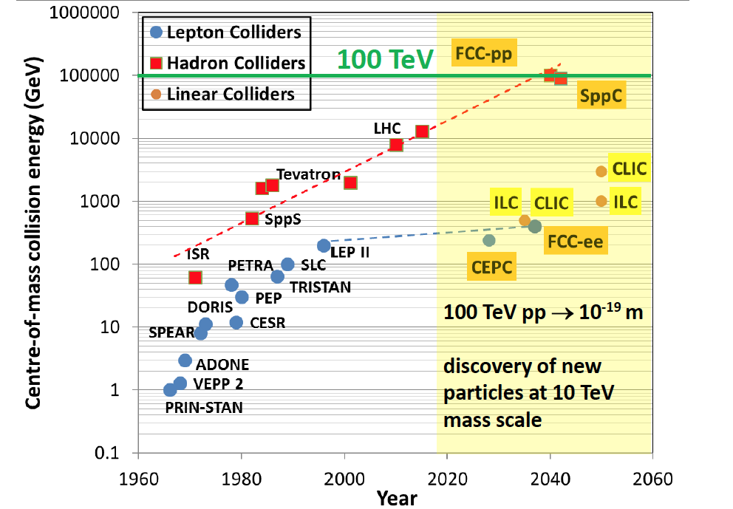
The exploration continues
Particle colliders are powerful instruments in physics for discoveries and high precision measurements because they provide well controlled experimental conditions in laboratory environment

Slide 5
Global vision for the future of particle physics
“CERN should undertake design studies for accelerator projects in a global context, with emphasis on proton-proton and electron-positron high-energy frontier machines.” -European Strategy for Particle Physic
”A very high-energy proton-proton collider is the most powerful tool for direct discovery of new particles and interactions under any scenario of physics results that can be acquired in the P5 time window...” -US Particle Physics Strategy (P5)
  ”...ICFA supports studies of energy frontier circular colliders and encourages global coordination...” -ICFA

Slide 6
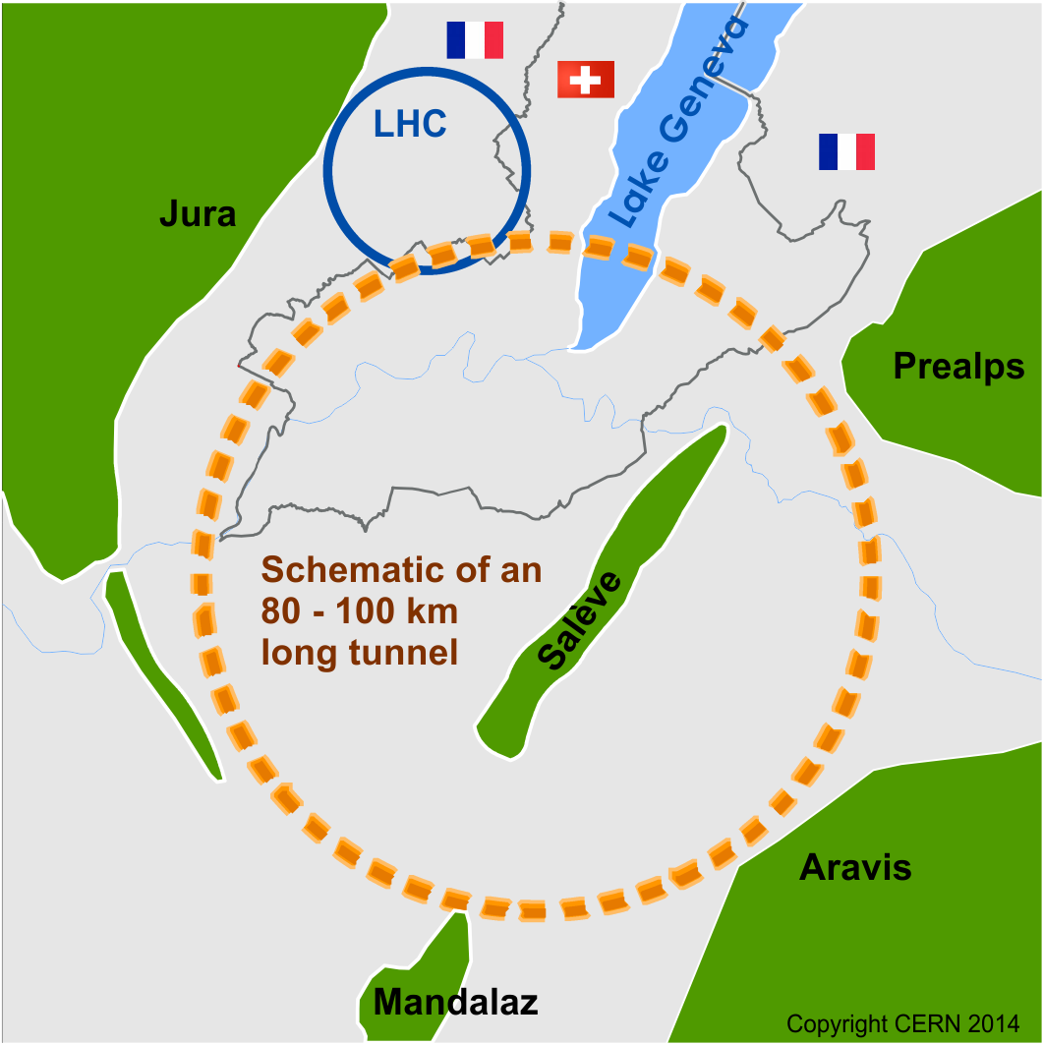
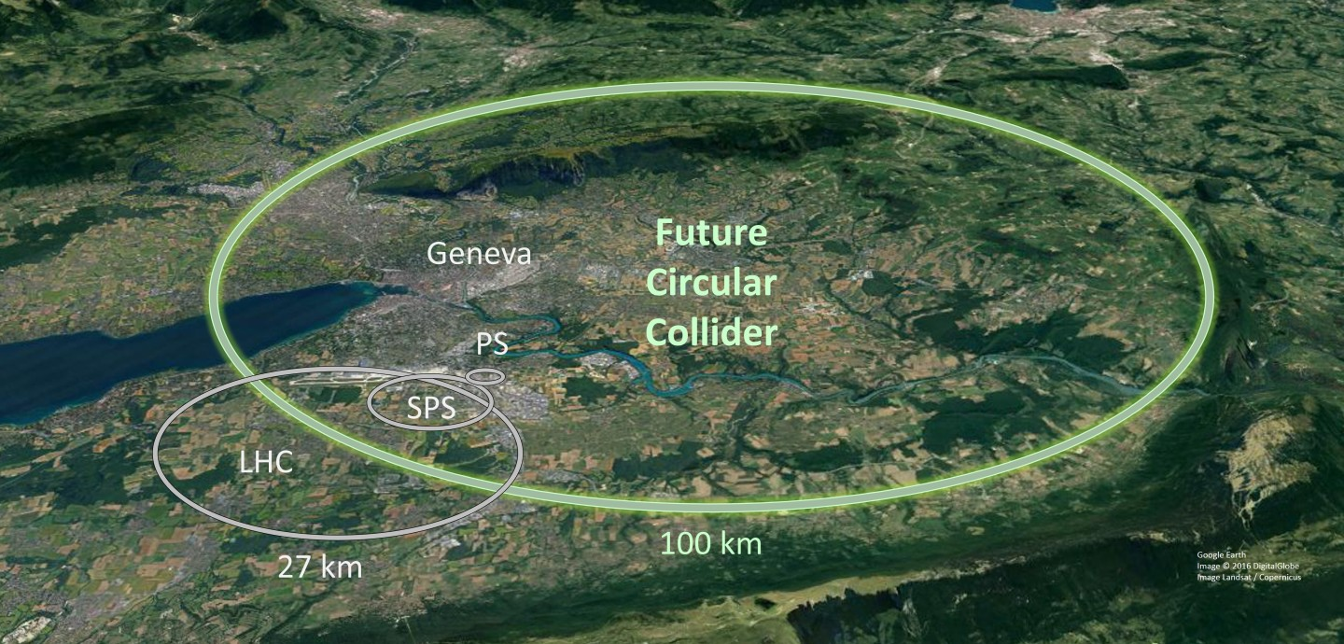
Expanding our Horizons
Future Circular Collider Study
International collaboration with CERN as host laboratory:
exploring the feasibility of several particle collider scenarios with the aim of significantly expanding the current energy and luminosity frontiers.
Lepton collider as possible first step and 100 TeV proton collider as long-term goal
100 km tunnel infrastructure in Geneva area

Slide 7
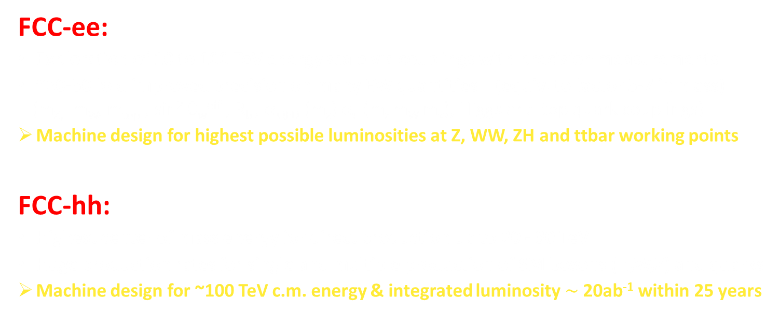
FCC physics and design goals
FCC-ee:
Exploration of 10 to 100 TeV energy scale via couplings with precision measurements
~20-50 fold improved precision on many EW quantities (equiv. to factor 5-7 in mass) (m_{Z,} m_{W}, m_{top} , sin² θ_{w}^{eff} , R_{b} , α_{QED} (m_{z}) α_{s} (m_{z} m_{W} m_{τ}), Higgs and top quark couplings)
Machine design for highest possible luminosities at Z, WW, ZH and ttbar working points
FCC-hh:
Highest center of mass energy for direct production up to 20 - 30 TeV
Huge production rates for single and multiple production of SM bosons (H,W,Z) and quarks
Machine design for ~100 TeV c.m. energy & integrated luminosity $\sim$20ab⁻¹ within 25 years

Slide 8
HEP Timescale
1980
1985
1990
1995
2000
2005
2010
2015
2020
2025
2030
2035
2040
Construction
Physics
Upgr
LEP
Design
Proto
Construction
Physics
LHC operation
HL-LHC
Design
Implementation
Physics
Future Collider
Design
Proto
Construction
Physics
25 years

Slide 9
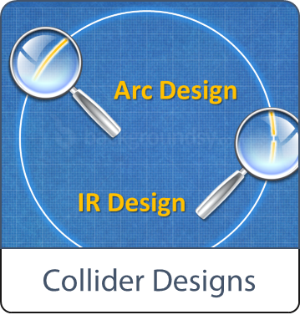

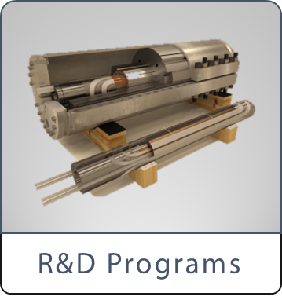

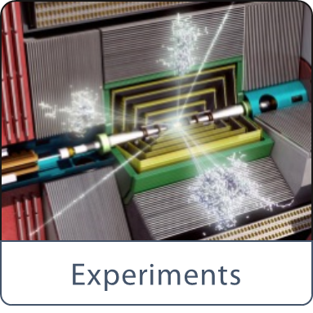

Domains covered by the FCC study:
- Designs for future colliders.
- Tunnel Infrastructure in Geneva area.
- Technologies pushed in dedicated R&D programs.
- Discovery areas.
- Design of new detectors.
- Overall cost models.

Slide 10
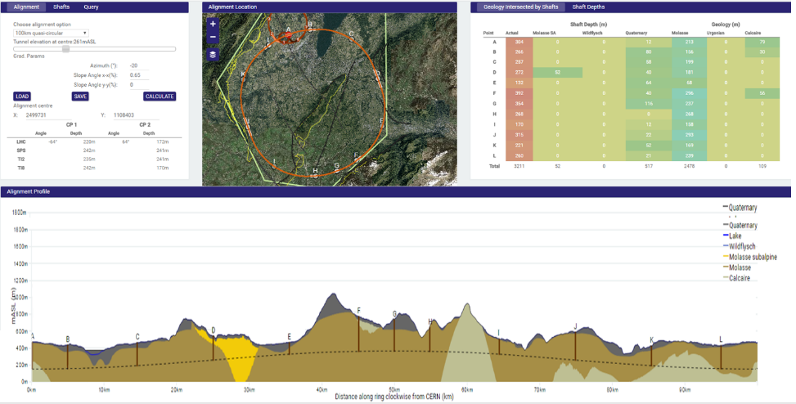
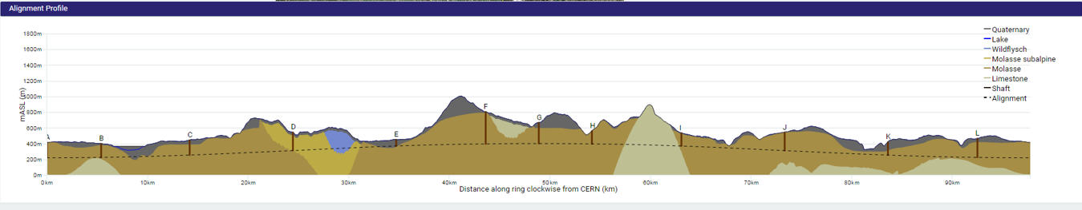
Geology and Civil Engineering studies
Implementation of the 100 km tunnel

Slide 11
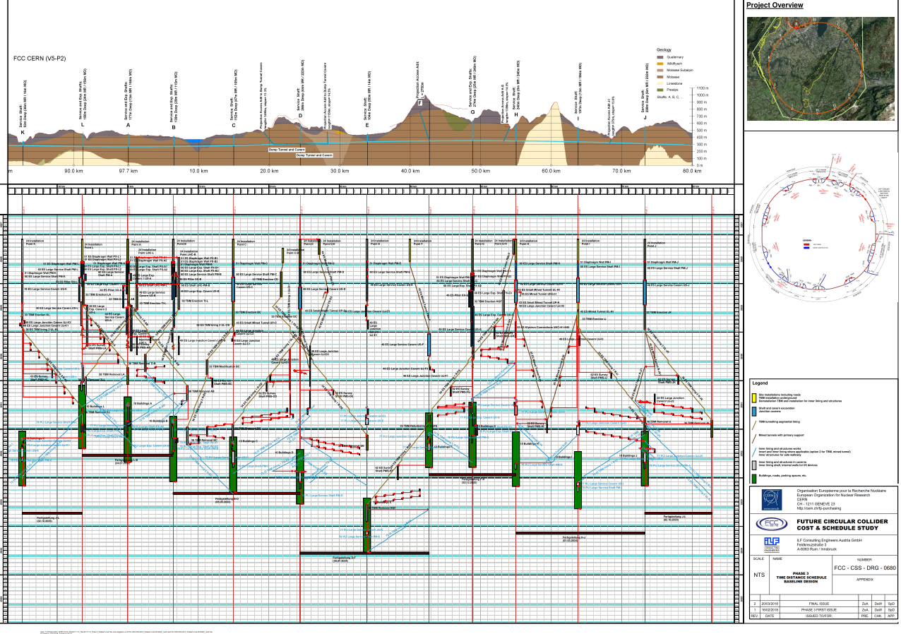
Future Circular Collider - Tunnel Layout
4.5yrs
6.5yrs
Total construction duration 7 years
First sectors ready after 4.5 years

Slide 12
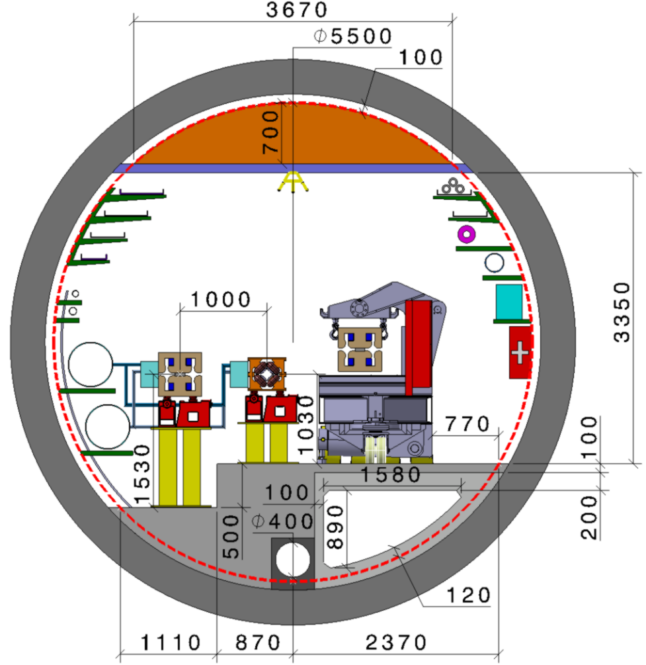
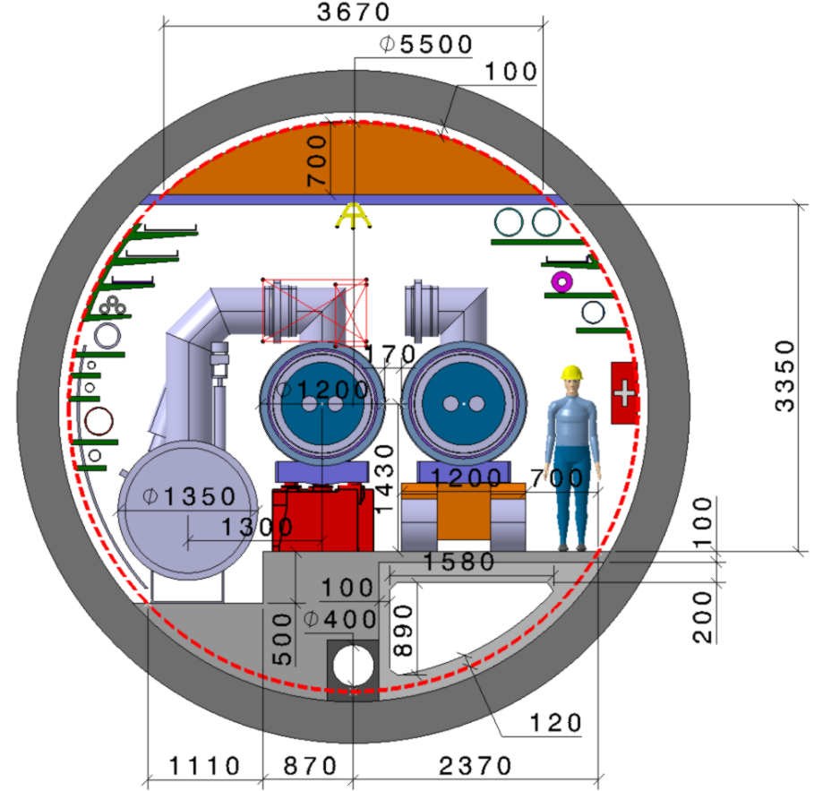
Tunnel Integration
  FCC-ee FCC-hh

Slide 13
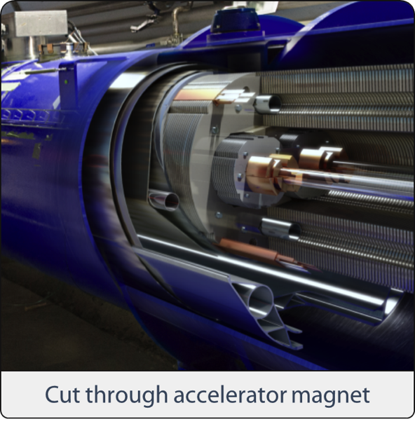
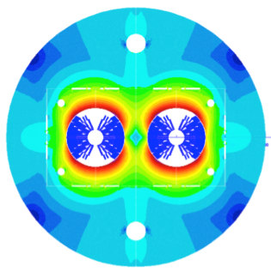
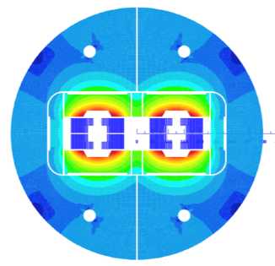
FCC high-field magnets
FCC requires 16 T magnets
Design with sufficient aperture (50 mm)
Meet operation requirements
  margins,
  field quality and stability,
  cycled operation,
  equipment protection,
  reliability and maintenance

Slide 14
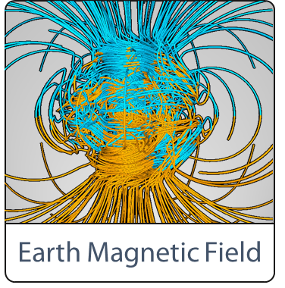
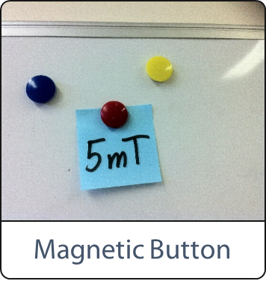
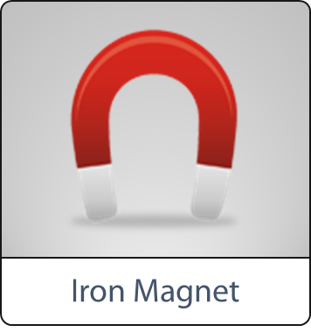
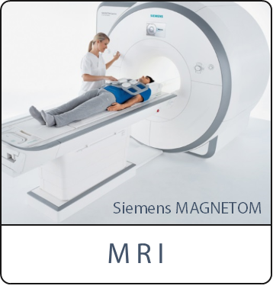
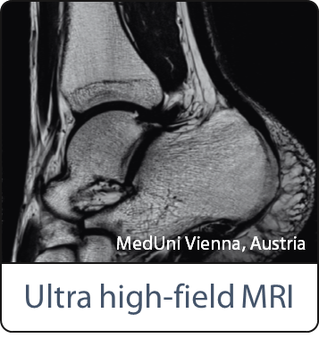
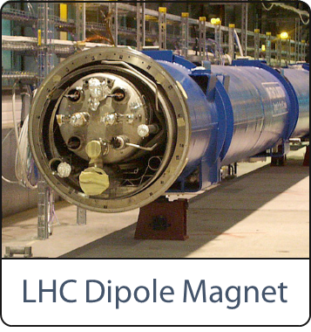
65 μT
0,005
0,01
1.5 – 3
7
8.3

Slide 15
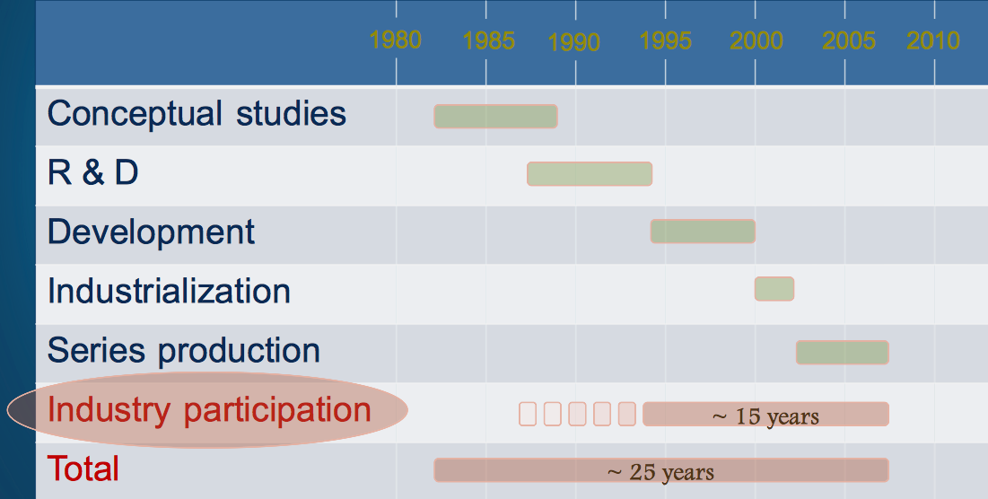
Time indicator superconducting magnets
LHC magnets – from concept to series production

Slide 16
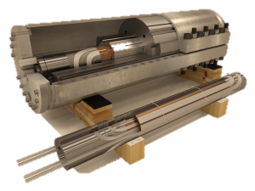
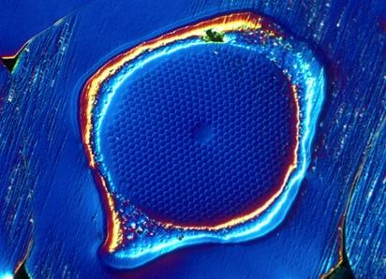
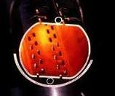
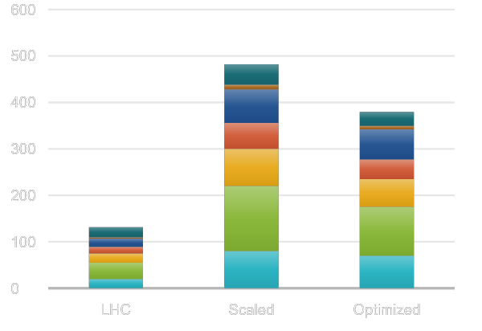


Push Novel Technologies
Nb₃Sn
16 T
High-field Magnets
Novel Materials and Processes
Large-scale Cryogenics
2.0
Repair &
Maintenance
Power Efficiency
Reliability & Availability
Global Scale Computing

Slide 17
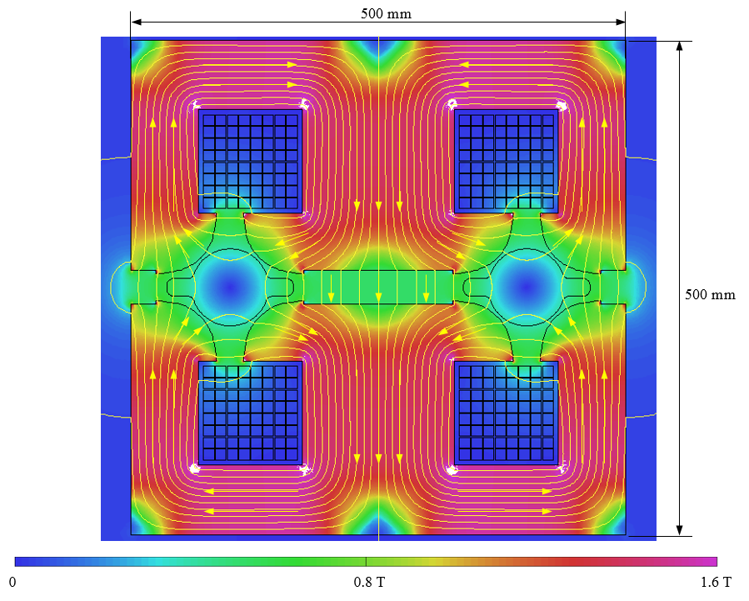
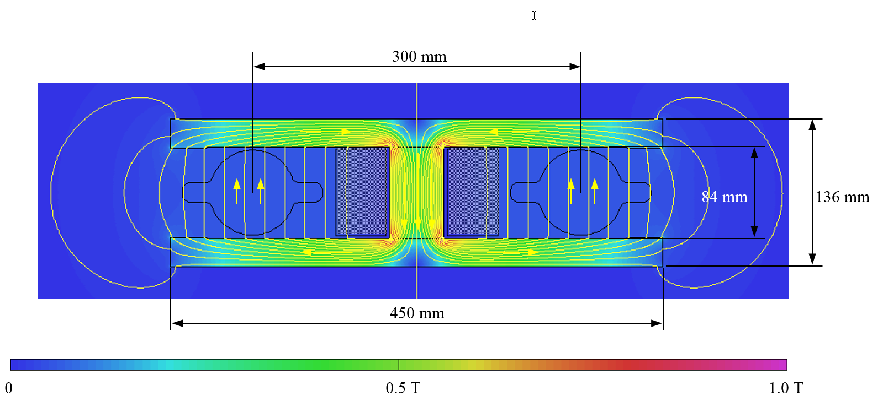
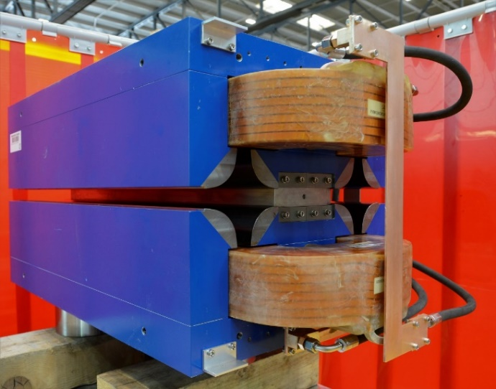
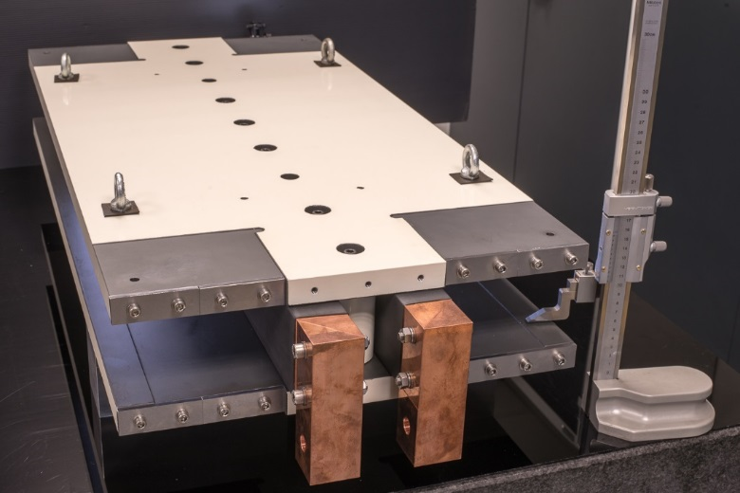
Lepton collider prototype magnets
Twin-dipole design with 2× power saving
16 MW (at 175 GeV), with Al busbars
Twin F/D arc quad design with 2× power saving
25 MW (at 175 GeV), with Cu conductor
prototype
prototype

Slide 18
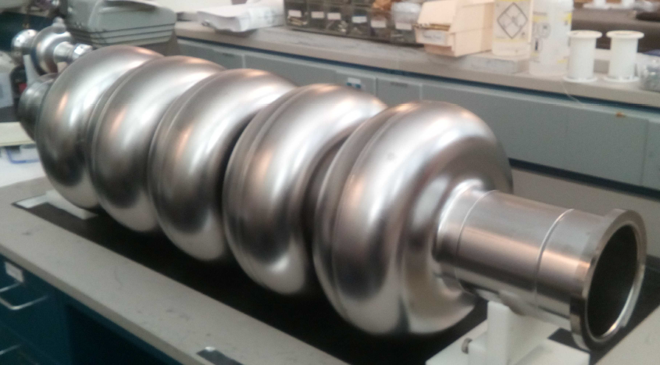
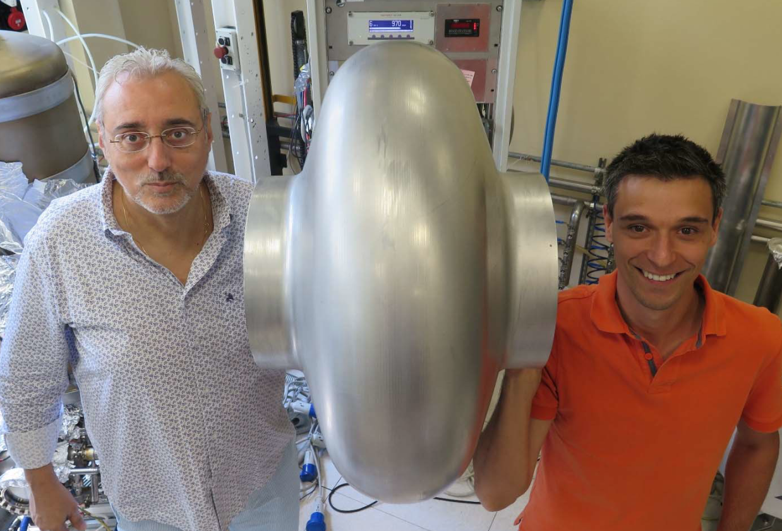
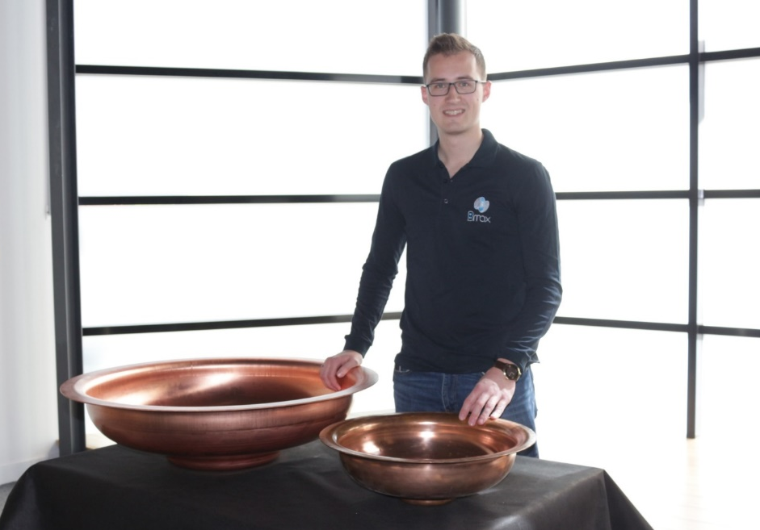
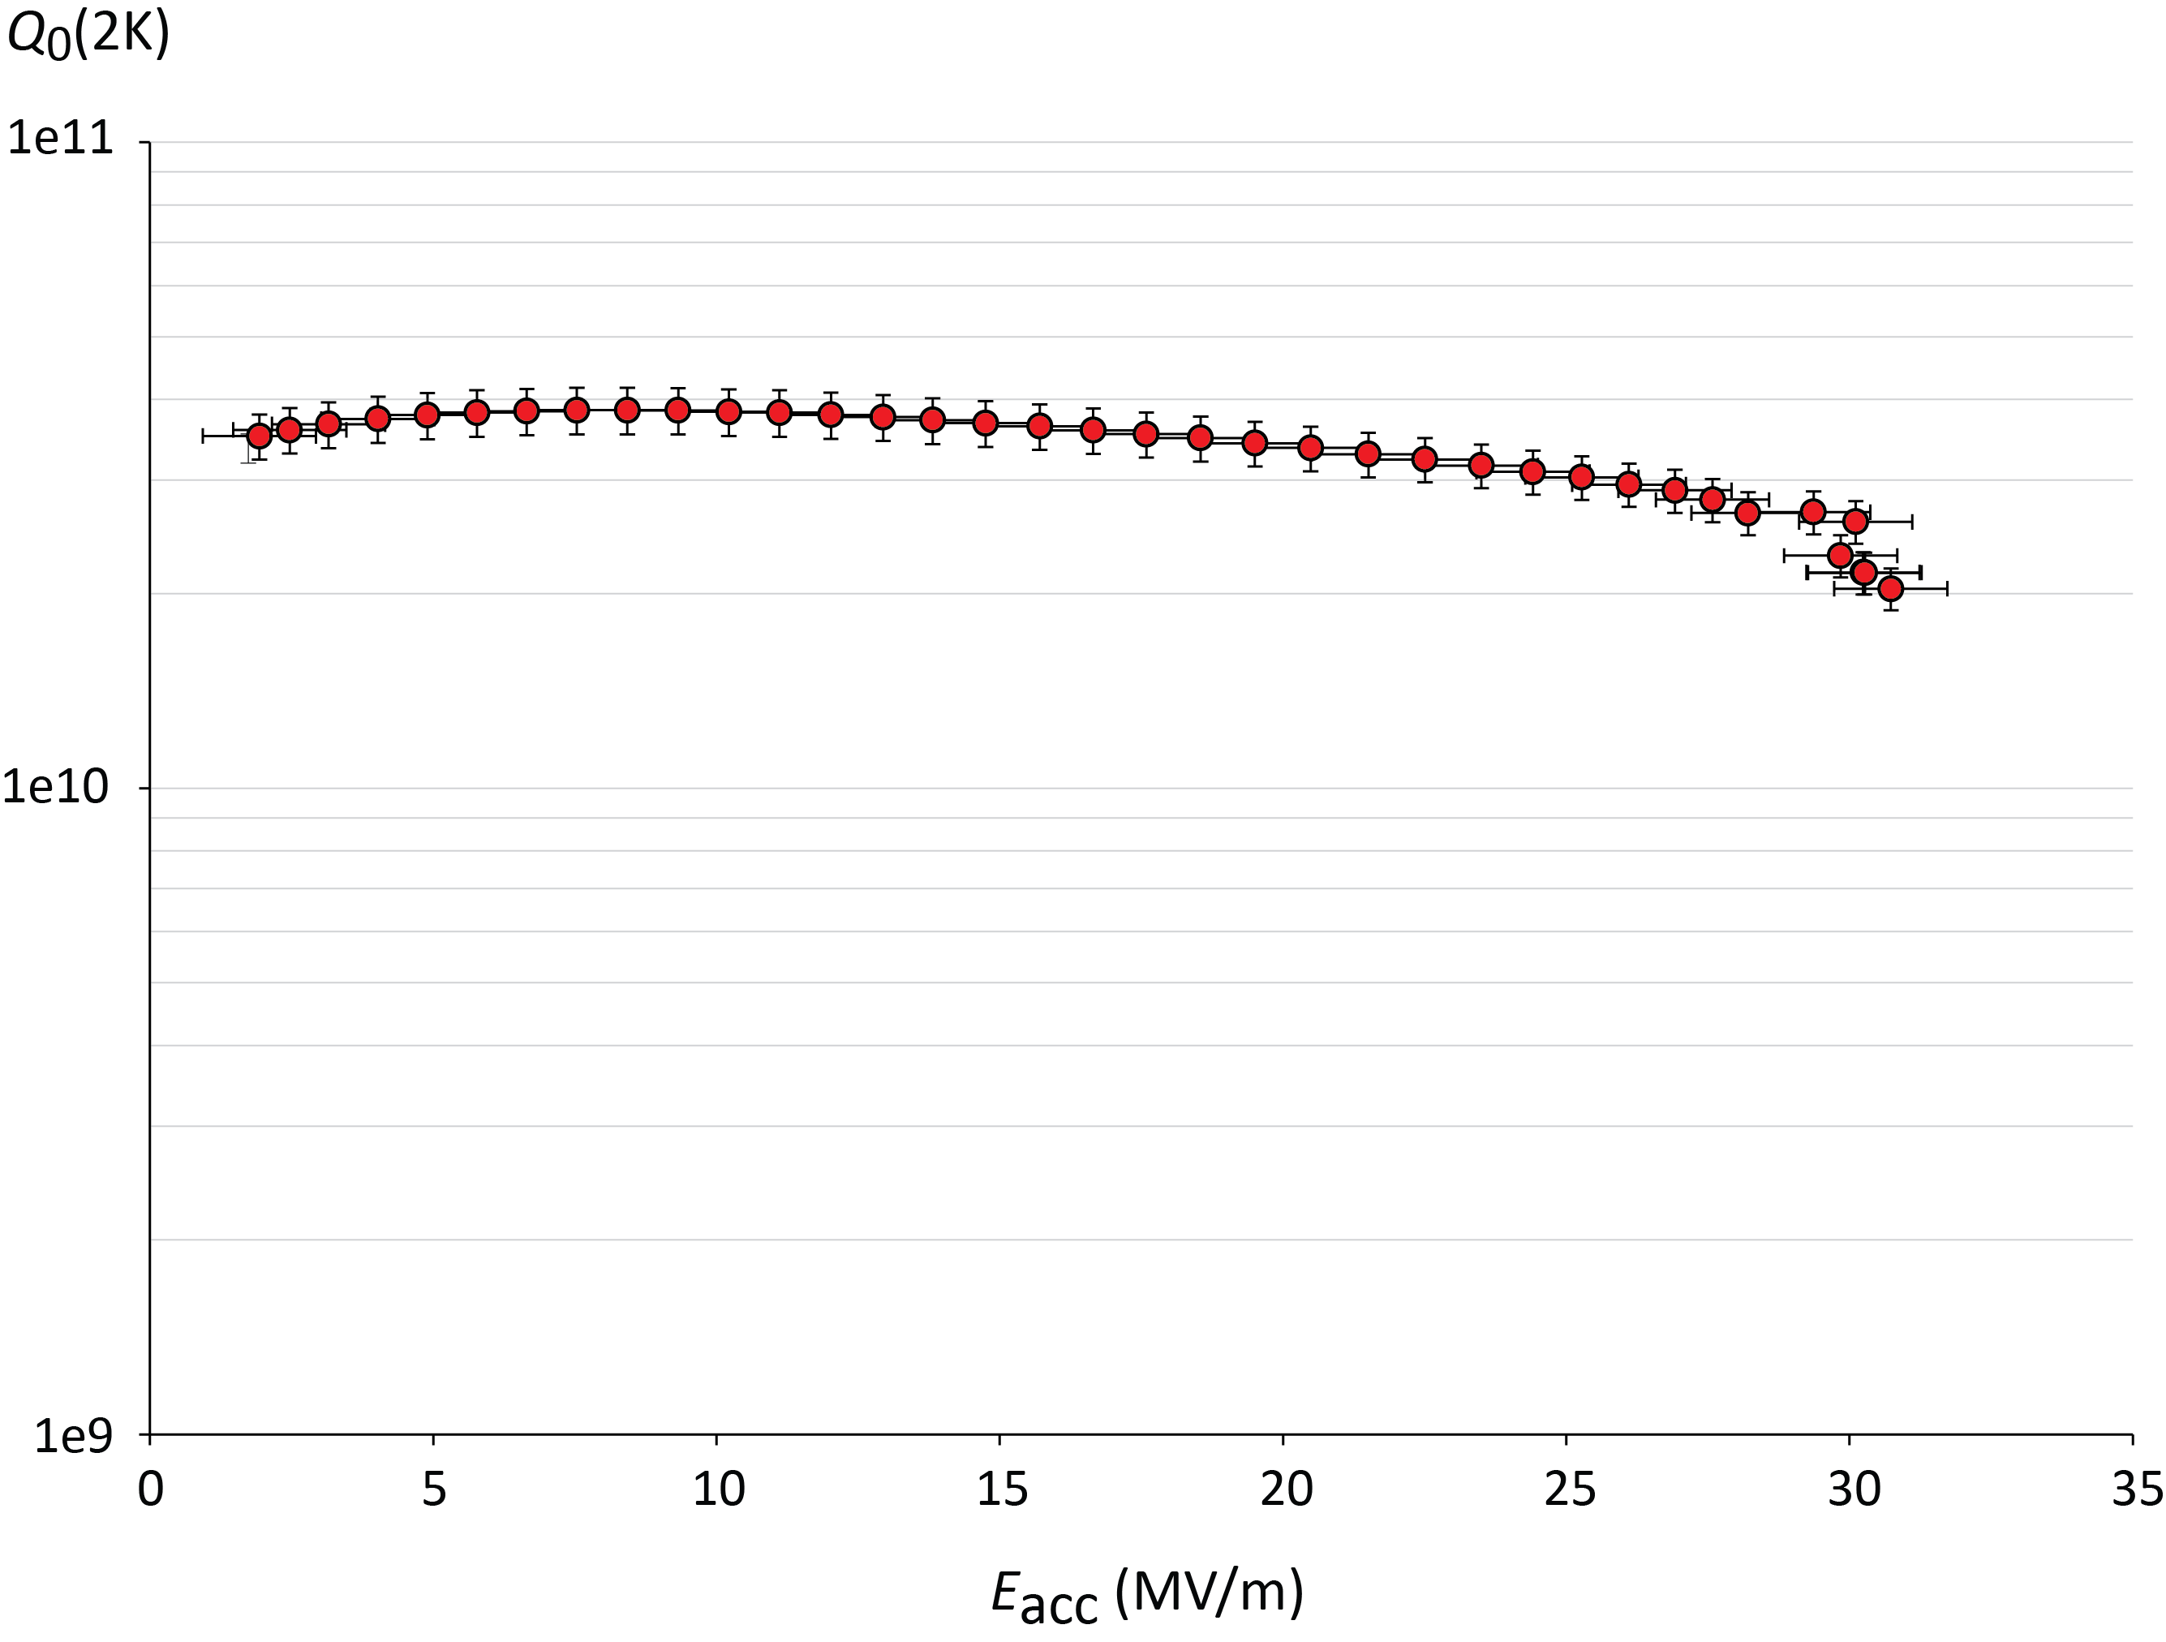

Radiofrequency system prototyping
5-cell 800 MHz cavity, JLAB prototype for both FCC-ee (t-tbar) & FCC-eh ERL (PERLE)
Seamless 400 MHz single-cell cavity formed by spinning at INFN-LNL
CERN half-cells formed using Electro-Hydro-Forming (EHF) at Bmax.
Legnaro, Feb 2018
JLAB, Oct 25, 2017
F. Marhauser et al
V. Palmieri † C. Pira
5.5 x 24m²
400 MeV, 3 turns,
20 mA, 802 MHz
$Q0 3∙{10}^{10}$ @ 2K
Tooling fabricated and successfully tested with an Aluminium cavity.
J.-F. Croteau, EASITrain PhD Student
Regime of E_{acc}
requirements
in LHeC, PERLE,
FCC-ee
31 MV/m
High strain rate technology using shockwaves in water from HV discharge.
EHF investigated for half-cells and seamless Nb and Cu cavities.
quench limit

Slide 19
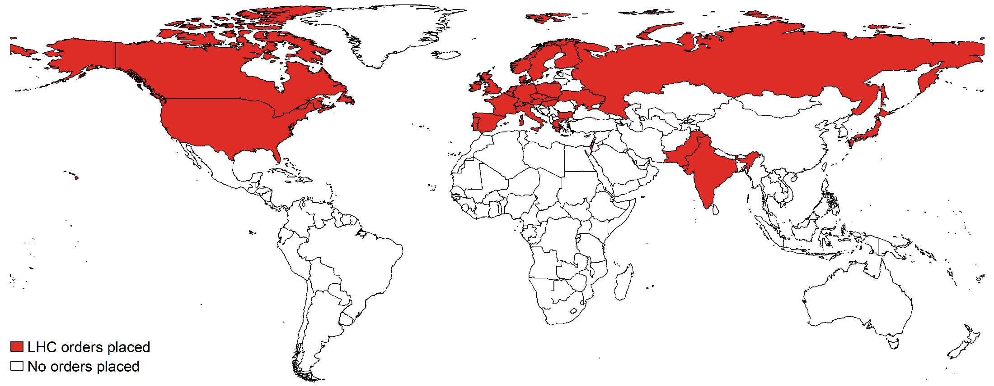
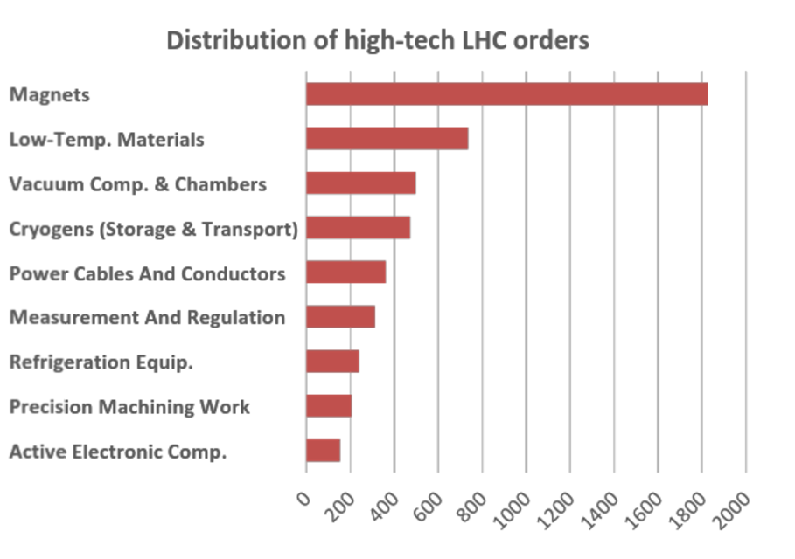
Approx. 1400 firms located in 30 countries have collaborated with CERN for the LHC project during 1995-2008

Slide 20
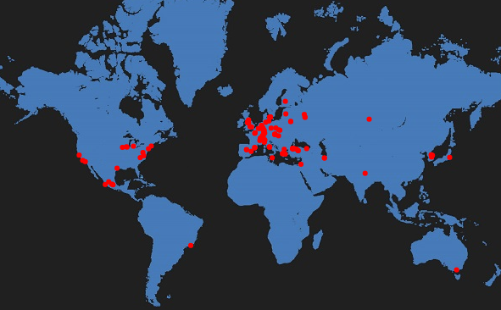

FCC international collaboration status
133 research centers & universities
European Commission
32 countries
25 companies
Geographically balanced
Topically complementary
Promote ownership among Participants

Slide 21

EU H2020 Design Study EuroCirCol
European Union Horizon 2020 program
3 MEURO co-funding
June 2015 - May 2019
15 European beneficiaries & KEK & associated FNAL, BNL, LBL, NHFML
Scope:
FCC-hh collider key work packages
Collider design
Cryogenic beam vacuum system
16 T dipole magnet design
Notes:
New slide from Davide.
Showing that conductor development is launched at international level, Russia, Japan, (Korea and Europe in preparation)
Underline importance of that development as main cost driver for the hadron collider machine.

Slide 22


EU H2020 EASITrain Training Network
European Advanced Superconductivity Innovation and Training Network
October 2017 to September 2021
SC wires at low temperatures for magnets (Nb₃Sn, MgB₂, HTS)
Superconducting thin films for RF and beam screen (Nb₃Sn, Tl)
Electrohydraulic forming for RF structures
Turbocompressor for NeliMagnet cooling architectures
um refrigeration
Funding for 15 Early Stage Researchers over 3 years & training
13 Beneficiaries
I-CUBE
12 Partners

Slide 23
FCC conceptual design report & documentation
FCC-Conceptual Design Reports:
  Vol 1 – Physics, Vol 2 – FCC-ee, Vol 3 – FCC-hh, Vol 4 – HE-LHC
  Preprints available since 15 January 2019 on http://fcc-cdr.web.cern.ch/
  CDRs accepted for publication in the European Physical Journal
  Summary documents submitted to EPPSU SG in December 2018
  FCC-integral, FCC-ee, FCC-hh, HE-LHC accessible on http://fcc-cdr.web.cern.ch/

Slide 24
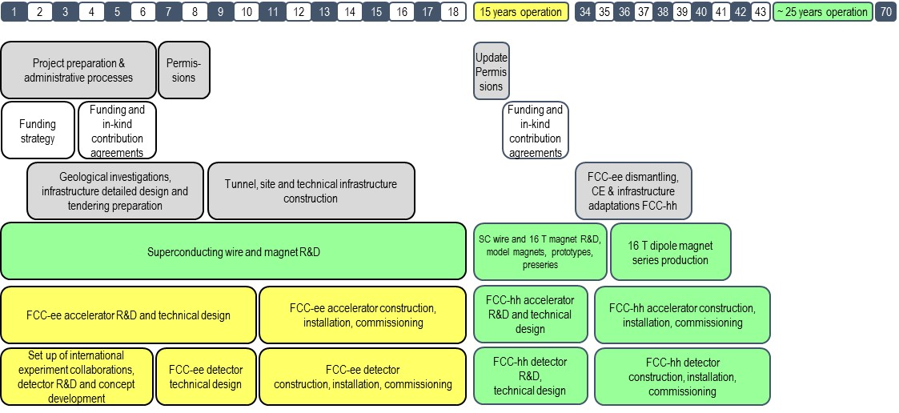
FCC integrated project – technical timeline
A coherent HEP program throughout the 21st century

Slide 25
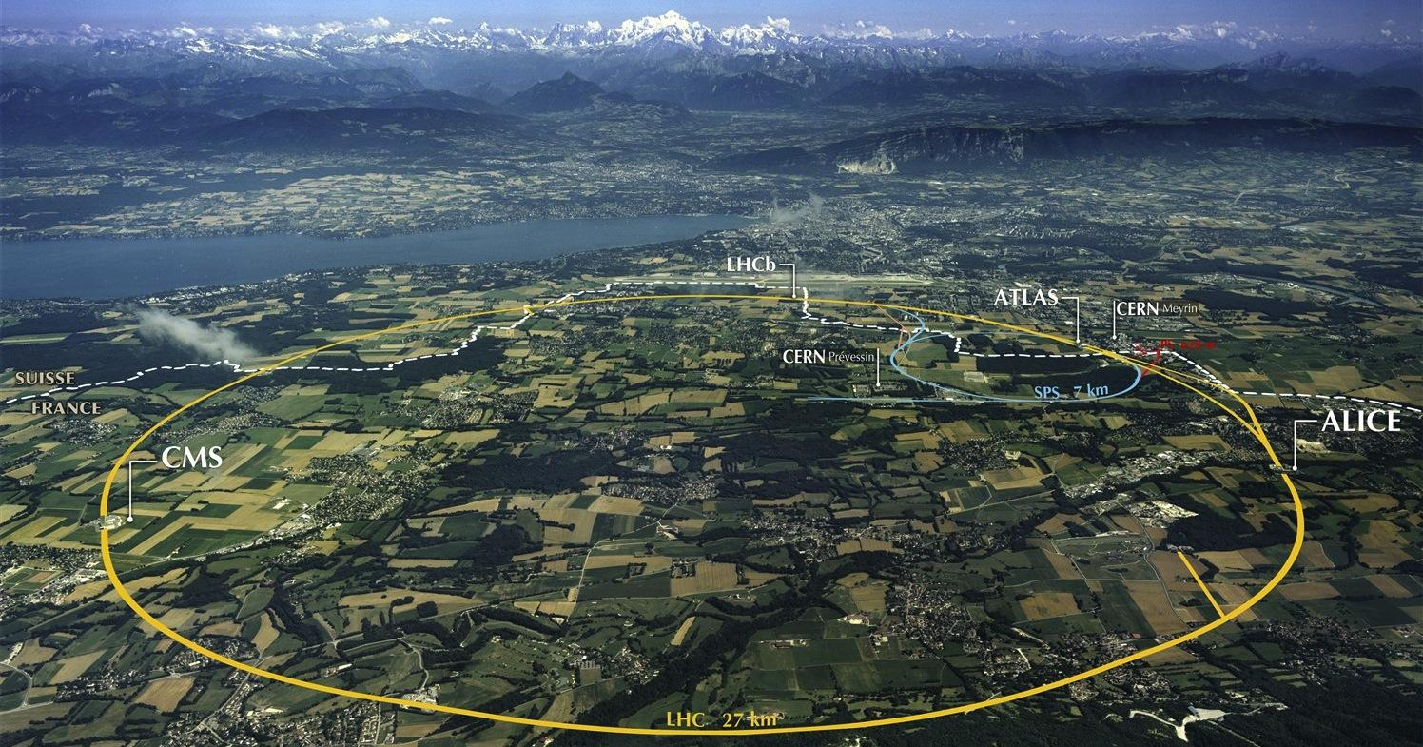
Future Circular Collider
Developing a largest scale research and technical infrastructure
Strengthen long-term attractiveness of Europe as world leading high-energy physics research location
Driven by international contributions and aiming at
long-term liaisons for high-tech R&D with industry.

Slide 26

Final thoughts
We are at an important moment in the history of particle physics. The highest priority is to gain an in-depth understanding of the Higgs particle. It is considered the portal to explore the open questions of modern physics such as the origin of dark matter, matter-antimatter asymmetry, neutrino masses and others.
To continue exploring, the next facility must be versatile and powerful. Future colliders must offer: More Sensitivity, More Precision, More Energy.
CERN is best placed for such a challenging enterprise, given its demonstrated success in delivering international projects and the existing infrastructure.
FCC attracts a diverse community of scientists, engineers and partners from industry, going beyond geographical and cultural boundaries, who collaborate to address these fundamental questions.

