Slide 1

FEL Parameter Discussions
Frascati, 5/3/2019
Neil Thompson, Jim Clarke

Slide 2
Preface
This is a bit of a ‘mish-mash’ – a few separate pieces of work that have been done over the last couple of months in support of the aim of making progress in parameter and layout decisions.
Some is just data, which may be useful in our discussions, whereas there are also some proposals for which direction we could take.
A Ming Xie parameterisation of FEL dependence on emittance, peak current and energy spread. This was done to support Simone in his task. (I have omitted the plots looking at what bunch charge and peak current we need to achieve 1mJ output, as this is no longer part of the specification).
Genesis simulations of 16keV FEL output using parameters of the bunches from the LiTrack simulations. This was done with and without the energy chirp.
A presentation made in the last WP2 meeting – a potential facility outline that is matched to the essential and desirable output parameters from the Science Case
A quick look at how we achieve the required peak spectral brightness and which are the most important parameters
A study of relative performance for four different undulator technologies (and impact on required electron beam parameters)
Contents

Slide 3
Ming Xie Parameterisation

Slide 4
Parameters
Undulator type – CPMU, with field equation
B = 3.896*EXP((-4.022*C)+(0.529*C^2)), where C is gap/period.
Period 16.5mm
Minimum gap 4mm
E = 7GeV
Undulator tunes from 8keV at minimum gap to 16keV at 6.9mm
Plots shown are for output at 16keV
Calculations are based on the Ming Xie parameterisation, calibrated against Genesis simulations at 25keV by scaling the beta function to achieve the same saturation power and saturation length.

Slide 5
P_{sat}, L_{sat} (Slice Energy spread 0.03%)

Slide 6
P_{sat}, L_{sat} (Slice Energy spread 0.06%)

Slide 7
Peak current 4kA emittance vs energy spread scan

Slide 8
Genesis Simulations of LiTrack Bunches

Slide 9
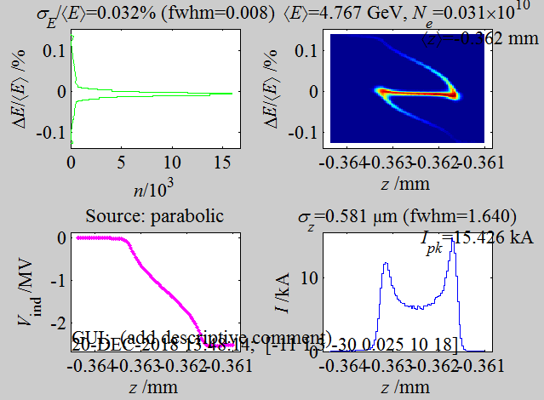
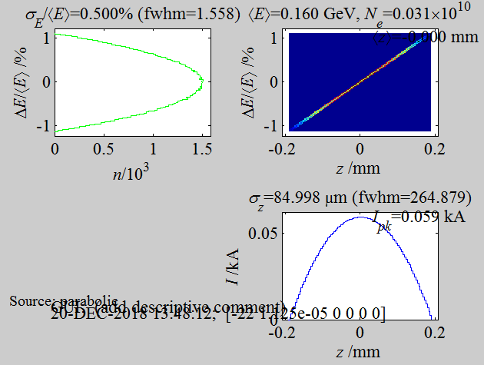
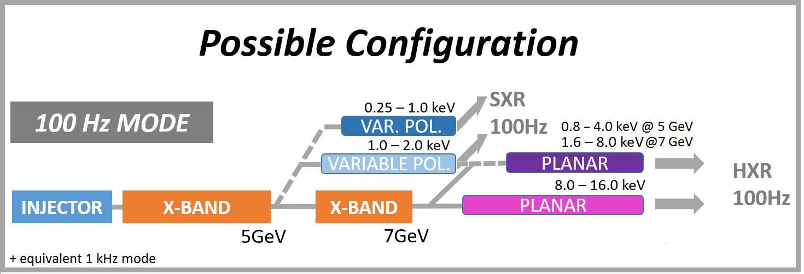
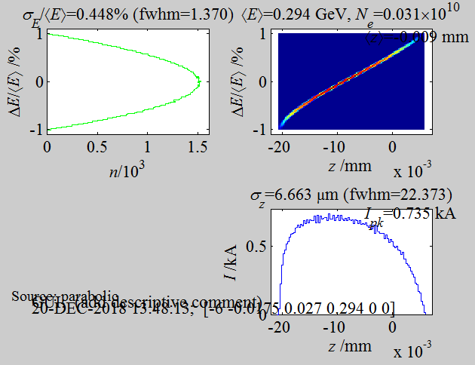
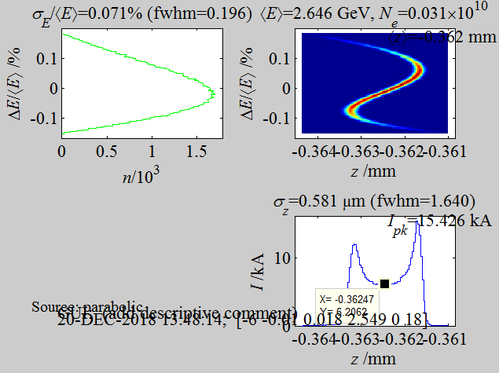
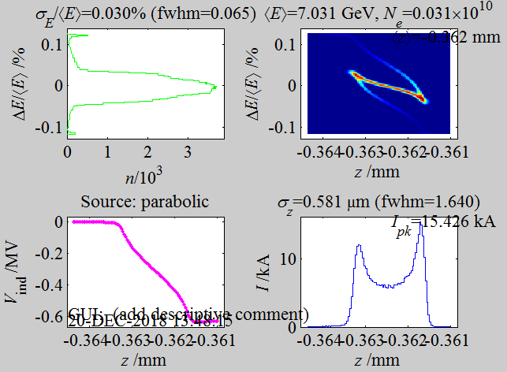
4.3 - 4.8 GeV
0.2 um
6 kA
5 fs fwhm
0.005% - 0.01% rms slice e.spr.
50 pC
160 MeV
0.2 um emit
60 A
SX
INJ
6.5 – 7.5 GeV
0.2 um
6 kA
5 fs fwhm
0.003% - 0.01% rms slice e.spr.
BC1
BC2
HX

Slide 10
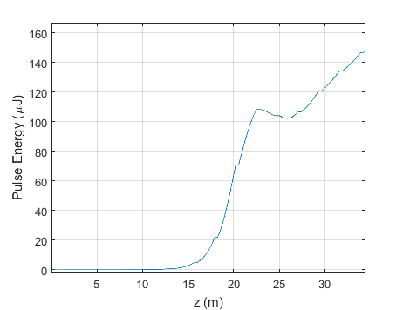
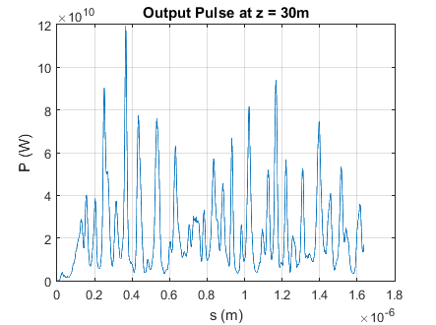
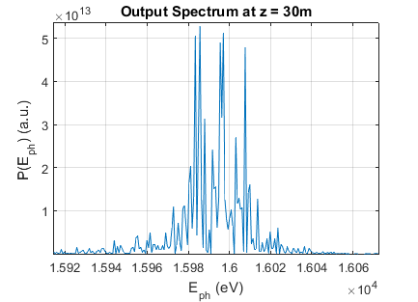
HX Genesis Simulation – Flat Bunch
Parameters:
Rectangular 5.45fs pulse
Peak Current 6kA
Energy 7GeV
Slice energy spread 1e-4
Emittance 0.2 mm-mrad
Cryogenic PM undulator with period 16.3mm and
aw = 0.8856 (gap 4mm)
Photon energy 16keV
No wakes.

Slide 11
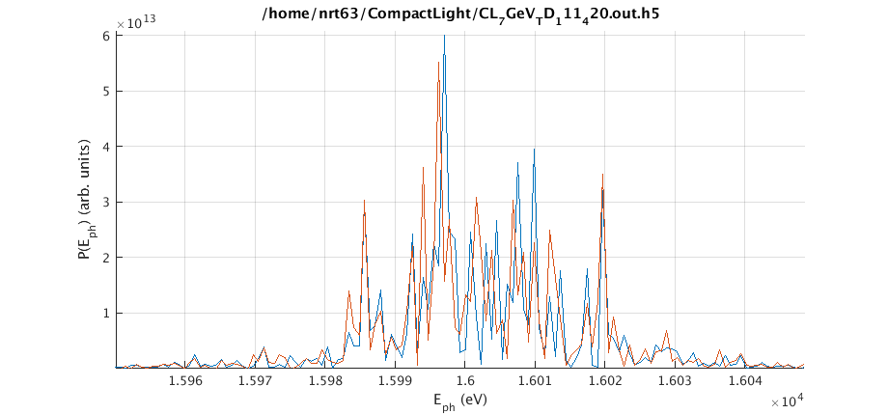
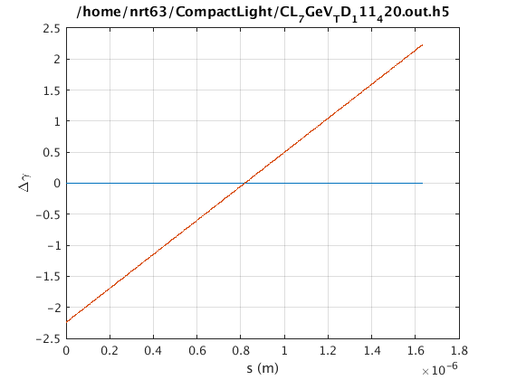
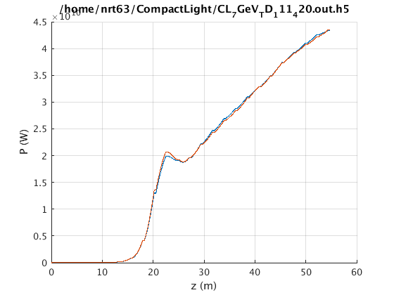
HX Genesis Simulation – with Chirp
Parameters:
Rectangular 5.45fs pulse
Peak Current 6kA
Energy 7GeV
Slice energy spread 1e-4
Emittance 0.2 mm-mrad
Cryogenic PM undulator with period 16.3mm and
aw = 0.8856 (gap 4mm)
Photon energy 16keV
No wakes.
Linear energy chirp 0.1% / 0.005mm (approx match to LiTrack) with high energy at head of bunch
Flat bunch
With Chirp (same shot noise seed)
Conclusion: this level of chirp has negligible impact on performance

Slide 12
Potential Facility Outline

Slide 13
WP2: From Science Case to Facility Outline:
ESSENTIALS + DESIRABLES
Neil Thompson, David Dunning

Slide 14
From the user requirements there are ESSENTIALS and DESIRABLES
The ESSENTIALS:
Should be provided by the CORE FACILITY which should be as compact and upgradeable as possible while not exceeding an acceptable level of risk
The DESIRABLES:
Could be provided parasitically by the CORE FACILITY if this does not increase the scale and cost.
Otherwise they could be upgrades.

Slide 15
ESSENTIAL USER REQUIREMENTS
Photon energy range at the fundamental: 0.25 – 16.0 keV
Variable, selectable polarisation
Repetition rate 100Hz
2-colour operation with timing separation +/- 100fs and colour separation 20% in SXR and 10% in HXR
Wavelength tuning primarily by undulator scanning with several discrete beam energies.
Pulse duration 1 – 50 fs
Even pulse spacing and <10fs synchronisation between FEL pulse and external laser.
Competitive pulse energy

Slide 16
Implication of ESSENTIAL requirements
We need a strong field undulator with short period and small gap to minimise beam energy, with period set appropriately to give a factor of two wavelength tuning at each beam energy, and 6 discrete beam energy working points to cover the whole range 0.25 – 16 keV.
The most aggressive undulator technologies are not variably polarising. Therefore the variable polarisation should be provided by using an AFTERBURNER for the last one or two gain lengths. In combination with a positive taper to suppress the fundamental while maintaining bunching growth we can then provide highly polarised FEL output.
For pulses separated independently in time and wavelength we need in effect a double electron bunch. Schemes such as transverse wake/betatron oscillation to get lasing at separate sections of the electron bunch in different undulators have been demonstrated, but pulse energies are low (not all bunch used) and as each colour starts independently from noise the undulator length is doubled, the source positions are widely separated and it is difficult to also incorporate self seeding.
A more attractive option would be a double FEL:
  a double bunch (two PI lasers) with each bunch on separate cycle of RF, with independent charge, separated in energy (for example, by a lower frequency RF cavity operating near zero cross then dc magnet + septum) into two beam lines with the delay between the electron bunches controlled with a magnetic delay line.
  Total undulator length would be the same but building length would be less, the delay, wavelength separation, polarisation, pulse length, bandwidth and pulse energy of the two pulses would be independently tunable, and their source positions would be close to each other. Also pulse energies would be high through using full bunch.
  To date, double pulses from FELs have been compromised by using existing facilities which weren’t designed for that purpose. A specially designed and optimised double pulse FEL would be truly world-leading – a real USP.

Slide 17
CORE MACHINE SCHEMATIC LAYOUT
FIXED POL.
VAR POL.
FEL-1
AB-1
GUN
≤1-2 GeV
≤ 5-7 GeV
X-BAND
X-BAND
FEL-2
AB-2
TIMING CHICANE
FIXED POL.
VAR POL.
BEAM SPLITTER – Lower freq. RF + Dipole + septum?
TWIN PI LASERS
OPERATING MODES
FEL-1/FEL-2 independent double pulses to one experiment HXR 100Hz
FEL-1/FEL-2 independent single pulses to two experiments HXR 100Hz
FEL-1/FEL-2 independent double pulses to one experiment SXR 1kHz
FEL-1/FEL-2 independent single pulses to two experiments SXR 1kHz

Slide 18
ESSENTIAL USER REQUIREMENTS
Photon energy range at the fundamental: 0.25 – 16.0 keV
Variable, selectable polarisation
Repetition rate 100Hz
2-colour operation with timing separation +/- 100fs and colour separation 20% in SXR and 10% in HXR
Wavelength tuning primarily by undulator scanning with several discrete beam energies.
Pulse duration 1 – 50 fs
Even pulse spacing and <10fs synchronisation between FEL pulse and external laser.
Competitive pulse energy

Slide 19
DESIRABLE USER REQUIREMENTS
Stability
Seeding at all wavelengths
Pulse duration 0.1-1.0 fs in SXR
Repetition rate 1kHz
Simultaneous HXR/SXR operation
Peak brightness 10³³ ph/s/mm-mrad²/0.1%bw at 16keV

Slide 20
UPGRADED MACHINE SCHEMATIC LAYOUT
EEHG SEED
EEHG MODULATORS
VAR POL.
FIXED POL.
VAR POL.
SXR BYPASS LINE
FIXED POL.
FEL-1
FEL-1
AB-1
AB-1
GUN
≤ 5-7 GeV
GUN
≤1-2 GeV
≤ 5-7 GeV
≤1-2 GeV
X-BAND
X-BAND
AB-2
X-BAND
FEL-2
AB-2
X-BAND
TIMING CHICANE
100 Hz
KICKER
TIMING CHICANE
FIXED POL.
VAR POL.
SELF SEEDING CHICANE
VAR POL.
BEAM SPLITTER – Low freq. RF + Dipole?
BEAM SPLITTER – Lower freq. RF + Dipole + septum?
TWIN PI LASERS
TWIN PI LASERS
OPERATING MODES
FEL-1/FEL-2 independent double pulses to one experiment HXR 100Hz
FEL-1/FEL-2 independent single pulses to two experiments HXR 100Hz
FEL-1/FEL-2 independent double pulses to one experiment SXR 1kHz
FEL-1/FEL-2 independent single pulses to two experiments SXR 1kHz
FEL-1 SASE/SEEDED SXR 100Hz + FEL-2 SASE/SELF SEEDED HXR 100Hz

Slide 21
DESIRABLE USER REQUIREMENTS
Stability
Seeding at all wavelengths
Pulse duration 0.1-1.0 fs in SXR
Repetition rate 1kHz
Simultaneous HXR/SXR operation
Peak brightness 10³³ ph/s/mm-mrad²/0.1%bw at 16keV

Slide 22
Achieving Required Peak Spectral Brightness

Slide 23
FEL Brightness
Have spec: B ≥ 1e33 ph/s/mm²/marad²/0.1%bw at 16keV
δ is the normalised degeneracy parameter - a correction factor to account for longitudinal and transverse coherence.
The most dominant parameters are the peak current, the beam energy and the wavelength.

Slide 24
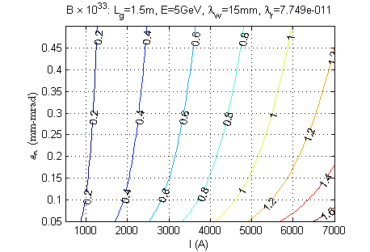
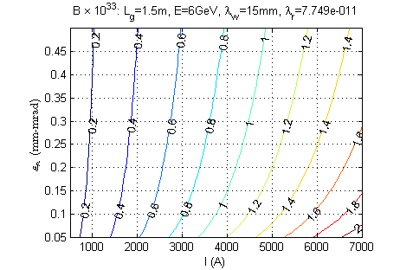
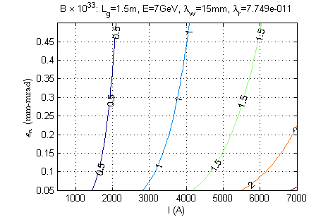
FEL Brightness
Required peak current to achieve FEL peak brightness 10³³
 | Normalised emittance (mm-mrad)
E | 0.1 | 0.2 | 0.3 | 0.4 | 0.5
5GeV | 4.6kA | 5.2kA | 5.6kA | 5.8A | 6.0kA
6GeV | 3.7kA | 4.2kA | 4.5kA | 4.7kA | 4.9kA
7GeV | 3.2kA | 3.5kA | 3.8kA | 4.0kA | 4.1kA

Slide 25
Relative Performance for Four Undulator Technologies

Slide 26

Undulator Comparison
Quick comparison of different undulator technologies to motivate discussions
Have calculated, for beam energies from 4 – 9 GeV, for different undulators:
  the period for the FEL to tune from 8keV at minimum gap (or max field) to 16keV
  the a_{w} parameter at 16keV
  The 1D saturation length and saturation power at 16keV (no corrections for emittance, energy spread, diffraction) for a constant peak current
  Not intended to provide absolute answers to the performance but to illustrate the relative differences we could expect between the different undulator types and how the technology would affect our choice of beam energy, for example
  Achievable field:
 | c₁ | c₂ | c₃ | REF
Cryogenic PMU | 3.896 | -4.022 | 0.529 | EuPraxia Report D6.1, 2016
DELTA helical | 1.45 | -1.28 | -2.24 | A. B. Temnykh, PR-STAB 11, 120702, 2008
Hybrid Planar | 3.67 | -5.08 | 1.54 | P. Ellaume et al, NIM A455, 2000, 503-523

Slide 27
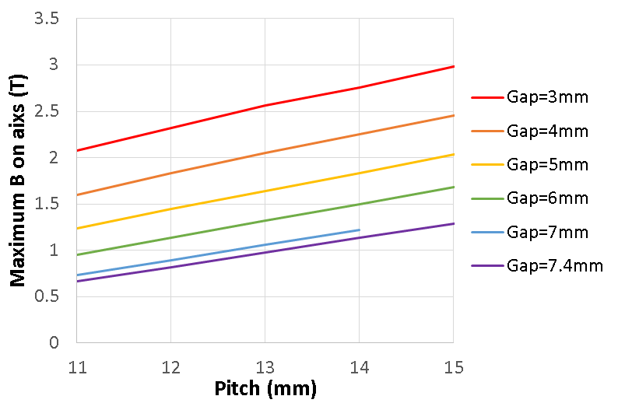

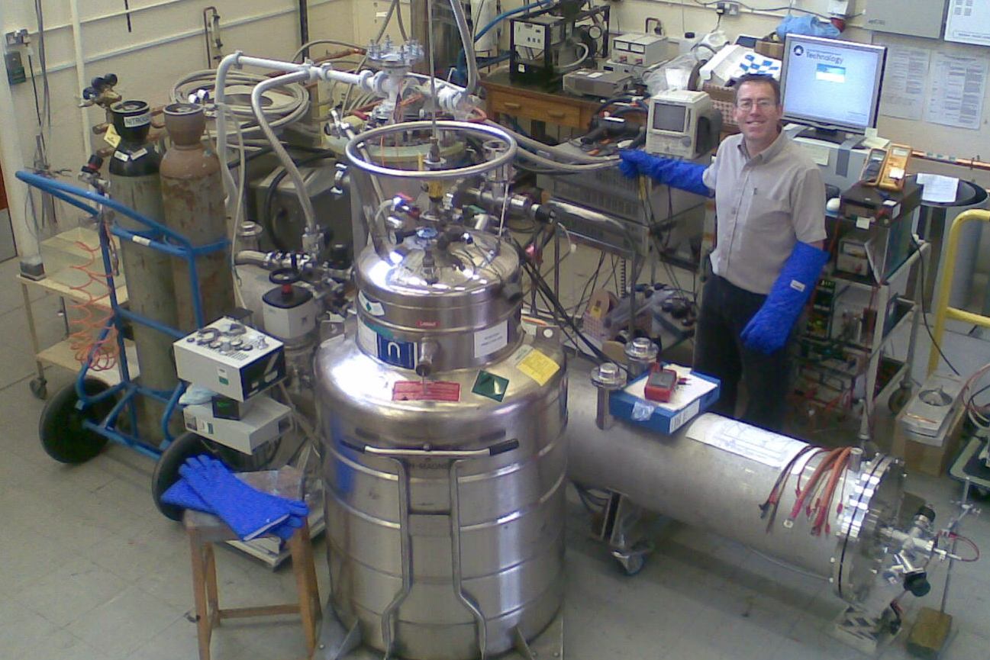
Undulator Comparison
Helical SCU data from 3D modelling at STFC (Vicky Bayliss + Mike Courthold)
4m SCU with 4mm gap and 11.5m period was built at STFC as prototype for the ILC positron source.

Slide 28
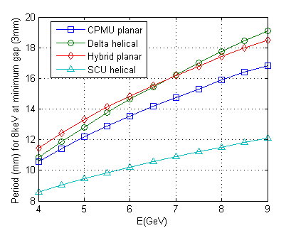
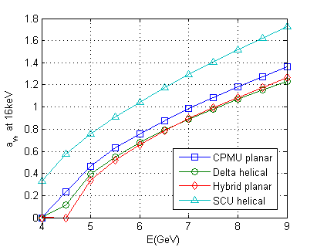
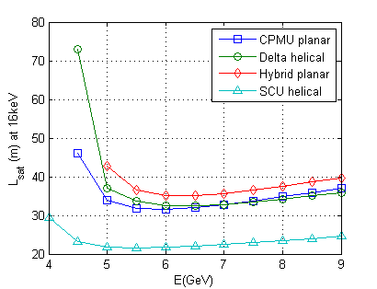
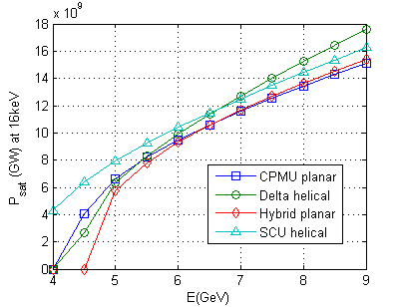
Undulator Comparison – 3mm gap
Period required for 8keV at minimum gap of 3mm
Corresponding a_{w} at 16keV
1D saturation length for peak current 4kA, beam radius 25um
1D saturation power for peak current 4kA, beam radius 25um

Slide 29
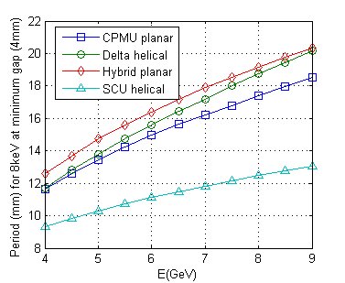
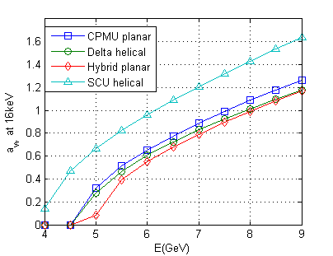
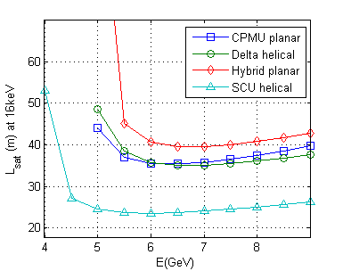
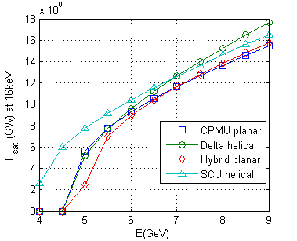
Undulator Comparison – 4mm gap
Period required for 8keV at minimum gap of 4mm
Corresponding a_{w} at 16keV
1D saturation length for peak current 4kA, beam radius 25um
1D saturation power for peak current 4kA, beam radius 25um

