Slide 1
XLS Face-to-Face WP Leaders Meeting
FEL Simulations & Parameters for
XLS-CompactLight
F. Nguyen, G. Dattoli, S. Di Mitri, L. Giannessi, A. Latina
March 5th 2019

Slide 2
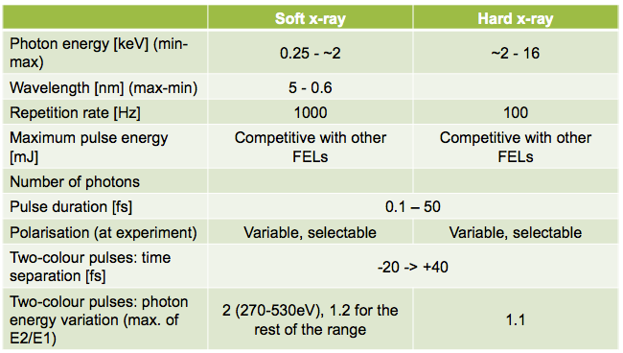
CompactLight Specification
From J. Clarke – coordinator of the XLS WP on “FEL Science Requirements
and Facility Design” – presented at the last XLS Collaboration Meeting @ ALBA
Disclaimer: Polarisation and Two-colour performance constraints not yet accounted for!
Federico Nguyen
1

Slide 3
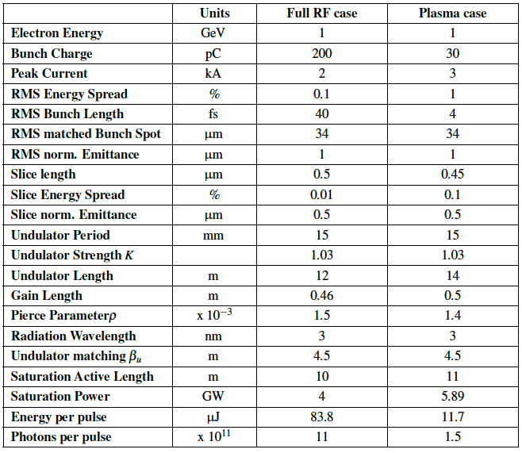
Goal: provide a table similar to the EuPRAXIA@SPARC CDR
Also in XLS, two cases are foreseen: Hard & Soft X-rays
Following results are obtained considering longitudinal dynamics under discussion in WP3 and WP6, with significant INFN contributions
We analysed a couple of beams from S. Di Mitri and A. Latina accounting for considerations from M. Croia & A. Giribono
Fac-Simile
Federico Nguyen
2

Slide 4
Workflow (after discussing with S. Di Mitri)
1)
Uniform E_{beam}, I, ε_{x,y}, ΔE/E distributions
Either analytical formulae or Perseo
One-valued early FEL table results
Chance to implement longitudinal profiles
2)
Proper E_{beam}, I, ε_{x,y}, ΔE/E as a function of z
Time-dep. Perseo detailed long. profiles
Table results + λ spectrum + growth…
Chance to have full 6D macroparticles
3)
All distributions from 6D macroparticles
Full 3D time-dep. Genesis simulations
Comprehensive set of FEL results
Federico Nguyen
3

Slide 5
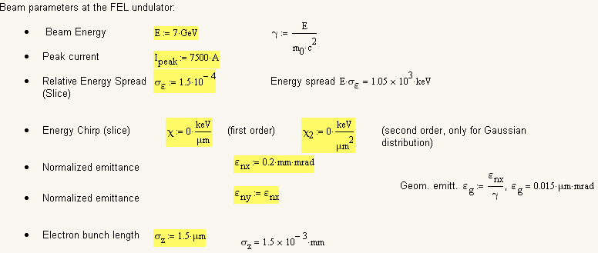
Hard X-ray beam from S. Di Mitri: uniform distributions
Total bunch charge Q = 75 pC
Federico Nguyen
4

Slide 6
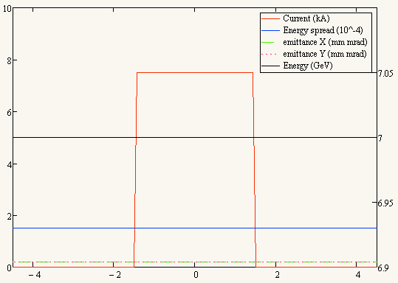
Hard X-ray beam from S. Di Mitri: uniform distributions
z [μm]
Federico Nguyen
5

Slide 7
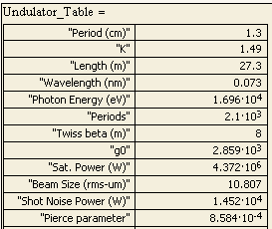
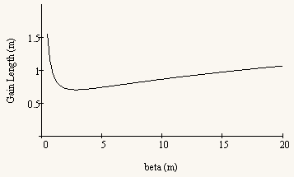
HX: undulator parameters
NdFeB In-vacuum undulator
Federico Nguyen
6

Slide 8
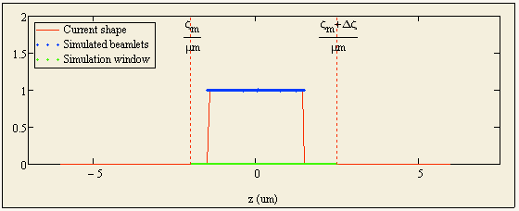
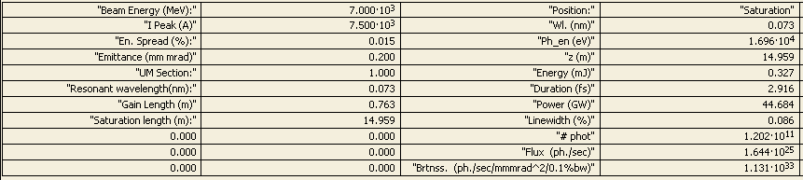
HX FEL results: tables
We have run the full time-dependent simulation to cover this current window
z [μm]
Federico Nguyen
7

Slide 9
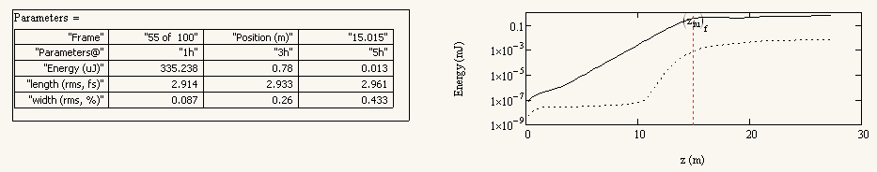
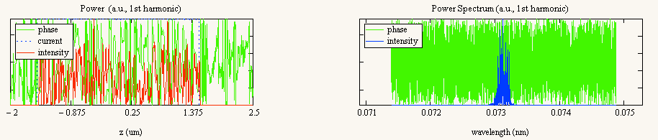
HX FEL results: profile, growth & spectrum
Federico Nguyen
8

Slide 10
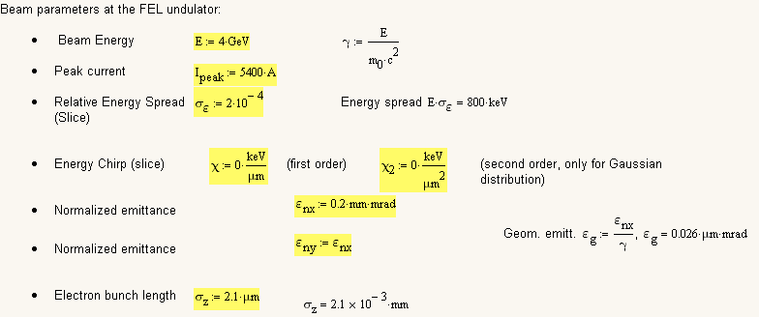
Soft X-ray beam from S. Di Mitri: uniform distributions
Total bunch charge Q = 75 pC
Federico Nguyen
9

Slide 11
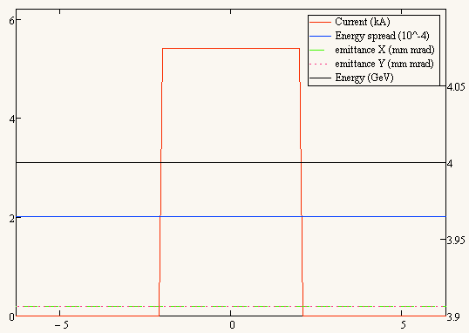
Soft X-ray beam from S. Di Mitri: uniform distributions
z [μm]
Federico Nguyen
10

Slide 12
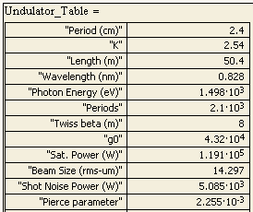

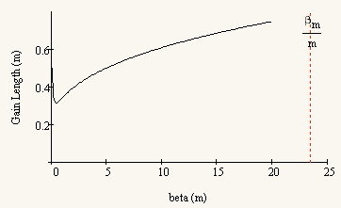
SX: undulator parameters
NdFeB In-vacuum undulator
Federico Nguyen
11

Slide 13
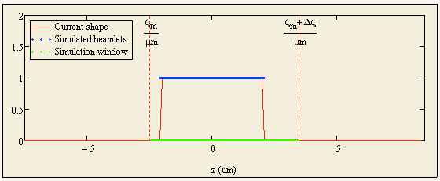
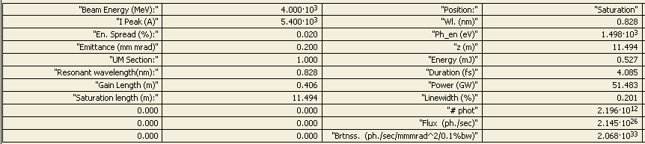
SX FEL results: tables
We have run the full time-dependent simulation to cover this current window
Federico Nguyen
12

Slide 14
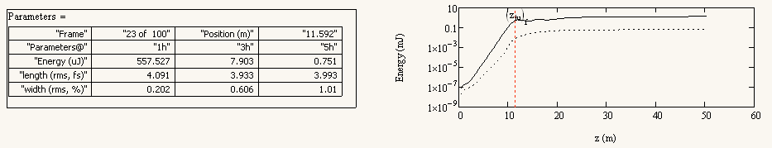
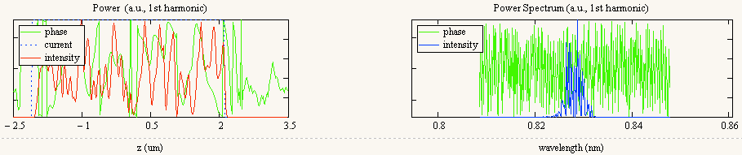
SX FEL results: profile, growth & spectrum
Federico Nguyen
13

Slide 15
Tables to be circulated among XLS WP leaders
Input (i.e. beam and undulator) parameters similar to SwissFEL (see below), with improved performance
Federico Nguyen
14

Slide 16
Conclusions
Comprehensive one-value tables for both Hard and Soft X-ray FEL configurations are drawn at this 2nd iteration stage
Parameter values are in the ballpark of the SwissFEL Concept Design Report tables, with improved light power and saturation length performance
These 1D results describe uniform distributions: they target the “FEL slice definition” guiding the studies all the way back to the injector: “⬅”
Then, at the “integrated CDR” stage, when also transverse dynamics and full 3D distributions are available, also full 3D FEL studies will be performed: “➔” within a joint WP2+WP5+WP6 collaboration,
Soft X-Ray ⬅➔ Uppsala Hard X-Ray ⬅➔ ENEA+STFC
Federico Nguyen
15

Slide 17
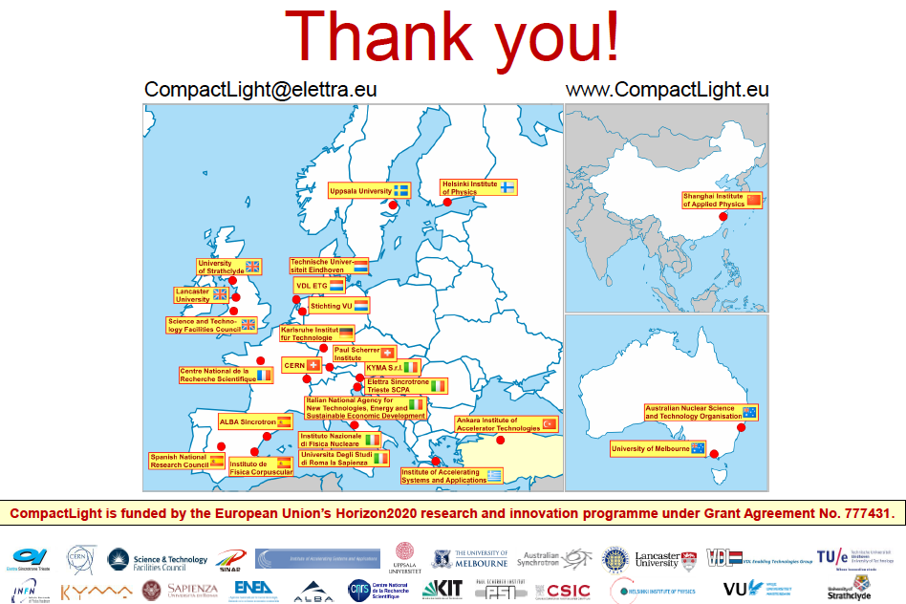
Federico Nguyen

Slide 18
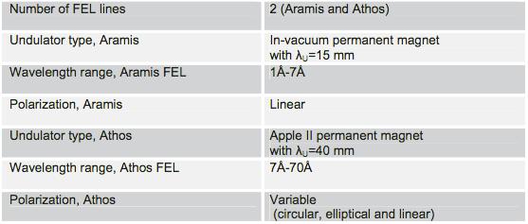
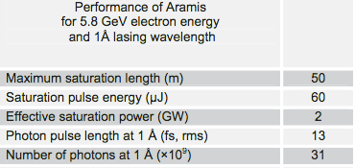
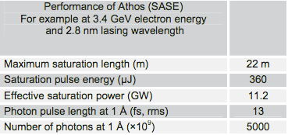
Comparison with SwissFEL
Federico Nguyen

Slide 19
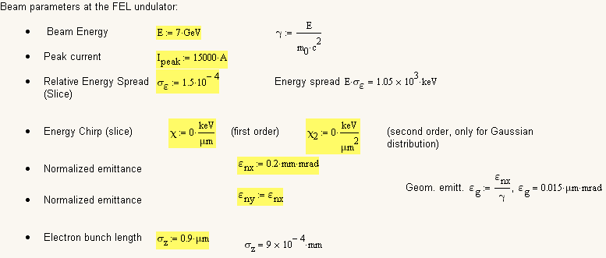
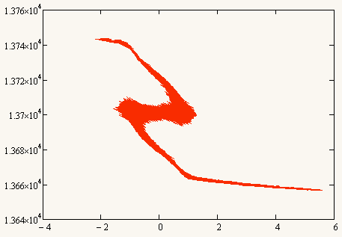
Hard X-ray beam from S. Di Mitri
Total bunch charge = 75 pC
100k macroparticles with given z, E
γ
z [m]
Federico Nguyen

Slide 20
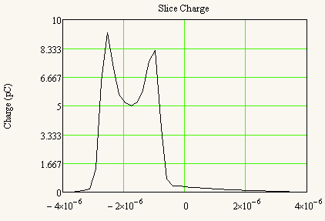
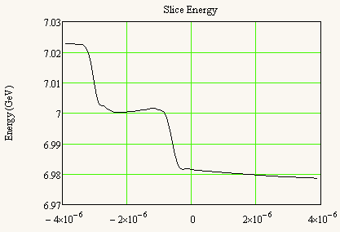
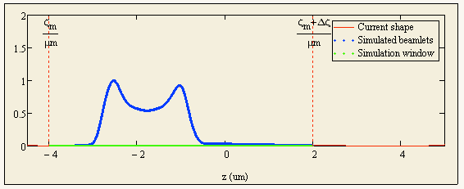
HX: slice energy and current parameterisations
z [m]
z [m]
With PERSEO we analysed the slice energy spread parameterisation clipping the long off-energy tails
We run the full time-dependent simulation to cover the current window
a.u.
Federico Nguyen

Slide 21
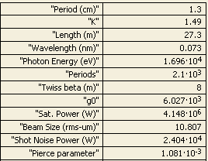
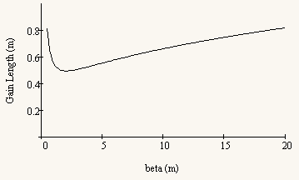
HX: undulator parameters
NdFeB In-vacuum undulator
Federico Nguyen

Slide 22
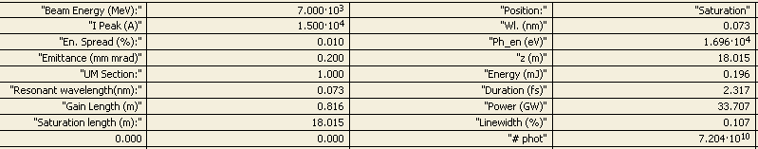
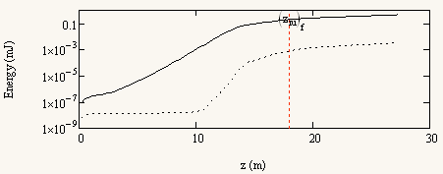
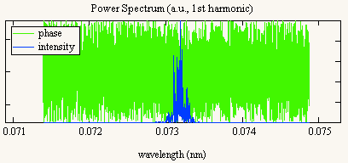
1D-FEL time dependent with slice E, σ_{ε} parameterisations
Federico Nguyen

Slide 23
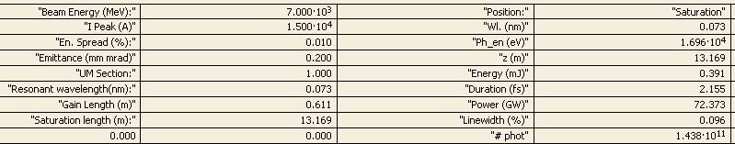
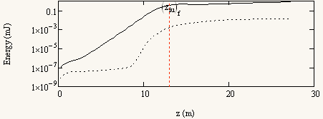
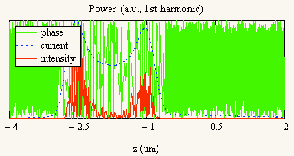
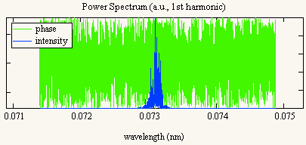
1D-FEL time dependent with σ_{ε} = 1.5 × 10⁻⁴
Federico Nguyen

Slide 24
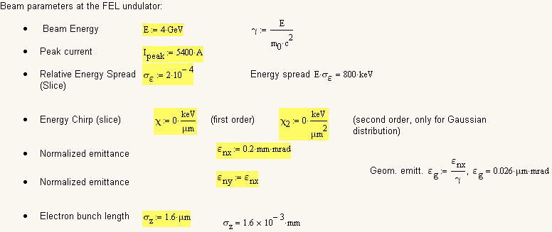
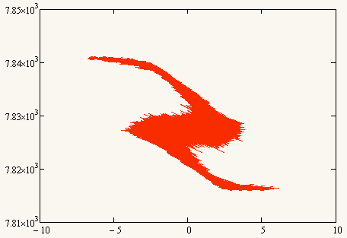
Soft X-ray beam from S. Di Mitri
Total bunch charge = 75 pC
100k macroparticles with given z, E
γ
Federico Nguyen
z [m]

Slide 25
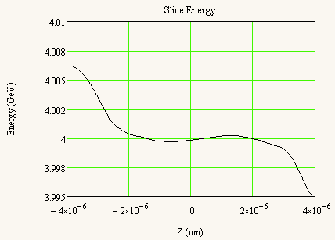
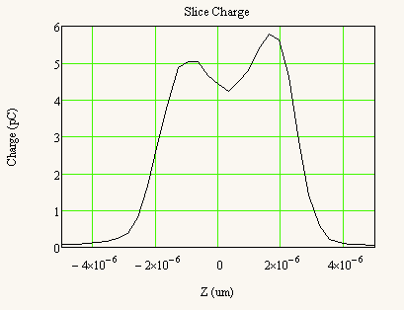
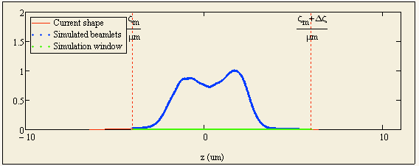
SX: slice energy and current parameterisations
a.u.
We run the PERSEO simulation to cover the current window
Federico Nguyen

Slide 26
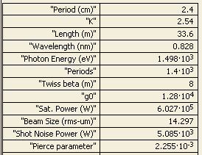
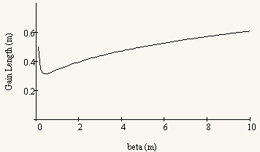
SX: undulator parameters
NdFeB In-vacuum undulator
Remark: not yet fully investigated whether
this configuration could provide efficient Two-Colours operation
Federico Nguyen

Slide 27
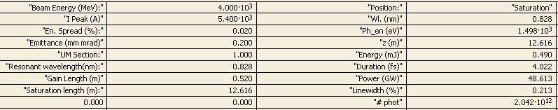
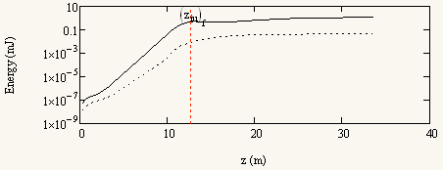
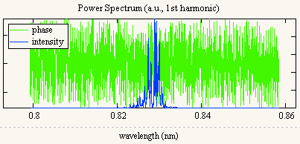
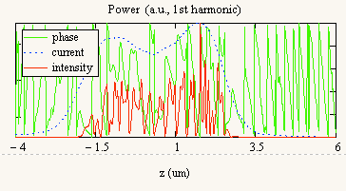
1D-FEL time dependent with σ_{ε} = 2 × 10⁻⁴
Federico Nguyen

Slide 28
Tables to be circulated among XLS WP leaders
Input (i.e. beam and undulator) parameters similar to SwissFEL (see below), with improved performance
Federico Nguyen

Slide 29
Conclusions
Comprehensive one-value tables for both Hard and Soft X-ray FEL configurations are drawn at this 1st iteration stage
Parameter values are in the ballpark of the SwissFEL Concept Design Report tables, with improved light power and saturation length performance
These 1D FEL results describe the longitudinal dynamics details, guiding the studies all the way back to the injector: “⬅”
Then, at a later stage, when also transverse dynamics and full 3D distributions are available, also full 3D FEL studies will be performed: “➔” within a joint WP2+WP5+WP6 collaboration,
Soft X-Ray ⬅➔ Uppsala Hard X-Ray ⬅➔ ENEA+STFC
Federico Nguyen

