Slide 1
WP6 update
Avni Aksoy
Institute of Accelerator Technologies

Slide 2
Contents
FEL tuning range → Eneegy tuning range
Lattice performance
Additional injector (x-band injector)
Benchmarking
Report contents
Conclusion

Slide 3
Parameters
Parameter | unit | Soft X-Ray | Hard X-Ray
photon energy | keV | 0.25-2 | 2-16
Wavelength | nm | 5-0.6 | 0.6-0.08
Repetition | Hz | 1000 | 100
pulse duration | fs | 0.1-50 | 1-50
Polarization |  | Variable, selectable | Variable, selectable
two pulse deleay | fs | +- 100 | +- 100
two color seperation | % | 20 | 10
Synchronization | fs | <10 | <10
Fixed and signle?
Undulator Period | mm | 24 | 13
Undulator strength | # | ??- 2.54 | 1.49
Beam energy | GeV | ??-4 | ?? - 7
Tuneable?
Tuneable?
Tuneable

Slide 4
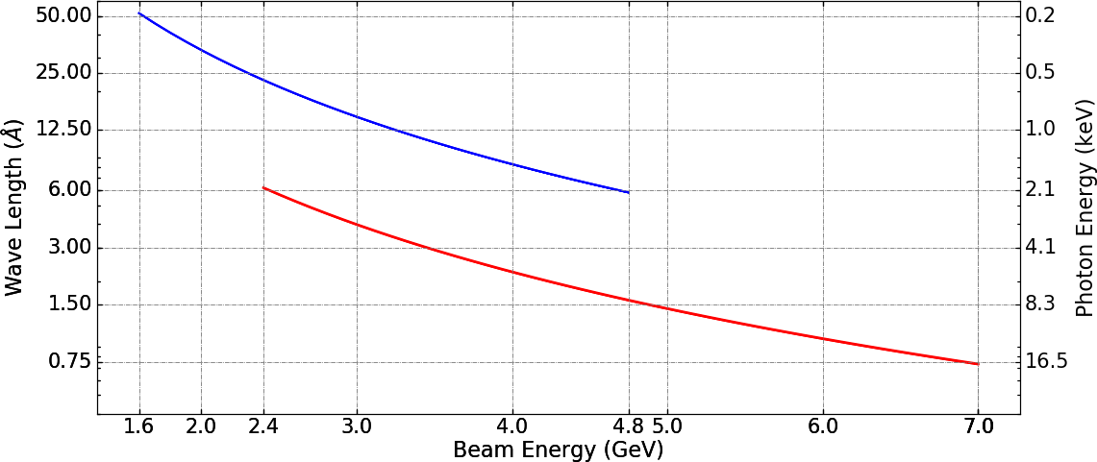
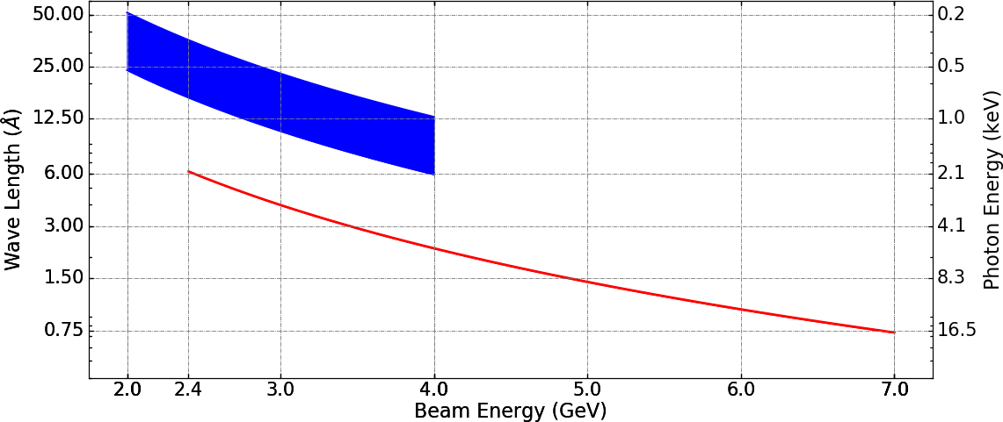
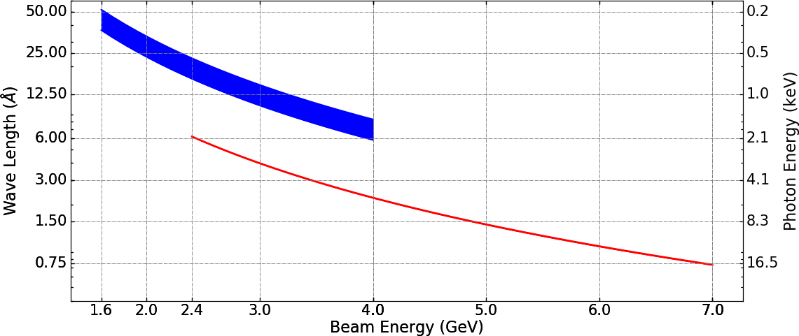

Paractise-Resonant wavelength
$λ_{FEL}=\frac{λ_{U}}{2γ^{2}}(1+\frac{K^{2}}{2})$
K is fix for both Soft and Hard Xrays
Soft X-ray
λ_{U}=24 mm
K_{U}=2.54
E_{beam}=1.6-4.8 GeV
Hard X-ray
λ_{U}=13 mm
K_{U}=1.49
E_{beam}=2.4-7 GeV
K is tuneable for Soft Xray
Soft X-ray
λ_{U}=24 mm
K_{U}=2.0-2.54
E_{beam}=1.6-4.0 GeV
Hard X-ray
λ_{U}=13 mm
K_{U}=1.49 (Fixed)
E_{beam}=2.4-7 GeV
K is tuneable for Soft Xray
Soft X-ray
λ_{U}=37 mm
K_{U}=1.4-2.55
E_{beam}=2.0-4.0 GeV
Hard X-ray
λ_{U}=13 mm
K_{U}=1.49 (Fixed)
E_{beam}=2.4-7 GeV

Slide 5
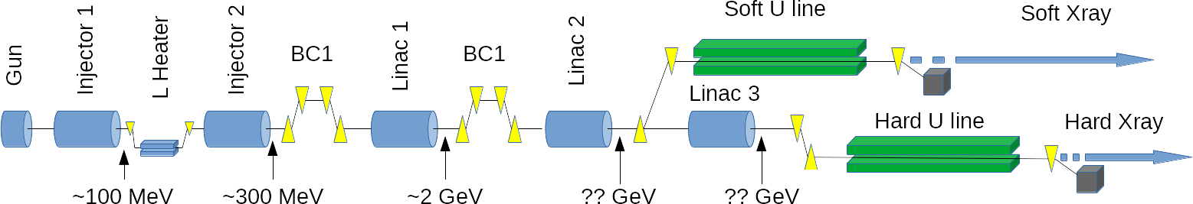
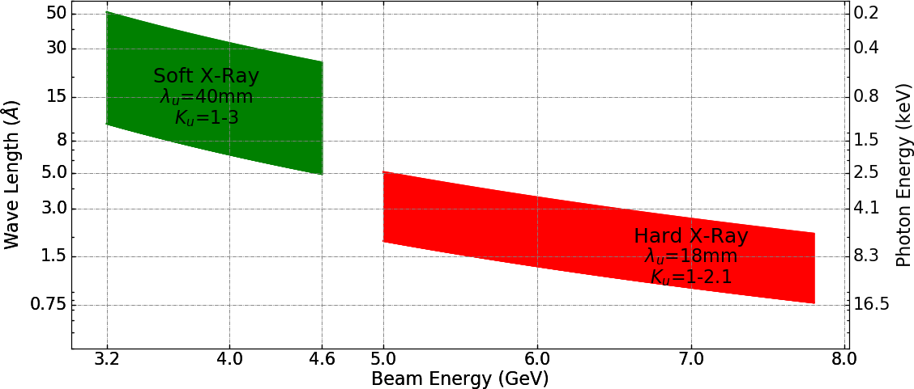
Compact Light FEL Specification
WP6
Barcelona

Slide 6
Layout
Soft X-ray
λfel = 0.6-5 nm
Injector
Linac-1
Linac-2
Hard X-ray
λfel = 0.8-6 Å
E0=0.2 GeV
E1=0.2 → 2 GeV
E2=2 → 7 GeV
N.Thompson
Hard X-ray
Case 1: E₀=0.2 GeV, E₁=0.2→~2 GeV, E₂=~2→7 GeV ➔ λ_{fel} = 0.8 Å
Case 2: E₀=0.2 GeV, E₁=0.2→~0.6 GeV, E₂=~0.6→2.4 GeV ➔ λ_{fel} = 6 Å
Large Energy tuning range
Soft X-ray
Case 1: E₀=0.2 GeV, E₁=0.2→~1 GeV, E₂=~1→4 GeV ➔ λ_{fel} = 6 Å
Case 2: E₀=0.2 GeV, E₁=0.2→~0.5 GeV, E₂=~0.5→2 GeV ➔ λ_{fel} = 5 nm

Slide 7
Transverse stability
Hard X-Ray
  Energy gain per cavity for 100 Hz reprate: ΔV=58.5 MV
  Max energy gain in linacs: ΔE=6.8 GeV → Ncavity≈120 (for ~15º off-crest phase)
  Min energy gain in linacs: ΔE=2.4 GeV → Ncavity≈120 → Cavity gradient: G=23 MV/m (for ~15º off-crest phase)
Soft Xray
  Ncavity≈120
  Max energy gain in linacs (at ~15º off-crest phase): ΔE=4 GeV → Cavity gradient: G=38.3 MV/m
  Min energy gain in linacs (at ~15º off-crest phase): ΔE=2 GeV → Cavity gradient: G=19.5 MV/m

Slide 8
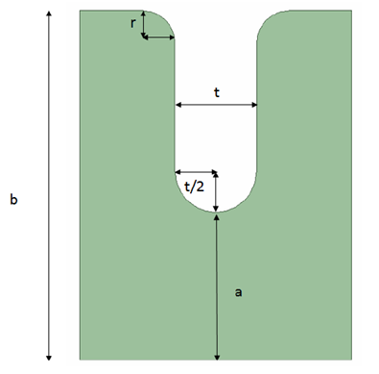
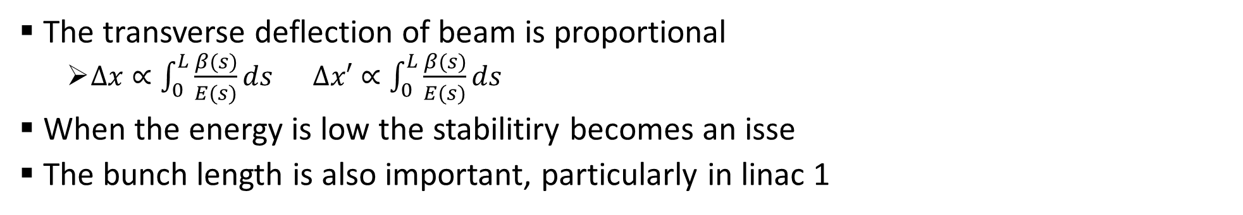
Linac 1 optimization
The transverse deflection of beam is proportional
  $∆x∝\int_{0}^{L}{\frac{β(s)}{E(s)}ds}$ $∆x′∝\int_{0}^{L}{\frac{β(s)}{E(s)}ds}$
When the energy is low the stabilitiry becomes an isse
The bunch length is also important, particularly in linac 1
Parameter | Value
Frequency | 11.9942 GHz
Gradient | 65 MV/m
Number of Cells | 108+2
Total (effective) length | 103 (91.6) cm
Average aperture (a) | 3.5 mm
Cell length (d) | 8.332 mm (2π/3 mode)
Gap length (d-t) | 5.832 mm
Cell Diameter (2b) | 10.139 mm
Nstruc/FODO/2=1-4
Total number of structures=120
Initial energy = 200 MeV
Final energy = 2 – 7 GeV
WP4 Meeting,15 Mar 2018, Alessandro Gallo (INFN)

Slide 9
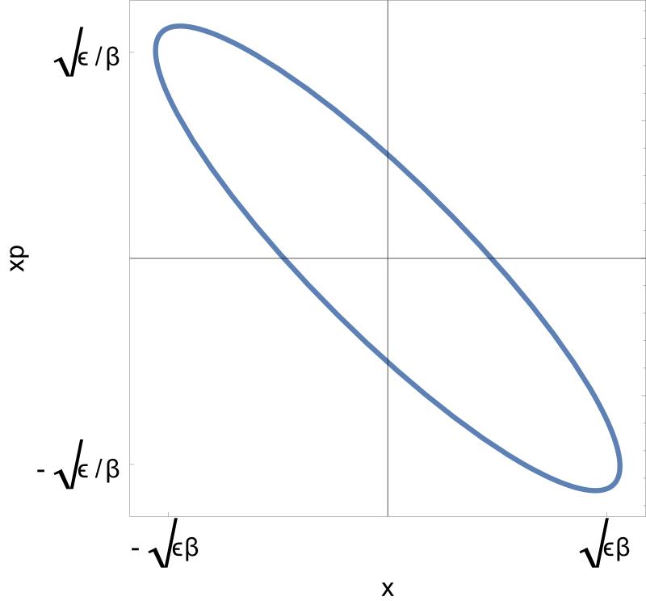
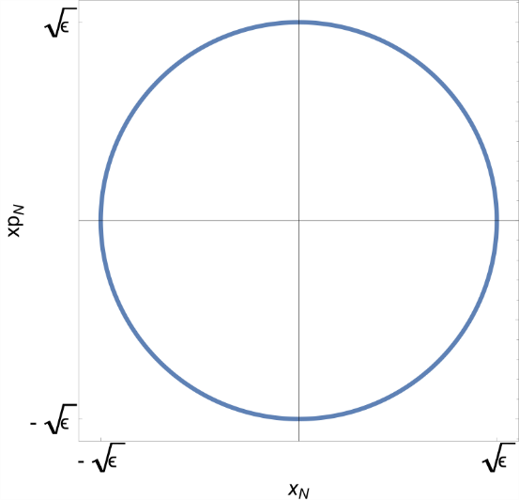
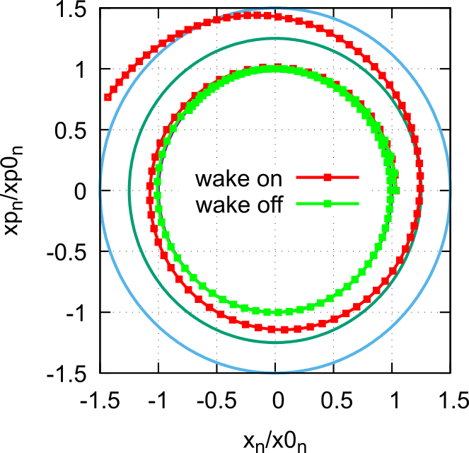
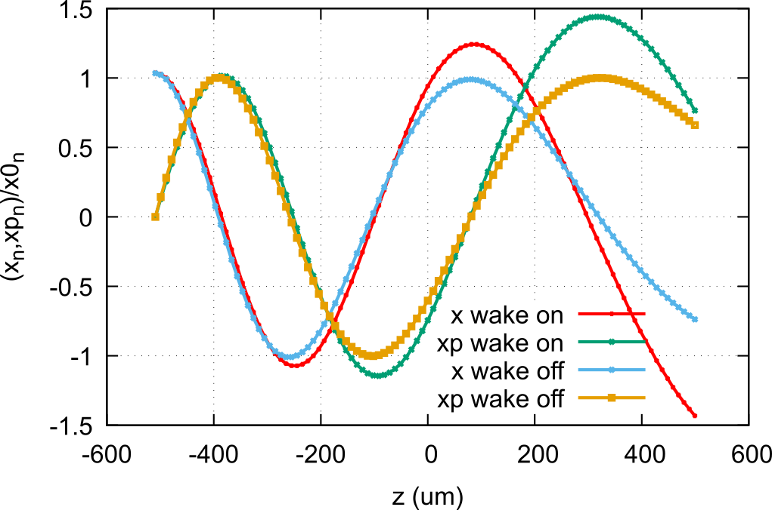
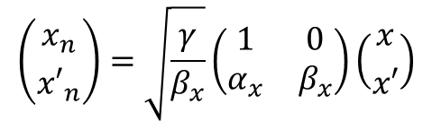
How to check transverse stability?
To check the effect of wakefield we use normalized phase space notation (removing the Twiss dependence of phase space).
Normalized coordinates of center of slices of a bunch with wake and without wake
$$\left({x_{n} \atop {x′}_{n}}\right)=\sqrt{\frac{γ}{β_{x}}}\left(\begin{matrix}1 & 0 \\ α_{x} & β_{x}\end{matrix}\right)\left({x \atop x′}\right)$$
In normalized phase space the bunch is
characterized by a emittance only

Slide 10
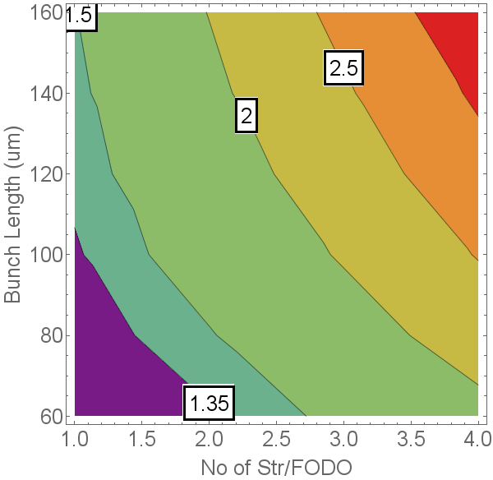
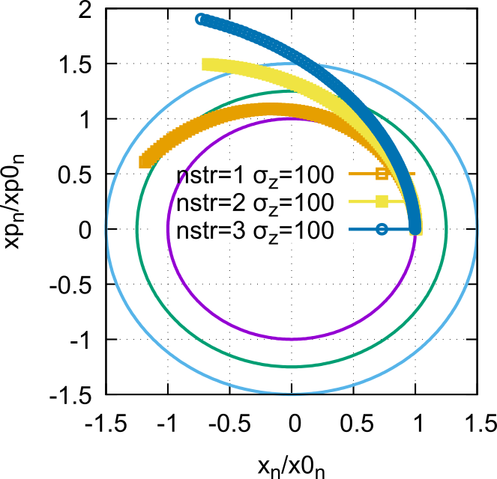
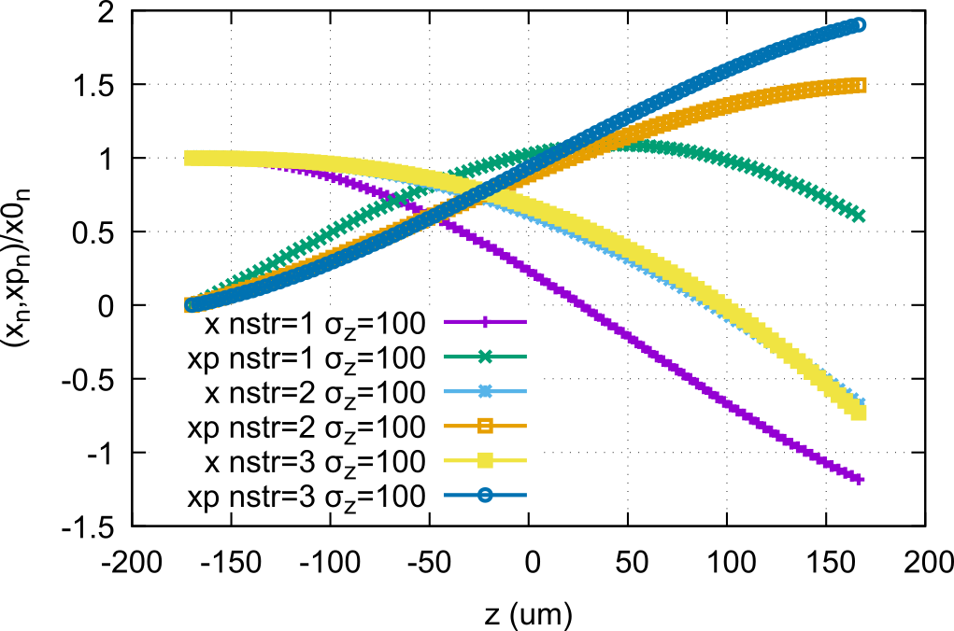

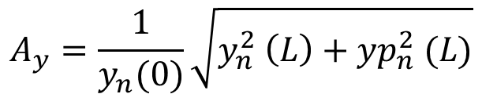
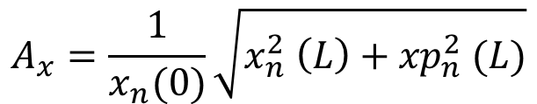
Transverse stability linac for max beam energy
Ein=0.2, Efin=7 GeV, Nstr=120, G=65 MV/m
Maximum slice deflection for max beam energy
$$A_{x}=\frac{1}{x_{n}(0)}\sqrt{x_{n}^{2} \left(L\right)+{xp}_{n}^{2} (L)}$$
$$A_{y}=\frac{1}{y_{n}(0)}\sqrt{y_{n}^{2} \left(L\right)+{yp}_{n}^{2} (L)}$$
$A_{max}=Max (A_{x}∨A_{y}$)

Slide 11
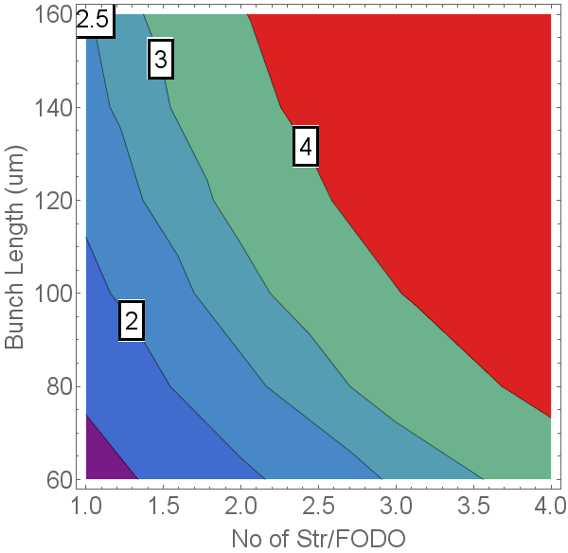
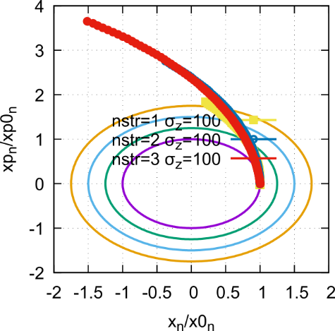
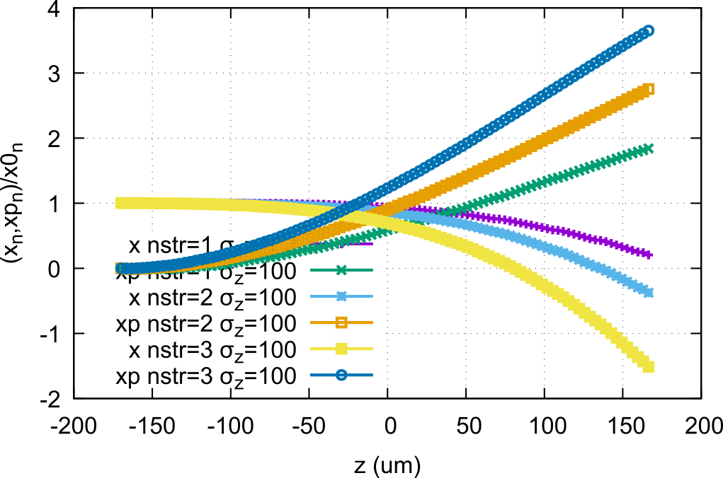

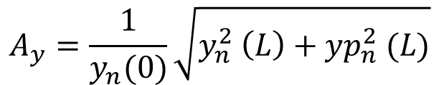
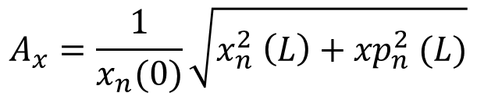
Transverse stability linac for min beam energy
Ein=0.2, Efin=7 GeV, Nstr=120, G=20 MV/m
Maximum slice deflection for max beam energy
$$A_{x}=\frac{1}{x_{n}(0)}\sqrt{x_{n}^{2} \left(L\right)+{xp}_{n}^{2} (L)}$$
$$A_{y}=\frac{1}{y_{n}(0)}\sqrt{y_{n}^{2} \left(L\right)+{yp}_{n}^{2} (L)}$$
$A_{max}=Max (A_{x}∨A_{y}$)

Slide 12
Injector Simulations
X-Band injector

Slide 13
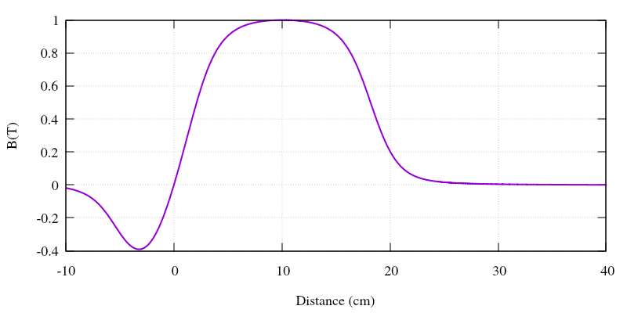
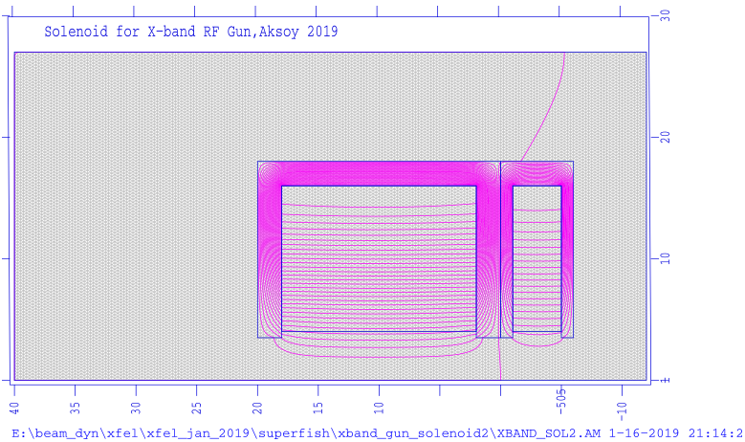
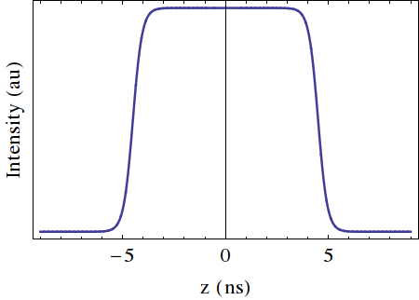
X-band based Injector
Laser
12 GHz RF Gun
5.6 Cell, 200 MV/m
12 GHz Traveling wave structures
108 cell, ~0.9 m, 65MV/m, 120 degree
σ_{z} = 2 ps (FWHM)
σ_{x,y} = 0.25 mm

Slide 14
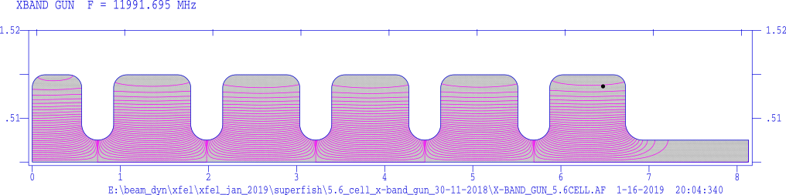
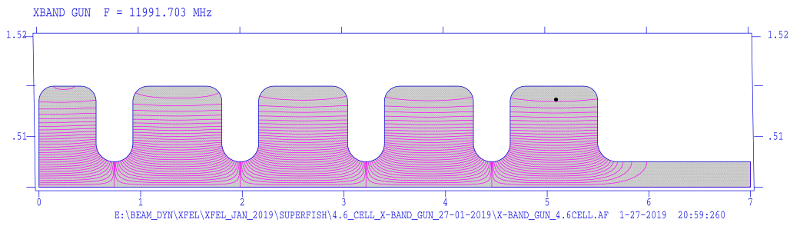
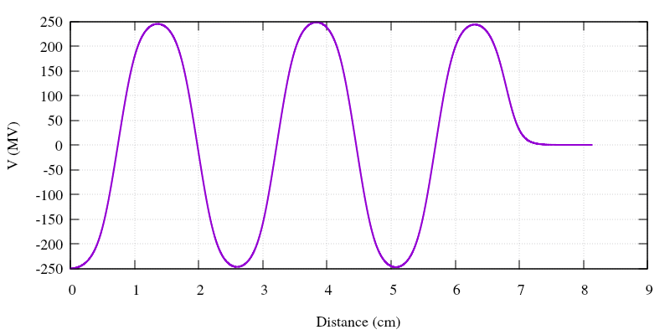
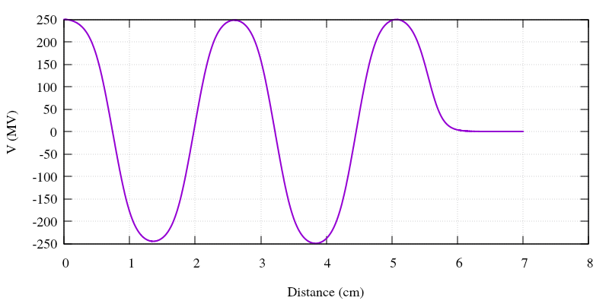
X-band based Injector
Laser
12 GHz RF Gun
5.6 Cell, 200 MV/m
12 GHz Traveling wave structures
108 cell, ~0.9 m, 65MV/m, 120 degree
Parameter | Value | Unit
Frequency | 12 | GHz
Gradient | 200 | MV/m
Cell number | 5.6 | #
Parameter | Value | Unit
Frequency | 12 | GHz
Gradient | 250 | MV/m
Cell number | 4.6 | #

Slide 15
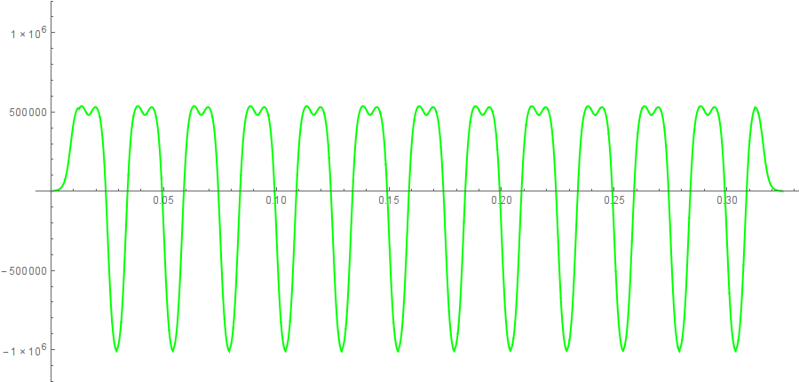
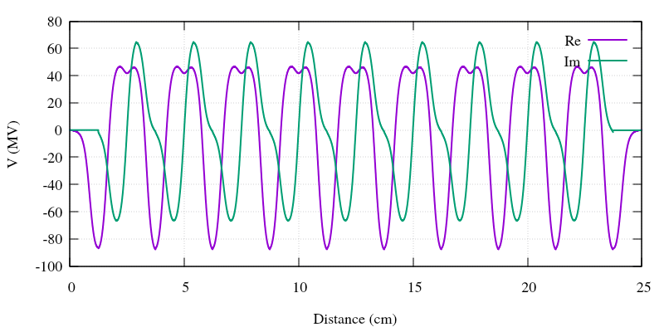
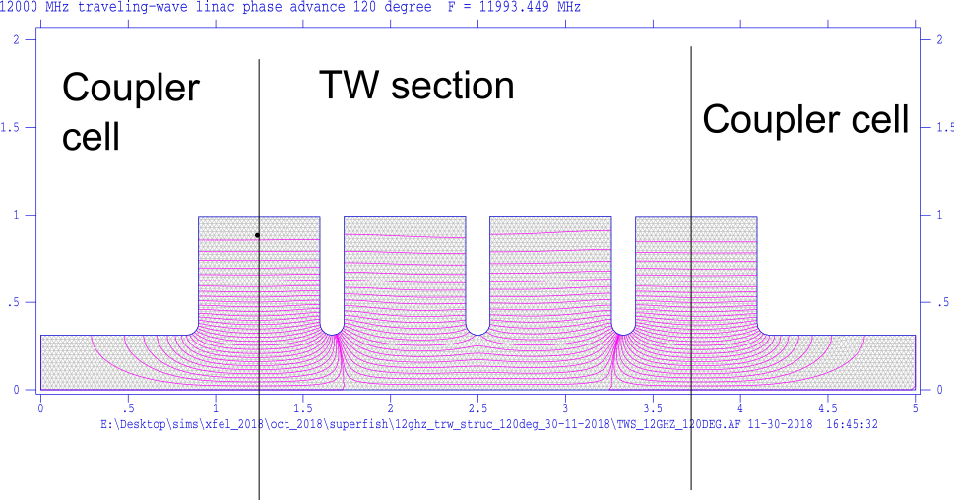
X-band based Injector
Parameter | Value | Unit
Frequency | 12 | GHz
Gradient | 65 | MV/m
Total lengt | ~1 | m
Cell number | 108 | #
Laser
12 GHz RF Gun
5.6 Cell, 200 MV/m
12 GHz Traveling wave structures
108 cell, ~0.9 m, 65MV/m, 120 degree

Slide 16
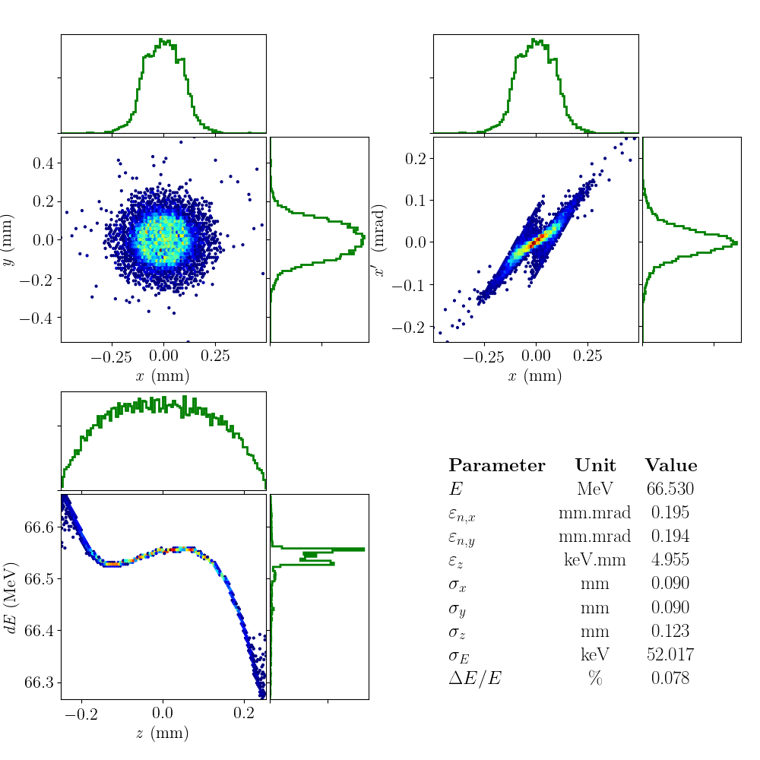
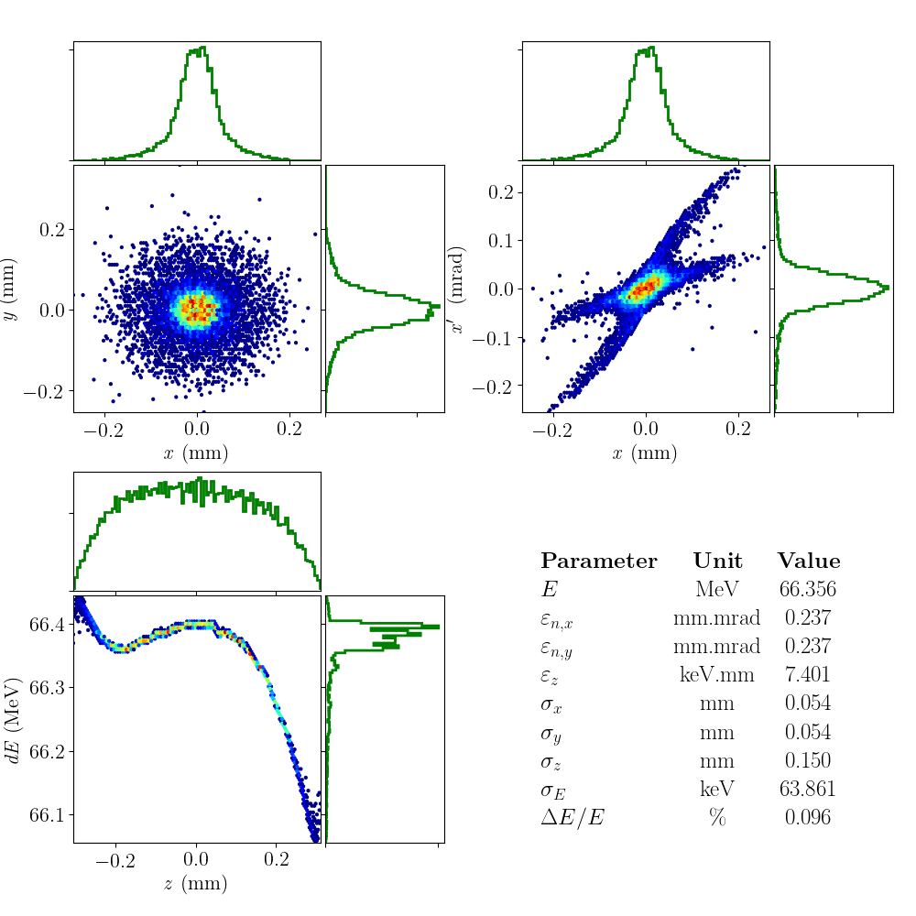
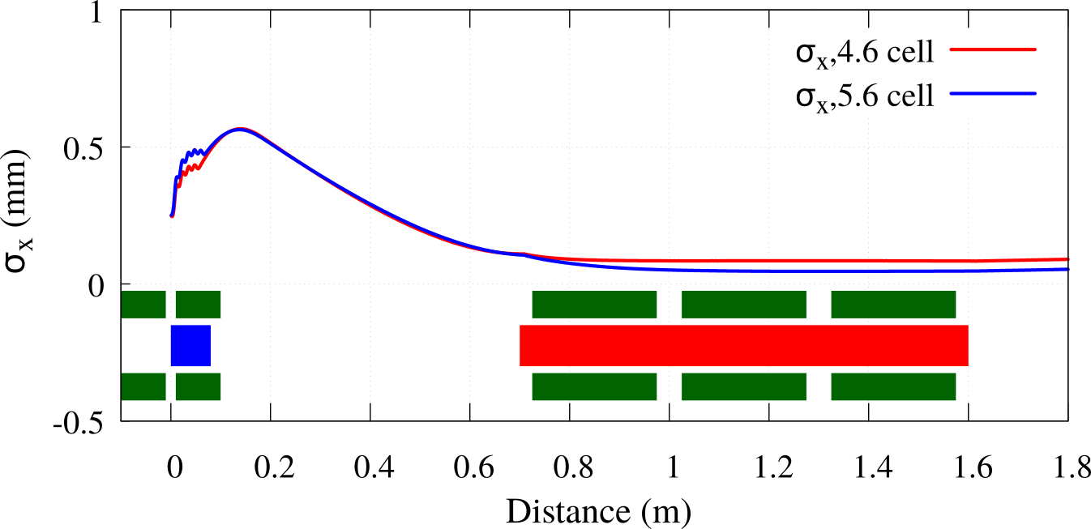
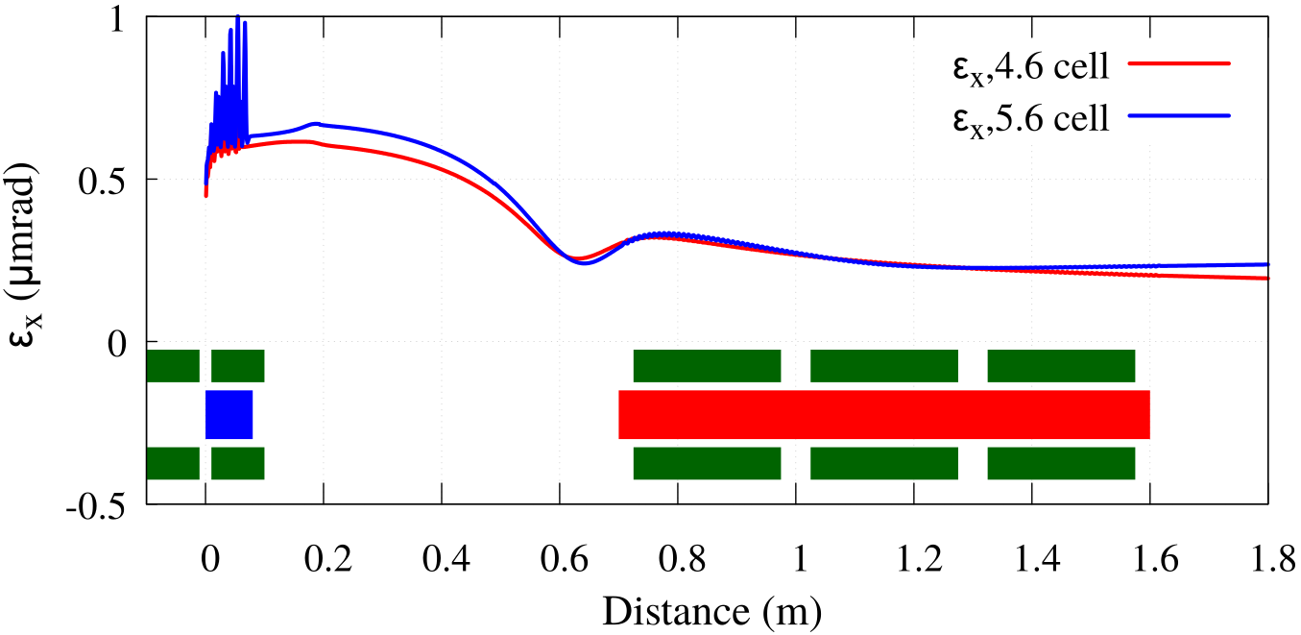
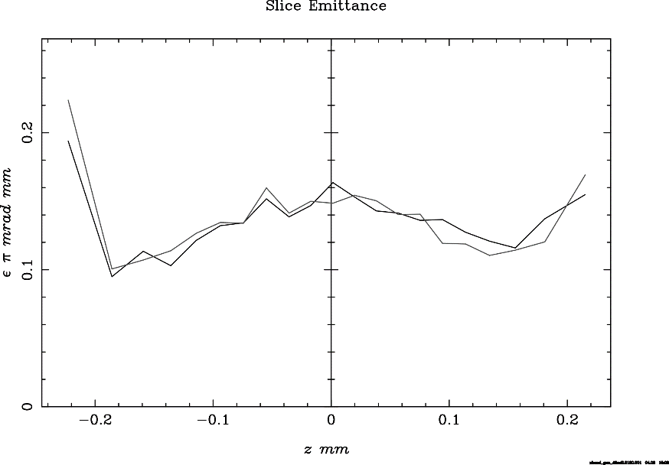
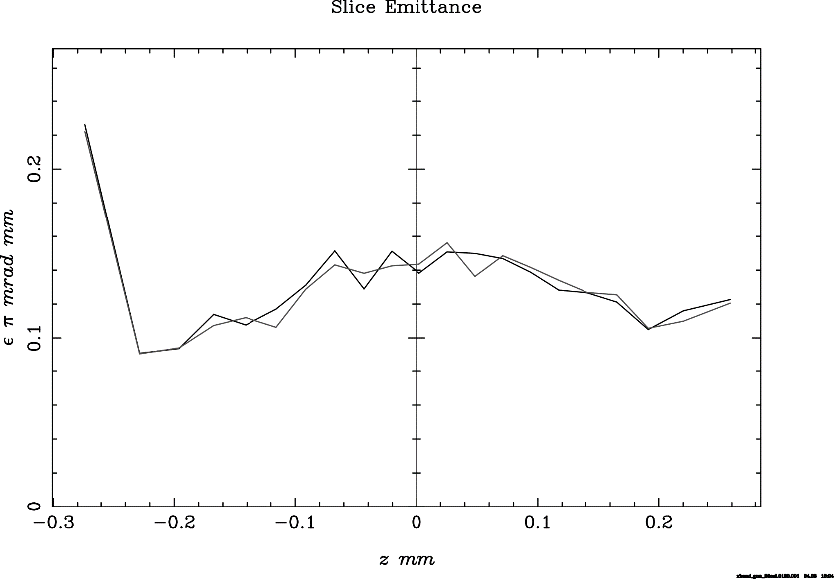
X-band Injector Optimization
4.6 cell
5.6 cell
4.6 cell
5.6 cell

Slide 17
Benchmarking of codes
ASTRA-GPT

Slide 18
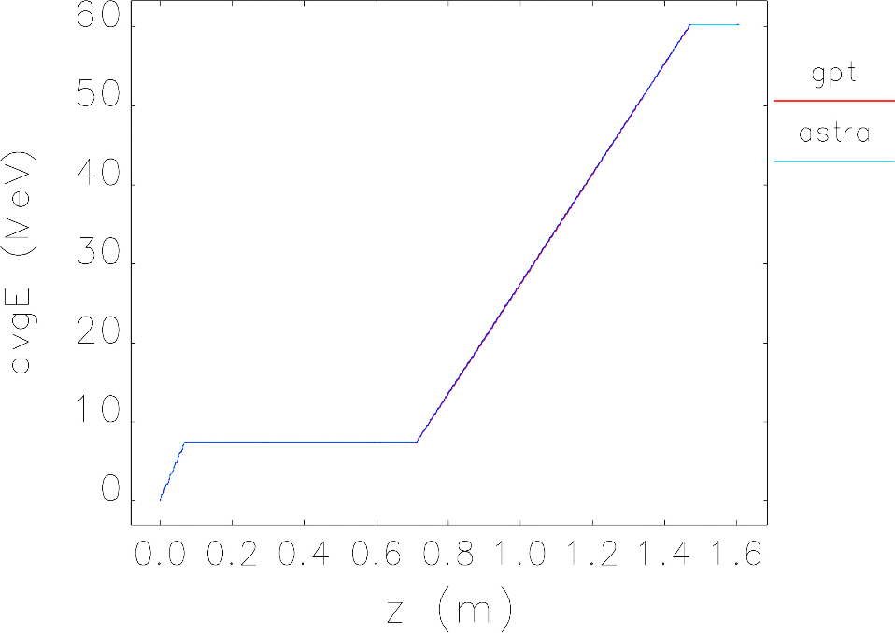
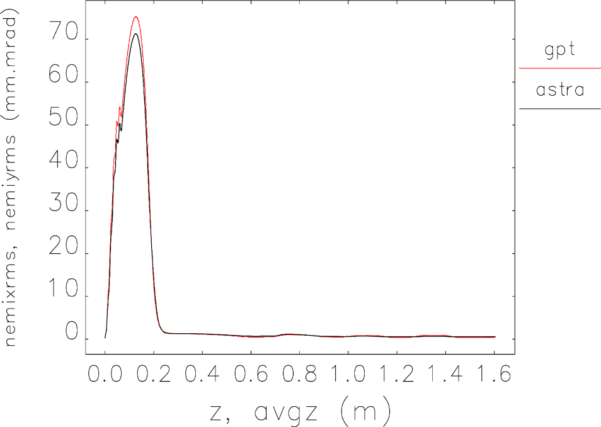
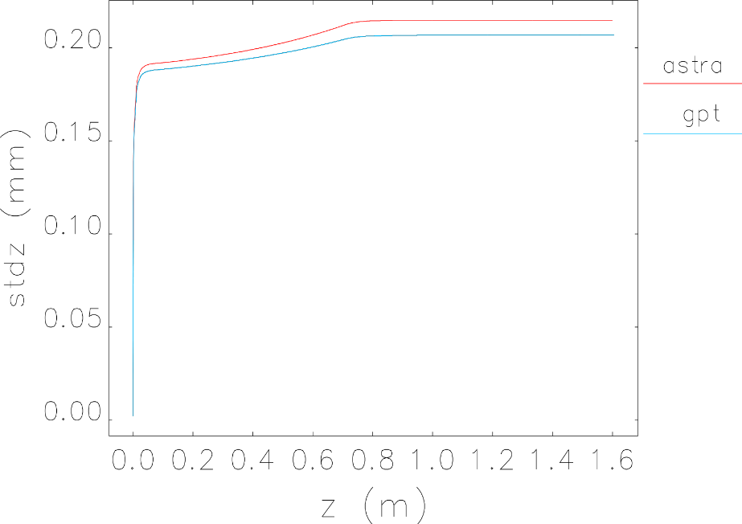
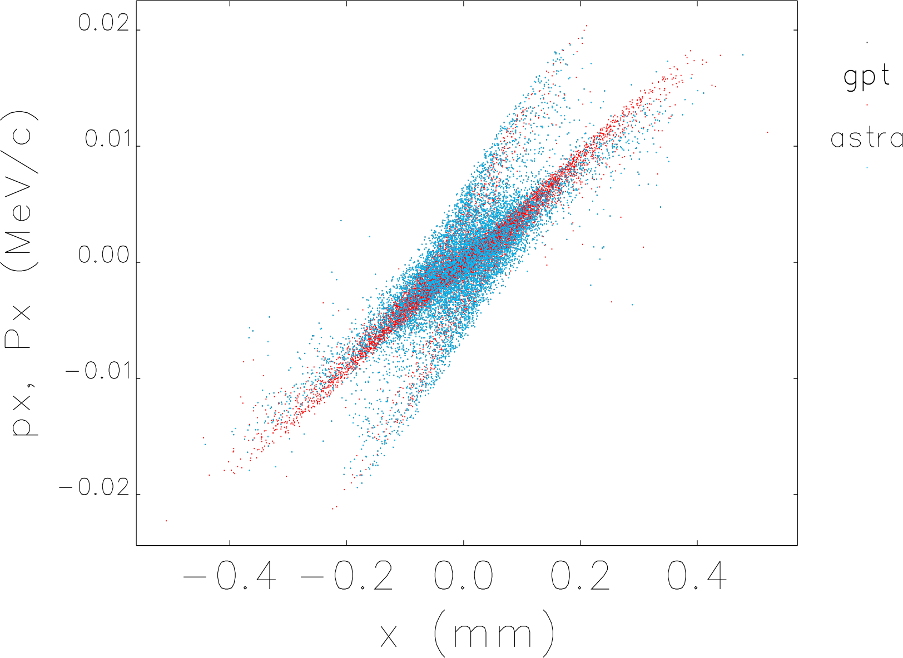
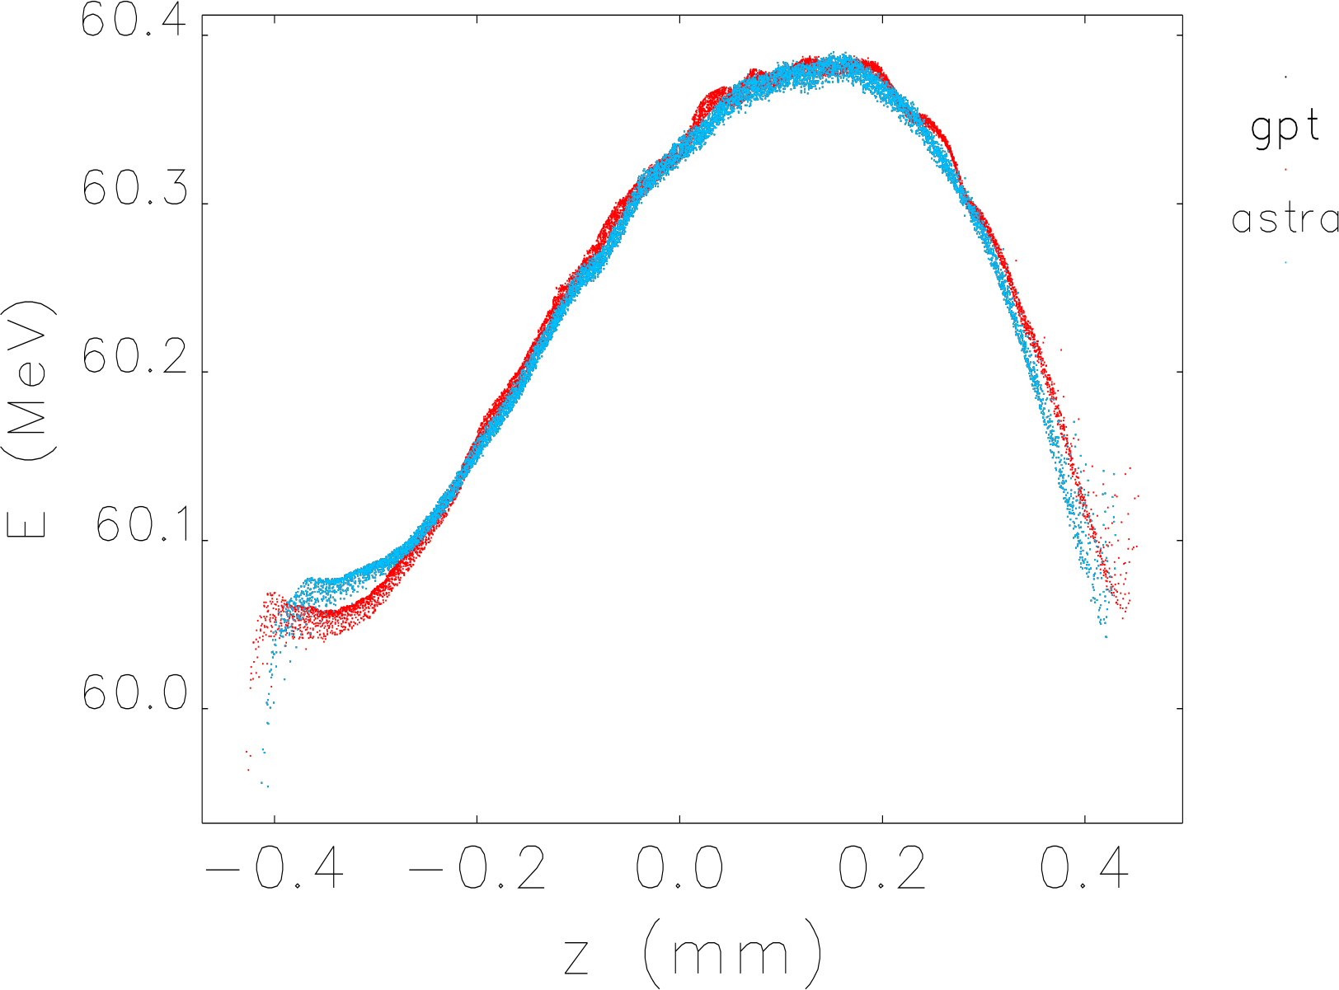
4.6 Cell X-Band Gun + X-Band structure

Slide 19
First Deliverable

Slide 20
First Report
D6.1: A report providing a global analysis of the most advanced computer codes available for the facility design and performance evaluations (R, PU, M18).

Slide 21
Tasks and Task members
 | Task 6.1 - Injector |  |  |  | Task 6.2 - Linac |  |  |  | Task 6.3 - FEL |  | Task 6.4 S2E
 | 6.1A | 6.1B | 6.1C | 6.1D | 6.2A | 6.2B | 6.2C | 6.2D | 6.3A | 6.3B | 6.4A
Task Leader | Anna Giribono | Michel Croia | Cristina Vaccarezza | Zafer Nergiz | Simone Di Mitri | Avni Aksoy | Andrea Latina | Rohan Dowd | Vitaliy Goryashko | Federico Nguyen | Avni Aksoy
 | Anna.Giribono@lnf.infn.it | Michele.Croia@lnf.infn.it | Cristina.Vaccarezza@lnf.infn.it | znergiz@cern.ch | simone.dimitri@elettra.eu | aaksoy@cern.ch | alatina@cern.ch | Rohan.Dowd@synchrotron.org.au | vitaliy.goryashko@physics.uu.se | federico.nguyen@enea.it | aaksoy@cern.ch
Task Members | A. Latina | C. Vaccarezza | A. Giribono | A. Aksoy | X. Liu | R. Dowd | R.M. Horta | X. Liu | G. Dattoli | G. Dattoli | Z. Nergiz
 | andrea.latina@cern.ch | Cristina.Vaccarezza@lnf.infn.it | Anna.Giribono@lnf.infn.it | aaksoy@cern.ch | xingguang.liu@cern.ch | Rohan.Dowd@synchrotron.org.au | rmunoz@cells.es | xingguang.liu@cern.ch | giuseppe.dattoli@enea.it | giuseppe.dattoli@enea.it | znergiz@cern.ch
 | A. Aksoy | Andrea Latina | A. Latina | F. Yaman | R.M. Horta | X. Liu | X. Liu | M. Olvegård | Zafer Nergiz | Z. Nergiz | X. Liu
 | aaksoy@cern.ch | andrea.latina@cern.ch | andrea.latina@cern.ch | fatihyaman@iyte.edu.tr | rmunoz@cells.es | xingguang.liu@cern.ch | xingguang.liu@cern.ch |  | znergiz@cern.ch | znergiz@cern.ch | xingguang.liu@cern.ch
 | A. Mavridis | Avni Aksoy | A. Faus-Golfe | W. Wuensch | A. Faus-Golfe | R.M. Horta |  |  | H. Castaneda | H. Castaneda | H. Castaneda
 |  | aaksoy@cern.ch | angeles.faus.golfe@cern.ch | walter.wuensch@cern.ch | angeles.faus.golfe@cern.ch | rmunoz@cells.es |  |  | hector.castaneda@stfc.ac.uk | hector.castaneda@stfc.ac.uk | hector.castaneda@stfc.ac.uk
 | A. Faus-Golfe |  |  | A. Latina |  | S. Di Mitri |  |  | A. Mak
 | angeles.faus.golfe@cern.ch |  |  | andrea.latina@cern.ch |  | simone.dimitri@elettra.eu |  |  | alan.mak@physics.uu.se
 |  |  |  | E. Trachanas |  |  |  |  | F. Nguyen
 |  |  |  |  |  |  |  |  | federico.nguyen@enea.it
Layout | SBand Gun + SBand Acc | CBand Gun + C(S)band Acc | SBand Gun + CBand RF vel. comp + CBand Acc | Xband gun + Xband Acc | SBand Acc + XBand lnrz + BC1 + Xband Acc + BC2 + XBand Acc + BD | XBand Acc + Optic Lnrz XBand Acc + BC2 XBand Acc + BD | XBand Acc + KBand lnrz + BC1 + XBand BC2 + XBand Acc +BD | Beam based alignment for the final layout | Soft X-Ray | Hard X-Ray | Start to End modeling
Codes | GPT |  |  |  | ELEGANT |  |  |  | GENESIS
 | ASTRA |  |  |  | PLACET |  |  |  | PROMETEO
 | RF-TRACK |  |  |  | GPT |  |  |  | PARSIFEL
 |  |  |  |  |  |  |  |  | PERSEO

Slide 22
TOC of First Delivery
Introduction
Set of parameters
Summary of available tools
Comperasion of coodes
  Injector (Space charge dominant) (Presently we use ASTRA, GPT and TSTEP)
    Sband Injector
    C band Injector
    Xband Injector
  Linac (wakefield dominant) (Presently we use ELEGANT and PLACET, LiTrack also used for BCs)
    Sband Based injector Linac
    C band Based Linac
    X Injector based linac
  FEL (Genesis Ginger)
    Hard Xray
    Soft Xray
Conclusion

Slide 23
Units of Parameters

Slide 24
Units to compare results..
Phase space
Others
x | x’ | px | y | y’ | py | z | t | pz | p | E
mm | mrad | MeV/c | mm | mrad | MeV/c | mm | ns | MeV/c | MeV/c | MeV
x | px | y | py | z | t | p
mm | MeV/c | mm | MeV/c | mm | ps | MeV/c
Preferred
β | α | εx,y | εx,y | lenght | time | p | E
m | # | m.mrad | keV.ps | m | s | MeV/c | MeV

Slide 25
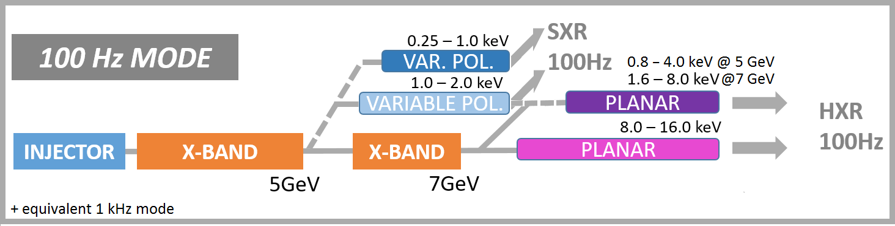
Conclusion
We have to vide range of energy tuning requirement.. BCs will be included to the module optimization
  Shall we use several undulator?
GitLab repository is being used
  All simulation results will be collected at gitlab
Parameters for injector is more less clear but machine?
S. Di Mitri

