Slide 1
ATLAS ITk Pixel endcap demonstrator construction and testing
John Matheson, STFC Rutherford Appleton Laboratory
On behalf of the ATLAS ITk Pixel Endcap community
Pixel endcap and half-ring layout
Ring-0 detector module reception testing
Module loading to Ring-0, including gluing trials
Ring-0 serially powered (SP) tests at Liverpool
Tuning results with SP
Testing with SP and Sr-90
Conclusions and future work

Slide 2
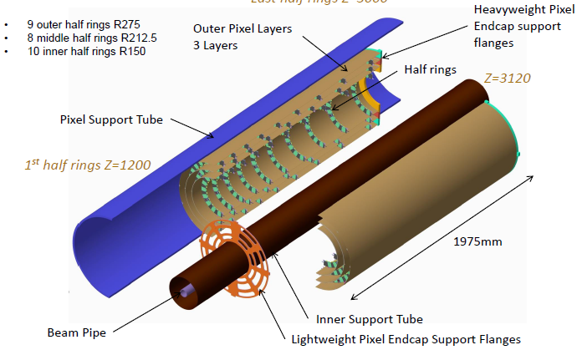
Layout of one ITk PixelEndcap
1140 quad modules

Slide 3
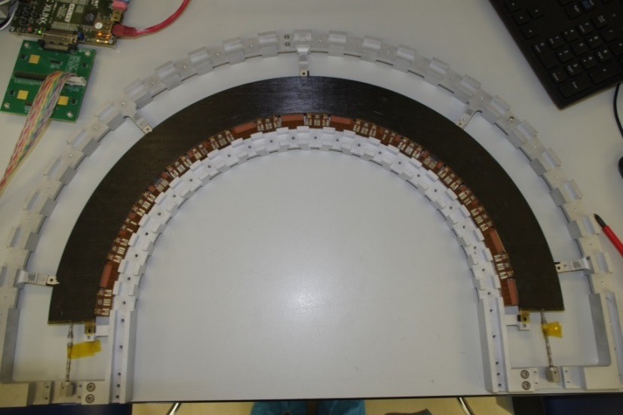
Layout of a half-ring
Carbon foam core
Carbon fibre facings
Ti cooling pipe
Bus tapes (HV, LV, NTC)
EOS cards (HV, LV, NTC)
Aluminium handling frame
Edinburgh
Current inner ring design: 8 RD53A quad modules per side
Ring-0: old design, 12 FE-I4B quad module positions per side. 6 per side populated
=> two 6-module SP chains
Manchester

Slide 4
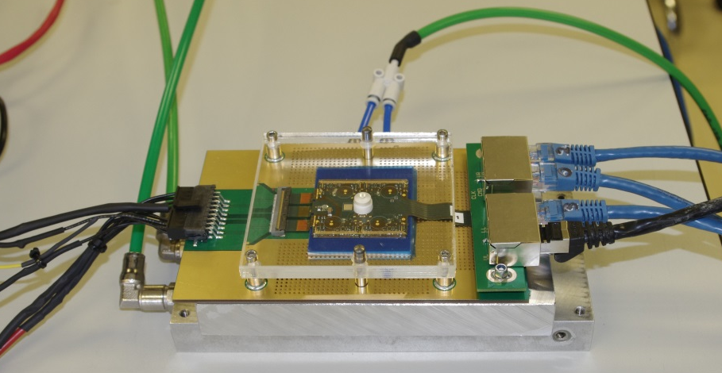
Modules and reception testing
Modules supplied on test jig
DAQ was USBPix3 (Bonn)
Modules tested before and after mounting
Module supply current check
Sensor leakage current check
Digital scan
FE-I4B Tuning
Hot pixel scan (mask noisy pixels)
Threshold scan (sensor bias voltage on)
Threshold scan (sensor bias voltage off)
4 modules each made by:
  Glasgow
  Liverpool
  Oxford

Slide 5
FE-I4B front end
Vcal - analogue injection
FDAC Tune - preamp feedback
TDAC Tune – local threshold
DigHit – digital injection
Pulse height information from ToT

Slide 6
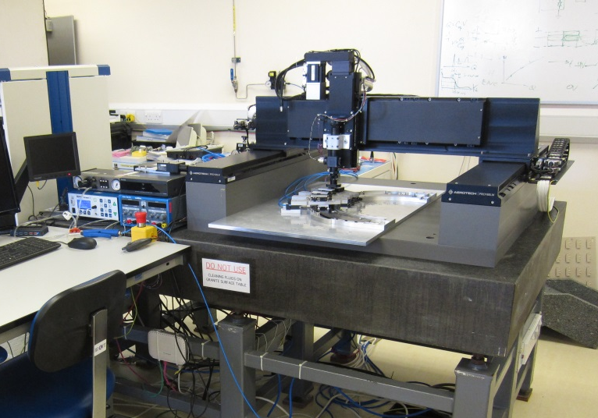
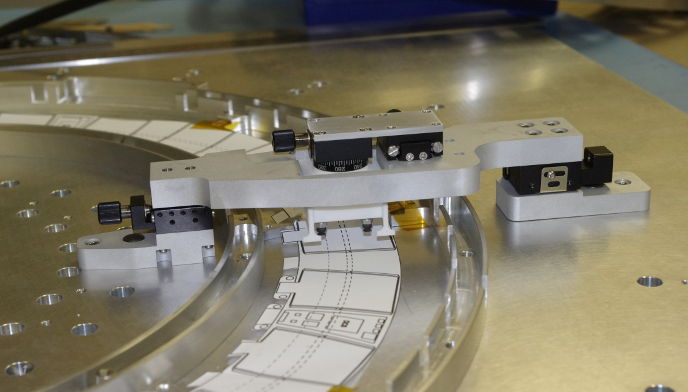
Assembly of modules to the half-rings
Aerotech XYZ gantry
CMOS camera + long working distance optics
Keyence laser displacement sensor
Nordson EFD Ultimus V adhesive dispenser
Modules mounted using adjustable bridge
3D-printed vacuum chuck
Radial, tangential, rotational adjustments
Chuck is spring-loaded in Z

Slide 7
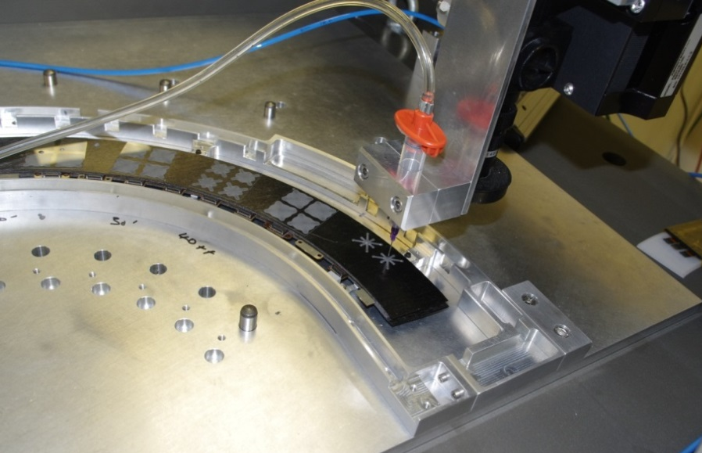
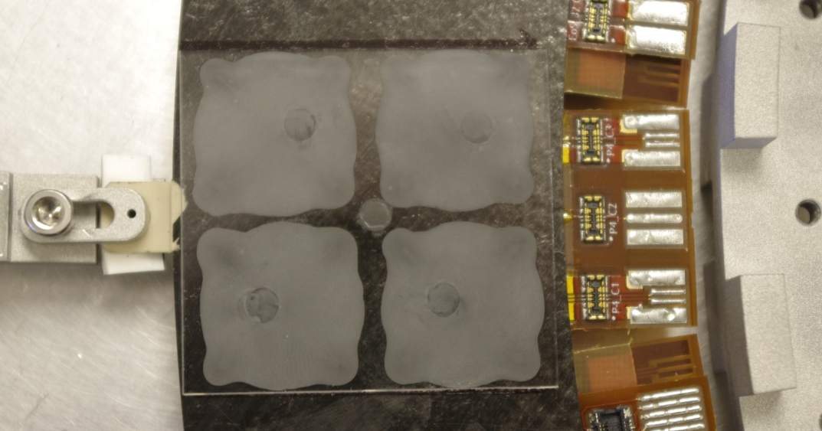
Mounting and gluing procedure
Place bridge on pickup jig, pick up module.
Place bridge on dowels in tooling plate.
Use Labview to check module corners, use bridge to align.
Remove bridge, apply mounting adhesive.
Replace the bridge, check alignment.
Allow the adhesive to cure.
Aim for square under each ROIC.
Dow Corning SE4445 thermally conductive adhesive.
Can be cut with 100μm nylon monofilament.
Aim thickness 100-200μm – important for thermal contact.
Clear lanes – avoid adhesive tracking up the ROIC edges.

Slide 8
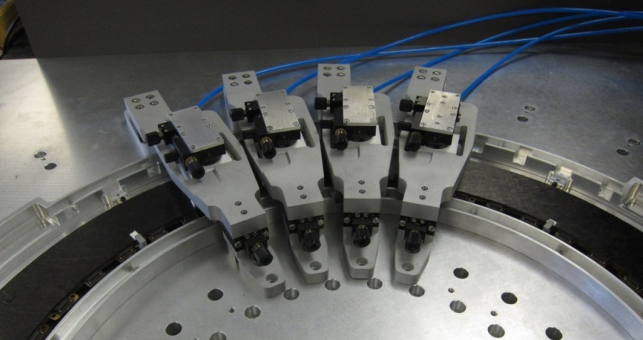
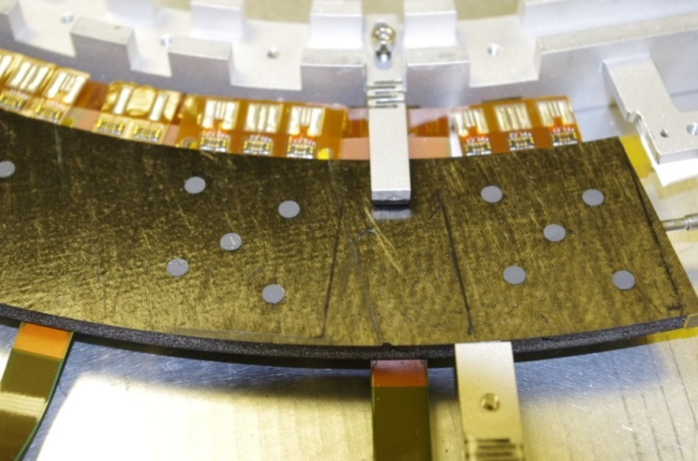
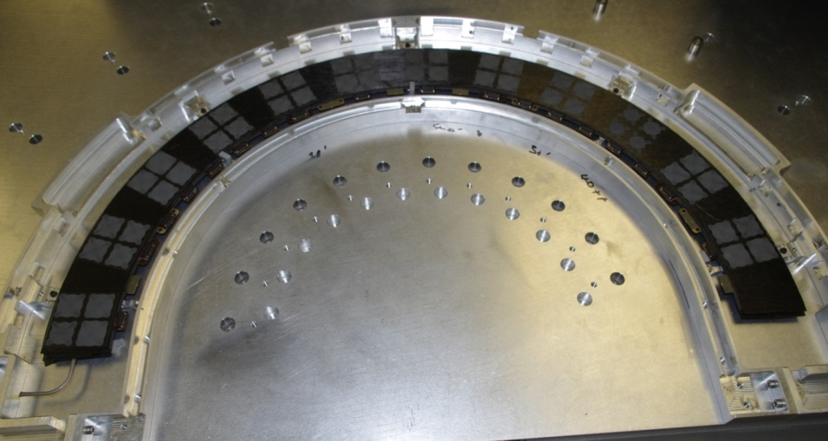
Mounting and gluing – some details
Adhesive thickness set by:
  Vacuum chuck feet
  Use of spacers
Important for SP isolation
Many trials so far.
1 half-ring with glass dummies.
More of this on the way….

Slide 9
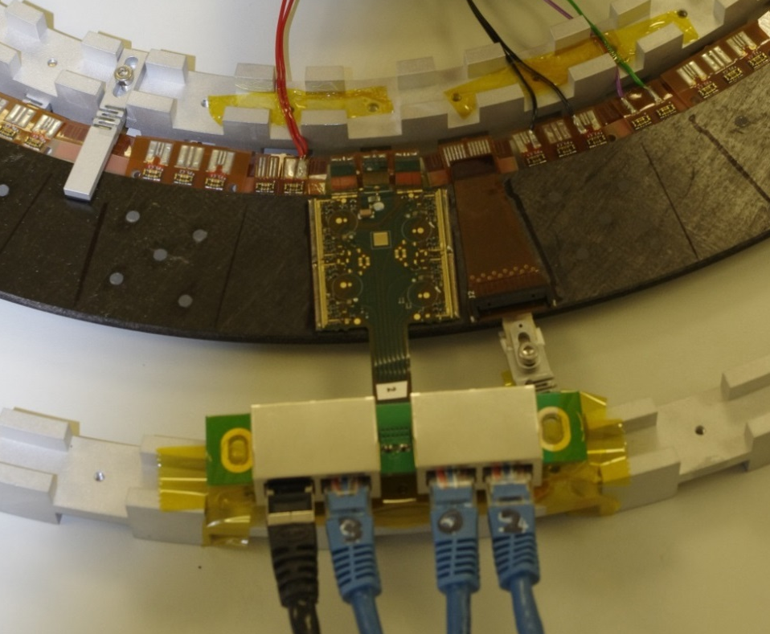
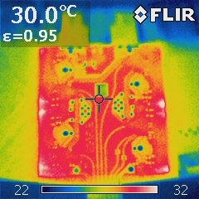
Testing after mounting
Same tests as reception:
Module supply current check
Sensor leakage current check
Digital scan
FE-I4B Tuning
Hot pixel scan (mask noisy pixels)
Threshold scan (sensor bias voltage on)
Threshold scan (sensor bias voltage off)
Looking for pixels which are quiet at low sensor bias – indicates broken bump
Air cooled (temporary)
Pogo pin fixture allows individual powering (didn’t use SP at this stage)
Module tails soldered to bus tape

Slide 10
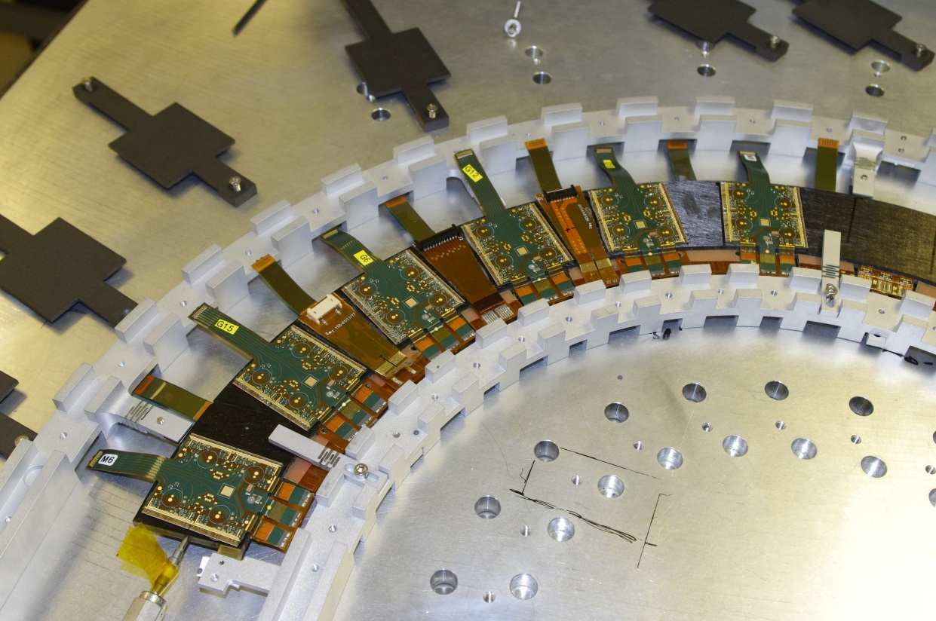
Ring 0 after module mounting
6 modules on each side
1 SP chain (6) each side
Or combine => 12 SP modules
Smallest complete electrically functional unit
Individual modules tested
SP chain tested at 0.5A
Then to Liverpool for further tests

Slide 11
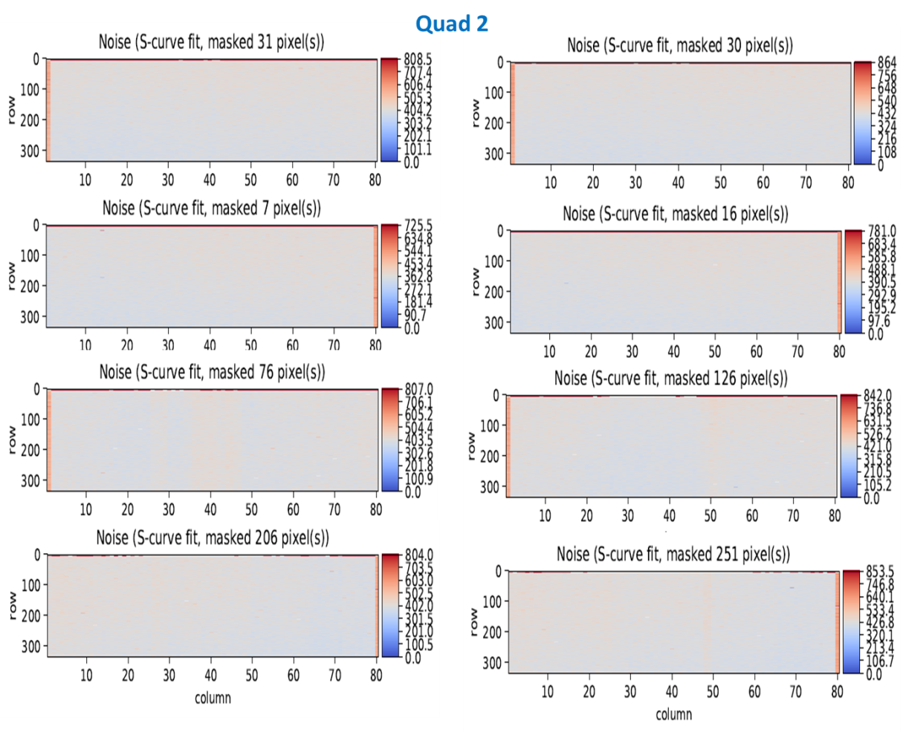
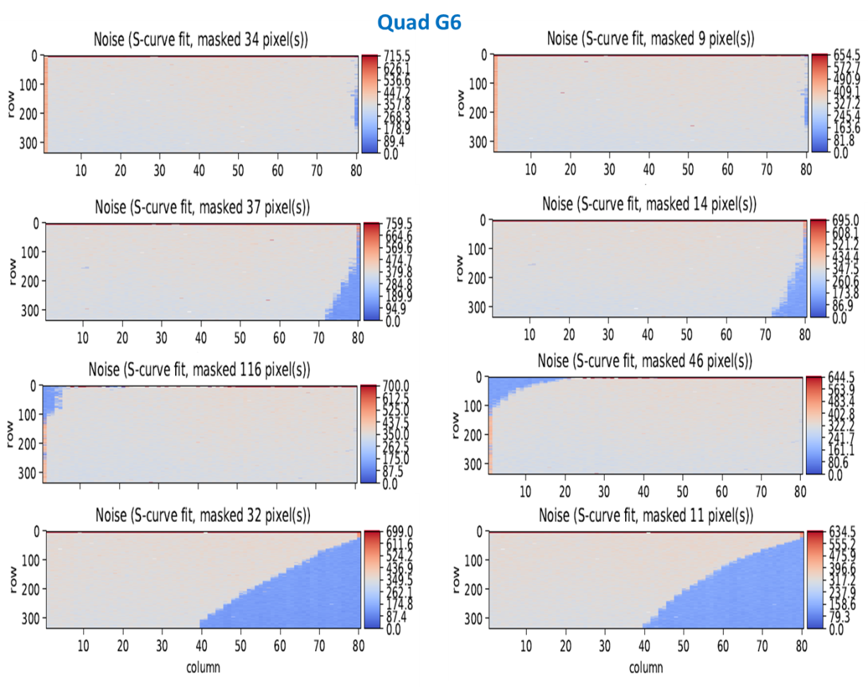
Comparing noise maps reception test / post mounting
Reception test
After mounting
Bump bond failures =>
less Cu in flex
parylene
RD53A – bumps x5
Oxford Quad 2 Chip 1
Glasgow Quad 6 Chip 4

Slide 12
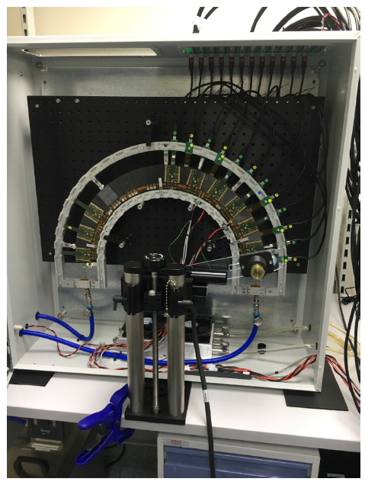
Ring 0 setup at Liverpool
Middle ring with one quadrant fully populated (6/side)
Readout with HSIO-II (RCE) DAQ with 18 data links
Patch panel above ring for CPLD. Interlock for monitoring T & RH
Cooling: chiller with water/ethylene glycol 75:25, using Ti cooling pipe.
Serial power using TTi QL355TP power supply (35V, 3A)
SP chains on the 2 sides joined to form a single 12 module chain
Keithley 2410 x 2 for HV to the 2 sides
Sr-90 source attached to arm on rotary stage, Python code
Jon Taylor/Liverpool U

Slide 13
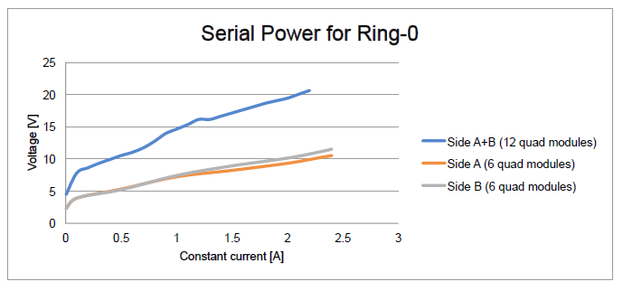
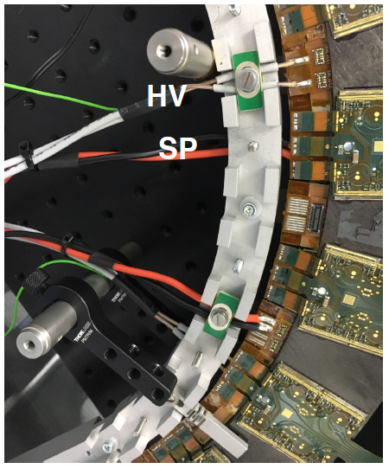
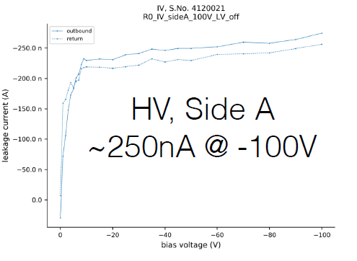
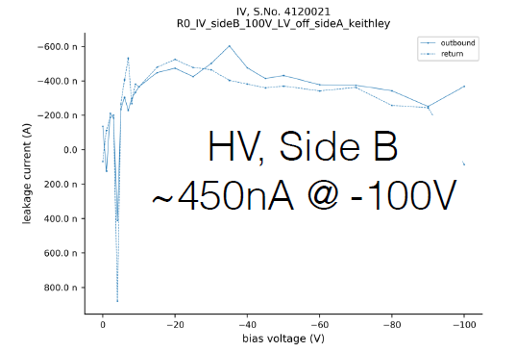
Serial Power and High Voltage
HV and SP soldered directly to the bus tape
Strain relief mounted on the handling frame

Slide 14
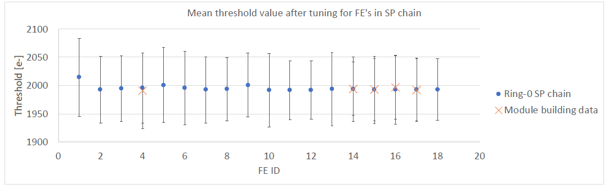
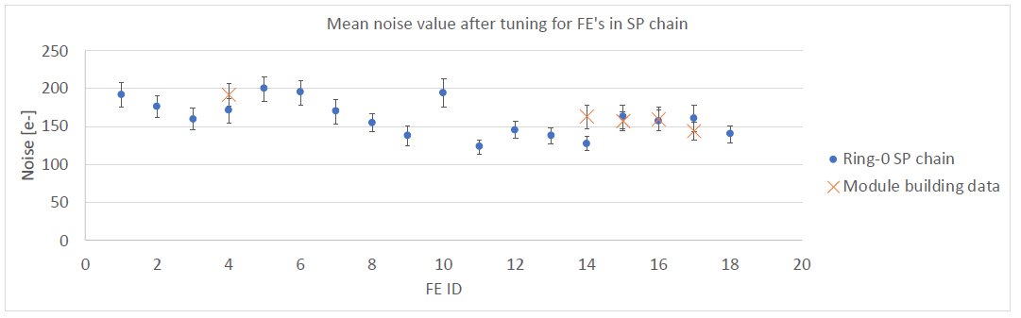
Module testing in SP chain
Readout used HSIO2 (18 data links)
SP chain of 12 quads, first and last have 4 FEs read out. All other quad modules have a single FE delivering data only
Threshold tuning to 2000e-
Comparison with module building and loading data ongoing, little difference seen so far between modules in SP chain or powered individually after building
T and RH not precisely controlled between module tuning test and SP tuning tests
Need to agree standard tuning
1 chip per quad except at the ends of the SP chain. After tuning.

Slide 15
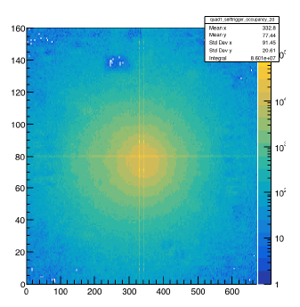
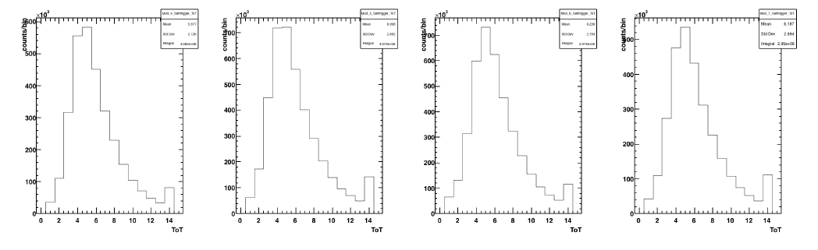
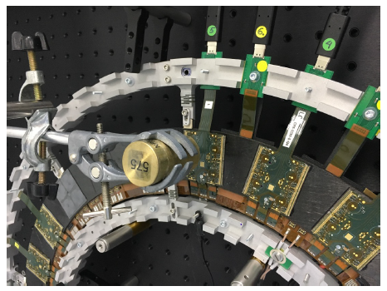
Counts vs ToT
Source tests
37 MBq Sr-90, source scan for 20s on side A
ToT spectrum -> Landau
Potting compound does not cause problems
Source positioned over modules on a clamp
Now using a rotary stage with Python code
Can also do HV on/off for comparison
Source scan more reliable at finding bad bumps

Slide 16
Summary and Next Steps
Ring-0
Ring-0 is operational with 12 modules in a SP Chain
Experience for 3 module building sites (flex attach, wire bonding, potting)
Experience for module loading sites (loading, interconnect)
Electrical and thermal behaviour of a realistic prototype
Module hybrid design issues – bump bond disconnection => less Cu, parylene, RD53A has more bumps
Embedded tape with connectors proved impractical
Need to share data between module building and loading better => standard tuning, production DB
One FE failed – add burn-in to procedures (IBL used 10 hr burn-in)
Next measurements
Grounding and shielding measurements (signal on pipe, look for pickup)
Tests with external trigger (e.g. cosmics)
Check orbital TIG welding of pipes doesn’t damage half-ring electronics
Vthin scans (Make some FE very noisy, measure propagation along SP)
Disabling of FEs (pull wires, check for correct shunt behaviour)
Ring-1 with RD53A quads – planning and acquiring parts

Slide 17
Spare Slides

Slide 19
Ring 0 adhesive thickness measurements

Slide 20
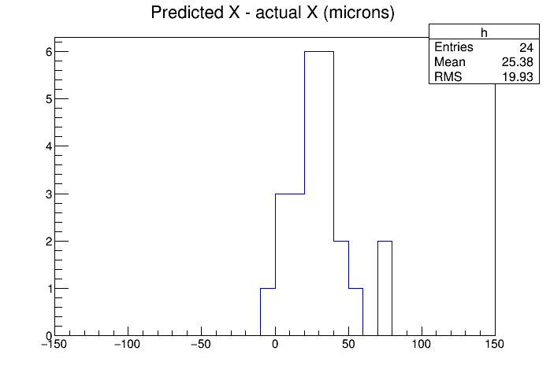
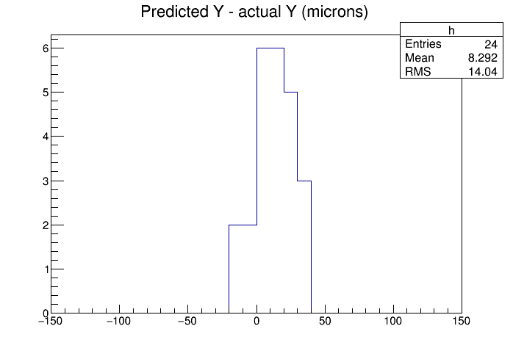
Ring 0 mechanical measurements
How to estimate mounting accuracy ?
Drive camera to expected module corner
Adjust to actual corner position
What’s the difference ?

Slide 21
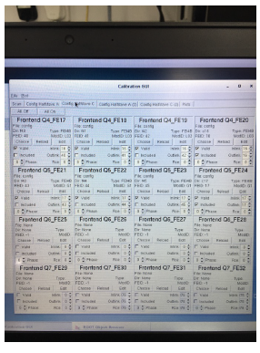
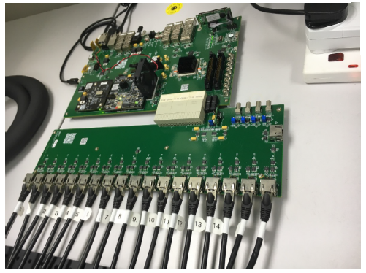
Multi-module readout with HSIO-II
Readout carried out by HSIO2 using all 18 data links
Minimum 1 data link per chip to supply clk/cmd to each quad -> all FEs in a quad configured and all regulators drawing current
  Allows full SP chain without reading out data from all FEs (as not enough links available)
  Requires setup of fake data links in the CalibGUI panel
Currently read out 4/4 FEs at both ends of chain and 1 FE/quad in all other modules

Slide 22
Sr90 scan of two back-to-back modules

Slide 23
Next step: Ring-1 planning

Slide 24


Slide 25
