Slide 1
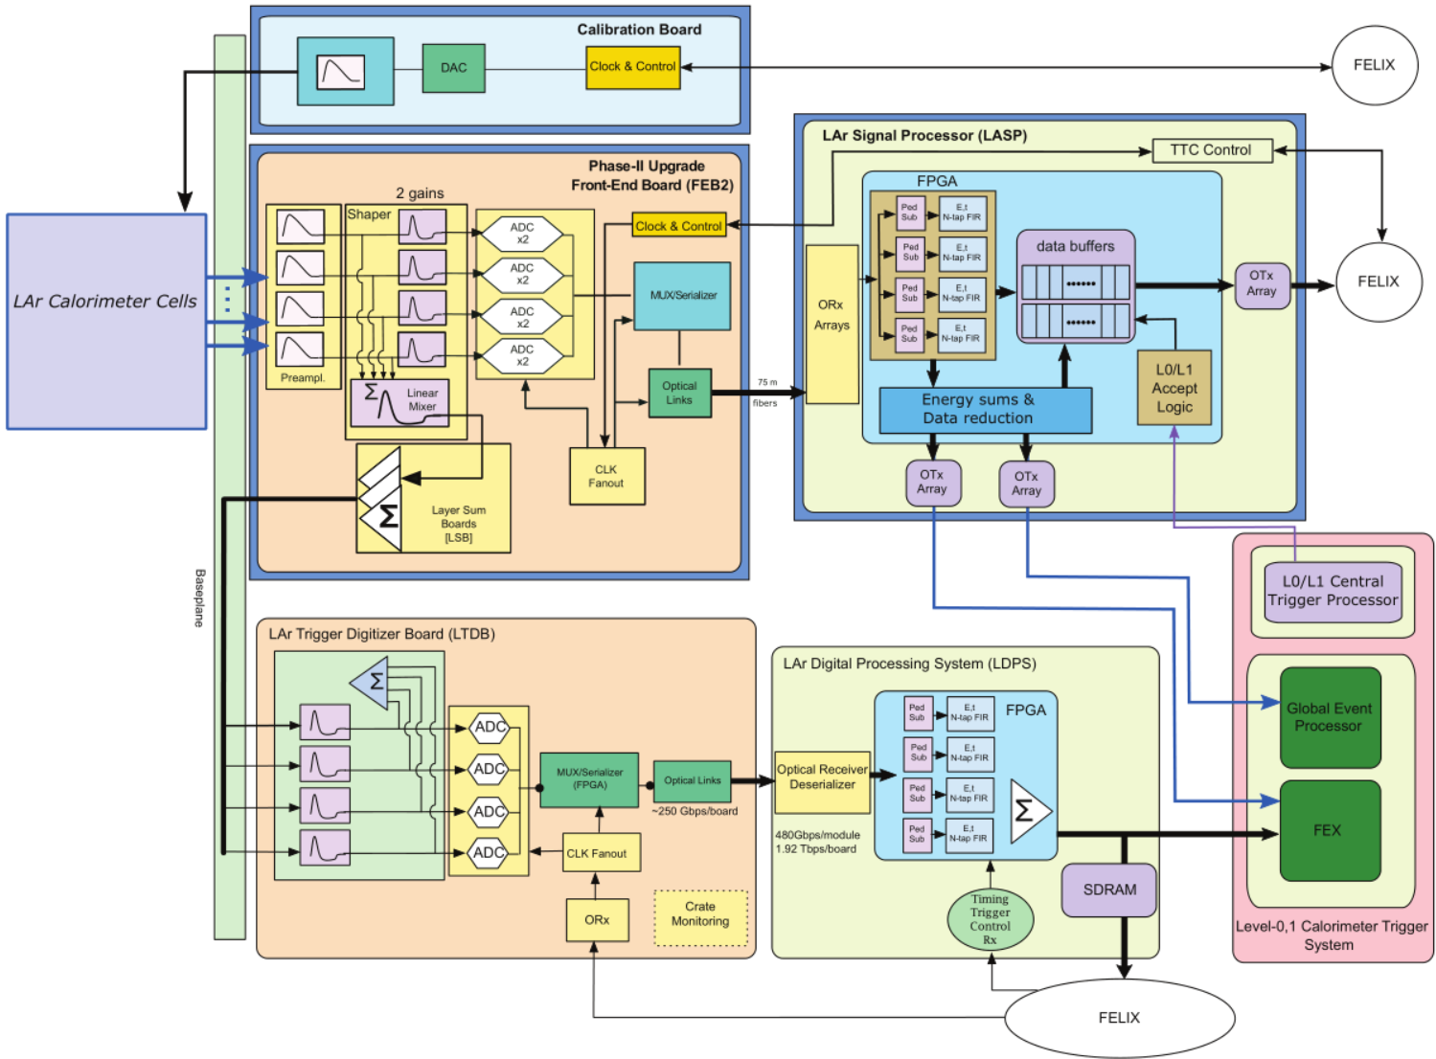
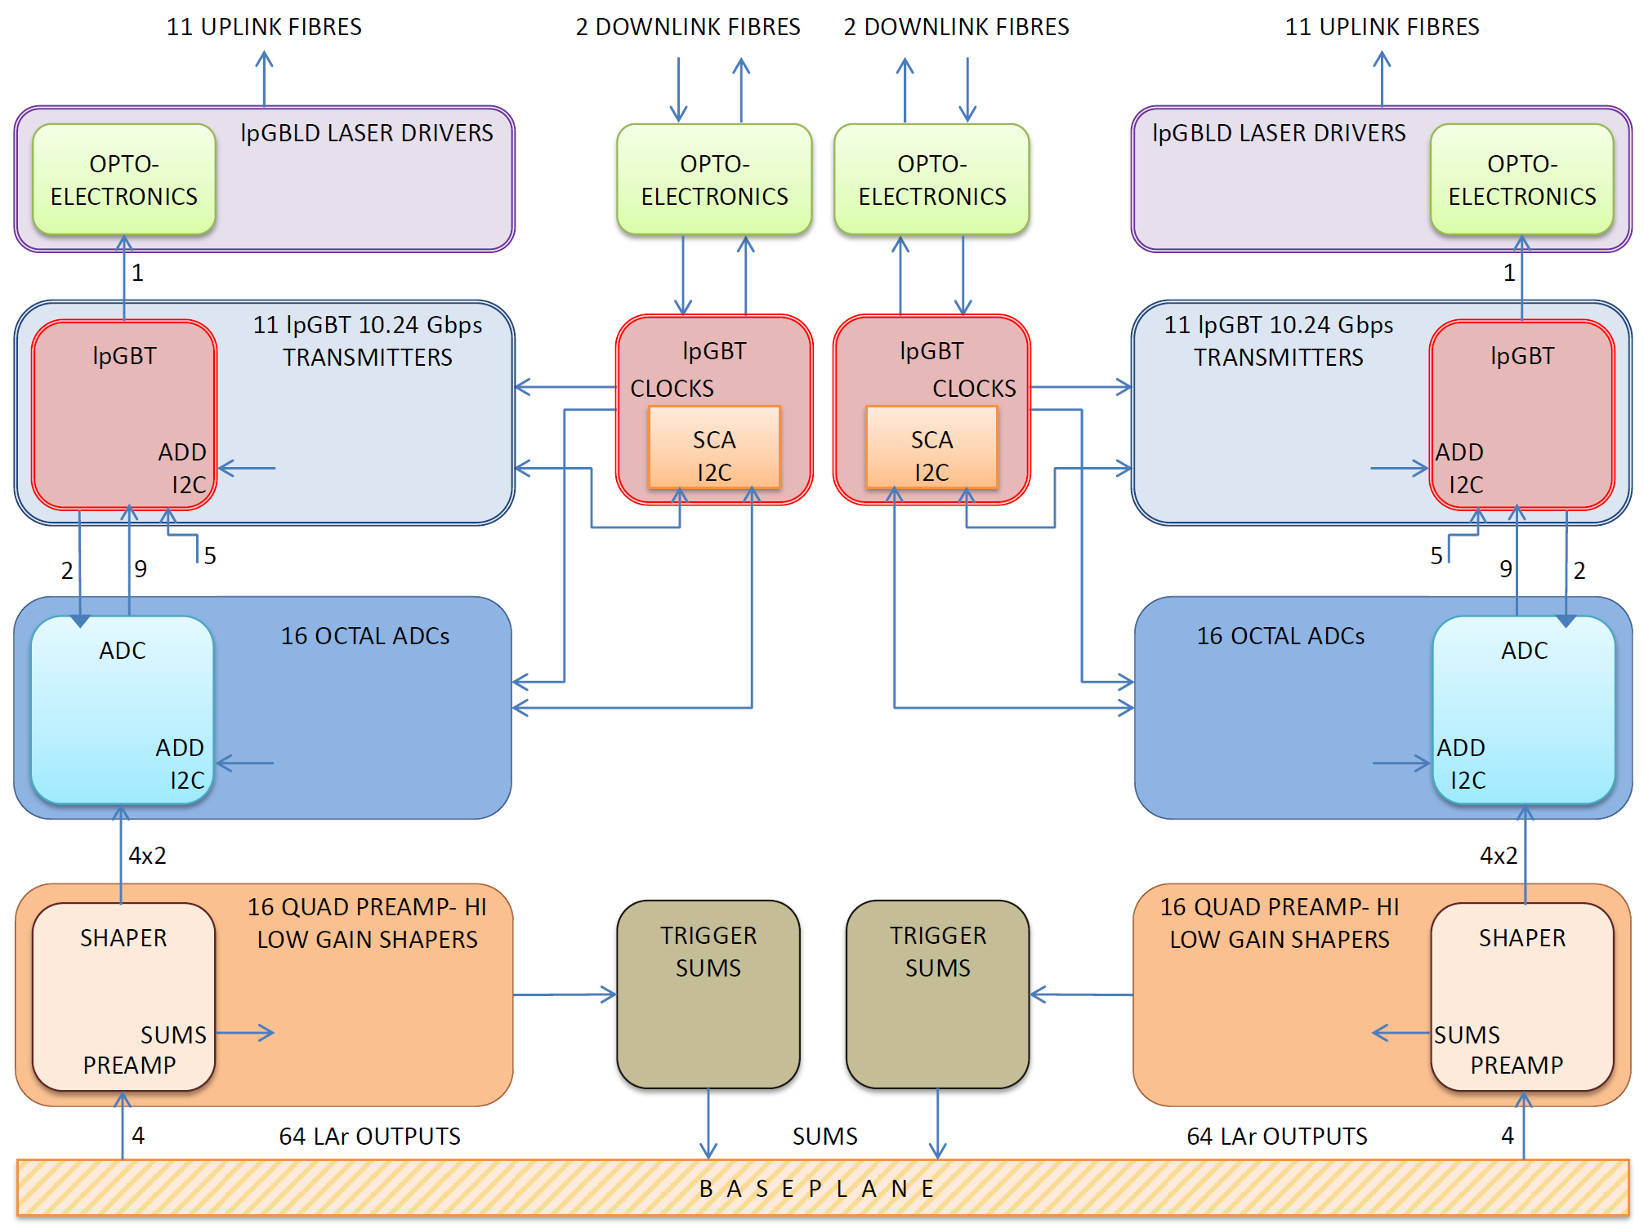
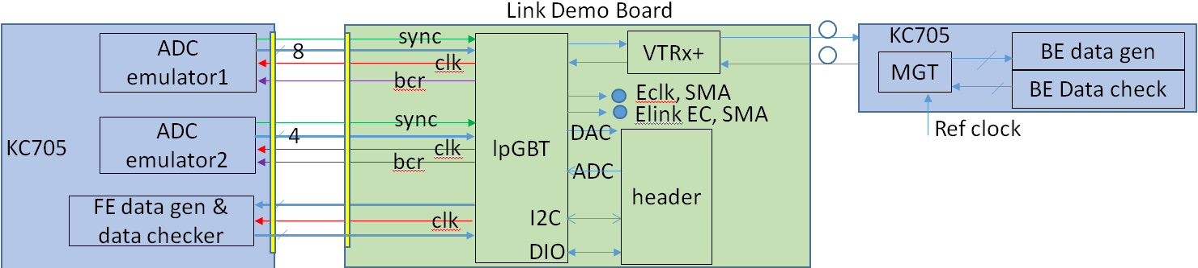
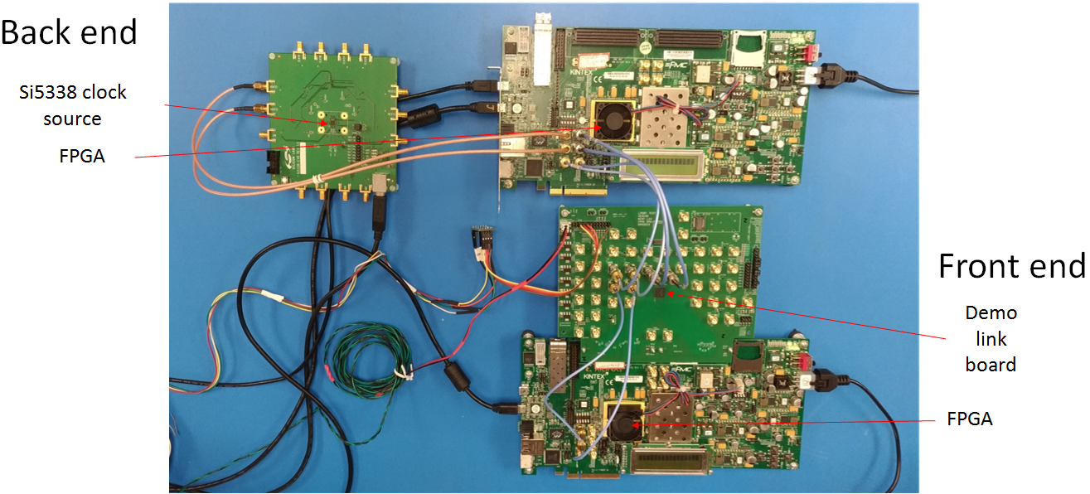
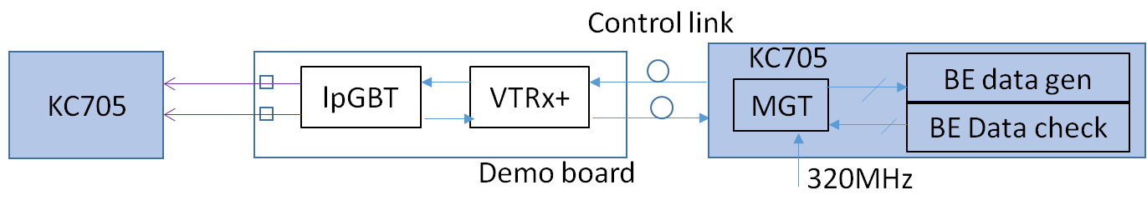
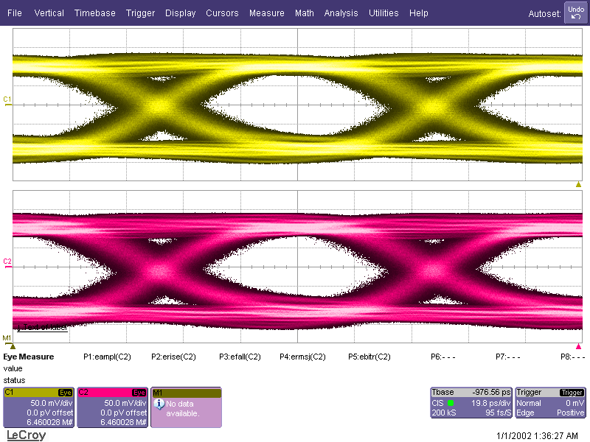
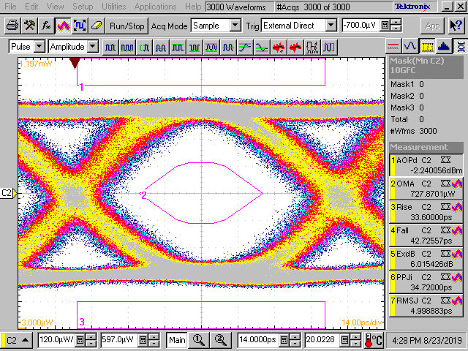
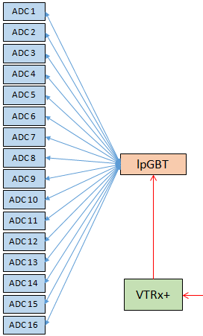
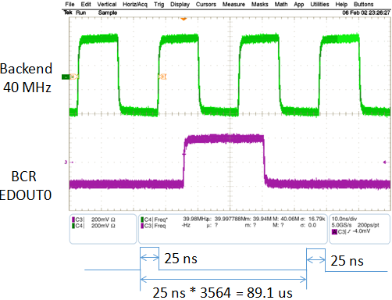
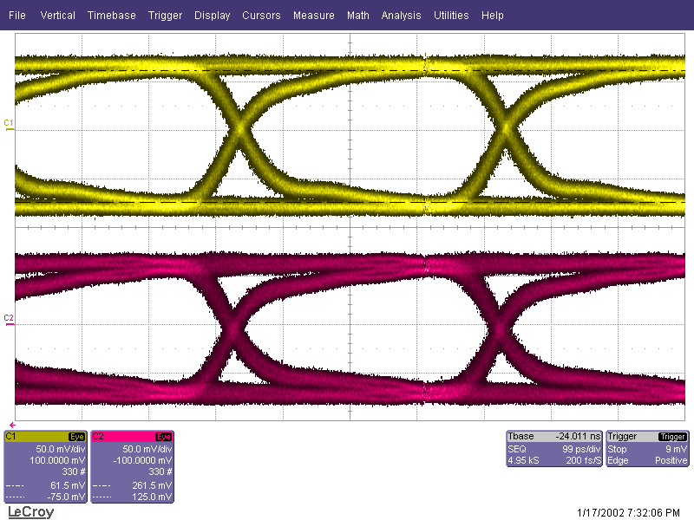
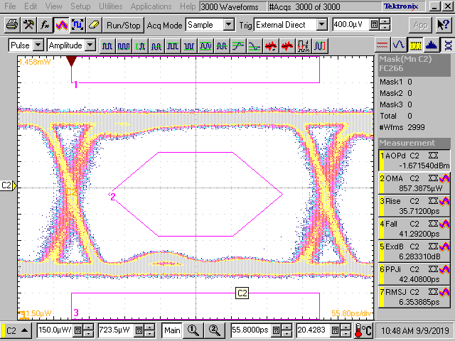
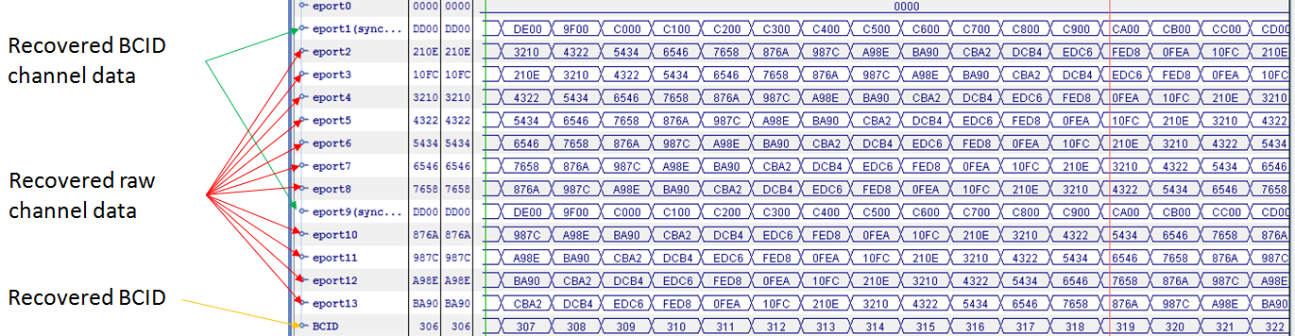
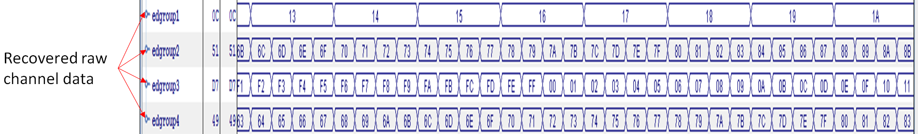
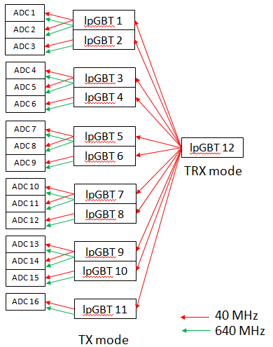

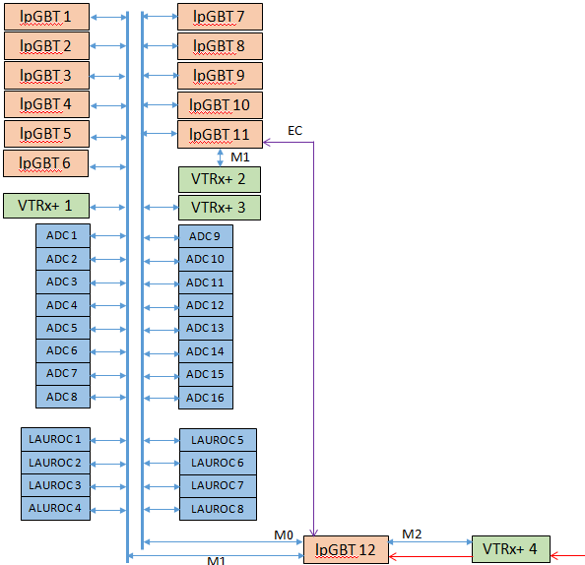
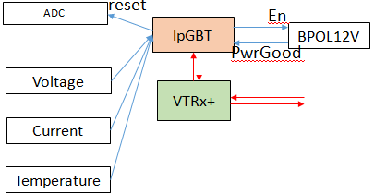
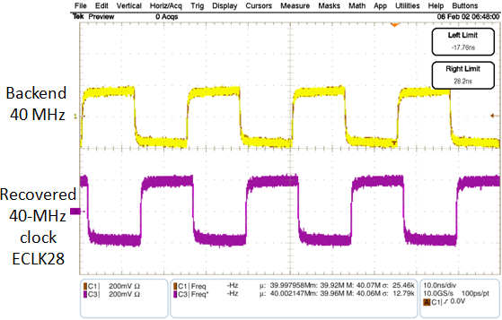


Design and hardware evaluation of the optical-link system for the ATLAS Liquid Argon Calorimeter Phase-II Upgrade
Binwei Deng,^{a,b} Chonghan Liu,^{b} Datao Gong,^{b} Chufeng Chen, ^{b,c} Xing Huang, ^{b,c} Suen Hou,^{d} Tiankuan Liu,^{b,*} Hanhan Sun,^{c} Li Zhang,^{b,c} Wei Zhang,^{b,c} Jingbo Ye^{b}
ª Department of Electronic Information Engineering, Hubei Polytechnic University,Huangshi, Hubei 435003, P.R. China
^{b} Department of Physics, Southern Methodist University, Dallas, TX 75275, USA
^{c} Department of Physics, Central China Normal University,Wuhan, Hubei 430079, P.R. China
^{d} Institute of Physics, Academia Sinica, Nangang 11529, Taipei, Taiwan
* tliu@mail.smu.edu
Introduction
The front-end readout electronics of the ATLAS Liquid Argon Calorimeter is being developed for the HL-LHC upgrade.
In the proposed upgrade, the detector data are transmitted out of the detector to the counting room about 150 meters away with no trigger filtering.
In the trigger-less readout scheme, large amount of data are transmitted through optical links.
In addition to the data transmission, the front-end electronics needs clocks, control and monitoring from the backend through optical links.
The optical link system is based on lpGBT and VTRx+.
The optical link system serves 1524 Front-End Boards (FEBs) through 26 optical fibers per FEB.
A printed circuit board has been designed to evaluate the major functions of the optical link system.
The design of the optical link system and the evaluation results are presented.
Architecture of the proposed ATLAS
LAr Calorimeter Phase-II upgrade
FEB
Optical link system overall architecture
Demo-link system design
For data links, each FEB has 22 simplex optical links, each operating at 10.24 Gbps. The detector data come from 640-Mbps e-ports of 8-ananlog-channel ADCs.
For control links, each FEB employs 2 duplex optical links. Control links provide recovered clocks for ADCs, a bunch crossing reset (BCR) signal for each ADC, remotely control ASICs, and monitor the temperatures and power supply voltages/currents of each FEB.
We designed a PCB to demonstrate the optical link functions.
The demo board has an lpGBT and a VTRx+.
The demo board has two FMC connectors to interface with an FPGA.
The FPGA emulates two ADCs and generates/checks data.
The demo board includes SMA connectors for clocks and e-links and headers for I2C, ADCs, DAC, and general-purpose I/Os (PIO).
A second FPGA operates as the back end.
Block diagram of overall architecture
Optical Link Demonstrator Board
Data transmission design and verification
BCR distribution design and verification
Block diagram of uplink test setup
Electrical eye diagram
Optical eye diagram
Eye diagrams of uplink at 10.24 Gbps
Electrical eye diagram
optical eye diagram
Eye diagrams of downlink at 2.56 Gbps
Each downlink provides BCR for 16 ADC chips
Each lpGBT has 16 e-port outputs
Recovered data of downlink on the front-end
Recovered data of uplink in backend
Clock distribution design and verification
ASIC configuration design and verification
PIO, DAC and ADC design and verification
lpGBT, as an I2C slave
  Can be configured by an external I2C master. Verified.
  Can be configured by its IC channel. To be Verified.
  Can be configured by its EC channel. To be Verified.
lpGBT, as an I2C master,
  Can configure (write/read) an I2C slave (our optical module). Verified
General-purpose I/O (PIO) can control a digital I/O signal (e.g., EN of BPOL12V, Reset of ADC/lpGBT, etc.). Verified.
PIO can monitor a digital I/O signal (e.g., Power Good of BPOL12V). Verified.
DAC can control a voltage. Verified.
ADC can monitor temperature/voltage/current. Verified
Block diagram and test of Verification of Clock system
A control lpGBT recovers a clock form the serial data and operates on a clock recovered by itself.
A data lpGBT operates on a clock recovered by a control lpGBT.
Summary and outlook
An optical link system is being designed for the ATLAS LAr Calorimetor Phase-2 upgrade.
Major functions of the optical link system have been verified in the current link demonstrator board, though extensive tests are still ongoing.
After all the tests are complete, a new slice (multiple lpGBT chips and VTRx+ modules) of optical link system will be designed.
HSTD12 – 12th International “Hiroshima” Symposium on the Development and Application of Semiconductor Tracking Detectors
14-18 December, 2019, International Conference Center Hiroshima, Hiroshima, Japan

