Slide 1

Evaluation the first SOI pixel detector with 3D integration technology
15 Dec 2019
T. Tsuboyama (KEK)
for the SOIPIX collaboration

Slide 2
Motivation for the 3D integration in pixel sensors.
3D integration technologies
Micro bump bonding for the SOI pixel sensor
Summary

Slide 3
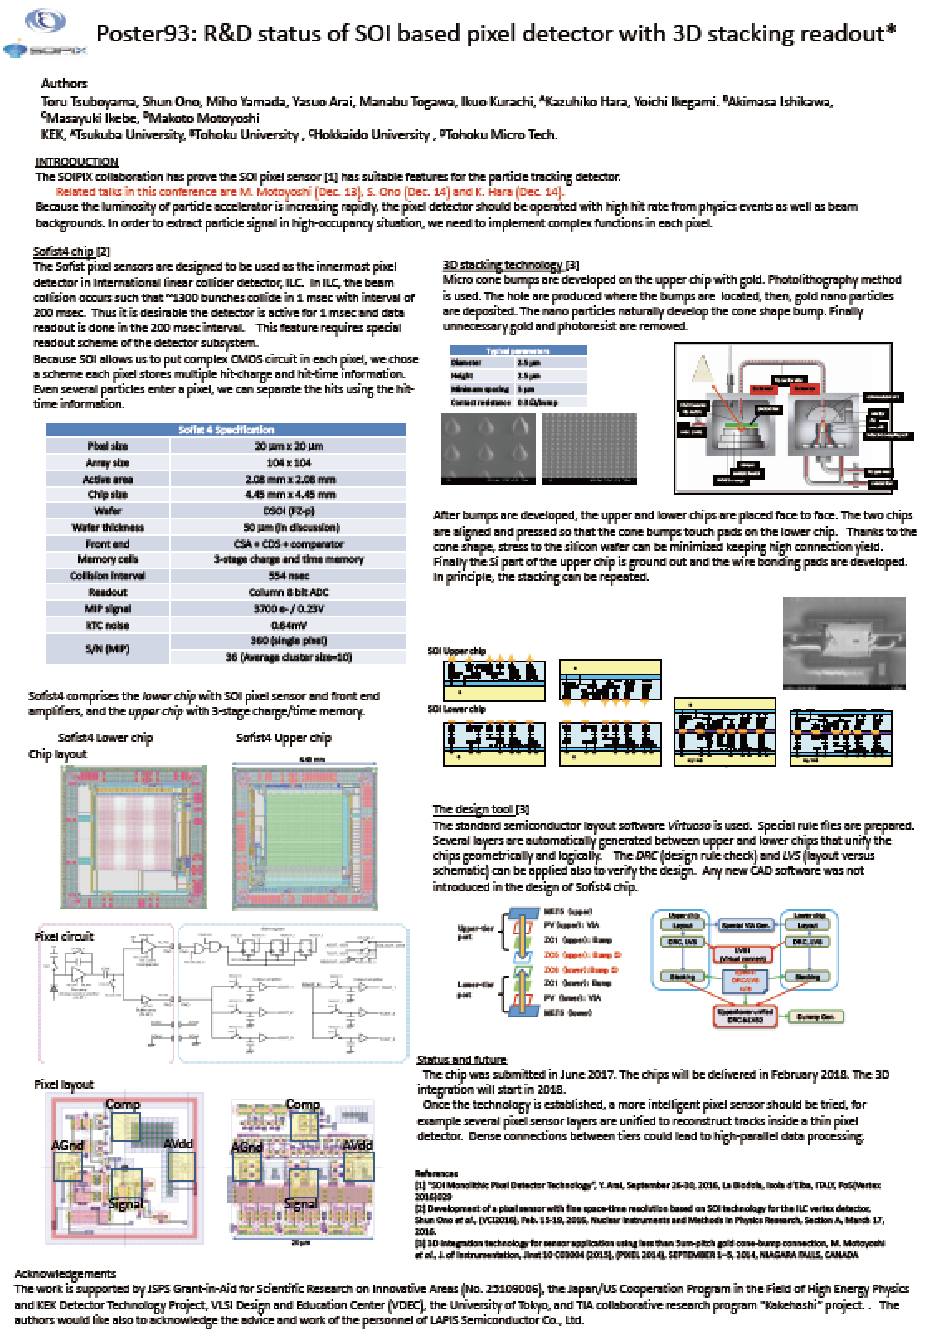
In HSTD12 (2018) we presented the plan for the 3D stacking of the SOI pixel sensor.
Various improvement of technology were performed.
The first chip was delivered in July 2019.
The results, including the response to charged tracks will be reported in this presentation.

Slide 4
Overview of 3D stacking
  In the present and future high luminosity collider experiments, the high signal rate and background environment is anticipated.
  Detection efficiency of sensors should not be degraded.
  Occupancy reduction is essential for the design of the pixel vertex detector.
  Reduction of occupancy with time resolution is quite beneficial.
ATLAS
Time resolution
Belle2

Slide 5
Integration of additional readout chip
For the commercial image sensors, the first trial was to move the peripheral circuits to the second chip and stacked by using TSV, through silicon via.
This is not an answer for HEP. We have to increase the performance of the circuit in each pixel.
The benefits of pixel-by-pixel connection.
  Parallel data processing.
  Low power operation thanks to minimum parasitic capacitance.
Pixel
Memory
Pixel
Memory
Logic
Logic

Slide 6
3D bonding methods
Direct bonding
  Utilize the diffusion bonding of flat and clean surfaces.
  When two surface is attached tightly the molecules can be merged with proper temperature and pressure.
  Metal-metal surface or SiO2 surface can be fused by itself.
  This method is suitable for mass production of image sensors, where, the LSI production, bonding and post processes can be done in one fab.
Micro bump bonding
  Forming bumps made of soft metal (In, Au) on the silicon surface.
  Put the wafers face to face and pressed and heated for the electric connection.
  Low viscosity glue is injected between two chips for mechanical stability.
  Mechanical tolerance is determined by the height of the bumps.
  Suitable for small size production.

Slide 7
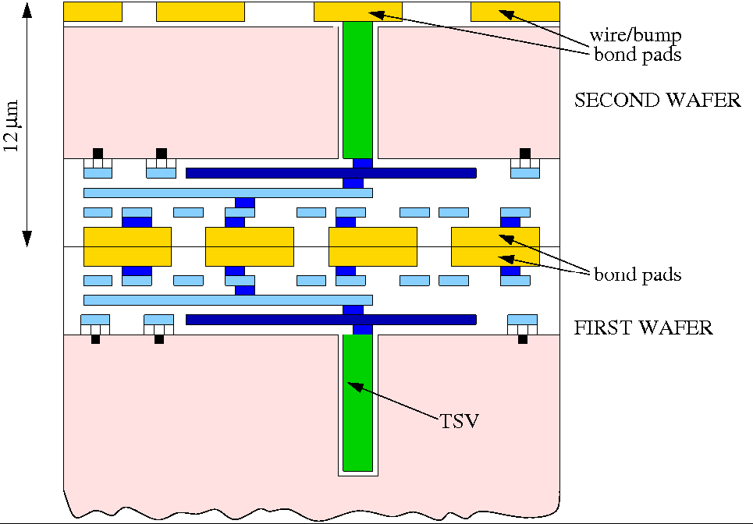
Method-I: Direct Bonding Interconnect
Two wafers are prepared.
The bonding surface is flattened and cleaned.
Aligned and attached. Apply suitable pressure and heat for the diffusion bonding of pads.
SiO2 surfaces is also fused, resulting in the stable structure.
Widely used for the mass production of high-end image sensors.
Slide from Valerio Re, Vertex2018

Slide 8
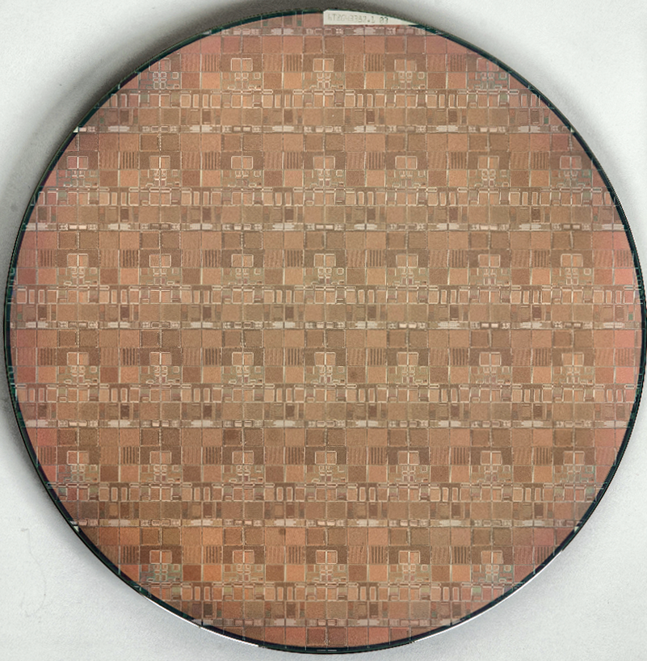
Progress of 3D bonding in FNAL
Slide from R. Lipton Vertex2017
Fermilab led a consortium to demonstrate 3 dimensional electronics – a 4+ year effort.
A working 3D process was demonstrated using 2-tier 3D Global Foundries 0.13 μm TSV wafers. FNAL chips for ILC(VIP), CMS(VICTR) and X-ray imaging (VIPIC) in collaboration with Tezzaron and Ziptronix.
This took about 18 months longer than anticipated – Tezzaron copper bonding issues finally solved by using Ziptronix DBI process
LEFT (bottom)
chips
Right (top)
chips

Slide 9
Method-II: Micro Bump bonding
Metal bumps are formed on the bump pads.
Two chips are aligned and pushed to establish electric connection.
The procedure is close to that of hybrid pixel sensors, however, by using SOI chip, an advanced 3D stacking is enabled.
Si
High R-Si

Slide 10
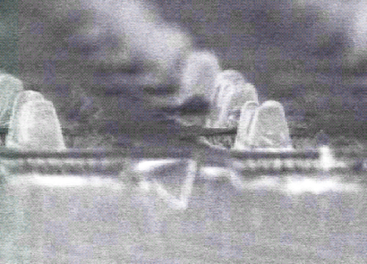
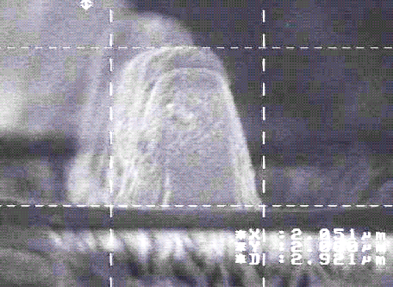



Formation of metal micro bumps
$2 μ$m
The stacking is performed in Tohoku Microtech (T-micro)
The early development was done by using indium bumps.
The bumps were made with photolithographics method
$2 μ$m
$2 μ$m
Zycube 2008

Slide 11
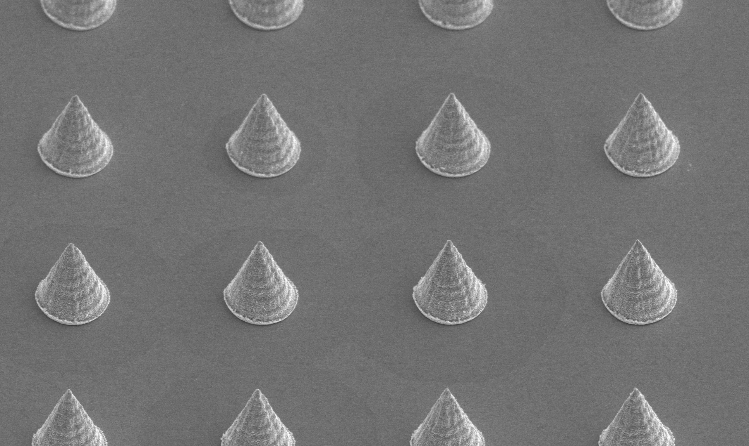

Au cone bumps
Piling up gold nano particles on the under-bump-metal.
Dimensions: 3 $μ\text{m}$ in diameter, 3 $μ\text{m}$ in height and 6 $μ\text{m}$ spacing.

Slide 12
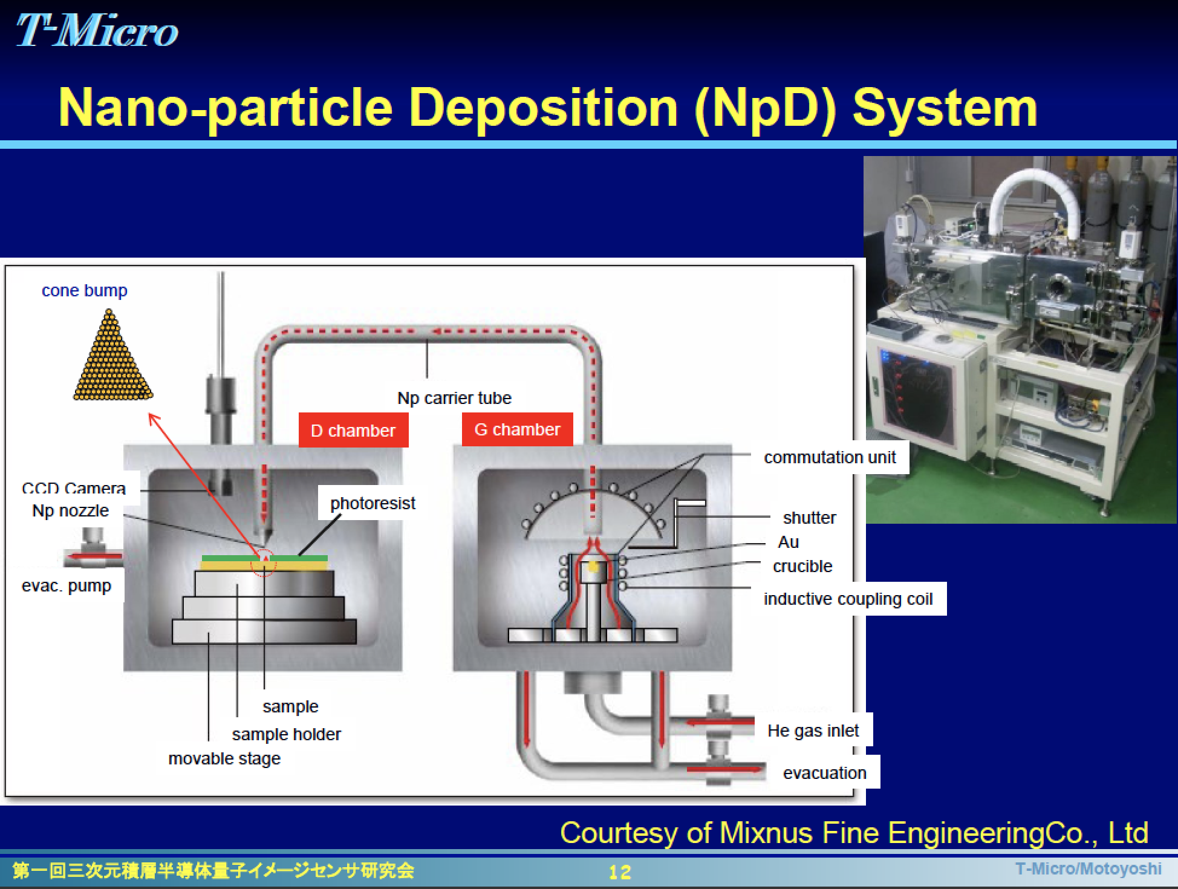
Formation of gold cone bumps
Pros and cons of the gold cone bump method.
Pros: High efficiency and low resistivity.
Cons: Spraying gold particles takes long time.

Slide 13
Micro gold cylinder bump bonding
Gold cylindrical bump method is introduced to solve
Process time: Sputtering
Reduction of the contact stress:

Slide 14
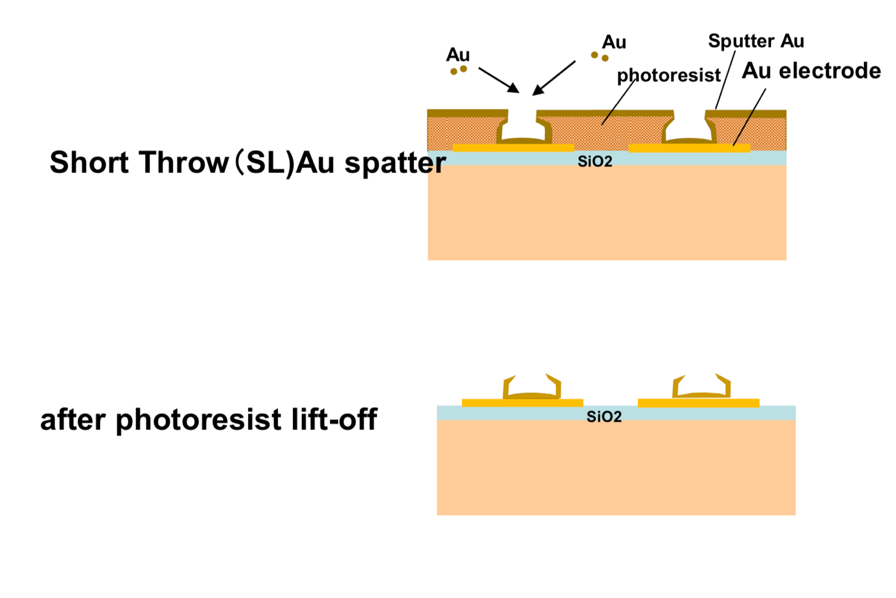
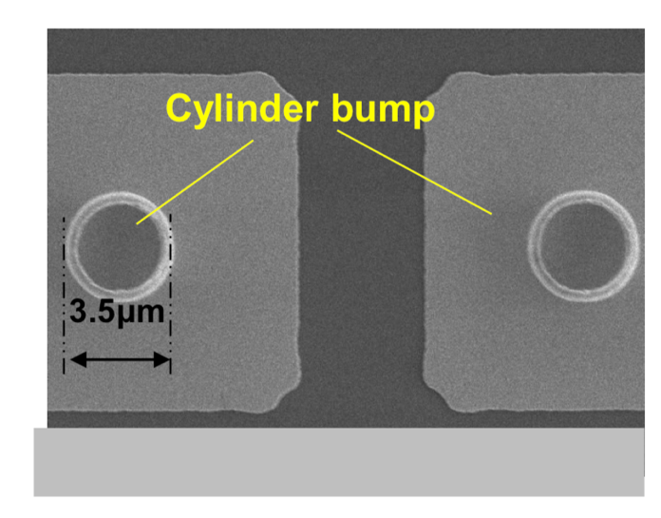
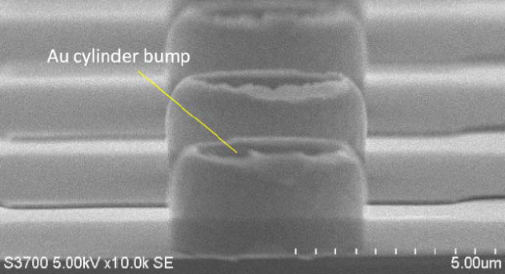
Formation of micro gold cylinders
Gold cylinders after combined
We collaborate with Tohoku Microtec

Slide 15
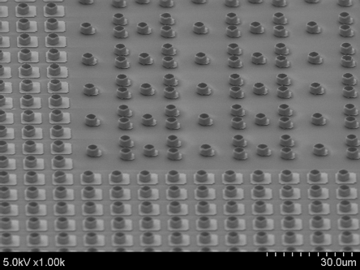
Results
Bonding pressure: 0.05 N / bump → 0.003 N/bump
Even the silicon – CdTe bonding became possible
The low resistivity is kept
CdTe sensor
Silicon ROIC

Slide 16
3D stacking procedure of SOI pixel chip
Lower Chip
Upper Chip
Step 1
Step 2
Prepare upper and lower chip
High R-Si
Si
Bump Metal deposition & patterning
High R-Si
Si
Au cylinder Bump formation
High R-Si
Si

Slide 17
Step 3
Lower & Upper Chip alignment
Si
High R-Si
Press and heat for Bonding
Adhesion Glue injection
Step 4
Si
High R-Si
Upper silicon removed.
Upper Metal (Bonding pad) deposition & pattering
Step 5
High R-Si

Slide 18
The stacking can be repeated in the same procedure
Step 6
High R-Si

Slide 19
3D design tool
Virtuoso with Special rule files.
Virtual layers are automatically generated between upper and lower chips that unify the chips geometrically and logically.
The DRC (design rule check) and LVS (layout versus schematic) can be applied for the whole pixel system.
Upper chip
Lower chip
MET5 (upper)
Special VIA Gen.
Upper-tier
port
PV (upper)： VIA
Layout
LayoutZ
ZC1 (upper)：Bump
LVS1
(Virtual connect)
ZC5 (upper)：Bump ID
DRC, LVS
DRC, LVS
ZC6 (lower)：Bump ID
Lower-tier
port
ZC1 (lower)：Bump
Stacking
Special
DRC/LVS rule
Stacking
PV (lower)： VIA
MET5 (lower)
Unified
DRC＆LVS2
Dummy Gen.

Slide 20
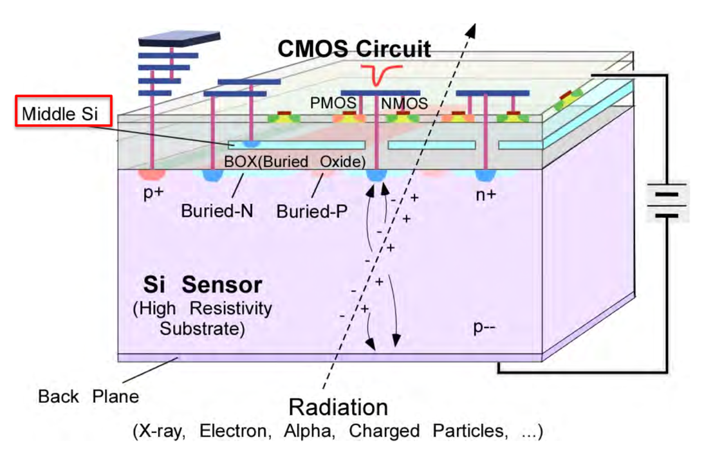
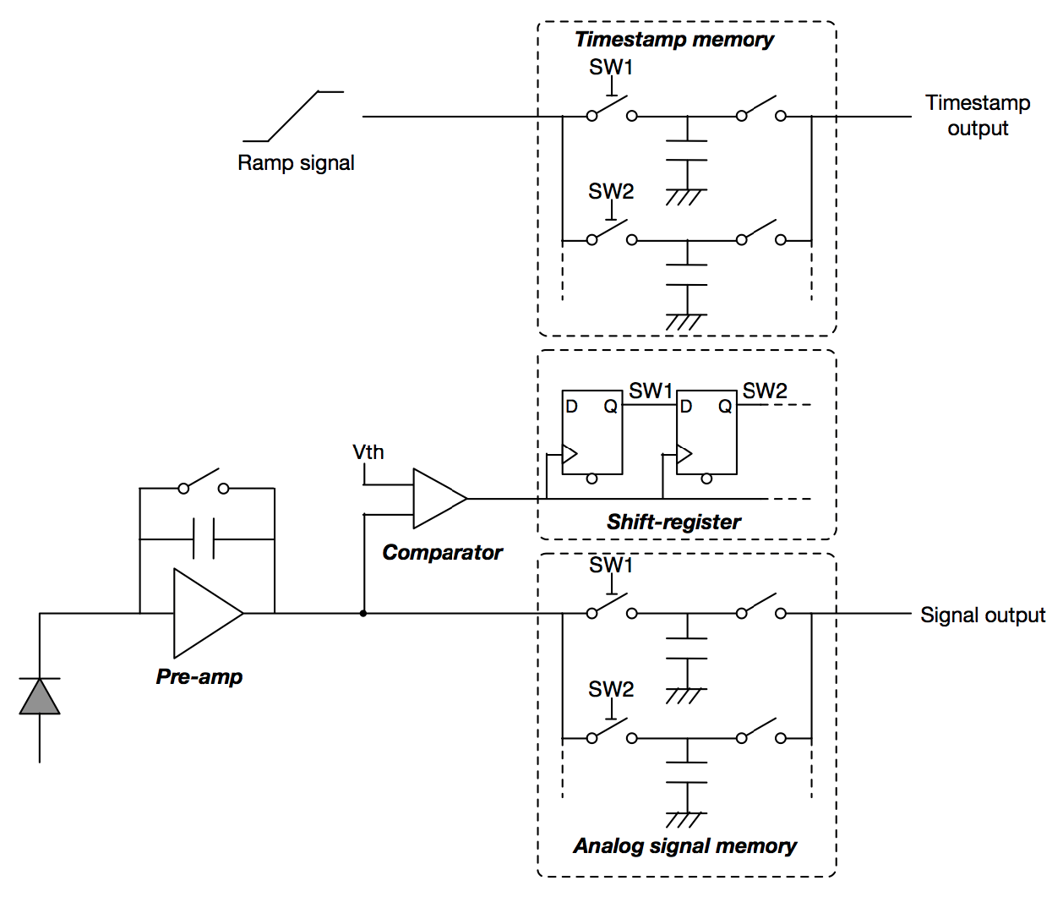
SOFIST: A SOI pixel sensor designed for ILC
Preamplifier, comparator, hit charge memories and time-stamp memories are integrated.
For the ~1 ms long bunch train, multiple hits data are stored in each pixel.
The data is read out in the 200 ms interval of ILC beam collision structure.
SOI PIX sensor is already a 3D integrated pixel sensor.

Slide 21
SOFIST development
 | Ver. 1 | Ver. 2 | Ver. 3 | Ver. 4
Produced /Tested | 2016/2017 | 2017/2018 | 2018/2019 | 2018/2020
Wafer | SOI | DSOI | DSOI | DSOI
Pixel size (μm x μm) | 20x20 | 25x25 | 30x30 | 20x20
Charge memory | 2 | 0 | 3 | 3
Time stamp memory | 0 | 2 | 3 | 3
Chip size (mm x mm) | 3x3 | 4.5x4.5 | 6x6 | 4.5x4.5
Notes | Global shutter. Charge memories | Time memories | Time and charge | 3D integration
Performance of SOFIST Ver.1 was reported in HSTD10

Slide 22
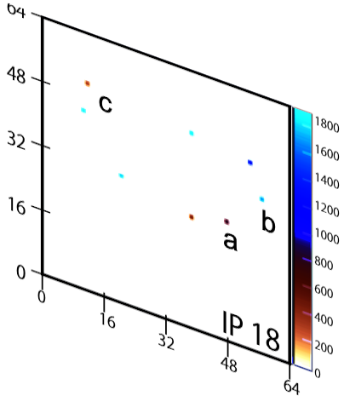
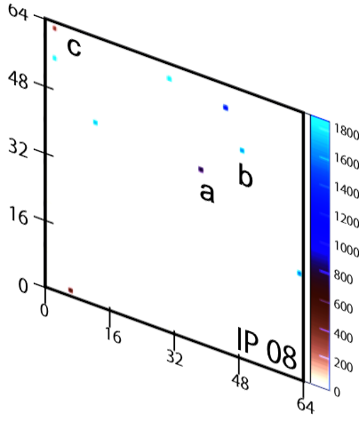
SOISFT Ver. 3 Beam test data @FNAL
Multiple hits in one sample can be separated with hit-time information in the time-stamp memory.

Slide 23
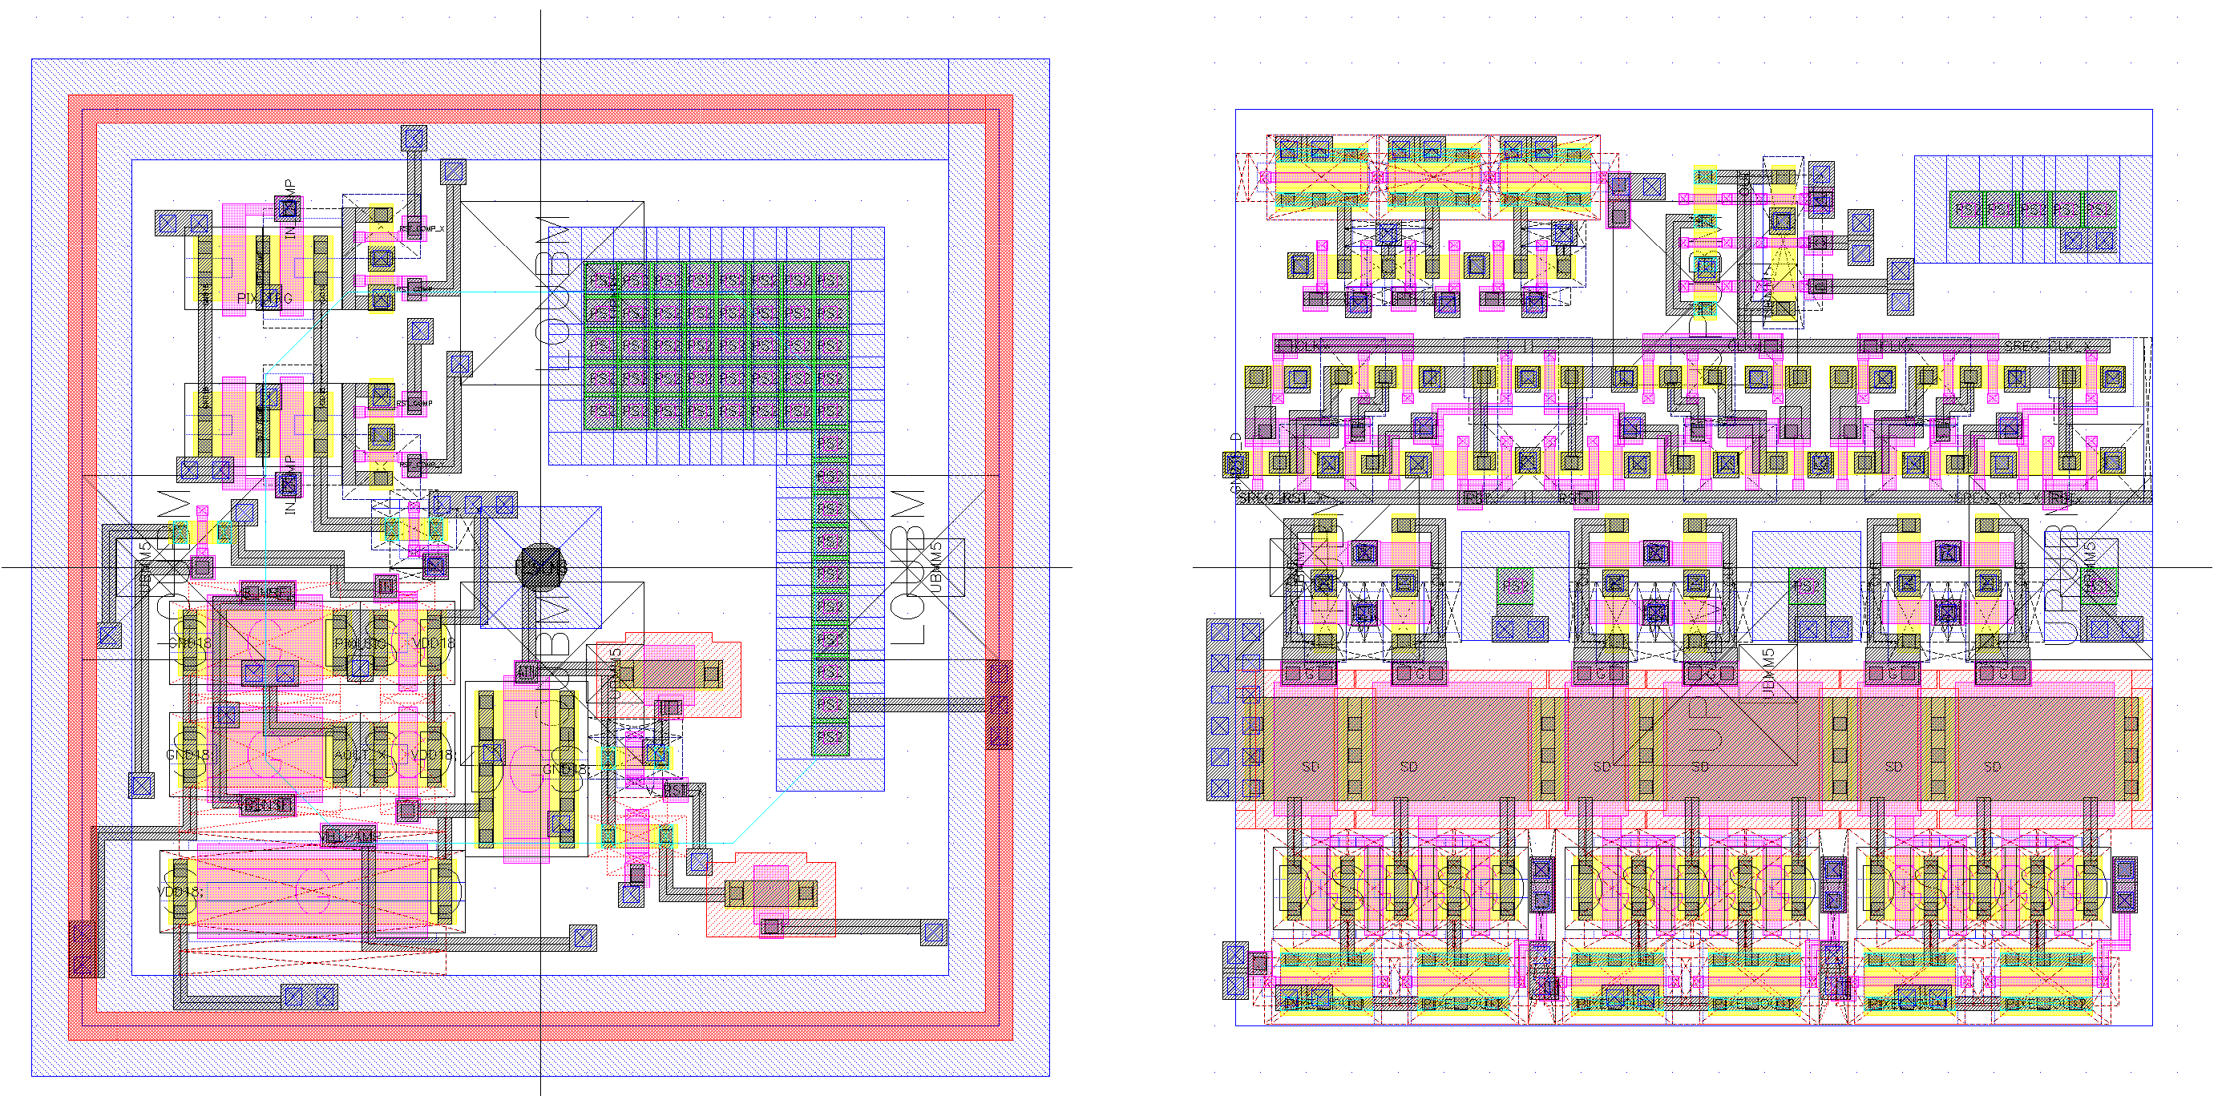
SOFIST4: First SOIPIX sensor with 3D stacking
SOFIST Ver. 3
SOFIST Ver. 4
Lower chip Upper chip
Comp
Comp
20 μm
AGnd
AVdd
AGnd
AVdd
Signal
Signal

Slide 24
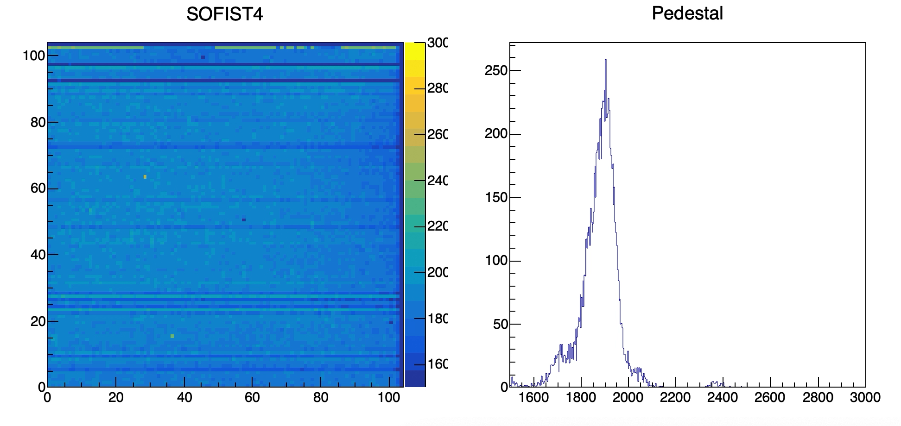
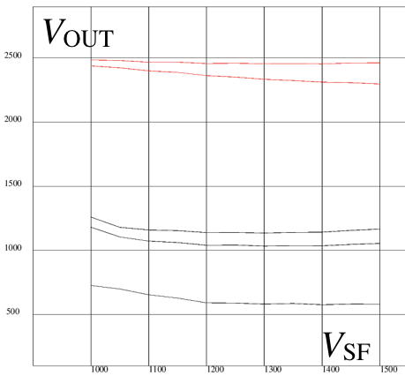
Performance of SOFIST Ver. 4
Response to ⁹⁰Sr β source
Analog output voltage versus bias voltage of the preamplifier. Extracted pixels whose gain is less than the design.
3 out of 102x102 pixels do not show response.
Connection yield = 99.97 %
Preliminary
Problem in the preamplifier
Bump bonding failure
(Preliminary)

Slide 25
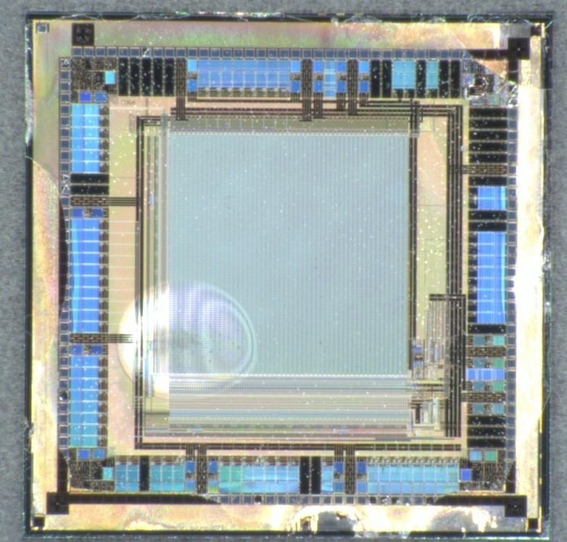
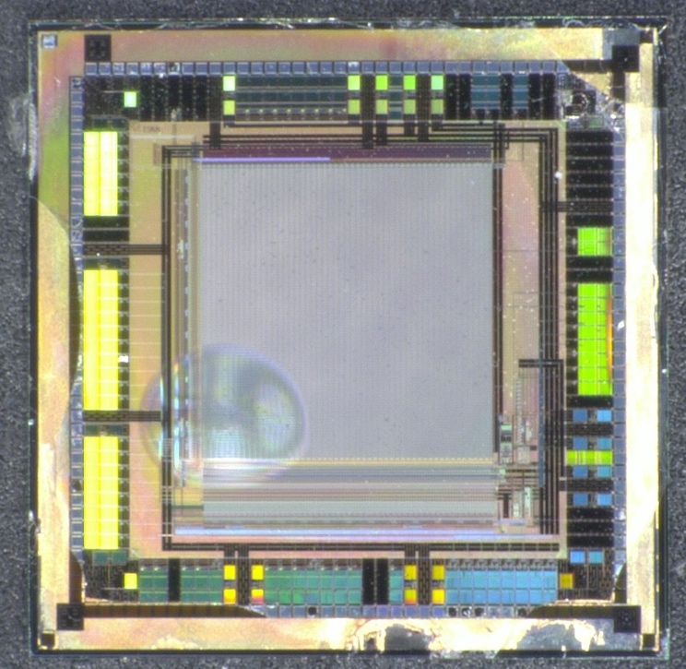
Radiation hardness of the 3D glue
70 MeV Proton irradiation to NIEL 5x10¹⁴ n-eq/cm² and TID 0.4 MGy, similar to the environment of the LHC pixel detector.
Visual inspection was done (destructive tests are not allowed). No clacks, bubbles, color changes observed: The glue is enough rad-hard.
Before irradiation Two month after irradiation
3mm

Slide 26
Advantages of the SOI micro-bump bonding:
Requirement to surface flatness is determined by the height of the cylinders: a few μm tolerance.
The soft cylindrical gold bumps results in high-connection yield.
TSV is not necessary: The through BOX via (TVB) for the back side are produced at the SOI CMOS circuit processes.
The circuit chip has SiO2 layer on both sides: The stacking process can be repeated.
Upper chip: Only CMOS circuit in SiO₂ remains.
  The thickness is about 10 μm.
Remaining issues for the 3D stacking:
  Large area sensor
  Thinning of the wafer thickness

Slide 27
Summary
The 3D stacking is a reasonable solution to improve the performance of pixel sensors.
The direct connection method and bump bonding method are briefly explained.
SOFIST Ver.4, the SOI PIX sensor with micro cylindrical bump showed a high bonding connection yield of 99.97 %.
The glue used for the stacking is radiation hard to NIEL 5x10¹⁴ n-eq/cm² and TID 0.4 MGy.
We are preparing a beam test of the SOFIST Ver.4 chip in this winter.
Remaining issues for the micro bump bonding:
  Stacking of the large area sensors and thinned sensors

Slide 28
Thank you for your attention.

Slide 29
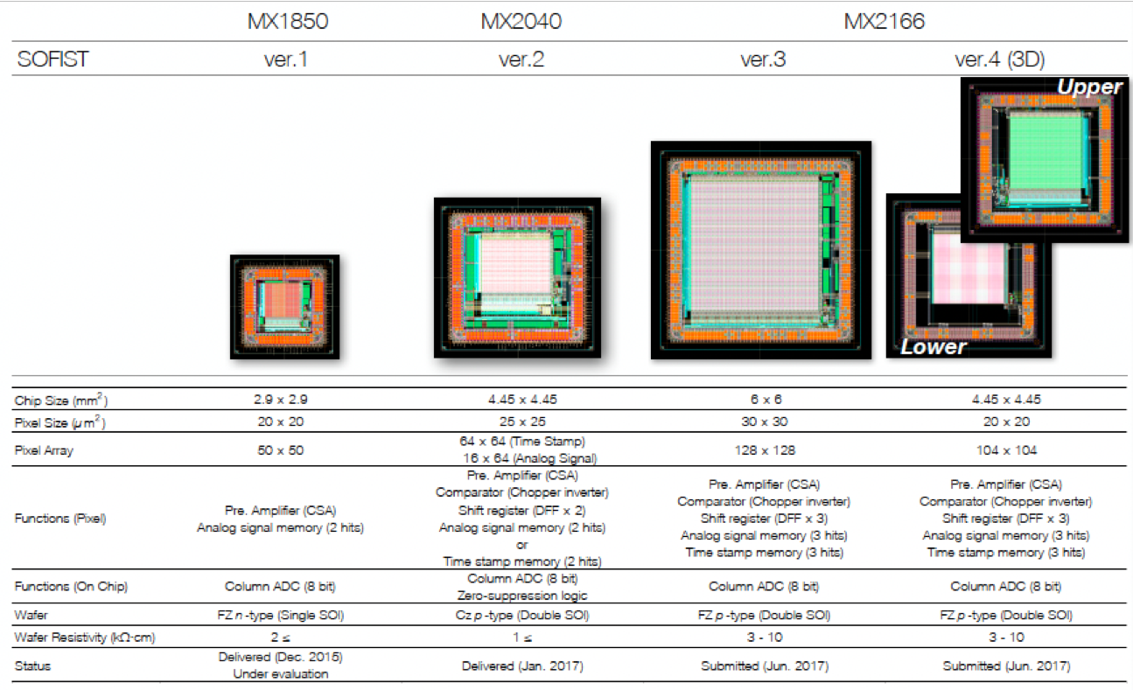
a

